Slide 1
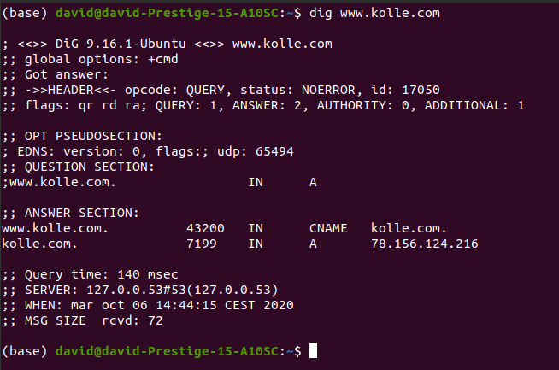
Obtaining IP with dig utility
www.kolle.com is a Canonical name that points to the kolle.com A register. 78.156.124.216

Slide 2
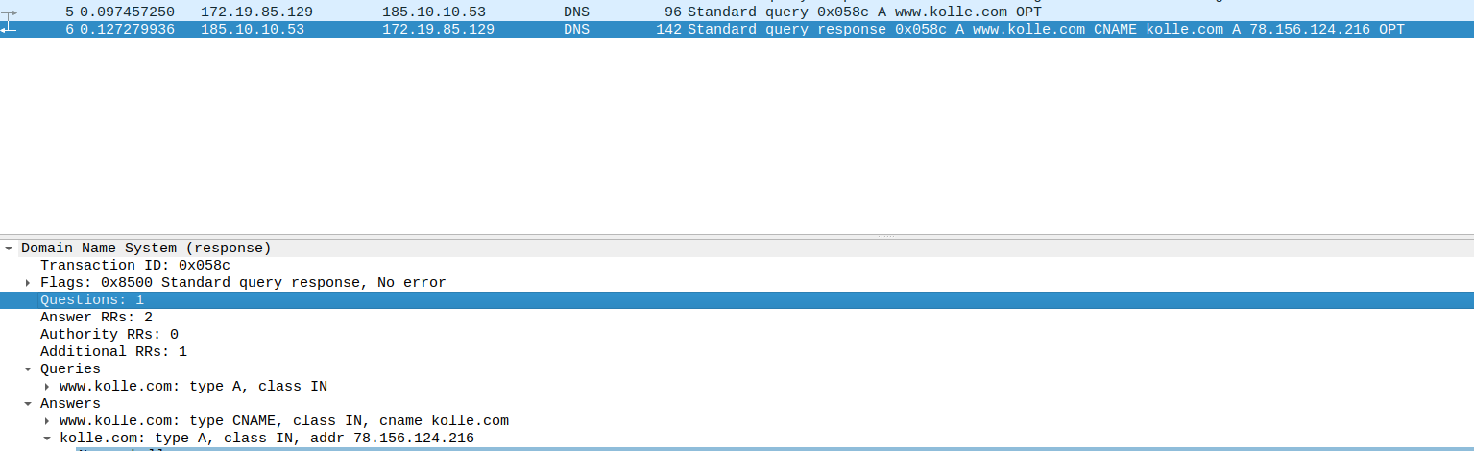
Obtaining IP with wireshark

Slide 3
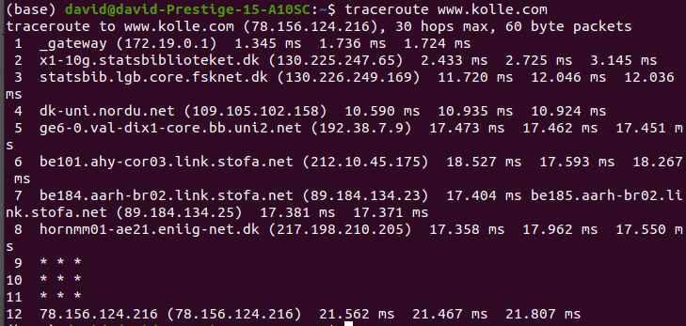
Route for packages

Slide 4
Ping teammate
From the royal library I cannot ping my teammate (both connected to eduroam)

Slide 5
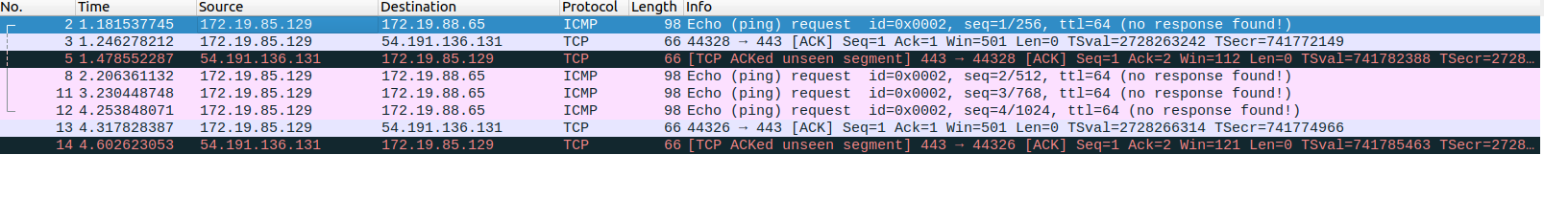
Monitor ping with wireshark
The protocol used is ICMP (Internet Control Message Protocol)

Slide 6
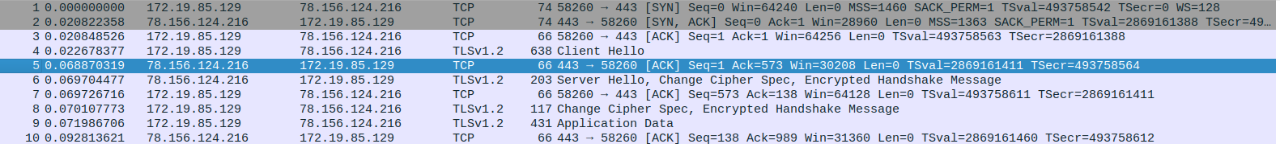
Monitor connection to kolle.com
If the test needs to be redone, closing the web browser is a good idea to remove the possibility of cached assets
The first ten packets look like they are the start from the TCP protocol: syn, acknowledges, handshake and finally the requested data
The packages seq. and ack. numbers keep increasing
Packet 5 is sent by the server to ACK the data sent by the client (that’s why ACK number is 573)

Slide 7
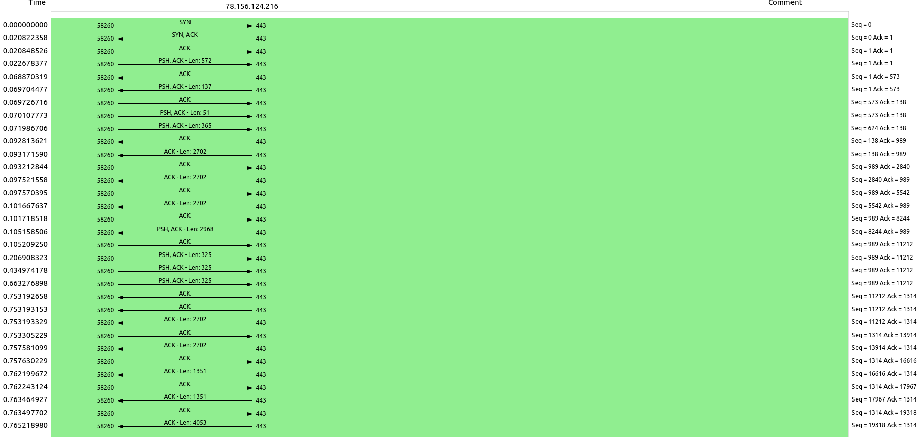
Monitor connection to kolle.com
By using the flow chart with flow type TCP we can see what is happening

Slide 8

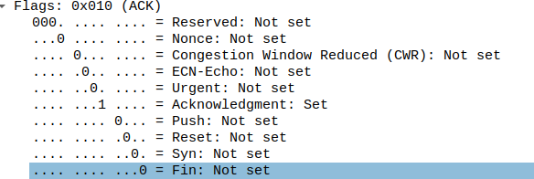
Monitor connection to kolle.com
The first package uses the SYN flag, which is used to initiate a connection
The ACK packages have the ACK flag

