Slide 1
Cloud-KNN Classifier
Di Mei & Zhihao Wang

Slide 2
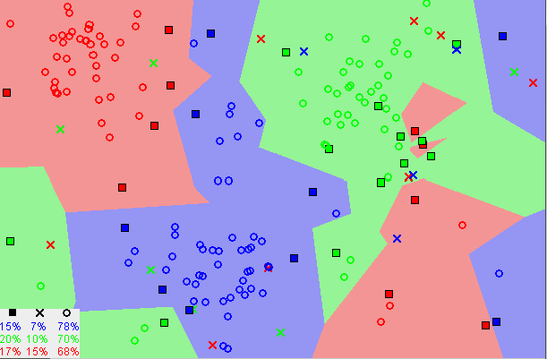
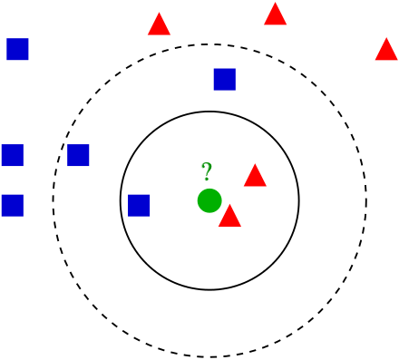
KNN Algorithm
A multi-threaded k-nearest neighbors’ algorithm
Input consists of the k closest training examples
Object is classified by a plurality vote of its neighbors,

Slide 3
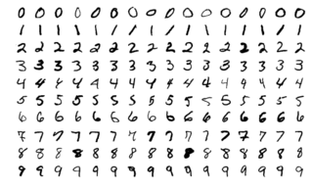
Dataset and Preprocessing
MNIST Dataset from Yann LeCun, Courant Institute, NYU
Handwritten Digits Dataset
Training Set Size: 6000
Testing Set Size: 1000
Data type: 28*28 Normalized Pixel Values

Slide 4
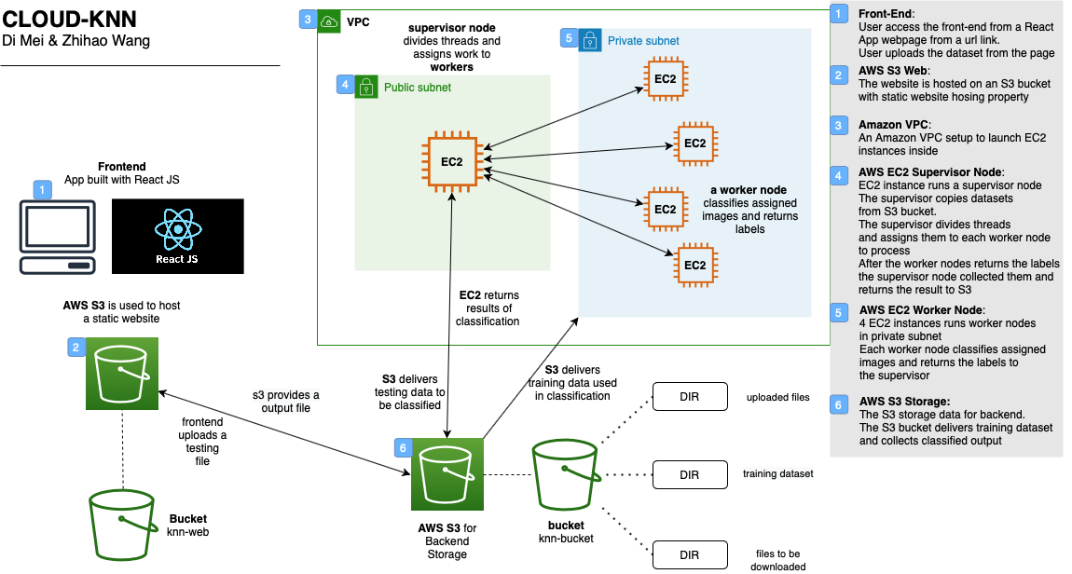
Data Flow Architecture

Slide 5
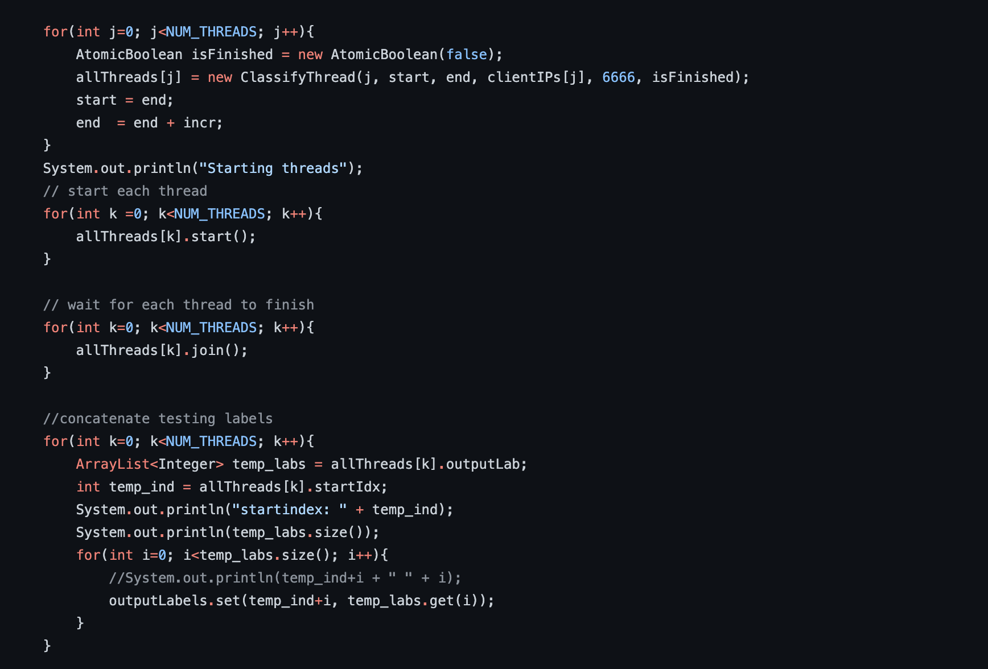
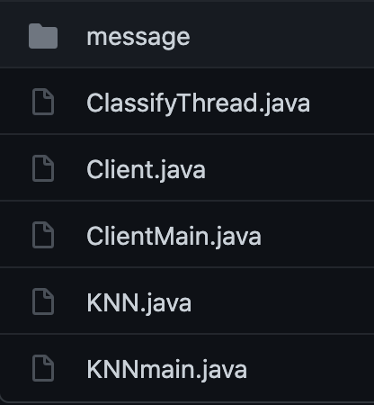
Backend Implementation
KNN.java

Slide 6
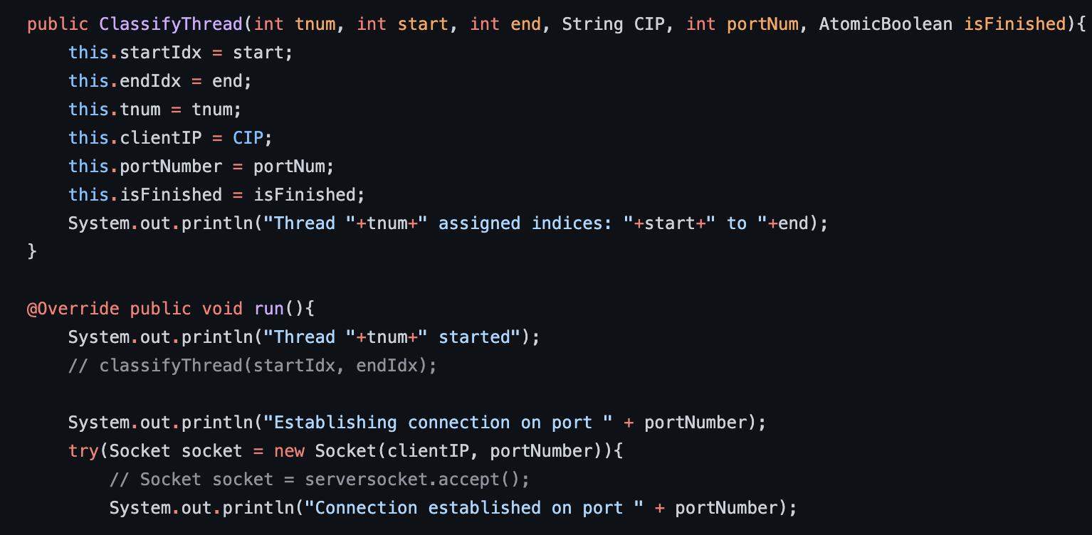
Backend Implementation
ClassifyThread.java

Slide 7
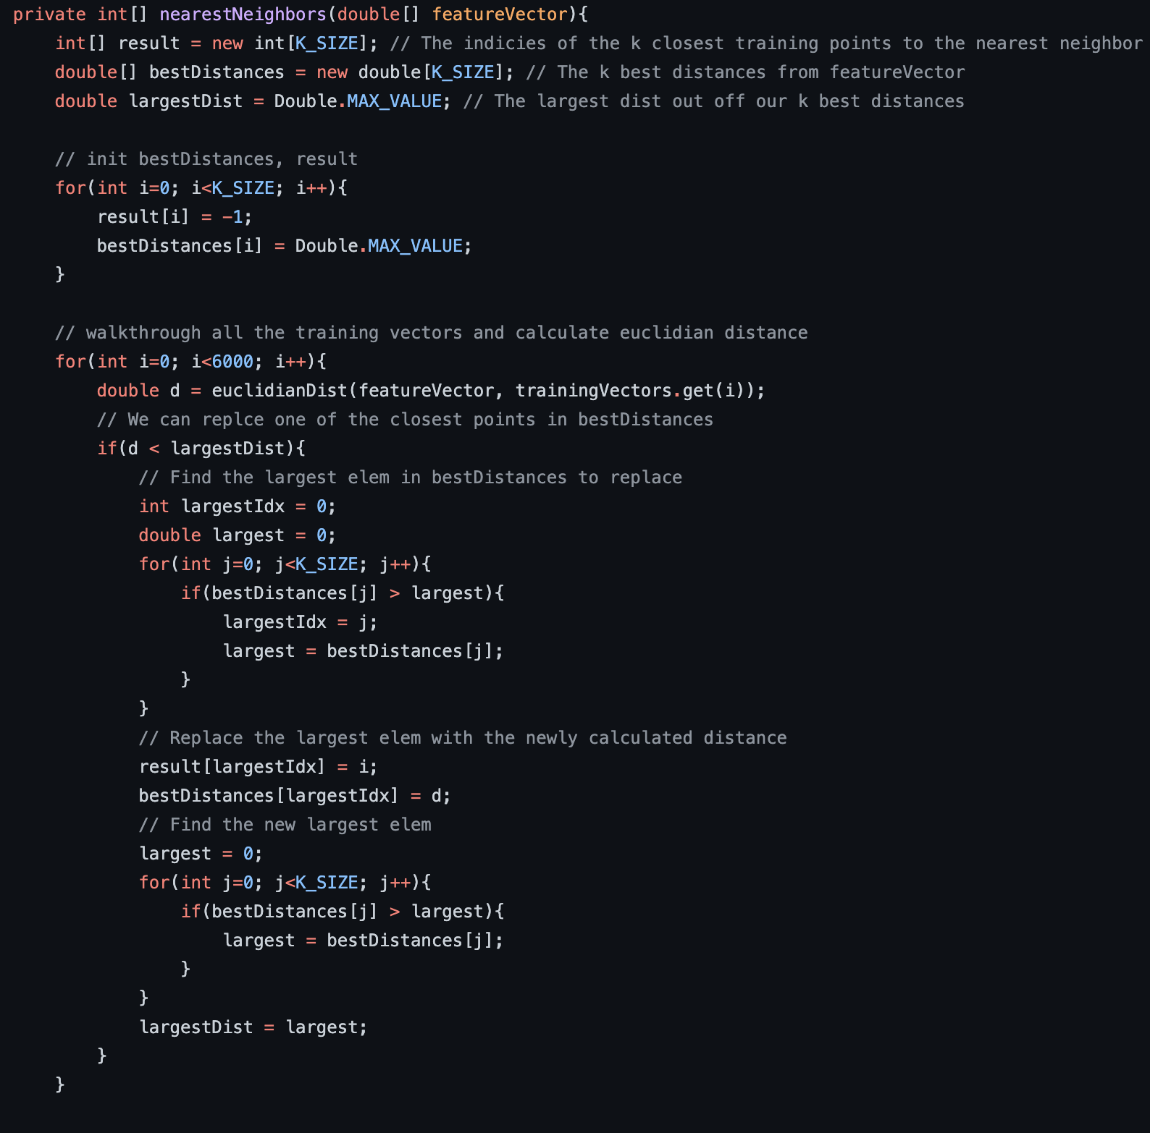
Backend Implementation
Client.java

Slide 8
Future Works
- Visualization
- A more flexible frontend
- Multiple Connection

