Slide 1
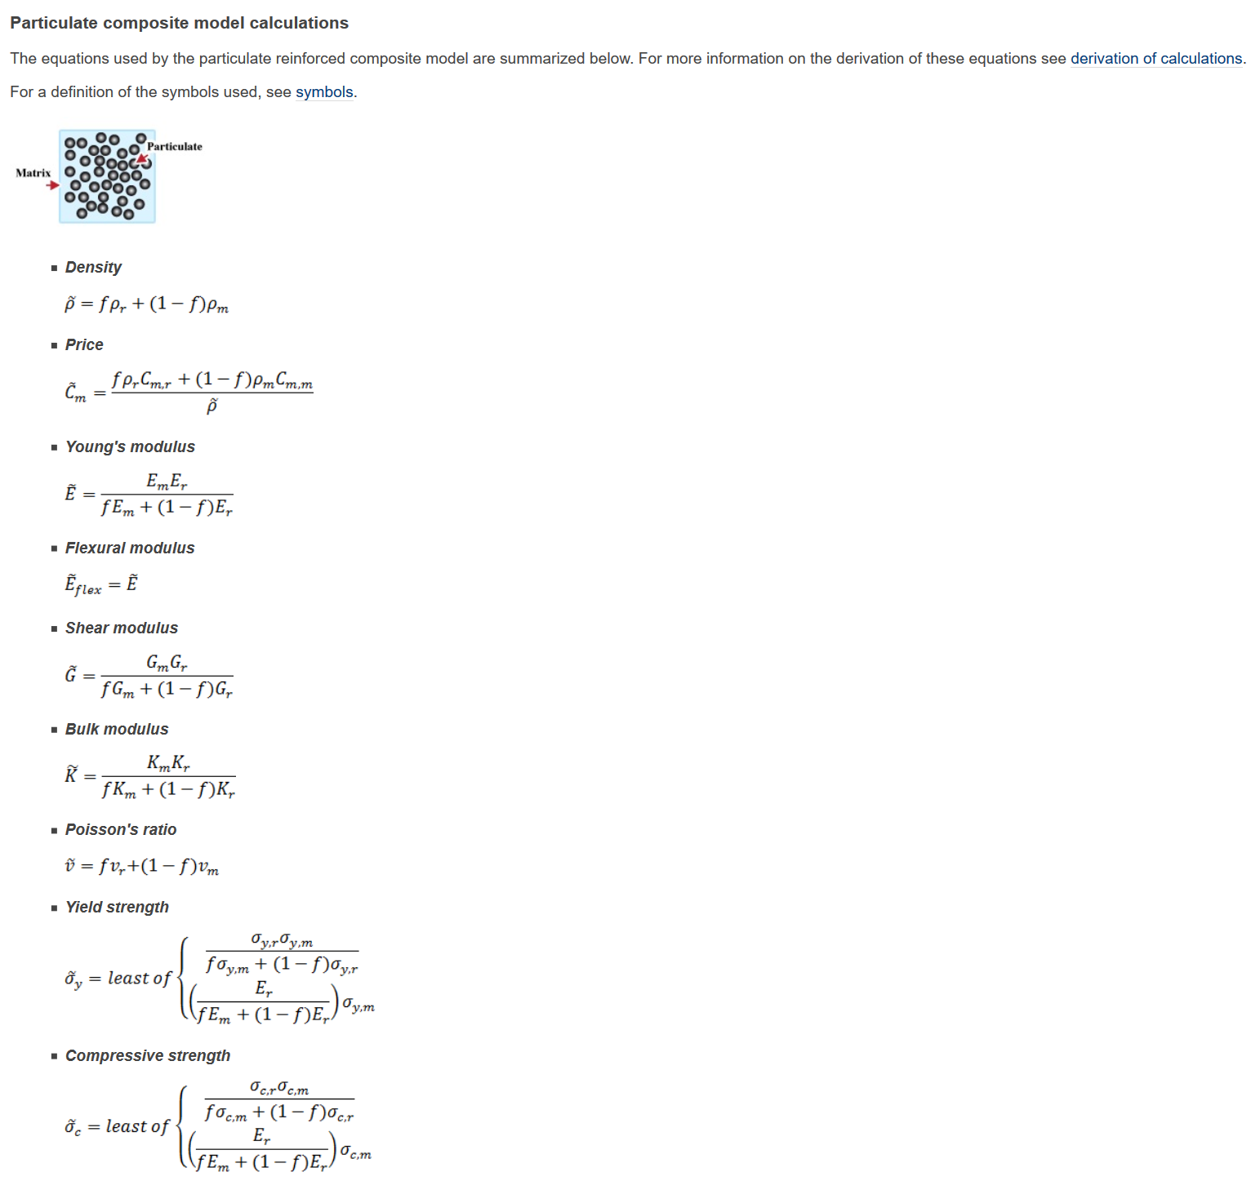
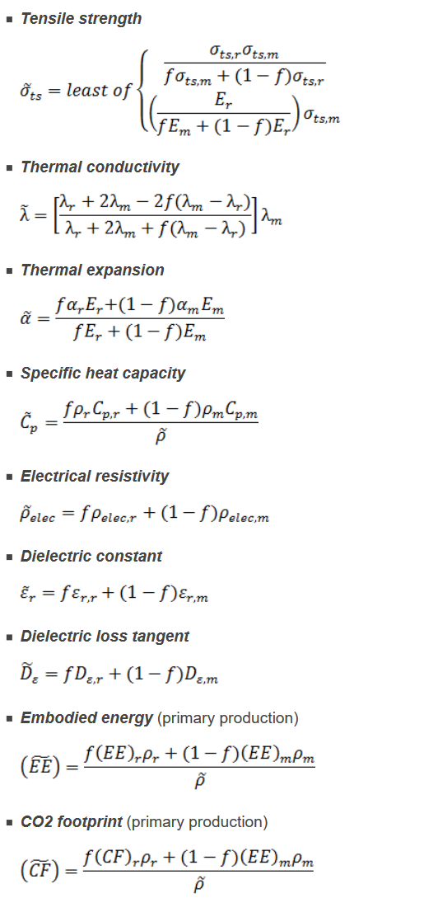
→ Missing models and attributes in the Synthesizer…

Slide 2
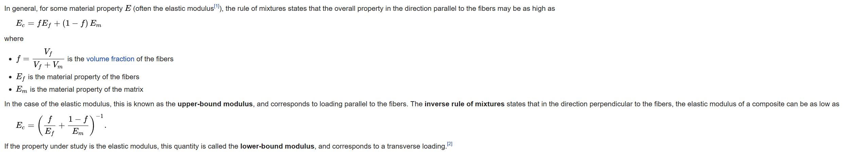
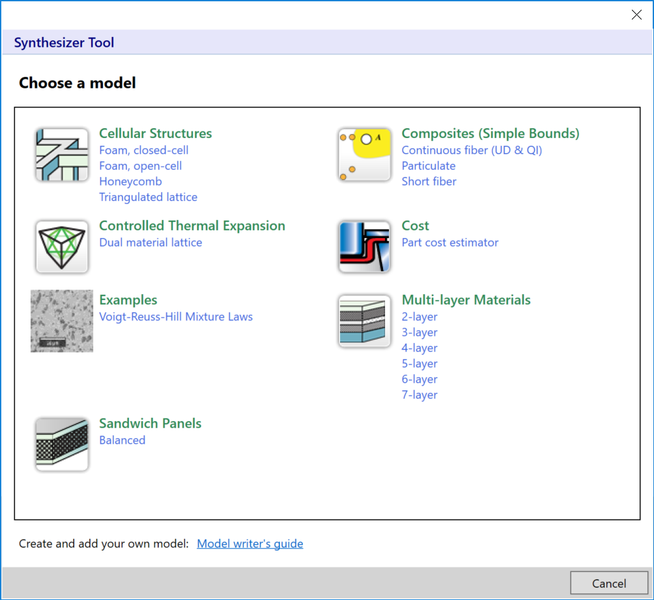
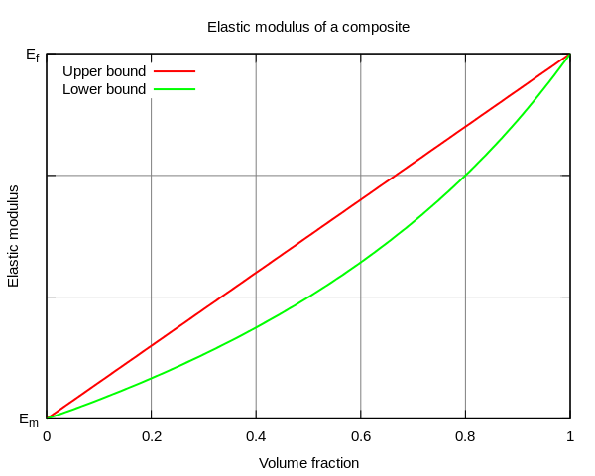
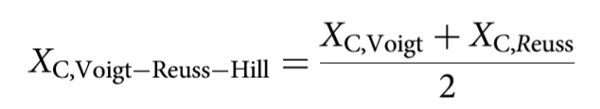
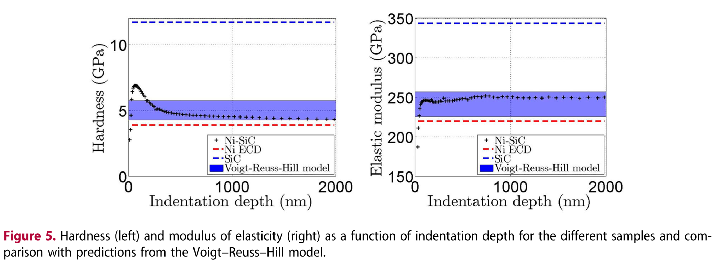
Voigt
Reuss
Voigt-Reuss-Hill
https://en.wikipedia.org/wiki/Rule_of_mixtures
New plug-in written for metallic matrix for example…
https://doi.org/10.1080/02670844.2018.1433270

Slide 3
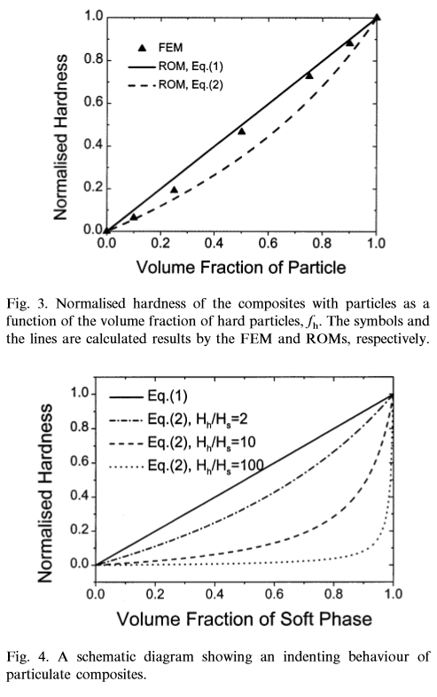
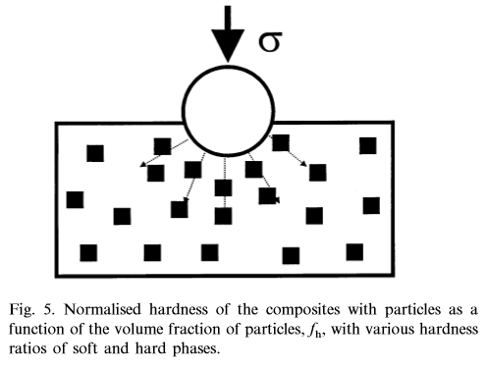

https://doi.org/10.1016/S0921-5093(00)00909-6

Slide 4
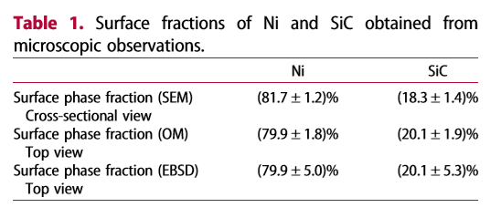
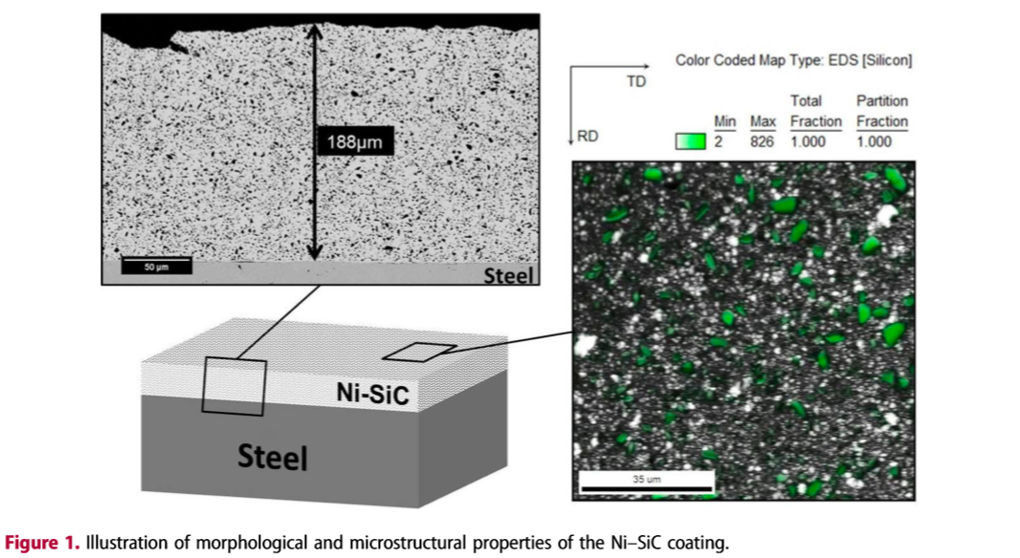
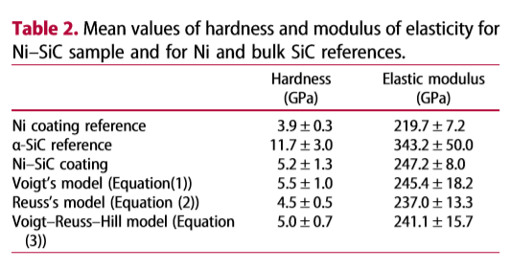
https://doi.org/10.1080/02670844.2018.1433270

Slide 5
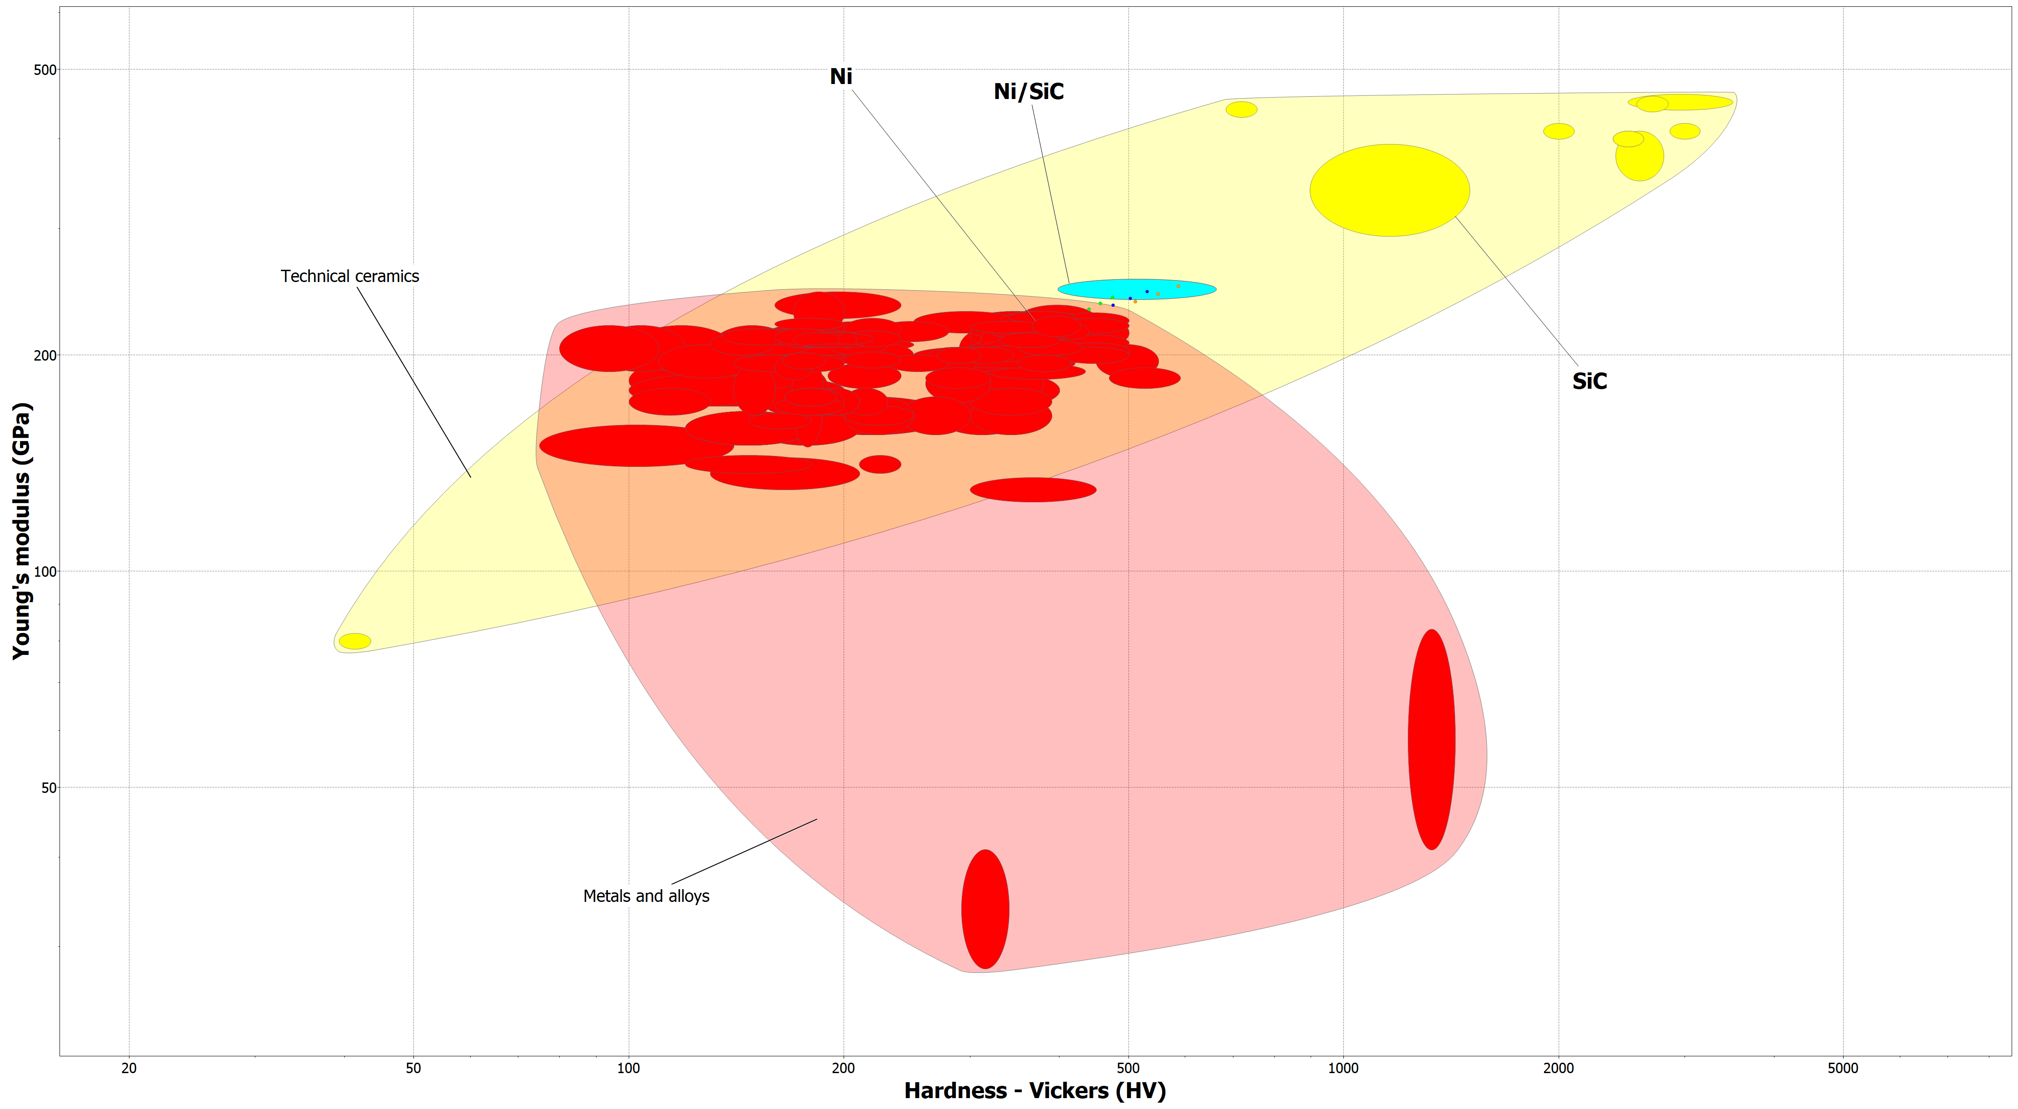

Slide 6
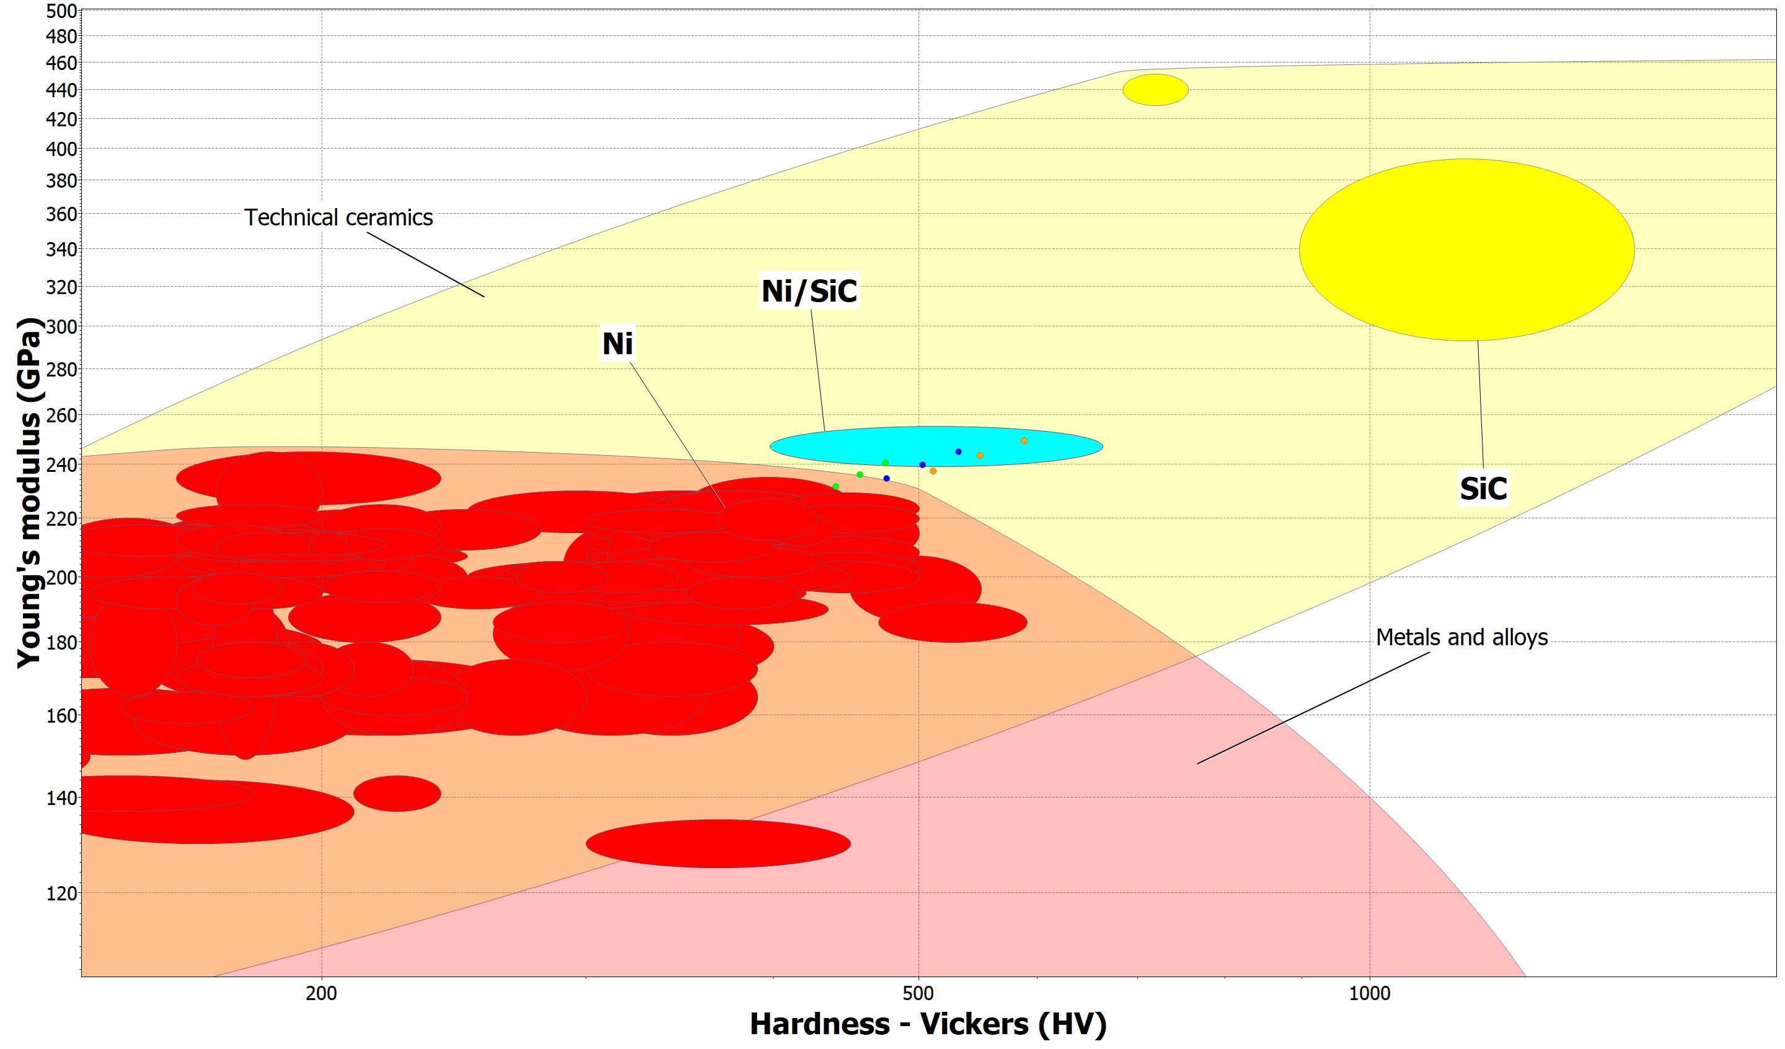
Voigt-Reuss-Hill
Lower bound
Upper bound

