Slide 1
OSCon 2012: Cloud Computing & Data Privacy David Mertz
Let's take this as our starting point:
“No matter how paranoid you are, what they're actually doing is worse than you can possibly imagine.”
- Ralph J. Gleason (1917-75)
Notes:
This talk traces lightweight concurrency from Python 2.2's generators, which enabled semi-coroutines as a mechanism for scheduling "weightless" threads; to PEP 342, which created true coroutines, and hence made event-driven programming easier; to 3rd party libraries built around coroutines, from older GTasklet and peak.events to the current Greenlet/gevent and Twisted Reactor.
Type: Talk
This talk aims to provide both a practical guide and theoretical underpinnings to the use of generator-based lightweight concurrency in Python.
Lightning tour of generator constructs. Why generator-based scheduling is particularly useful for event-based programming.
Simple example of a "trampoline" or scheduler.
Slightly fleshed out example of scheduler with discussion of data-passing issues.
Examples using GTasklet to make coroutine code look more like familiar sequential code (the framework is based on greenlets rather than generators, but accomplishes similar purpose).
Brief examples of Twisted Reactors and Deferreds.
Limits of generator-based concurrency (i.e. doesn't help with multiple cores and multiple servers). "Throw at the wall" list of ways to generalize to larger scales than single cores.

Slide 2
OSCon 2012: Cloud Computing & Data Privacy David Mertz
Or to be specific:
While misuse and abuse of the NSL power has been widely documented, the Obama administration [is seeking to allow] the FBI to demand even more records without court approval. [T]he administration proposed to expand the statute to allow the FBI to get American's internet activity records without court approval or even suspicion of wrongdoing.
http://www.aclu.org/national-security/doe-v-holder
Notes:
This talk traces lightweight concurrency from Python 2.2's generators, which enabled semi-coroutines as a mechanism for scheduling "weightless" threads; to PEP 342, which created true coroutines, and hence made event-driven programming easier; to 3rd party libraries built around coroutines, from older GTasklet and peak.events to the current Greenlet/gevent and Twisted Reactor.
Type: Talk
This talk aims to provide both a practical guide and theoretical underpinnings to the use of generator-based lightweight concurrency in Python.
Lightning tour of generator constructs. Why generator-based scheduling is particularly useful for event-based programming.
Simple example of a "trampoline" or scheduler.
Slightly fleshed out example of scheduler with discussion of data-passing issues.
Examples using GTasklet to make coroutine code look more like familiar sequential code (the framework is based on greenlets rather than generators, but accomplishes similar purpose).
Brief examples of Twisted Reactors and Deferreds.
Limits of generator-based concurrency (i.e. doesn't help with multiple cores and multiple servers). "Throw at the wall" list of ways to generalize to larger scales than single cores.

Slide 3
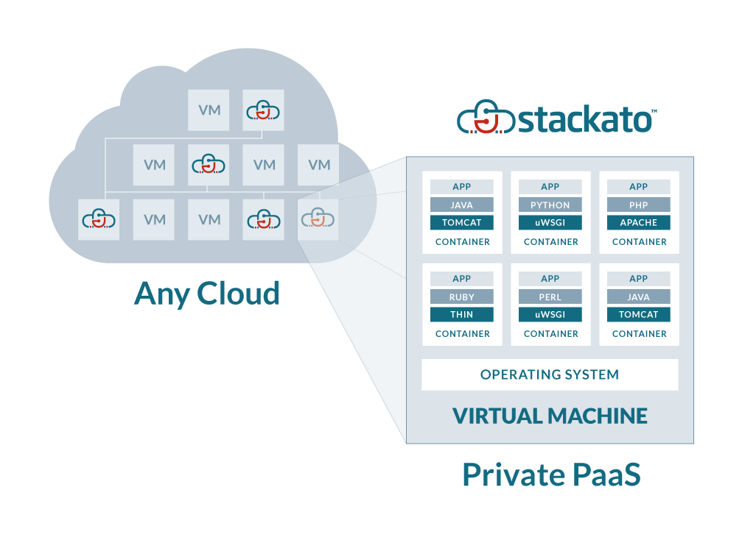
OSCon 2012: Cloud Computing & Data Privacy David Mertz
Let's take an illustration from ActiveState:
Notes:
This talk traces lightweight concurrency from Python 2.2's generators, which enabled semi-coroutines as a mechanism for scheduling "weightless" threads; to PEP 342, which created true coroutines, and hence made event-driven programming easier; to 3rd party libraries built around coroutines, from older GTasklet and peak.events to the current Greenlet/gevent and Twisted Reactor.
Type: Talk
This talk aims to provide both a practical guide and theoretical underpinnings to the use of generator-based lightweight concurrency in Python.
Lightning tour of generator constructs. Why generator-based scheduling is particularly useful for event-based programming.
Simple example of a "trampoline" or scheduler.
Slightly fleshed out example of scheduler with discussion of data-passing issues.
Examples using GTasklet to make coroutine code look more like familiar sequential code (the framework is based on greenlets rather than generators, but accomplishes similar purpose).
Brief examples of Twisted Reactors and Deferreds.
Limits of generator-based concurrency (i.e. doesn't help with multiple cores and multiple servers). "Throw at the wall" list of ways to generalize to larger scales than single cores.

Slide 4
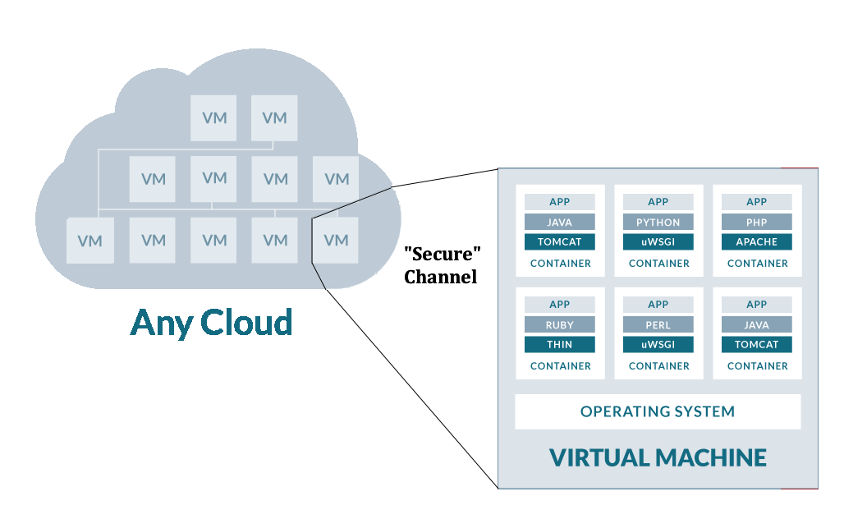
OSCon 2012: Cloud Computing & Data Privacy David Mertz
What security guarantee does this give us? It does verify that the bytes that make up the VM received by the Cloud Host are those you intended.
Notes:
This talk traces lightweight concurrency from Python 2.2's generators, which enabled semi-coroutines as a mechanism for scheduling "weightless" threads; to PEP 342, which created true coroutines, and hence made event-driven programming easier; to 3rd party libraries built around coroutines, from older GTasklet and peak.events to the current Greenlet/gevent and Twisted Reactor.
Type: Talk
This talk aims to provide both a practical guide and theoretical underpinnings to the use of generator-based lightweight concurrency in Python.
Lightning tour of generator constructs. Why generator-based scheduling is particularly useful for event-based programming.
Simple example of a "trampoline" or scheduler.
Slightly fleshed out example of scheduler with discussion of data-passing issues.
Examples using GTasklet to make coroutine code look more like familiar sequential code (the framework is based on greenlets rather than generators, but accomplishes similar purpose).
Brief examples of Twisted Reactors and Deferreds.
Limits of generator-based concurrency (i.e. doesn't help with multiple cores and multiple servers). "Throw at the wall" list of ways to generalize to larger scales than single cores.

Slide 5
OSCon 2012: Cloud Computing & Data Privacy David Mertz
If Cloud Host receives a National Security Letter they might be compelled to inject code into your VM (and have a gag order against revealing they did so).
NSL: “Inject code!”
Notes:
This talk traces lightweight concurrency from Python 2.2's generators, which enabled semi-coroutines as a mechanism for scheduling "weightless" threads; to PEP 342, which created true coroutines, and hence made event-driven programming easier; to 3rd party libraries built around coroutines, from older GTasklet and peak.events to the current Greenlet/gevent and Twisted Reactor.
Type: Talk
This talk aims to provide both a practical guide and theoretical underpinnings to the use of generator-based lightweight concurrency in Python.
Lightning tour of generator constructs. Why generator-based scheduling is particularly useful for event-based programming.
Simple example of a "trampoline" or scheduler.
Slightly fleshed out example of scheduler with discussion of data-passing issues.
Examples using GTasklet to make coroutine code look more like familiar sequential code (the framework is based on greenlets rather than generators, but accomplishes similar purpose).
Brief examples of Twisted Reactors and Deferreds.
Limits of generator-based concurrency (i.e. doesn't help with multiple cores and multiple servers). "Throw at the wall" list of ways to generalize to larger scales than single cores.

Slide 6
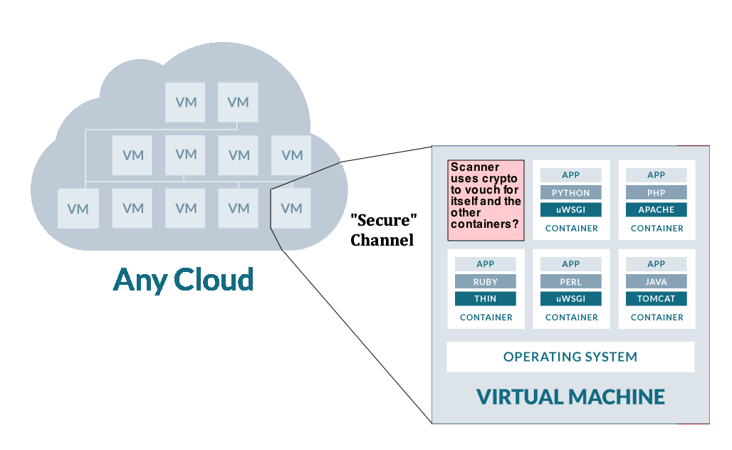
OSCon 2012: Cloud Computing & Data Privacy David Mertz
It would be nice if clever cryptography can let a process self-verify against code injection. But is it possible in the face of a bad actor or a hostile law?
PKI on (own)
controlled machine
Notes:
This talk traces lightweight concurrency from Python 2.2's generators, which enabled semi-coroutines as a mechanism for scheduling "weightless" threads; to PEP 342, which created true coroutines, and hence made event-driven programming easier; to 3rd party libraries built around coroutines, from older GTasklet and peak.events to the current Greenlet/gevent and Twisted Reactor.
Type: Talk
This talk aims to provide both a practical guide and theoretical underpinnings to the use of generator-based lightweight concurrency in Python.
Lightning tour of generator constructs. Why generator-based scheduling is particularly useful for event-based programming.
Simple example of a "trampoline" or scheduler.
Slightly fleshed out example of scheduler with discussion of data-passing issues.
Examples using GTasklet to make coroutine code look more like familiar sequential code (the framework is based on greenlets rather than generators, but accomplishes similar purpose).
Brief examples of Twisted Reactors and Deferreds.
Limits of generator-based concurrency (i.e. doesn't help with multiple cores and multiple servers). "Throw at the wall" list of ways to generalize to larger scales than single cores.

Slide 7
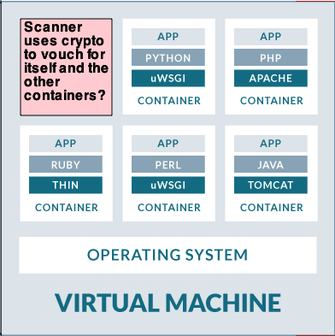
OSCon 2012: Cloud Computing & Data Privacy David Mertz
If the “Scanner” can vouch for itself, and it can poke at the bytes inside other containers, this is sufficient to guarantee against injection attacks. How might it do this?
PKI on (own)
controlled machine
Public key authentication against secured machine?
Response to random queries of its own memory image?
Response to random timing challenges to demonstrate known behavior?
OS authentication of scanner? (but VM could inject into OS)
Notes:
This talk traces lightweight concurrency from Python 2.2's generators, which enabled semi-coroutines as a mechanism for scheduling "weightless" threads; to PEP 342, which created true coroutines, and hence made event-driven programming easier; to 3rd party libraries built around coroutines, from older GTasklet and peak.events to the current Greenlet/gevent and Twisted Reactor.
Type: Talk
This talk aims to provide both a practical guide and theoretical underpinnings to the use of generator-based lightweight concurrency in Python.
Lightning tour of generator constructs. Why generator-based scheduling is particularly useful for event-based programming.
Simple example of a "trampoline" or scheduler.
Slightly fleshed out example of scheduler with discussion of data-passing issues.
Examples using GTasklet to make coroutine code look more like familiar sequential code (the framework is based on greenlets rather than generators, but accomplishes similar purpose).
Brief examples of Twisted Reactors and Deferreds.
Limits of generator-based concurrency (i.e. doesn't help with multiple cores and multiple servers). "Throw at the wall" list of ways to generalize to larger scales than single cores.

Slide 8
OSCon 2012: Cloud Computing & Data Privacy David Mertz
As can the audience, I can quickly poke holes in each of the methods in the last slide. On the other hand, I am not certain this quest is quixotic.
Inspirations:
PKI on (own)
controlled machine
GPG/PGP: RSA lets me to send messages over insecure SMTP with assurance that only the intended recipient has access.
Freenet: I can participate in a peer-to-peer data network without having even the capability of revealing or determining which content my node helps share.
Notes:
This talk traces lightweight concurrency from Python 2.2's generators, which enabled semi-coroutines as a mechanism for scheduling "weightless" threads; to PEP 342, which created true coroutines, and hence made event-driven programming easier; to 3rd party libraries built around coroutines, from older GTasklet and peak.events to the current Greenlet/gevent and Twisted Reactor.
Type: Talk
This talk aims to provide both a practical guide and theoretical underpinnings to the use of generator-based lightweight concurrency in Python.
Lightning tour of generator constructs. Why generator-based scheduling is particularly useful for event-based programming.
Simple example of a "trampoline" or scheduler.
Slightly fleshed out example of scheduler with discussion of data-passing issues.
Examples using GTasklet to make coroutine code look more like familiar sequential code (the framework is based on greenlets rather than generators, but accomplishes similar purpose).
Brief examples of Twisted Reactors and Deferreds.
Limits of generator-based concurrency (i.e. doesn't help with multiple cores and multiple servers). "Throw at the wall" list of ways to generalize to larger scales than single cores.

Slide 9
OSCon 2012: Cloud Computing & Data Privacy David Mertz
Even if a “Scanner” is possible with the desired properties, it does nothing whatsoever to protect against attacks on applications within containers. App-level security is a distinct issue.
PKI on (own)
controlled machine
If code running in a container is the binary intended (i.e. no injection), it may still needs to encrypt connections/stored data/etc. per app requirements.
App-level software has known and unknown attacks. The best we are hoping for is “no worse than” hosting an application on privately controlled hardware.
Notes:
This talk traces lightweight concurrency from Python 2.2's generators, which enabled semi-coroutines as a mechanism for scheduling "weightless" threads; to PEP 342, which created true coroutines, and hence made event-driven programming easier; to 3rd party libraries built around coroutines, from older GTasklet and peak.events to the current Greenlet/gevent and Twisted Reactor.
Type: Talk
This talk aims to provide both a practical guide and theoretical underpinnings to the use of generator-based lightweight concurrency in Python.
Lightning tour of generator constructs. Why generator-based scheduling is particularly useful for event-based programming.
Simple example of a "trampoline" or scheduler.
Slightly fleshed out example of scheduler with discussion of data-passing issues.
Examples using GTasklet to make coroutine code look more like familiar sequential code (the framework is based on greenlets rather than generators, but accomplishes similar purpose).
Brief examples of Twisted Reactors and Deferreds.
Limits of generator-based concurrency (i.e. doesn't help with multiple cores and multiple servers). "Throw at the wall" list of ways to generalize to larger scales than single cores.

Slide 10
OSCon 2012: Cloud Computing & Data Privacy David Mertz
“No matter how paranoid you are, what they're actually doing is worse than you can possibly imagine.” - Ralph J. Gleason (1917-75)
Ideas?
Notes:
This talk traces lightweight concurrency from Python 2.2's generators, which enabled semi-coroutines as a mechanism for scheduling "weightless" threads; to PEP 342, which created true coroutines, and hence made event-driven programming easier; to 3rd party libraries built around coroutines, from older GTasklet and peak.events to the current Greenlet/gevent and Twisted Reactor.
Type: Talk
This talk aims to provide both a practical guide and theoretical underpinnings to the use of generator-based lightweight concurrency in Python.
Lightning tour of generator constructs. Why generator-based scheduling is particularly useful for event-based programming.
Simple example of a "trampoline" or scheduler.
Slightly fleshed out example of scheduler with discussion of data-passing issues.
Examples using GTasklet to make coroutine code look more like familiar sequential code (the framework is based on greenlets rather than generators, but accomplishes similar purpose).
Brief examples of Twisted Reactors and Deferreds.
Limits of generator-based concurrency (i.e. doesn't help with multiple cores and multiple servers). "Throw at the wall" list of ways to generalize to larger scales than single cores.

