Slide 1

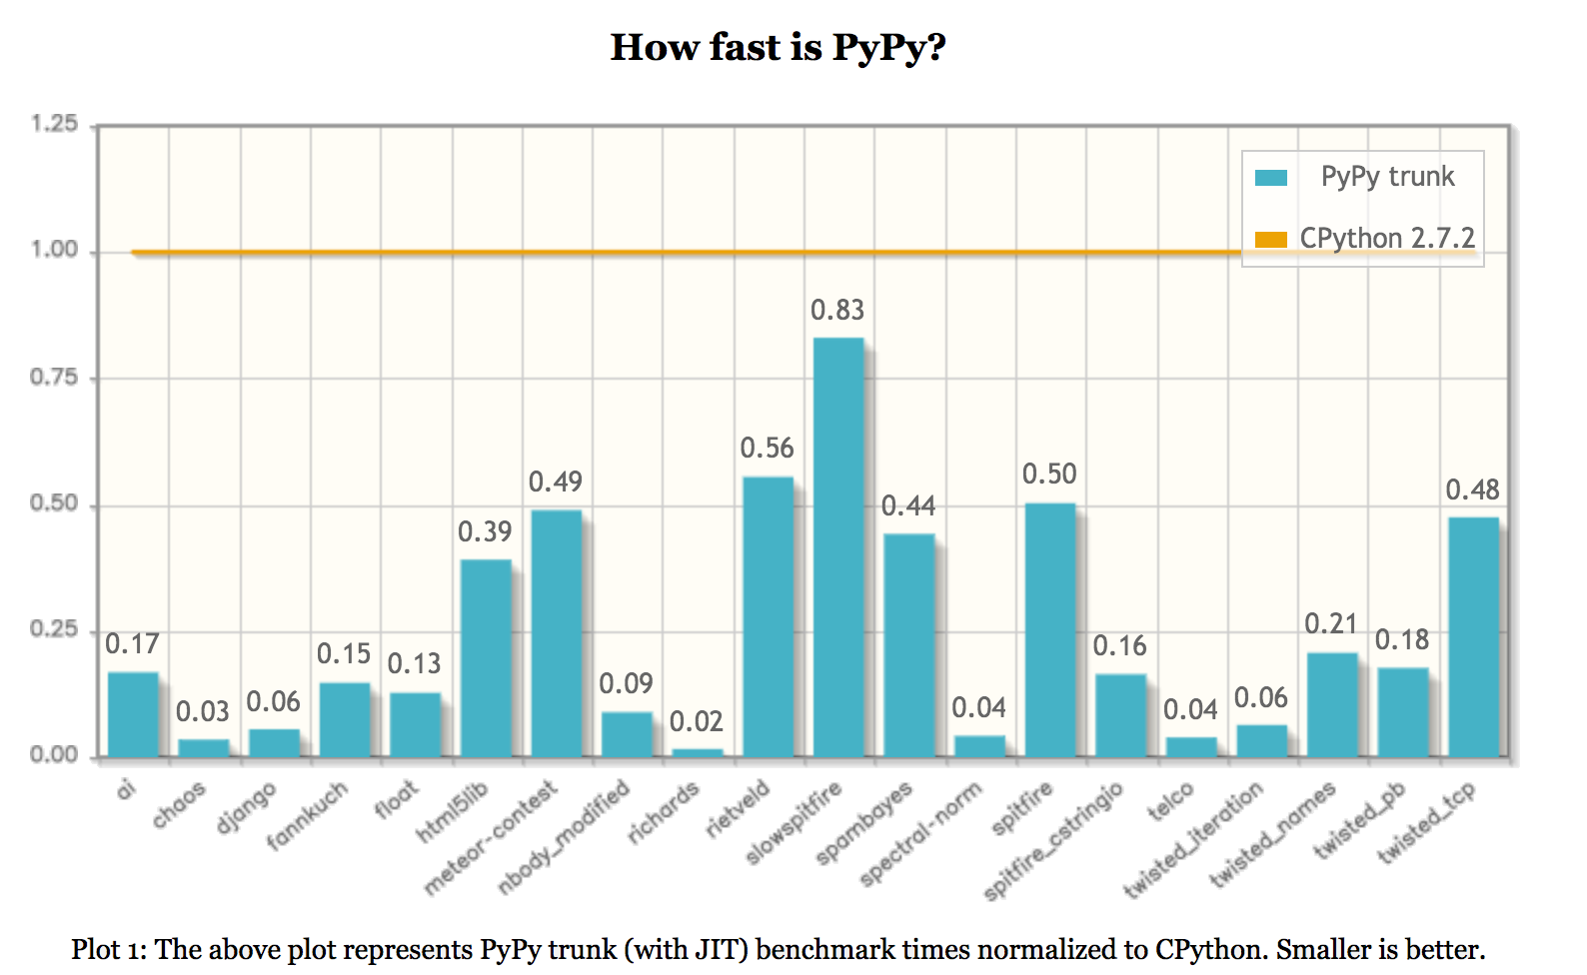
PyPy-STM David Mertz
What is PyPy?
PyPy is a compliant alternative implementation of the Python language, written in Python... It's fast!
Notes:
This talk traces lightweight concurrency from Python 2.2's generators, which enabled semi-coroutines as a mechanism for scheduling "weightless" threads; to PEP 342, which created true coroutines, and hence made event-driven programming easier; to 3rd party libraries built around coroutines, from older GTasklet and peak.events to the current Greenlet/gevent and Twisted Reactor.
Type: Talk
This talk aims to provide both a practical guide and theoretical underpinnings to the use of generator-based lightweight concurrency in Python.
Lightning tour of generator constructs. Why generator-based scheduling is particularly useful for event-based programming.
Simple example of a "trampoline" or scheduler.
Slightly fleshed out example of scheduler with discussion of data-passing issues.
Examples using GTasklet to make coroutine code look more like familiar sequential code (the framework is based on greenlets rather than generators, but accomplishes similar purpose).
Brief examples of Twisted Reactors and Deferreds.
Limits of generator-based concurrency (i.e. doesn't help with multiple cores and multiple servers). "Throw at the wall" list of ways to generalize to larger scales than single cores.

Slide 2
PyPy-STM David Mertz
What is PyPy?
That's weird! How can an interpreter written in Python be (much) faster than one written in C?
PyPy is actually written in RPython, a restricted subset of the language amenable to static analysis.
Conditional code paths are translated to machine code with tracing just-in-time compilation (JIT).
What is JIT'ed is the interpreter itself, not the user program.
Ref: https://bitbucket.org/pypy/extradoc/src/tip/talk/icooolps2009/bolz-tracing-jit-final.pdf
Notes:
This talk traces lightweight concurrency from Python 2.2's generators, which enabled semi-coroutines as a mechanism for scheduling "weightless" threads; to PEP 342, which created true coroutines, and hence made event-driven programming easier; to 3rd party libraries built around coroutines, from older GTasklet and peak.events to the current Greenlet/gevent and Twisted Reactor.
Type: Talk
This talk aims to provide both a practical guide and theoretical underpinnings to the use of generator-based lightweight concurrency in Python.
Lightning tour of generator constructs. Why generator-based scheduling is particularly useful for event-based programming.
Simple example of a "trampoline" or scheduler.
Slightly fleshed out example of scheduler with discussion of data-passing issues.
Examples using GTasklet to make coroutine code look more like familiar sequential code (the framework is based on greenlets rather than generators, but accomplishes similar purpose).
Brief examples of Twisted Reactors and Deferreds.
Limits of generator-based concurrency (i.e. doesn't help with multiple cores and multiple servers). "Throw at the wall" list of ways to generalize to larger scales than single cores.

Slide 3
PyPy-STM David Mertz
What is STM?
Concurrency is hard! Models include: shared-memory threads (i.e. with locks); the actor model; shared-nothing or shared-little processes (i.e. with queues) or message passing interface (MPI); and software transactional memory (STM).
STM is a “concurrency control mechanism analogous to database transactions for controlling access to shared memory in concurrent computing. It is an alternative to lock-based synchronization.”
Ref: https://en.wikipedia.org/wiki/Software_transactional_memory
Notes:
This talk traces lightweight concurrency from Python 2.2's generators, which enabled semi-coroutines as a mechanism for scheduling "weightless" threads; to PEP 342, which created true coroutines, and hence made event-driven programming easier; to 3rd party libraries built around coroutines, from older GTasklet and peak.events to the current Greenlet/gevent and Twisted Reactor.
Type: Talk
This talk aims to provide both a practical guide and theoretical underpinnings to the use of generator-based lightweight concurrency in Python.
Lightning tour of generator constructs. Why generator-based scheduling is particularly useful for event-based programming.
Simple example of a "trampoline" or scheduler.
Slightly fleshed out example of scheduler with discussion of data-passing issues.
Examples using GTasklet to make coroutine code look more like familiar sequential code (the framework is based on greenlets rather than generators, but accomplishes similar purpose).
Brief examples of Twisted Reactors and Deferreds.
Limits of generator-based concurrency (i.e. doesn't help with multiple cores and multiple servers). "Throw at the wall" list of ways to generalize to larger scales than single cores.

Slide 4
PyPy-STM David Mertz
What is STM?
“STM is very optimistic: a thread completes modifications to shared memory without regard for what other threads might be doing, recording every read and write that it is performing in a log. [...] the reader, […] after completing an entire transaction, verifies that other threads have not concurrently made changes to memory that it accessed in the past.”
Ref: https://en.wikipedia.org/wiki/Software_transactional_memory
Notes:
This talk traces lightweight concurrency from Python 2.2's generators, which enabled semi-coroutines as a mechanism for scheduling "weightless" threads; to PEP 342, which created true coroutines, and hence made event-driven programming easier; to 3rd party libraries built around coroutines, from older GTasklet and peak.events to the current Greenlet/gevent and Twisted Reactor.
Type: Talk
This talk aims to provide both a practical guide and theoretical underpinnings to the use of generator-based lightweight concurrency in Python.
Lightning tour of generator constructs. Why generator-based scheduling is particularly useful for event-based programming.
Simple example of a "trampoline" or scheduler.
Slightly fleshed out example of scheduler with discussion of data-passing issues.
Examples using GTasklet to make coroutine code look more like familiar sequential code (the framework is based on greenlets rather than generators, but accomplishes similar purpose).
Brief examples of Twisted Reactors and Deferreds.
Limits of generator-based concurrency (i.e. doesn't help with multiple cores and multiple servers). "Throw at the wall" list of ways to generalize to larger scales than single cores.

Slide 5
PyPy-STM David Mertz
What is STM?
You can think of STM as “speculative threading—i.e. perhaps among multiple cores, avoiding the global interpreter lock (GIL).
“Threads execute their code speculatively, and at known points (e.g. between bytecodes) they coordinate with each other to agree on which order their respective actions should be “committed”, i.e. become globally visible. Each duration of time between two commit-points is called a transaction.”
Ref: http://pypy.readthedocs.org/en/latest/stm.html
Notes:
This talk traces lightweight concurrency from Python 2.2's generators, which enabled semi-coroutines as a mechanism for scheduling "weightless" threads; to PEP 342, which created true coroutines, and hence made event-driven programming easier; to 3rd party libraries built around coroutines, from older GTasklet and peak.events to the current Greenlet/gevent and Twisted Reactor.
Type: Talk
This talk aims to provide both a practical guide and theoretical underpinnings to the use of generator-based lightweight concurrency in Python.
Lightning tour of generator constructs. Why generator-based scheduling is particularly useful for event-based programming.
Simple example of a "trampoline" or scheduler.
Slightly fleshed out example of scheduler with discussion of data-passing issues.
Examples using GTasklet to make coroutine code look more like familiar sequential code (the framework is based on greenlets rather than generators, but accomplishes similar purpose).
Brief examples of Twisted Reactors and Deferreds.
Limits of generator-based concurrency (i.e. doesn't help with multiple cores and multiple servers). "Throw at the wall" list of ways to generalize to larger scales than single cores.

Slide 6
PyPy-STM David Mertz
What is PyPy-STM?
A win in using STM is that code that looks like threaded Python code can actually execute (optimistically) on multiple CPU cores.
“[A]lthough running on multiple cores in parallel, pypy-stm gives the illusion that threads are run serially”
Ref: http://pypy.readthedocs.org/en/latest/stm.html#user-guide
Notes:
This talk traces lightweight concurrency from Python 2.2's generators, which enabled semi-coroutines as a mechanism for scheduling "weightless" threads; to PEP 342, which created true coroutines, and hence made event-driven programming easier; to 3rd party libraries built around coroutines, from older GTasklet and peak.events to the current Greenlet/gevent and Twisted Reactor.
Type: Talk
This talk aims to provide both a practical guide and theoretical underpinnings to the use of generator-based lightweight concurrency in Python.
Lightning tour of generator constructs. Why generator-based scheduling is particularly useful for event-based programming.
Simple example of a "trampoline" or scheduler.
Slightly fleshed out example of scheduler with discussion of data-passing issues.
Examples using GTasklet to make coroutine code look more like familiar sequential code (the framework is based on greenlets rather than generators, but accomplishes similar purpose).
Brief examples of Twisted Reactors and Deferreds.
Limits of generator-based concurrency (i.e. doesn't help with multiple cores and multiple servers). "Throw at the wall" list of ways to generalize to larger scales than single cores.

Slide 7
PyPy-STM David Mertz
What is PyPy-STM?
Let's look at a toy benchmark published with the 2.3r2 release of PyPy-STM. This is running “multithreaded” code:
# of threads | PyPy (head) | PyPy-STM (2.3r2)
N = 1 | real 0.92s | real 1.34s
N = 2 | real 1.77s | real 1.39s
N = 3 | real 2.57s | real 1.58s
N = 4 | real 3.38s | real 1.64s
Ref: http://morepypy.blogspot.com/2014/07/pypy-stm-first-interesting-release.html
Notes:
This talk traces lightweight concurrency from Python 2.2's generators, which enabled semi-coroutines as a mechanism for scheduling "weightless" threads; to PEP 342, which created true coroutines, and hence made event-driven programming easier; to 3rd party libraries built around coroutines, from older GTasklet and peak.events to the current Greenlet/gevent and Twisted Reactor.
Type: Talk
This talk aims to provide both a practical guide and theoretical underpinnings to the use of generator-based lightweight concurrency in Python.
Lightning tour of generator constructs. Why generator-based scheduling is particularly useful for event-based programming.
Simple example of a "trampoline" or scheduler.
Slightly fleshed out example of scheduler with discussion of data-passing issues.
Examples using GTasklet to make coroutine code look more like familiar sequential code (the framework is based on greenlets rather than generators, but accomplishes similar purpose).
Brief examples of Twisted Reactors and Deferreds.
Limits of generator-based concurrency (i.e. doesn't help with multiple cores and multiple servers). "Throw at the wall" list of ways to generalize to larger scales than single cores.

Slide 8
PyPy-STM David Mertz
What is PyPy-STM?
import thread, sys
def f(n):
total, lst1 = 0, ["foo"]
for i in xrange(n):
lst1.append(i)
total += lst1.pop()
sys.stdout.write('%d\n' % total)
T = 4 # number of threads
N = 100000000 # number of iterations in each thread
for i in range(T):
lock = thread.allocate_lock()
lock.acquire()
thread.start_new_thread(f, (N))
lock.release()
Ref: https://bitbucket.org/pypy/benchmarks/raw/default/multithread/minibench1.py
Notes:
This talk traces lightweight concurrency from Python 2.2's generators, which enabled semi-coroutines as a mechanism for scheduling "weightless" threads; to PEP 342, which created true coroutines, and hence made event-driven programming easier; to 3rd party libraries built around coroutines, from older GTasklet and peak.events to the current Greenlet/gevent and Twisted Reactor.
Type: Talk
This talk aims to provide both a practical guide and theoretical underpinnings to the use of generator-based lightweight concurrency in Python.
Lightning tour of generator constructs. Why generator-based scheduling is particularly useful for event-based programming.
Simple example of a "trampoline" or scheduler.
Slightly fleshed out example of scheduler with discussion of data-passing issues.
Examples using GTasklet to make coroutine code look more like familiar sequential code (the framework is based on greenlets rather than generators, but accomplishes similar purpose).
Brief examples of Twisted Reactors and Deferreds.
Limits of generator-based concurrency (i.e. doesn't help with multiple cores and multiple servers). "Throw at the wall" list of ways to generalize to larger scales than single cores.

Slide 9
PyPy-STM David Mertz
What is PyPy-STM?
Being able to run “threaded code” much faster on multi-core machines is good. What is better is not explicitly using threads at all. i.e. instead of:
for key, value in bigdict.items():
f(key, value)
You can use the transaction module and write:
import transaction # Internally uses thread module
for key, value in bigdict.items():
transaction.add(f, key, value)
transaction.run()
Ref: http://pypy.readthedocs.org/en/latest/stm.html#user-guide
Notes:
This talk traces lightweight concurrency from Python 2.2's generators, which enabled semi-coroutines as a mechanism for scheduling "weightless" threads; to PEP 342, which created true coroutines, and hence made event-driven programming easier; to 3rd party libraries built around coroutines, from older GTasklet and peak.events to the current Greenlet/gevent and Twisted Reactor.
Type: Talk
This talk aims to provide both a practical guide and theoretical underpinnings to the use of generator-based lightweight concurrency in Python.
Lightning tour of generator constructs. Why generator-based scheduling is particularly useful for event-based programming.
Simple example of a "trampoline" or scheduler.
Slightly fleshed out example of scheduler with discussion of data-passing issues.
Examples using GTasklet to make coroutine code look more like familiar sequential code (the framework is based on greenlets rather than generators, but accomplishes similar purpose).
Brief examples of Twisted Reactors and Deferreds.
Limits of generator-based concurrency (i.e. doesn't help with multiple cores and multiple servers). "Throw at the wall" list of ways to generalize to larger scales than single cores.

Slide 10
PyPy-STM David Mertz
Who am I?
A Director of the Python Software Foundation. Chair of PSF's Trademarks, and Outreach and Education, Committees.
I used to be well known as author of the IBM developerWorks column Charming Python and the Addison-Wesley book Text Processing in Python.
Nowadays, I work at a research lab, D. E. Shaw Research, who have built the world's fastest supercomputer for doing molecular dynamics.
Ref: http://gnosis.cx <mertz@gnosis.cx>
Notes:
This talk traces lightweight concurrency from Python 2.2's generators, which enabled semi-coroutines as a mechanism for scheduling "weightless" threads; to PEP 342, which created true coroutines, and hence made event-driven programming easier; to 3rd party libraries built around coroutines, from older GTasklet and peak.events to the current Greenlet/gevent and Twisted Reactor.
Type: Talk
This talk aims to provide both a practical guide and theoretical underpinnings to the use of generator-based lightweight concurrency in Python.
Lightning tour of generator constructs. Why generator-based scheduling is particularly useful for event-based programming.
Simple example of a "trampoline" or scheduler.
Slightly fleshed out example of scheduler with discussion of data-passing issues.
Examples using GTasklet to make coroutine code look more like familiar sequential code (the framework is based on greenlets rather than generators, but accomplishes similar purpose).
Brief examples of Twisted Reactors and Deferreds.
Limits of generator-based concurrency (i.e. doesn't help with multiple cores and multiple servers). "Throw at the wall" list of ways to generalize to larger scales than single cores.

