Slide 1
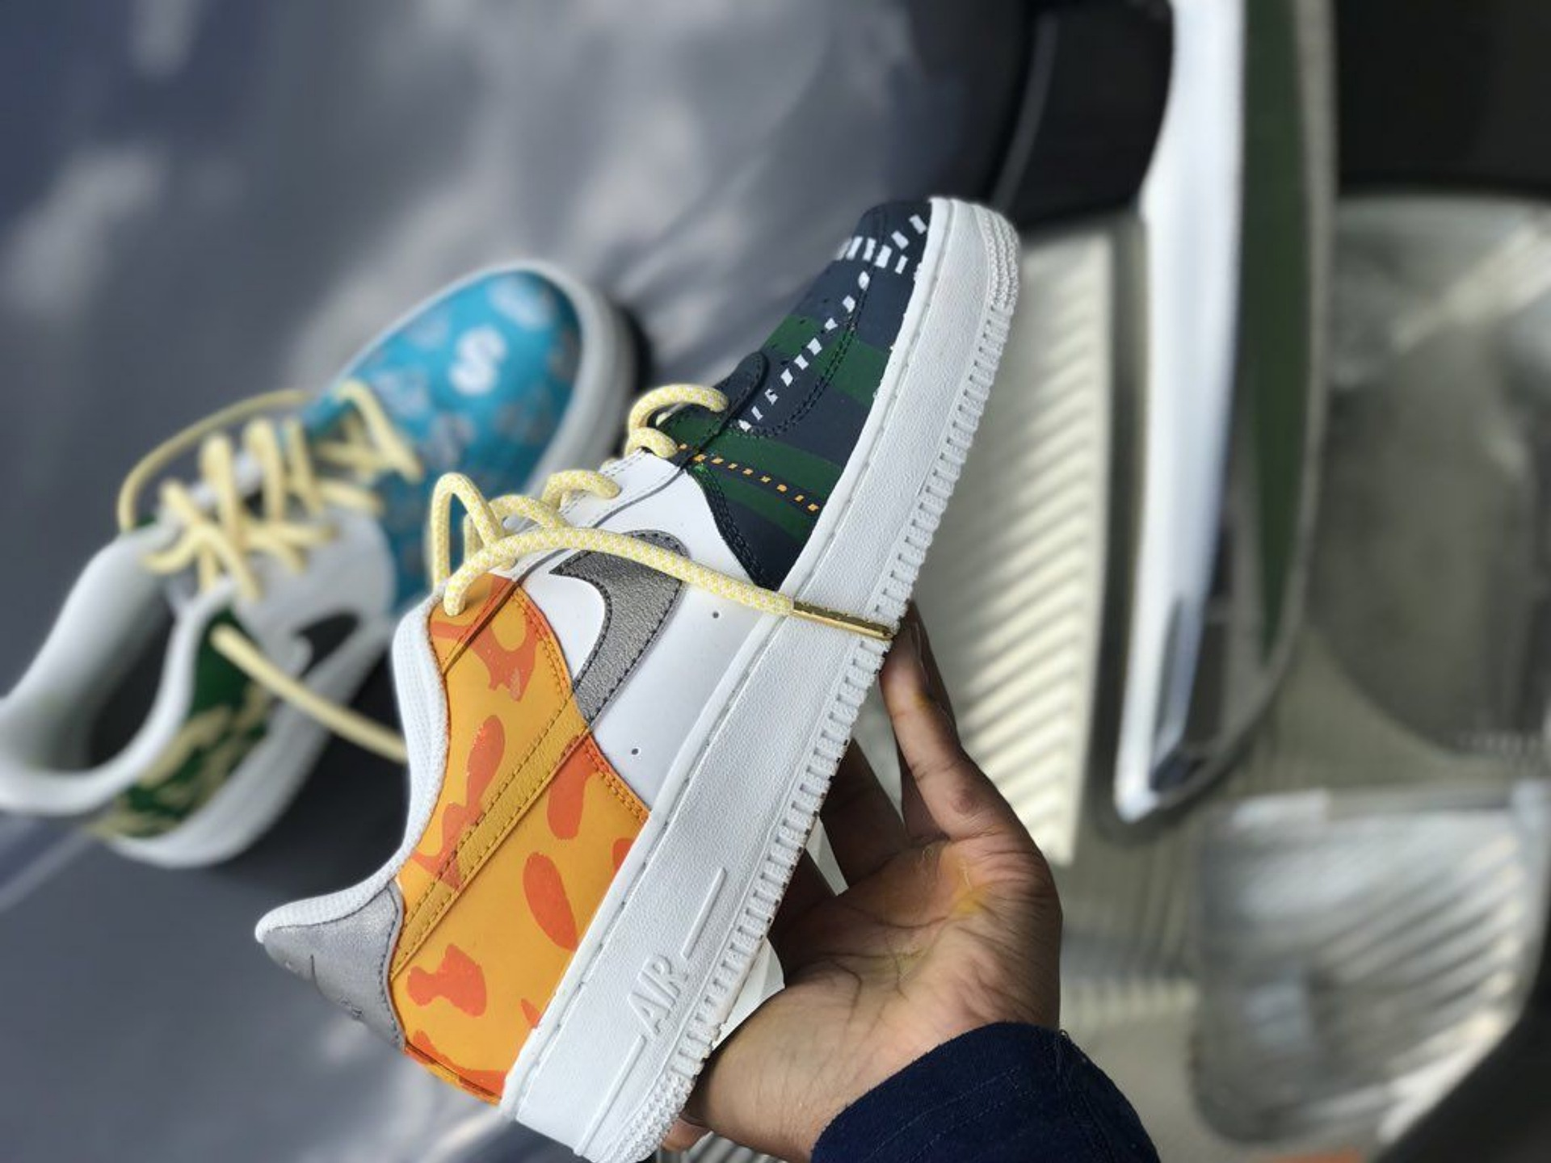
CASCADE DATA LABS x NIKE
Nike By You (NIKEiD)
Analysis Attack Plan
Data Analyst / Data Engineer Candidate
EunJeong Heo
Notes:
Hi, My name is Eun Jeong a candidate for the data analyst or engineer position, today I’m here to present ‘Nike By You’ aka NIKEiD sales Analysis Attack plan.

Slide 2

Table of Content
01
Introduction: ‘Nike By You’ Strategy
02
Business Problem: How to diagnose the recent two months sales divergence?
03
Dataset Exploration: Product, Orderline, Order, Customer
04
Data Pre-processing: Data Merging, Cleansing and Sampling
05
Hypotheses and Validation: The significant sales drop in products A, B and C
06
Business Implications: How to improve NIKEiD business?
Notes:
This is the table of contents that I will cover today. First off, I will quickly introduce ‘Nike By You’ business.
Then will start to dig into our given business problem which is how to diagnose the recent two-month sales drop at NIKEID.
And, from there I defined the four datasets to conduct the analysis, set the reasonable hypotheses and conducted the validation test based on the statistical approach method.
Finally, I will advise the business implications based on my findings.

Slide 3
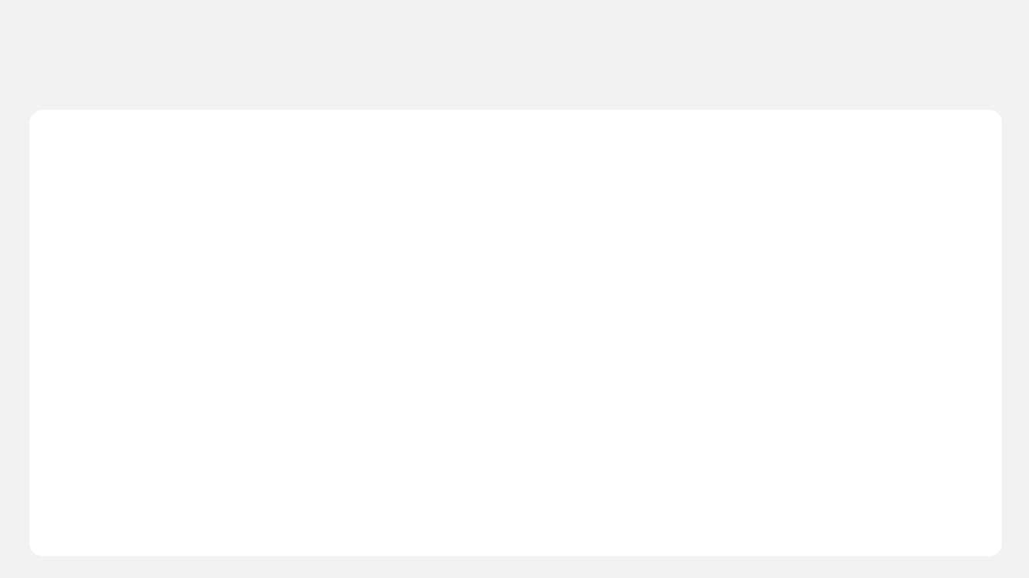
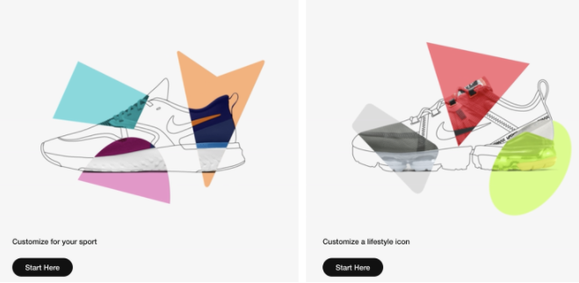





Introduction
About ‘Nike By You’ Strategy
1
Nike By You (Previously "NikeiD") is a service provided by Nike allowing customers to personalize and
design their own Nike merchandise, most specifically footwear but also sportswear.
Strategy
Viral Marketing by its customers
Direct to Customer (D2C)
Enhance customer
engagement and loyalty
Enhance price competitiveness
by eliminating the distribution stage
Notes:
Nike By You (Previously "NikeiD") is a service provided by Nike allowing customers to personalize and design their own Nike merchandise. The customer can pick from their favorite Nike Styles, and color the merchandise to reflect their unique personality. By providing customized service online, besides positive effects on sales, the customers feel more attachment to NIKE, and the use of viral marketing is expected to bring significant reductions in marketing costs and expenses. In addition, eliminating each stage of distribution margin also enhance price competitiveness.

Slide 4


Business Problem
: How to diagnose the recent two months sales divergence?
2
Question to Answer
NIKEiD( 'Nike By You') business
missed sales forecast targets
for the last 2 fiscal months
How to diagnose the recent divergence
from sales forecast?
Notes:
However, for the last 2 fiscal months, ‘Nike By You’ business missed sales forecast targets, therefore, NIKE wants to diagnose the possible factors causing their sales drop.

Slide 5
Business Problem
: Mutually Inclusive Collectively Exclusive Framework
2
Sales forecast miss
Internal
Driver of Profit
Customer need
external
Market Attractiveness
Competitive Landscape
Have customer purchasing habits changed?
Any correlation between product and customer?
Do customers view NIKEiD differently?
Market size
Growth rate
Avg. profit margin
Have existing competitors made any recent strategic moves?
Have new competitors entered the market?
revenue
volume
Price/unit
Will investigate this part! →
Notes:
Before diving into investigating random factors, I wanted to brainstorm to set priorities the factor can look into first. Here I divided into two big sides internal and external.
From there, in terms of the internal side, again, I divided into two sectors; the driver of profit and customer needs. When it comes to profitability, NIKE identified their sales have been dropped. With that being said, it could mean that their volume has been decreased because of outside factors or they have changed the price per unit so that it impacts the sales volume.
Move on to the next sector customer needs, here I threw a couple of questions we can think about such as;
- Have customer purchasing habits changed?
- Any correlation between product and customer?
- Do customers view NIKEiD differently?
A lot of time revenue drop is correlated to consumers' purchasing habit change. It could be caused internally such as NIKEiD set the wrong branding pathway, therefore, the consumer could have lost their interest in the customized service or since it's e-commerce merchandise we can also investigate if has there been any technical or distribution channel issues recent two months.
When it comes to external factors, again I divided into two sectors; market attractiveness and competitive landscape. NIKE BY YOU belongs to an e-commerce service on a larger scale and a sneaker or customized sneaker market on a smaller scale. As NIKE detected their sales drop these recent two months, I believe it is too early to look into their industry's market size, growth rate, or avg. profit margin, however, if any strong external factors have been impacted to these markets, still it's possible the entire market trend could have been decreased.
Last but not least, the competitive landscape is also one of the potential strongest factors that led to NIKEiD's sales drop. Nike has several well-known competitors such as Adidas, New Balance, Puma, Rebook, Fila, etc. If the existing competitors have made any recent strategic moves such as entering the customized merchandise service or releasing brand new design sneakers, it can directly impact NIKEiD sales within a short period. Additionally, new competitors’ market entry is another factor we could look at. Especially, living in a time of trending in social media platforms, people can easily pursue the celebrities' trends impacted by Instagram or TikTok.
Considering all these possible factors, I would like to start off investigating customer segmentation or needs change in recent two months. It's not only easier to narrow the further analysis plan down but also it's the fastest way to collect the data and identify the main issue. (5’00)

Slide 6





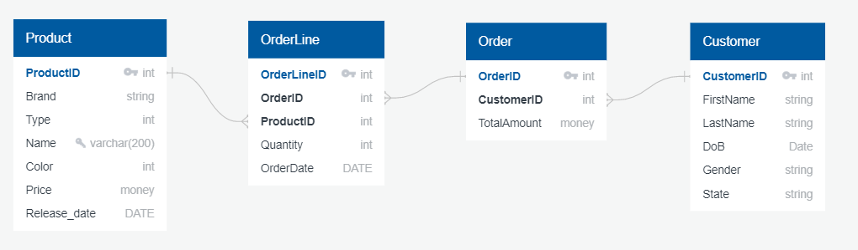
Internal Factor Dataset Exploration
Exploration of Original Datasets
3
Important Datasets
“Product.csv” | “OrderLine.csv” | “Order.csv” | “Customer.csv”
Notes:
As I decided to investigate customers’ needs change, I collected the 4 datasets which are product, orderline, order, and customer.
To give a brief introduction of each table, the product table is a list of products options that NIKEiD provides to their customers.
Orderline is a bridge entity that lies between the two entities, product and order, and this composite entity shares the primary keys from both the connecting tables.
And, order table has customers' transaction record, lastly, the customer table includes the customer's personal data.(40”)

Slide 7

Internal Factor Dataset Exploration
:Questions to Explore
3
“Product.csv”
“Orderline.csv”
“Order.csv”
“Customer.csv”
What month has the least # of new product releases?
Which brand product has the most?
Data Exploration
Questions
to explore
Is there any transaction pattern by date/month?
Which product has been sold the most?
Summary Statistic
count
mean/median
std
quartile
min/max
What is the avg. revenue by month?
What is the statistic summary of transaction?
What is the % of segmentation of customer gender/age/region?
Notes:
Align with our main goal of identifying customer segmentation change, there are a couple of things we can look into from each data table.
For example, we can visualize the data with python or tableau to see what month has the least # of new product releases or which brand product has the most in the product table.
In orderline and order table, we can identify any transaction pattern or average revenue by month so that can recognize how significant have the sales been dropped these recent two months.
Last but not least, through the customer table we can see customer demographic and segmentation share by gender, age, region, etc. (50”)

Slide 8
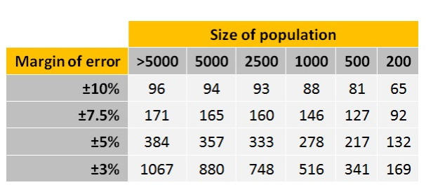


Data Preprocessing
Data Merging, Cleansing and Sampling
4
Sampling helps to make statistical inferences about the population and make the model to run much more efficient
How to decide the sample size?
Orderline
Product
Order
Customer
Dropping duplicates
& null values
Correlation coefficient
Confidence level
Confidence interval (margin of error)
NIKEiD_sampled.csv
N independent observations
→ Split the dataset into two: 70% for training and 30% for validation
Notes:
First off, I would merge the 4 datasets using ‘left-join’ based on orderline and order tables, and dropped any duplicates or missing values. And here I sampled certain proportion of data from the entire population.
But in this process, I will make sure that the collected sample size is not too small or too big.
If the sample is too small, some disproportionate number of observations such as outliers and anomalies could skew the results, therefore, I would not be able to get a fair picture of the whole population. At the same time, if the sample is too big, the whole data manipulation process becomes too complex, expensive and time-consuming to run, and although the results are more accurate, the benefits don’t outweigh the costs.
In order to ensure or enhance performance of sampled dataset, we can simply calculate the sample size using the confidence level and confidence interval. These numbers tell us plus-or-minus figure that represents the accuracy and how confident of this result is respectively.
[Margin of error] A Canadian national sample showed "Who Canadians spend their money on for Mother's Day." Eighty-two percent of Canadians expect to buy gifts for their mom, compared to 20 percent for their wife and 15 percent for their mother-in-law. In terms of spending, Canadians expect to spend $93 on their wife this Mother's Day versus $58 on their mother. The national findings are accurate, plus or minus 2.75 percent, 19 times out of 20.
For example, if you use a confidence interval of 2.75 and 82% percent of your sample indicates they will "buy a gift for mom" you can be "confident (95% or 99%)" that if you had asked the question to ALL CANADIANS, somewhere between 79.25% (82%-2.75%) and 84.75% (82%+2.75%) would have picked that answer.
[Confidence level]
When you put the confidence level and the confidence interval together, you can say that you are 95% (19 out of 20) sure that the true percentage of the population that will "buy a gift for mom" is between 79.25% and 84.75%.

Slide 9
Hypotheses and Validation
The significant sales drop has occurred on products A,B and C in recent two months!
5
Steps in Testing a Hypothesis
H0: status quo
vs
Ha: what we wish to observe
Assume H0 is true
Find the evidence
Calculate the test statistic to see the distance between the evidence and H0
Determine if the distance is large enough to reject the initial assumption (H0)
Assumption
The significant sales drop has occurred on products A,B and C in recent two months!
Notes:
After preprocessing, and during the exploration phase, assuming that I found that there is a significant sales drop has occurred on sneakers A,B and C in recent two months.
Then, in order to statistically measure if these drops is significantly correlated to NikeiD entire sales drop and I would conduct the Hypothesis test.
In this synario I would set the null hypothesis as The product A,B and C’s impact on the resent 2 months sales decrease ARE NOT significant and set the alternate hypothesisis as ‘The product A,B and C’s impact on the resent 2 months sales decrease are significant’
Assuming that I set the critical value alpha as 0.05 and found that p-value is smaller that 0.05, I can reject the null Hypothesis and select the alternate hypothesis.
In other words, I can define that product A, B, C’s sales volume decrease impacted on NikeiD’s recent two months revenue.
Null Hypothesis (H0)
:The product A,B and C’s volume decrease impact on the resent
2 months sales decrease ARE NOT significant.
Alternate Hypothesis (Ha)
:The product A,B and C’s volume decrease impact on the resent 2 months sales decrease are significant.
Alpha = 0.05
Conclusiton = p < 0.05

Slide 10



Hypotheses and Validation
Overall Process
5
Step 1: Hypothesis
Informal method : scatter plot
Are X and Y linearly related?
Statistical test: correlation matrix, p-value, t-test
Step 2: Significance test
Y = $β_{0}+ β_{1}∗x+ε$
If yes, how significant is the relationship?
If $β_{1}≠0$ then what is the value of $β_{1}$?
→ A 95% confidence interval for $β_{1}$ is …
Step 3: regression model
Simple linear regression model
Multi linear regression model
Given X, what is the predicted Y value?
Step 4: Usefulness test
RMSE
R square
How good is the model (good fit)?
Notes:
To identify wheather my hypothesis is reliable or not, here is the overall process of setting the hypothesis and validation.
In step one, once I set the hypothesis I can simply visualize the data to see if X and Y has some correlation
and if so, we can conduct the statistical test as I have just done at the previous slide. In other words, this is the process of identifying what is the regression’s slope or weight.
Next, depends on the # of factors we have, we can decide whether we use simple or multi linear regression model,
And finally once we finalized the model that see what is the r square so that can see how much of variance can be explained.

Slide 11
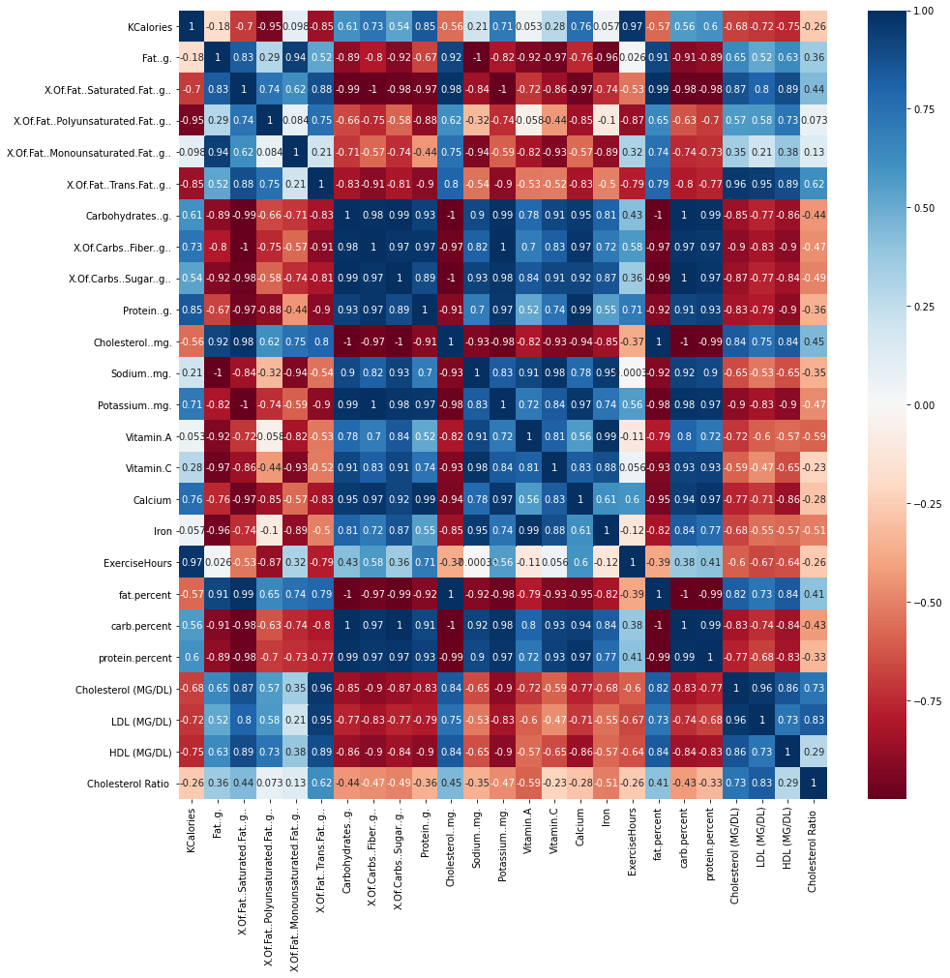
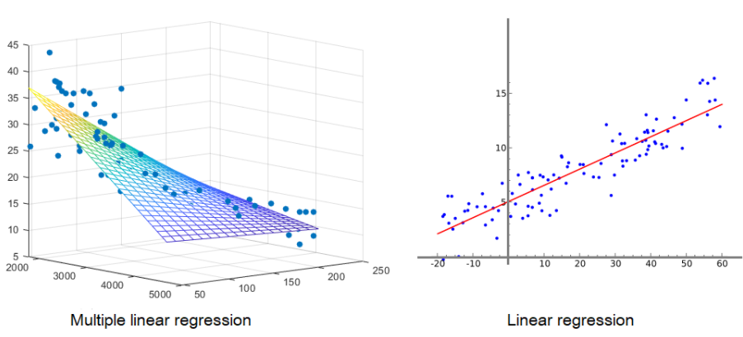
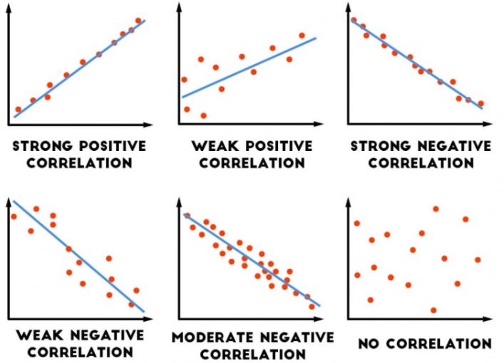
Hypotheses and Validation
Validation Method (1)
5
Validation Methods
Correlation Matrix
Linear regression
Multi-linear regression
Correlation matrix (example)
T-test
Confidence interval
Notes:
Here is the couple of example of validating the hypothesis process and we can visualize the data points scatter using python matplotlib, skitlearn, ggplot, seaborn etc.

Slide 12



Hypotheses and Validation
Further Hypothesis among product A,B and C data
5
X
Age
Gender
Price/unit
Y
A, B and C sales
Does the factor
have an effect of recent two months product decrease?
Hypothesis
H0: X is NOT an effect of recent two months product Y decrease
Ha: X is an effect of recent two months product Y decrease
Y = $β_{0}+ β_{1}∗x+ε$
If $β_{1}≠0$ then what is the value of $β_{1}$?
→ A 95% confidence interval for $β_{1}$ is …
Notes:
Now we know that sneakers A,B and C ‘s revenue drop is the main factor of the entire recent two month’s sales drop at NikeiD, I would like to set futher hypothesis and see what specific factors have impacted to A,B and C sales’ decrease. Here I arbitrarily selected a coupe of independent variables from the our cleaned dataset which are age, gender and price/unit.
I assuemd that I ended up selecting age and gender were a significant factors for A,B and C’s sales decrease while Price/unit was not significant since its p-value was bigger than critical value 0.05.

Slide 13


Data Hypotheses and Validation
There is a correlation on male, age(20-30),
5
Linear regression
Multi-linear regression
Revenue = $β_{0} {−100(β}_{1)}∗male$
Revenue = $β_{0} {−80(β}_{1})∗male$ -120 ($β_{2})∗age(20−30)$
With 95 % confidence, per 100 decrease in ‘male(X)’,
the ‘revenue(Y)’ is estimated to decrease by anywhere between $10M to $15M.
With 95 % confidence, per 80 decrease in ‘male (X1)’ and
120 decrease in ‘age(X2)’ , the ‘revenue(Y)’is estimated to decrease by anywhere between $30M to $30M
R square: 0.6
60% of a dependent variable(Y) is explained by the independent variable(X) in a regression model.
R square: 0.8
80% of a dependent variable(Y) is explained by the independent variables(X) in a regression model.
Revenue = $β_{0}−{200(β}_{1)}∗age(20−30)$
With 95 % confidence, per 200 decrease in ‘age’, the ‘revenue(Y)’is estimated to decrease by anywhere between $20M to $25M
R square: 0.7
70% of a dependent variable(Y) is explained by the independent variable(X) in a regression model.

Slide 14



Business Implications
6
Focusing on Male customers in age 20-30 to increase sales!
Internal
External
Competitive Landscape
& Market Size
Customer Segmentation
Investigate why targeted customers lost interest
Change male customer in age 20-30 marketing strategy
Monitor if competitors made any recent strategic moves
Check male sneakers market size and growth rate

Slide 15


Thank You
Data Analyst / Data Engineer Candidate
EunJeong Heo
Email: eunjeong.heo95@gmail.com
Phone: (+1) 202 705 0133
https://www.linkedin.com/in/eunjeongheo/
https://github.com/hej6853

