Slide 1
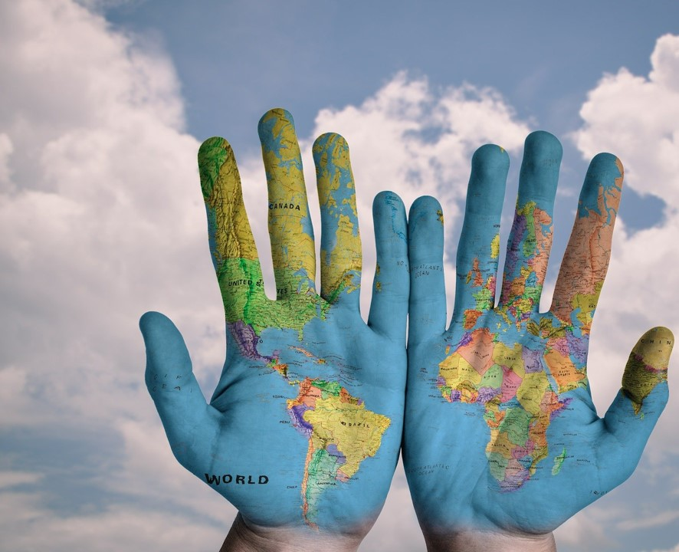
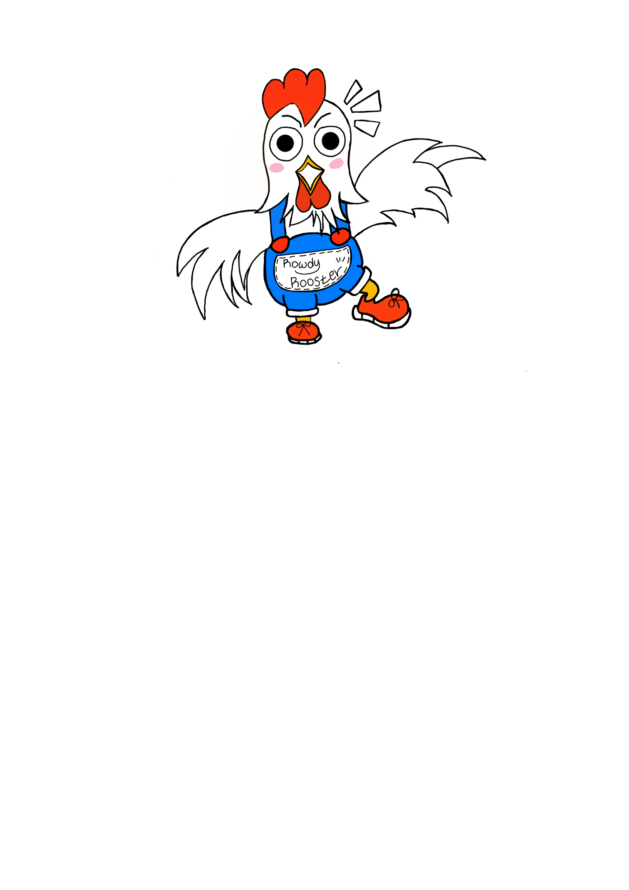
Make the world better place
Boya Li
David Moon
EunJeong Heo

Slide 2
Table of Content
01
Motivation
02
Question to Answer
03
Project/Dataset Summary
04
Key Approaches
05
Machine Learning Model
06
Conclusion

Slide 3
QUIZ
X
Quiz
Q1. In all low-income countries across the world today, how many girls finish primary school?
A) 20%
B) 40%
C) 60 %
Q3. In the last 20 years, the proportion of the world population living in extreme poverty has . . .
A) Almost doubled
B. Remained more or less the same
C) Almost halved
Q5. There are 2 billion children in the world today, aged 0 to 15 years old.
How many children will there be in the year 2100, according to the United Nations
A) 4 billion
B. 3 billion
C) 2 billion
Q13. Global climate experts believe that, over the next 100 years, the average temperature will...
A) get warmer
B. remain the same
C) get colder
CONTENT
CONTENT

Slide 4



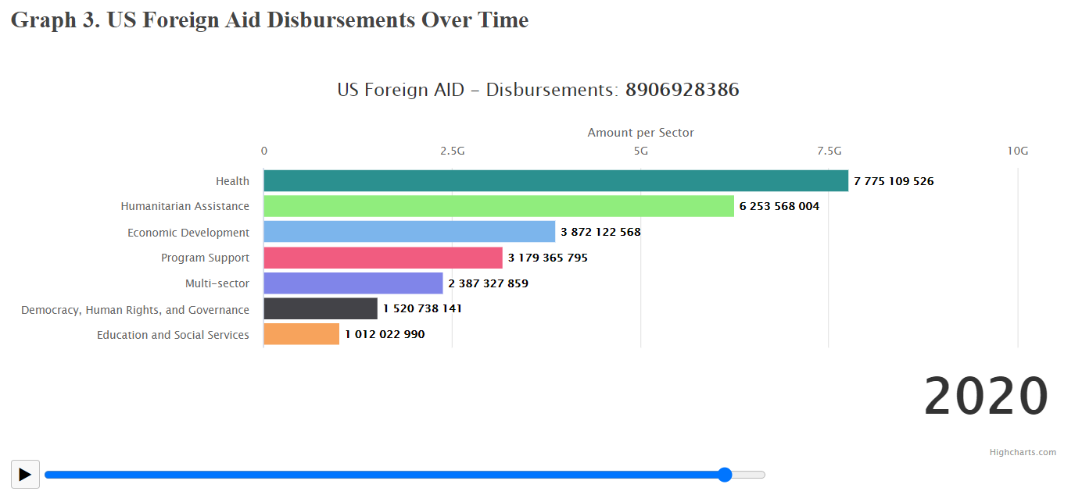
Motivation
: ‘Factfulness’ and AID
1
Why do we need Foreign Aid?
Notes:
In project 2, we created a web application based on the book ‘Factfulness’, discussed how much our worldview is skewed across certain fronts, and found some correlation between our data and USAID's foreign aid trend.
Following the last part of Project 2, in Project 3, we would like to find out how the variables held by countries receiving the aid are predictable and affect the actual amount of aid with the following machine learning models.

Slide 5

Introduction
About ‘Nike By You’ Strategy
1

Slide 6

01
X
Motivation
page
When asked simple questions about global trends,
we systematically get the answers wrong. So wrong that a chimpanzee choosing answers at random will consistently outguess journalists, Novel laureates, and investment bankers.
-Factfulness-
Notes:
Our motivation comes from this book called ‘Factfulness’ by Hans Rosling. The book says when asked simple 13 questions about global trends, much of our worldview is skewed across certain fronts.

Slide 7
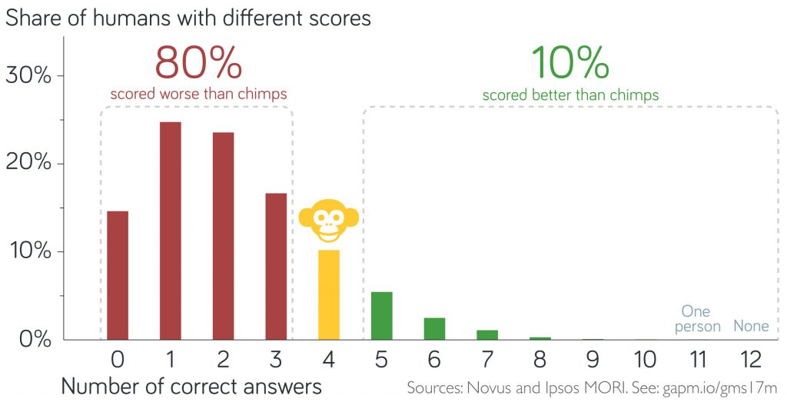
02
X
Motivation
page
On average a chimpanzee picking answers randomly would score 4 out of 12 correct answers. But the average score for the humans was much lower: only 2.2!
Notes:
Actually, there was one question, number 13 global warming question, which we have excluded because 87% of respondents, picked the right answer.
We can tell this is the ideal situation how people recognize and accept the data.
From now on, we will only consider the 12 questions.
Okay, let’s do simple math! If I let the Chimpanzees choose marked bananas with A, B and C then the chimpanzees gonna randomly pick one of those, therefore, the score would be 4 out 12. But the average score for the humans was much lower which was only 2.2!
(So if you got less than 4 correct answers than no worries ! you are not alone)
Interestingly, most people in the richest countries or even the scientists, ppl work in NGO or governments are absolutely wrong about the state of the world.
Overall, all the groups asked considered the world a scarier, more violent and more hopeless place than it really is.

Slide 8
03
X
Quiz
page
Top 3 wrong answer rate | Correct | Wrong
Q1. In all low-income countries across the world today, how many girls finish primary school? |  | X
Q3. In the last 20 years, the proportion of the world population living in extreme poverty has . . . |  | ○
Q5. There are 2 billion children in the world today, aged 0 to 15 years old. How many children will there be in the year 2100, according to the United Nations
90 %
10%
→ 60 %!
95 %
5%
→ Almost halved
90 %
10%
→ 2 billion !
CONTENT
CONTENT
Notes:
Among 13, the last question the global warming one, 87% of respondents, picked the right answer. We can tell this is the ideal situation how people recognize and accept the data. But the average score for the humans was much lower which was only 2.2!

Slide 9



02
X
Question to Answer
page
The wrong answers tend to lean in one (negative)direction.
All the groups asked considered the world a scarier, more violent and more hopeless place than it really is.
how those decision-makers who work in the government sector, NGO or leader
can make decisions wisely?
Notes:
Actually, there was one question, number 13 global warming question, which we have excluded because 87% of respondents, picked the right answer.
We can tell this is the ideal situation how people recognize and accept the data.
From now on, we will only consider the 12 questions.
Okay, let’s do simple math! If I let the Chimpanzees choose marked bananas with A, B and C then the chimpanzees gonna randomly pick one of those, therefore, the score would be 4 out 12. But the average score for the humans was much lower which was only 2.2!
(So if you got less than 4 correct answers than no worries ! you are not alone)
Interestingly, most people in the richest countries or even the scientists, ppl work in NGO or governments are absolutely wrong about the state of the world.
Overall, all the groups asked considered the world a scarier, more violent and more hopeless place than it really is.

Slide 10

02
X
Question to Answer
page
WHO needs help?
Notes:
Therefore, our question to answer for this project is Why things are better than you think and Why knowing the fact based on the data is important?

Slide 11
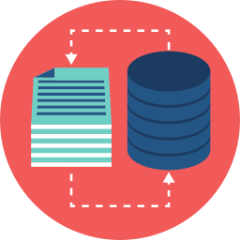


02
X
Question to Answer
page
Dataset related to the quiz
US Foreign Aid data
Dataset related to the quiz
Is there any correlation or discrepancy
between the statistics and US Foreign Aid?

Slide 12




03
X
03. Dataset Summary
page
Analysis Dataset
Insight Dataset
primary_completion_rate_low_income.csv
extreme_poverty_percent_people.csv
population_aged_0_14_years_rate.csv
immunized_percent_of_one_year_olds.csv
us_foreign_aid.json/csv

Slide 13
04
X
04. Key Coding Approach
page
Data clean up (Python)
&
Exploration
MongoDB
&
Python Flask
JavaScript
&
HTML/CSS
START
Website

Slide 14

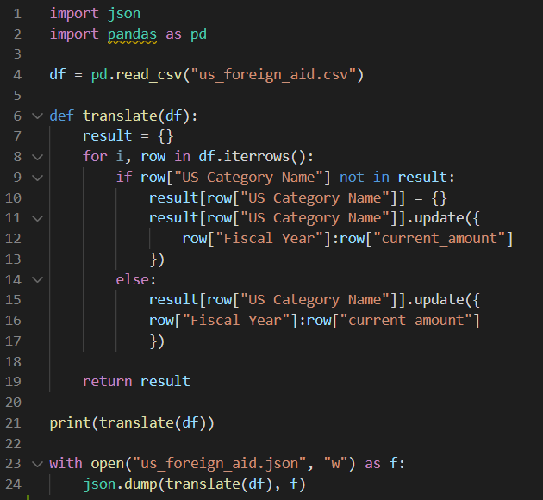
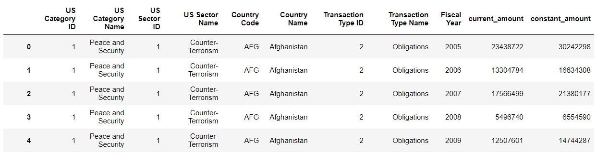


04
X
04. Key Coding Approach
page
Dataset Manipulation
Built with
Python – Pandas

Slide 15
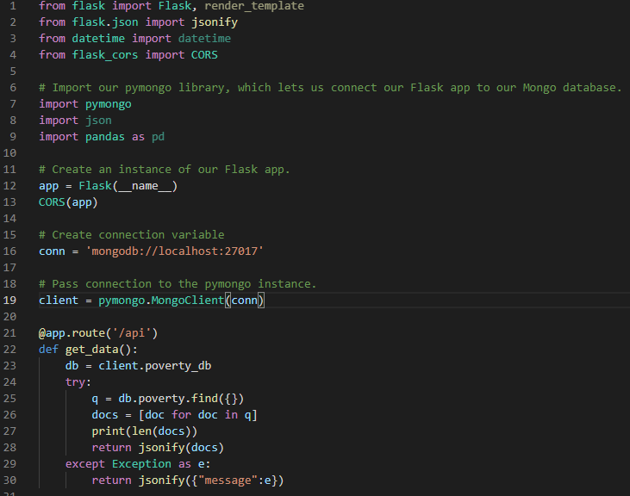
04
X
04. Key Coding Approach
page
Build a Database
Import our pymongo library,
which lets us connect our Flask app to our Mongo database
Built with
Python – flask, jsonify
MongoDB

Slide 16
04
X
04. Key Coding Approach
page
Additionally Built with…
Plotly/D3 JavaScript
HighCharts – Interactive JavaScript charts library
Surveyjs.io - customizable surveys, forms and quizzes that seamlessly integrate into your application

Slide 17
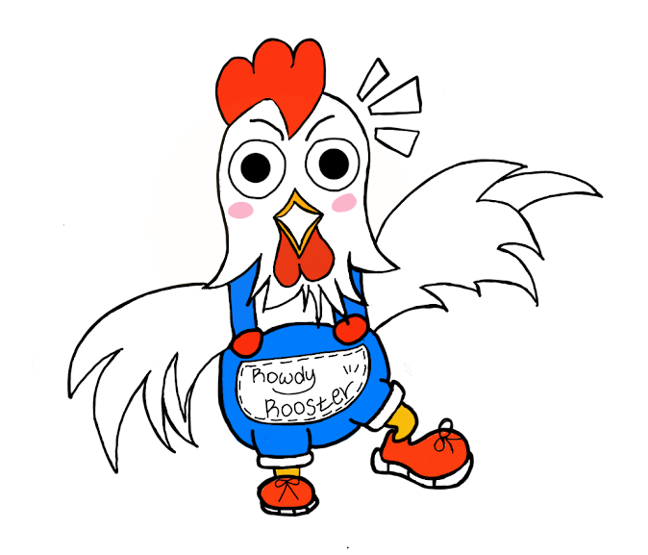
05
X
05. Data Analysis
page
Hey,
click me !

Slide 18

06
X
06. Conclusion
page
Step 1
Recognize that the world isn’t
as bad as I thought
Recognize
Notes:
The three questions we analyzed with the lowest correction rates, are the ones people generally have negative views of the future world development trend. When we analyzed government data, we found that it was consistent with the factfulness data, so the U.S. government provided assistant in the right direction. It’s just the common people think the world too badly.

Slide 19
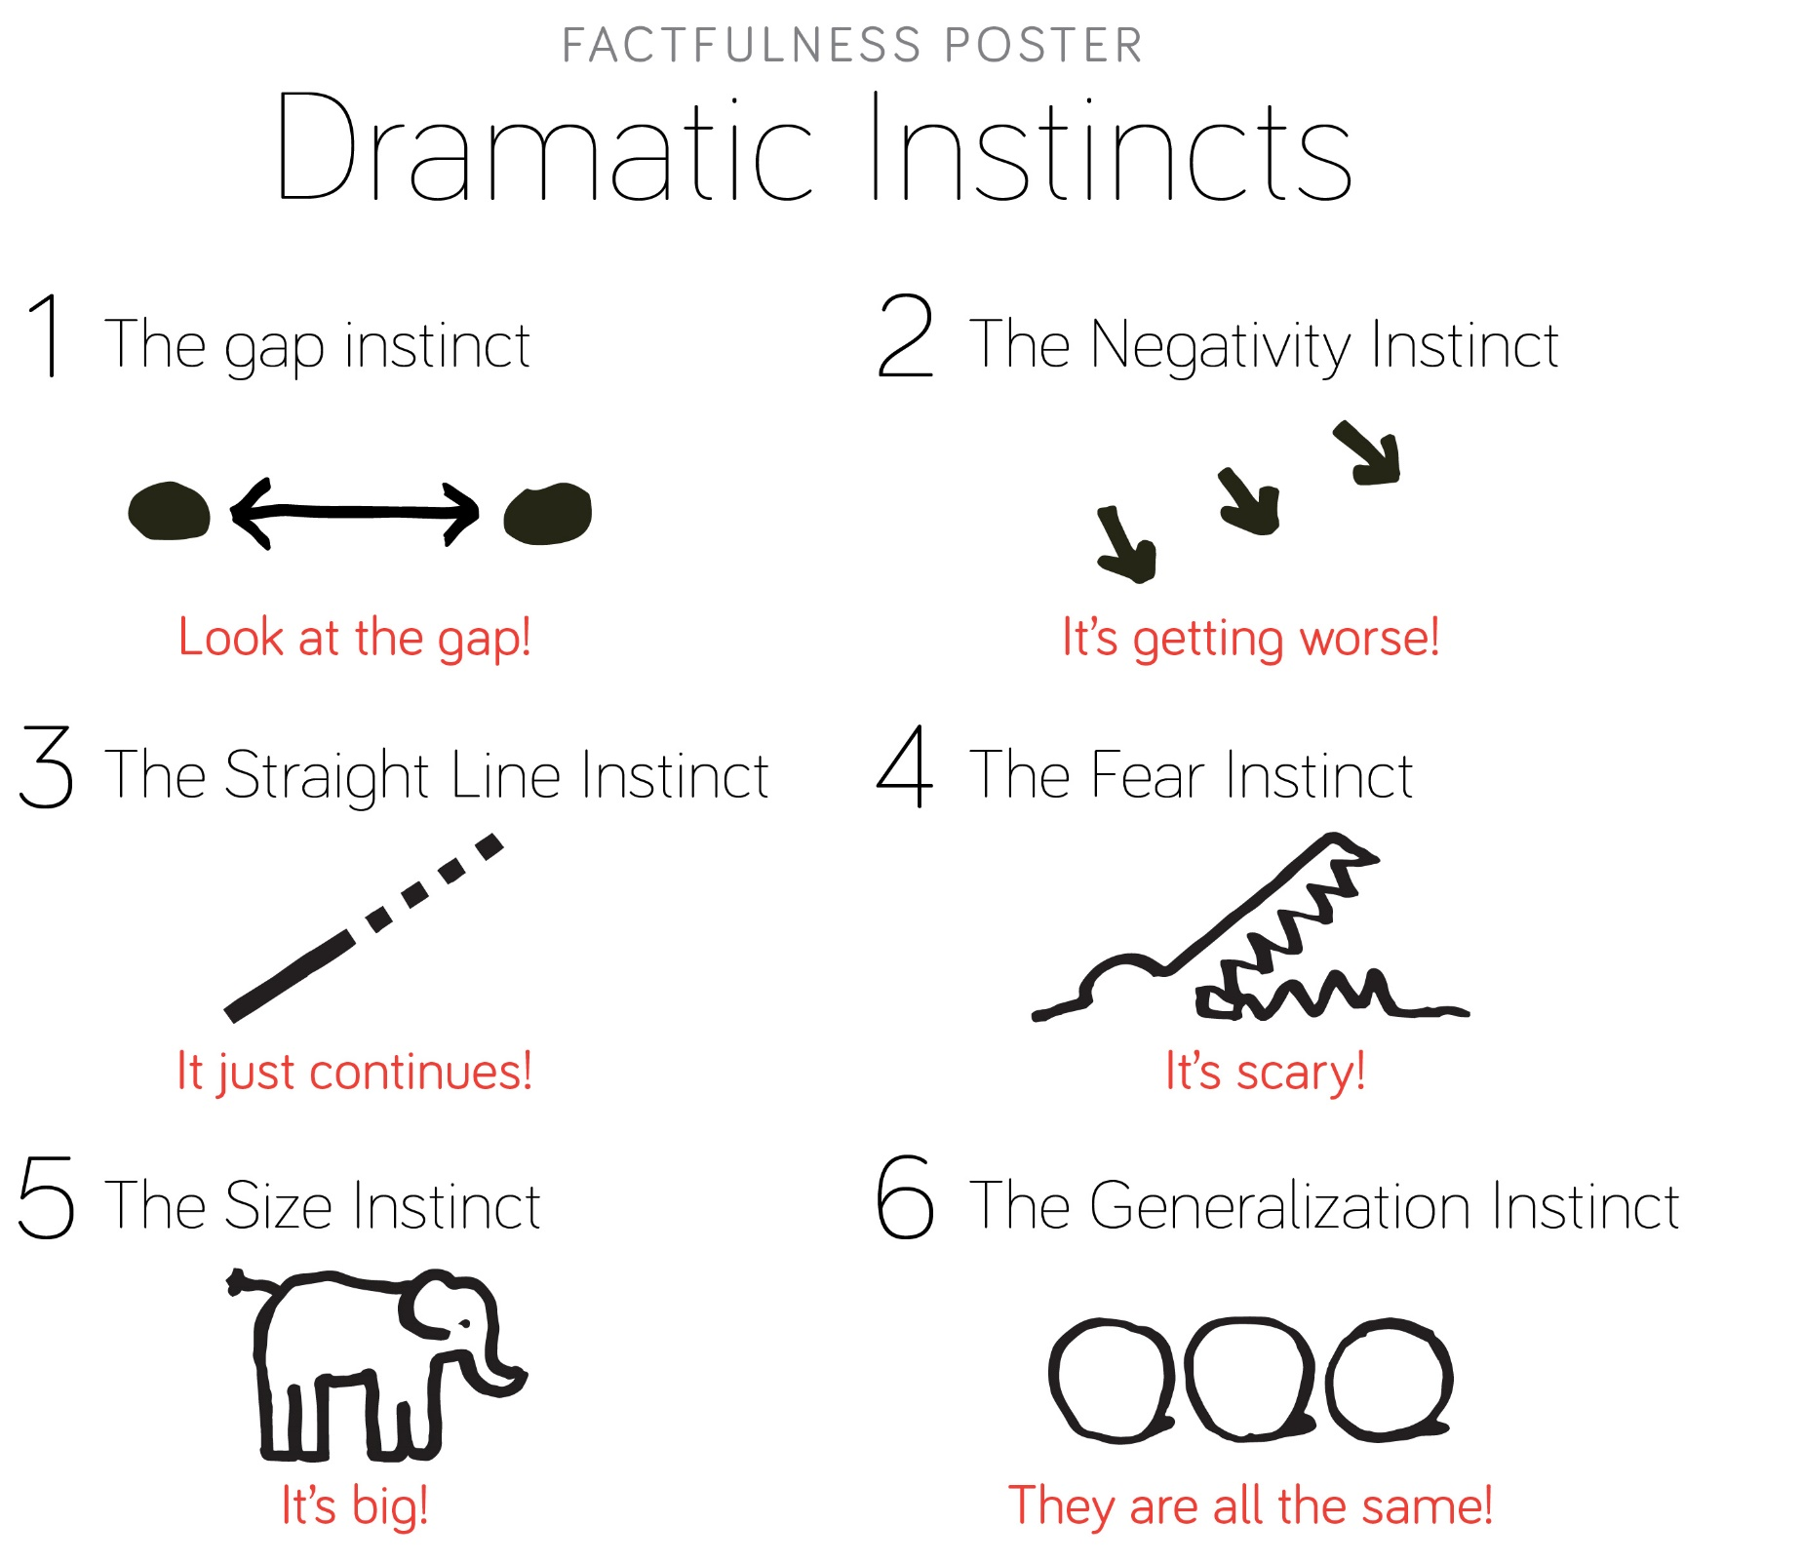

06
X
06. Conclusion
page
Step 2
Problem Solving
Do your analysis
Notes:
These deep-rooted ideas are related to biases. There are three biases that prevent our feelings from matching the numbers: the straight-line instinct, the fear instinct, and the size instinct. All this called dramatic instincts. Which means We misplace our primal fears, think trends continue in a straight line, and overestimate their size. That’s why population growth might feel like a huge threat, when, it’ll likely not be a big deal.

Slide 20

06
X
06. Conclusion
page
Step 3
See the world in multiple angles!
Take an Action
Notes:
Therefore, the only thing that allows us to see the world as it really is is to look at everything from multiple angles. The last question of the quiz is regarding to the global climate change. It’s asking the average temperature in the next 100 years. 90% of people get it right. It’s going to getting warmer. it is because most people learn about the facts of global warming from the media. But for the most other questions, people’s correction rate is very low, even though the dataset is always there in the us gov database. We need to understand the news and advertising-driven media becoming more and more extreme. Usually, life is better than news outlets make us believe.

Slide 21

06
X
06. Conclusion
page
Recognize
Problem Solving
Take an Action
Recognize that the world isn’t as bad as I thought
Do your analysis
See the world
in multiple angles
Notes:
So, when getting your information online, it’s always best to read multiple sources, not just one. It’s the equivalent of traveling around the world. Only when we surf the globe can we learn to see it as it really is, so that we may form our opinions based on facts, not feelings.

Slide 22
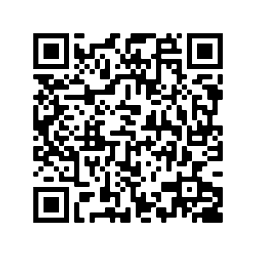
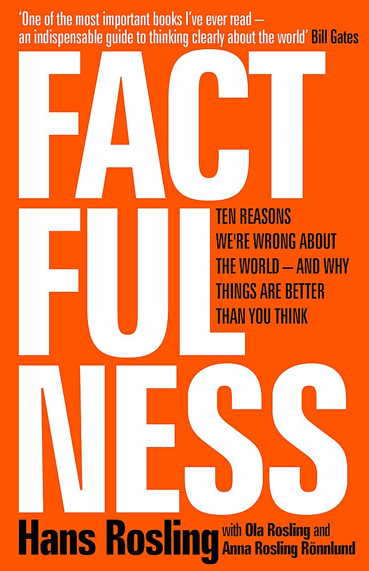
06
X
Conclusion
page
All 13 questions are here
Do you like to know more about the world you live in?
Read this book!
Notes:
So, when getting your information online, it’s always best to read multiple sources, not just one. It’s the equivalent of traveling around the world. Only when we surf the globe can we learn to see it as it really is, so that we may form our opinions based on facts, not feelings.

Slide 23
Thank you!
Q&A?

Slide 24
Reference
X
Rosling, H., Rosling, O., & Rönnlund, A. R. (2019). Factfulness: ten reasons we're wrong about the world - and why things are better than you think
Gapminder : https://www.gapminder.org/
World Bank : https://data.worldbank.org/
UNESCO Database : http://data.uis.unesco.org/

