Slide 1
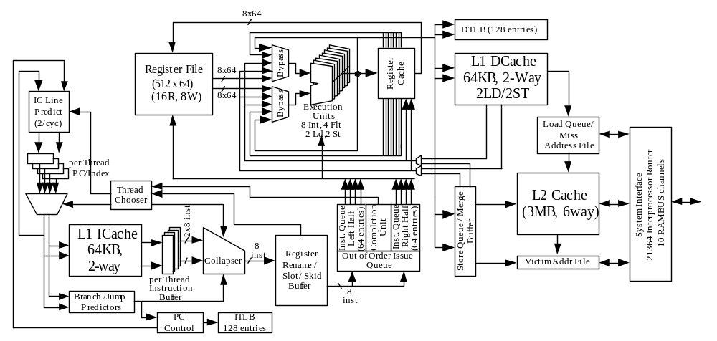
Figure 20.1.1 – CPU Block Diagram

Slide 2
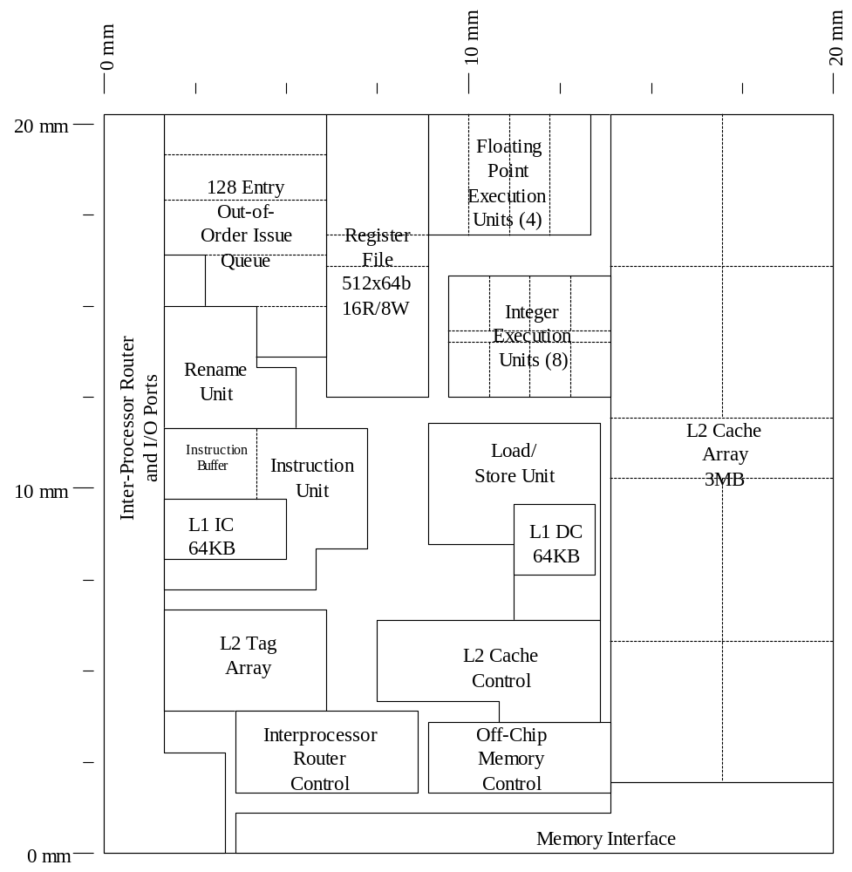
Figure 20.1.2 – High Level Floorplan

Slide 3
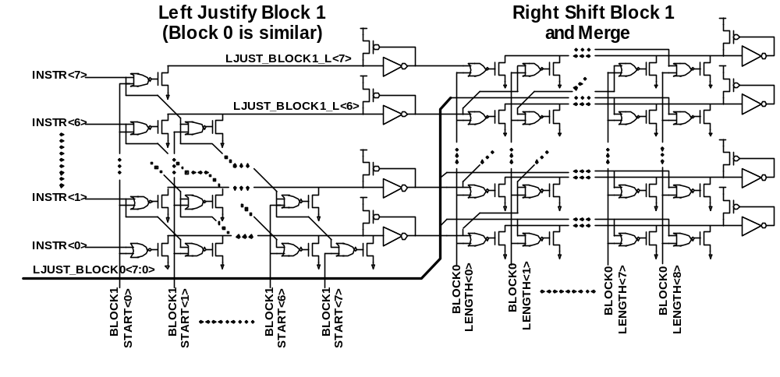
Figure 20.1.3 – Collapsing Buffer Network

Slide 4
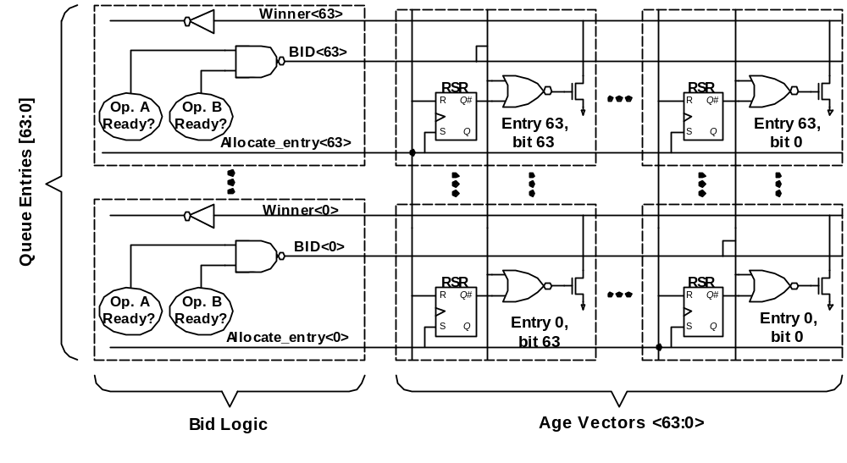
Figure 20.1.4 Instruction Queue Age Mask

Slide 5
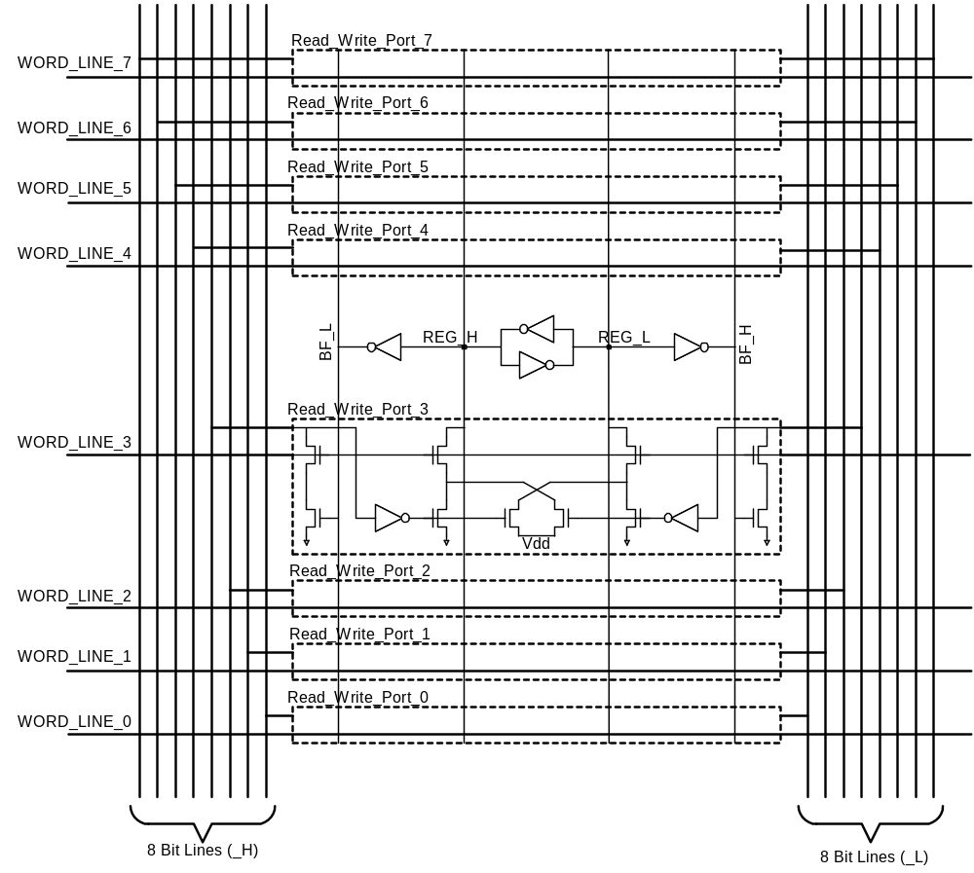
Figure 20.1.5 – 8 Port Register File Cell

Slide 6
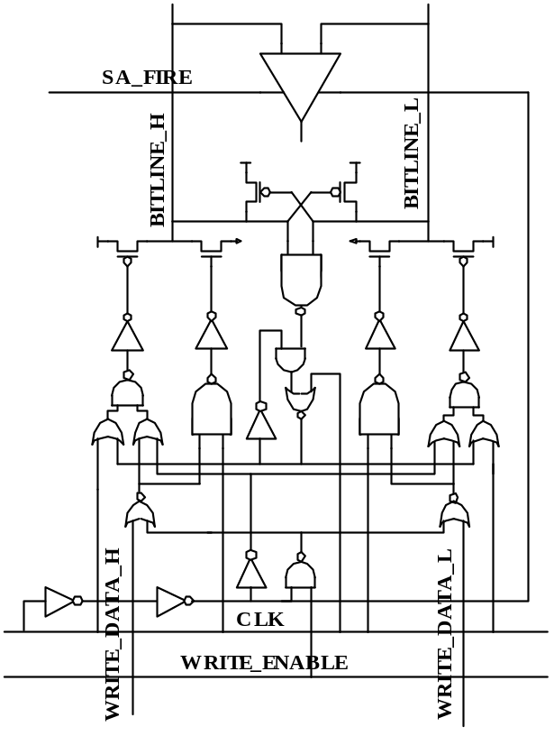
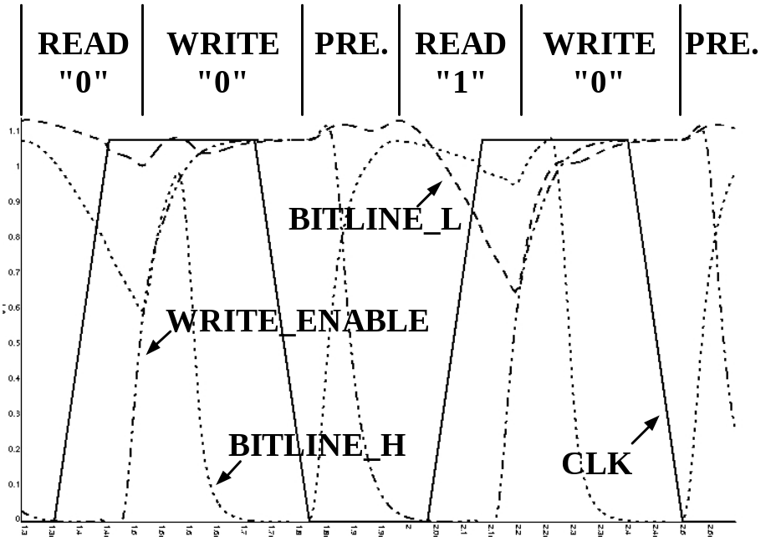
Figure 20.1.6 – Register File Write Amp / Precharge

Slide 7
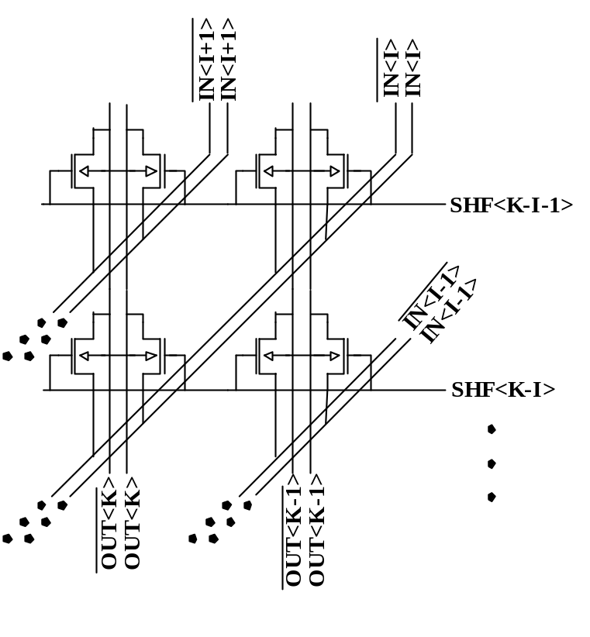
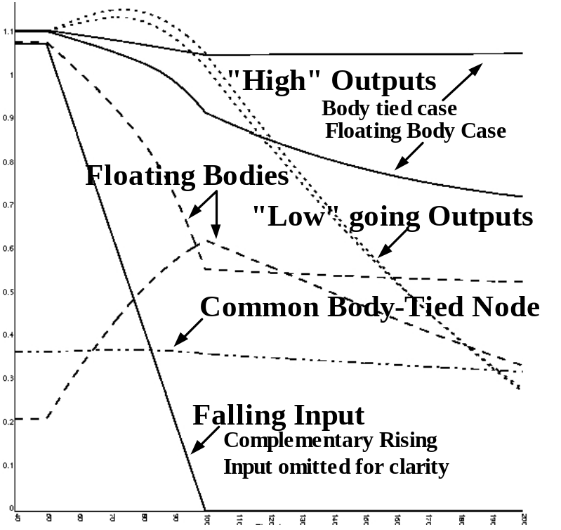
Figure 20.1.7 – 64b Integer Shifter with Body-Ties

