Slide 1
active station
similar to Tomasulo's reservation station
implements dynamic register renaming
src1
src2
dst1
path,tt,addr,val
path,tt,addr,val
path,tt,addr,pval,nval
decoded instruction
time-tag
other information used if committed
predicate
cancelling predicates
control logic
register names take the form :
  path : time-tag : addr
  for example "1 : 27 : r6"

Slide 2
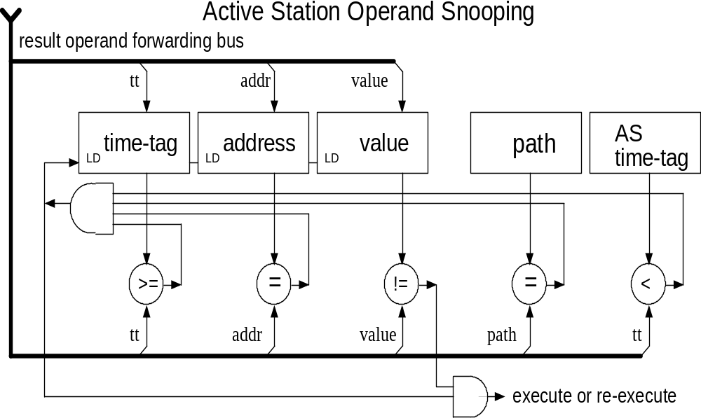
snoop/snarf operation
Notes:
2

