Slide 1



Realizing High IPC Using Time-Tagged Resource-Flow Computing
→ .
Augustus K. Uht
Dept. of Electrical and
Computer Engineering
Alireza Khalafi
David Morano
Marcos de Alba
David Kaeli
Dept. of Electrical and
Computer Engineering
&
Euro-Par August 28, 2002
Notes:
- Who I am
- where from
- title

Slide 2
Acknowledgements
Work supported by:
U.S. National Science Foundation
URI Office of the Provost
Intel
Mentor Graphics
Xilinx
Ministry of Education, Culture and Sports of Spain (D. Kaeli)
Notes:
- Intel: old
- NSF: ‘97 grants

Slide 3
Outline
Closely Related Work
Needs and Solutions
High-Level Architecture and Microarchitecture
Time-Tag Example
Resource-Flow Execution
High-IPC Multipath Method Example
Experiments
Summary
Notes:
- Say it.
- Levo: just a little on this, see paper for more; will show DEE elements here.

Slide 4
Closely Related Work
Riseman & Foster (1972), Lam & Wilson (1992) and others (unconstrained resources):
much ILP in General Purpose code: > x100
But: little IPC realized in real machines: ~ 1-2
Segmented IQ’s – ISCA2002, etc.: don’t scale,
  in dispatch stage, PE’s not distributed; we predate.
Tomasulo ’67 – elegant, but doesn’t scale
Limited register lifetime – Sohi et al ’92
  One key to Levo scalability
Warp machine – Cleary et al ’95 – time-tags
  Basic idea good, but used floating-point tags

Slide 5
Needs and Solutions
Cheap and scalable dependency detection & operand linking
→ time-tags (small): link & order operand usage.
Little cycle-time impact & scalability
→ constant length segmented or spanning buses
Simple execution algorithm
→ resource-flow execution: Instructions flow to PE’s, executed regardless of dependencies.
High IPC → hardware predication &
Disjoint Eager Execution (DEE) - smart multipath
Legacy code → ISA independent, no compiler assist

Slide 6
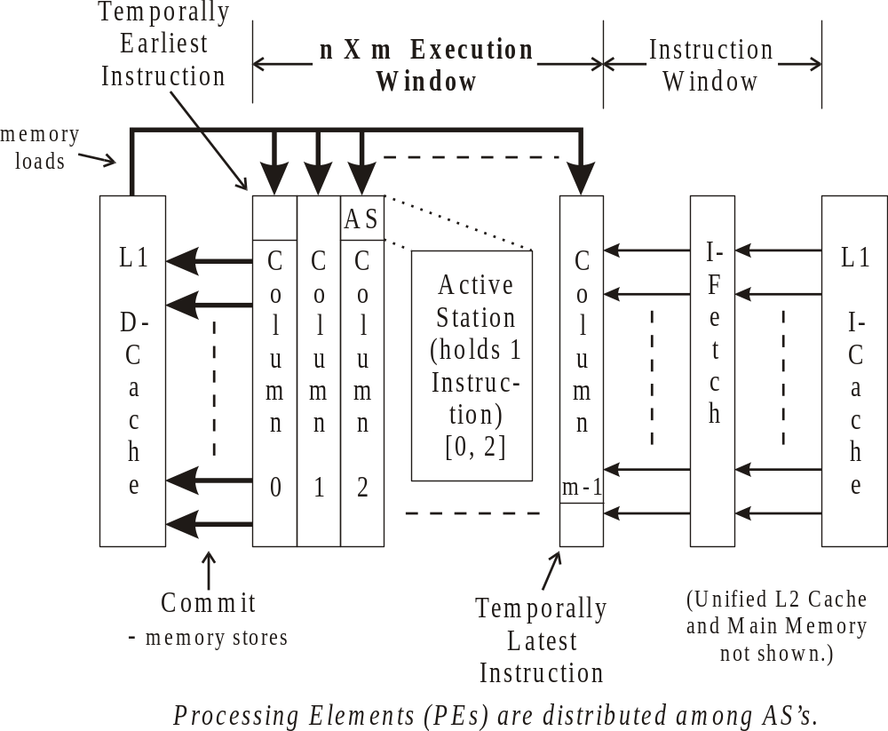

High-LevelArchi-tecture

Slide 7
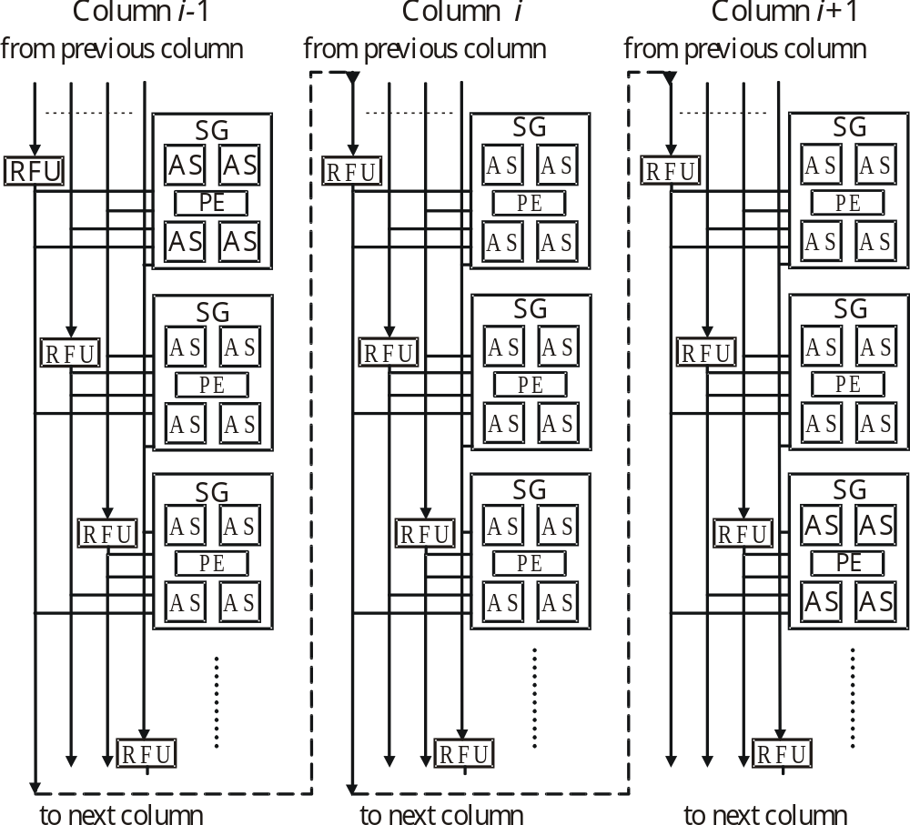
Micro-archi-tecture
(Execution Window)
Note: no central register file: Reg. Fwd. Units used
SG: Sharing Group

Slide 8
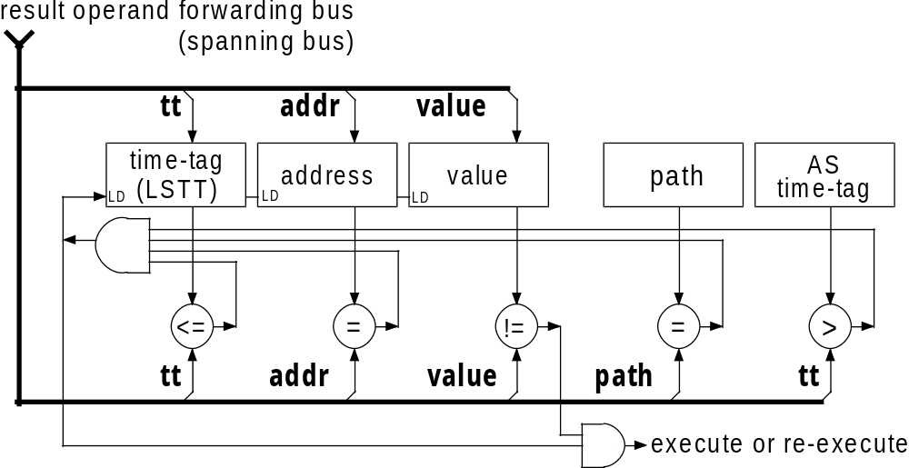
Active Station (AS)
LSTT (Last-Snarfed Time Tag) is key to operand linking
(Snoop: look at bus
Snarf: read off of bus)

Slide 9
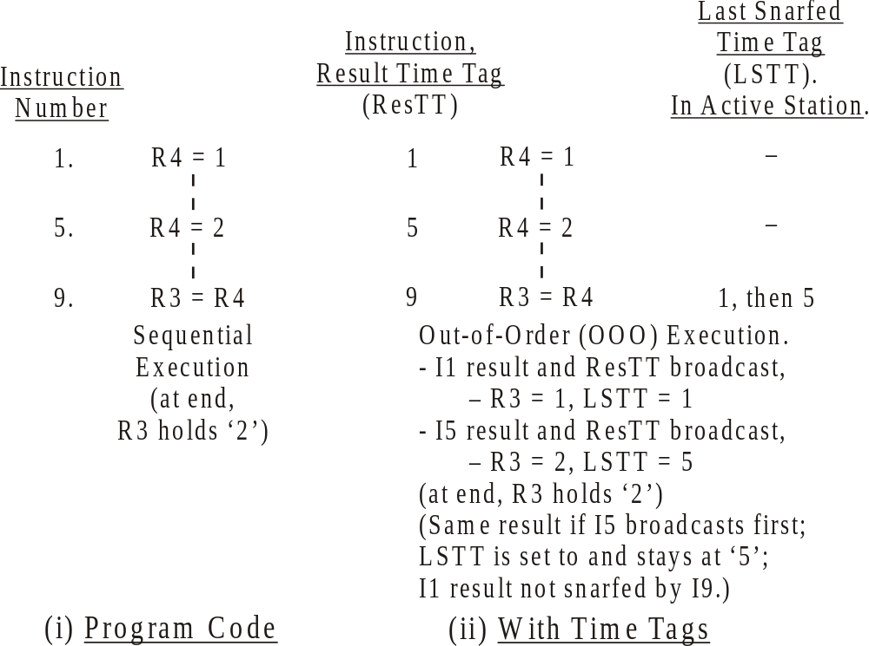

Time-Tag Example
Case 1
Case 2

Slide 10
Time-Tag Example
I9 needs closest previous value of R4. Case 1:
Broadcast (I1):
TT: 1 R: 4 V: 1
bus
AS (I9): Snoop and Snarf:
TT >= LSTT, R=ADDRESS:
LSTT -1 → 1, VALUE → 1

Slide 11
Time-Tag Example
Broadcast (I5):
TT: 5 R: 4 V: 2
bus
AS (I9): Snoop and Snarf:
TT >= LSTT, R=ADDRESS:
LSTT 1 → 5, VALUE → 2
DONE (Case 1):
R3 =2

Slide 12
Time-Tag Example
I9 needs closest previous value of R4. Case 2:
Broadcast (I5):
TT: 5 R: 4 V: 2
bus
AS (I9): Snoop and Snarf:
TT >= LSTT, R=ADDRESS:
LSTT -1 → 5, VALUE → 2
DONE:
R3 =2

Slide 13
Time-Tag Example
Broadcast (I1):
TT: 1 R: 4 V: 1
bus
AS (I9): Snoop and NO Snarf:
TT < LSTT, R=ADDRESS:
LSTT stays at 5,
VALUE stays at 2.
I9 already has closest previous value (Case 2): Already DONE: R3 =2

Slide 14
Resource-Flow Execution
What it is:
Execute everything, then clean up.
(Example of this: in last set of slides, if: I1, I5, I9 all execute in first cycle, then either Case 1 or 2.)
Or, more precisely:
Execute any instruction regardless of the presence of its operands or predicates,
resources permitting, then apply programmatic constraints to obtain correct execution.

Slide 15
High-IPC Methods
Hardware predication:
  Predicates generated with hardware
  Branch domains determined with hardware
D-paths: multipath execution based on DEE
  Not-predicted path of some branches executed just-in-case; has lower priority for resources

Slide 16
Micro-archi-tecture
(Execu-tion Window)
M D
M D
M D
“M” – Mainline Path
“D” –
DEE Path

Slide 17
Micro-archi-tecture
M D
M D
M D
B-nt
B-t
“M” – Mainline Path
“D” –
DEE Path
“B-nt” –
Branch pred. not taken

Slide 18
Micro-archi-tecture
M D
M D
M D
B-nt
B-t
“M” – Mainline Path
“D” –
DEE Path
“B” –
Branch mispredicted

Slide 19
Micro-archi-tecture
M D
D M
M D
B-t
“D” → “M” Mainline Path
“M” → “D” DEE Path
“B-t” –
Branch now pred. taken

Slide 20
Experimental Methodology
Trace-driven simulator used
MIPS-1 ISA binaries simulated
Five SPECint95 and SPECint2000 benchmarks simulated
L1 D-cache: 1 cycle hit, 10 cycles miss
L1 I-cache, L2, memory: perfect (100% hit)
Baseline Machine (BM): bound by true dependencies, no time-tagging, no resource flow, no D-paths.
BM-CM: baseline with Conventional Memory
Notes:
SPECint95 – go
SPECint2000 – bzip2 + gzip + gap + parser
First 100 million warm-up, then gather data for 500 million. (Standard Levo methodology.)
I-fetch – 100% hit, no oracle.
Used final committed value for value prediction; much better than MICRO
method; responsible for about 30% X of the improvement of
D-xM over RF-xM data here.
BL-CM – no value prediction, also -PM
RF-CM – no value prediction, also –PM
D-both – used above form of value prediction

Slide 21
Experiments
Varying machine configuration:
s(SG’s/column) a(M-path AS’s /SG) c(columns)
[c is # M-path columns,
is also # D-path columns when present]
CM vs. PM (Perfect Memory: 100% L1 hit)
BL: baseline – no resource flow, no D-paths
vs. RF: w/resource flow but no D-paths
vs. D: w/resource flow and D-paths

Slide 22
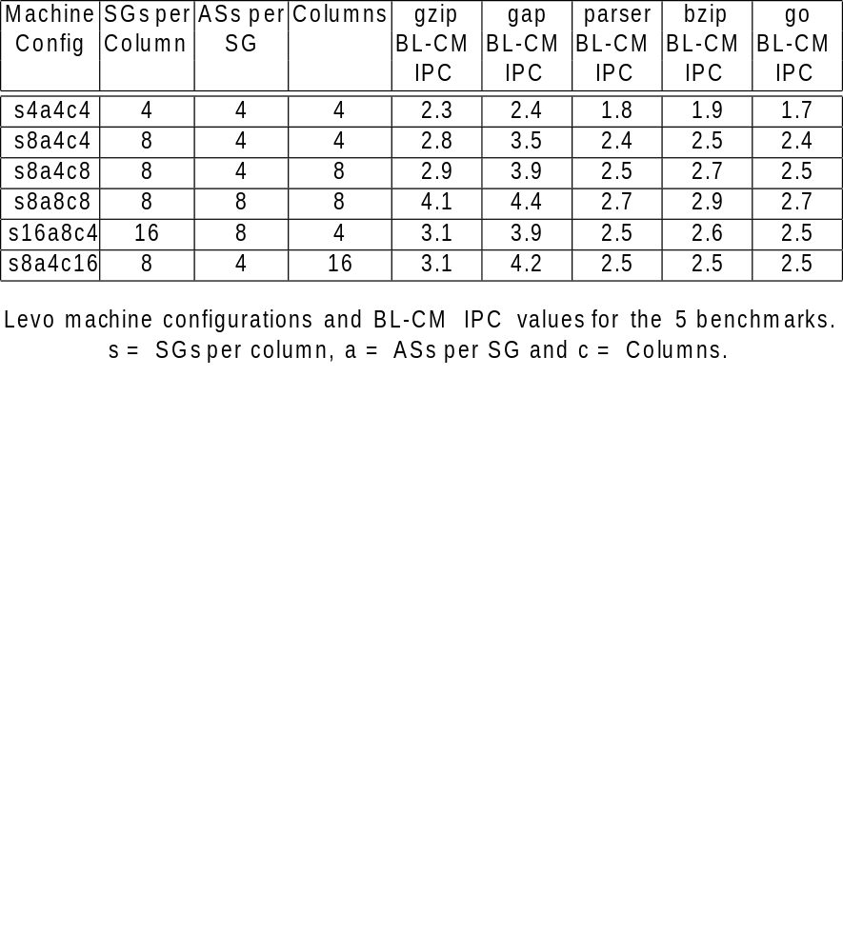
Raw IPC vs. Configuration

Slide 23
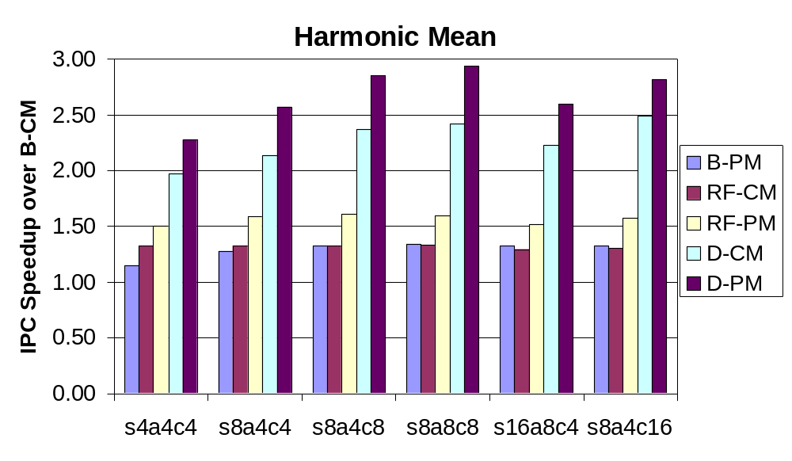
Speedups vs. Config. & Machine Type
Overall IPC ~ 7.9

Slide 24
Summary
:
  New execution core
  Novel techniques for scalability with low cycle time
  Time-Tags & Resource Flow Execution are wins
  High-IPC, & more there:
    D-CM with branch oracle: about 50% more IPC
  Conventional memory IPC close to perfect memory
  D-paths quite effective at improving performance

Slide 25
Relevant Web Sites
Levo links:
www.ele.uri.edu/~uht
Or: www.levo.org
Levo visualization (direct):
ovel.ele.uri.edu:8080

