Slide 1
Good practices that help minimize the need for debugging
#1: Use Iterative Enhancement:
Repeat the following until you have a solution to your problem:
Find a stage for your problem that:
is a step toward a solution, and
is a SMALL step, and
can be TESTED.
Solve the stage and TEST your solution to it. Don’t proceed until you get this stage working.
#2: Break a problem into sub-problems.
Write AND TEST separate functions for the sub-problems.
#3: Keep patterns in mind. Don’t reinvent the wheel.
#4: Maintain intellectual control of your program. Techniques to do so include using descriptive names, sparse but well-chosen internal comments, and good use of white space.
The next slides explain each of these practices.

Slide 2
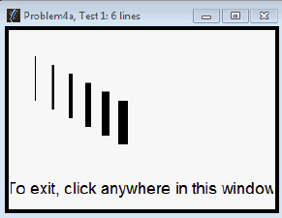
#1: Use Iterative Enhancement:
Repeat the following until you have a solution to your problem:
Find a stage for your problem that:
is a step toward a solution, and
is a SMALL step, and
can be TESTED.
Solve the stage and TEST your solution to it. Don’t proceed until you get this stage working.
How would you apply Iterative Enhancement to this Session 7 problem? (Answer on next slide.)
def problem4a(window, point, n):
"""
See problem4a_picture.pdf in this project for pictures that may
help you better understand the following specification:
Draws a sequence of n rg.Lines on the given
rg.RoseWindow, as follows:
-- There are the given number (n) of rg.Lines.
-- Each rg.Line is vertical and has length 50.
(All units are pixels.)
-- The top of the first (leftmost) rg.Line
is at the given rg.Point.
-- Each successive rg.Line is 20 pixels to the right
and 10 pixels down from the previous rg.Line.
-- The first rg.Line has thickness 1.
-- Each successive rg.Line has thickness 2 greater than
the zg.Line to its left, but no greater than 13.
(So once a rg.Line has thickness 13, it and all
the rg.Lines to its right have thickness 13.)
Returns the sum of the thicknesses of
the rg.Line's.
(See problem4a_picture.pdf for two test cases you can use for this.)
Preconditions:
:type window: rg.RoseWindow
:type point: rg.Point
The third argument is a positive integer
and the given point is inside the given window.
"""

Slide 3
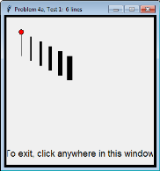
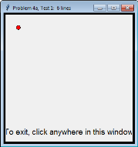
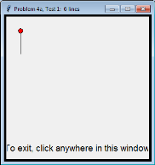
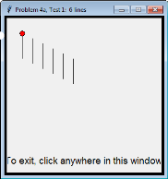
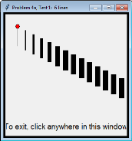
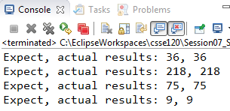
#1. Use Iterative Enhancement:
Repeat the following until you have a solution to your problem:
Find a stage for your problem that:
is a step toward a solution, and
is a SMALL step, and
can be TESTED.
Solve the stage and TEST your solution to it. Don’t proceed until you get this stage working.
How would you apply Iterative Enhancement to this Session 7 problem?
def problem4a(window, point, n):
"""
See problem4a_picture.pdf in this project for pictures that may
help you better understand the following specification:
Draws a sequence of n rg.Lines on the given rg.RoseWindow,
as follows:
-- There are the given number (n) of rg.Lines.
-- Each rg.Line is vertical and has length 50.
(All units are pixels.)
-- The top of the first (leftmost) rg.Line
is at the given rg.Point.
-- Each successive rg.Line is 20 pixels to the right
and 10 pixels down from the previous rg.Line.
-- The first rg.Line has thickness 1.
-- Each successive rg.Line has thickness 2 greater than
the zg.Line to its left, but no greater than 13.
(So once a rg.Line has thickness 13,
it and all the rg.Lines to its right have thickness 13.)
Returns the sum of the thicknesses of the rg.Line's.
(See problem4a_picture.pdf for two test cases you can use for this.)
Preconditions:
:type window: rg.RoseWindow
:type point: rg.Point
The third argument is a positive integer
and the given point is inside the given window.
"""
Answer: Here is one Iterative Enhancement Plan. The key is to get each stage TESTED and WORKING before continuing to the next stage.
Stage 1: A test window appears, with your test point drawn on the window. (Remove that point when you finish the problem.)
Stage 2: The first line is drawn successfully, at the right place.
Stage 3: N lines are drawn successfully, where your test has (say) N=6 lines. All the same width at this stage.
Stage 4: The line widths increase by 2 per line.
Stage 5: The line widths don’t increase past 13.
Stage 6: The sum of the thicknesses is computed and returned.

Slide 4
#2: Break a problem into sub-problems.
Write AND TEST separate functions for the sub-problems.
def keep_integers(list_of_lists):
"""
Given a list of sub-sequences, returns a list
that contains only the sub-sequences that contain ONLY integers. For example, if the given argument is:
[(3, 1, 4),
(10, 'hi', 10),
[1, 2.5, 3, 4],
'hello',
[],
['404'],
[30, -4]
]
then this function returns:
[(3, 1, 4),
[],
[30, -4]
]
Has non-integers, so don’t keep it
Has non-integers, so don’t keep it
Has non-integers, so don’t keep it
What would be a reasonable sub-problem for the problem to the right? (It is a variation of a problem from Session 16.) (Answer on next slide.)
Has non-integers, so don’t keep it

Slide 5
#2. Break a problem into sub-problems.
Write AND TEST separate functions for the sub-problems.
def keep_integers(list_of_lists):
"""
Given a list of sub-sequences, returns a list
that contains only the sub-sequences that contain ONLY integers. For example, if the
given argument is:
[(3, 1, 4),
(10, 'hi', 10),
[1, 2.5, 3, 4],
'hello',
[],
['oops'],
[30, -4]
]
then this function returns:
[(3, 1, 4),
[],
[30, -4]
]
Has non-integers, so don’t keep it
What would be a reasonable sub-problem for the problem to the right? (It is a variation of a problem from Session 16.)
Answer: One way to solve this problem is to:
loop through the list and, for each sub-sequence,
determine if the sub-sequence has any non-integers in it.
It would be reasonable to make the latter a sub-problem of its own (in its own function). Here is a full solution, with the “helper” function on the right.
def is_all_integers(sequence):
""" Returns True if the given
sequence contains
only integers. """
for k in range(len(sequence)):
if type(sequence[k]) != int:
return False
return True
def keep_integers(list_of_lists):
answer = []
for k in range(len(list_of_lists)):
if is_all_integers(list_of_lists[k]):
answer.append(list_of_lists[k])
return answer
Using the FIND pattern

Slide 6
#3. Keep patterns in mind. Don’t reinvent the wheel.
From Session 3 et al: Looping through a RANGE with a FOR loop.
range(m) – goes m times (from 0 to m-1, inclusive)
range(m, n+1) – goes from m to n, inclusive (does NOT include n+1)
From Session 3 et al: Using objects.
Constructing an object
Applying a method
Referencing a data attribute
Using the DOT trick (and what to do when it seems not to work)
From Session 4 et al: Calling functions, including functions defined within the module
From Session 6: The Accumulator Pattern, in:
Summing: total = total + number
Counting: count = count + 1
Graphics: x = x + pixels
From various sessions: the SWAP pattern:
temp = a a = b b = temp
From various sessions: Introducing an auxiliary variable that works within a FOR or WHILE loop.
From Session 9: Waiting for an Event (using a WHILE loop with an IF statement and BREAK)
From Session 11: Accumulating a sequence.
From Session 11: Patterns for iterating through sequences, including:
Beginning to end
Other ranges (e.g., backwards and every-3rd-item)
The COUNT/SUM/etc pattern
The FIND pattern (via LINEAR SEARCH)
The MAX/MIN pattern (in a number of variations)
Looking two places in the sequence at once
Looking at two sequences in parallel
From Session 12: Mutating a list or object, and TESTING whether the mutation worked correctly.

Slide 7
#4. Maintain intellectual control of your program. Techniques to do so include using descriptive names, sparse but well-chosen internal comments, and good use of white space.
For example:
def index_of_largest_number(numbers, n):
""" ... """
index_of_largest = 0 # using max/min pattern
for k in range(1, n):
if numbers[k] > numbers[index_of_largest]:
index_of_largest = k
return index_of_largest
Short internal comment indicating the pattern used (keep these sparse!)
Single blank line to separate the “chunks” of the function from each other (but two blank lines between function definitions)
Names:
Use plurals for names of sequences (numbers). Use singular for non-sequence items (circle or circle1 vs circles).
The name might indicate the type of the object (index_of_largest, makes it clear that this is an INDEX)
The name certainly should indicate WHAT it stands for (so upper_left_corner instead of just point)
j, k, and i for index variables (this practice goes back over 60 years!)
m, n for integers (and perhaps x for floats) for which no better name is easily available

Slide 8
Review: Good practices that help minimize the need for debugging
#1: Use Iterative Enhancement:
Repeat the following until you have a solution to your problem:
Find a stage for your problem that:
is a step toward a solution, and
is a SMALL step, and
can be TESTED.
Solve the stage and TEST your solution to it. Don’t proceed until you get this stage working.
#2: Break a problem into sub-problems.
Write AND TEST separate functions for the sub-problems.
#3: Keep patterns in mind. Don’t reinvent the wheel.
#4: Maintain intellectual control of your program. Techniques to do so include using descriptive names, sparse but well-chosen internal comments, and good use of white space.

