Slide 1

Hydrowatch analytics
David muthama

Slide 2
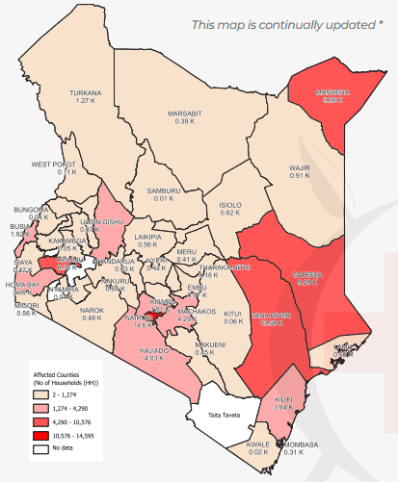
Problem Statement
Flooding is a significant natural disaster that can lead to loss of life, extensive property damage, and long-term economic disruption.
Effective flood prediction is crucial for timely disaster response, infrastructure management, and community preparedness.
Given some flood data from red cross search and rescue, we can see a need for the adoption of to help mitigate.
Kenya Red Cross. (2024, June 18). Floods Operations, 2024 | Kenya Red Cross. Kenya Red Cross | Always There. https://www.redcross.or.ke/floods/

Slide 3
Objectives
Data Collection and Integration:
Gather historical data on flood events, including timing, magnitude, and locations.
Model Development:
Utilize machine learning and statistical methods to create predictive algorithms that can analyze complex relationships within the data.
Develop a framework for real-time data processing and prediction that can be easily updated as new data becomes available.
Model Validation and Calibration:
Test the model against historical flood events to assess accuracy and reliability.
Implement techniques to minimize overfitting and enhance generalizability across varying geographical regions.

Slide 4
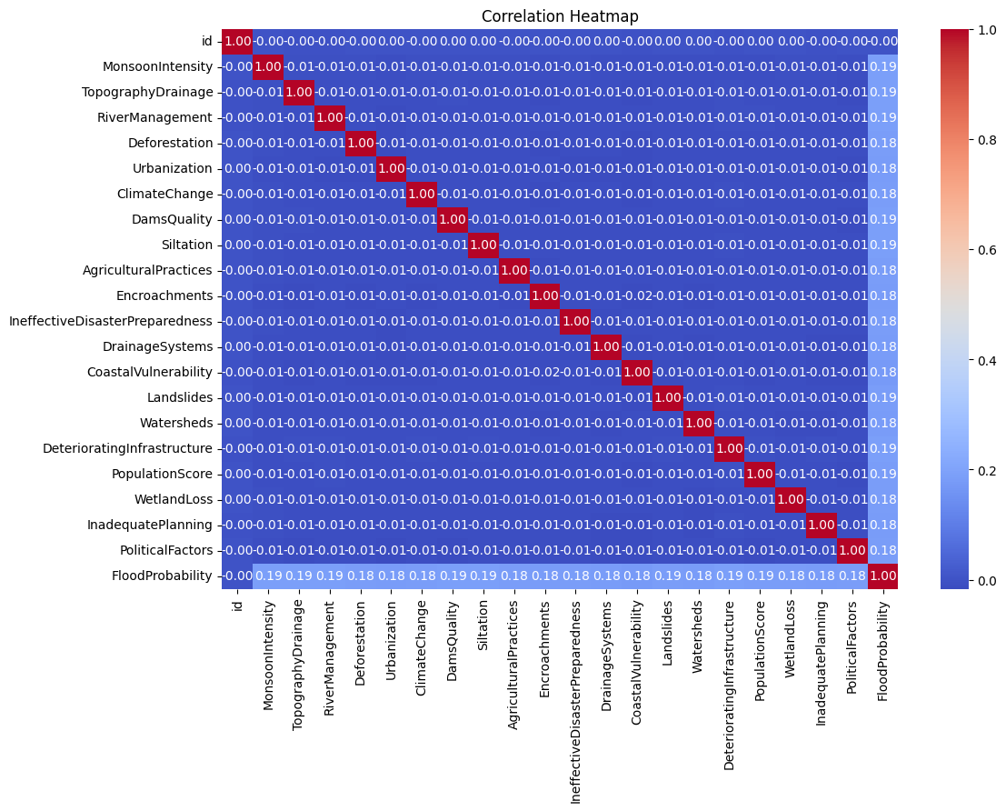
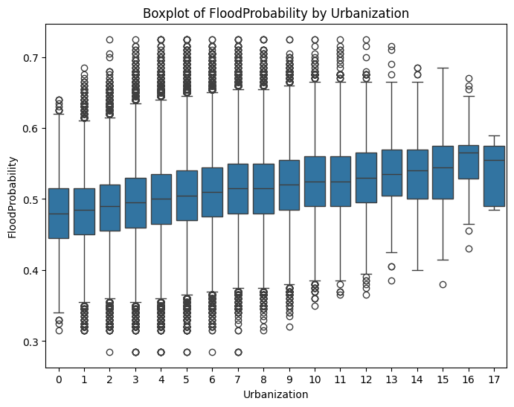
Data Description
The dataset contains 1,117,957 records with 21 features and a target variable (FloodProbability)
FloodProbability ranges from 0.285 to 0.725, with a mean of 0.504

Slide 5
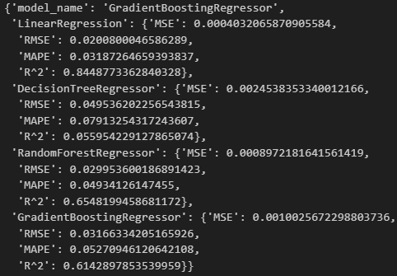
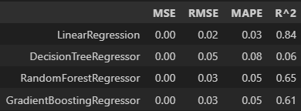
Model performance analysis

Slide 6
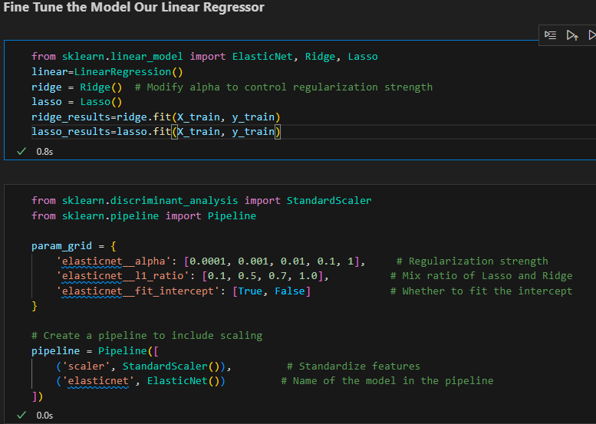
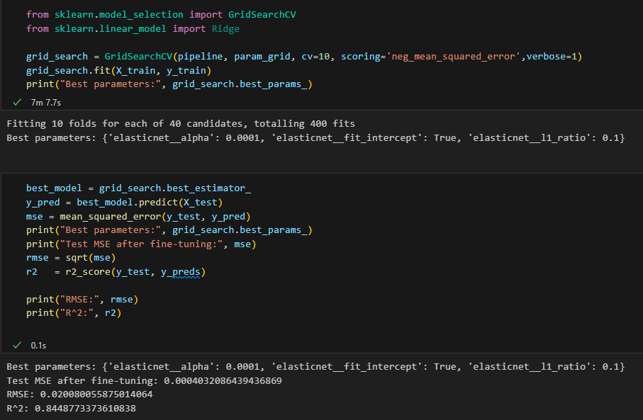
Model selection and optimization

Slide 7
Result analysis
Results on validation data | Results on test data
MAE: 0.031876 | MAE: 0.054828
MSE: 0.000403 | MSE: 0.004790
R^2: 0.8448773 | R^2: 0.84436495
Model creation and optimization
Model implementation
Model Deployment

Slide 8
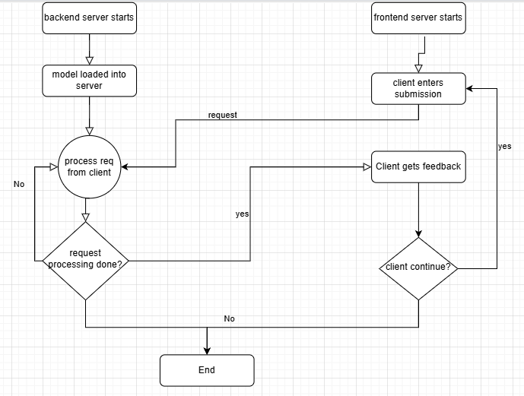
work flow and demonstration

Slide 9

Thank You

Slide 10
references
Kenya Red Cross. (2024, June 18). Floods Operations, 2024 | Kenya Red Cross. Kenya Red Cross | Always There. https://www.redcross.or.ke/floods/
Flood Prediction Dataset. (2024, June 26). Kaggle. https://www.kaggle.com/datasets/naiyakhalid/flood-prediction-dataset
Regression with a Flood Prediction Dataset. (n.d.). Kaggle. https://www.kaggle.com/competitions/playground-series-s4e5/data?select=train.csv
Kenya: Floods - Apr 2024. (2024, May 17). ReliefWeb. https://reliefweb.int/disaster/fl-2024-000045-ken
European Commission - Joint Research Centre. (n.d.). Global Flood Awareness System – GLOFAS News. https://global-flood.emergency.copernicus.eu/news/168-flooding-in-kenya-march-to-may-2024/

