Slide 1


Predicting Hit Songs
By: David Wiley
Advisor: Dr. Vasilis Zafiris

Slide 2
INTRODUCTION
Why? According to the IFPI's (International Federation of the Phonographic Industry) Global Music Report 2019, the total revenue for 2018 was US$19.1 billion. The report also states the global recorded music market grew by 9.7% since 2017. With an increase in recorded music and the potential revenue it generates it is evident that being able to predict whether a song will be a hit could prove to be an extremely lucrative practice.
What? The Billboard has tracked the top 100 songs every week since 1955 and has since become the industry standard record chart in the United States. This will also be used as the popular standard to determine if a song is a hit.

Slide 3



OBJECTIVE
The objective is to use data analysis and machine learning techniques to predict the popularity of songs.

Slide 4
PROGRAMMING
Everything is programmed in Python
Packages:
spotipy
pandas, matplotlib, seaborn, sklearn

Slide 5


DATA
The data for popular songs will be scraped from the Billboard Top 100 website using Python. This part of the data will be used as the popular songs.
The non-popular songs are being randomly pulled from a dataset downloaded from Kaggle
There are 55,000+ songs included in this dataset
Since there are only ~7,400 in the Billboard dataset, ~7,400 are randomly pulled from this dataset so there is an even amount of popular and non-popular songs

Slide 6
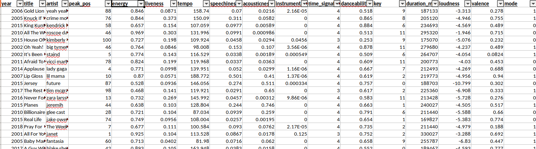
What the data looks like:

Slide 7
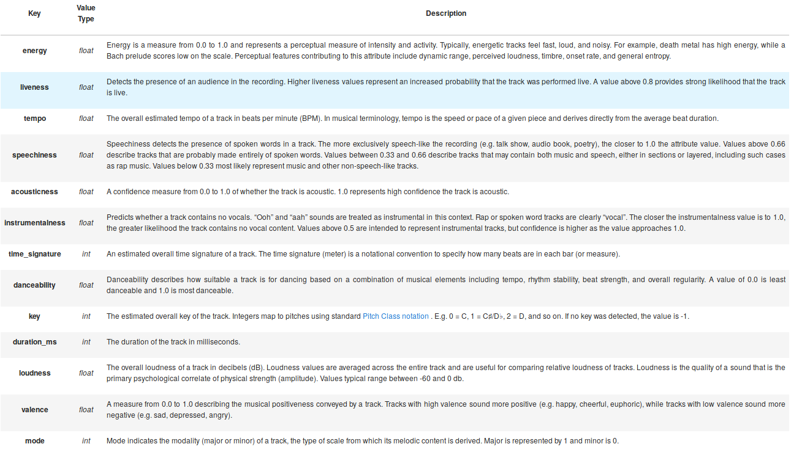
CHARACTERISTICS
Values are calculated and provided by Spotify, calculations are unknown
The characteristics are pulled directly from Spotify using the spotipy package in Python

Slide 8
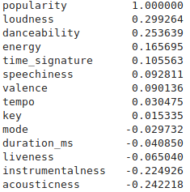
DATA ANALYSIS
Calculating the correlation of each characteristic with the popularity
Strong correlation between loudness, danceability, energy, time_signature, speechiness, valence, liveness, instrumentalness, acousticness
These are the characteristics kept when sending the data through the machine learning models

Slide 9
METHODS
Classification problem
Using the following machine learning methods:
Logistic Regression Classifier
Stochastic Gradient Descent Classifier
K-Nearest Neighbors Classifier
Random Forest Classifier
Linear Discriminant Analysis
Simple Vector Machine

Slide 10
RESULTS
LogisticRegression – 69%
SGDClassifier – 69%
KNeighborsClassifier – 68%
RandomForestClassifier – 68%
LinearDiscriminantAnalysis – 69%
SVM – 68%

Slide 11
DISCUSSION
Accuracy is not currently at an acceptable standard
Wouldn't be able to make important/costly decisions with only a ~70% accuracy
Tweak parameters within scikit-learn functions to increase accuracy
Possibly not enough/inaccurate data
More testing

Slide 12
REFERENCES
https://data.world/typhon/billboard-hot-100-songs-2000-2018-w-spotify-data-lyrics
https://www.kaggle.com/mousehead/songlyrics
https://spotipy.readthedocs.io/en/latest/

