Slide 1

Cyrille Desponds
Maxime Jaques
Corentin Marchandise
David Nastase
Tomas Papuga
SEI Investments Co.
NASDAQ: SEIC
IS Lausanne | Financial Services
1

Slide 2

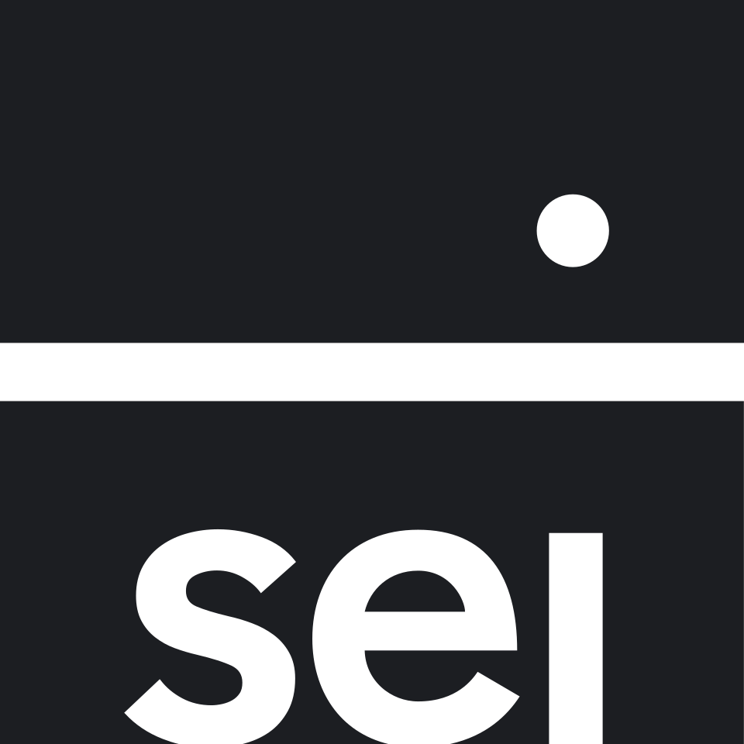
Key Metrics
Price: 78.11 USD
P/E : 13.6x
Implied Shares Outstanding: 122.44M
Market Cap: 9.55B USD
Net Debt: 28.56M USD
Debt-to-Equity: 1.06%
EV: 9.11M USD
EV / EBIT : 11.0x
Earnings Yield : 9.1%
Dividend Yield : 1.35%
P/B : 3.89x
Koyfin, Refinitiv, YahooFinance, as of 29.03.2026

Slide 3




SEI at a Glance
Company overview
Founded in 1968
HQ:
Pennsylvania,
United States
Financial technology, outsourcing & asset management
CEO:
Ryan Hicke
SEI provides financial technology, investment operations, and asset-management services to institutions, banks, and advisors. Its platform includes custody, fund administration, outsourced back-office processing, and portfolio technology.
The company operates globally, with service centers in the U.S., UK, Ireland, and other regions. However, the business is strongly U.S.-focused: in 2024, about 85.5% of revenue came from the United States, followed by smaller contributions from the UK, Ireland, Canada, and Luxembourg.
It earns mostly recurring fees from asset management/administration and software/processing services. Revenues are linked to AUM/AUA or assets processed on its platforms, making the model stable and sticky. Around 55% of revenue comes from operations/processing and ~40% from asset management.
SEI operates in a competitive market, facing custodians, advisor tech platforms, and asset managers such as Charles Schwab, Fidelity, Envestnet, and LPL Financial. It differentiates itself through its integrated platform and outsourcing capabilities.
SEI Investments Co. 10-K

Slide 4
Leadership & Governance
Company Management
SEI is led by CEO Ryan Hicke, a 27-year company veteran and former CIO, supported by an experienced leadership team across its main business lines.
Founder influence remains, but SEI is no longer founder-run. Alfred P. West Jr. founded the company in 1968, stepped down as CEO in 2022, and became Chairman Emeritus in 2026.
Management is aligned with shareholders. Executives and directors owned 14.6% of SEI, and the company requires meaningful equity ownership from senior leaders.
Family influence is still present, but capital allocation is shareholder-friendly. Loralee West owns 10.0%, and SEI returned about $632.8M through dividends and buybacks in 2024.
SEI Investments Company 2025 Proxy Statement (DEF 14A); SEI Investments Company 2024 Annual Report (Form 10-K); SEI Investor Relations.

Slide 5
Competitive Landscape & Pricing Power
Competitors
Structural Advantages
Competitive Outcomes
Global trend:
• Financial institutions seek to reduce costs
• Demand for outsourced investment operations and integrated technology platform
=> Shift towards platform-based solutions
End-to-end platform:
• Large ecosystem combines technology, investment solutions, and outsourced operations
• Embedded inside clients’ daily operations
• High client retention
• Pricing durability (switching is disruptive and risky, so fees are unchanged)
=> This explains strong earnings
• Strong margins (better profitability than many traditional asset managers)
Institutional Relationships :
• Serves 8 of the top 20 US banks
• 43 of top 100 investment managers
• Signals trust and credibility
Closest competitors:
• SS&C Technologies
• Broadridge Financial Solutions
• Envestnet
• FNZ (private market peer)
Similar service offerings:
• BNY Mellon
• State Street Corporation
• Northern Trust
SEI Investments Company 2025 Annual Report (Form 10-K); SEI Investor Relations.

Slide 6
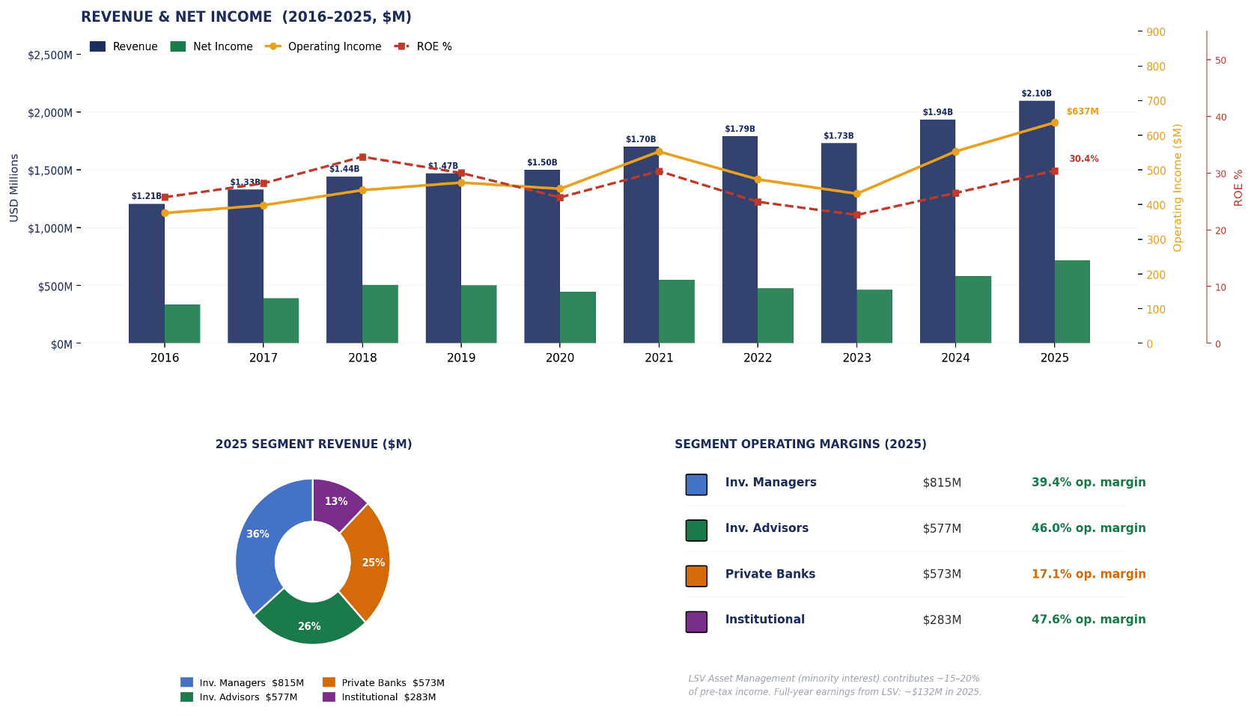
Financial Overview – Income Statement and Cash Flow
FY2016–2025 Income Trend · 2025 Segment Revenue & Margins · USD Millions
Ratios and KPIs
Price/Earnings = 13,6
Debt/Equity = 0,01 (Great)
Current Assets/Liabilities = 3,29
Dividend Analysis
Dividend yield = 1,35%
Dividend growth = 6,32% | 34 year consistent
EPS growth = 10,8% | 4% boost from Div. Growth due to share buyback
Source: SEIC Income Statement — stockanalysis.com, Thomson Reuters Eikon, SEIC EDGAR Filings
6

Slide 7
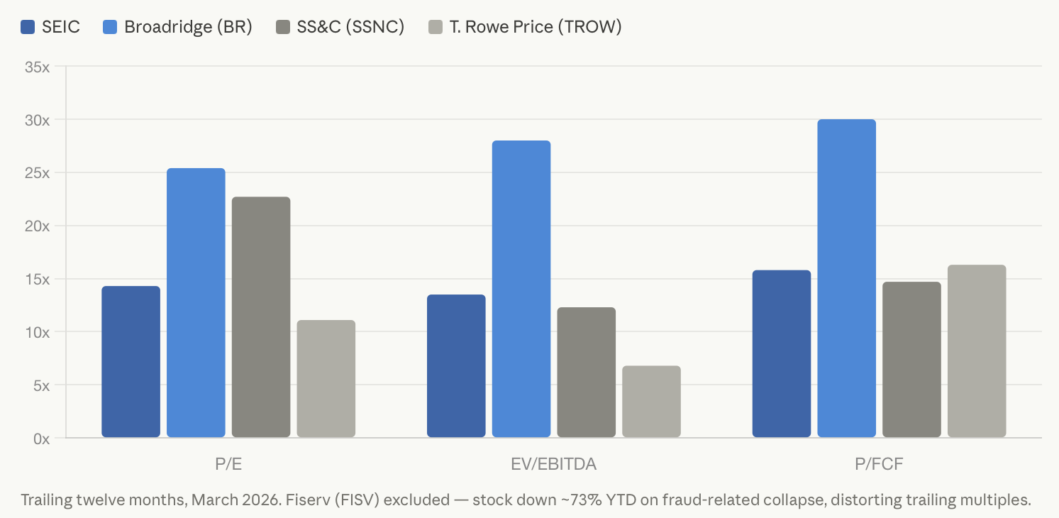
SEI: a Diversified Player at a Discount
Peer Valuation Comparison
Broadridge: near monopoly in proxy processing and regulated client relationships but expensive at ~28x EV/EBITDA.
SS&C: more comparable to SEI in EV/EBITDA (~12x) but riskier with substantially more debt (Net Debt/EBITDA ~5x).
T. Rowe Price: cheapest on P/E and EV/EBITDA, but pure active asset management with outflow pressure and no technology moat.
SEI: cheaper than Broadridge on every metric, better quality than T. Rowe Price, and less leveraged than SS&C, yet priced as if none of those advantages matter.
FinanceCharts, MacroTrends, YahooFinance

Slide 8
SEIC
The Case for a Price Increase
① Wall Street Consensus
② P/E Mean-Reversion
③ Conservative Growth Case
$104
$102 – $111
~$96
~33% upside
~31–42% upside
~23% upside
Avg. of 5-7 analyst price targets
Range: $93 - $120
Rating: Buy consensus
5-yr avg P/E: ~17.2x
FY2026E EPS: $6.00 – $6.50
Assumes ~8% earnings growth
16x multiple
Same $6.00 EPS assumption
Still significant appreciation
Dividend Floor
~1.32% yield · $1.04/yr (semi-annual, $0.52/payment) · Low ~18% payout ratio with consistent growth. Provides a modest but growing return floor while awaiting re-rating.
Key Assumptions & Context
— Current P/E ~13.9x trades at a ~19% discount to the 5-yr average of 17.2x : significant re-rating potential
— FY2025 TTM EPS: ~$5.63 · FY2026E: $6.00–$6.50 (buybacks + operating leverage driving ~8% growth)
— 52-wk range: $64.66–$93.96 · Mkt cap: ~$9.5B · Next earnings: Apr 16, 2026
Benzinga, FinanceCharts, MacroTrends, TipRanks
8

Slide 9
Risks and Catalysts
Risks
Catalysts
Macro level:
Equity Market Sensitivity: ~40% of revenue is directly linked to AUM, a market downturn would likely result in reduced revenue
Interest Rate Consequences: Current rate-cutting cycle threatens $49M in annual interest income generated by cash reserves
Company level:
Active to Passive Shift: Client migration to index funds consistently reduces average fee rates even when AUM grows, this shrinks income, particularly in the LSV affiliate
Implementation Execution: SWP installations are complex, multi-year projects, there is a risk of failure that could cause severe reputational damage
Macro level:
The Outsourcing Wave: Rising tech costs and strict regulations are forcing mid-sized banks to adopt SEI’s end-to-end solutions (e.g., U.S. Bank)
Alternative Assets Trend: Growth in private equity and private credit is driving heavy demand for SEI's high-margin fund administration services
Company level:
SWP Modularisation: Selling individual platform components significantly expands customer base by removing the friction of full system migrations
Strategic Balance Sheet: Zero debt and >$600M in annual FCF provide massive resources for M&A and/or technology, while many competitors remain constrained by high leverage

Slide 10





Investment Proposal
SEI Investments Co.
Shares to Buy (NASDAQ:SEIC)
15 shares
Maximum Entry Price
~ 80 USD/share (current price: 78.11 USD)
Maximum Investment
~ 1200 USD (~960 CHF)
Target / Exit Price
> 100 USD/share
Holding Period
3-4 years

