Slide 1
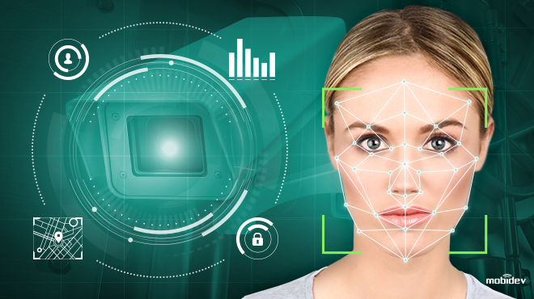
Detection and Face Recognition Project code:MSS03
Seliman David-1306B
Arsene Stefan-1307B

Slide 2
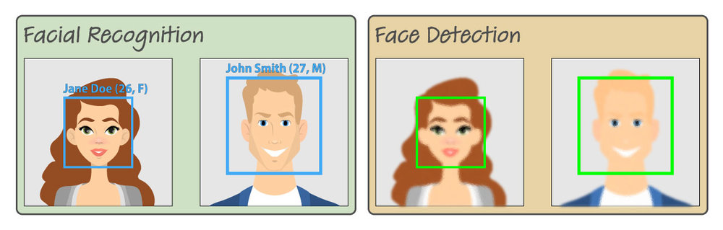
Introduction
The difference between Facial Recognition and Face Detection is a small but important.
While face detection trains a computer to pick out a human face, face recognition software will analyze the image.
It will turn the image into a set of data about your facial features.
This can include the distance between your eyes, forehead, and chin, and other geometric measurements.

Slide 3


Face detection is the process of automatically locating human faces in visual media (digital images or video)
Two popular types of Face Detectors image_recognition supports : HoG face detector, CNN based face detector (included in Dlib which use convolutional neural network or deep learning to do the face detection).
The first one (HoG) is quick and the second one is a bit slow, but more accurate.
In code I will use the face-recognition library for face detection and opencv library for other depended activities like display the image.

Slide 4
HoG, Histogram of Oriented Gradients (An image gradient is a directional change in the intensity or color in an image)
PROS: work faster if you are using CPU, it's very light weight and you don’t have to deal with different convolution layers or deep learning, just calculate the flow of gradients or the intensity change of gradients and it work under small occlusion (occlusion means deforming of face, like wearing sunglasses or a hat or a scarf).
CONS: The disadvantage while using HOG face detector is that it should have a face with a minimum size of 80x80 pixels and also the image should be almost front-faced (it will not work fine with side-faded or looking up or looking down faces and it does not work with heavy occlusion like wearing sunglasses or a hat or a scarf)

Slide 5
CNN face detector in Dlib, it uses Convolutional Neural Network based deep leaning procedure in detecting a face.
PROS: detect multiple face orientations, works with medium occlusion and it's fast on GPU
CONS: very slow on CPU
We don't need a large amount of training data to do the detection but the problem is that this method uses multiple feature maps generated using convolutional neural network and that's how it's doing the prediction.
So it will be a lot of work for a CPU (with GPU things are a lot better doing much convolution one by one will be much time taking than doing everything in parallel)

Slide 6
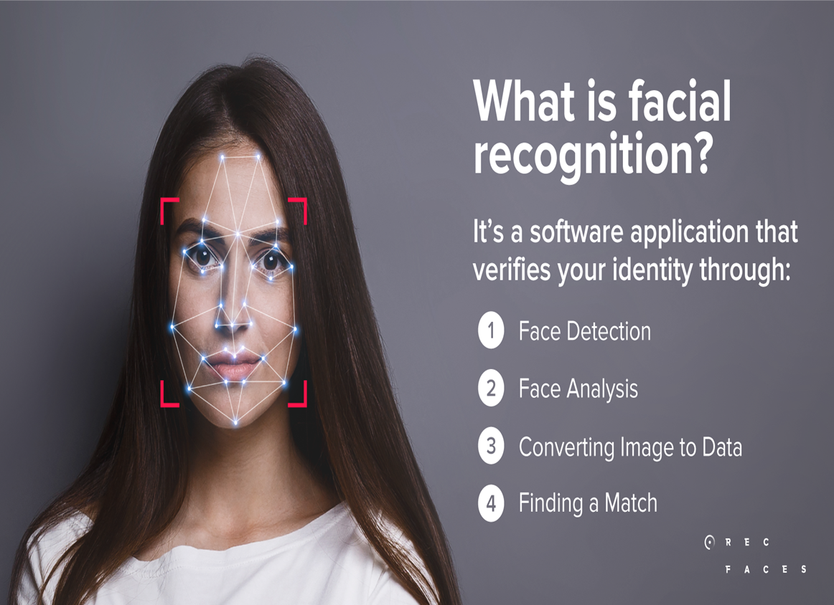
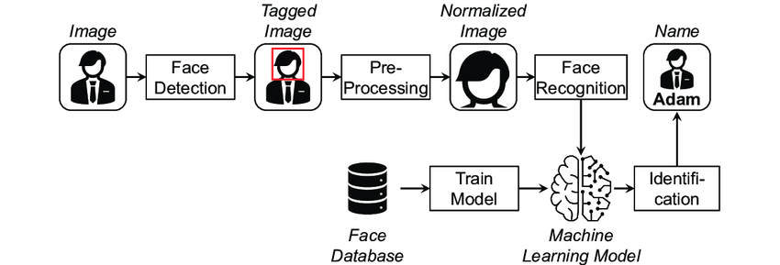

Slide 7
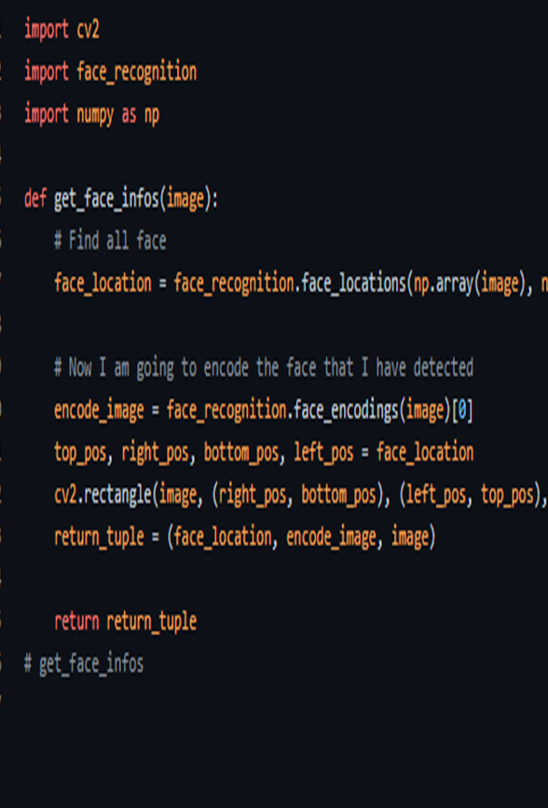

The main idea in the entire application will be to first detect the face by capturing a small piece from the image and encapturing only the face.

Slide 8

With the theme "DETECTION AND FACE RECOGNITION", we proposed to create an easy-to-use application, which will aim to implement it in the identification of faces from a database with those recognized at the time of application.
The project can also be later used for other applications like editing.

Slide 9

Conclusion
The presented project will be simple to use, as it will capture an image with a single or multiple faces, then using parts of the photo to compare only the interested rectangle in which the face is included.

