Slide 1
De-Distracted driving:
Hackathon 2022 project
Presented by kristina_johnsons_team

Slide 2
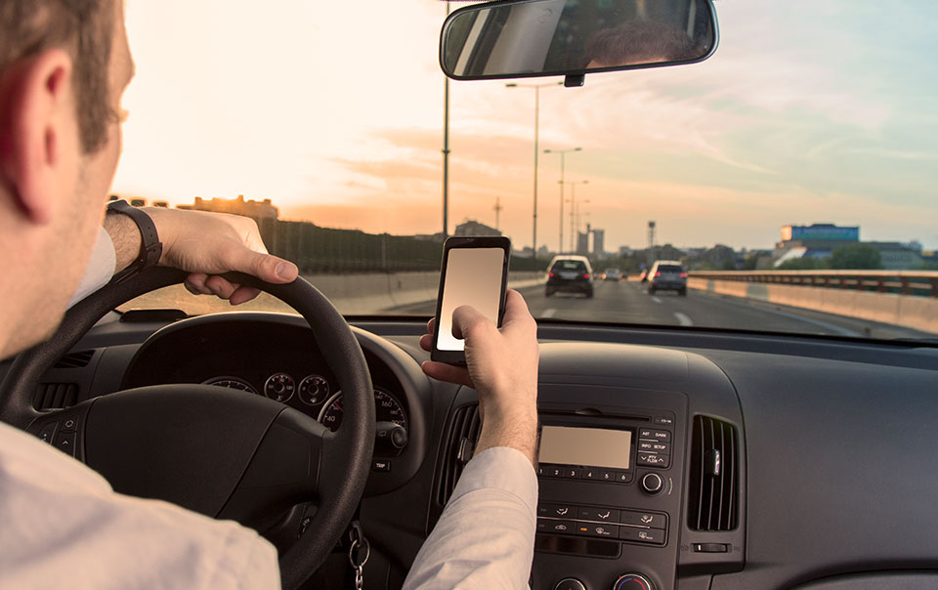
Motivation
Distracted driving is a primary cause of traffic accidents.
‘68.3% of crashes involved some type of observable distraction’ [1]
By alerting a driver when their behavior is dangerous, we can prevent future accidents
[2]

Slide 3
Outline
Motivation
Data sourcing
Training ML Model
Integrating ML with hardware
Performance

Slide 4
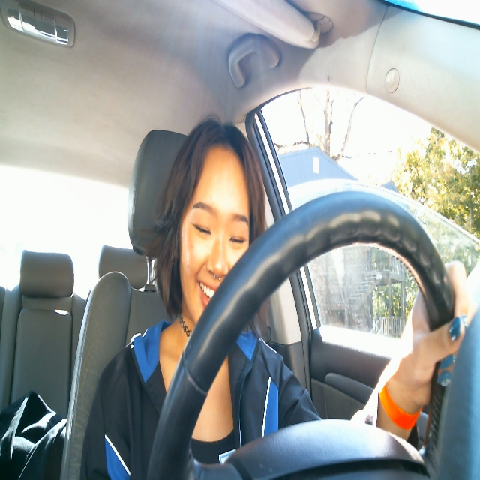
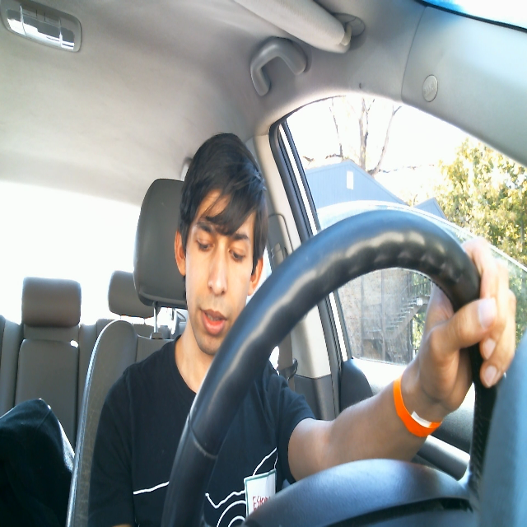
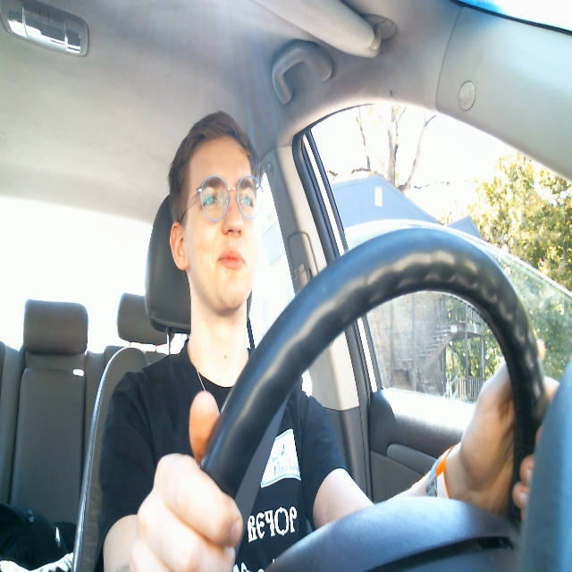
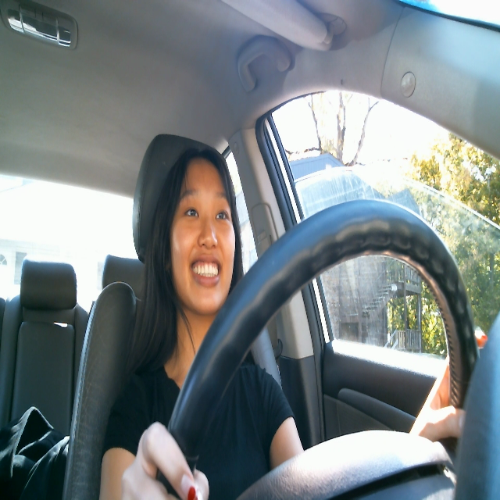
Data sourcing
Videos recorded during hackathon
Automated annotation of 13,037 frames
Split into training, testing, and validation sets

Slide 5
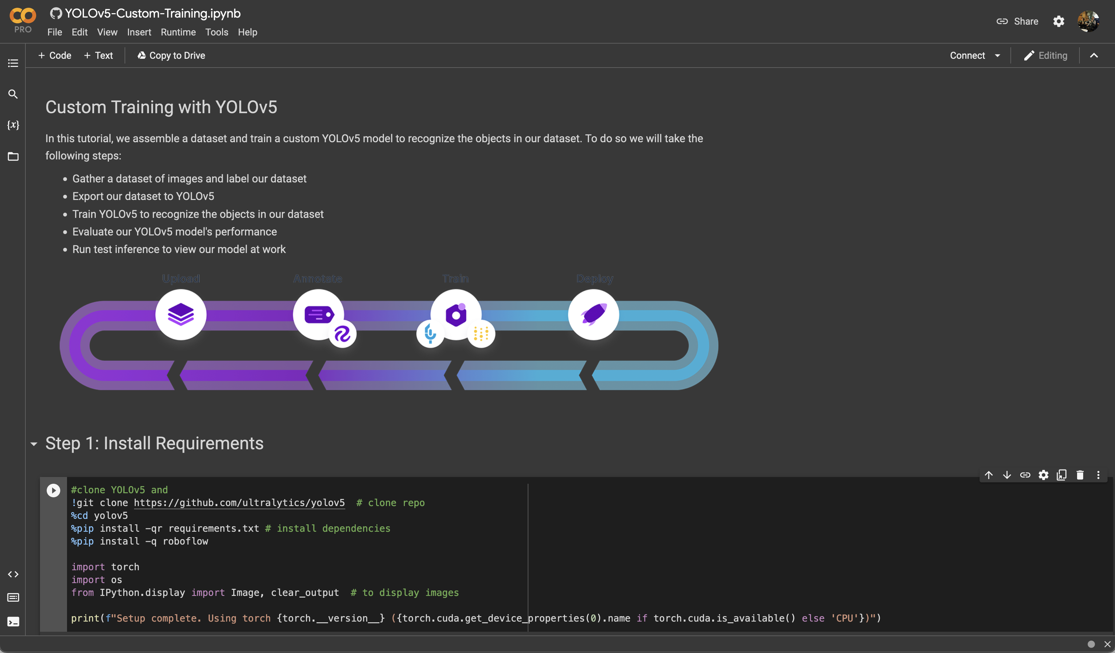
Training ML Model
Imported Images into Roboflow
Trained yolov5s model to detect distracted driving behaviours

Slide 6
Integrating ML with hardware
We used an Arduino to indicated how distracted the driver is
Blue and Green LEDs indicate engaged driving (calms the driver too)
Red LEDS indicate distracted driving for >1 second
Buzzer indicates distracted driving for > 2 seconds
Vibrate indicates distracted driving for > 3 seconds
PUT PICTURE IN

Slide 7
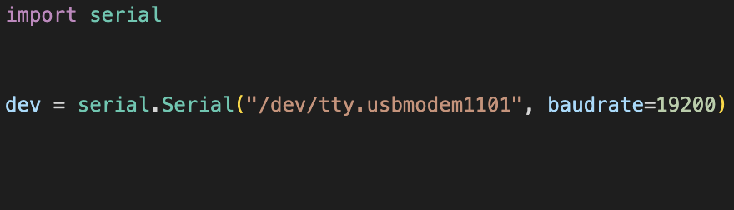
Integrating ML with hardware
We interface with the Arduino using python using the serial module

Slide 8
Results
VIDEO

Slide 9
References:
[1] https://www.pnas.org/doi/10.1073/pnas.1513271113
[2] https://www.travelers.com/resources/auto/distracted-driving/what-is-distracted-driving

