Slide 1
YOLO: You Only Look Once
An introduction to object detection

Slide 2
Agenda
What is Object Detection?
What is a CNN?
How Does YOLO Work?
YOLO Training Example
YOLO Deployment Tutorial

Slide 3
What is Object Detection?

Slide 4
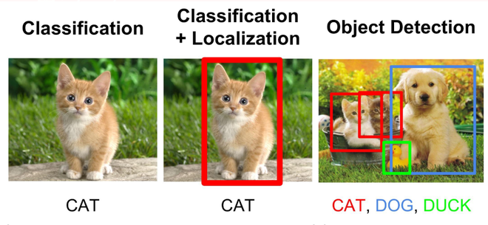
Object Detection
Our Focus Today

Slide 5
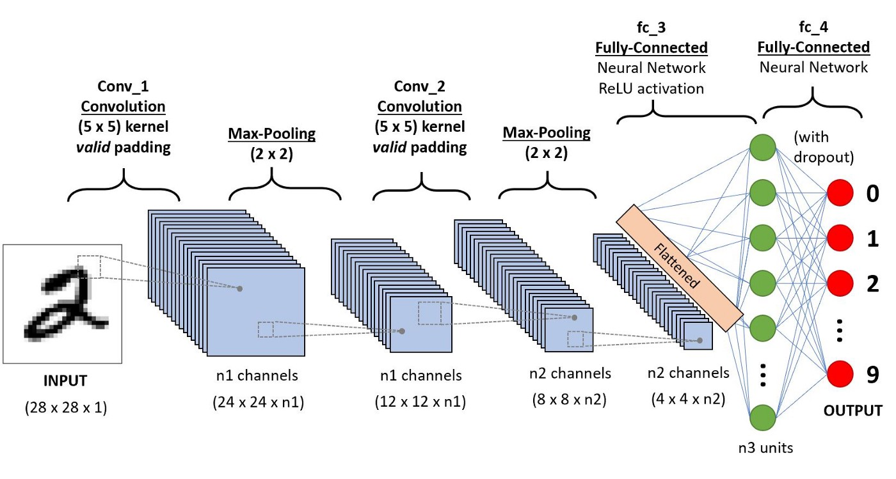
What is a CNN?
It’s a Convolutional Neural Network!

Slide 6
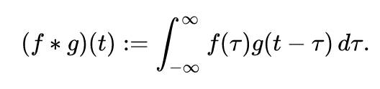
Convolutions! From Math!
Ah! Math! What’s that squiggly symbol?!
Let’s try something else…

Slide 7
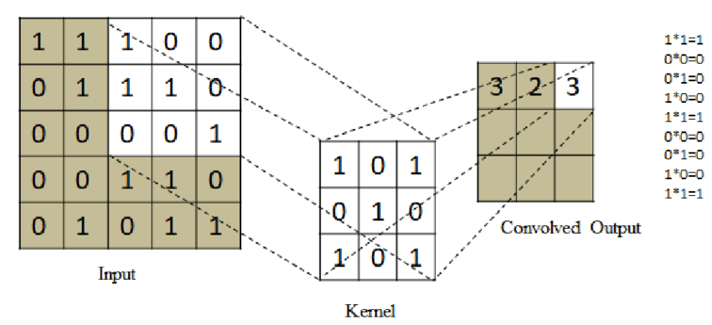
Let’s start with Kernels/Filters
Kernels/Filters are the building blocks of Convolutional Neural Networks
A Kernel is a small matrix (2-d) that lets us search for features in an image (ex on right)
Kernels are passed over the entire image
Result shows where this feature is present (and how close it is)

Slide 8
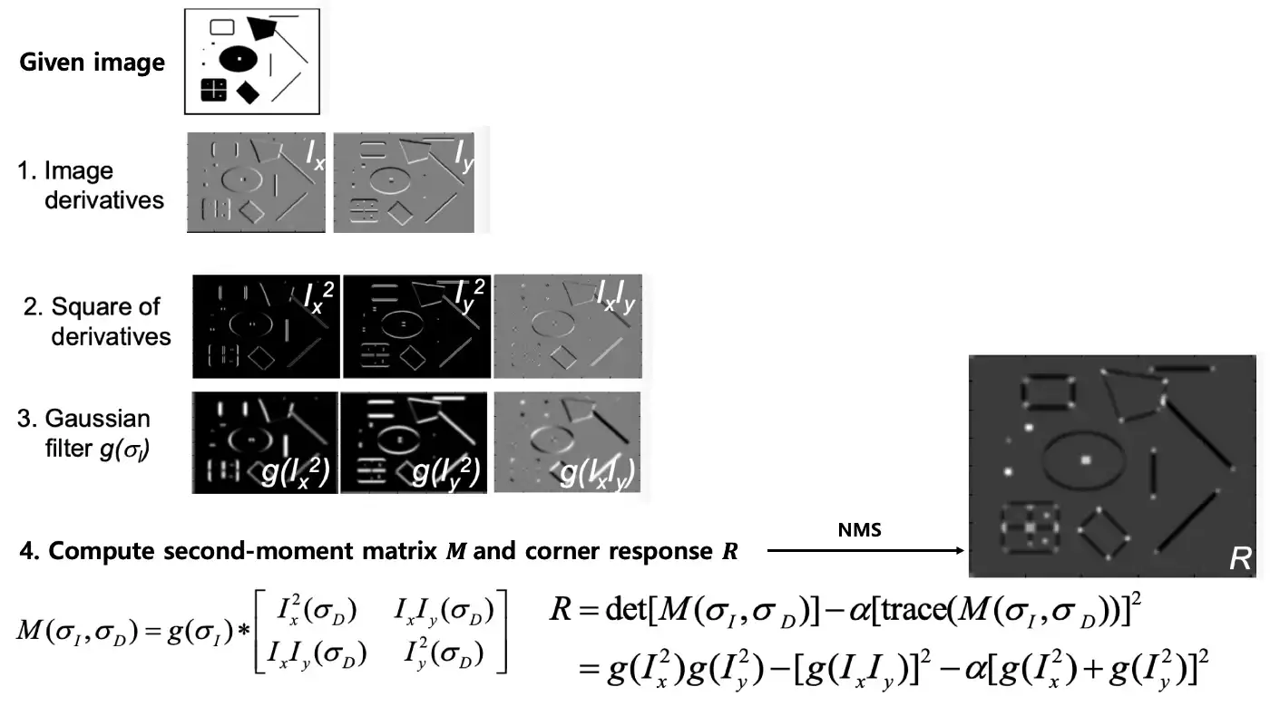
Let’s start with Kernels/Filters
Example with Harris feature detector

Slide 9
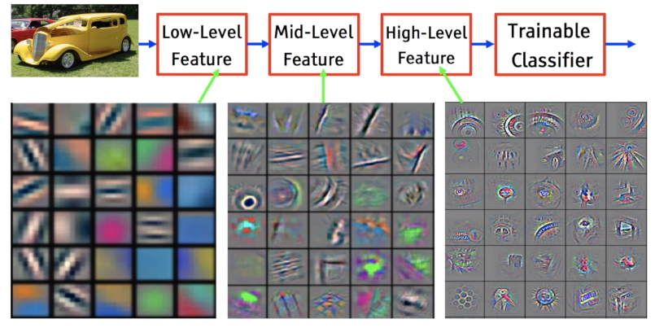
Convolutions! For Images!
They extract useful features!

Slide 10
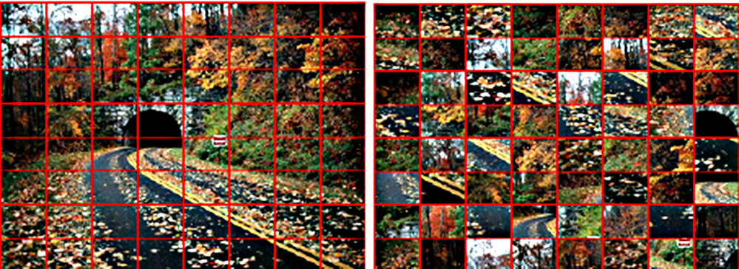
Convolutions! For Images!
Source: https://community.adobe.com/t5/image/serverpage/image-id/63027i3E66D974A6B65CC4/image-size/large?v=v2&px=999
They preserve spatial temporal information!
What is this?

Slide 11

How does Yolo work?
(Fast!(thank you Joseph Redmon))

Slide 12
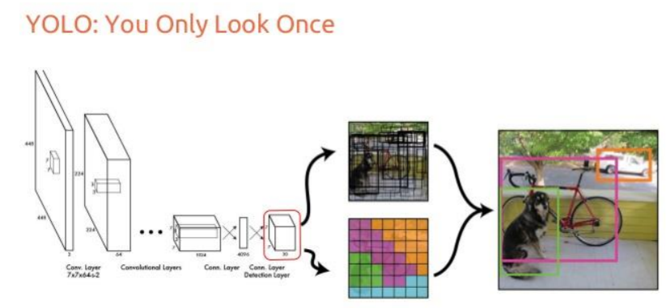
Yolo Architecture
Yolo only needs one pass to detect and localize multiple objects
This is possible because of its output format

Slide 13
Time to train!
Note: we are training yolov5, the latest and greatest is yolov8 (take a look too!)

Slide 14
References
https://miro.medium.com/max/1400/1*uAeANQIOQPqWZnnuH-VEyw.jpeg
https://www.kaggle.com/getting-started/169984
https://en.wikipedia.org/wiki/Convolution
https://www.researchgate.net/figure/The-process-of-convolution-of-kernel-over-the-image_fig1_353745513
https://miro.medium.com/max/1400/1*QNYKtp-cVLcYDreuIUrW3w.webp
https://medium.com/analytics-vidhya/the-world-through-the-eyes-of-cnn-5a52c034dbeb
https://editor.analyticsvidhya.com/uploads/1512812.png

