Slide 1
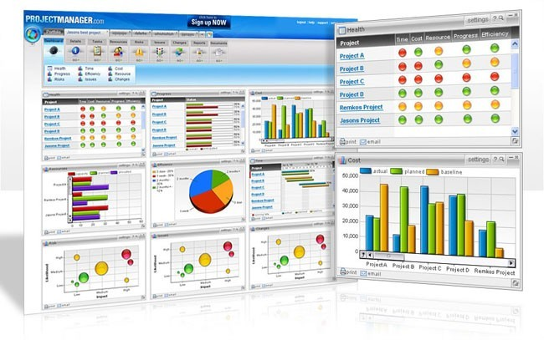
Software Project Management
Introduction, Fundamentals, Classic Mistakes
1

Slide 2
The Field
Jobs: where are they?
Professional Organizations
Project Management Institute (PMI) (pmi.org)
Software Engineering Institute (SEI)
IEEE Software Engineering Group
Certifications
PMI PMP
The “PMBOK” – PMI Body of Knowledge
Tools
Ms Project

Slide 3

PM History in a Nutshell
Birth of modern PM: Manhattan Project (the bomb)
1970’s: military, defense, construction industry were using PM software
1990’s: large shift to PM-based models
– 1985: TQM
1990-93: Re-engineering, self-directed teams
1996-99: Risk mgmt, project offices
2000: global projects
Notes:
New organizational structures, Considerable human resources, Extraordinary project leaders
https://www.planisware.com/hub/article/the-manhattan-project-project-management-during-difficult-times
Total quality management (TQM) is a structured approach to overall organizational management. The focus of the process is to improve the quality of an organization's outputs, including goods and services, through continual improvement of internal practices.
Business process reengineering is the act of recreating a core business process with the goal of improving product output, quality, or reducing costs.

Slide 4

Job Fundamentals
Skills required
PM Positions and roles
The process

Slide 5
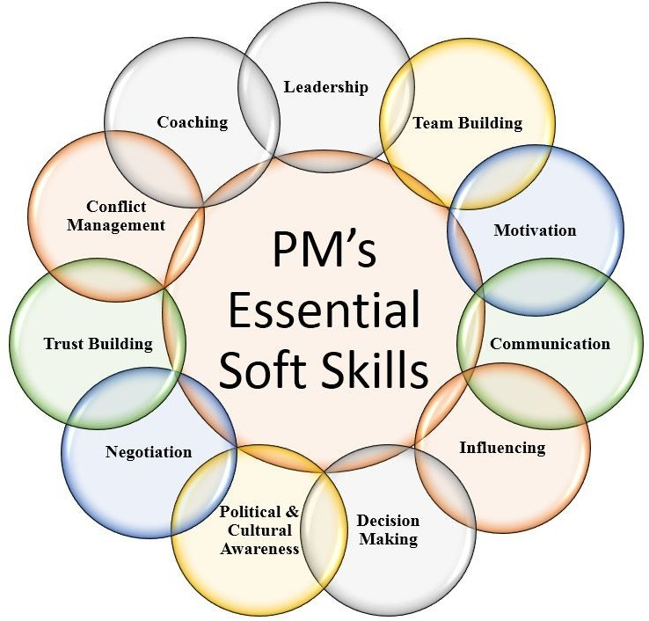
Project Management Skills
Leadership
Communications
Problem Solving
Negotiating
Influencing the Organization
Mentoring
Process and technical expertise

Slide 6
Project Manager Positions
Project Administrator / Coordinator
Assistant Project Manager
Project Manager / Program Manager
Executive Program Manager
V.P. Program Development

Slide 7
Software Project Management
Management
Project Management
Software Project Management

Slide 8
Software + Project + Management
Computer software, or just
software, is the collection of
computer programs and related data that provide the instructions telling a computer what to do

Slide 9
Software + Project + Management
What’s a project?
PMI definition
A project is a temporary attempt undertaken to create a unique product or service
Progressively elaborated
With repetitive elements
A project manager
Analogy: conductor, coach, captain

Slide 10
Software + Project + Management
A project in business and science is a collaborative enterprise, frequently involving research or design, that is carefully planned to achieve a particular aim
Project Management
Project management is the application of knowledge, skills, tools, and techniques to project activities in order to meet or exceed stakeholder needs and expectations from a project.

Slide 11
Dimensions of a Software Project
A software project has two main activity dimensions:
engineering and Project Management.
The engineering dimension deals with building the system and focuses on issues such as how to design, test, code, and so on.
The project management dimension deals with properly planning and controlling the engineering activities to meet project goals for cost, schedule, and quality.

Slide 12
Dimensions of a Software Project
For small projects an email may be fine, but for large commercial projects you need:
Defined Processes, a degree of formality
Tested and Documented processes
To Secure the Quality of outcome

Slide 13
Significance of Processes
♣ What is a Process?
Technically, a process for a task comprises a sequence of steps that should be followed to execute the task.
♣
So, why we require Processes?
Processes represent collective knowledge. Using them increases your chances of success.
A process may have some extra steps, but you will not always know beforehand which ones are not needed, and hence you will increase your risks by taking shortcuts.

Slide 14
Significance of Processes
♣
Without processes, you cannot predict much about the outcome of your project.
♣
You and the organization cannot learn effectively without having defined processes. Learning and improvement are imperative in today's knowledge-based world
♣
Processes lower your anxiety level. The checklists inevitably cover 80 % of what needs to be done. Hence, your task reduces to working out the remaining 20 percent.

Slide 15
Project vs. Program Management
What’s a ‘program’?
Mostly differences of scale
Often a number of related projects
Longer than projects
Definitions vary
16

Slide 16
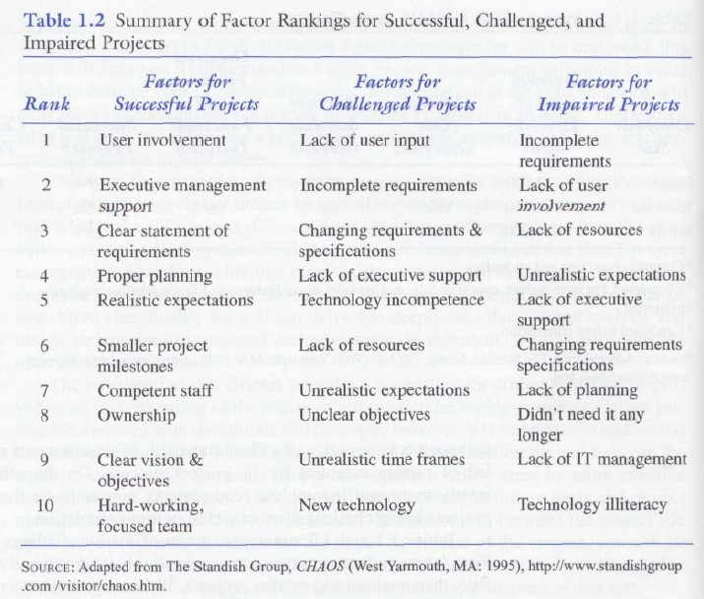
Factors affecting Software Projects

Slide 17
Interactions / Stakeholders
As a PM, who do you interact with?
Project Stakeholders
Project sponsor
Executives
Team
Customers
Contractors
Functional managers

Slide 18
PM Tools: Software
Low-end
Basic features, tasks management, charting
MS Excel, Milestones Simplicity
Mid-market
Handle larger projects, multiple projects, analysis tools
MS Project (approx. 50% of market)
High-end
Very large projects, specialized needs, enterprise
AMS Realtime (Adv Mngt Solution)
Primavera Project Manager

Slide 19
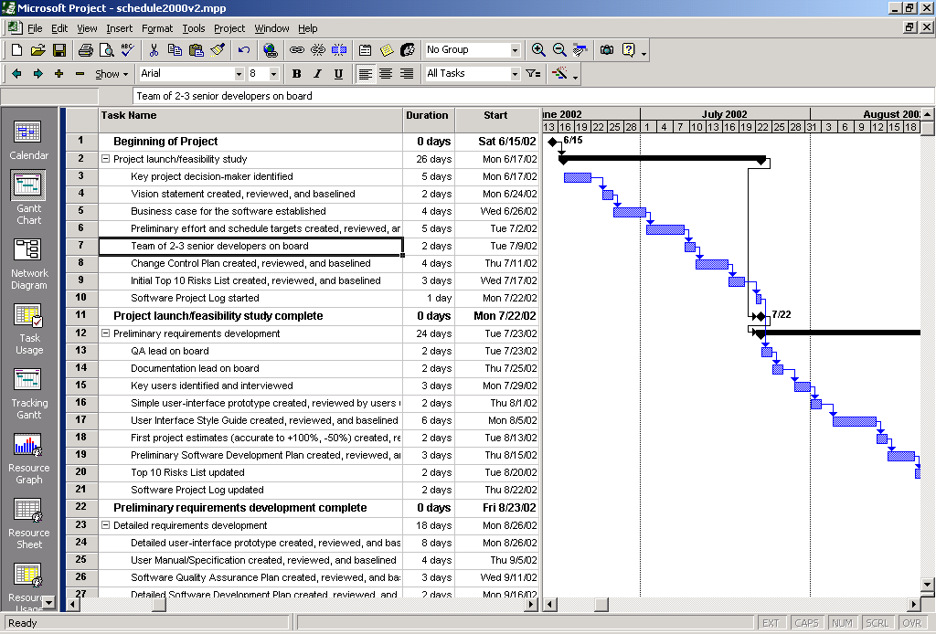
Tools: Gantt Chart

Slide 20
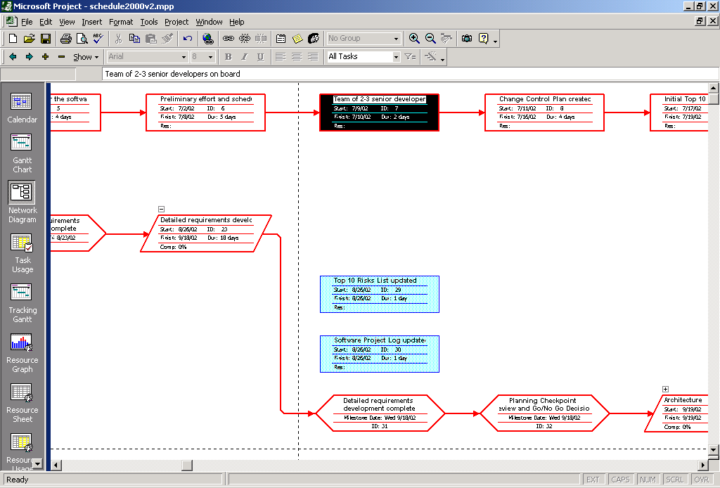
Tools: Network Diagram

Slide 21
PMI’s 9 Knowledge Areas
Project integration management
Scope
Time
Cost
Quality
Human resource
Communications
Risk
Procurement

Slide 22
First Principles
One project size does not fit all
Patterns and Anti-Patterns
Spectrums
Project types
Sizes
Formality and rigor (severity)

Slide 23
Why Rapid Development
Faster delivery
Reduced risk
Increased visibility to customer
Don’t forsake quality

Slide 24
Strategy
Classic Mistake Avoidance
Development Fundamentals
Risk Management
Schedule-Oriented Practices

Slide 25
Four Project Dimensions
People
Process
Product
Technology

Slide 26
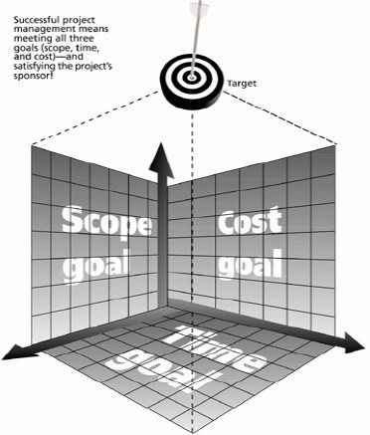






Traditional Project Management Constraints
Every project has 3 constrains Scope goals: What work will be done? Time goals: How long should it take t Cost goals: What should it cost?
o complete?
Scope
Time
Cost
Triple Constraint

Slide 27
Traditional Project Management Constraints
Time constraint may lead to less quality
because of ?
less time for analysis, less time for planning, less time for reviewing, less time for checking, less time for monitoring, less time for control,

Slide 28
Traditional Project Management Constraints
Cost constraint may lead to less quality because of ?
Hiring less skilled people,
Getting less quality resources
Ignoring some customer requirements

Slide 29
Traditional Project Management Constraints
Scope limitations may lead to less quality because of ?
Scope limitations may lead to Ignore some customer requirements
shortcuts

Slide 30
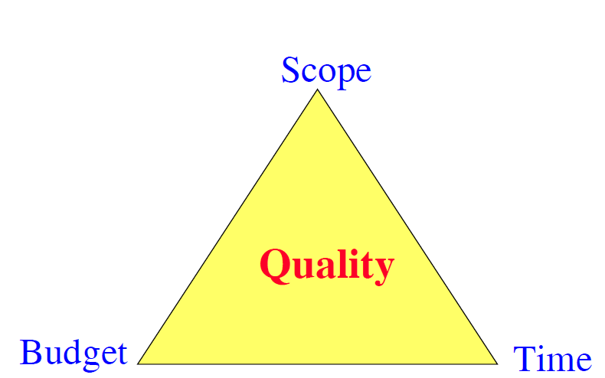










Traditional Project Management Constraints
Quadruple Constraint
Quality is a key factor for projects success
We may add Quality as a 4th constraint:
The Quadruple constraint =The Triple constraint +Quality
constraint
Scope
Quality
Time
Cost

Slide 31
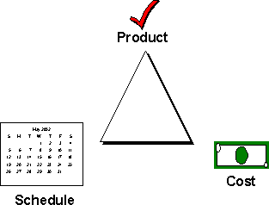
Trade-off Triangle
Fast, cheap, good. Choose two.

Slide 32
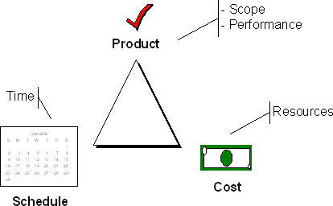
Trade-off Triangle
Know which of these are fixed & variable for every project

Slide 33
People
“It’s always a people problem” Gerald Weinberg, “The Secrets of Consulting”
Developer productivity: 10-to-1 range
Improvements:
Team selection
Team organization
– Motivation

Slide 34
People 2
Other success factors
Matching people to tasks
Career development
Balance: individual and team
Clear communication

Slide 35
Process
Is process stifling?
2 Types: Management & Technical
Development fundamentals
Quality assurance
Risk management
Lifecycle planning
Avoid abuse by neglect

Slide 36
Process contd.
Customer orientation
Process maturity improvement
Rework avoidance

Slide 37
Product
The “tangible” dimension
Product size management
Product characteristics and requirements
Feature creep management

Slide 38
Technology
Often the least important dimension
Language and tool selection
Value and cost of reuse

Slide 39
Planning
Determine requirements
Determine resources
Select lifecycle model
Determine product features strategy

Slide 40
Tracking
Cost, effort, schedule
Planned vs. Actual
How to handle when things go off plan?

Slide 41
Measurements
To date and projected
Cost
Schedule
Effort
Product features
Alternatives
Earned value analysis
Defect rates
Productivity (ex: SLOC)
Complexity (ex: function points)

Slide 42
Technical Fundamentals
Requirements
Analysis
Design
Construction
Quality Assurance
Deployment

Slide 43
Project Phases
All projects are divided into phases
All phases together are known as the Project Life Cycle
Each phase is marked by completion of Deliverables
Identify the primary software project phases

Slide 44
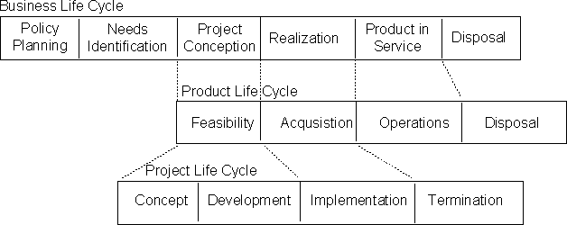
Lifecycle Relationships

Slide 45
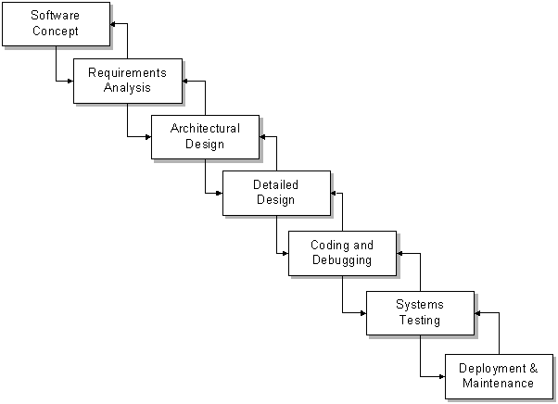
Seven Core Project Phases

Slide 46
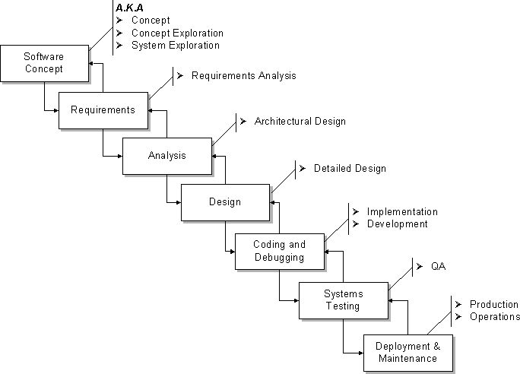
Project Phases A.K.A.
47

Slide 47
Phases Variation
Concept Exploration
System Exploration
Requirements
Design
Implementation
Installation
Operations and Support
Maintenance
Retirement
48

Slide 48
36 Classic Mistakes
McConnell’s Anti-Patterns
Seductive Appeal
Types
People-Related
Process-Related
Product-Related
Technology-Related
Gilligan’s Island

Slide 49
People-Related Mistakes Part 1
Undermined motivation
Weak personnel
– Weak vs. Junior
Uncontrolled problem employees
Heroics
Adding people to a late project

Slide 50
People-Related Mistakes Part 2
Noisy, crowded offices
Customer-Developer friction
Unrealistic expectations
Politics over substance
Wishful thinking

Slide 51
People-Related Mistakes Part 3
Lack of effective project sponsorship
Lack of stakeholder buy-in
Lack of user input

Slide 52
Process-Related Mistakes Part 1
Optimistic schedules
Insufficient risk management
Contractor failure
Insufficient planning
Abandonment of plan under pressure

Slide 53
Process-Related Mistakes Part 2
Wasted time during fuzzy front end
Shortchanged upstream activities
Inadequate design
Shortchanged quality assurance

Slide 54
Process-Related Mistakes Part 3
Insufficient management controls
Frequent convergence
Omitting necessary tasks from estimates
Planning to catch-up later
Code-like-hell programming

Slide 55
Product-Related Mistakes
Requirements gold-plating
Gilding the lily
Feature creep
Developer gold-plating
Beware the pet project
Push-me, pull-me negotiation
Research-oriented development

Slide 56
Technology-Related Mistakes
Silver-bullet syndrome
Overestimated savings from new tools and methods
– Fad warning
Switching tools in mid-project
Lack of automated source-code control

Slide 57
Reading
McConnell: Chapters 1-4
– We covered most of Ch 3 today
Schwalbe: chapters 1-2, 11 (344-345)

Slide 58
Textbooks
Required texts
“Rapid Development”, Steve McConnell
“Information Technology Project Management”, Kathy Schwalbe
These provide two very different viewpoints
In-the-trenches vs. PMI textbook perspective
Recommended reading
“Quality Software Project Management”, D. Shafer
“Software Project Survival Guide”, Steve McConnell
“Peopleware”, T. DeMarco and T. Lister

