Slide 1
Ben Bishop Head of Research & Development Sage Accountants Division

Slide 2
Vision for Accountants
To deliver Extraordinary User Experience by providing highly collaborative and compliant solutions, working with your customers and their data through intelligent use of Sage Connected Services, Platforms, Products and Government integration.
Notes:
Accountants sell Professional Services – Efficiency, Quality and Accuracy are key
We need to be “The Accountants’ Accountant” for Legislation and Compliance
Complete Requirement – Compliance is no longer enough
Connected services – What could Accountants provide?
Platforms – Autoupdate service, Mobile Platform, On-line Platforms
Data Integration – Own products plus others (xbrl as a data standard?)
Customer Integration – Collaborative environments, integrating with their systems, data access, Client Manager, Accountants Link
Government Integration – HMRC for Taxation and Accounts (under CT). Companies House for Company Accounts

Slide 3
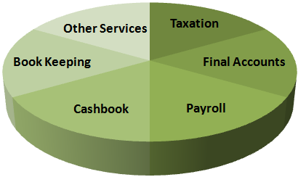

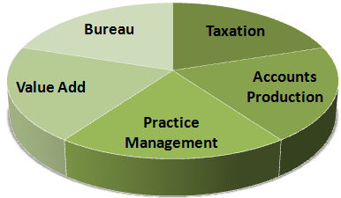


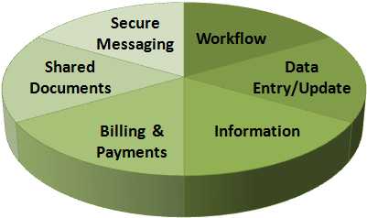






The Vision
Collaboration
Connected Services
Practice Solutions
Suppliers/Partners
Accountants
Clients
Notes:
Software, Service, Support, Collaborations
Collaborative environment for Accountants and their clients. Exposing and sharing data at the right level of fidelity to enable decisions, collaboration and sign off.
Facilitate and automate workflow where possible for efficiency
Client Manager and accountants link facilitating collaboration with your customers from a workflow, transactional and data perspective.
Utilising Sage pedigree alongside our other submission services (Payroll, VAT, P11D) to enable better integration with HMRC services

Slide 4
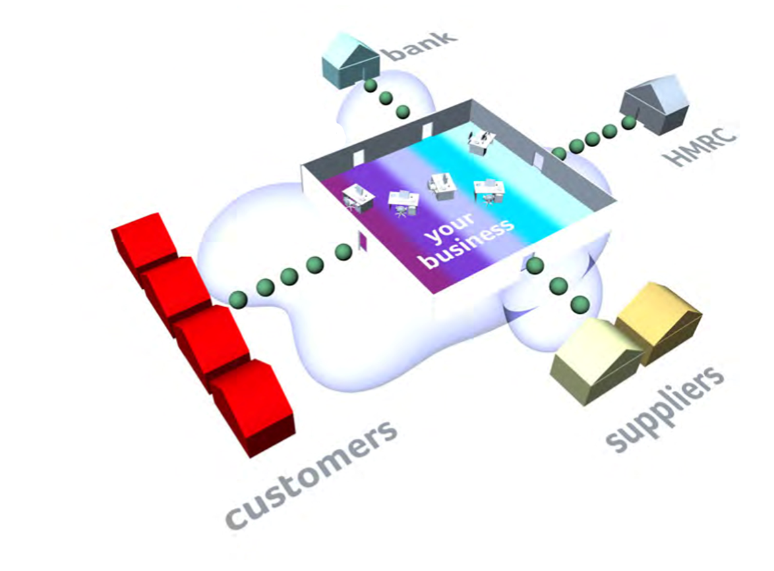

Notes:
Recognition – your business is similar to any other business. Same topology of interaction and same requirements of your suppliers, banks, legislative bodies etc.
Work closely within Sage to ensure that anything we do that benefits customers can be delivered to all of our relevant customers.
Practice solutions slightly different in that we also know we deliver expert user systems for many of our practices. However – you are running a business and need all of the tools for client management, tracking, marketing, supplier managament etc that are similar to any other organisation.

Slide 5
Our Immediate Focus
Notes:
MOT feedback

Slide 6



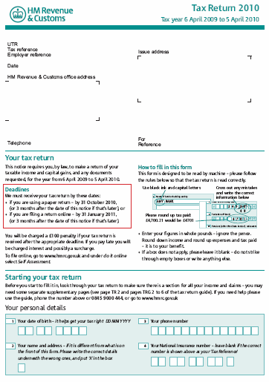







Notes:
Immediate/short term roadmap includes:
Work for HMRC compliance. In Taxation this is mainly around the changes to Capital Allowances that we will be delivering in Q3.
In relation to the HMRC iXBRL program this affects a number of our products:
CT – First delivery of the ixbrl enabled products have been signed off and are being released later this week
There will be a further update in line with our normal release program in Q4
Accounts production – again our primary focus has been on delivering ixBRL for HMRC compliance. Work is progressing well on the solution and again we expect to deliver in Q4 alongside the next release of CT
In addition we have been focussing on Platform compliance to ensure that our products will operate of 64 bit platforms, Windows 7 and also alongside Office 2010 both 32 and 64 bit.
Last but not least, we have also worked with our colleagues on the Sage 50 product to ensure compliance with our Sage Practice Solution for the 2011 release.

Slide 7
Medium Term Plan (2011)
Notes:
MOT feedback

Slide 8







HMRC/Companies House/Accounting Compliance
Taxation V14.00/14/01
Accounts Production V12
Continued focus on iXBRL
Workflow for Practice Management
SPS V2.0
Significant Usability Enhancements for Accounts Production
Enhancement of Interactive Financial Statements across all AP products
Close watching brief on IFRS for SME
Notes:
Our business as usual activities will focus on adding incremental value to the desktop products whilst ensuring the maintenance of key compliance and legislative updates. In addition we will continue to deliver on the enhancements within Accounts Production that were first delivered under the iXBRL program
From a practice management perspective we will be delivering a new Workflow module – which you can see today in one of the afternoon sessions. This allows your practice to set up standard workflows, assign and manage the tasks and activities associated with these and track overall progress.
We will also continue to keep a close watching brief on IFRS for SME. From our analysis to date, we have ensured that changes we have made to the products to implement iXBRL also provide us with a platform upon which to implement IFRS for SME at the relevant time.

Slide 9

On-Line Collaboration
Customer Engagement following User Centered Design for Use Cases to deliver priority Collaboration elements
Proof of concept development for Accountants to Client online collaboration
Notes:
A big part of our product focus for 2011.
Priority to work with Accountants to understand the ways in which they want to interact with their customers.
This can range from simple document and message sharing to complex workflow around Taxation or Accounts production.
Critical for us to deliver this in a format that meets the Accountants requirements and also their customers.
We need to also ensure that the solution is secure, highly intuitive and usable and performant.
Likely focus will be on simple use cases to enable us to build the correct platform and environment to deliver a robust and secure solution.
Internally we are collaborating with a number of other regions within Sage who are in the process of or already have implemented similar solutions for their customers.

Slide 10
Thank You
Notes:
MOT feedback

