Slide 1



Exploring the Effect of Personalized Virtual Reality
Serious Game for Stroke Rehabilitation
RVA 2025/2026 - Pitch Presentation
Ana Rita Guimarães - 124362
David Palricas - 108780

Slide 2
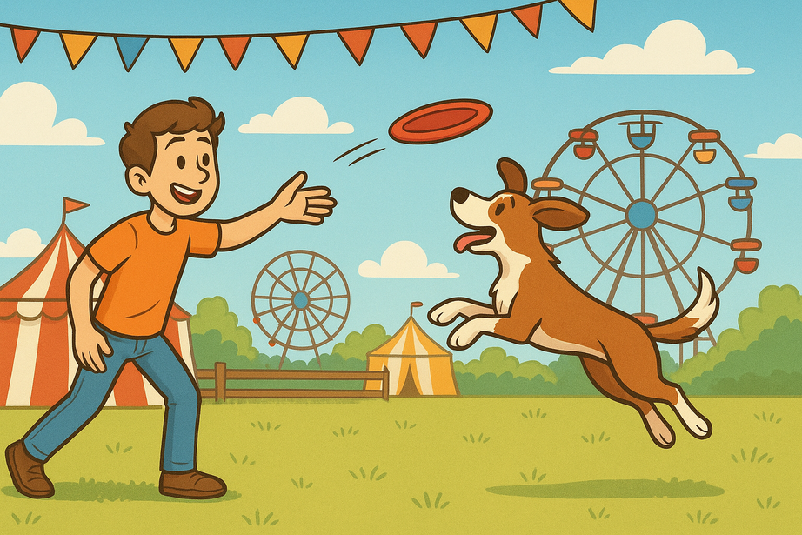
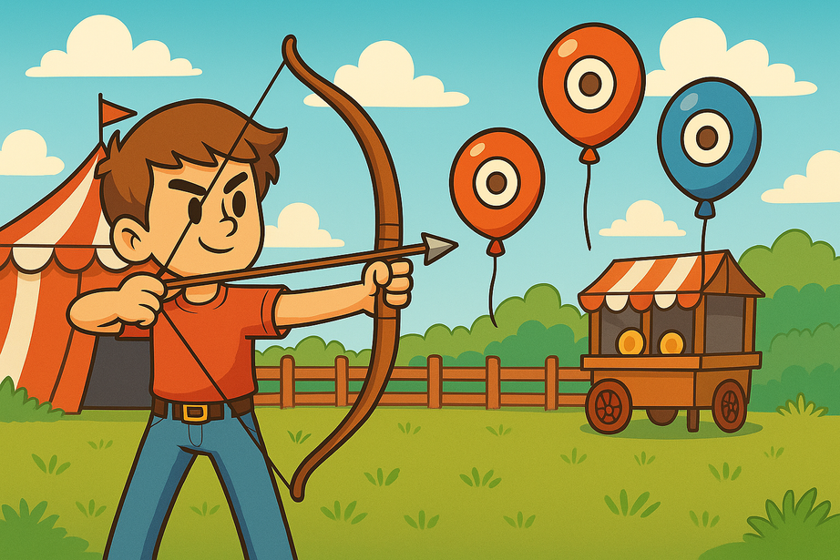
TO REMEMBER
What Is Our Project?
2

Slide 3
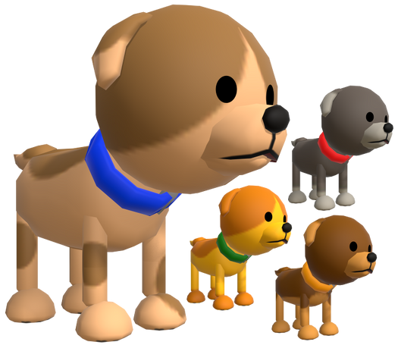
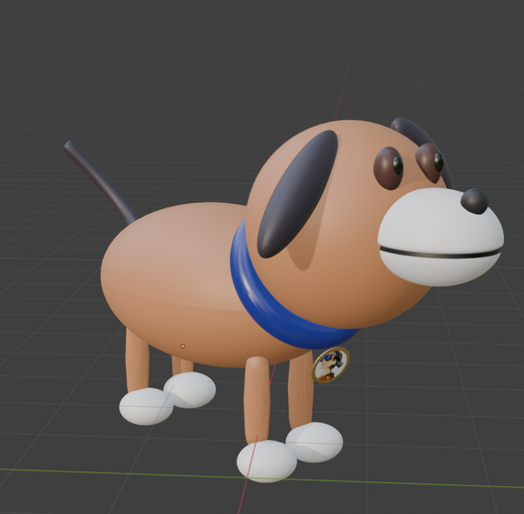
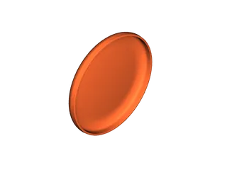
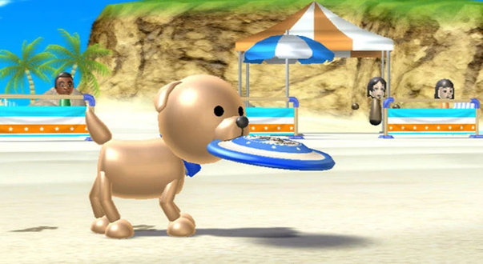
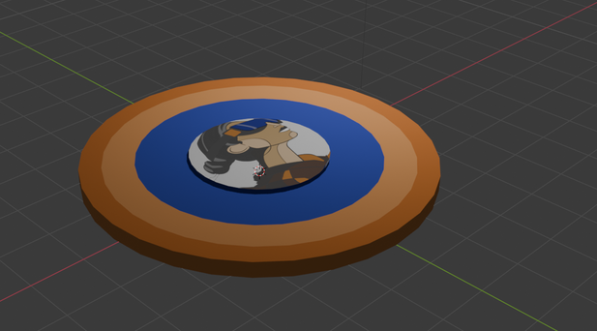
PROGRESS - FRISBEE GAME
3D Models
References
Current Models
3

Slide 4
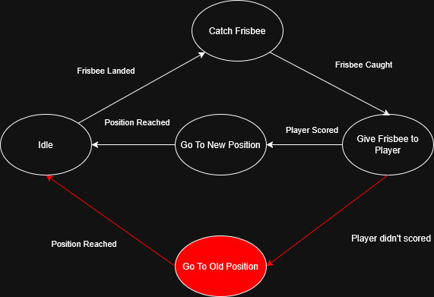
PROGRESS - FRISBEE GAME
Implemented Mechanics
Throw Frisbee
Show Frisbee Trajectory
Frisbee Physics
Display the Targets Area
Dog’s Behaviour
4

Slide 5
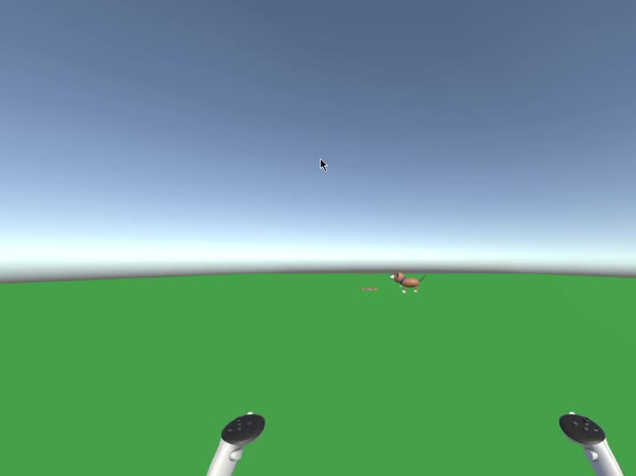
CURRENT STATE - FRISBEE GAME
5

Slide 6
NEXT STEPS
Frisbee Game
Define and apply the gestures for the frisbee’s throw
Improve the dog movement
Implement Score System and Streak System
Add a running/walk animation for the dog
6

Slide 7
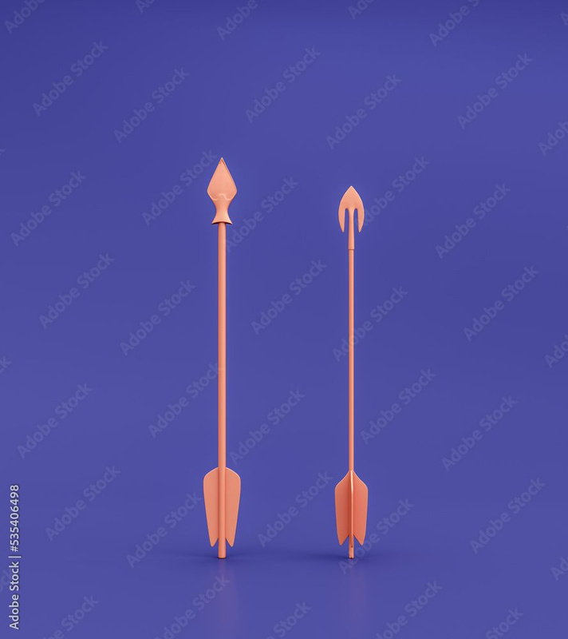
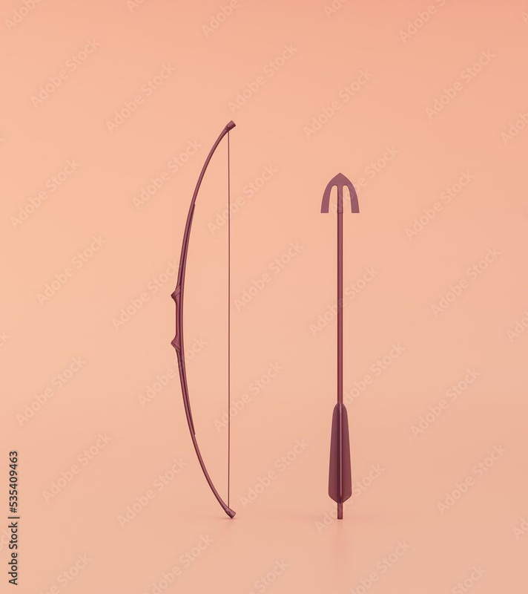
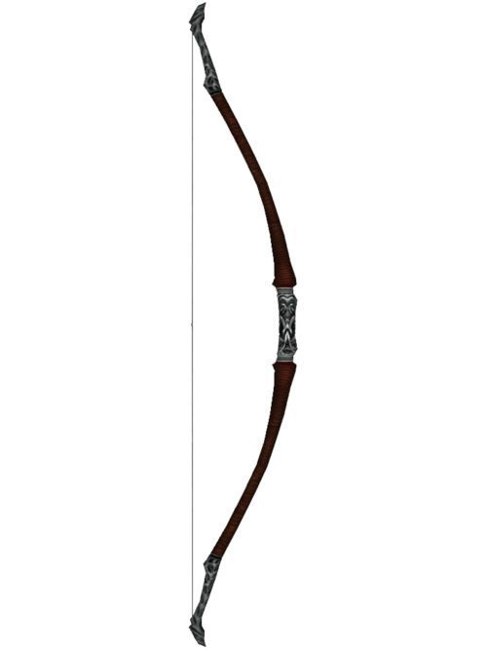


PROGRESS - ARCHERY GAME
References
7

Slide 8
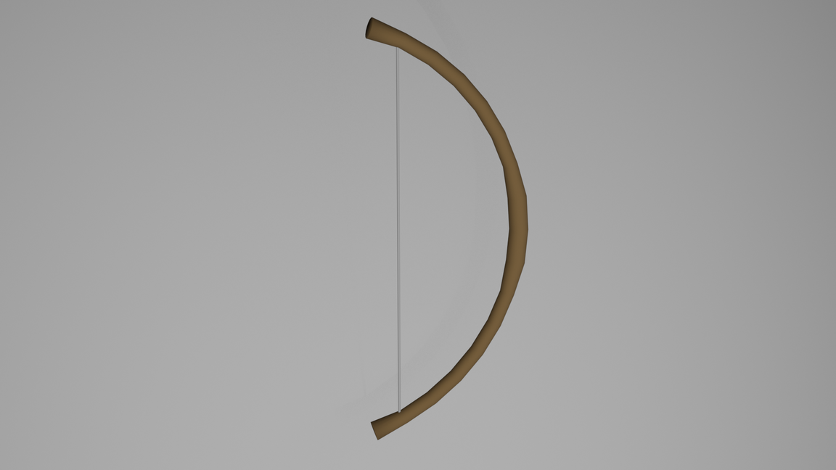
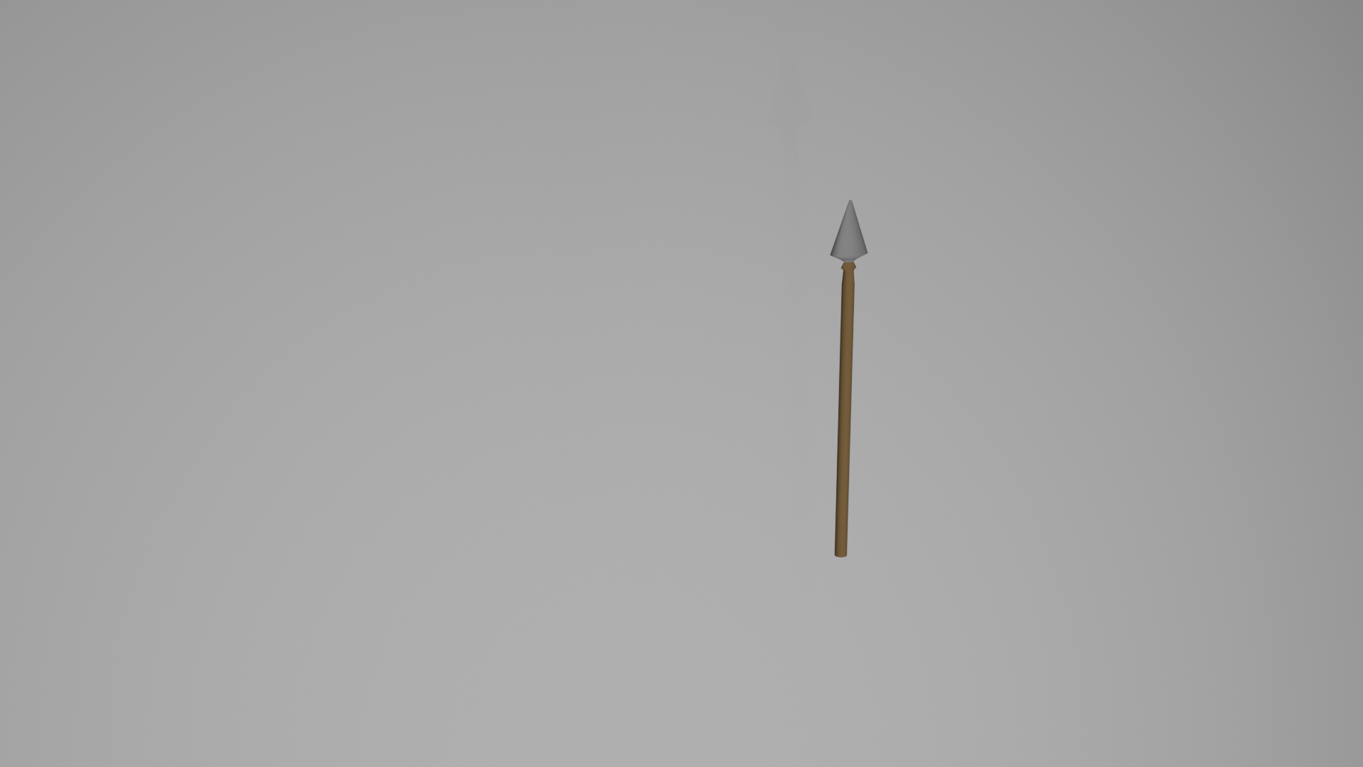
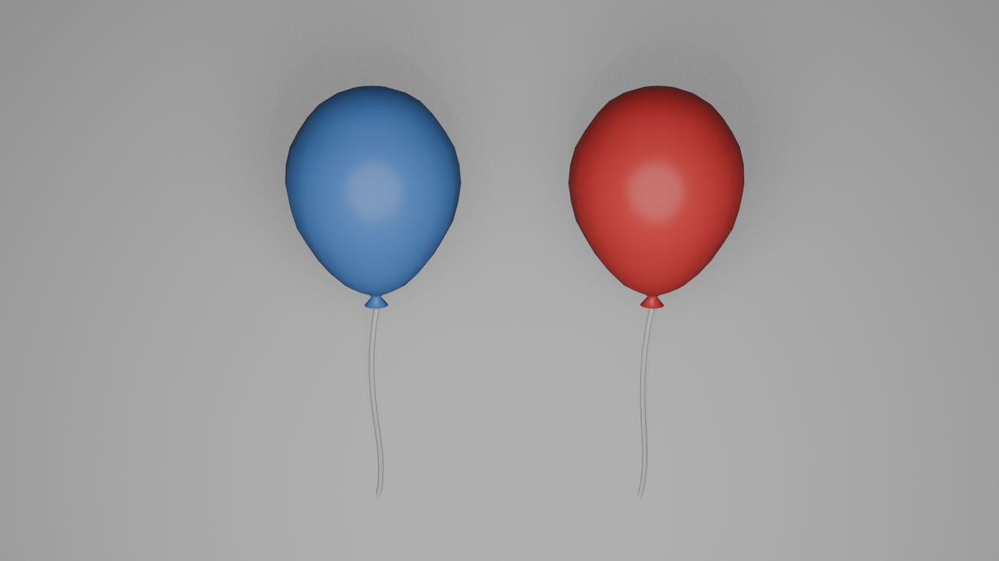
PROGRESS - ARCHERY GAME
3D Models
8

Slide 9
PROGRESS - ARCHERY GAME
Implemented Mechanics
Bow and Arrow
Arrow release
Arrow physics
Balloon interaction
9

Slide 10
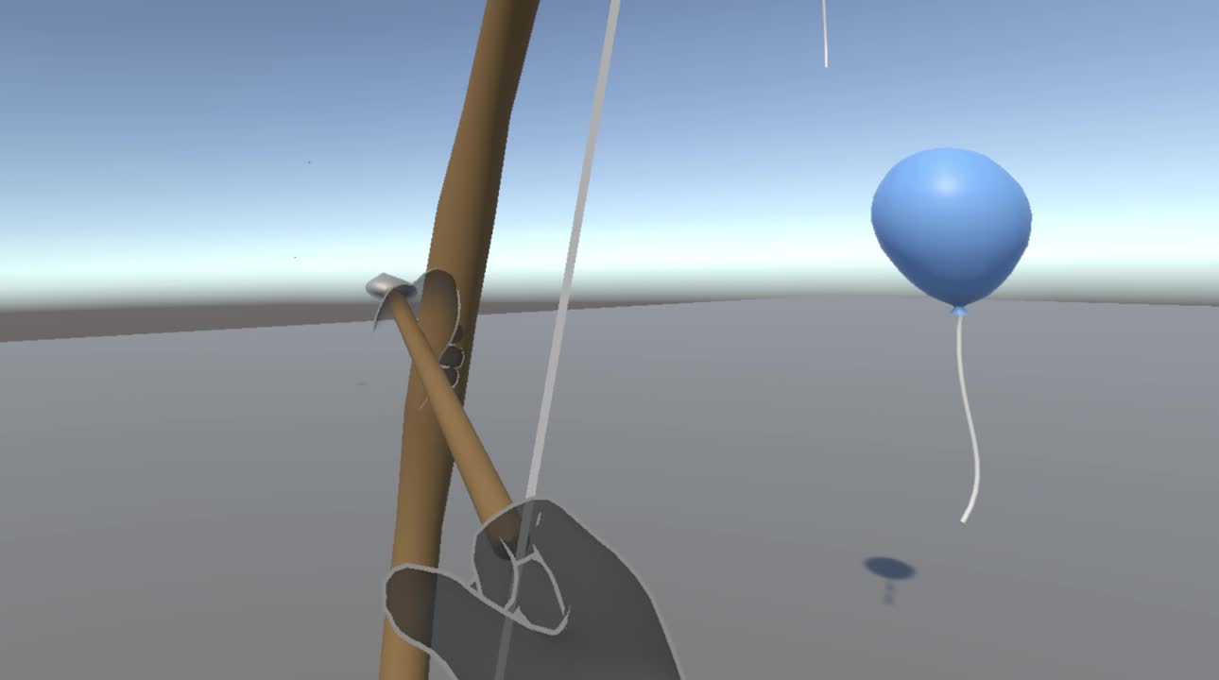
CURRENT STATE - ARCHERY GAME
10

Slide 11
NEXT STEPS
Archery Game
Improve the bow and arrow mechanics (physics, force);
Add more target types and basic scoring;
Add player feedback systems (sounds, particles, UI);
Create initial levels with simple challenges and targets.
11

Slide 12
The End
Thank Your For Listening

