Slide 1



Exploring the Effect of Personalized Virtual Reality
Serious Game for Stroke Rehabilitation
RVA 2025/2026 - Midterm Presentation
Ana Rita Guimarães - 124362
David Palricas - 108780

Slide 2
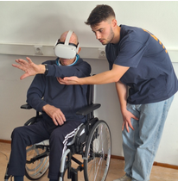

INTRODUCTION (1/2)
Why this Project?
How does stroke impacts our society?
Why VR for rehabilitation?
2

Slide 3
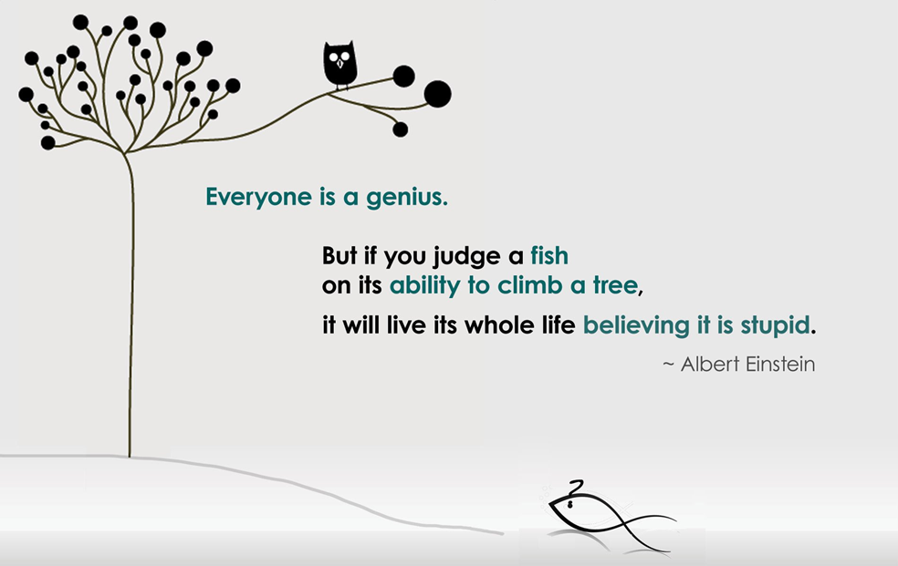
INTRODUCTION (2/2)
What is Personalization?
3

Slide 4
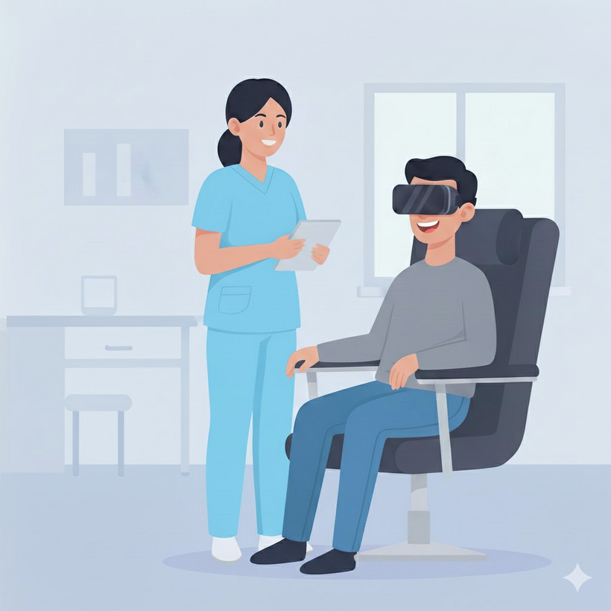
VISION
A functional VR prototype developed for rehabilitation
A new, more motivating and enjoyable form of rehabilitation
Prove the Usability & Effectiveness in VR Rehab
4

Slide 5



OBJECTIVES
Create at least 2 VR games
Create the personalisation’s structure
Test with users
5

Slide 6




BENEFITS
Increase survivors’ motivation
Improves surviors’ progress
Better progress tracking for healthcare professionals
Contribute to VR Rehabilitation Research
6

Slide 7
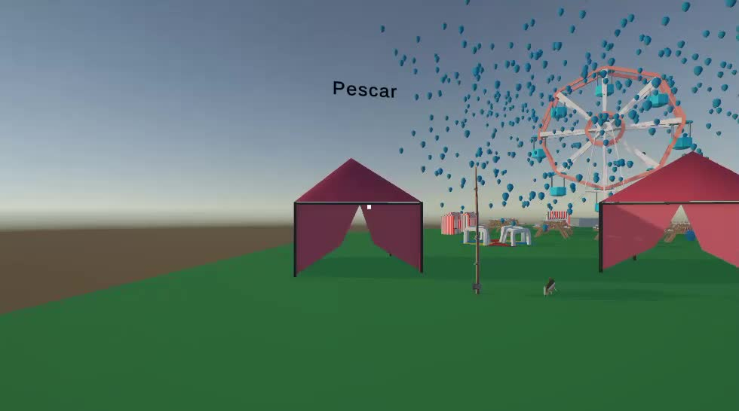
PROJECT ENVIRONMENT
7

Slide 8
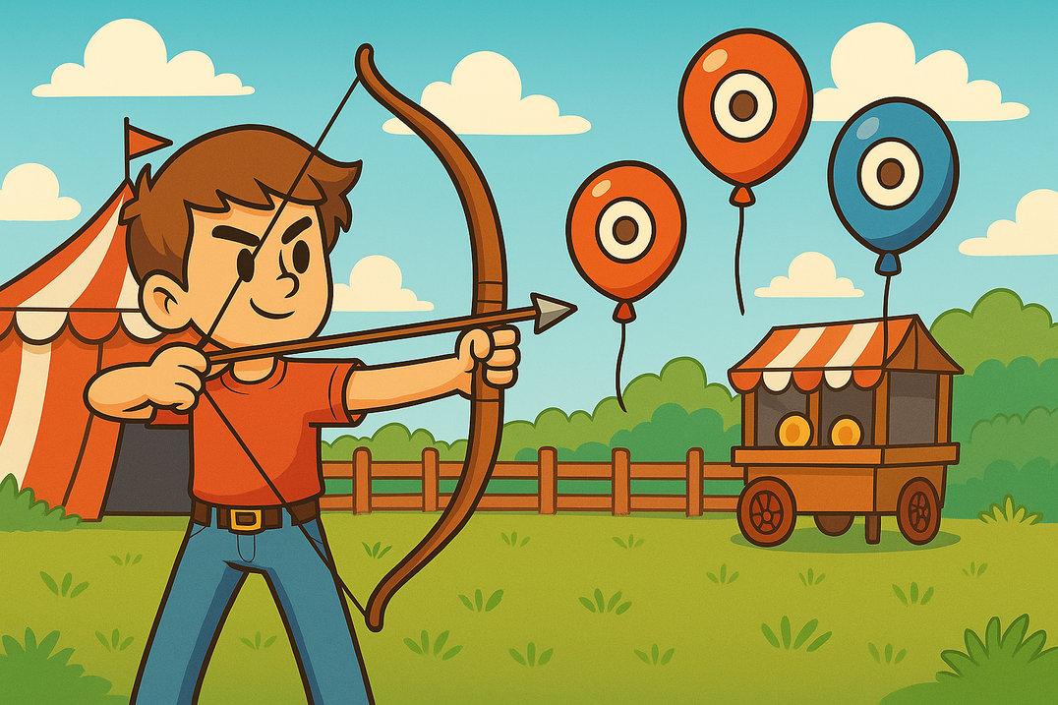
GAMES CONCEPT(1/2)
Why is relevant for stroke rehabilitation?
How it can be personalized?
8

Slide 9
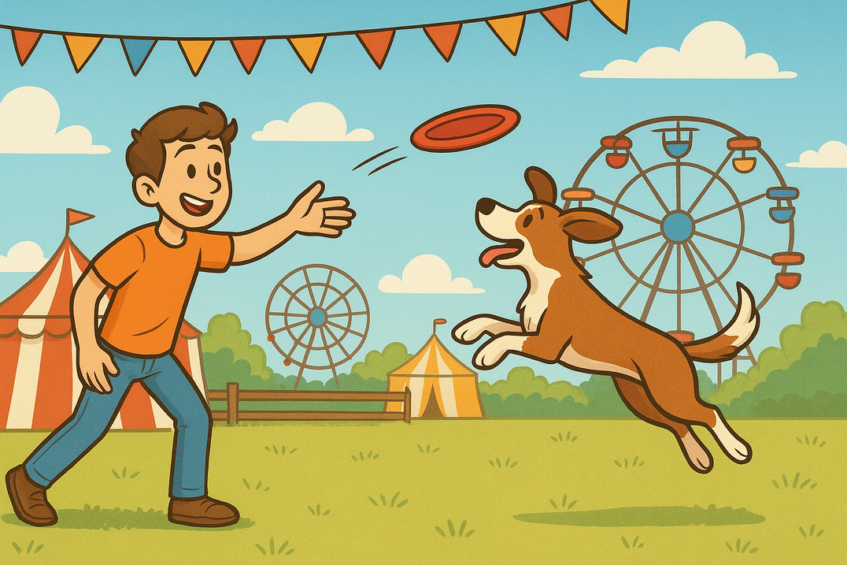
GAMES CONCEPT(2/2)
Why is relevant for stroke rehabilitation?
How it can be personalized?
9

Slide 10
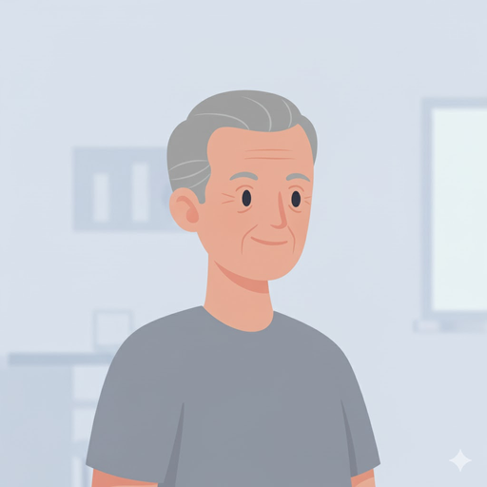
PERSONAS
Challenges
Problems: Partial paralysis in his left arm
Fears: Not moving your arm like before again or getting worse
Concerns: Difficulty adapting to new technologies
Desires: Improve left arm movement and coordination​
Manuel
72 years old
Plumber
40 years of experience
Retired
Relation with Technology
No prior experience with V.R.
Dream V.R. is something simple and easy to use
11

Slide 11

PERSONAS
Challenges
Problems: Having to explain to survivors how to use technology
Concerns: Survivors not adapting to new technologies
Desires: Wants patients to improve their abilities and to feel more motivated.
Maria
30 years old
Physiotherapist
Specialized in Stroke Rehabilitation
5 years of experience
Relation with Technology
Some experience with V.R. technologies
Sees V.R. as a valuable tool for rehabilitation
11

Slide 12
USER STORIES
Manuel
As a stroke survivor, I want to engage in enjoyable and motivating activities so that I can stay committed to my rehabilitation process.
Maria
As a healthcare professional, I want to monitor my patients’ progress in real time so that I can make informed adjustments to their therapy plans.
12

Slide 13
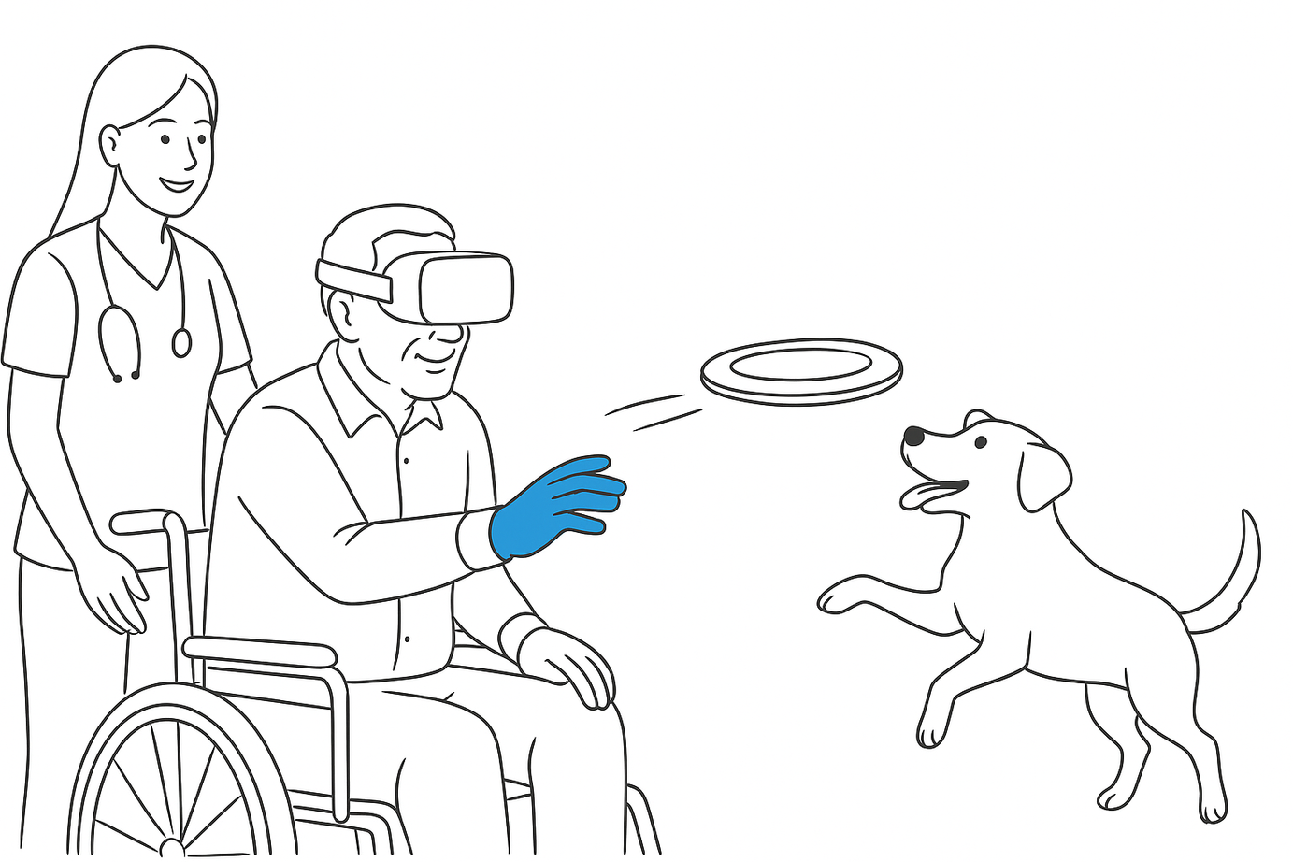
STORYBOARDS
Frisbee
15

Slide 14
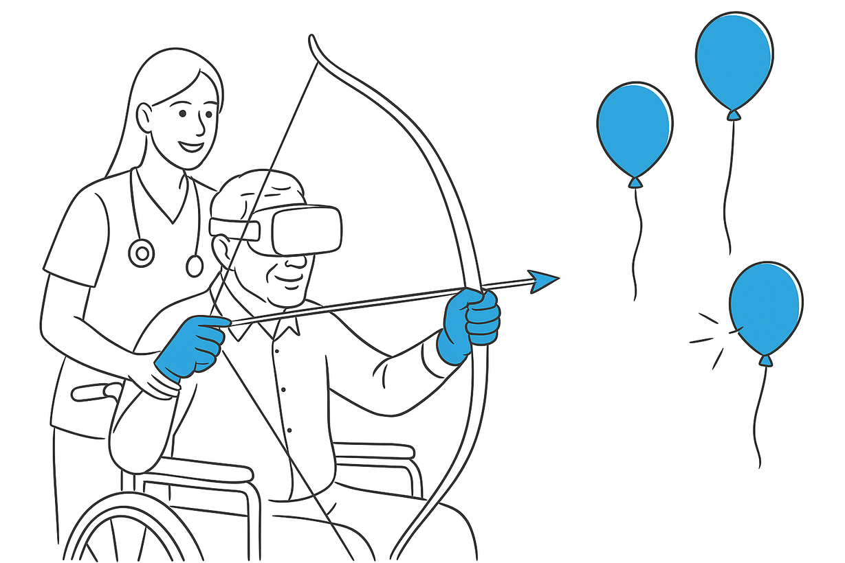
STORYBOARDS
Archery
14

Slide 15



QUALITY REQUIREMENTS
Accessibility
Intuitive UI
Low latency
Keep users engaged and motivated
16

Slide 16


FUNCTIONAL REQUIREMENTS
Simple mechanics
Clear goals and instructions
Quick feedback
Gamification for motivation and engagement
17

Slide 17
PROJECT CONSTRAINTS
Time
1.
Feedback
2.
Accessibility
3.
18

Slide 18
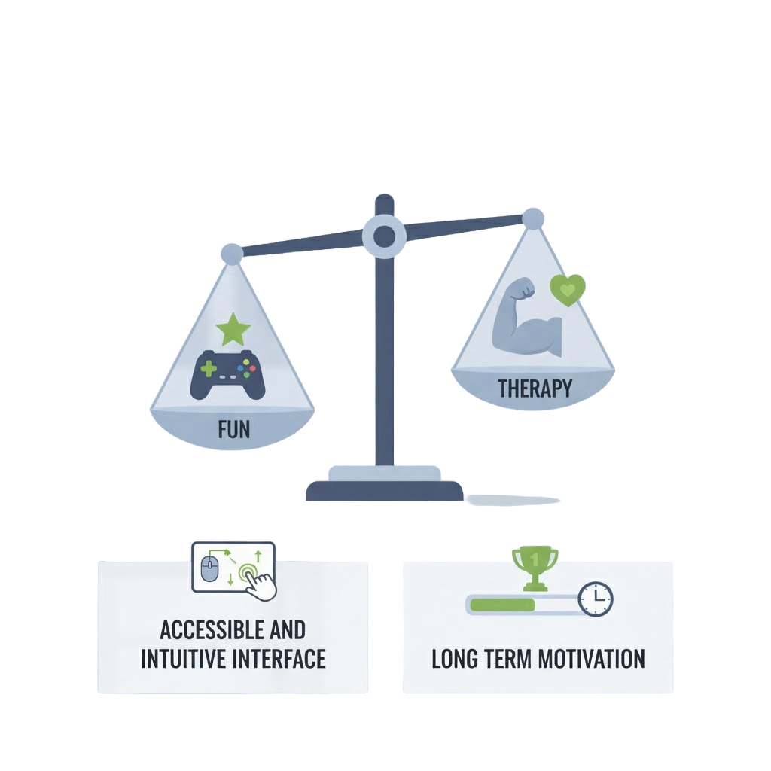
GREATEST CHALLENGES
19

Slide 19
NEXT STEPS
1. Analysis and learning of VR Technologies and Tools
2. Literature Review
3. Refinement of Game Concepts
4. VR Prototype Planning and Development
20

Slide 20
REFERENCES
Figueiredo, I. et al. (2025). Personalized Virtual Reality for Stroke Recovery. ISMAR 2025, University of Aveiro.
Mahlovanyy, A. et al. (2023). Physical Rehabilitation and Archery Exercises in Paralympic Athletes. Rehabilitation & Recreation, 15, 16–23.
21

Slide 21
The End
Thank Your For Listening

