Slide 1



Exploring the Effect of Personalized Virtual Reality
Serious Game for Stroke Rehabilitation
RVA 2025/2026 - Final Presentation
Ana Rita Guimarães - 124362
David Palricas - 108780

Slide 2
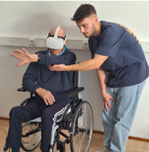

INTRODUCTION
Why this Project?
  How does stroke impacts our society?
  Why VR for rehabilitation?
2

Slide 3



OBJECTIVES
Create at least 2 VR mini-games
Create the personalisation’s structure
Test with users
5

Slide 4
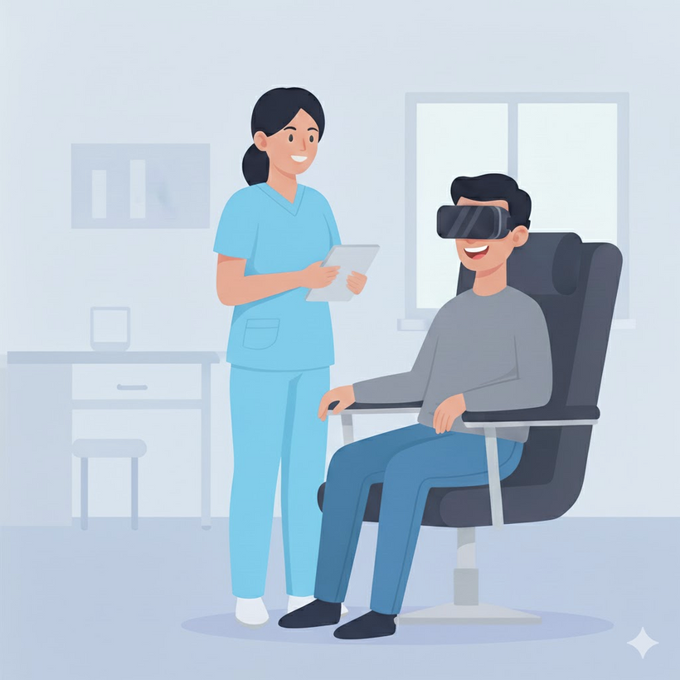
VISION
A functional VR prototype developed for rehabilitation
A new, more motivating and enjoyable form of rehabilitation
Contribute in in VR Rehab Field
4

Slide 5
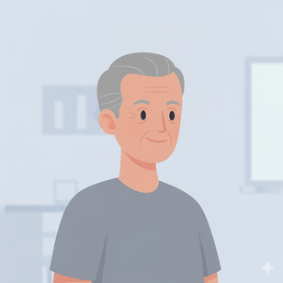

USER STORIES
As a stroke survivor, I want to engage in enjoyable and motivating activities so that I can stay committed to my rehabilitation process.
Manuel
  72 years old
  Plumber
  40 years of experience
  Retired
As a healthcare professional, I want to monitor my patients’ progress in real time so that I can make informed adjustments to their therapy plans.
Maria
  30 years old
  Physiotherapist
  Specialized in Stroke Rehabilitation
  5 years of experience
5

Slide 6
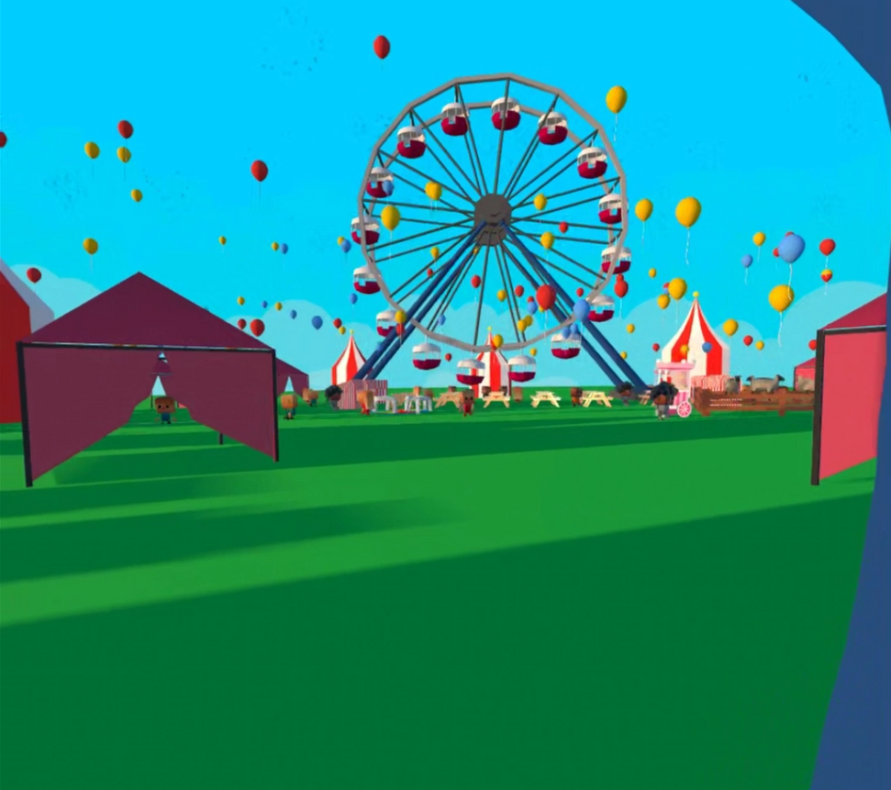
PROTOTYPE ENVIRNOMENT
Country Fair
  Cultural resonance
  Emotional value
  Promoting an engaging environment
6

Slide 7
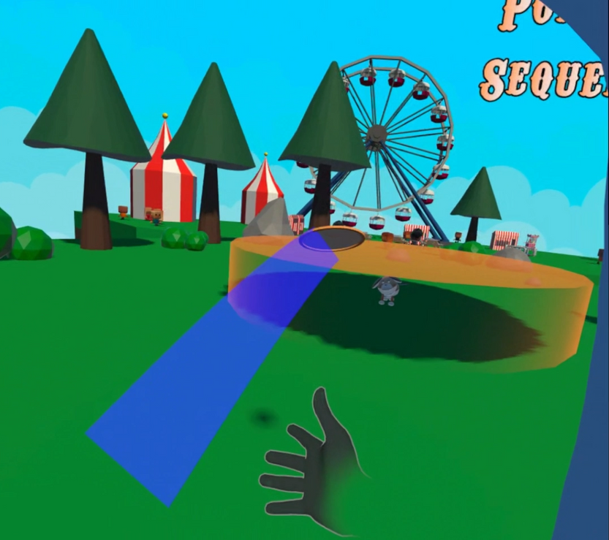
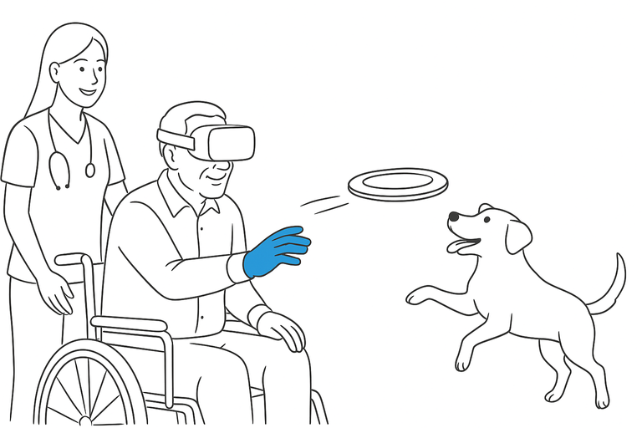
PROTOTYPE DEVELOPED
Frisbee Game
  Throw Frisbee and show trajectory
  Display the target area
  Dog’s behaviour to catch the frisbee and deliver it to the player
  Score and streak displayed in the UI
  Sound feedback
7

Slide 8
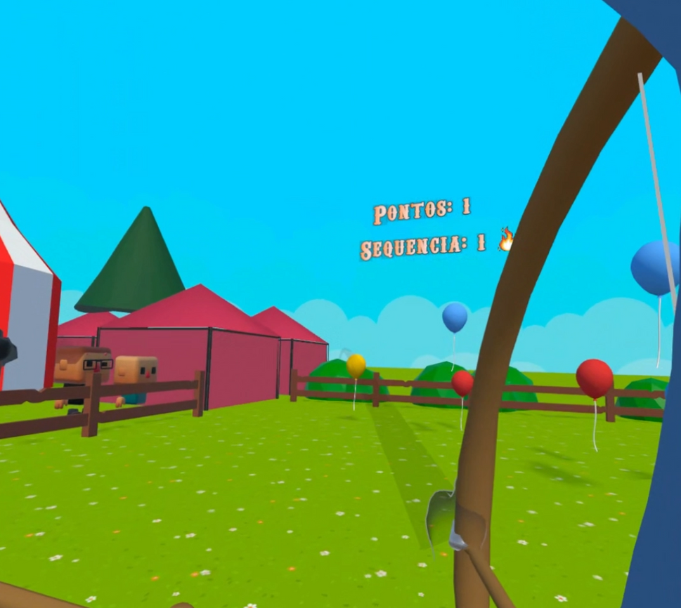
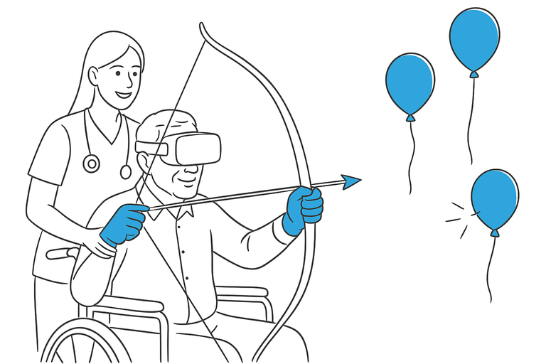
PROTOTYPE DEVELOPED
Archery Game
  Bow pull and arrow release
  Show arrow trajectory
  Balloon interaction and respawn
  Score and streak displayed in the UI
  Sound feedback
8

Slide 9



TOOLS USED
  Software: Unity, Blender and FMOD
  Hardware: Oculus Quest 3
  Libraries: Meta Interaction SDK, FMOD Unity, DotTween
3D Models:
  Balloons, bow and arrow - Rita
  Dog, frisbee, trees, bushes and stones - David
  Button - Meta
  Ferris Wheel and sheep - Poly by Google
  Fence - Quaternius
  Persons - J-Toastie
  Other models - sirkitree
9

Slide 10
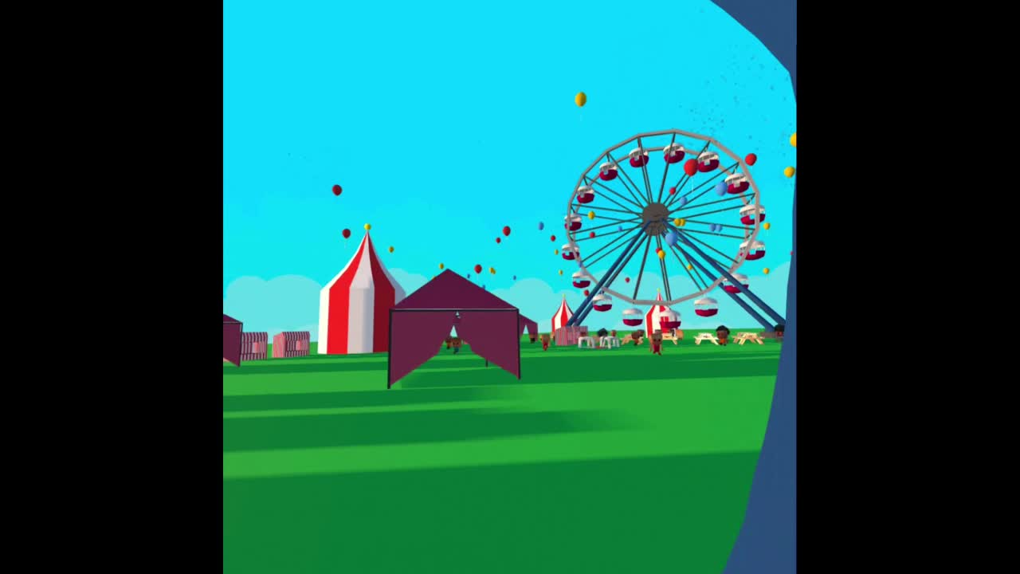
DEMO
10

Slide 11
USER EVALUATION - TASKS
Pessoa 1 | Pessoa 2
12s | 3s | Tarefa 1: Selecionar um mini jogo para jogar
5s | 8s | Tarefa 2: Voltar para a feira
11s | 11s | Tarefa 3: Arrebentar 3 balões no jogo do arco
53s | 37s | Tarefa 4: Marcar 1 ponto no jogo do frisbee
11

Slide 12
USER EVALUATION - FEEDBACK
Overall Experience:
  The mini game were fun to play
  The users felt they were in a country fair
  Liked the sound feedback
  Felt that the mini games needed a tutorial
12

Slide 13
USER EVALUATION - FEEDBACK
Frisbee mini-game:
  The frisbee curved to much in the direction of the throwing hand.
  Instead of going to the user’s exact position, the dog delivered the frisbee directly to the nearest outstretched hand
Archery mini-game:
  Balloon Scoring: Considers texture (e.g., metallic) and legend plates, not just color.
  The arrow sometimes launches while the string is still being pulled.
13

Slide 14
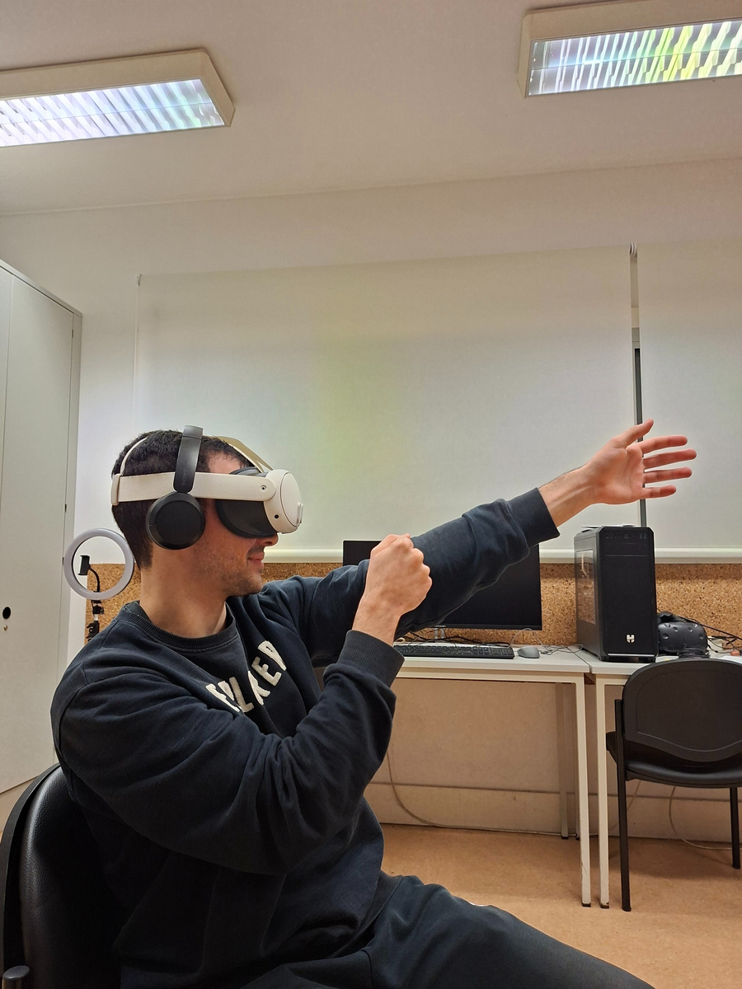
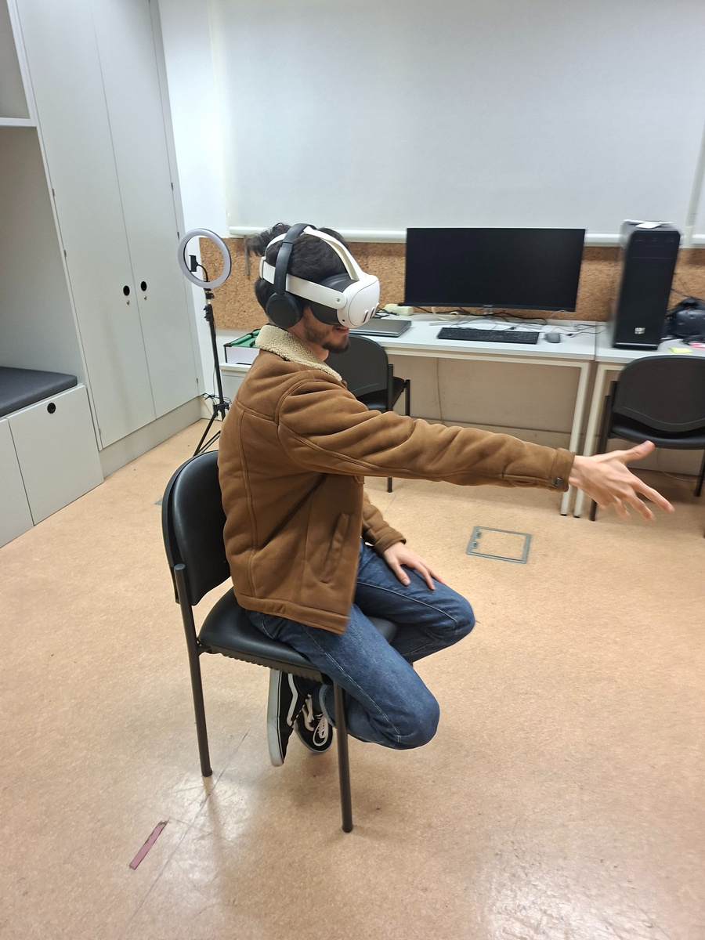
USER EVALUATION - OBSERVATIONS
  Users felt amused while playing
  1 user struggled to understand how to score a point in the Frisbee mini game
  There were no signs of any negative after effect
14

Slide 15
EXPECTATIONS VS REALITY
Expectations:
  Mini games would be simple to implement
  No bugs at final presentation
  We would be able to test with several users
  No major technical issues
Reality:
  Getting the physics right took longer than expected
  Minor bugs remained
  Tested with some users
  Overall no major difficulties were encountered
15

Slide 16
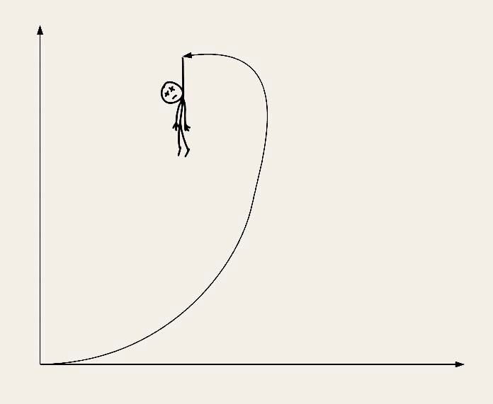
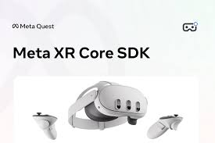
MAIN DIFFICULTIES
  Learn VR development in unity
  Hand tracking accuracy and stability
  Implementing and fine-tuning physics
  Debbuging and testing in VR
  Headset management
  Find information in Meta SDK Documentation
16

Slide 17
FUTURE WORK
  Add a tutorial
  Create a system that adapts to user's performance
  Improve physics
  Improve gameplay
  Add more feedback
17

Slide 18
Thank you!
Ana Rita Guimarães - 50%
David Palricas - 50%

