Slide 1



Exploring the Effect of Personalized Virtual Reality
Serious Game for Stroke Rehabilitation
JS 2025/2026 - Final Presentation
David Palricas - 108780

Slide 2
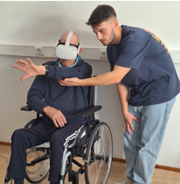

INTRODUCTION
Why this Project?
  How does stroke impacts our society?
  Why VR for rehabilitation?
2

Slide 3



OBJECTIVES
Create at least 2 VR mini-games
Create the personalization/DDA system
Test with users
3

Slide 4
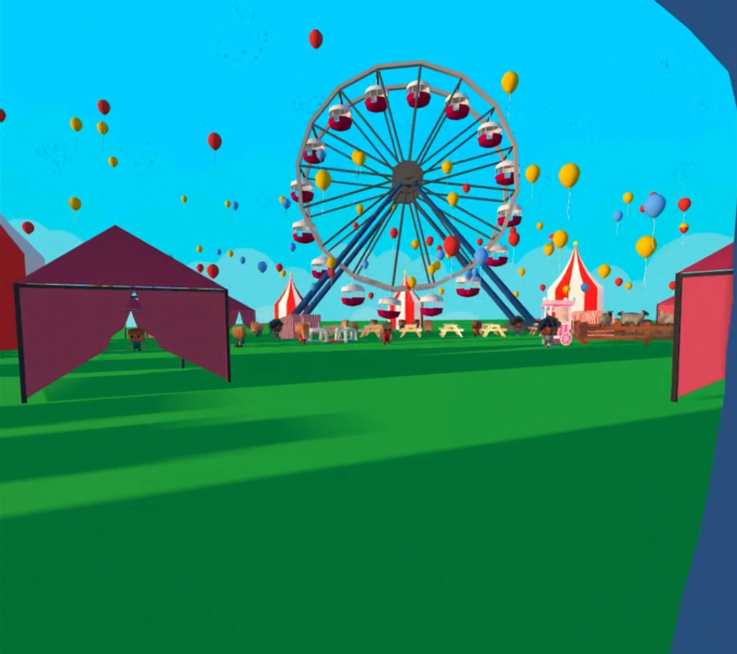
GAME ENVIRONMENT
Country Fair
  Cultural resonance
  Emotional value
  Promoting an engaging environment
4

Slide 5
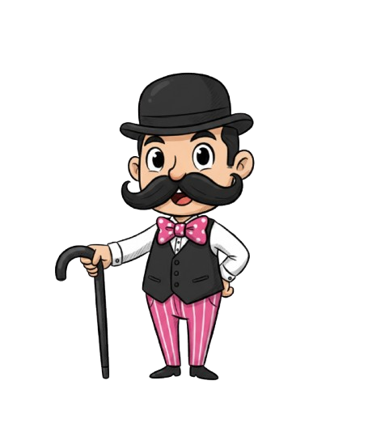
GAME CHARACTERS- FAIR’S OWNER ZECA BIGODES
  Gives an Introduction to the player about the game.
  Congrats The Player after finishing a mini game.
5

Slide 6
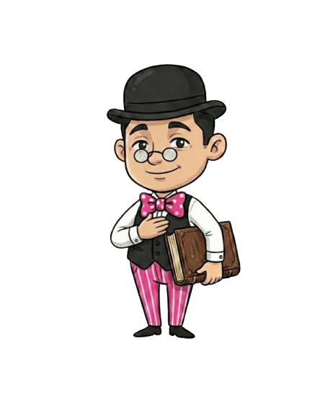
GAME CHARACTERS- CARNY WISE FAIR’S EMPLOYEE
Carny Wise- Fair Employee
  Explains each mini game rules and goal
  Adjusts the mini games difficulty and notifies when it has changed
6

Slide 7
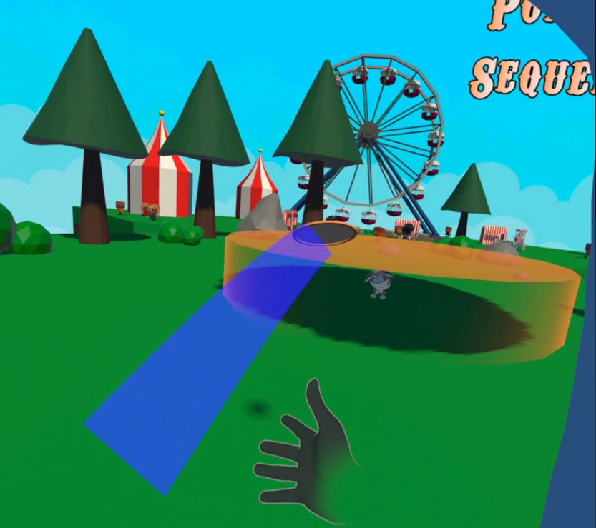
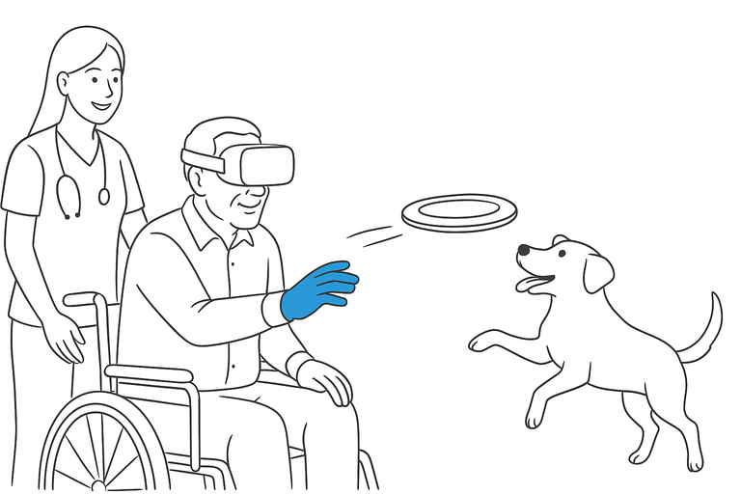
MINI GAMES(1/2)
Frisbee Game
  The player must throw a Frisbee to the orange area around the dog or the other orange areas.
  The orange areas can move, disappear or both
  Dog’s behavior to catch the frisbee and deliver it to the player
  Score and streak displayed in the UI
  Sound feedback
7

Slide 8
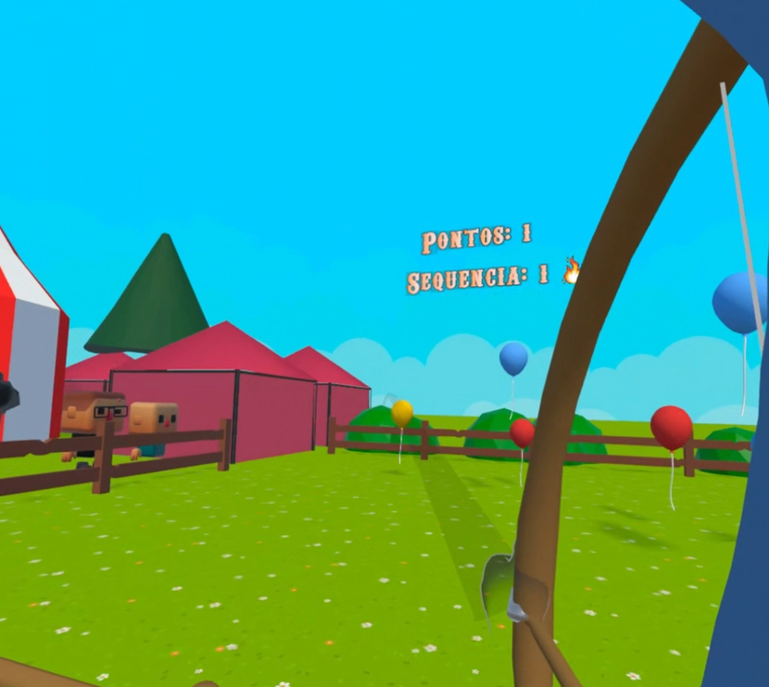
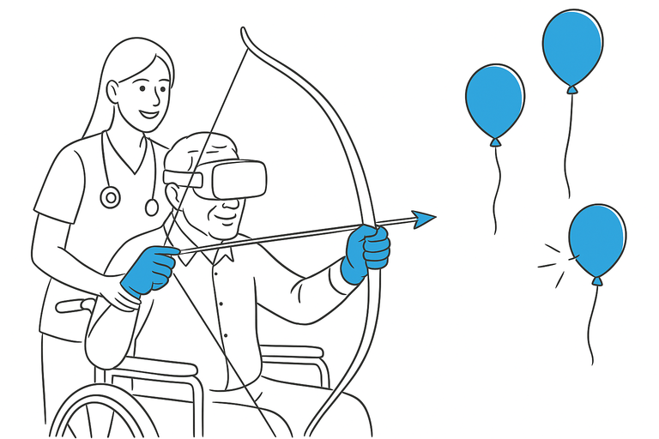
MINI GAMES(2/2)
Archery Game
  The player must shoot balloons with a specific color to score
  Balloons can move, their transparency can change or both.
  Score and streak displayed in the UI
  Sound feedback
8

Slide 9
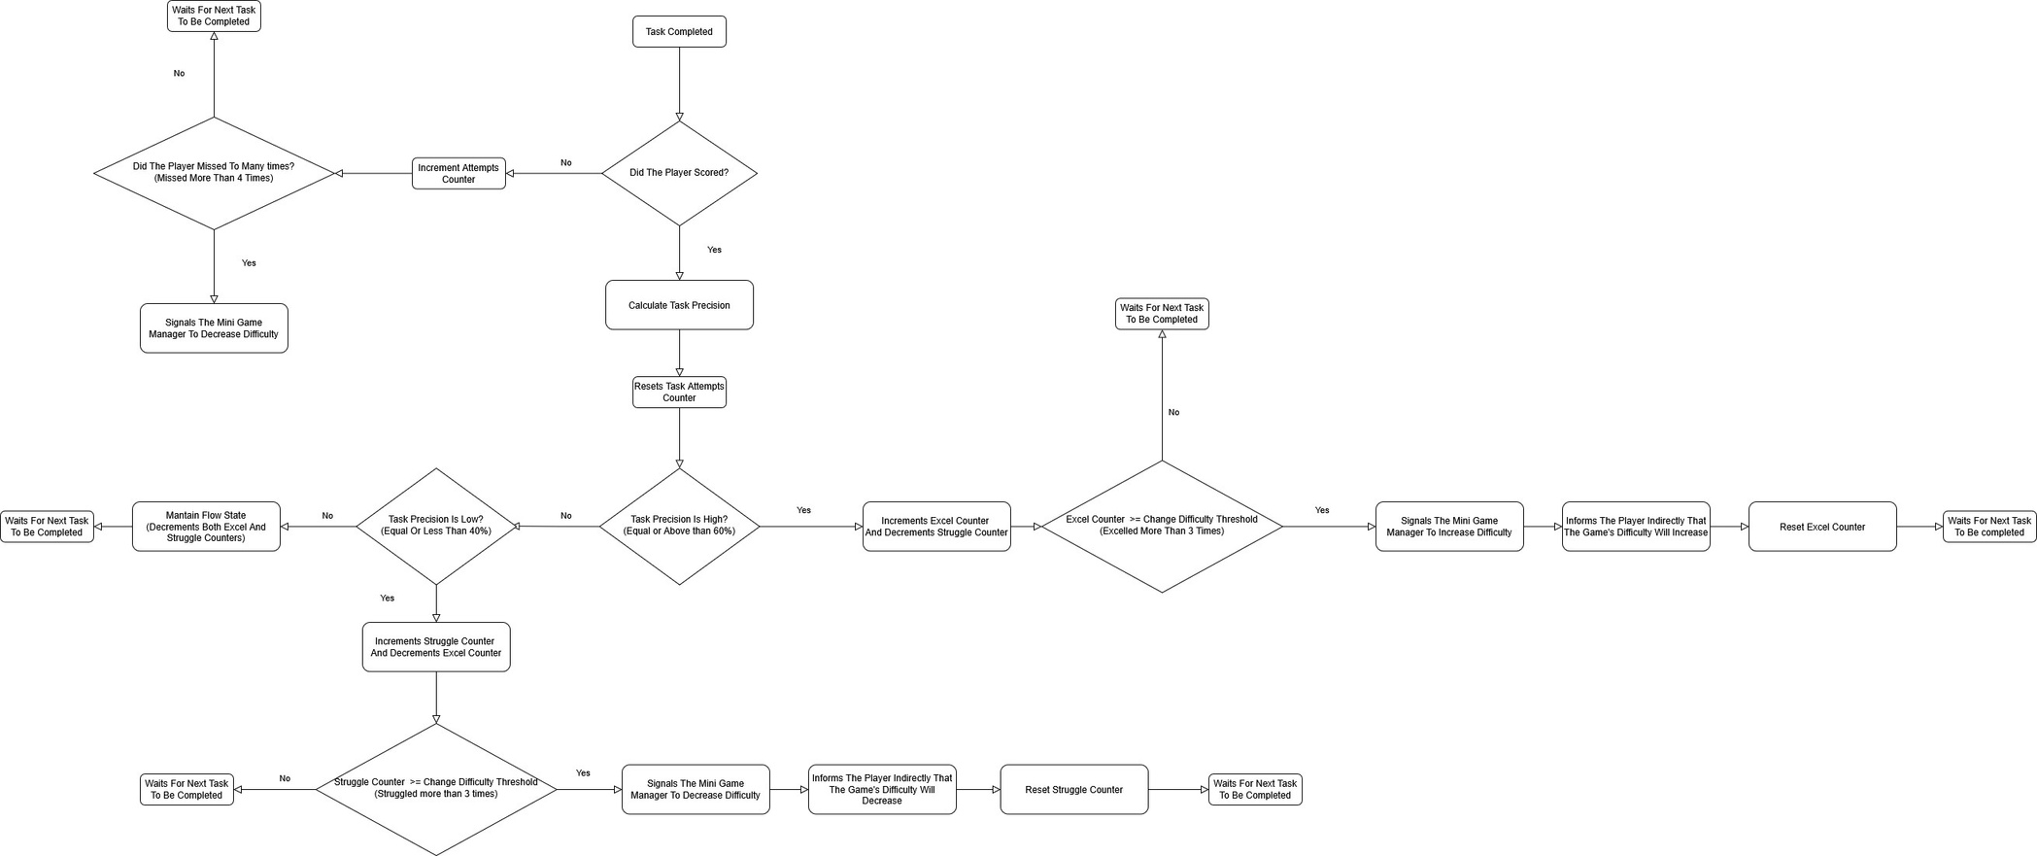
DDA SYSTEM- FLOWCHART
9

Slide 10
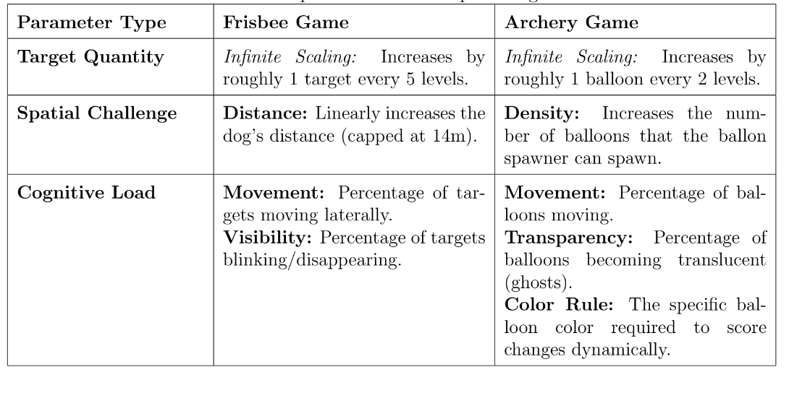
DDA SYSTEM- ADAPTIVE PARAMETERS
10

Slide 11
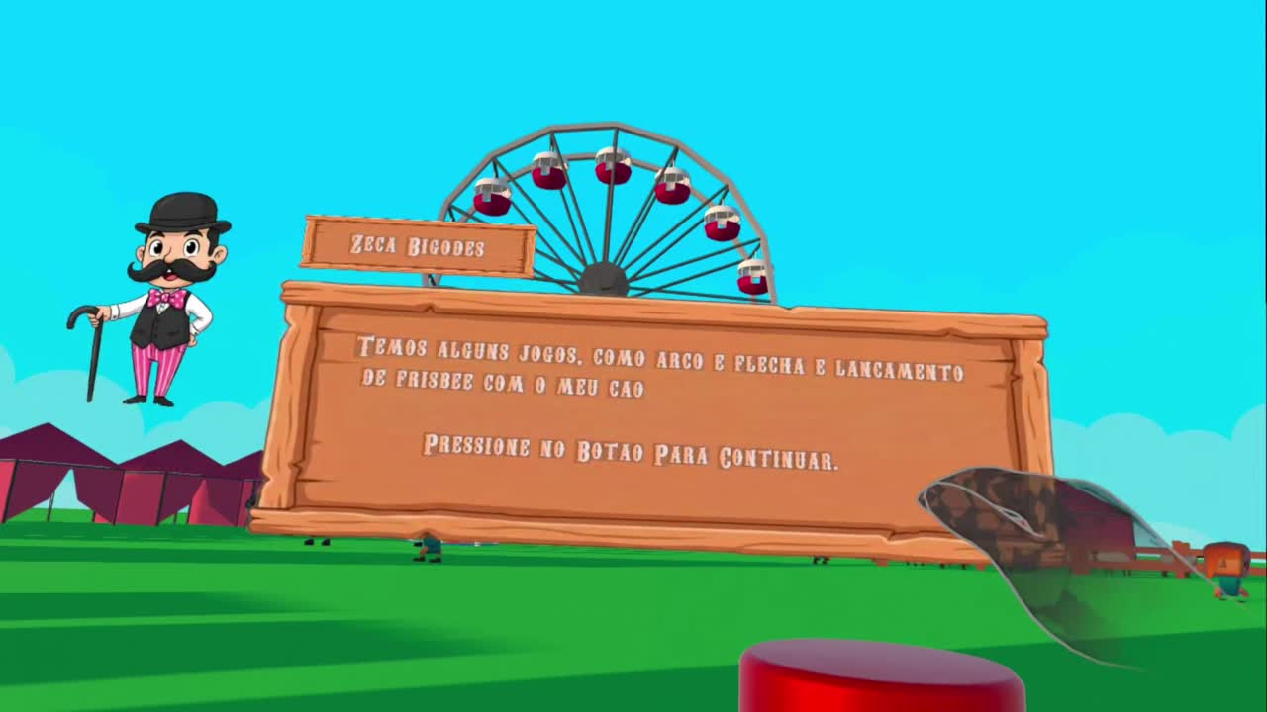
DEMO
11

Slide 12



TOOLS USED
  Software: Unity, Blender and FMOD
  Hardware: Oculus Quest 3
  Libraries: Meta Interaction SDK, FMOD Unity, DotTween,Newtonsoft
Acknowledgemnts
  Rita for her work in practical component in Virtual Reality Course
  Google: Sheep Model, Ferris Wheel Model, Tent Model;
  Quaternius: Fence Model;
  J-Toastie: Persons Models and Animations;
  sirkitree: Carnival Booth Model, Merry-Go-Round Model;
  Adam Tomkins: Grass Floor Model;
  Ian MacGillivray: Big Tent Model;
  Don Carson: Popcorn Cart Model;
  Sammy Bench Model.
12

Slide 13
USER EVALUATION - TASKS
User 1 | User 2
12s | 3s | Task 1 Select a mini game to play
5s | 8s | Task2 Return to the fair
11s | 11s | Task 3 Shoot 3 balloons
53s | 37s | Task 4 Score 1 point in Frisbee mini game
13

Slide 14
USER EVALUATION - FEEDBACK
Overall Experience:
  The mini-games were fun to play
  The users felt they were in a country fair
  Liked the sound feedback
  Felt that the mini-games needed a tutorial
14

Slide 15
USER EVALUATION - FEEDBACK
Frisbee mini-game:
  The frisbee curved to much in the direction of the throwing hand.
  Instead of going to the user’s exact position, the dog delivered the frisbee directly to the nearest outstretched hand
Archery mini-game:
  Balloon Scoring: Considers texture (e.g., metallic) and legend plates, not just color.
  The arrow sometimes launches while the string is still being pulled.
15

Slide 16
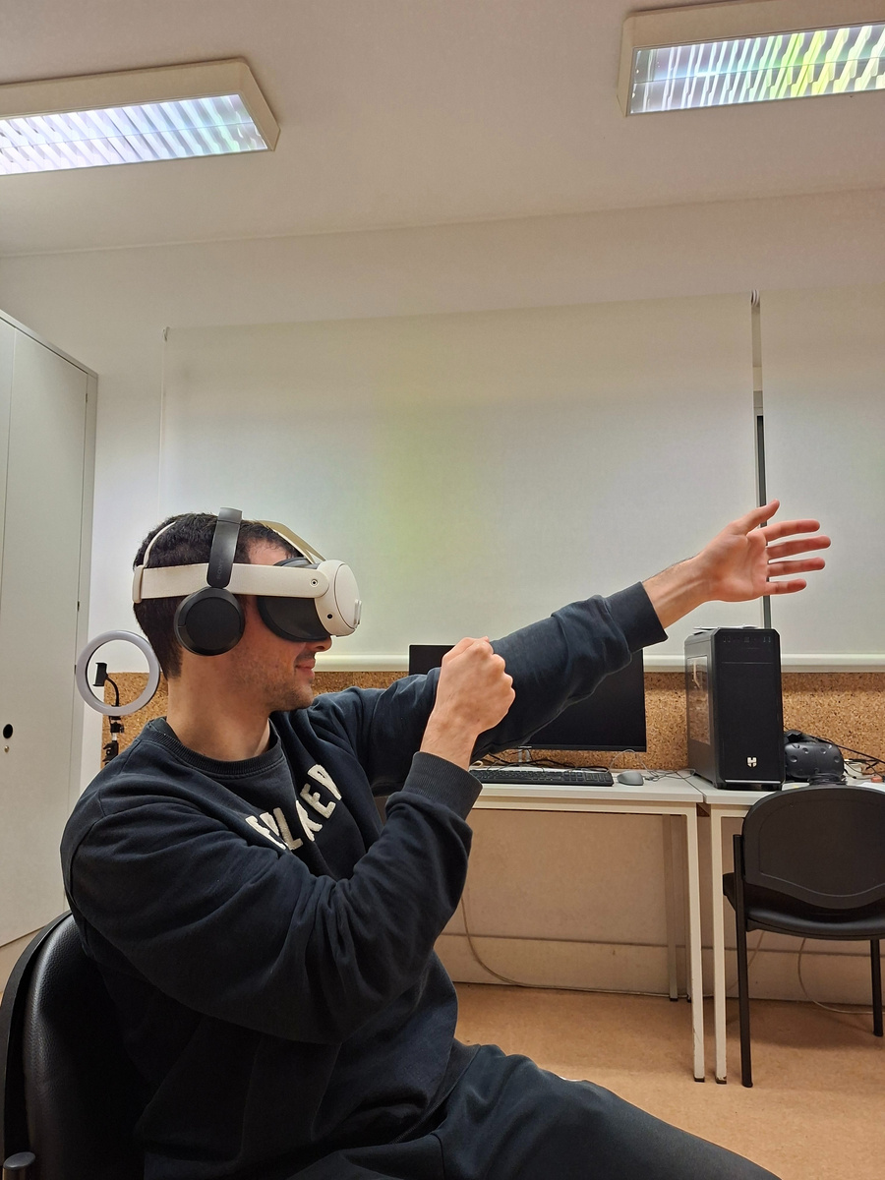
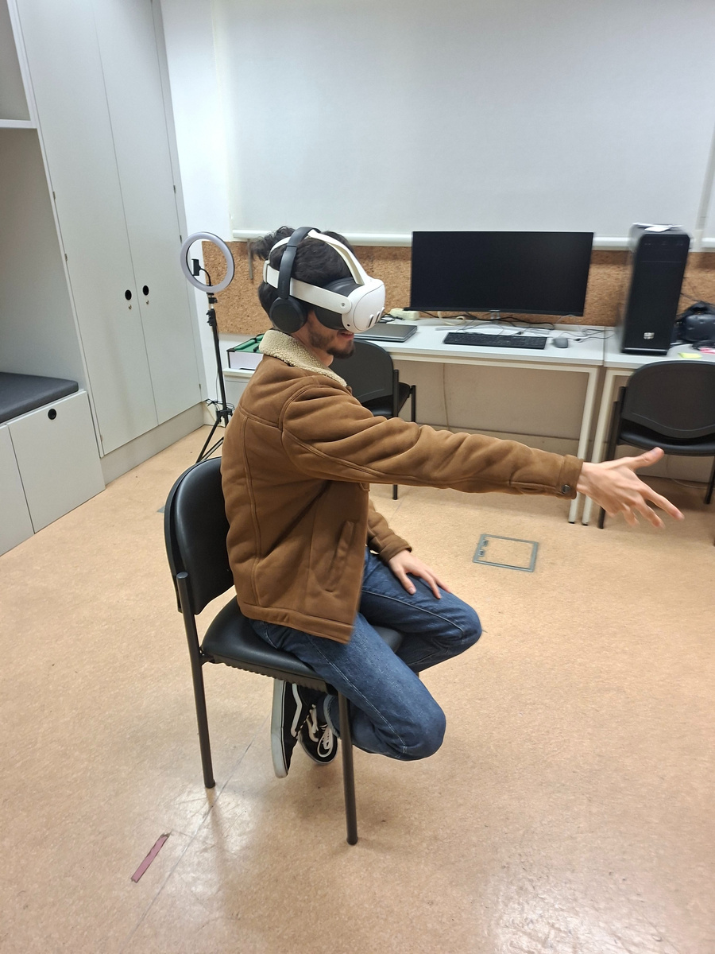
USER EVALUATION - OBSERVATIONS
  Users felt amused while playing
  1 user struggled to understand how to score a point in the Frisbee mini game
  There were no signs of any negative after effect
16

Slide 17
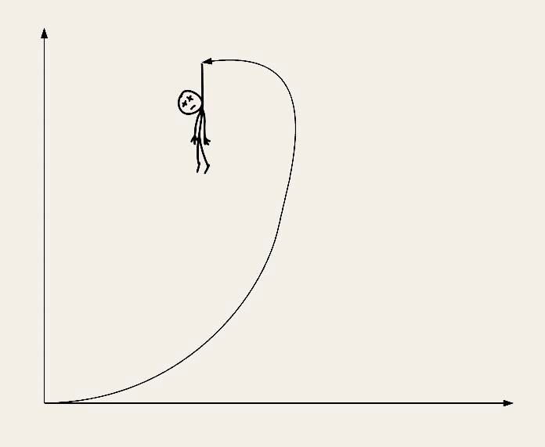
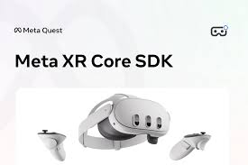
MAIN DIFFICULTIES
  Learn VR development in unity
  Hand tracking accuracy and stability
  Implementing and fine-tuning physics
  Debbuging and testing in VR
  Android Software problems (Reading JSON files)
  Find information in Meta SDK Documentation
17

Slide 18
FUTURE WORK
  Improve physics
  Improve the mini game difficulty progression
  Make user tests with target audience
18

Slide 19
Thank you!

