Slide 1


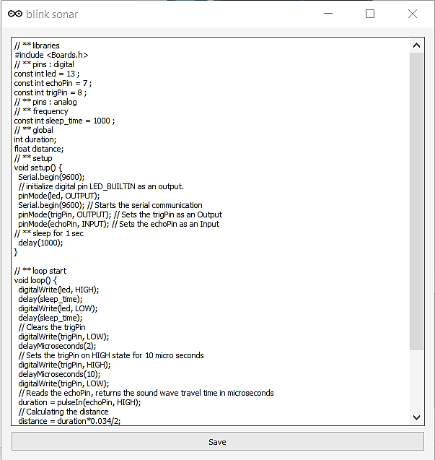
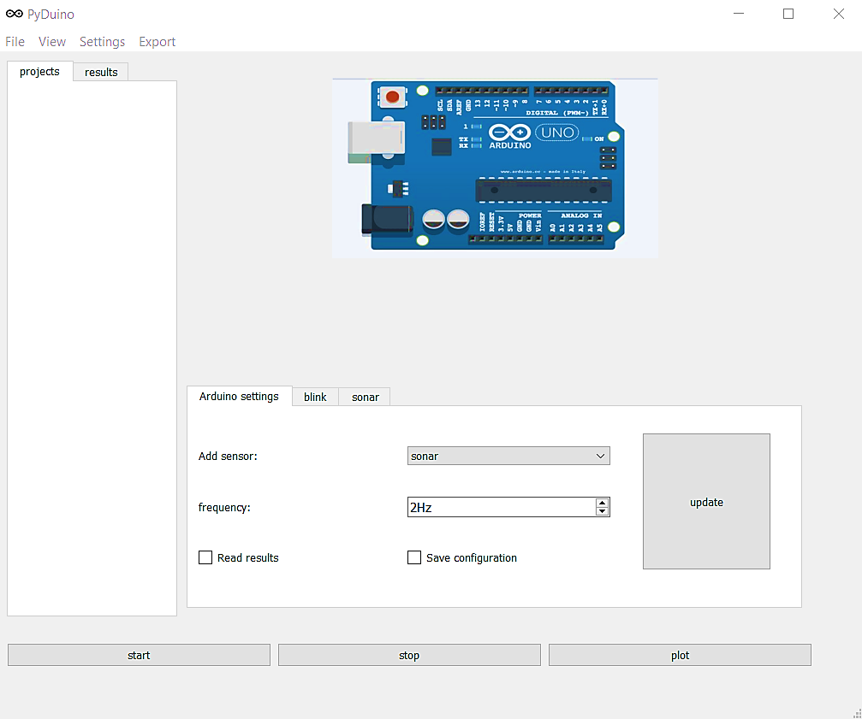
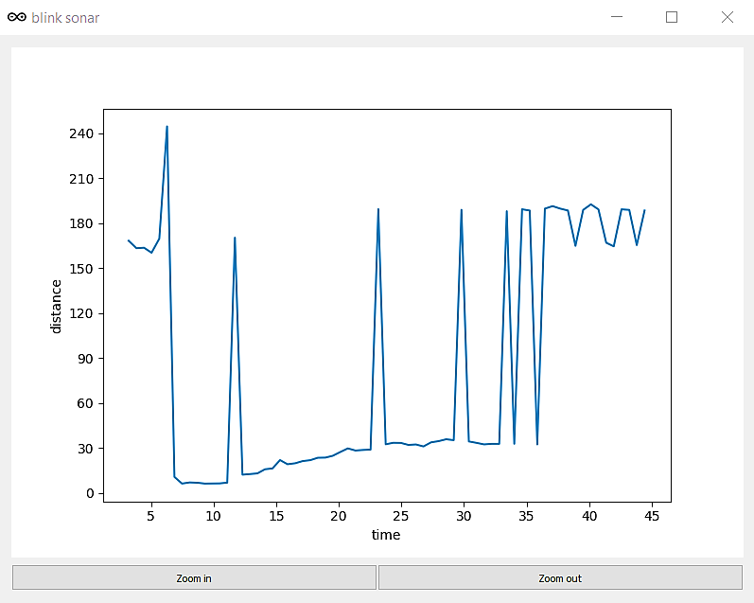
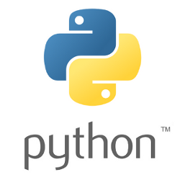
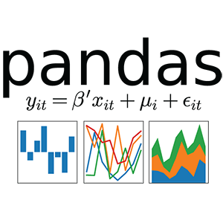
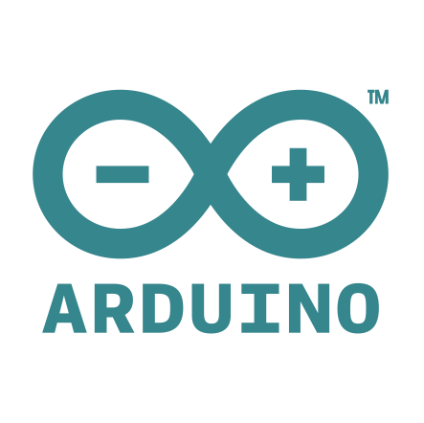

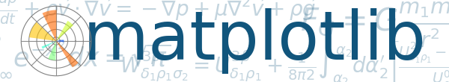
ExperiMate
Arduino experiment creator
David Peleg davidpeleg6@gmail.com
Supervisor: Noa Kurzweil
Background and Goals
Arduino is an AVR microcontroller that provides an interface for interacting with sensors.
The Arduino board is programmed using a dialect of C++ language.
Arduino provides a low-cost way for novices and professionals to create devices and experiments.
Since coding could be daunting for novices, a GUI interface is needed for quick experiment creation and extraction of data.
Back end
Create a backend API to support basic menu options such as:
compilation and upload of Arduino code.
creation of new experiments and sensors.
management of results using pandas.
Create a system to analyze code using a custom tag system and support:
Merging code of 2 or more sensors into an experiment.
Changing experiment attributes such as the sampling frequency and pin numbers.
Front end
Create a graphic interface using PyQt5 to support:
Loading and display of current and past projects.
Changing project and sensor attributes
Add a Text editor to enable quick access to sensor/project code for non-trivial changes.
Add an interface for plotting results and manipulating data using matplotlib and PyQt5
A dedicated option for adding new sensor code/project from the PC
Arduino IDE
Experiment builder interface
Result plotter

