Slide 1

. . .
Robot Market
Regulatory Body
Sales
Eng.
Domain
Expert
PM
Your supplier
Your customer
Communication
RE
Engineering
B2B
Domain
Expert
Sales
Eng.
Purchasing
B2C
Dev
Test
Sales
Internal
Your team

Slide 2
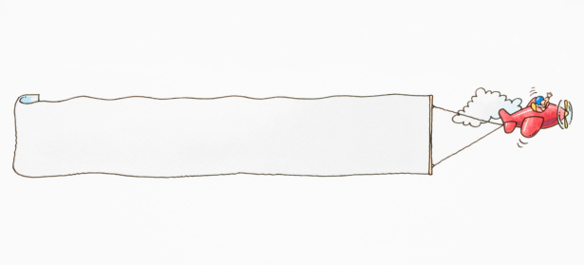

Sprint goals
Domain understanding
Sprint 1
Sprint 3
Sprint 2
RE
Team formation
Feature scoping
Marketing concept
Prototyping
Marketing
Test
Code
alpha
Evolve product
Maintain business relations
Develop Rumble strategy
Test
SRS
0.5
Marketing
RE
jar
Test
beta
Complete product
High-volume sales
Optimize Rumble strategy
Code
SRS
0.9
RE
jar
Final
Awards
Acc. test
- Rumble
- Profit
- Engineering
Test
1.0
SRS
1.0
jar
Acceptance testing
Business claims
Rumble!
Test
res

Slide 3
Engineering perspective
Domain understanding
Sprint 1
Sprint 3
Sprint 2
RE
Team formation
Feature scoping
Marketing concept
Prototyping
Marketing
Test
Code
alpha
Evolve product
Maintain business relations
Develop Rumble strategy
Test
SRS
0.5
Marketing
RE
jar
Test
beta
Complete product
High-volume sales
Optimize Rumble strategy
Code
SRS
0.9
RE
jar
Final
Awards
Acc. test
- Rumble
- Profit
- Engineering
Test
1.0
SRS
1.0
jar
Acceptance testing
Business claims
Rumble!
Test
res

