Slide 1
Water Gun Sentry Turret
Sophia Harrison and David Purdy

Slide 2
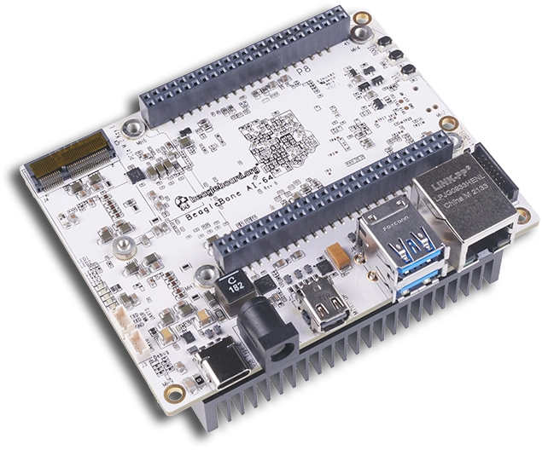
Project Features
BeagleBone AI-64
Facial Recognition used to detect an open mouth
Servo motor used to angle the water gun arm
Stepper motor rotates the platform
Relay used to fire water pump

Slide 3

Project Demo

