Slide 1

A semi-supervised pipeline for a comprehensive and scalable analysis of immune heterogeneity in human samples
by David Rach
UMGCCC Flow Cytometry Shared Resource
June 9, 2026

Slide 2
SFC is awesome!
Whether 20 markers or 60, ability to rapidly acquire millions of cells in minutes.
expanding our understanding human immunology, potential for biologica characterization rarer subsets,
particularly invaluable for clinical specimens limited biospecimen.

Slide 3
Cross-roads deal with the devil
Elephants in the room.
Uncertainty ~ marker "abundances",
everything affect, tandem degradagtion, non-speicifc, af variation, coexpression.
Caution in attributing to biology what could be technical artifact in these large panels.

Slide 4
No cell left behind
While if you are interested in a single cell population, the analysis remains essentially the same,
there is one area I have constantly grappled with over my PhD.
Namely, if we acquired 7 million cells to characterize 100 of our rare population, what is occurring in the rest of the cells.
Especially if for a rare clinical cohort.

Slide 5
Unsupervised
Unsupervised analytical methods have often been touted as the solution, but in their current implementation, are they fully leveraging the entirety of our unique datasets?
Or are they confined to skimming the surface.
Similarly, we cluster, is the statistical test even biologically relavent if three distinct groups of cells ended smooshed together.
And if our datasets have MFI batch effects, how reliable would they perform.

Slide 6
Where does a cell population vs. flavor begin
Because at the end of the day, when it's 3 AM, I step back.
On a spectrum, our discussions about clusters and metaclusters revolve about where we draw the lines.
On one end every cell is in a cluster with itself.
On the other everything is in the same cluster.

Slide 7
Every Panel Differs
Every panel, depending on our markers, has an ability to define cell populations that are present up to a certain point.
And various groups have previous implementations of trying to corral cells of these phenotypes for biological insight.

Slide 8
Just want to do the dataset justice
At the end of the day, I want to leverage the clearest insight out of my panel.
Just like I make my single-color controls each time because I don't want to spend hours after the fact trying to make things work,
I don't see the point of clustering only to spend hours laboriously re-glue-ing things back together. (too much, tone it back?)

Slide 9
Cohort
We are working with a cohort of malawian infants, well stratefied HIV and ART exposure.
- Cryopreserved
- 0,4,9 months
- Using a 32-fluorophore panel, intranuclear, high AB co-expression markers for cytokines and AIMs.
- Rested 6 hours, stimulated w PPD, SEB, w/o golgi for 3, with golgi for 9 hours.
- Acquired 5-laser cytek Aurora passed QC

Slide 10
Pipeline
- Our analysis pipeline has evolved since our previous papers. Previously mainly FlowJo, increasingly in R, with skeleton elements of Rust taking over performance behind the scenes. However, still traditional cytometrist, so interconversion is critical.
- Pre-Unmixing, we are using Luciernaga to screen our unmixing control signatures. Visualizing across time, pinpoint bad controls and remove. Similar approach for which samples are getting beads vs. cells.
- Screening with PeacoQC, originally R version, but James Moyihan's Rust implementation is sweet!

Slide 11
Pipeline
- Automated Gating to Cell Subsets: openCyto (mainly mindensity with a lot of gate_range arguments), but also flowMagic (both our own GatingSet implementation, but with sebastianos last update going his route).
- Using the old Cytoverse docker container to go from a GatingSet back to FlowJo v.10 workspace to allow for corrections by traditional flow cytometrist.
- Coereba: newer R packages. Main idea is on a per-cell basis defining a identity column that encompasses all the manual gated definitions for every marker interest. This then travels and can be used to cross-check assumptions for the dimensionality visualizations

Slide 12
Pipeline
- Run openCyto mindensity, check, constrain. We interactively update the placements via a Shiny App. Then Coereba is run
- Once column is incorporated, we can normalize. Trying CytoNorm and CyCombine, using a single-donor thaw specimen for each experiment. If anyone has suggestions, open, since so far results have been mixed. Typically applying at the cell node level rather than the whole file.
- Point, choosing to either downsample for larger pops, or concatenate entire population.
- Dimensionality Viz - UMAP or PaCMAP via Python

Slide 13
Pipeline
- Gate on "clusters/islands/pick-your-terminology", process of CoerebaID incorporation is reversible, and we retrieve/rederrive the proportion cells from each donor that ended up in the area that were positive or negative for each marker.
- Likewise, these outputs get incorporated into Bioconductor SummarizedExperiment object, allowing for filtering, renumeration, and passing to downstream statistical analysis packages.
- As suspected, not all dimensionality methods are separating down to pure populations when visualized.
- However, we can quickly iterate out the marker expression plots for an individual specimen.

Slide 14
Enough to anger both sides
- Enough to anger both sides of the automated gating vs. unsupervised clustering camps
- Strong emphasis at the moment on exploratory data analysis.
- No stand at this point on where to draw the clustering continuum
- Individual nodes are too noisy for standard tests
- Off-target uses are those that are fascinating, more programmatic outputs that not have in typical flow cytometry analysis

Slide 15
Targeting more difficult questions
- Identify freezer burned specimens otherwise would have included.
- Overnight staining vs. day of, differential population loss?

Slide 16
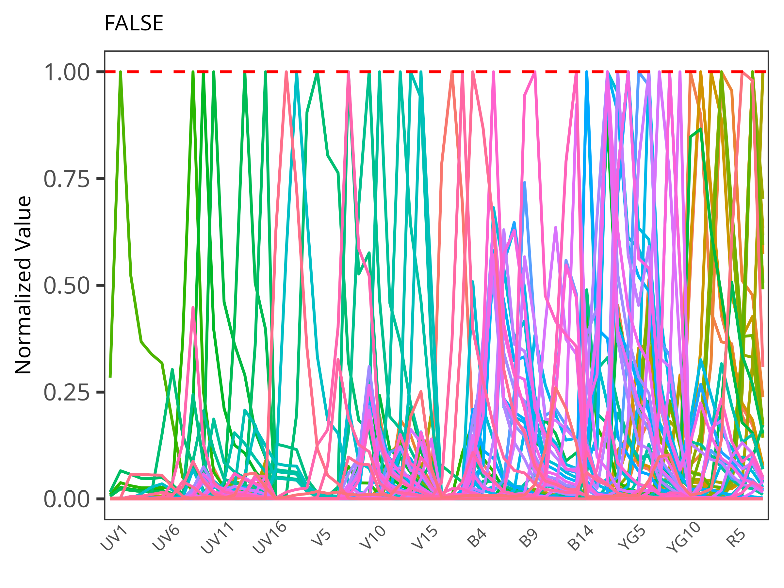
Spectral Flow Cytometry (SFC) is awesome!
Capacity to resolve spectrally similar fluorophores: greater number markers per panel than Conventional Flow Cytometry (CFC)
Faster acquisition speed: typically far more cells per .fcs file than Mass Cytometry (MC)
Analytical breadth and depth permits characterization rare cell populations (and potentially millions of other non-target cells)
Invaluable for human clinical samples with limited biospecimen

Slide 17
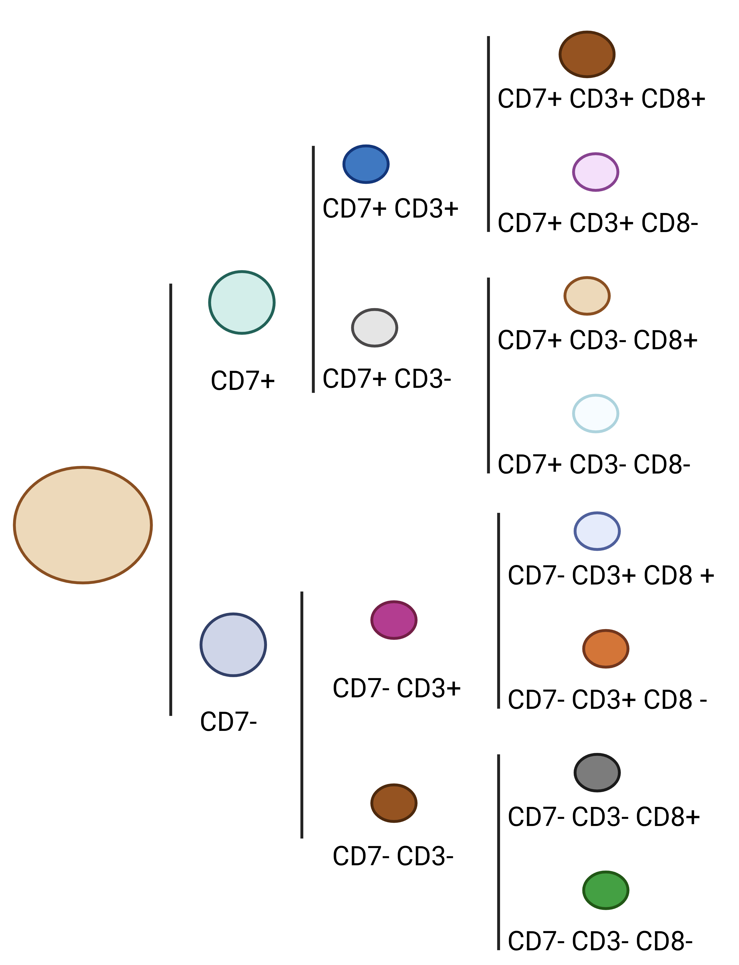
Complex Datasets, Combinatorially Exponential Clusters
If you are interested in a single population of cells, analysis process remains essentially unchanged.
If your goal is to characterize all cell populations that may be present, the breadth and depth complicate the analysis.

Slide 18
Complex Datasets, Combinatorially Exponential Clusters
If you are interested in a single population of cells, analysis process remains essentially unchanged.
If your goal is to characterize all cell populations that may be present, the breadth and depth complicate the analysis.
If we step back, and consider for a given marker:
- We split cells positive and negative populations
- Repeat the splitting process for every marker
- Group cells that have shared expression of every single marker
- Theoretical upper number of clusters would be 2^{n}

Slide 19
Complex Datasets, Combinatorially Exponential Clusters
If you are interested in a single population of cells, analysis process remains essentially unchanged.
If your goal is to characterize all cell populations that may be present, the breadth and depth complicate the analysis.
If we step back, and consider for a given marker:
- We split cells positive and negative populations
- Repeat the splitting process for every marker
- Group cells that have shared expression of every single marker
- Theoretical upper number of clusters would be 2^{n}
9-color CFC panel: 512 clusters at most
40-color SFC panel: 1.09e+12 clusters at most

Slide 20
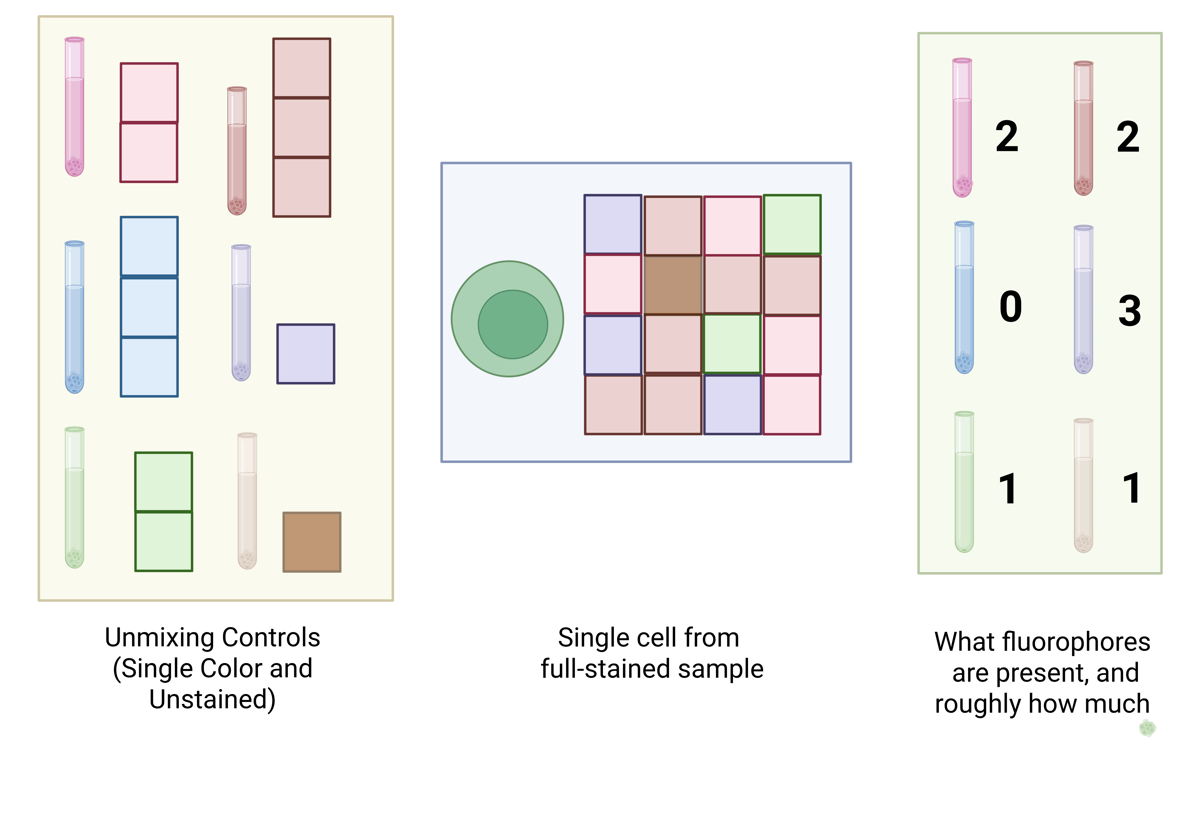
A crossroads deal with the Spectral Signature Devil
Consequently, there is a need for semi-supervised and unsupervised algorithmic analytical approaches
Immense potential for biological discovery, but at the cost of a major trade-off
Quality of our final data depends on our ability to infer the fluorophores present on individual fully-stained cells
How closely the fluorescent signatures of our unmixing controls (single-color and unstained) match the spectral signatures as present on the full-stained cells is critical to this final data quality.

Slide 21
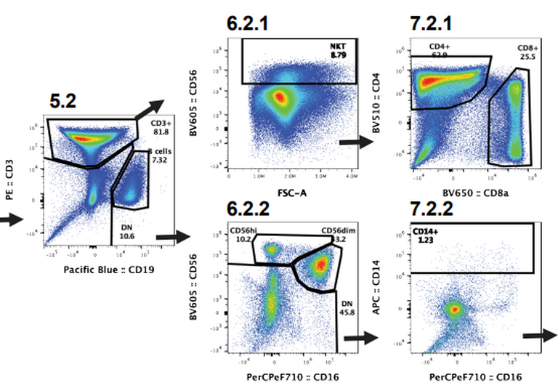
“We discovered this new dendritic cell cluster….”

Slide 22
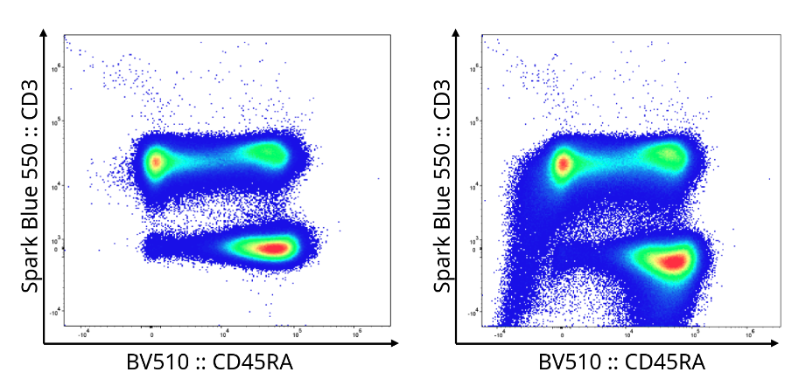
More unmixing errors, more downstream batch effects
Despite the critical importance unmixing controls play, few tools permit us to determine quality of the individual control before unmixing occurs
Existing quality control algorithms (PeacoQC, FlowAI, etc.) primarily focus on detecting laser and fluidic issues in already acquired .fcs files
Unmixing errors can be introduced by tandem degradation, additional autofluorescences, undiagnosed instrumental issues, etc.
Unmixing errors contribute to batch effects, and require complicated troubleshooting to be able to proceed with the downstream analysis

Slide 23





Open-source tool sets specifically for Spectral Flow Cytometry’s quirks
Spectral Signature Characterization and Isolation
Automated Instrument
Quality-Control Dashboards
Semi-supervised analysis via incorporation of manually-annotated gating information

Slide 24
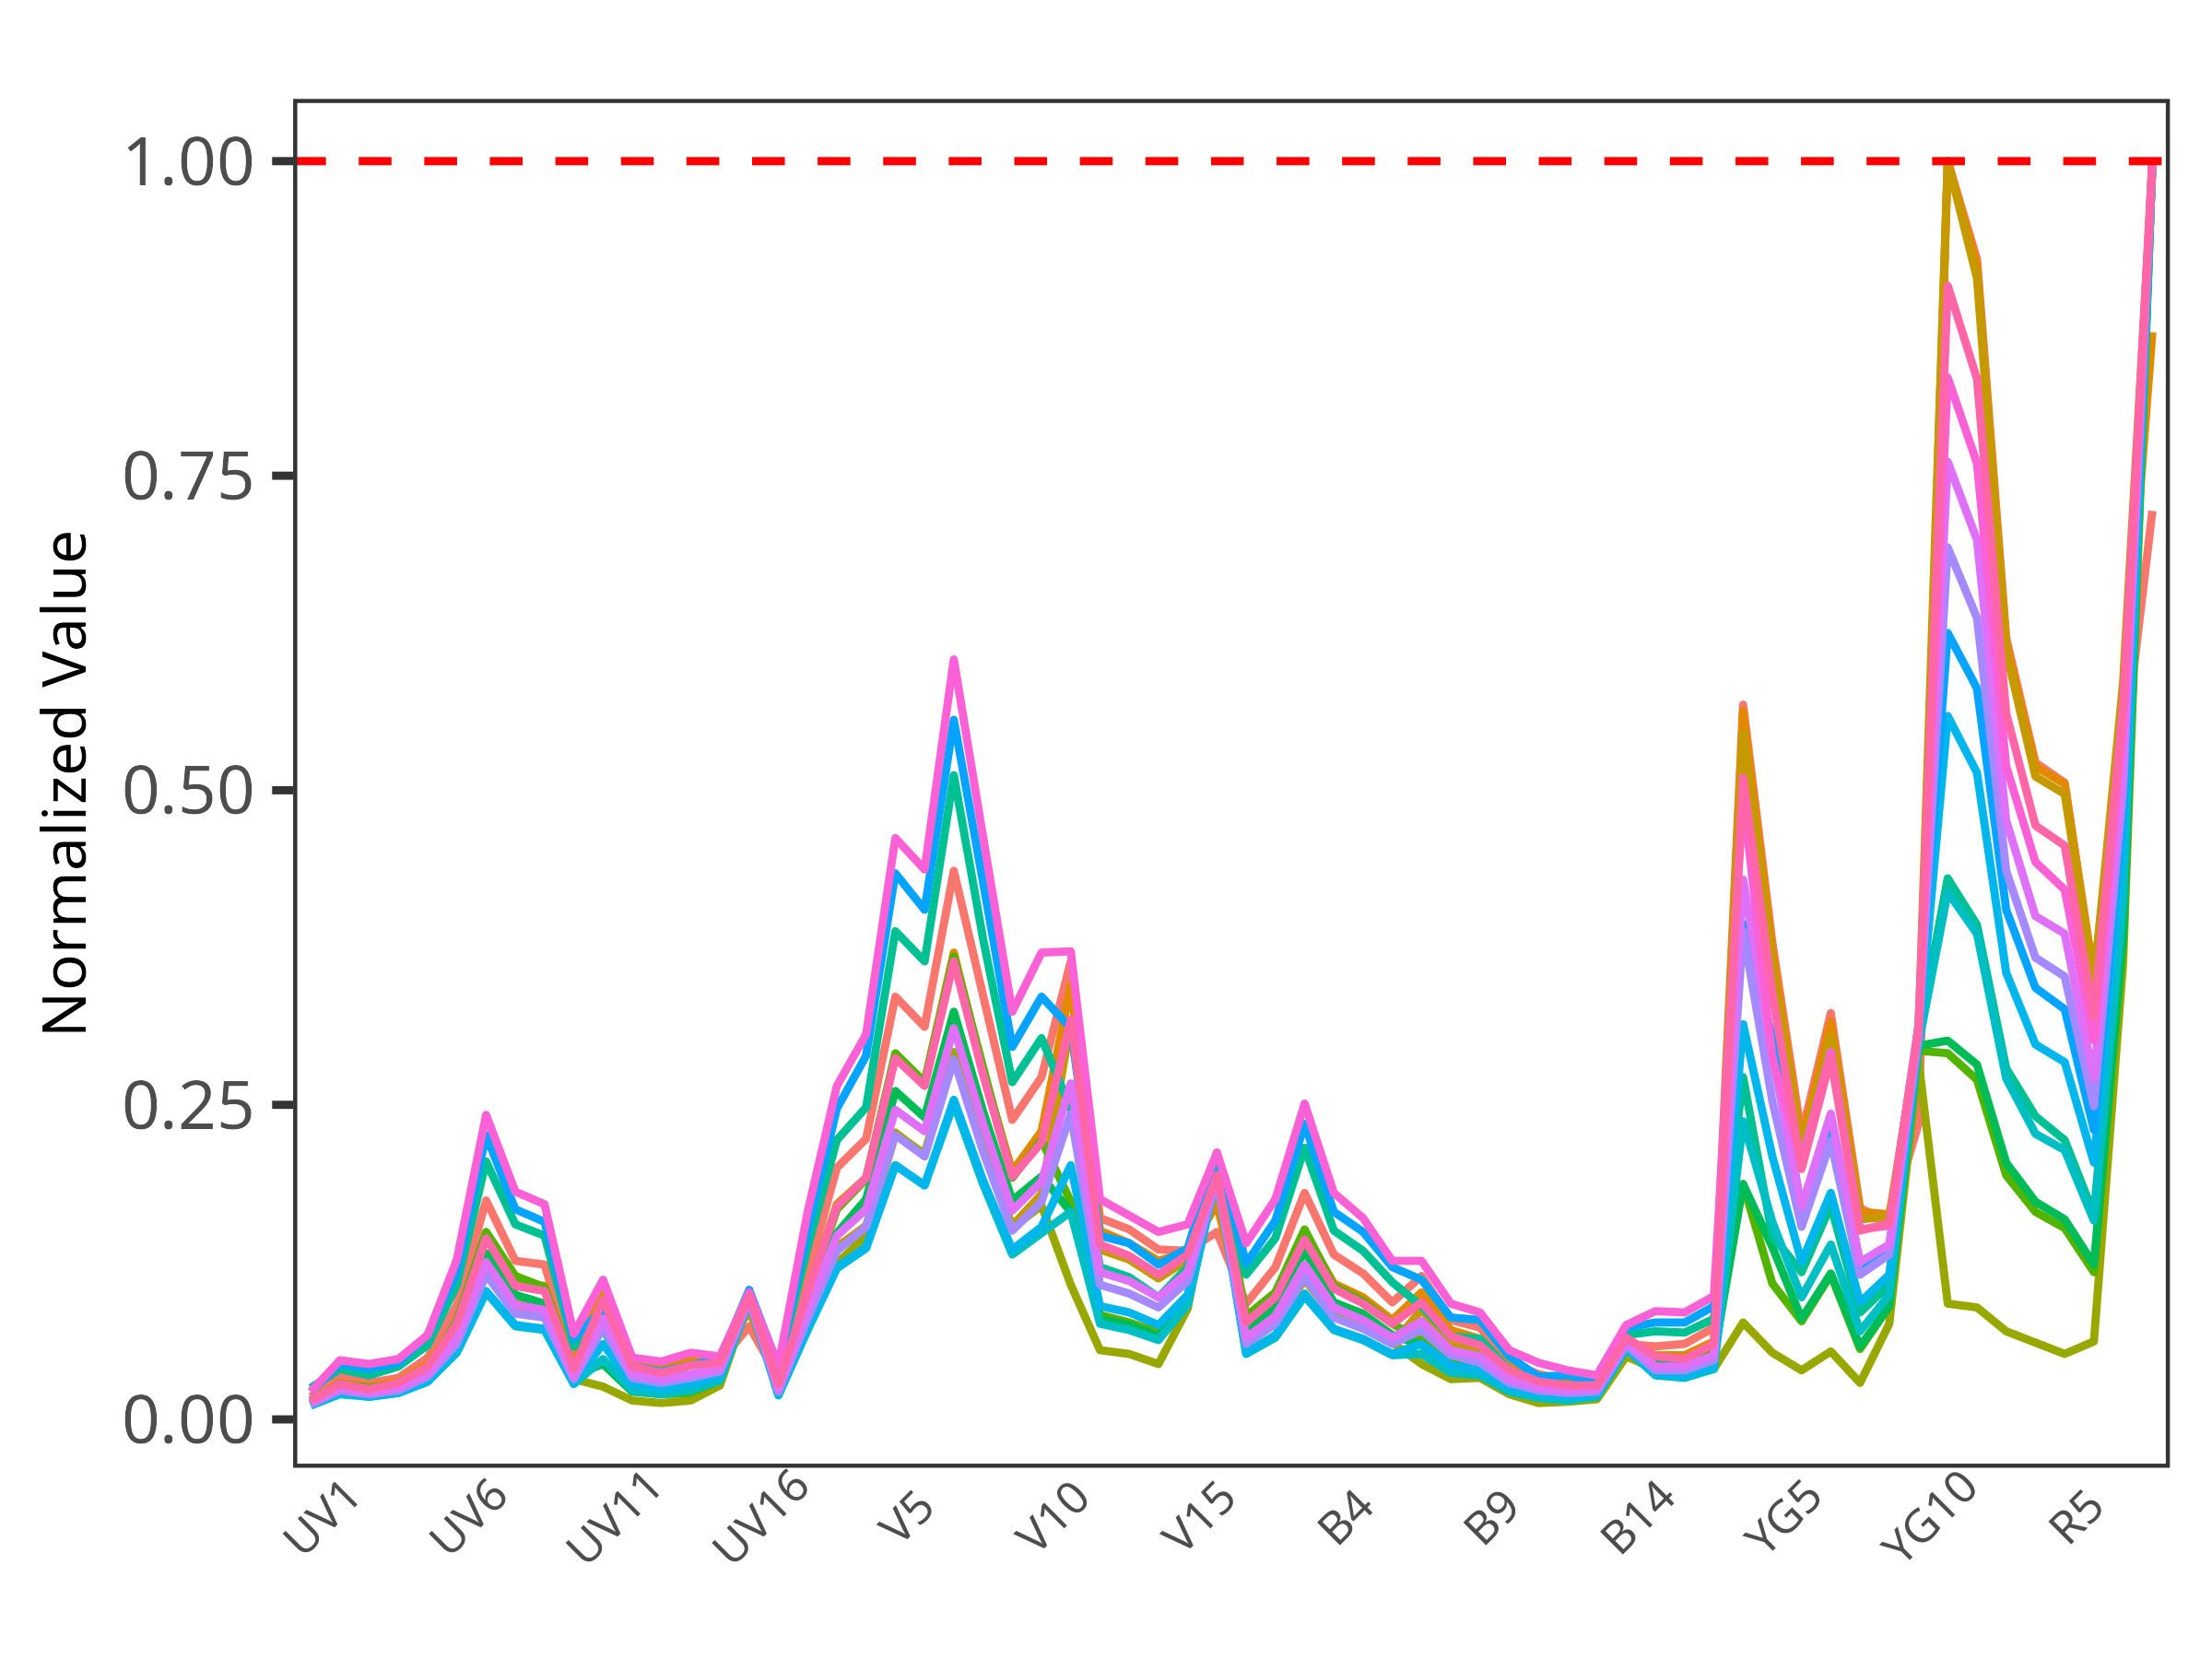
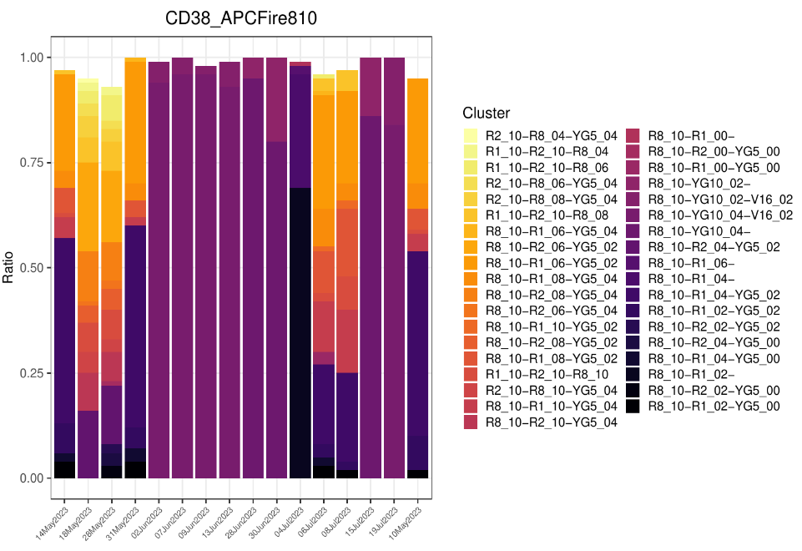
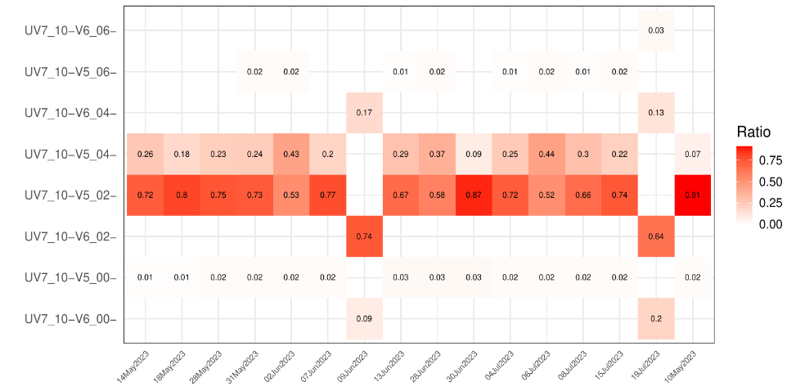
Spectral Signature Characterization and Clustering
For individual cells, it characterizes the cell’s normalized fluorescent signature
Cells that share normalized spectral signature peaks at individual detectors are then clustered
Fluorophore vials in good condition: we retrieve few normalized signatures from the raw .fcs file for each single-color unmixing control
When the tandem fluorophore decouples or degrades, noticeable increase in variant signatures, flag the issue
Setting up automation to retrieve and process reference controls for individual users experiments during off-hours

Slide 25
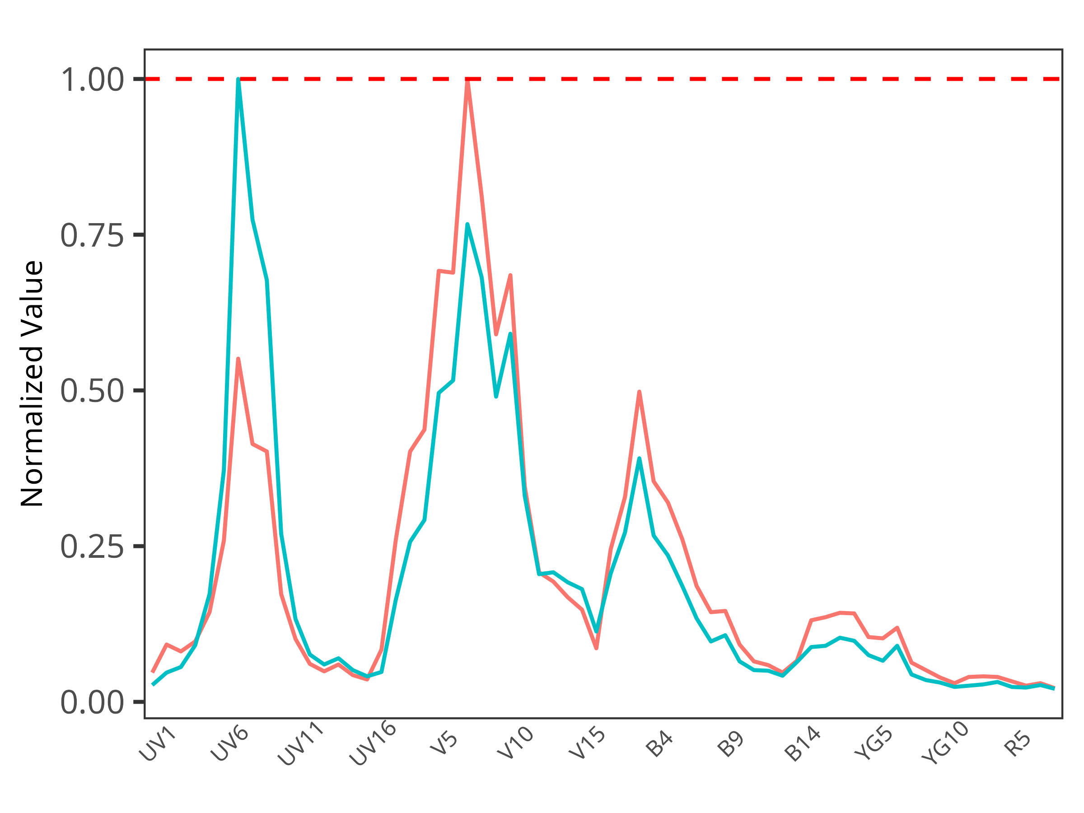
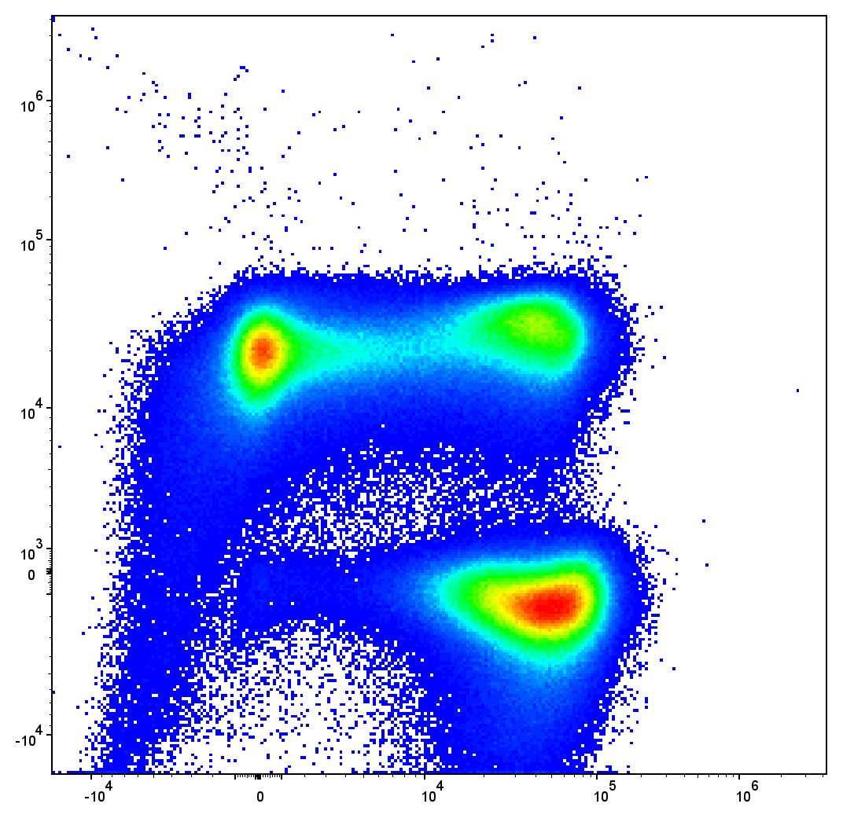
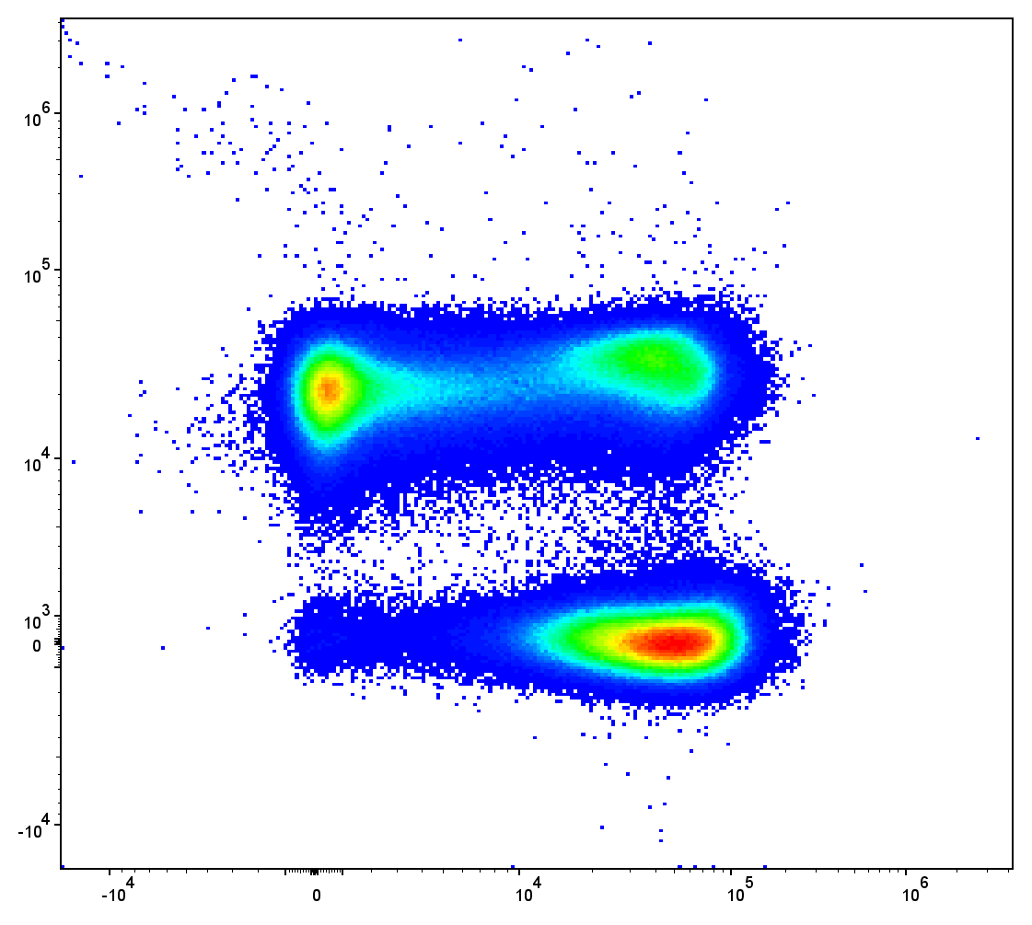
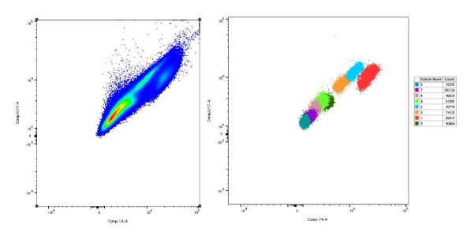
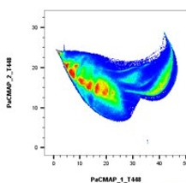
Automated isolation of autofluorescence signatures
Adapt this appproach to isolate out
normalized autofluorescence signatures
from unstained controls
Create .fcs files with purified autofloresence signatures, to use for unmixing with commercial software.
Isolated cells share same normalized signature, only differing in brightness, unlike the current Autoflorescence Explorer or gating a dimensionality-visualized island style approaches to autofluorescence isolation

Slide 26
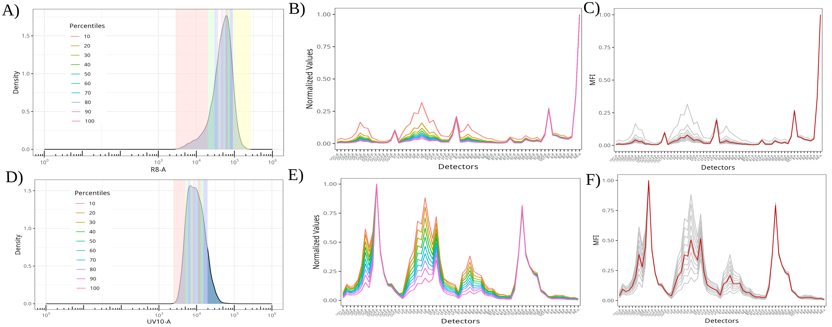
Residual Autofluorescence peaks in Single-Color Signatures
For cell controls with a moderate density antigen on bright fluorophores, we see that any
residual autofluorescence contributes minimally to the overall isolated single-color signature
when gated according to best practices

Slide 27
Residual Autofluorescence peaks in Single-Color Signatures
For cell controls with a moderate density antigen on dim fluorophores, we see substantial
residual autofluorescence contributions to the isolated single-color normalized signatures even
when gated according to best practices

Slide 28
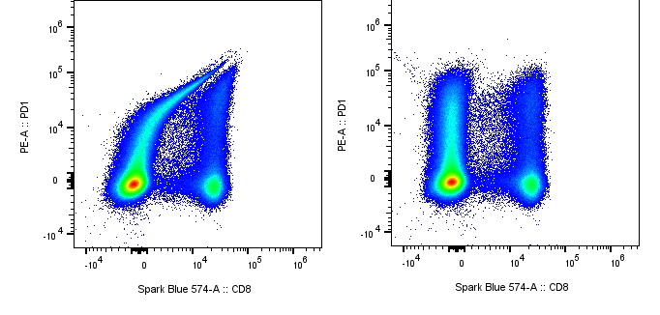
Residual Autofluorescence peaks in Single-Color Signatures
PE signature with
residual AF
PE signature without
residual AF
This residual autofluorescence contribution results in unmixing errors,
and the panel unmixing significantly improved when switched out for bead controls

Slide 29
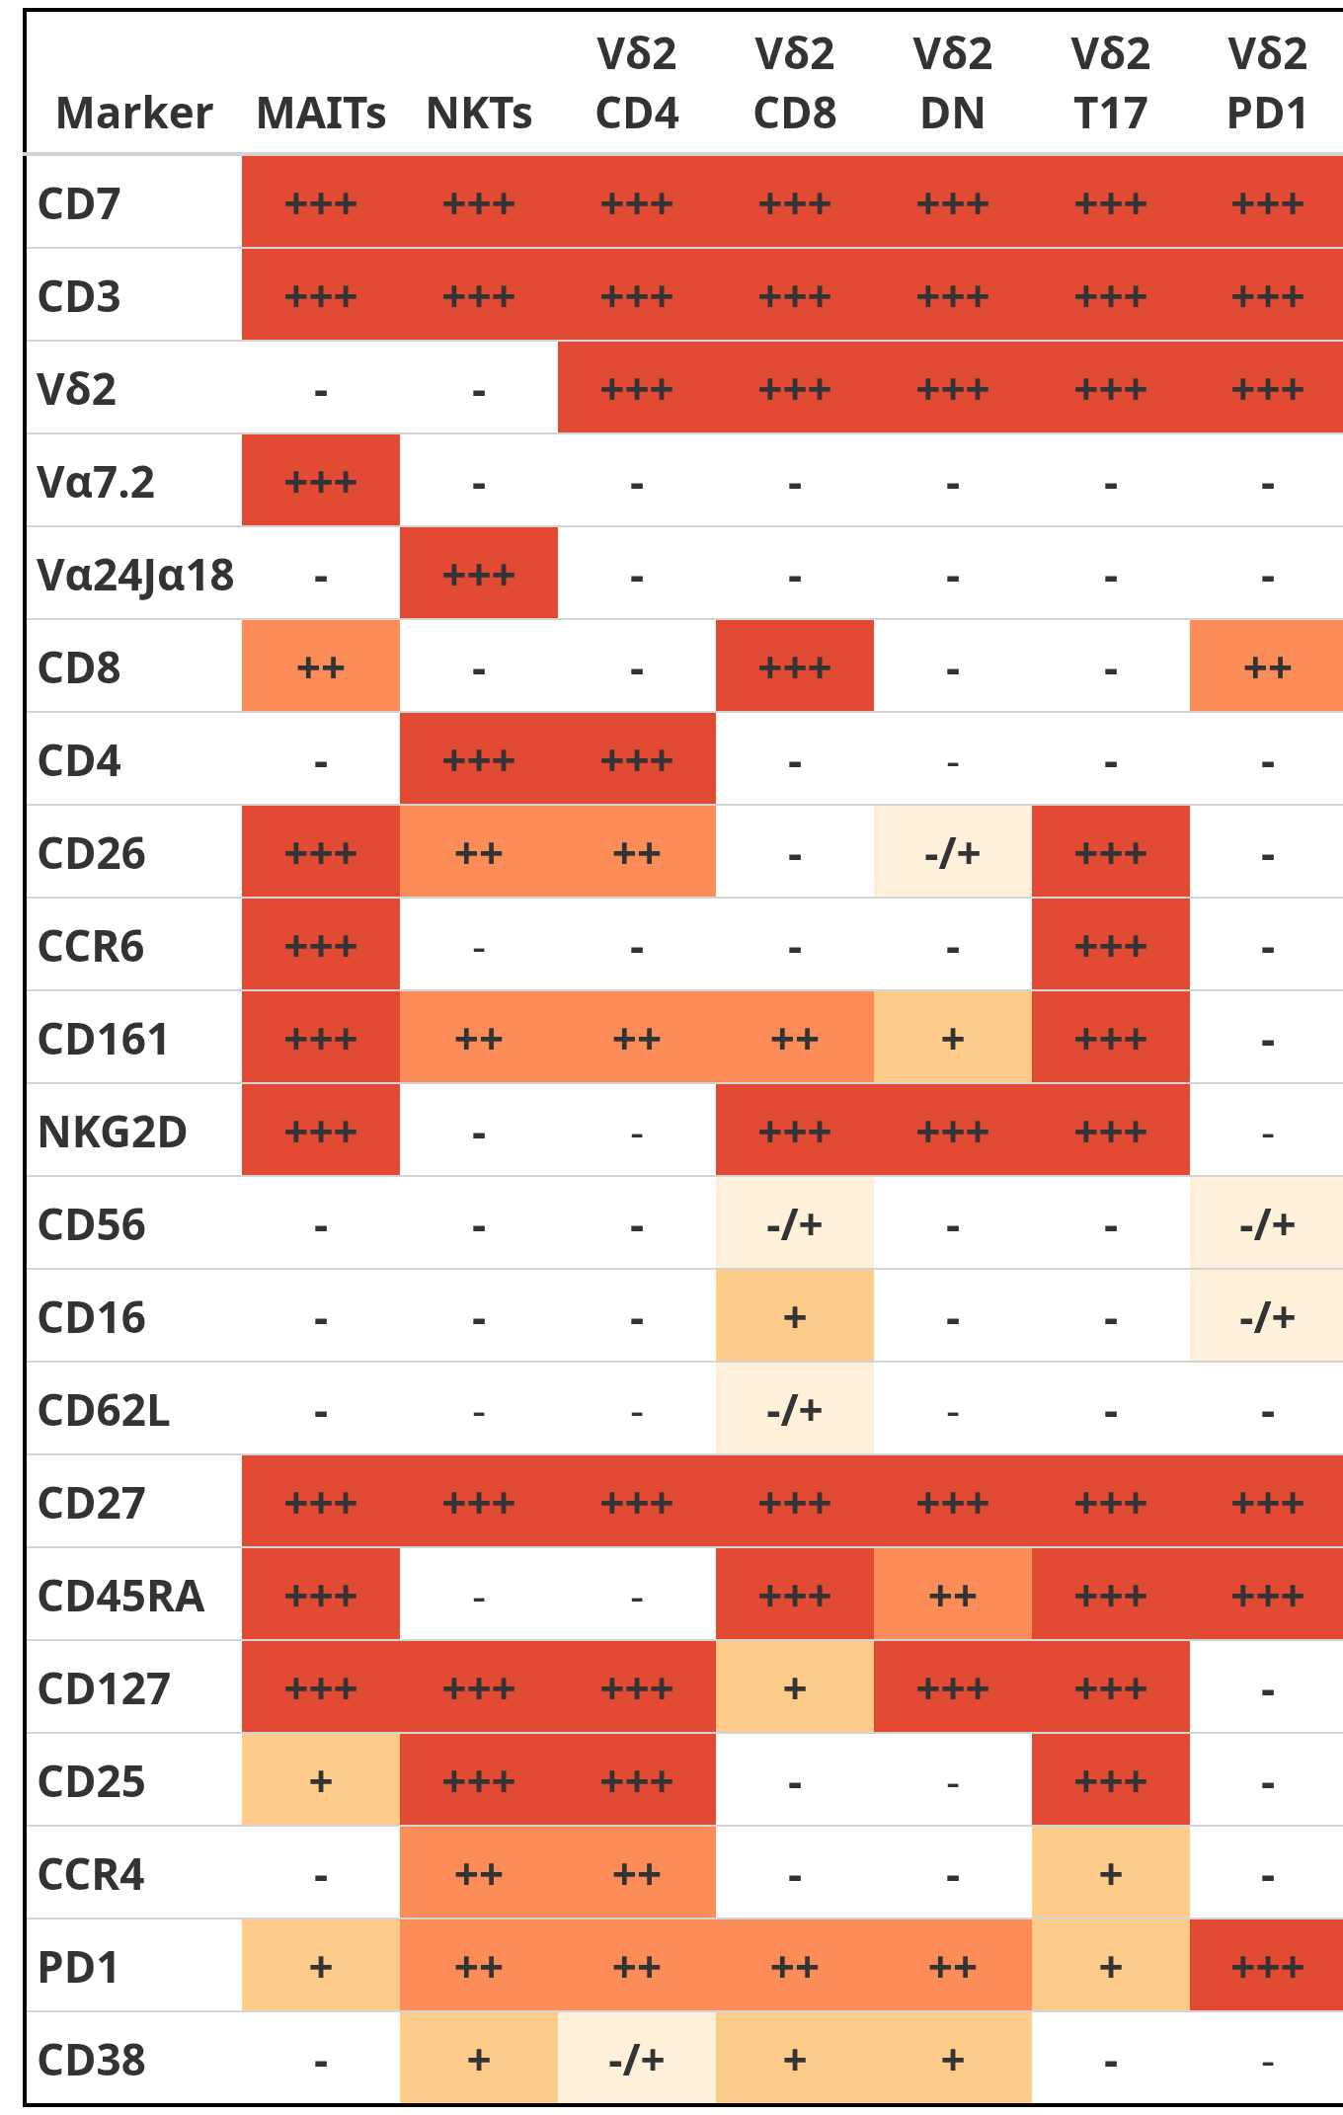
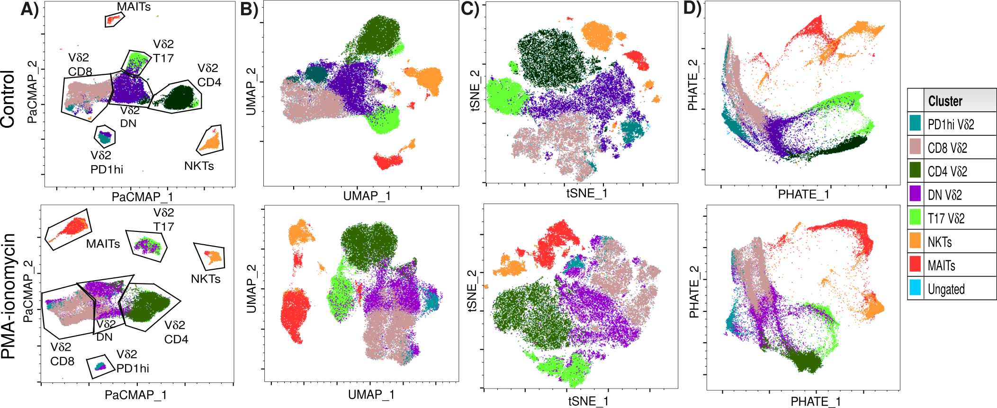
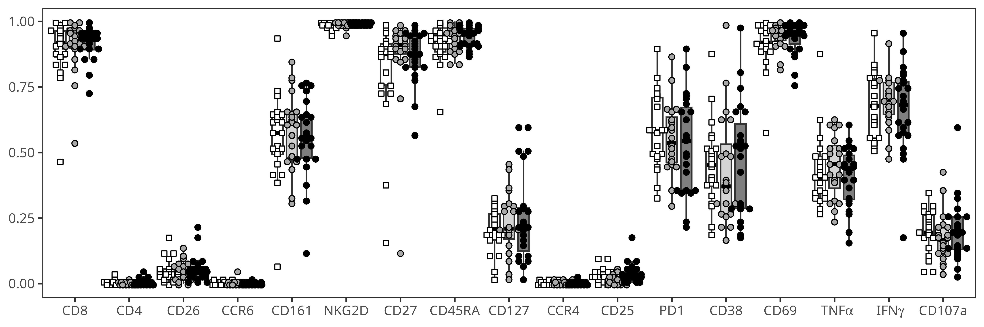
Semi-supervised analysis by annotating in manual gates
Comprehensive automated manual-gating information is appended to individual cells in an .fcs file
Can be passed to unsupervised algorithms for quality control, normalization, clustering, dimensionality visualization
Can retrieve underlying supervised gating information afterwards

Slide 30
Current Status
All packages are available via our GitHub
Fixing bugs and updating documentation
Submitting Bioconductor this year

Slide 31
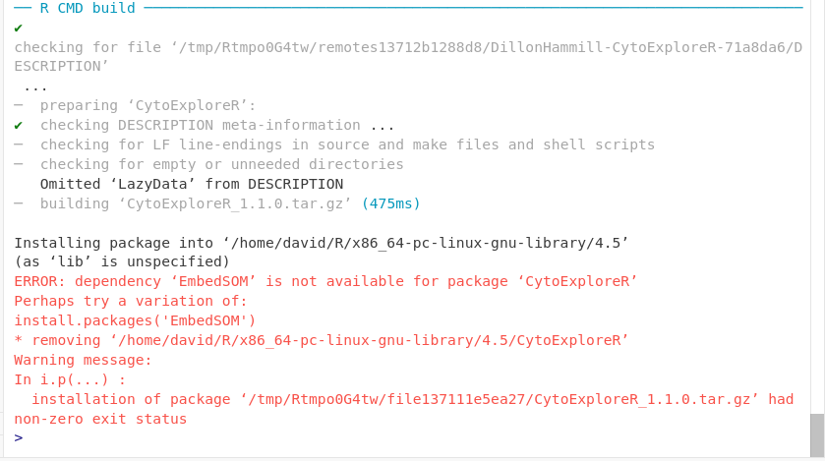
Current Status
All packages are available via our GitHub
Fixing Bugs and updating Documentation
Submitting Bioconductor this year
What good is a tool that the community can’t use?

Slide 32
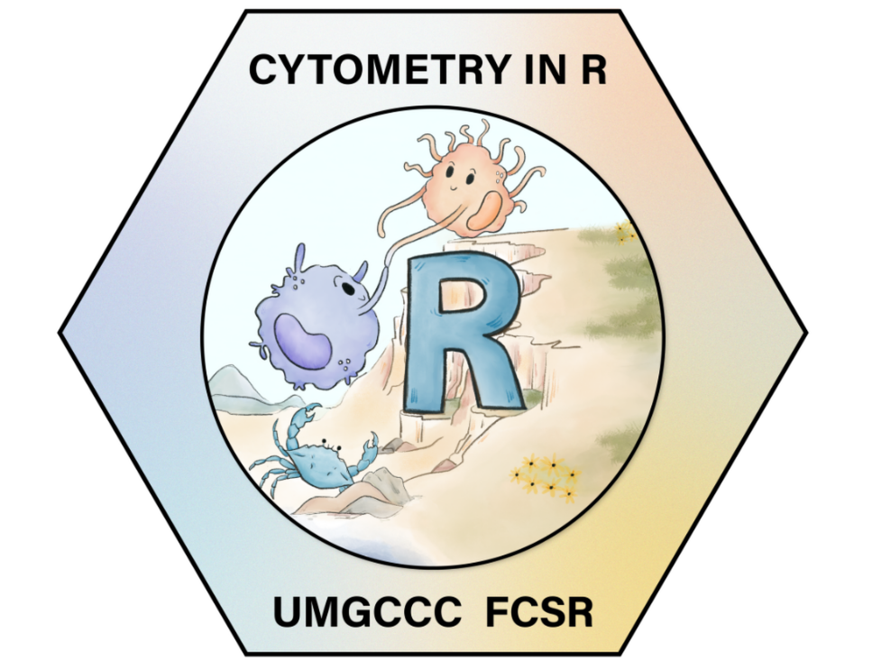

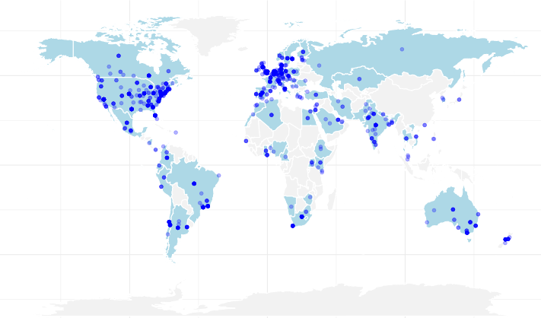
Free weekly Cytometry in R course, offered both in-person and online via YouTube livestreams.
Aimed at those with prior cytometry experience,
but no-to-little coding experience
Started in February, will be exploring from beginner to advanced topics for at least 30 weeks
Around 2000 interest forms completed, between 300-500 weekly participants

Slide 33
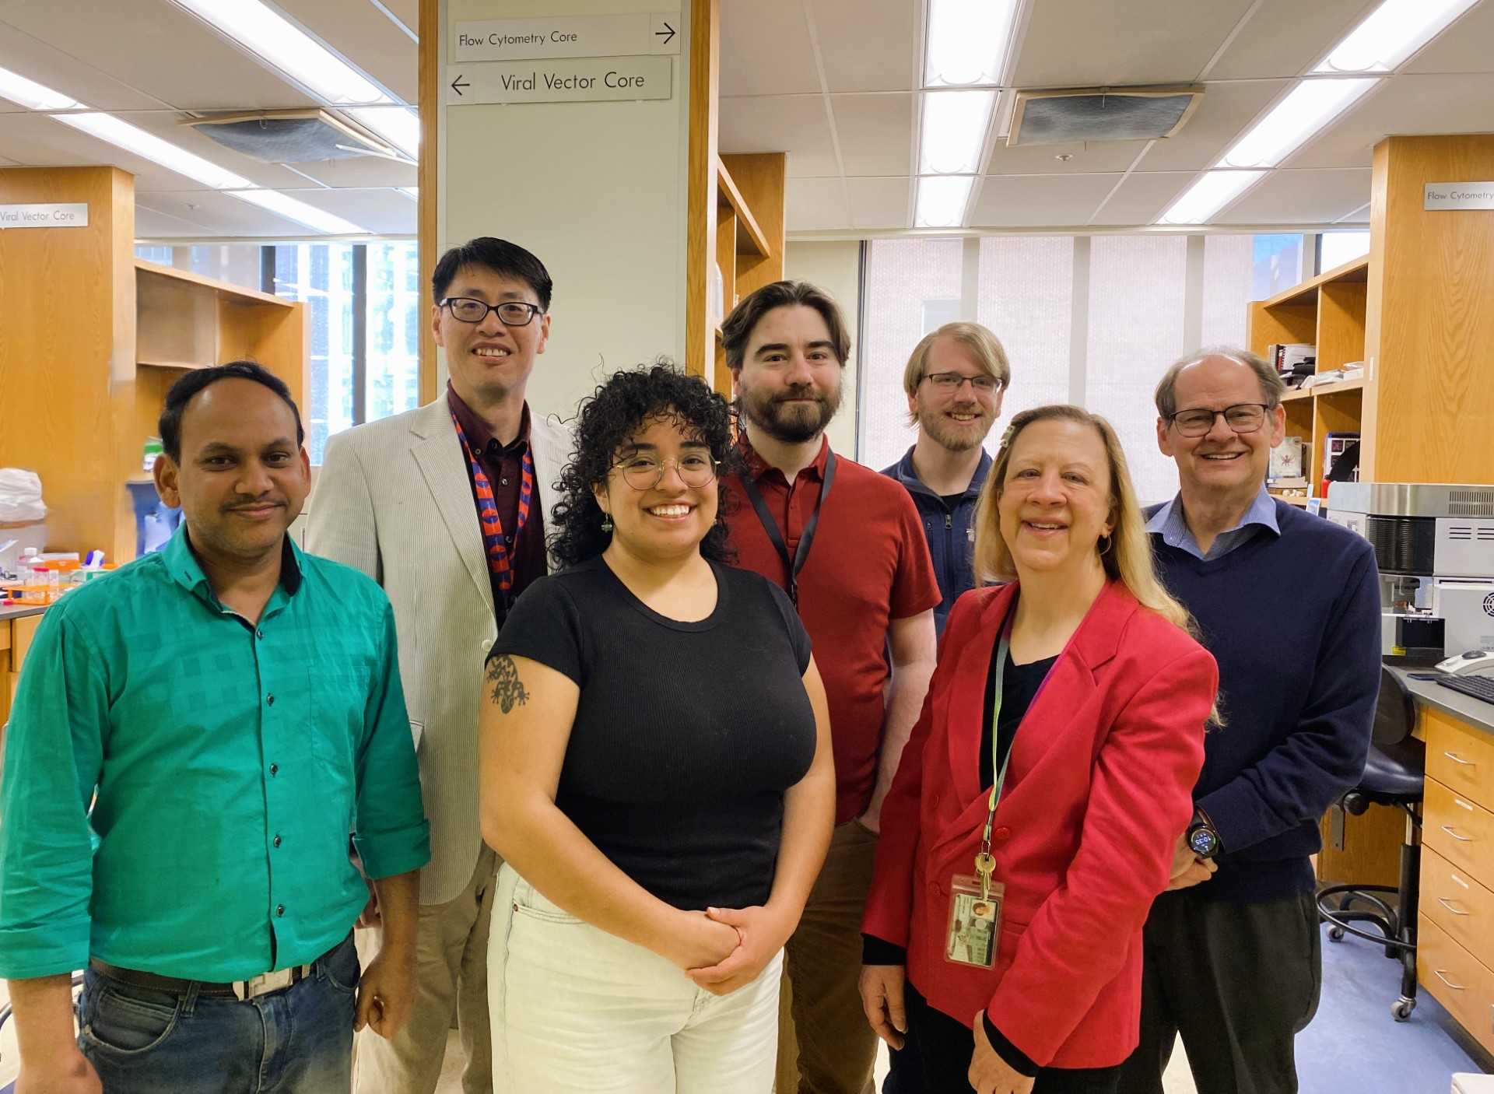
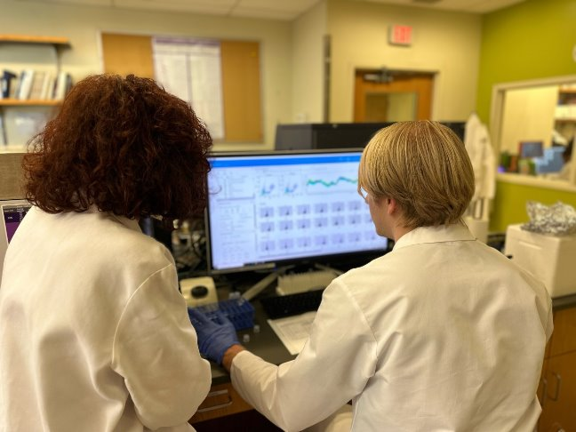


Acknowledgements
UMGCCC FCSR
Dr. Xiaoxuan Fan
Dr. Natarajan Ayithan
Mikayla Trainor
Molecular Microbiology Immunology Graduate Program
Dr. Eileen Barry
Bess Tracey
University of Maryland School of Medicine
Dr. Cristiana Cairo
Dr. Kirsten E. Lyke
PIN:
Daniela Franco
Cytometry
Discord
r/flowcytometry
U01 HD092308
Bioconductor Zulip
This publication was supported by funds through Maryland Department of Health’s Cigarette Restitution Fund Program – CH- 649-CRF and the National Cancer Institute – Cancer Center Support Grant (CCSG) – P30CA134274.d Service

Slide 34
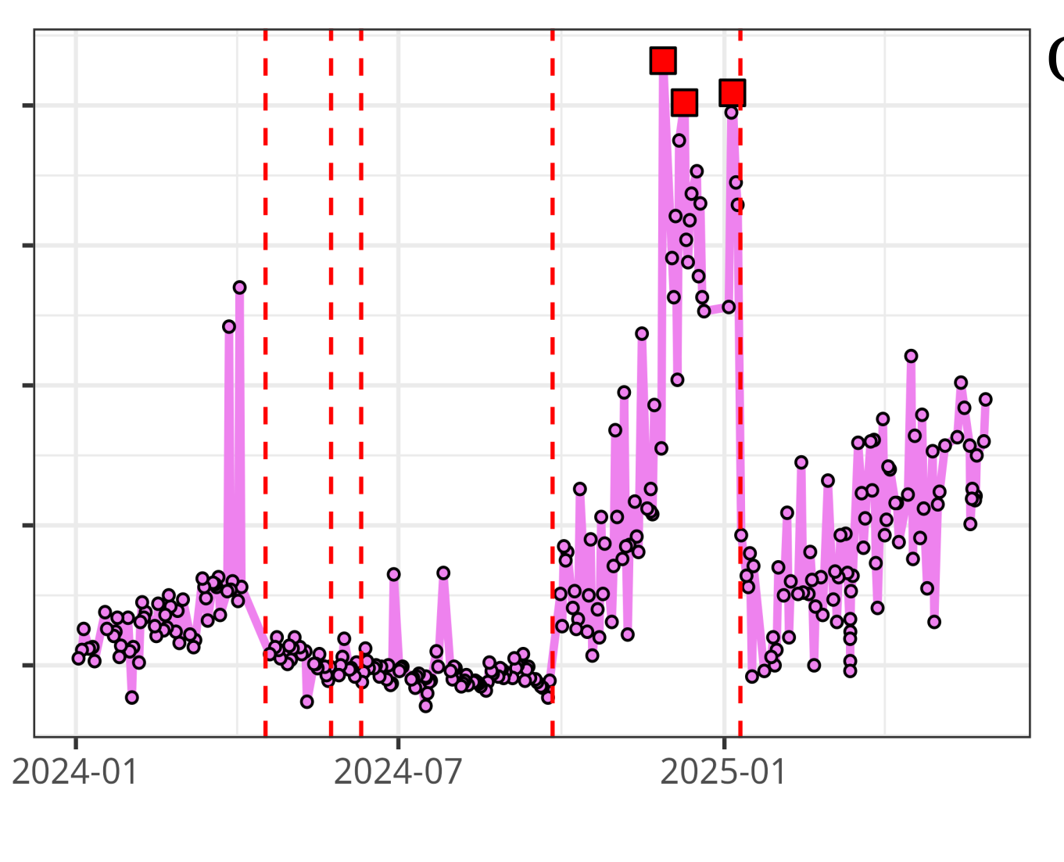
Questions?
UMGCCC FCSR
InstrumentQC dashboard
Luciernaga
Website - CytometryInR
InstrumentQC How-To
Coereba
YouTube @CytometryInR

