Slide 1

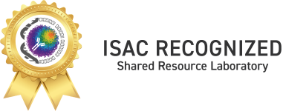
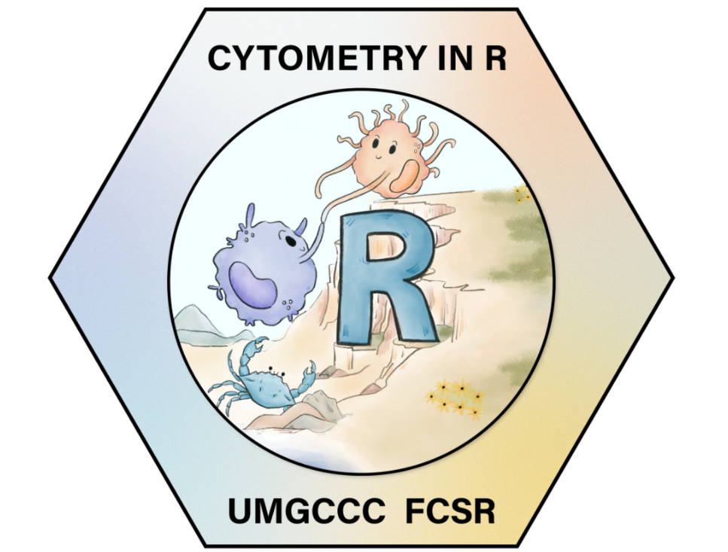
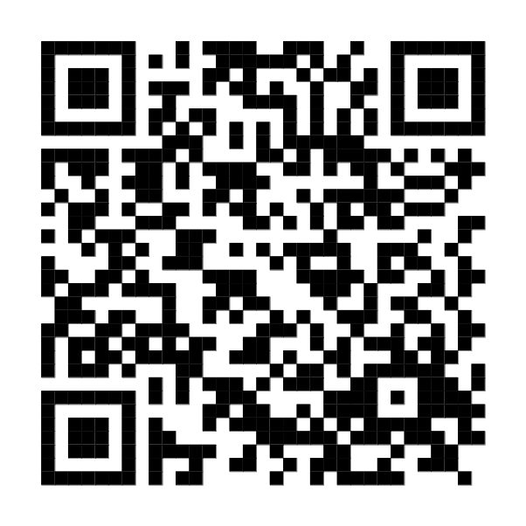
Cytometry in R: A free weekly course for flow cytometrist with no-to-little coding experience
David Rach, Natarajan Ayithan, Xiaoxuan Fan.
UMGCCC Flow Cytometry Shared Resource
August 10, 2026
Website

Slide 2
Flow Cytometry

Slide 3
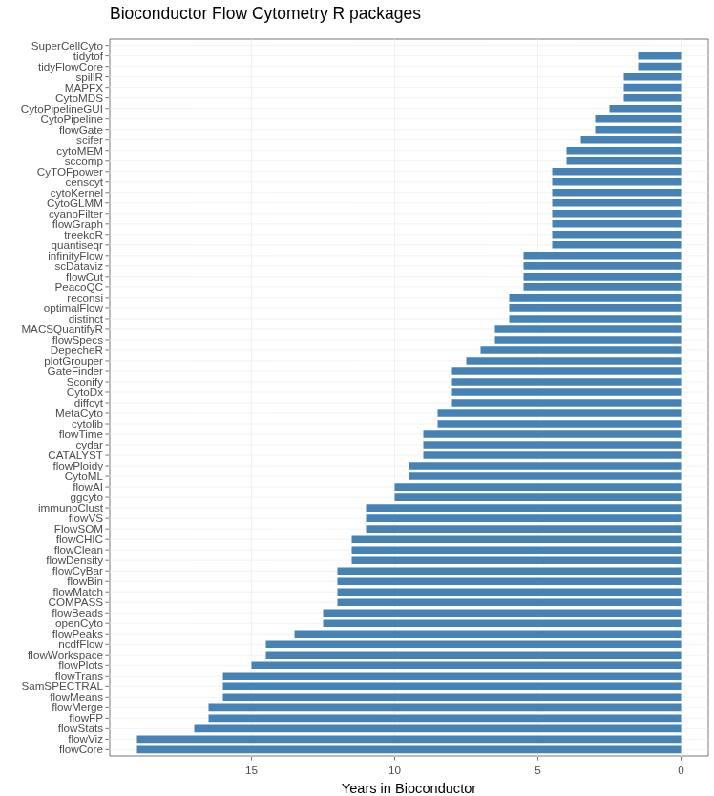
Flow Cytometry and Bioconductor
FlowCore is the oldest extant package (Bioc 2.0, 2007)
72 packages list Flow Cytometry in their biocViews

Slide 4
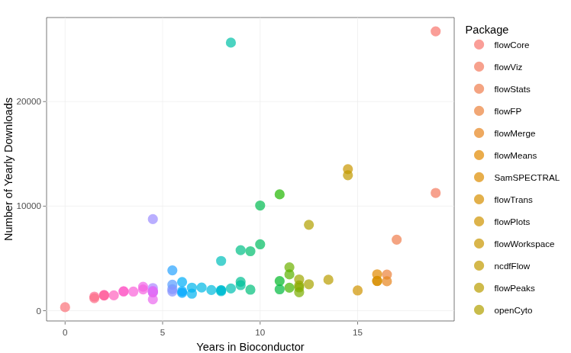
Flow Cytometry and Bioconductor
Most are severely under-utilized
7 packages with > 10,000 yearly downloads
15 packages with > 4000 yearly downloads

Slide 5
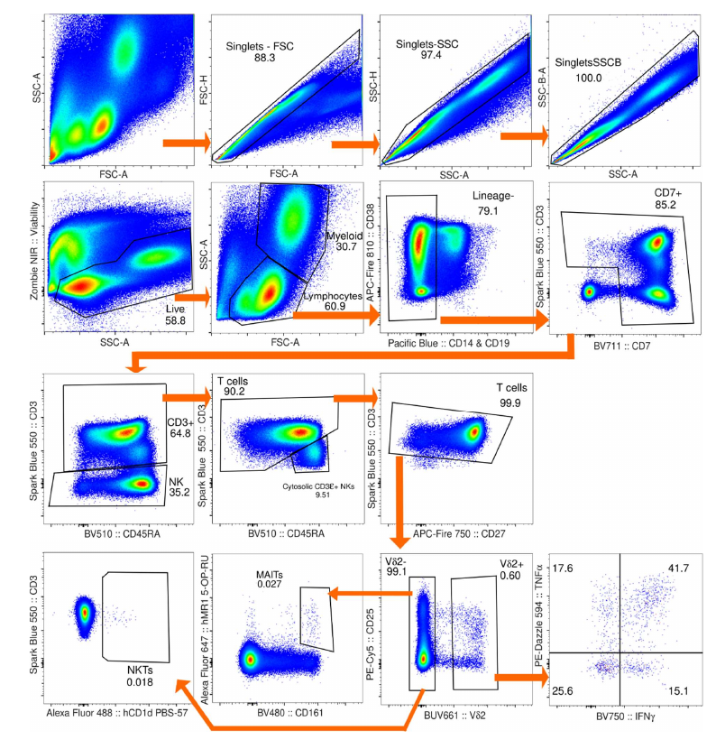
Lack of wider community adoption
Vast majority of the community uses commercial software (ex. FlowJo, FCSExpress, etc.)
Manual hierarchical gates are drawn around cell populations of interest via graphical-user interface

Slide 6
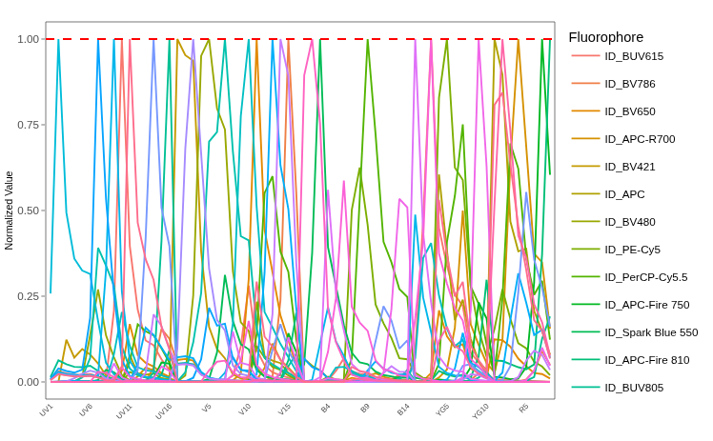
Spectral Flow Cytometry
Popularized by the Cytek Aurora
Able to resolve incredibly similar fluorophores
Largest panels >60 fluorophores, matching mass cytometry
Retains speed of acquisition of conventional flow cytometry

Slide 7
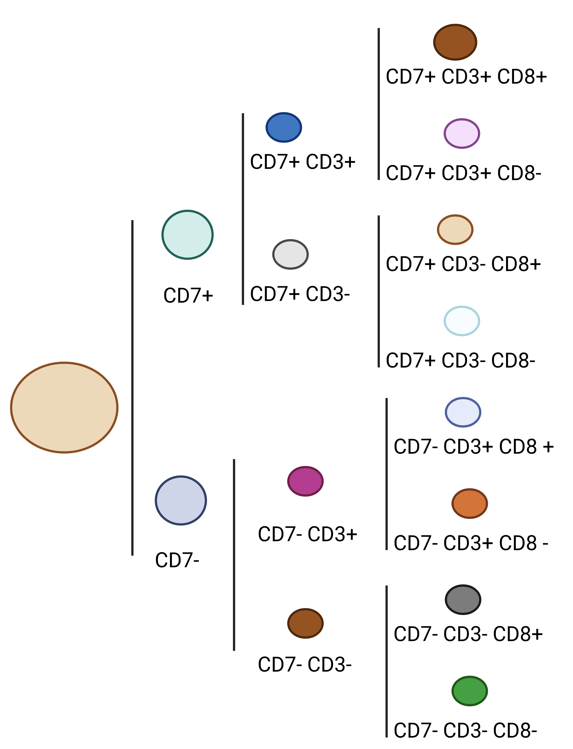
Complex Datasets, Combinatorially Exponential Clusters
Manual Gating no longer is sufficient to thoroughly profile individual specimens
If every marker split positive and negative; splits repeated for every marker:
  Potential groupings: 2^{NumberOfFluorophores}
60-color SFC panel: 1.2e+18 clusters at most (quintillion)
9-color CFC panel: 512 groups at most
Increasing use of semi-supervised and unsupervised algorithms for analysis, many already implemented as Bioconductor packages

Slide 8


Lack of beginner friendly resources a major barrier to entry
Few Existing Resources
Those that exist aimed at those with intermediate-advanced R skills.
Existing know-how concentrated at a few institutions
Most self-learning attempts end in frustration

Slide 9

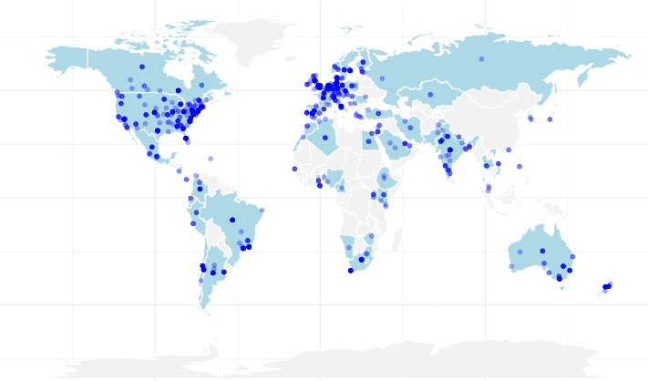
Cytometry in R: A free weekly course for flow cytometrist with no-to-little coding experience
Announced in November 2025
Woke up to find I had correctly guessed a community need
2000 researchers worldwide signed up for email updates
Had to update planned format

Slide 10
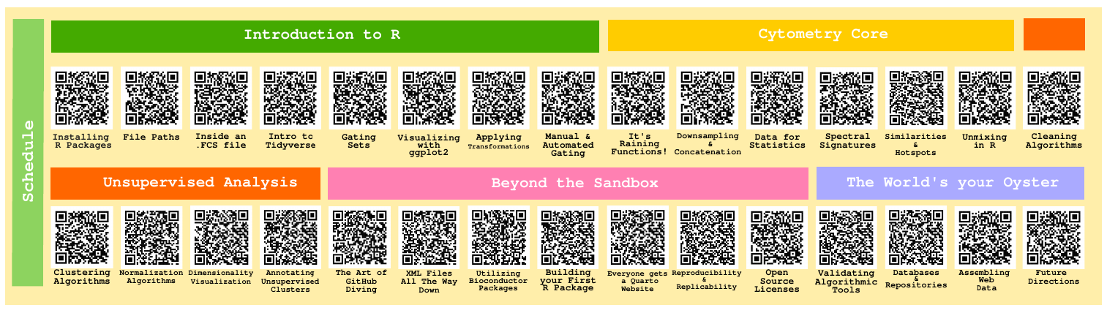
Overall structure
30-week course, starting from Intro to R, gradually moving to more advanced content. to more advanced content
Multiple ways to learn with flexible scheduling
Taught in Positron instead of Rstudio (ask me why!)
Version Control/Git introduced from the beginning

Slide 11
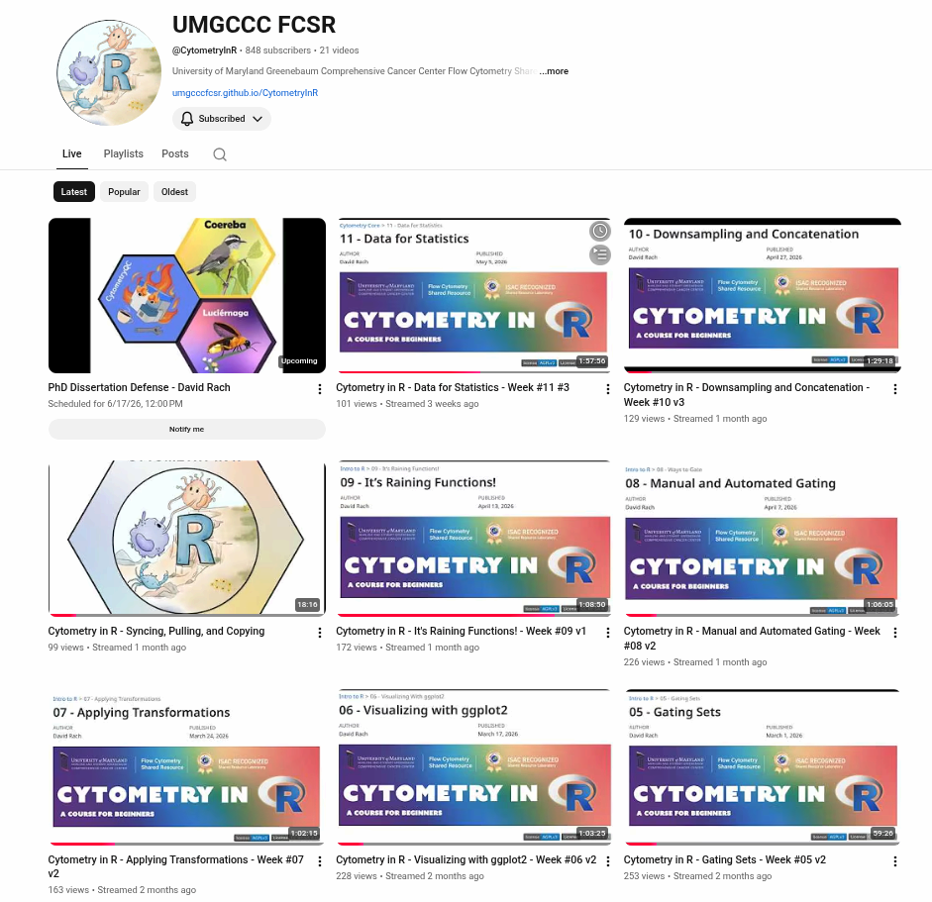
YouTube
If
If

Slide 12
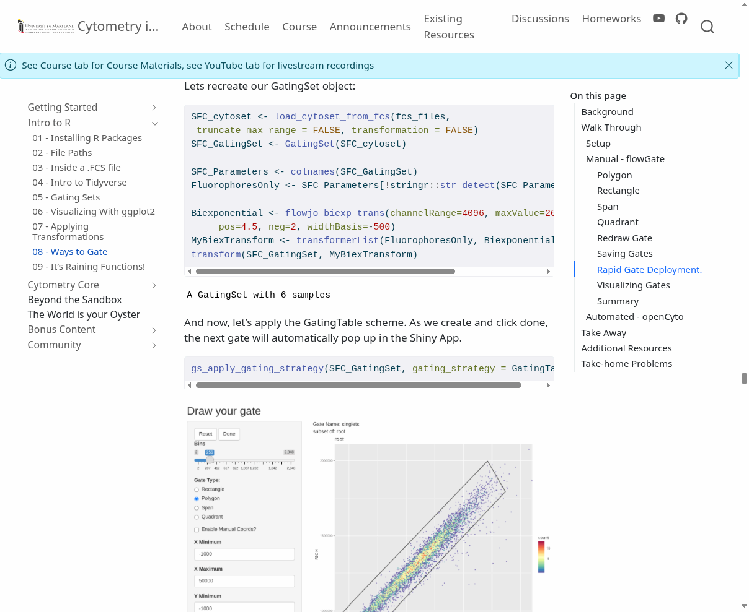
Website
If
If

Slide 13
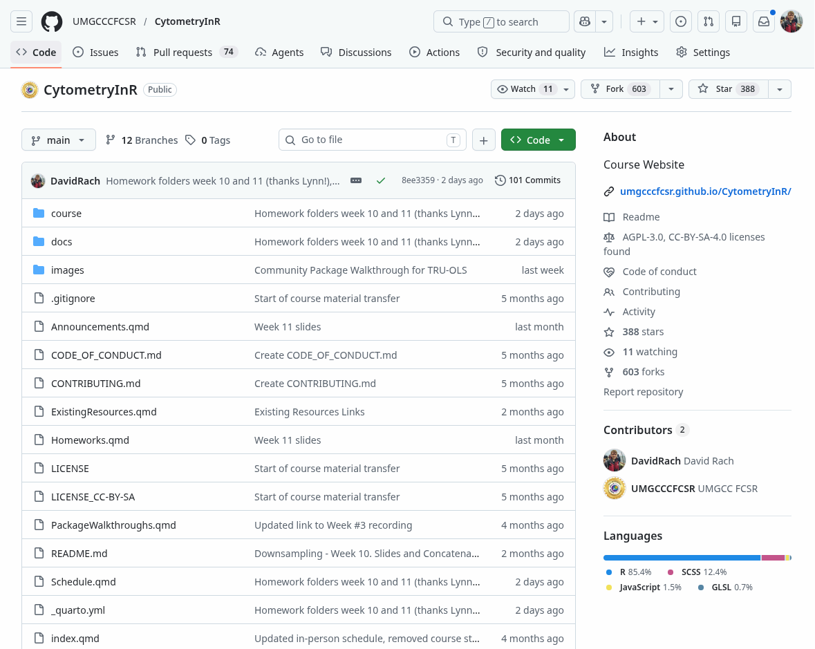
GitHub
If
If

Slide 14
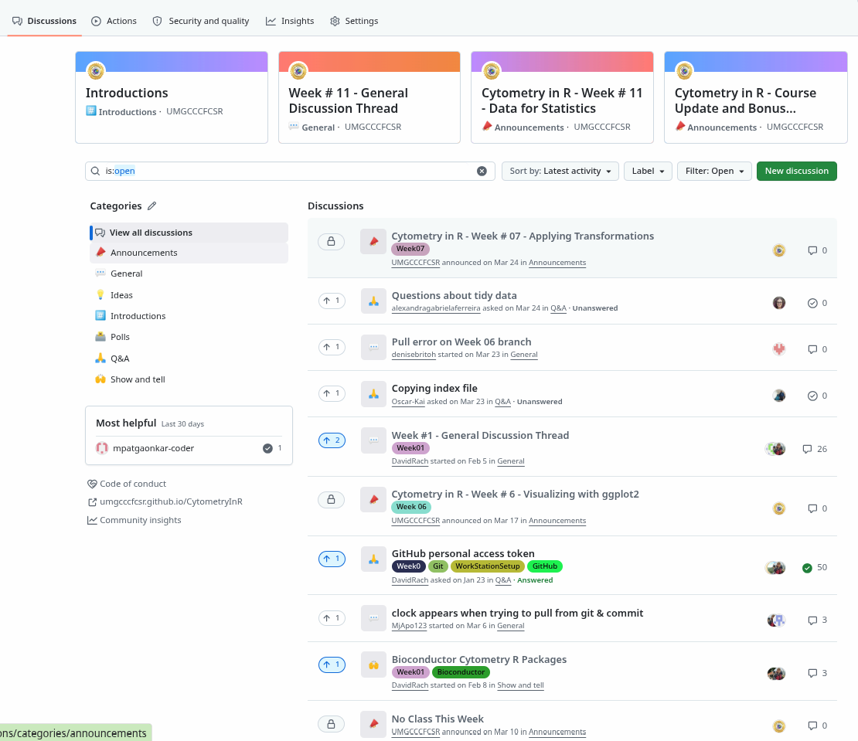
Discussion Forum
If
If

Slide 15
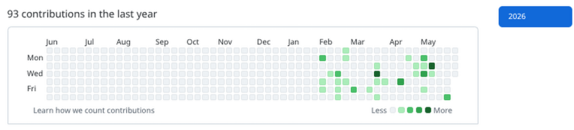
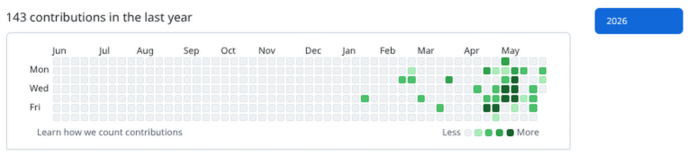
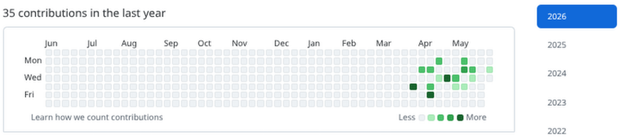
How has it been going?
Per Google, GitHub and YouTube analytics:
  Subscribers
  Forks
  200-350 average weekly participants
Learning to code is like an ultra marathon

Slide 16
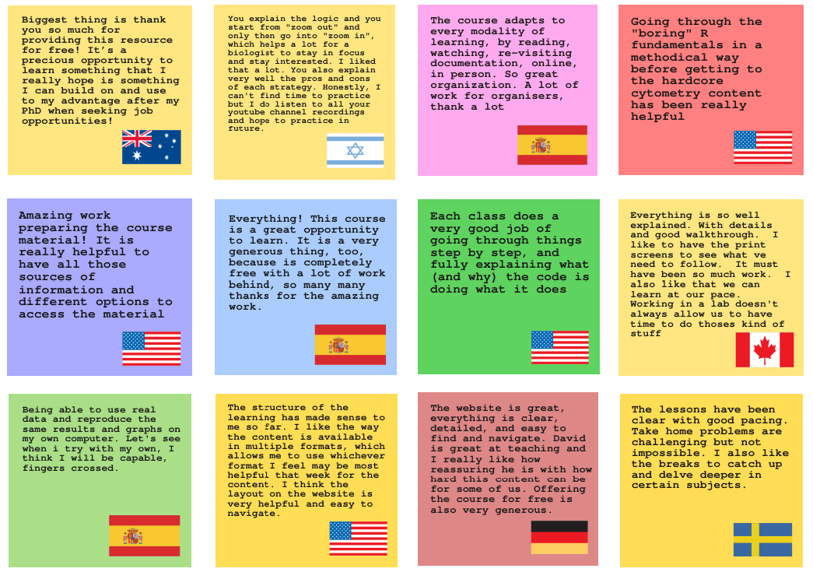
Community Feedback Surveys: What has worked well?
If
Flexible schedule, with
multiple formats
Detailed explanations from a cytometry perspective
Free
Strangely… Positron and Git?
If

Slide 17
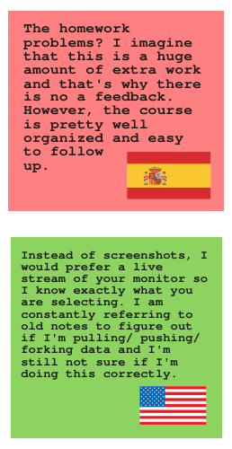
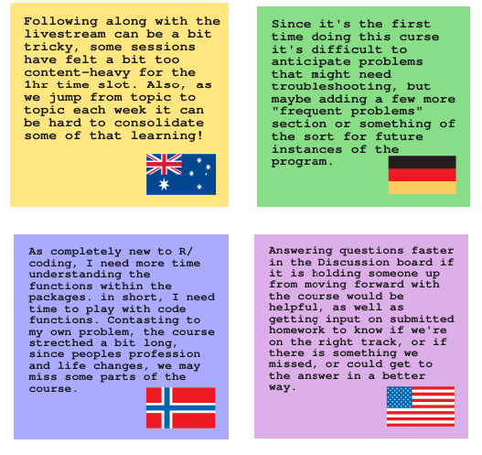
Community Feedback Surveys: What can be improved on?
In hindsight: Probably shouldn’t have started this project at the same time as writing my thesis.
Case-in-point: Feedback on the Optional Take-Home Problems
Despite planning for it, still vastly underestimated the number of potential installation issues on Windows vs. individual IT policies

Slide 18
Where to next?
Wrapping up Cytometry Core module
Starting on Unsupervised Analysis section

Slide 19
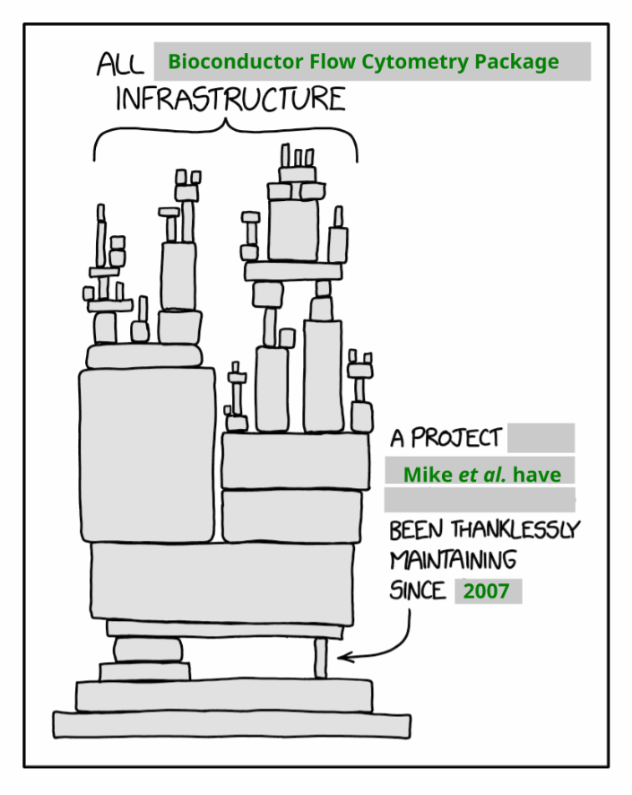
A rising tide floats all boats
72 Bioconductor cytometry packages (+ 20? GitHub based packages)
Only subset will have been covered during the planned 30 week course
One-off community walk-throughs?
Hopefully those just getting started contribute to projects of interest in their own right in time

Slide 20
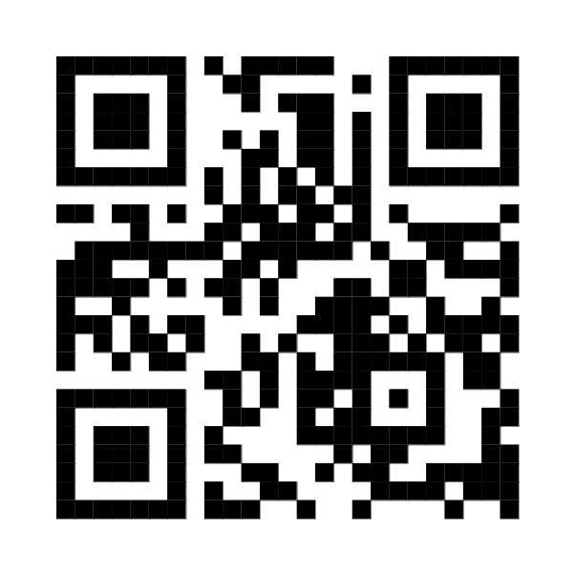
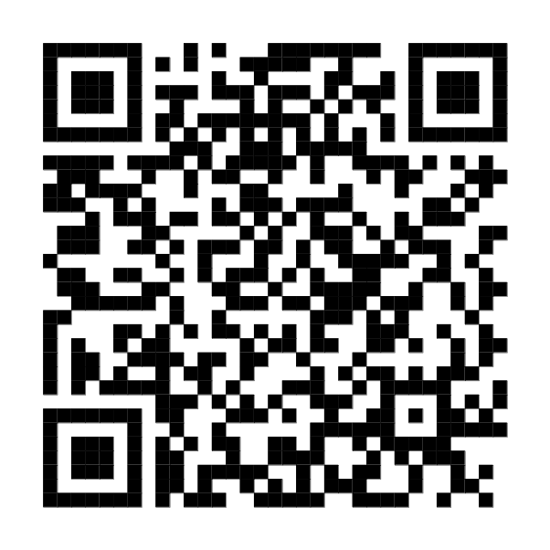


Acknowledgements
All the open-source contributors, developers, and maintainers, that collectively made the tool sets without which this course would not be feasible
All course participants, who have had occasionally had to witness us building the plane as we fly it
Cytometry
Discord
Bioconductor
Zulip
This publication was supported by funds through Maryland Department of Health’s Cigarette Restitution Fund Program – CH- 649-CRF and the National Cancer Institute – Cancer Center Support Grant (CCSG) – P30CA134274.d Service
Dr. Cristiana Cairo
Dr. Kirsten E. Lyke
This publication was supported by funds through Maryland Department of Health’s Cigarette Restitution Fund Program – CH- 649-CRF and the National Cancer Institute – Cancer Center Support Grant (CCSG) – P30CA134274.d Service
Dr. Daniela Franco

Slide 21
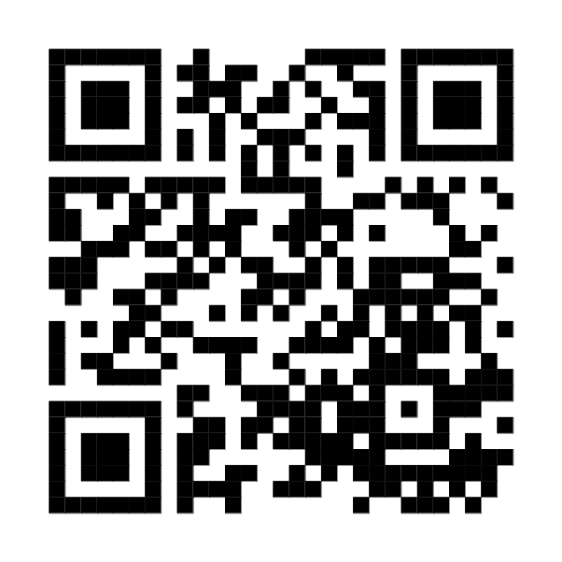

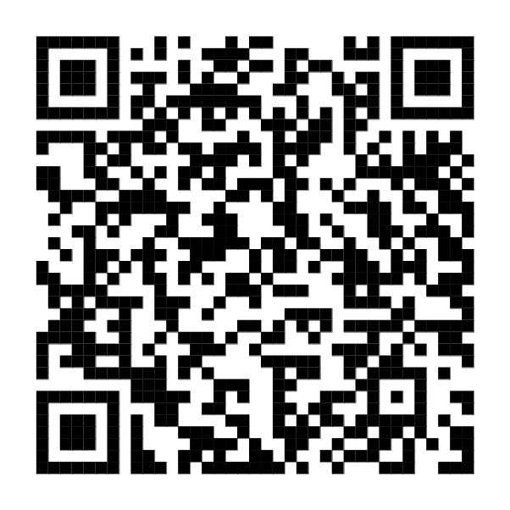
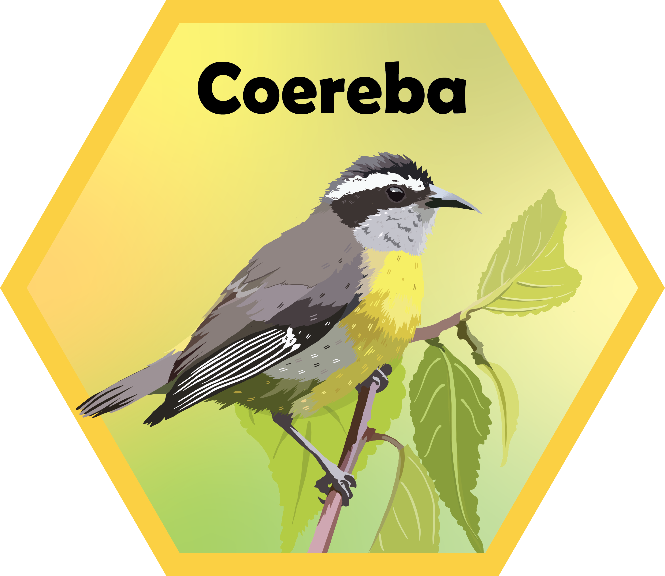
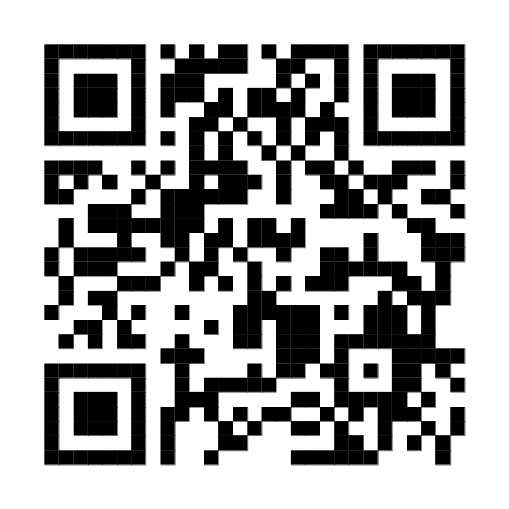
Questions?
Current Works
In Progress
Website:
https://github.com/UMGCCCFCSR/CytometryInR
Luciernaga
YouTube @CytometryInR
Coereba

