Slide 1



Everything, Everywhere, All at Once: Open-source Automation for Situational Awareness in Shared Resource Laboratories
David Rach, Natarajan Ayithan, Xiaoxuan Fan
UMGCCC Flow Cytometry Shared Resource
June 6th, 2026
Slides Here

Slide 2
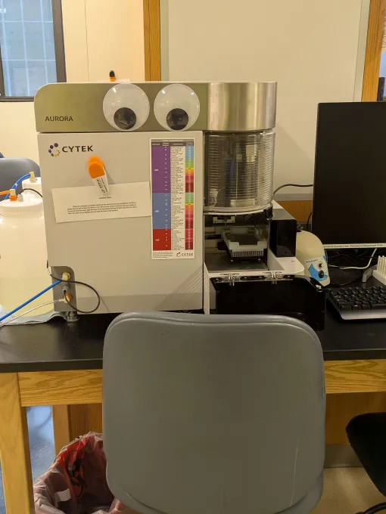
On a good day at a small SRL
Everything is normal
Show up
Change sheathe and waste
Flush out the fluidic lines
Run QC
Drink your fourth cup of coffee
Cell Sorting
Training new users
Building panels
Deep diving interesting data
Go home, rinse and repeat

Slide 3
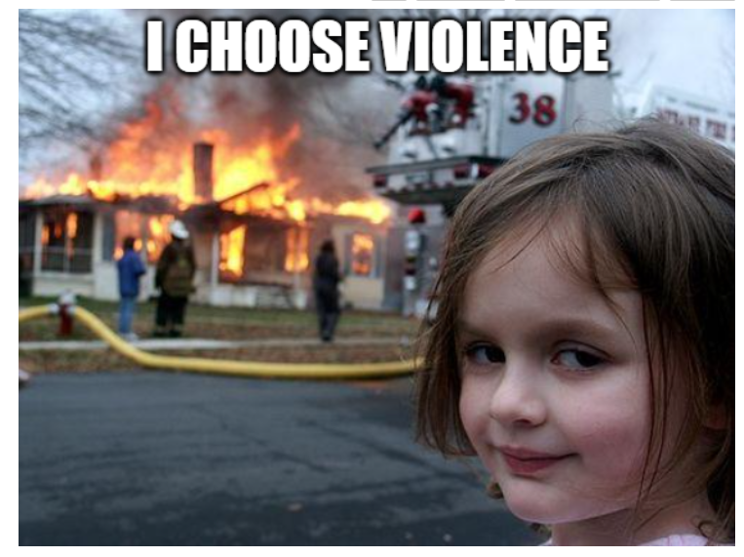
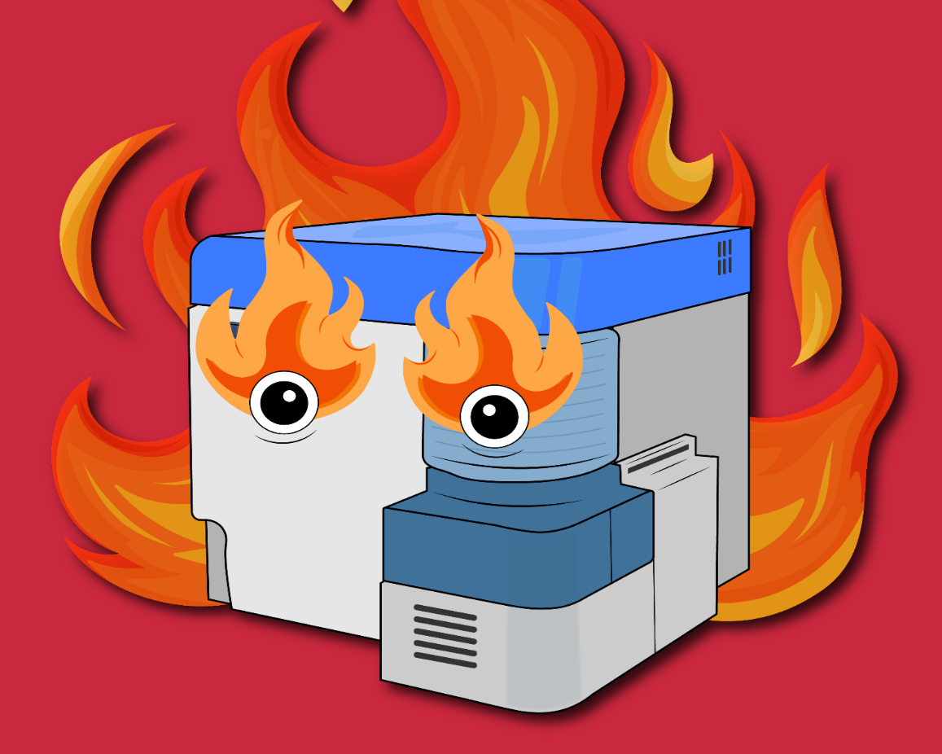
However, on a bad day at a small SRL…

Slide 4
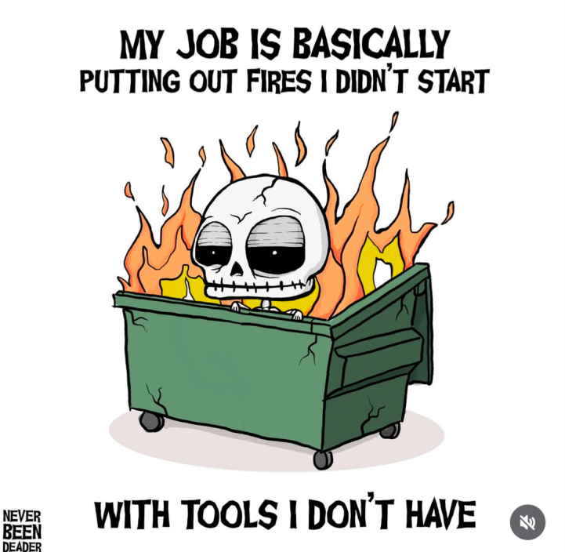
New Goal for the Day: Simply Survive

Slide 5
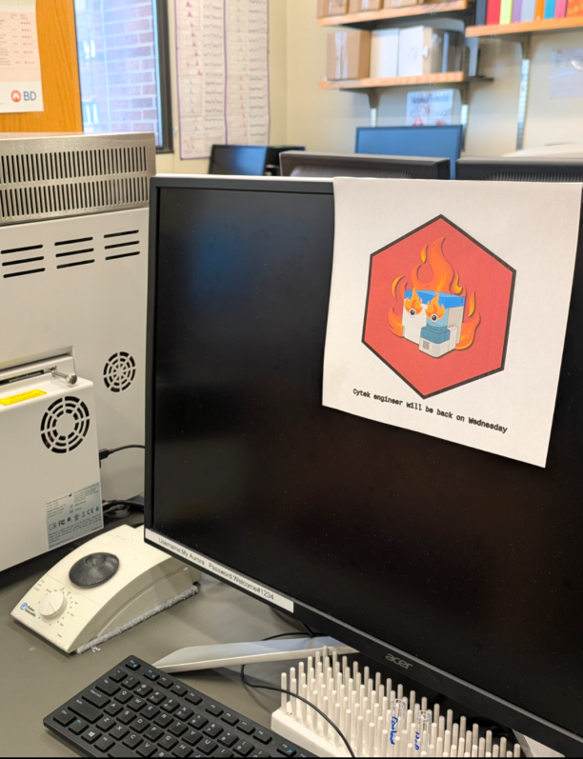
Visible and Hidden Costs
Issue was detected, cytometer not in use
Staff time
Lost Revenue
Delayed User Experiments
Issue undetected, cytometer still in use
Poor Quality Data
More complex analysis
Need for experiment repeats
Reputational Costs

Slide 6
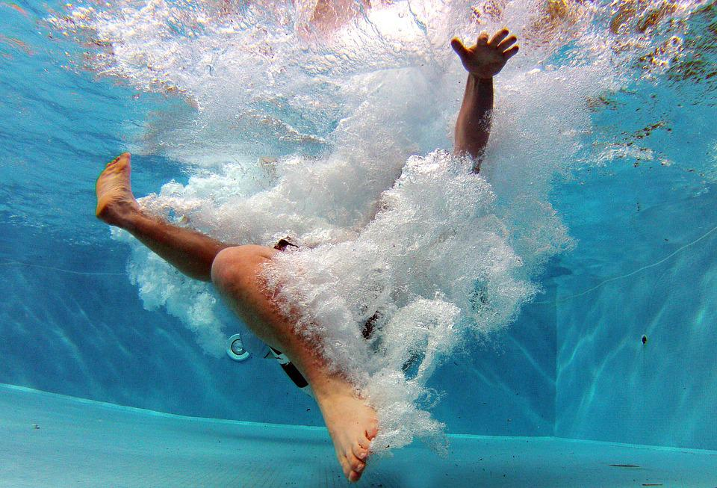
Are you treading water or drowning?
https://homeschooling2e.com/2021/04/11/treading-water/

Slide 7
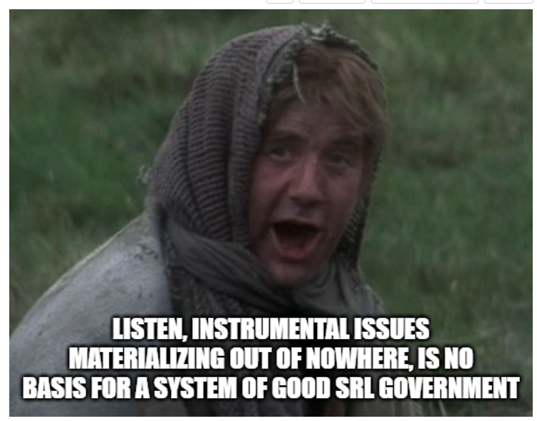
Can we anticipate the waves?
Laser/Detector Issues
Bleach-damaged QC Beads
Debris Accumulation in fluidic lines
Degrading tandem dyes
Additional autofluorescences
What stories can the data already being acquired daily at out cores tell us?

Slide 8
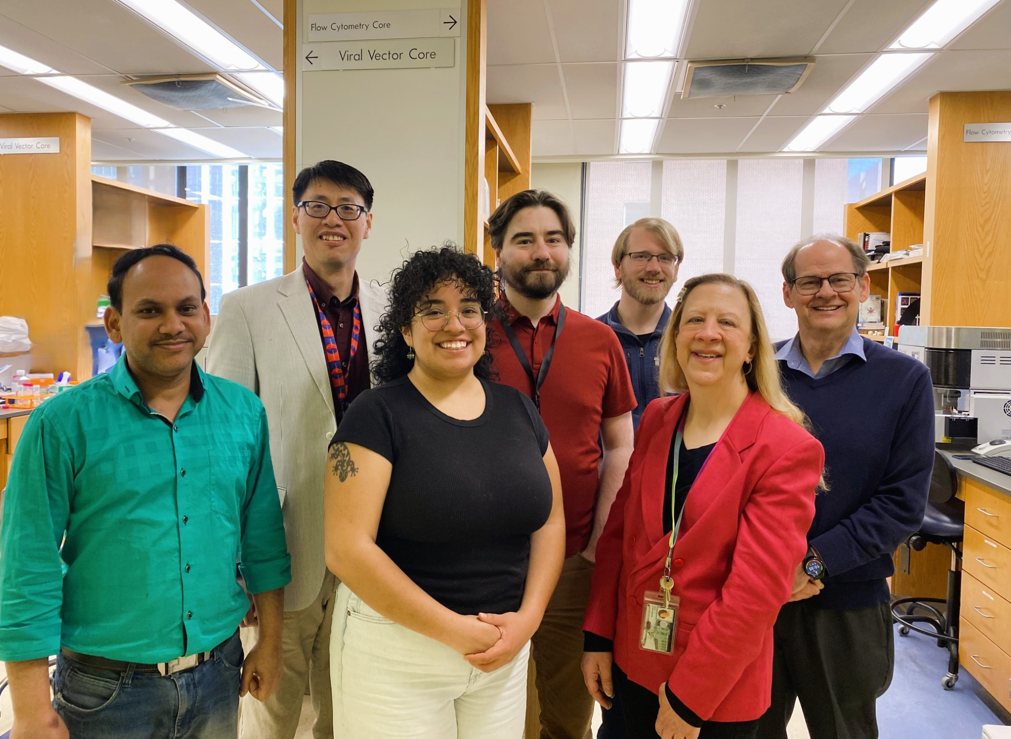

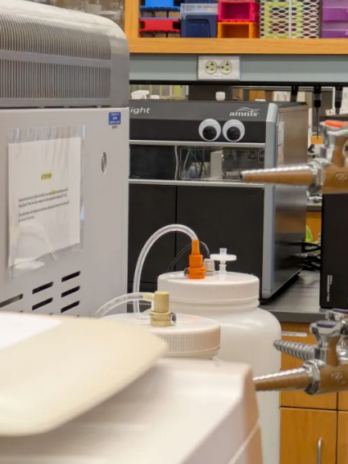
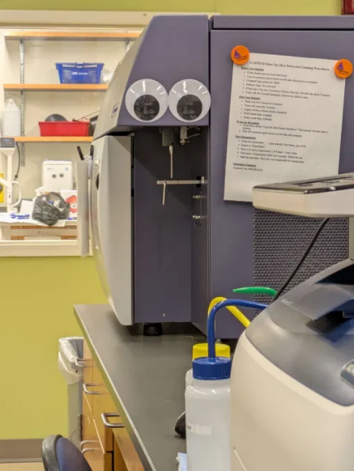
UMGCCC Flow Cytometry Shared Resource
Analyzers:
3 Cytek Aurora
1 Amnis FlowSight
1 MacsQuant10
1 BD LSR-II
1 BD Canto
Cell Sorters:
1 Cytek Aurora CS
1 BD Aria II
Flow Cytometry Staff: 3

Slide 9
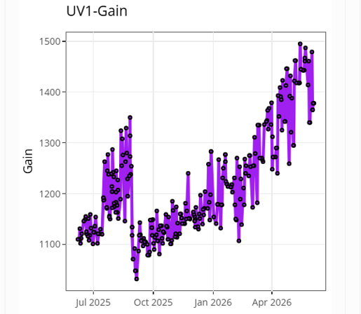
Our Goals
Develop the tools
Find bandwidth to leverage them
Keep expenses minimal
Share our code

Slide 10
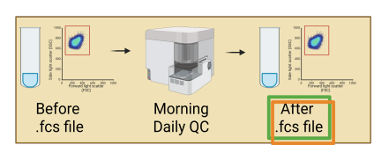
What data is already sitting around?
Before and After QC .fcs files
For Every Instrument
Back to 2017

Slide 11
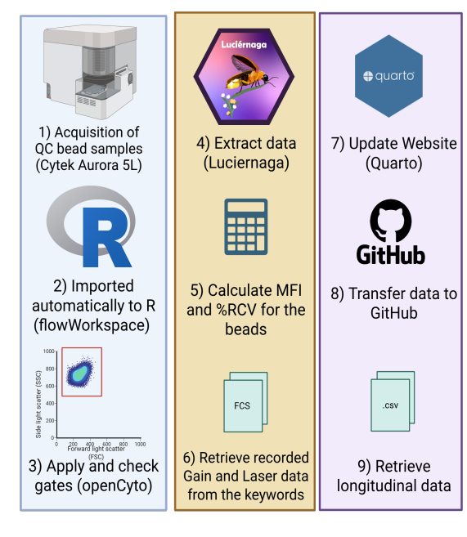
Automated Daily Processing
Behind-the-scenes:
Using R (and increasingly Rust) to process the .fcs files
Automated transfer to GitHub via Windows Task Scheduler
Our Quarto Website gets updated twice daily via a GitHub action
Eclectic Mix of Computation:
Existing Instrument Computers
Repurposed Windows 10 End-of-Life computers running Linux
Small motherboard computers (Raspberry Pi 4b)

Slide 12
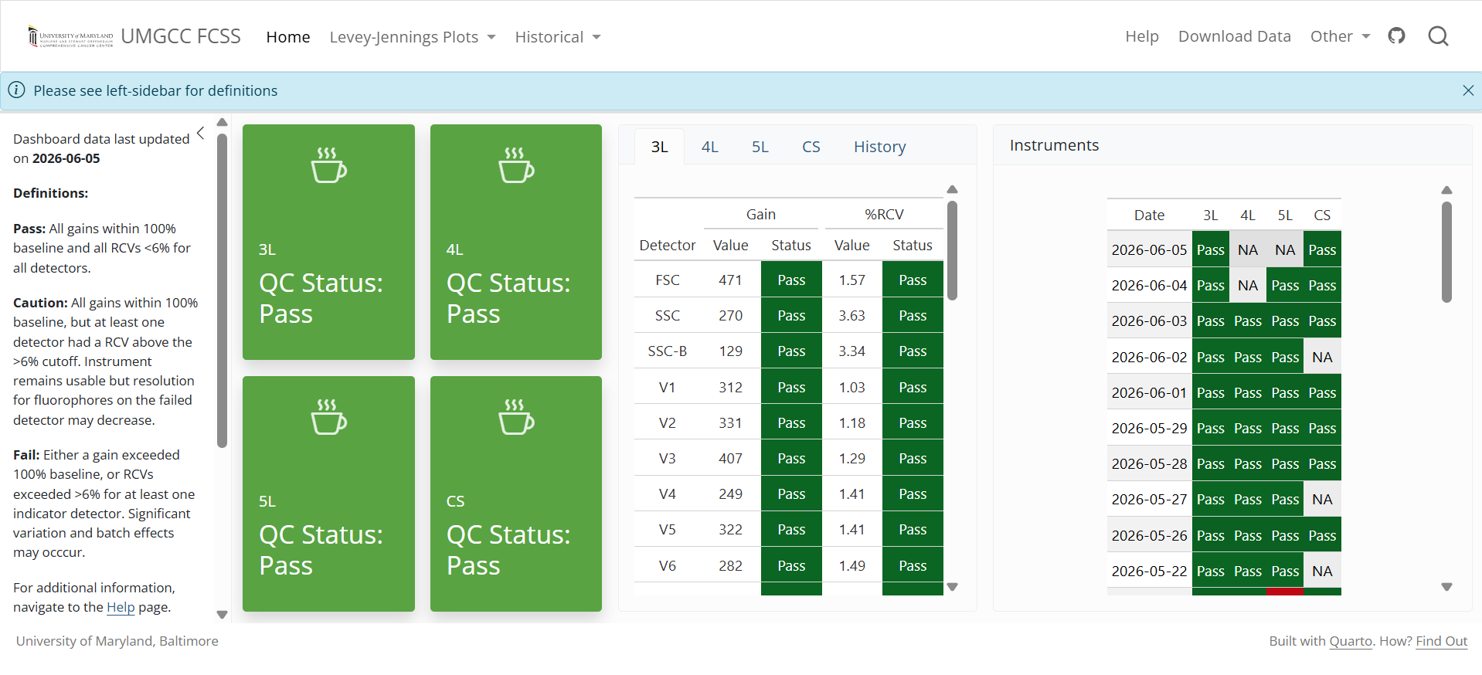
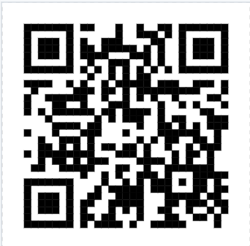
Instrument Quality Control Dashboard
Dashboard
How-To

Slide 13

Instrument Quality Control Dashboard

Slide 14
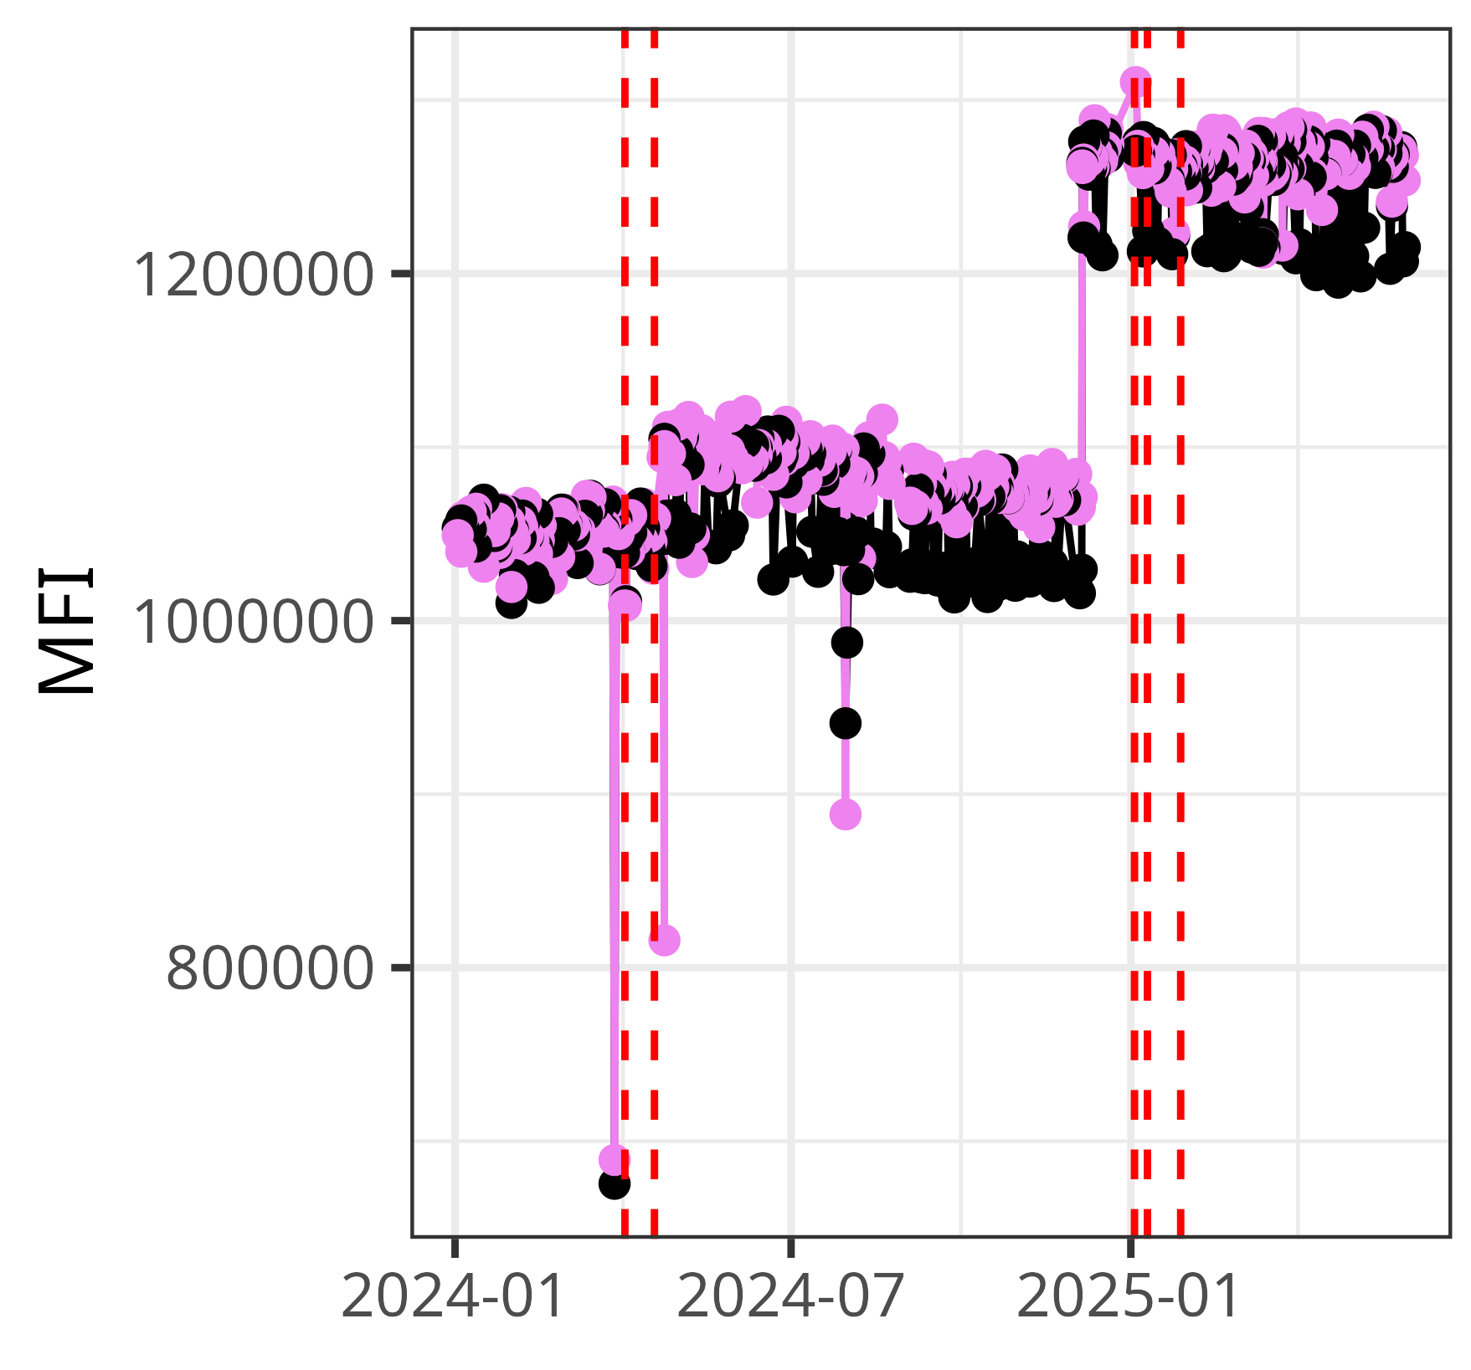
Instrument Stability over Time

Slide 15
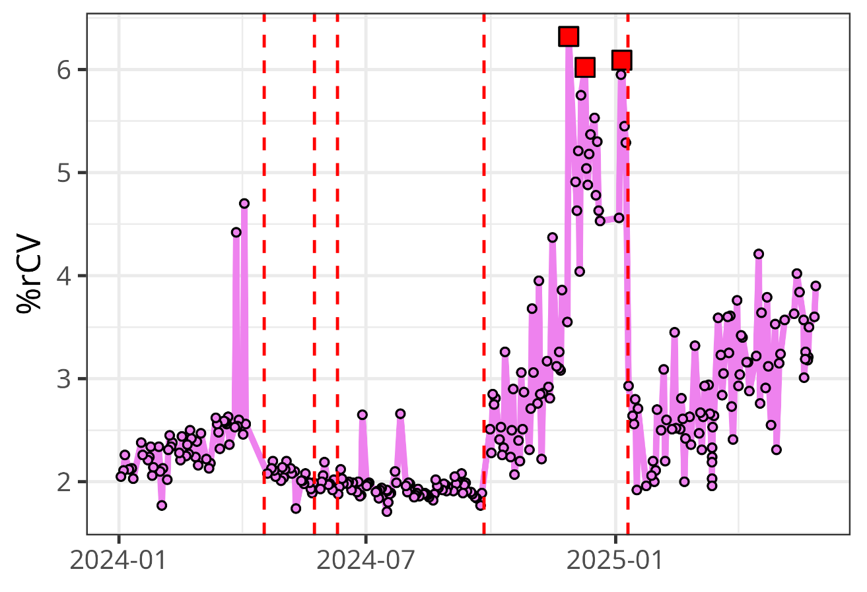
Early warning on Lasers/Detectors

Slide 16
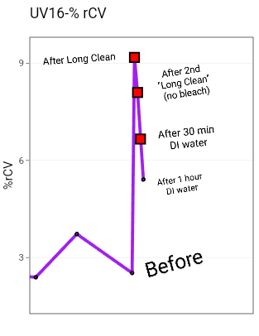
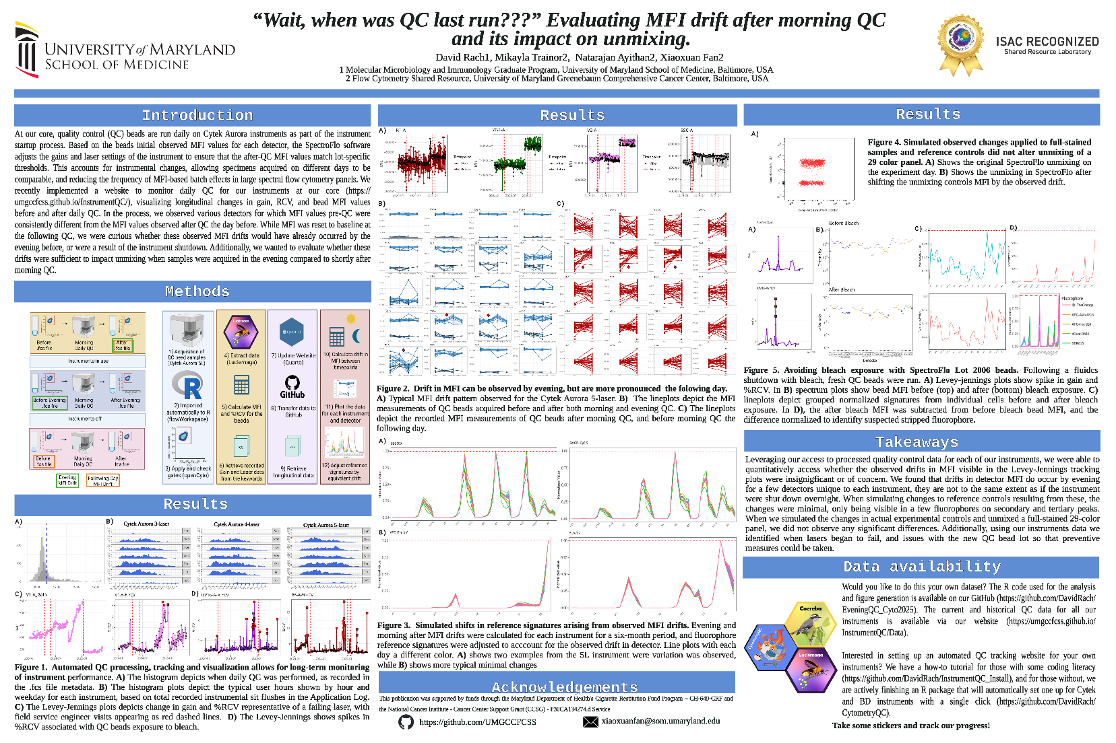

Front row seats to Bleach-Sensitive QC Bead Lots
Data

Slide 17
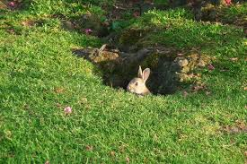
Beyond .fcs files, what else can we leverage?

Slide 18
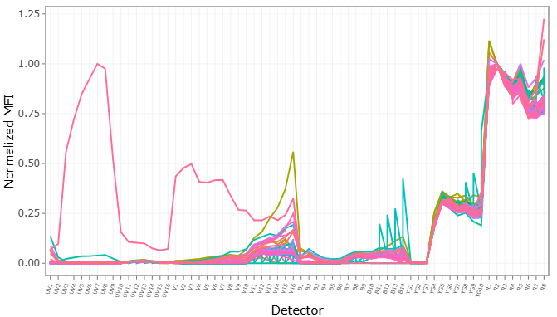
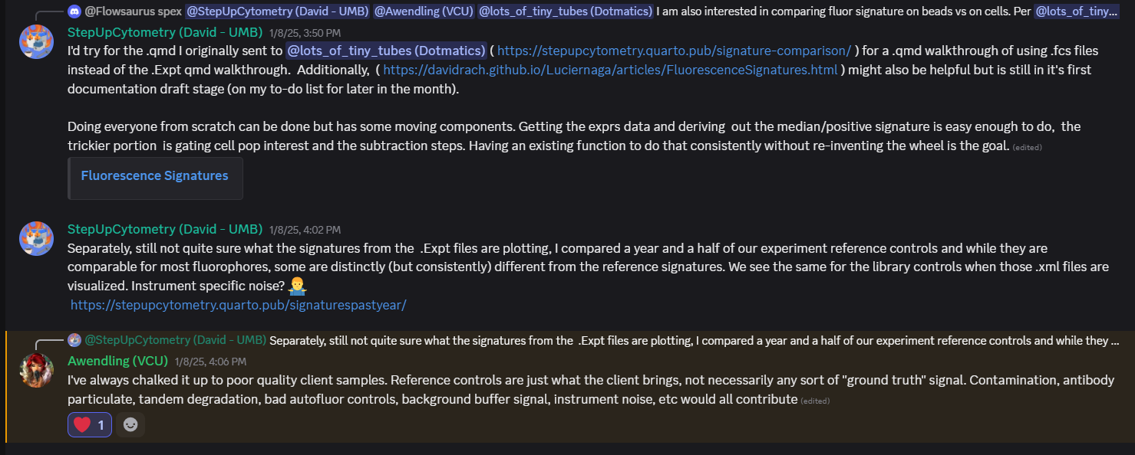
SpectroFlo .Expt Files
Every .Expt file
Read in XML to R
Access Experimental Metadata
Useful
Fluorophores
Markers

Slide 19
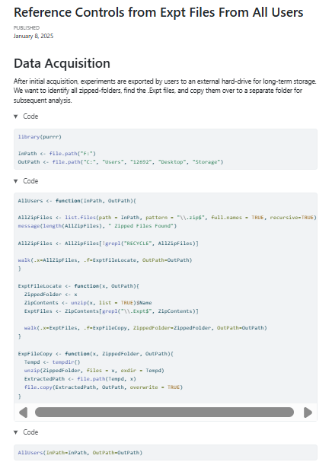

SpectroFlo .Expt files
Gather
Identify the Zipped Folders
Unzip
Copy out the .Expt File
Re-zip
Process
Parse for Fluorophores
Parse for Markers
Save outputs by user and experiment
Code

Slide 20
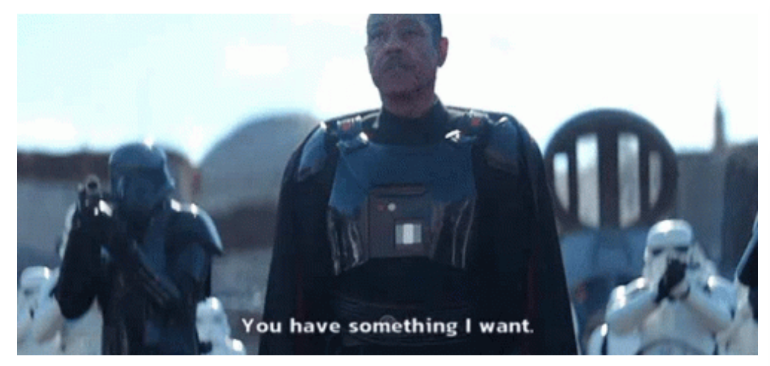
What can we do with that data?
How many fluorophores in our largest user panel?
“Does anyone have an anti-human Alexa Fluor 647 CD163 that we can borrow?”

Slide 21
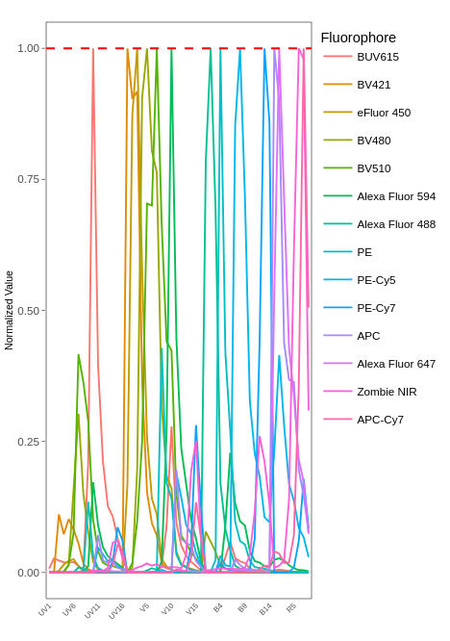
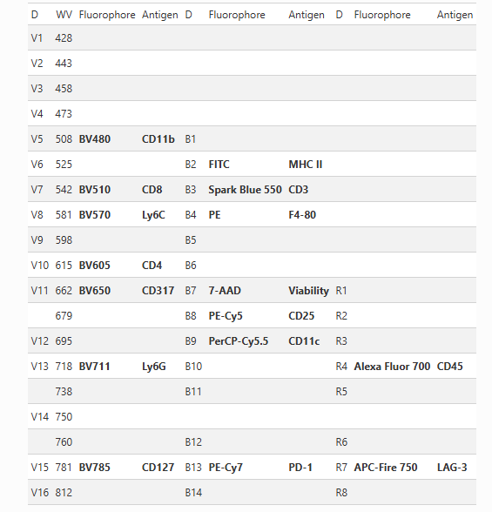

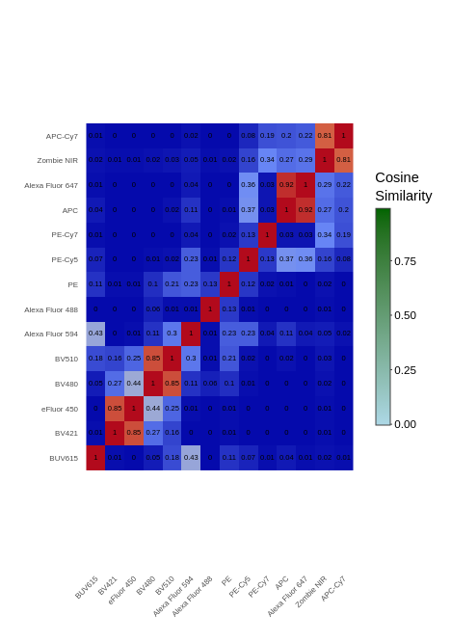
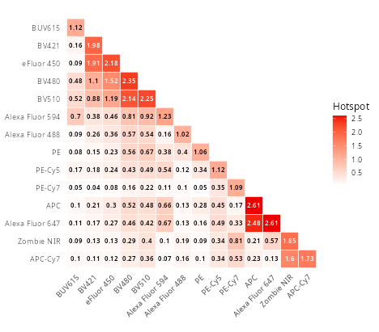
Evaluate User Panels
Not all user panels are “good”
Once we have parsed the panels fluorophores
Signatures (based on references)
Signature Worksheet
Cosine Values (Similarity Matrix)
Matrix Condition Number (Complexity Index)
Collinearity (Unmixing-dependent Spread)
Code

Slide 22
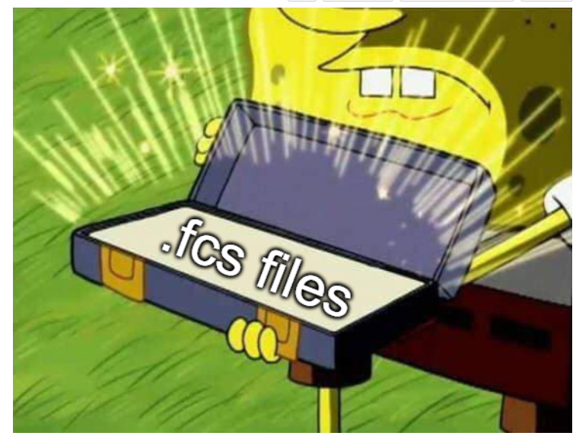
What about the quality of the actual data?

Slide 23
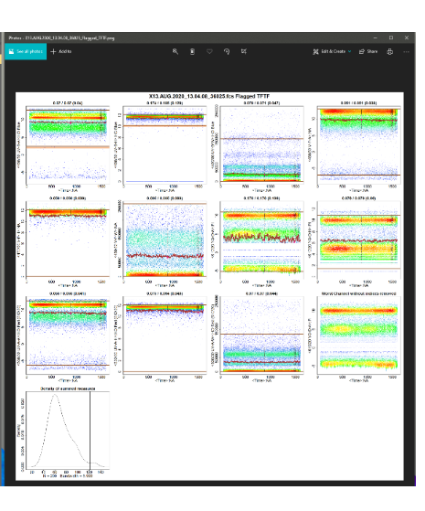
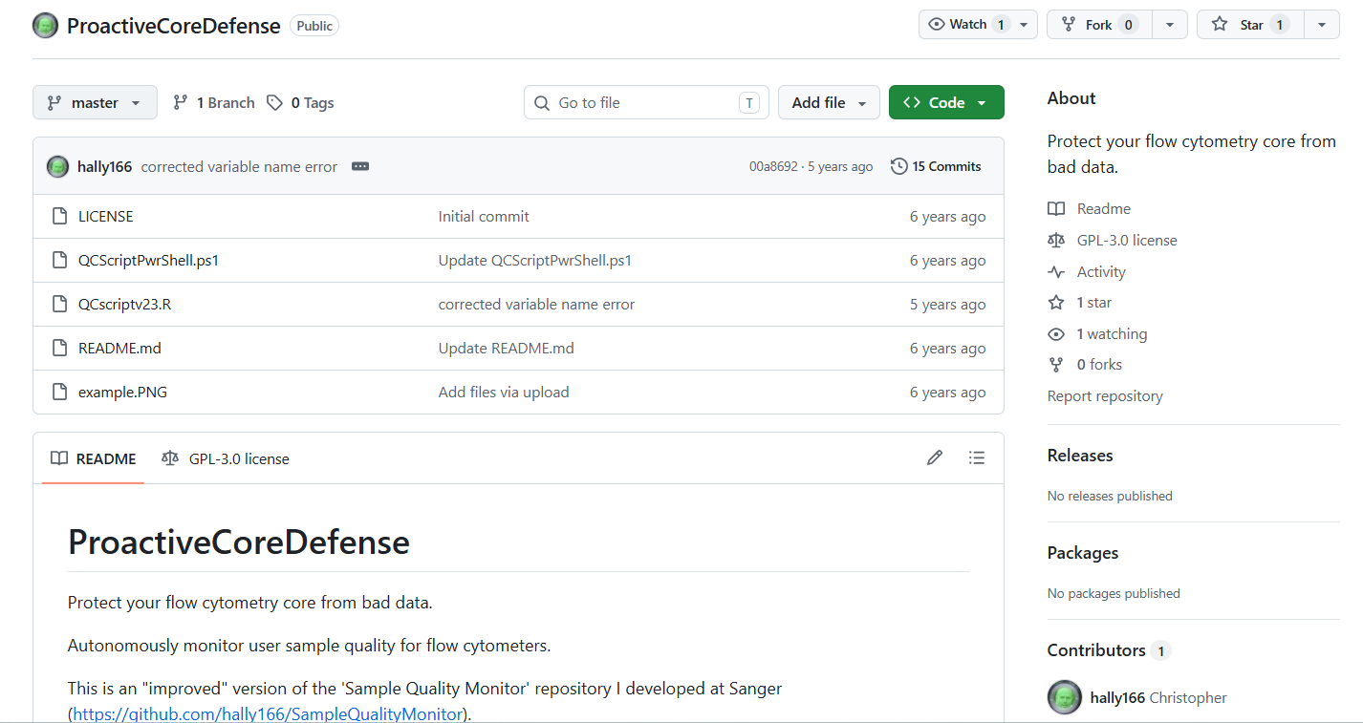
Christopher Hall’s previous attempts

Slide 24

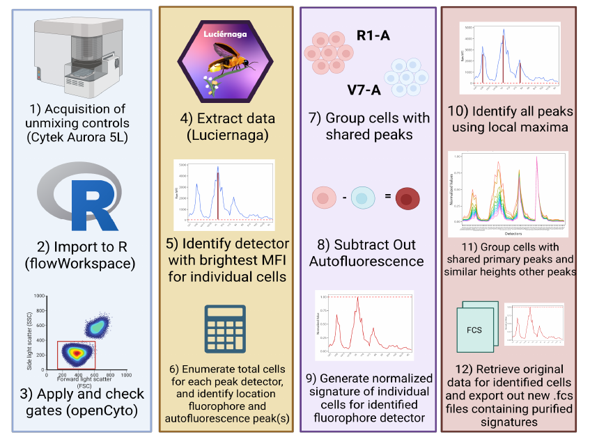

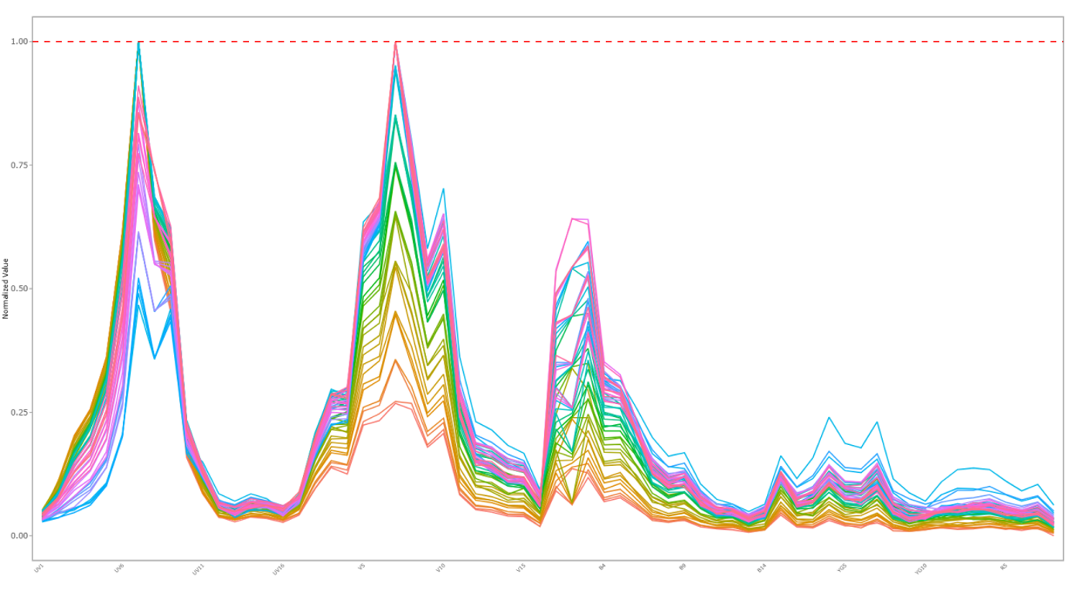
Evaluating Unmixing Controls

Slide 25
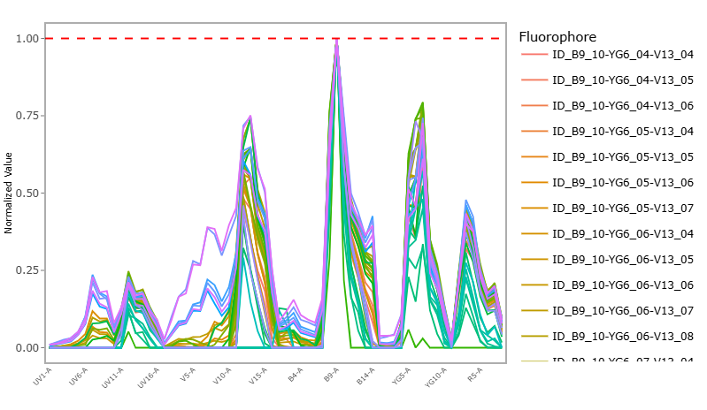

When PerCP-Cy5.5 degrades
Interactive
Plots

Slide 26
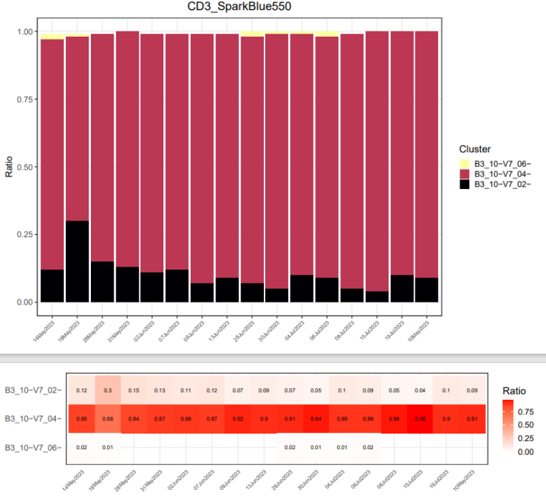
When antibody vials are in good condition
Few normalized signature variants

Slide 27
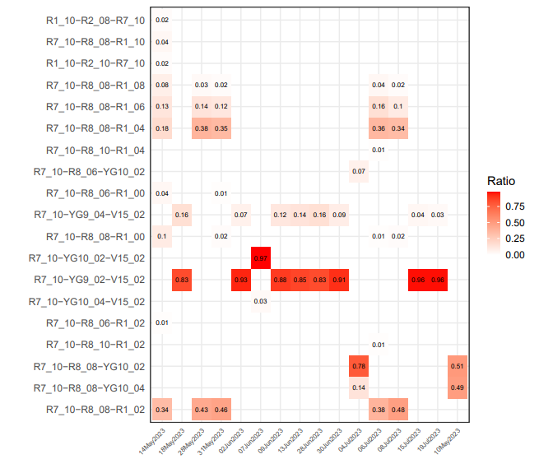
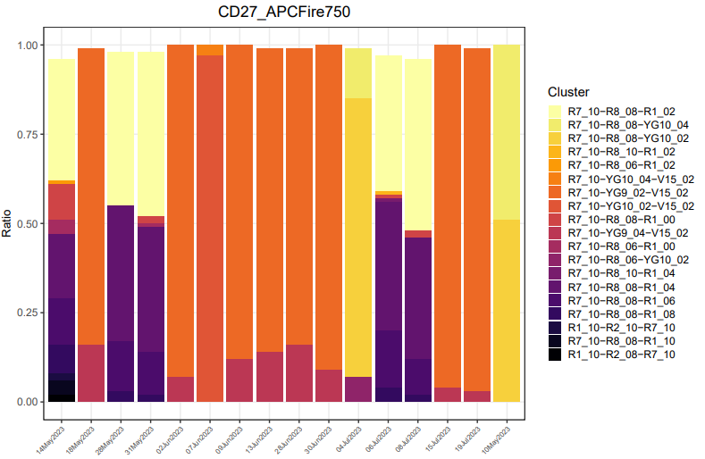
When the tandem starts degrading
Noticeable increase in normalized signature variants

Slide 28
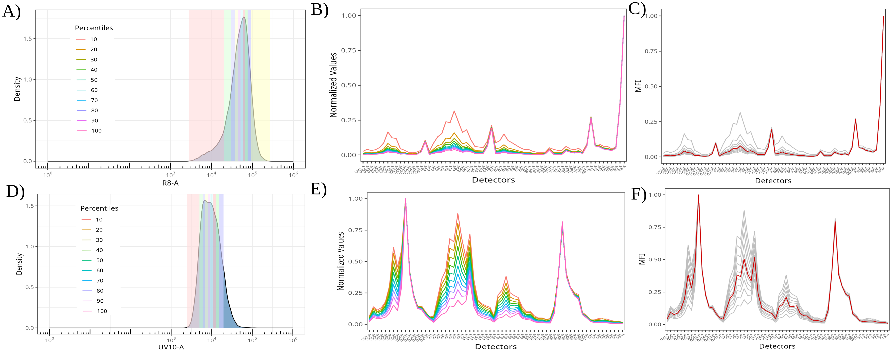
Residual Autofluorescence peaks in Single-Color Signatures
For cell controls with a moderate density antigen on bright fluorophores, we see that any
residual autofluorescence contributes minimally to the overall isolated single-color signature
when gated according to best practices

Slide 29
Residual Autofluorescence peaks in Single-Color Signatures
For cell controls with a moderate density antigen on dim fluorophores, we see substantial
residual autofluorescence contributions to the isolated single-color normalized signatures even
when gated according to best practices

Slide 30
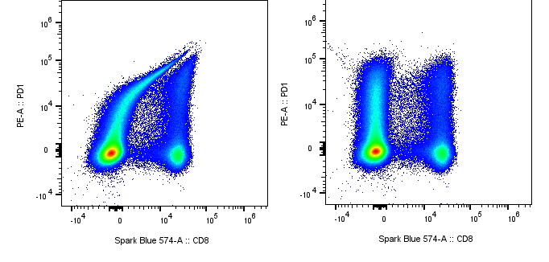
Residual Autofluorescence peaks in Single-Color Signatures
PE signature with
residual AF
PE signature without
residual AF
This residual autofluorescence contribution results in unmixing errors,
and the panel unmixing significantly improved when switched out for bead controls

Slide 31
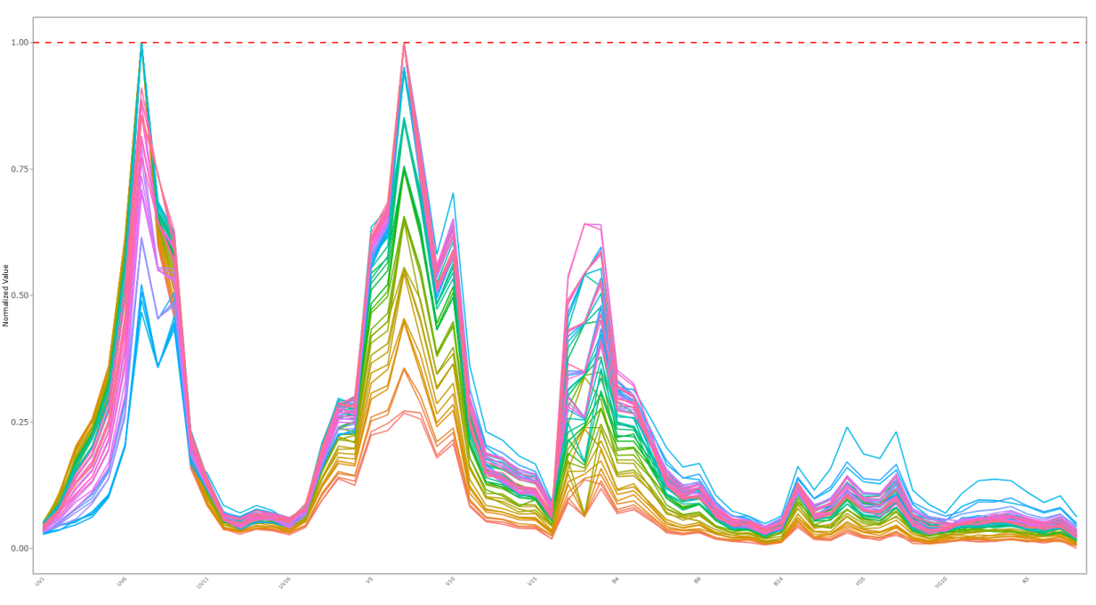
Autofluorescence
Same process to isolate autofluorescence variants
Isolate cells with same normalized signature for use in unmixing

Slide 32
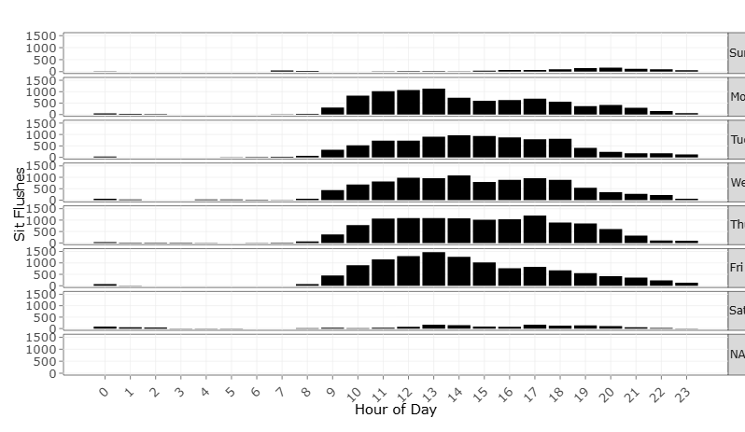
Application Log
Every time a sit-flush occurs, its recorded
Plotted over time, shows weekly usage patterns for instruments
Including “off-schedule” usage
Were clean flow cells and fluidic shut-downs performed?
What software issues occurring?
How many hours has each laser been left on?

Slide 33
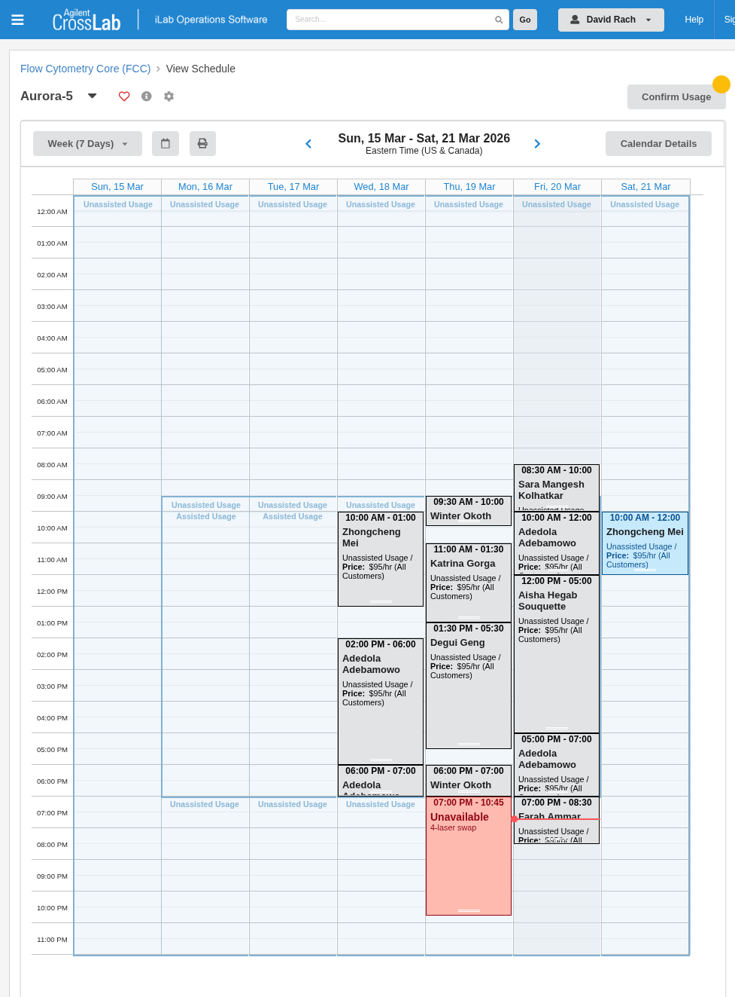
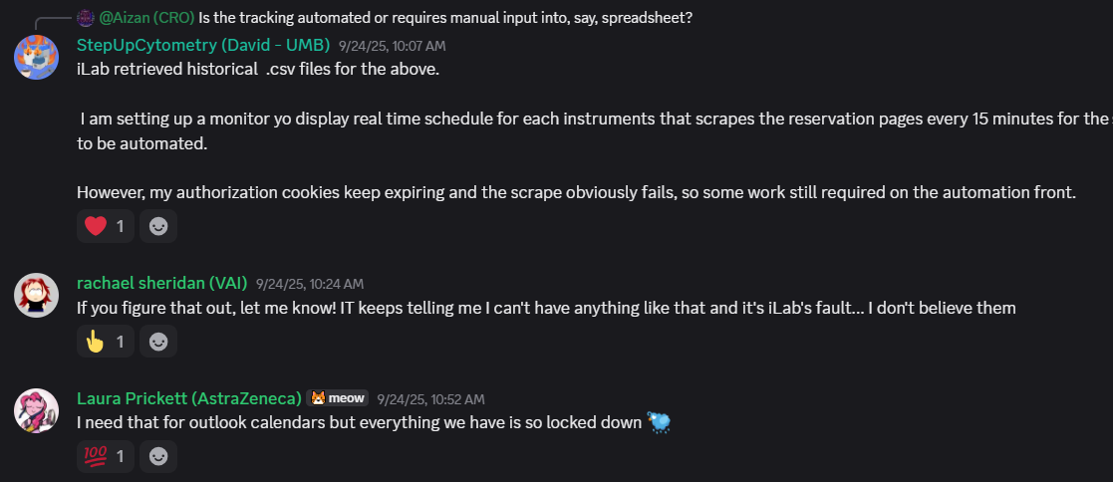
“Is anyone on after-me?”

Slide 34
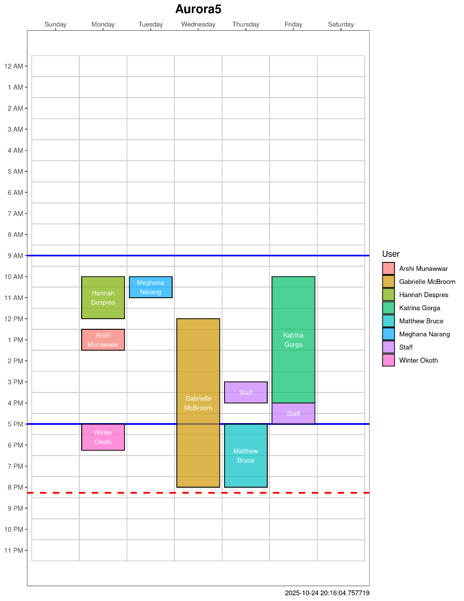
Updating Schedule to Display Monitor
Displayed on a monitor to a Raspberry Pi 4b
Cycles continuously through all the instrument schedules
Refreshes every 15 minutes
Sends booking data to GitHub
Currently working on identifying late evening cancellations and sending emails to power down the instrument

Slide 35
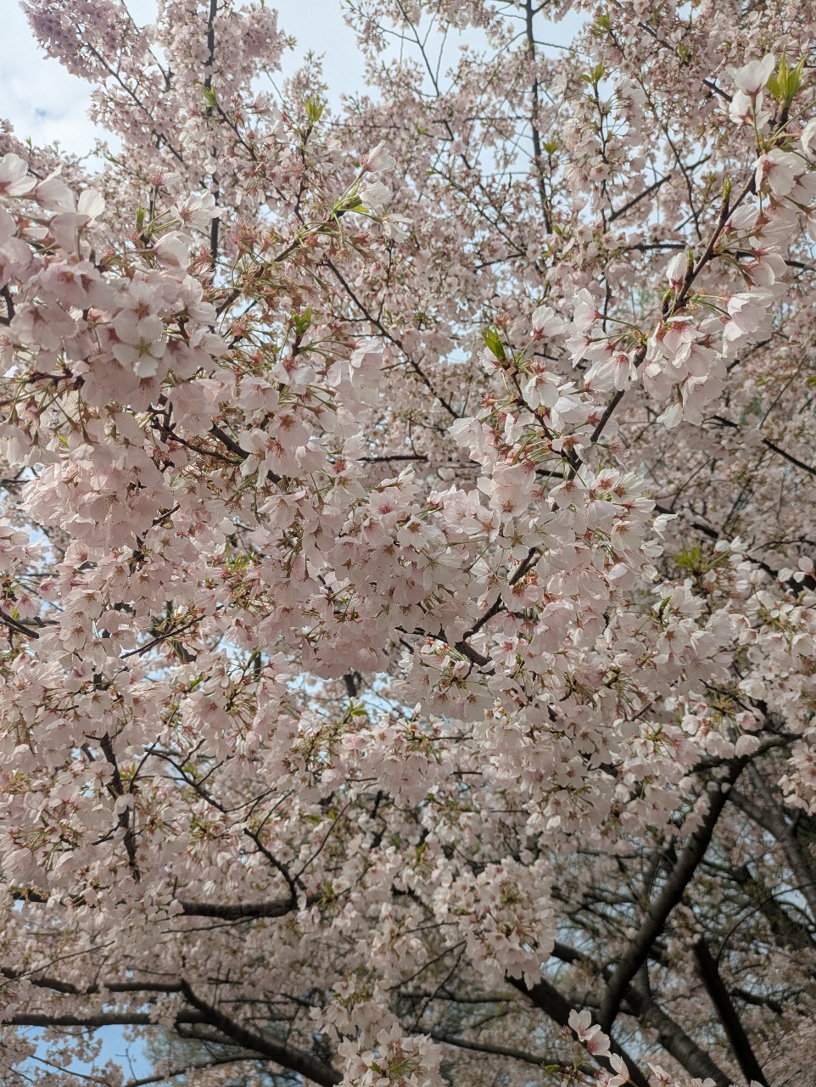
What have we learned?
Small steps, sequentially implemented, have improved our awareness over time.
With most instruments, useful information can be retrieved from unlikely sources
Repurposing existing open-source software infrastructure speeds things up
Set up for generalization requires additional planning

Slide 36
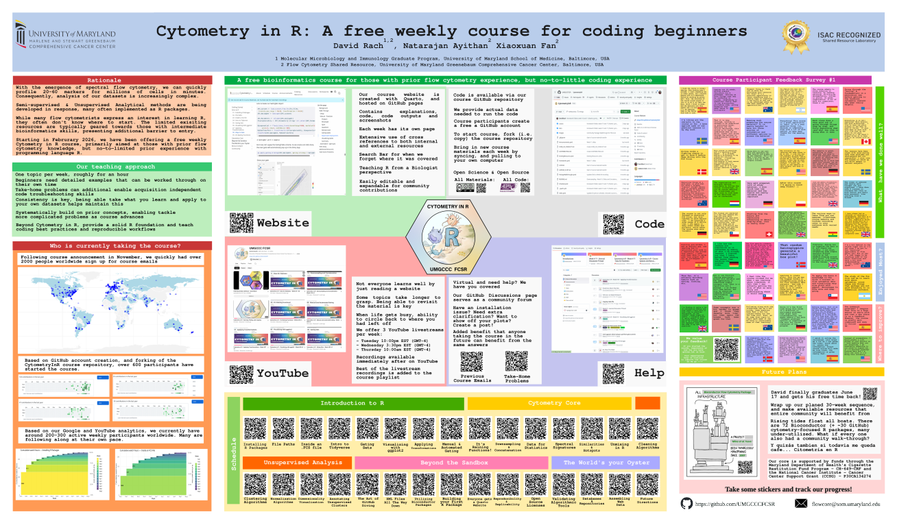

Learn R at your own pace
Website

Slide 37

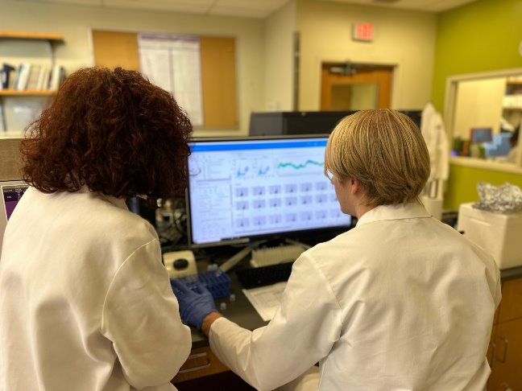


Acknowledgements
UMGCCC FCSR
Dr. Xiaoxuan Fan
Dr. Natarajan Ayithan
Mikayla Trainor
University of Maryland School of Medicine
Dr. Cristiana Cairo
Dr. Kirsten E. Lyke
Cytometry Discord
PIN:
Daniela Franco
This publication was supported by funds through Maryland Department of Health’s Cigarette Restitution Fund Program – CH- 649-CRF and the National Cancer Institute – Cancer Center Support Grant (CCSG) – P30CA134274.d Service
Molecular Microbiology Immunology Graduate Program
Dr. Eileen Barry
Dr. Heather Ezelle
Bess Tracey

Slide 38
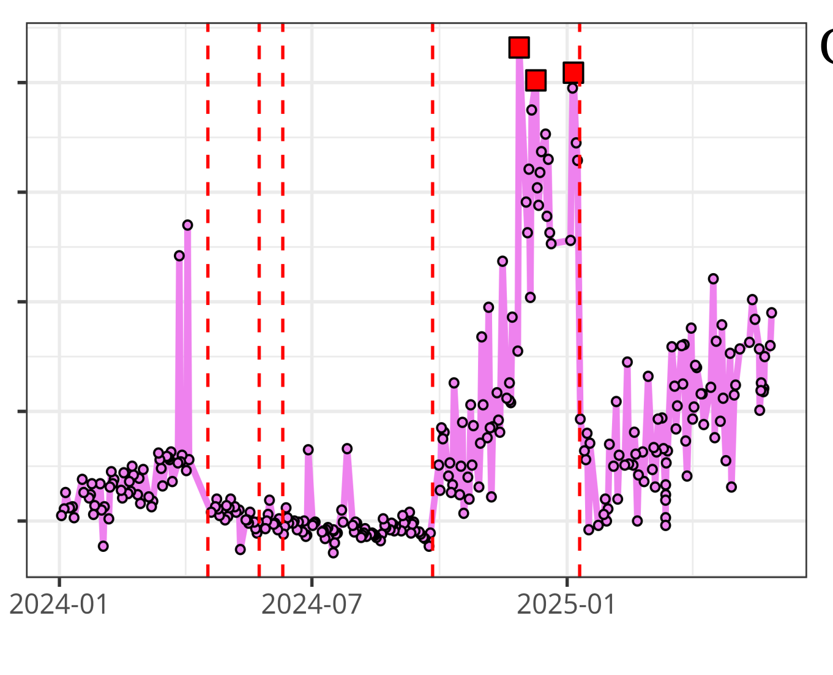


Questions?
UMGCCC FCSR
InstrumentQC dashboard
Luciernaga
Website - CytometryInR
InstrumentQC How-To
Coereba
YouTube @CytometryInR

Slide 39

Graduate Next Week
All coding side-projects will then resume post-defense

Slide 40
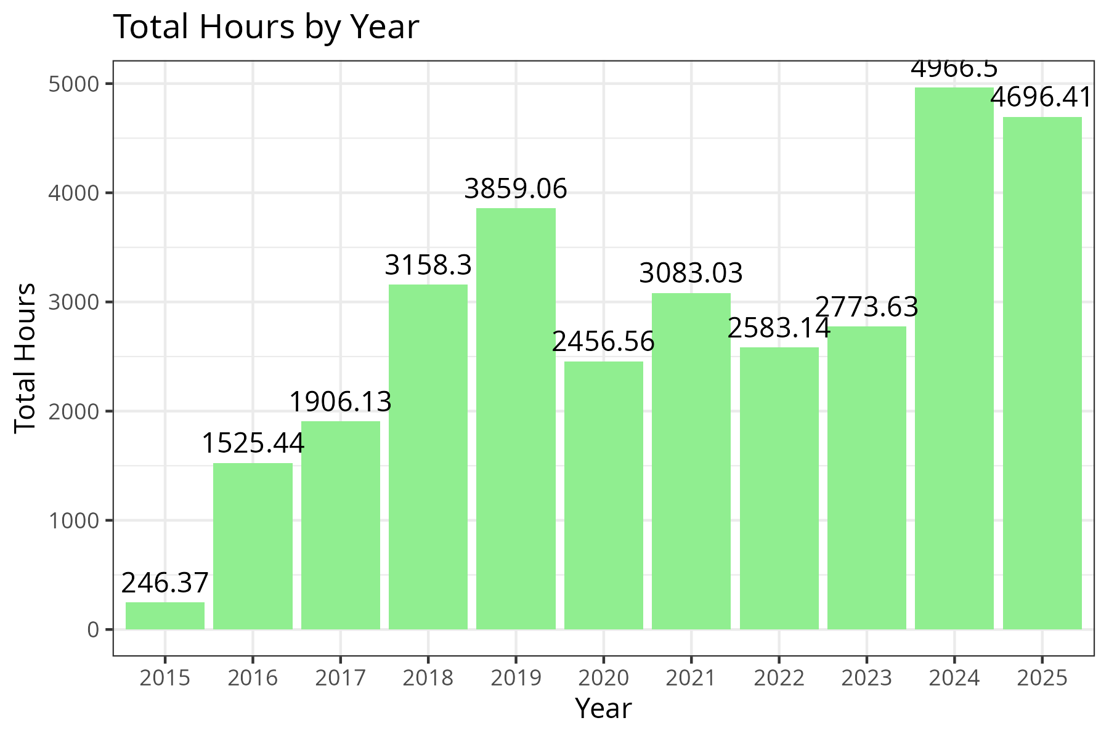
Metrics from iLab

Slide 41
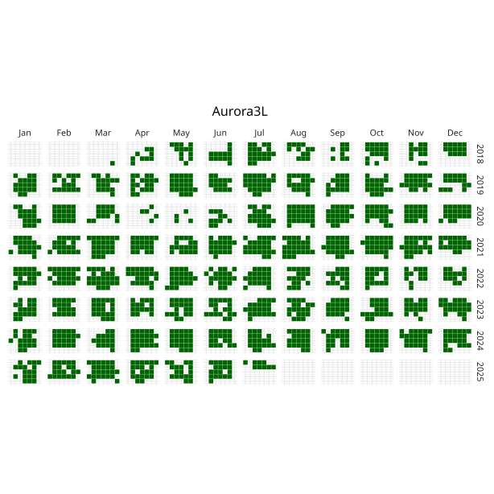

Instrument Use over Time

Slide 42


When did individual users or labs use the instruments?
David Rach
Cairo Lab

