Slide 1



“Deciphering the black box”: leveraging shared-resource laboratory
resources to tackle spectral flow cytometry’s quirks
David Rach, Ph.D.
UMGCCC Flow Cytometry Shared Resource
Baltimore, MD
November 05, 2026
Slides

Slide 2

Spectral is amazing

Slide 3
Making analyses possible

Slide 4
Success due to us as a community

Slide 5
Still has its quirks

Slide 6
Co-expression in unmixing

Slide 7
Unmixing controls autofluorescence

Slide 8
Unmixing controls single colors

Slide 9
QC goes bad with bleach

Slide 10
Mix art, science and hoodoo

Slide 11
SRLs as force for good

Slide 12
Wide range of panels and cell types

Slide 13
Instruments over lifespan

Slide 14
Who spots the issues

Slide 15
Im tired maaannn

Slide 16
Automate the detection

Slide 17
And decipher some underlying unanswered

Slide 18
Manufacturer accessability

Slide 19
What we do as far as QC

Slide 20
A little programming knowledge makes you dangerous

Slide 21
Things you may have not known about your Aurora

Slide 22
Sit Flushes in App Log

Slide 23
Usage Plots vs. hour

Slide 24
Commando Users

Slide 25
Usage Pattern Over Time

Slide 26
QC CSV folder

Slide 27
Temperature

Slide 28
QC Time

Slide 29
Parse for errors, sequences

Slide 30
FCS files undefined

Slide 31
QC doing what is says undefined

Slide 32
CSVs to dashboard undefined

Slide 33
Damaged QC beads

Slide 34
Expt files undefined

Slide 35
Users not knowing about threshold

Slide 36
Correct antibody

Slide 37
Stain index and prediction

Slide 38
Correlating variation

Slide 39
Is my unstained zombied?

Slide 40
Future works in progress

Slide 41
Regardless, what one person can do

Slide 42
But what if we had a community soapbox

Slide 43
Manufacturers can help or get out of the way

Slide 44
Rise together stronger

Slide 45
Open-source and shared

Slide 46
R not just for the analyst

Slide 47
Cytometry in R slides

Slide 48
My scripts are here

Slide 49
Call for Cytometry QC data

Slide 50
Acknowledgements

Slide 51
Questions

Slide 52

Spectral Flow Cytometry is amazing!!!
Capable of resolving remarkably similar fluorophores → increased number of markers per panel compared to conventional flow cytometry (CFC)
Allows for rapid acquisition of millions of events in a few minutes → typically greater number of acquired cells per sample compared to mass cytometry (MC)
Spectral Flow Cytometry (SFC) datasets have an unique combination of width and depth compared to preceding technologies

Slide 53
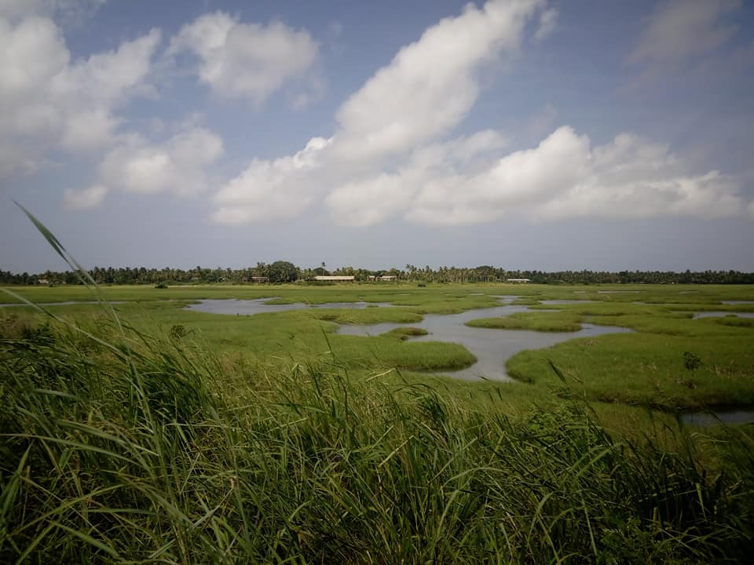
Spectral Flow Cytometry is amazing!!!
Able to efficiently acquire greater number of cells → carry out a more thorough profiling of rare cell subsets
Build one panel, evaluate multiple cell types → invaluable for clinical studies with limited biospecimen
Expand our knowledge about immune system heterogeneity

Slide 54
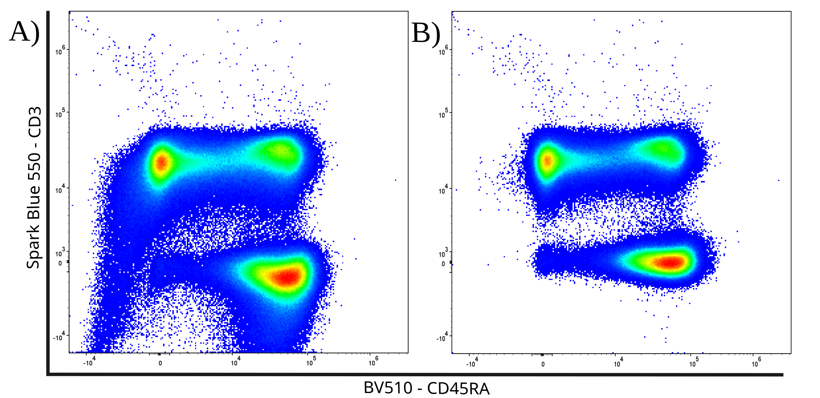
Adapted algorithmic tools struggle with unmixing errors
Adapted software packages heavily rely on having a consistent median fluorescent intensity (MFI) to cluster cells based on positive or negative marker expression
Existing batch correction / normalization / scaling tools target instrumental or experimental level variation for correction
Unmixing errors can seriously shift the MFI ranges for “negative” and “positive” cells for individual acquired specimens

Slide 55
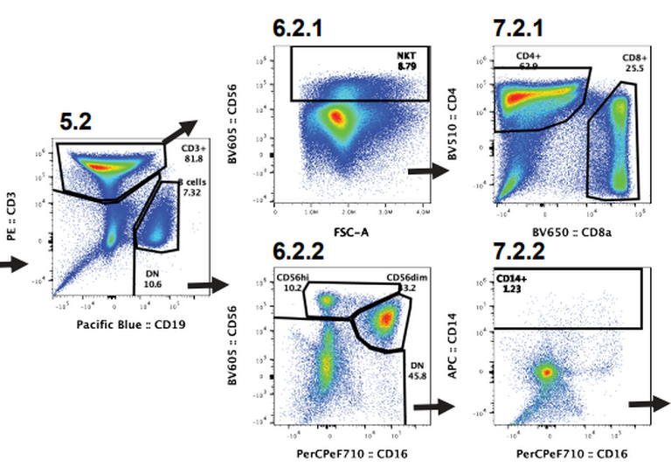

“We discovered a novel dendritic cell cluster”

Slide 56




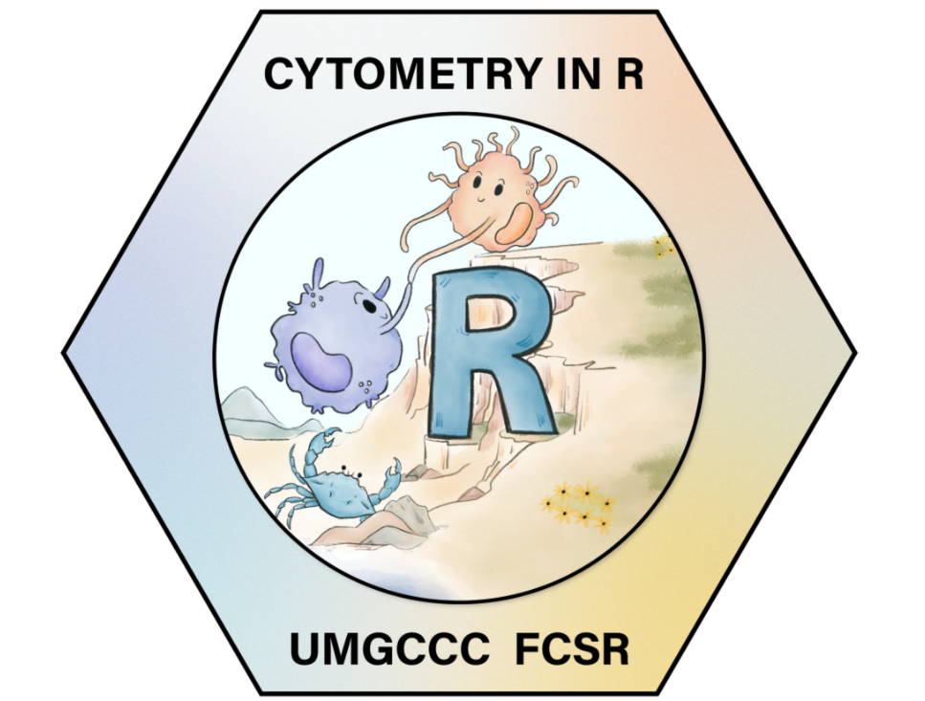
Building open-source tool-sets to address SFC’s quirks
Spectral Signature Characterization and Isolation
Incorporation of manually-annotated gating information
Automated Instrument
Quality-Control Dashboards
Rust

Slide 57
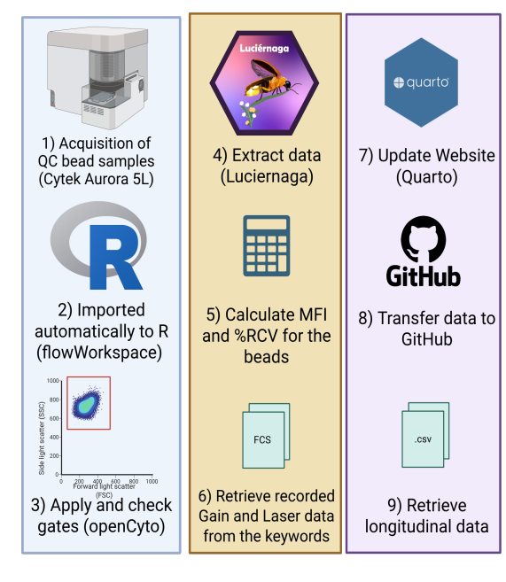
Automated Daily Processing
Behind-the-scenes:
Using R (and increasingly Rust) to process the .fcs files
Automated transfer to GitHub via Windows Task Scheduler
Our Quarto Website gets updated twice daily via a GitHub action

Slide 58

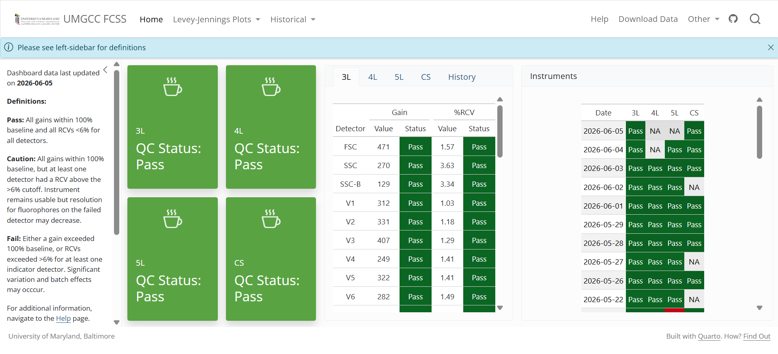
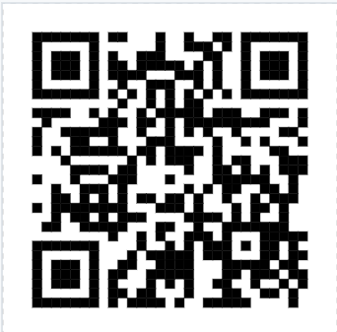
Instrument Quality Control Dashboard
Dashboard
How-To

Slide 59
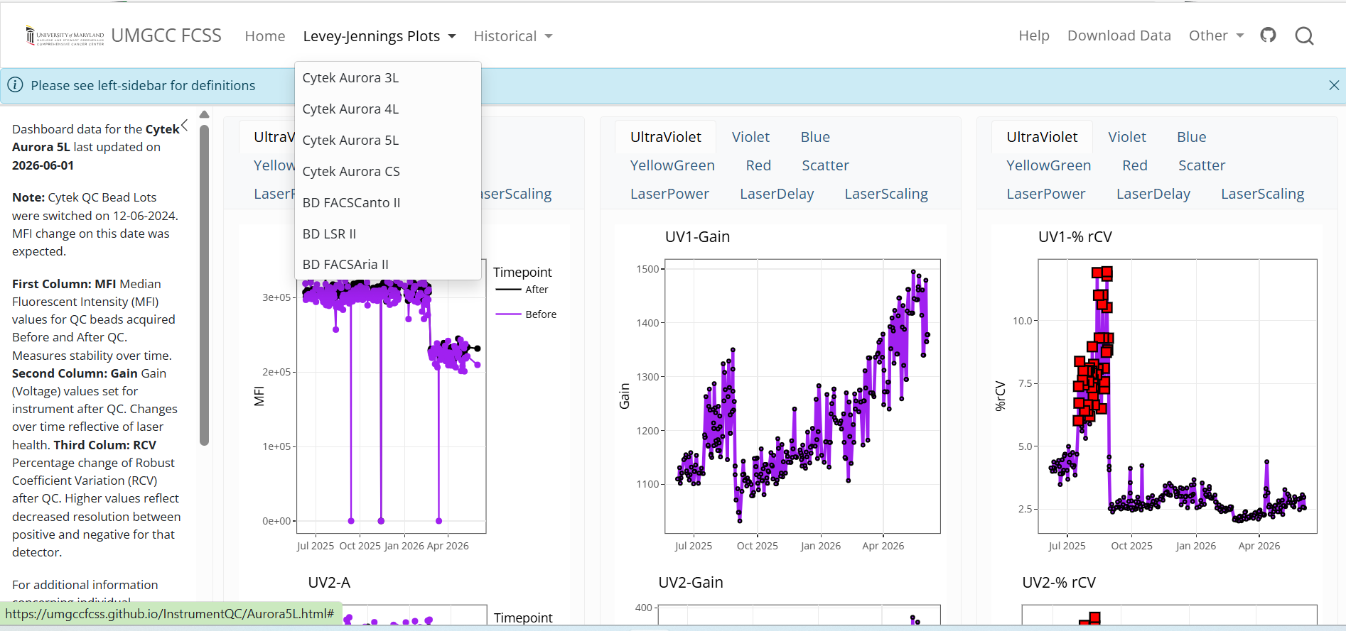
Instrument Quality Control Dashboard

Slide 60
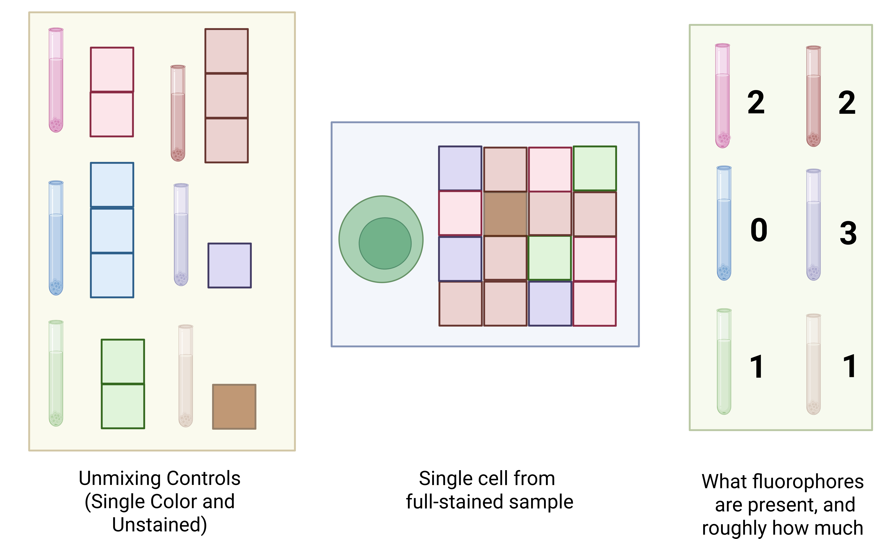
Spectral Unmixing
APC-Vio 770
PE-Vio 770

Slide 61
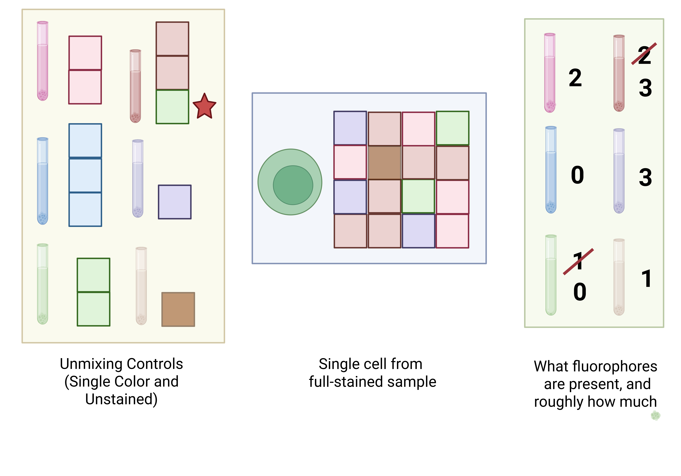
Mismatched references lead to errors in attribution
APC-Vio 770
PE-Vio 770

Slide 62
How to identify problematic unmixing controls
Despite the critical importance unmixing controls play, few tools permit us to determine quality of the individual control before unmixing
Existing quality control algorithms (PeacoQC, FlowAI, etc.) primarily focus on detecting laser and fluidic issues in already acquired .fcs files.
Unmixing errors can be introduced by tandem degradational, additional autofluorescences, undiagnosed instrumental issues, etc.

Slide 63
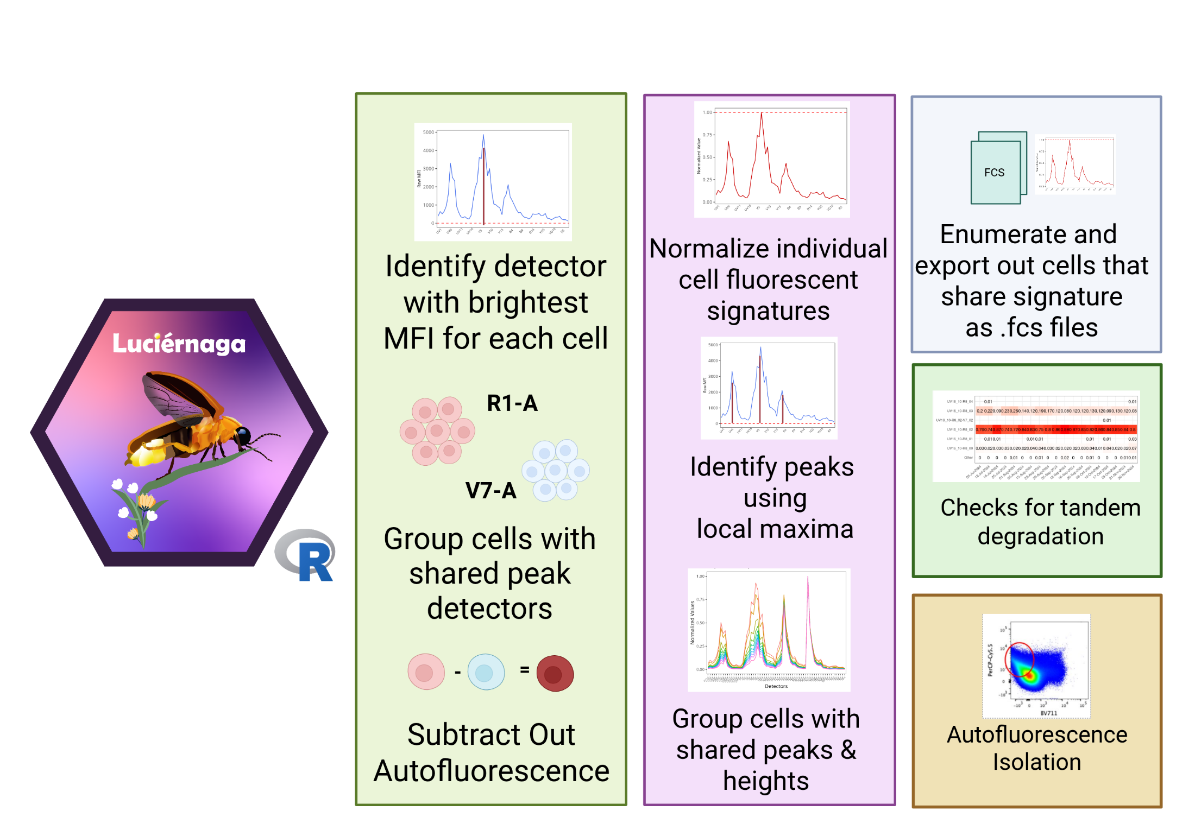

Luciernaga
Code

Slide 64
Luciernaga
Code

Slide 65
Luciernaga
Code

Slide 66
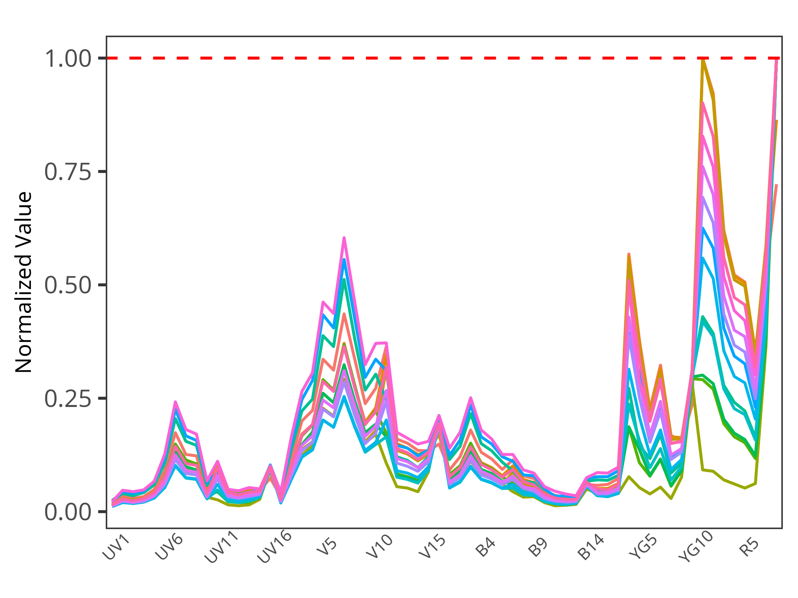
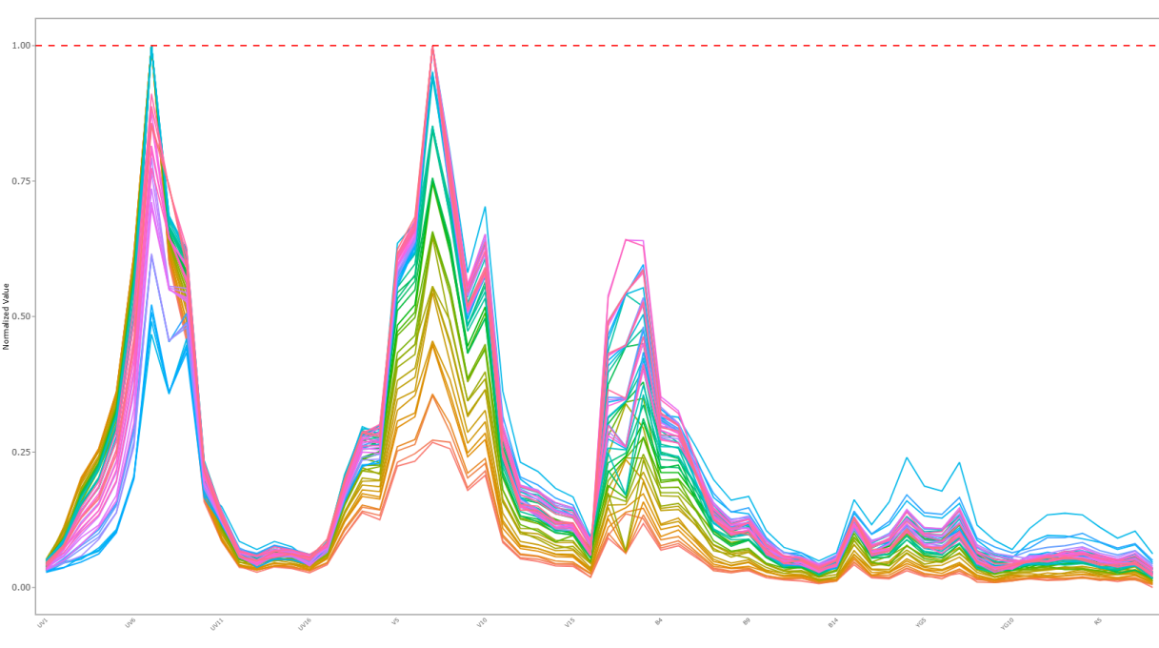
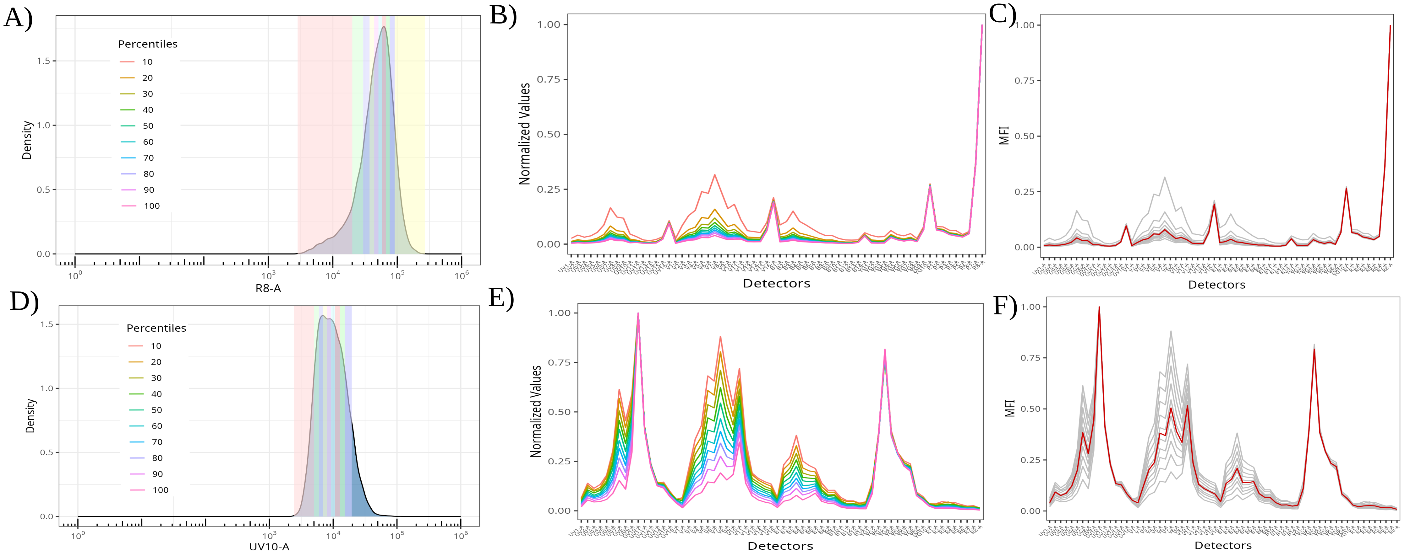
Automated tools for screening unmixing controls
APC
APC-Fire 810
Tandem Degradation
Autofluorescence Isolation
Residual Autofluorescence

Slide 67
Identifying degrading fluorophores
Fluorophores in good shape → one predominant normalized signature within the unmixing control raw .fcs file
When the fluorophore degrades, noticeable increase in variant signatures, making up substantial proportion of all cells in the unmixing control
Automated screening all acquired unmixing controls from campus users during off-hours

Slide 68
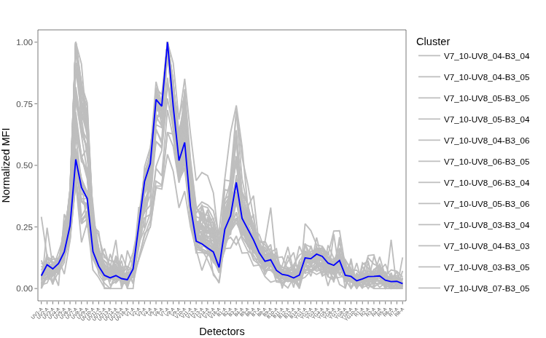
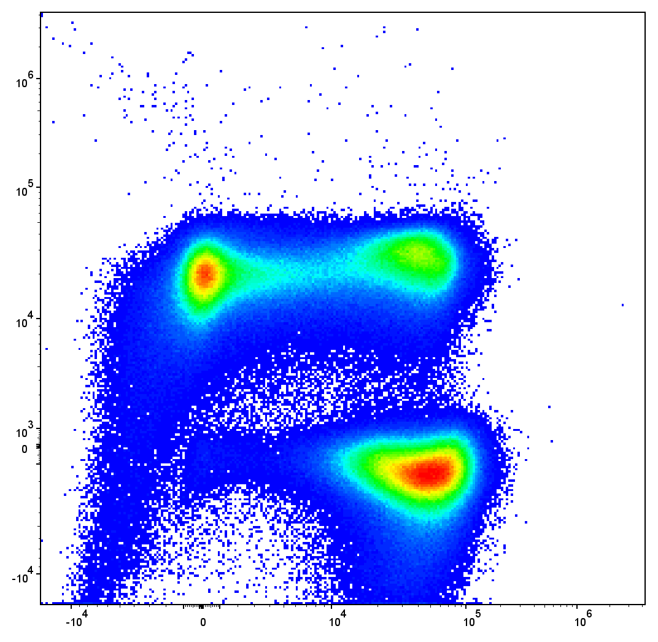
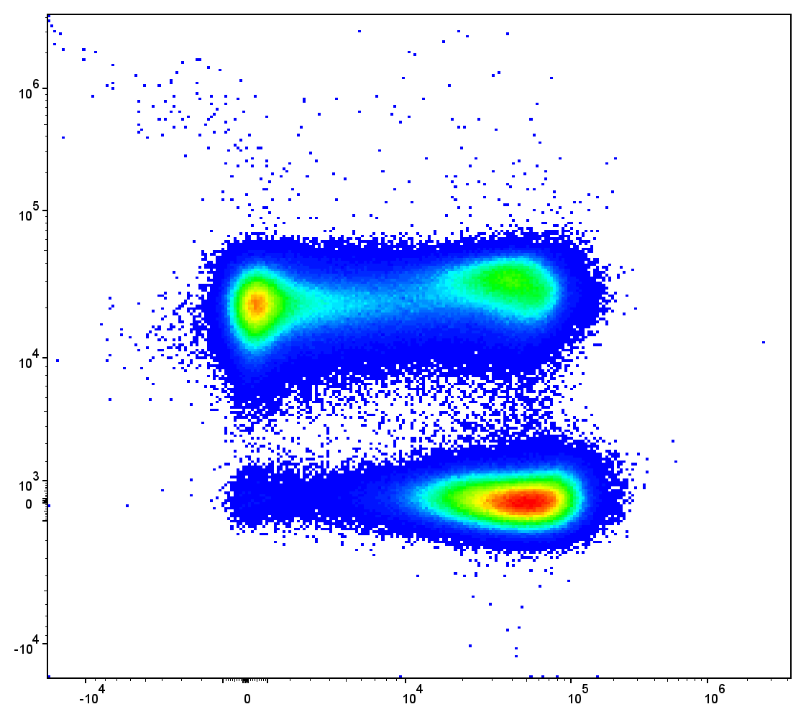
Isolating additional autofluorescence signatures
This approach also works to isolate variant autofluorescence signatures from unstained controls
Unlike other approaches, the isolated cells share normalized signatures, only differing in terms of brightness
Return directly as an .fcs file containing just cells with same signature for use as an autofluorescent tag in SpectroFlo

Slide 69
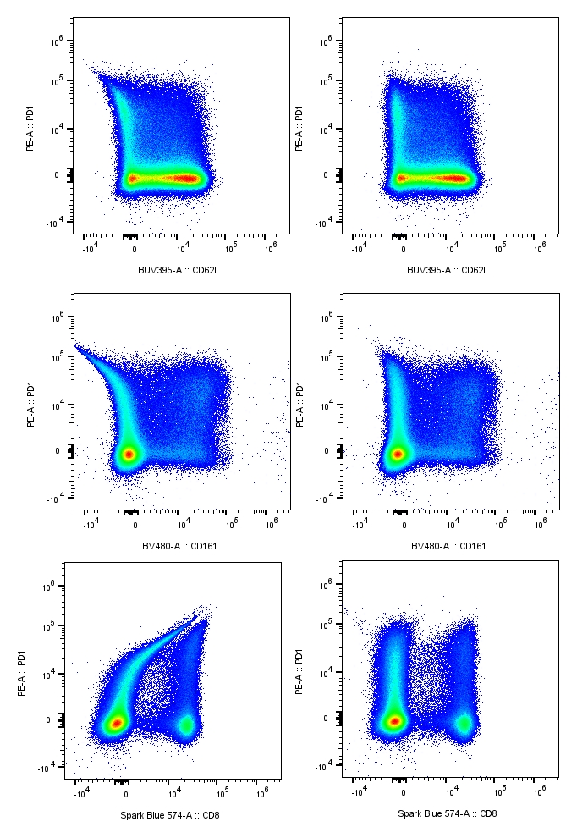
Residual autofluorescence in dim cell single-color controls
“As bright or brighter”
Dim antigen-fluorophore combinations acquired as cell single-color controls often have residual autofluorescence contribution to their signature
Identifying and switching these dim cell single-color controls to bead single-color controls significantly improved unmixing for our panels
Signature with
residual AF
Signature without
residual AF

Slide 70


What good is any tool if the community is not able to use it?
Few resources to learn Cytometry in R to begin with
Those that exist aimed at those with intermediate-advanced R skills, not beginners
Know-how concentrated at a few institutions
Most self-learning attempts end in frustration

Slide 71

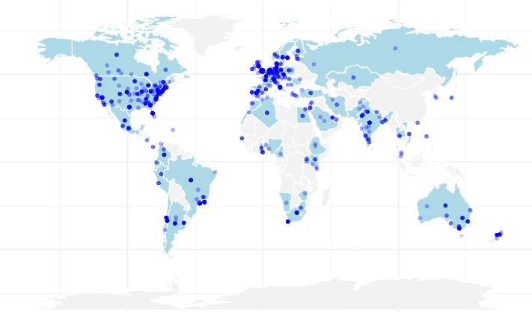

Cytometry in R: A free weekly course for flow cytometrist with no-to-little coding experience
Website

Slide 72
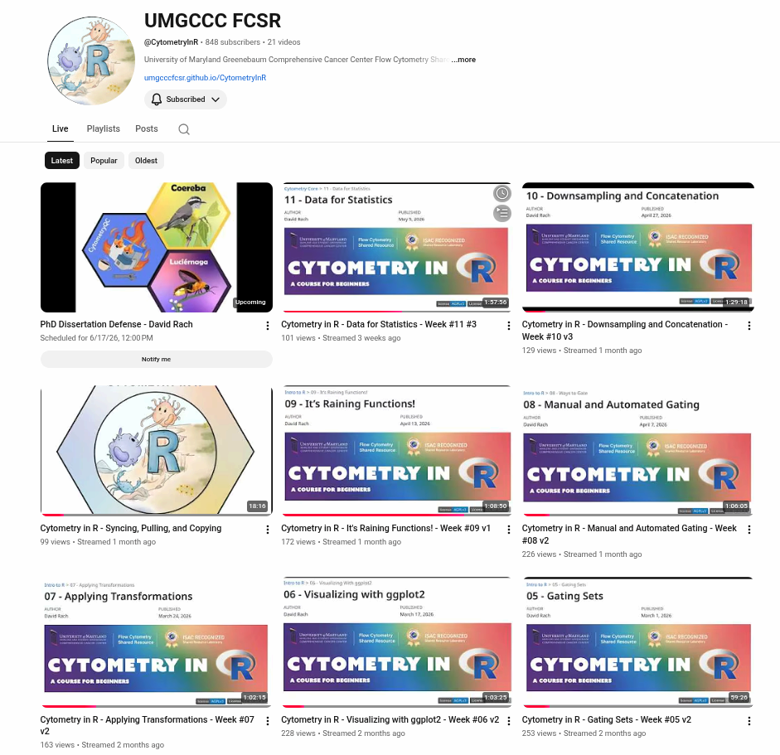
YouTube
Three live-streams a week (accommodating different timezones and schedules)
Recordings available immediately after
Best of the weekly livestreams added to the playlist, cutting down on editing

Slide 73
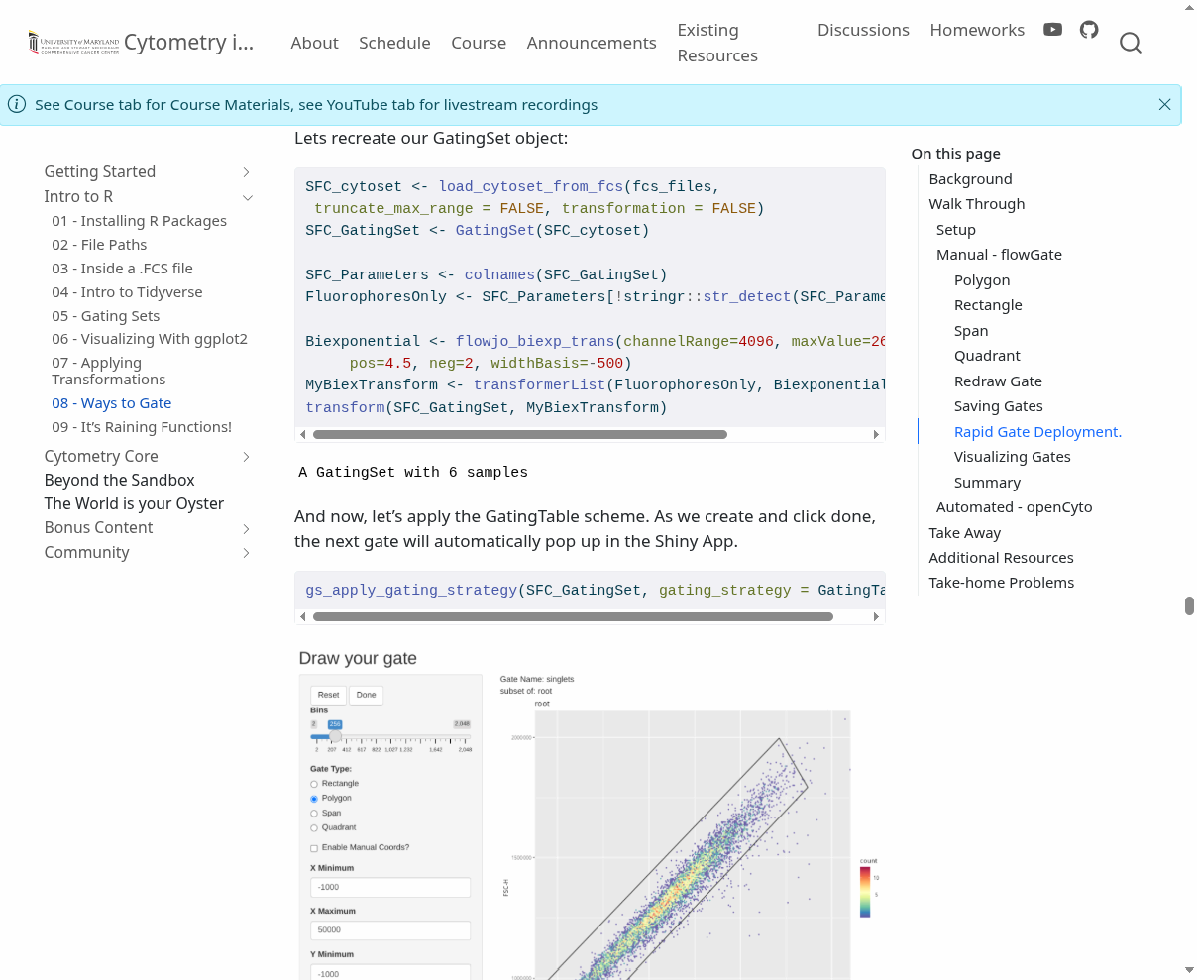
Website
Created with Quarto, hosted via GitHub pages.
Code, code outputs, screenshots and explanations
Searchable
New weekly material added as a new .qmd file

Slide 74
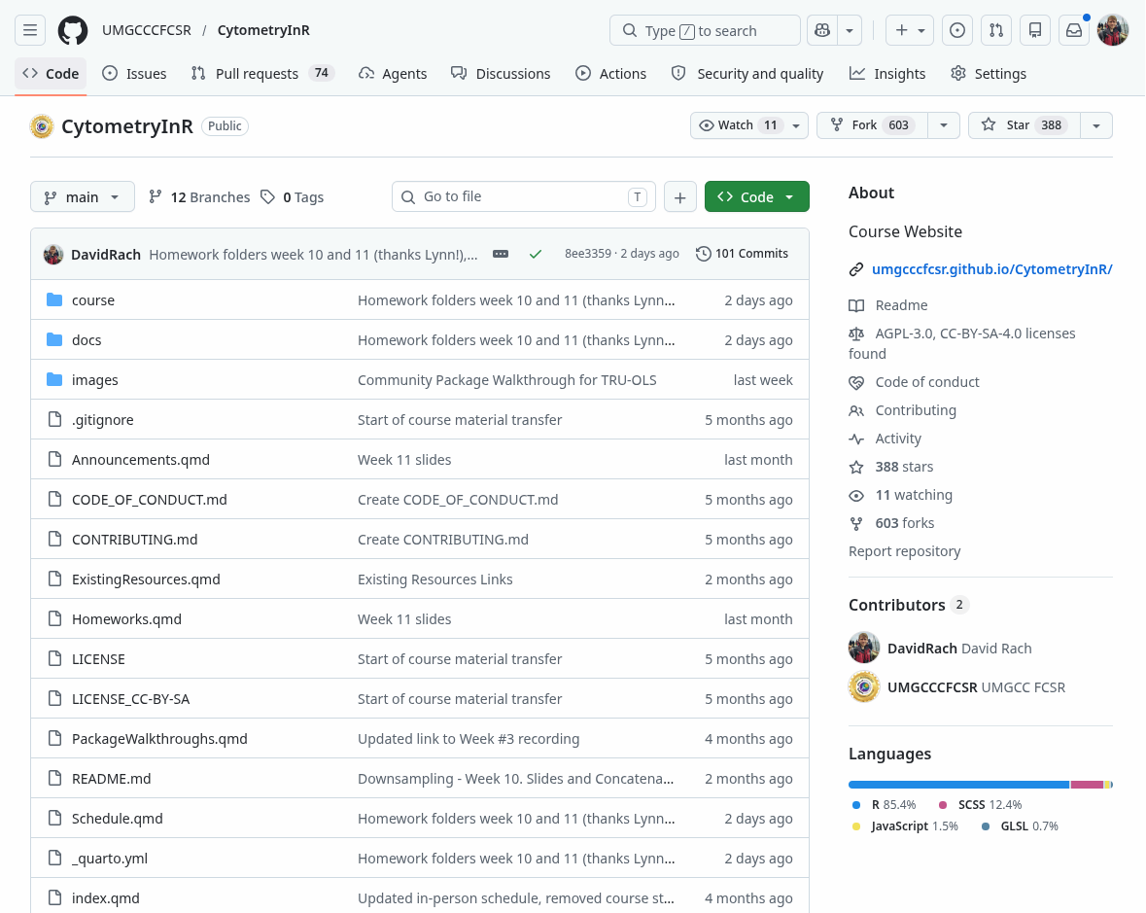
GitHub
Code and datasets available via the GitHub repository
Course participants start course by creating GitHub account and forking the repository
After Positron is linked to GitHub account, pull locally
When new material posted each week, sync and pull

Slide 75
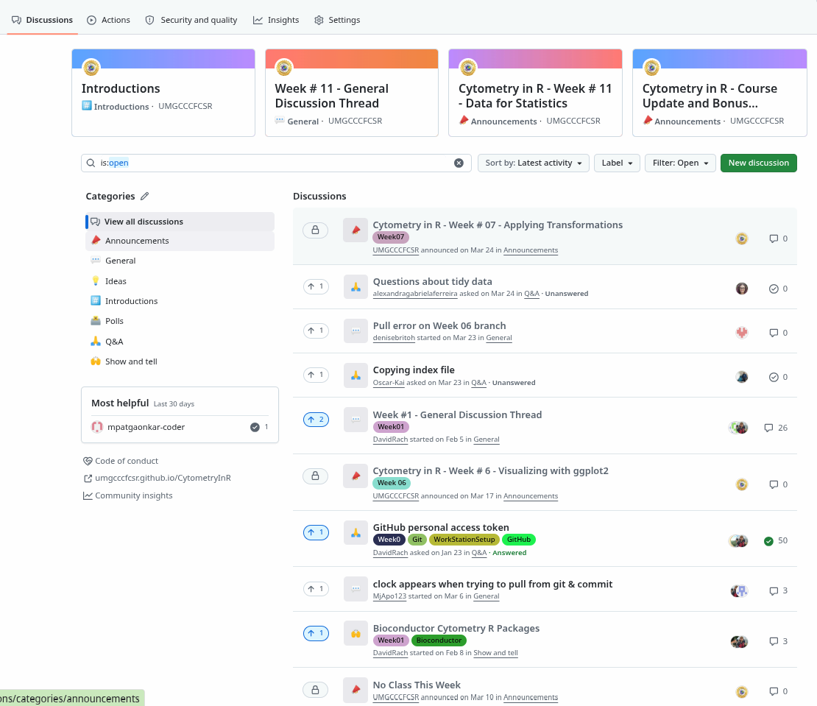
Discussion Forum
GitHub Discussions page has been repurposed as a community forum for questions, etc.

Slide 76
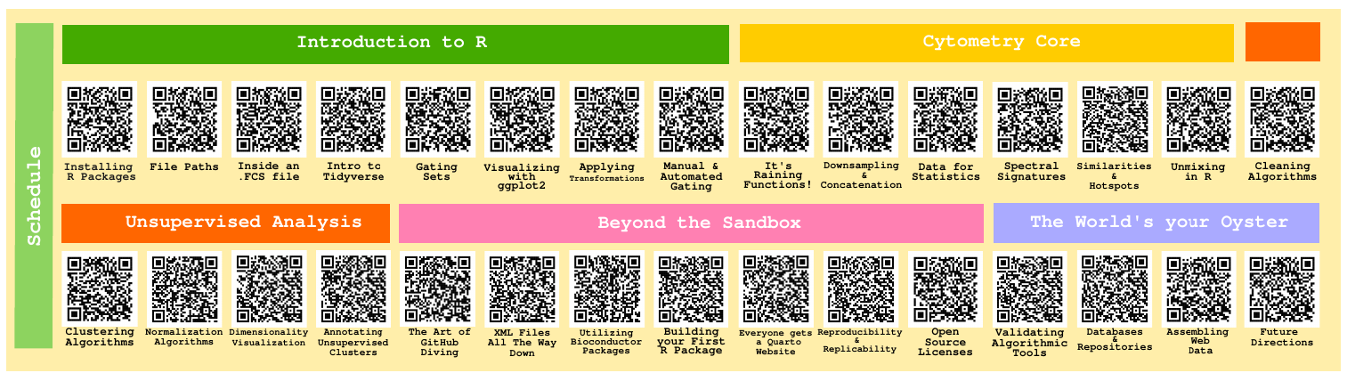
Half-way through this passion project
Wrapping up Cytometry Core module
Gathering steam to start on the Unsupervised Analysis section

Slide 77

As scientist, our community is our strength

Slide 78
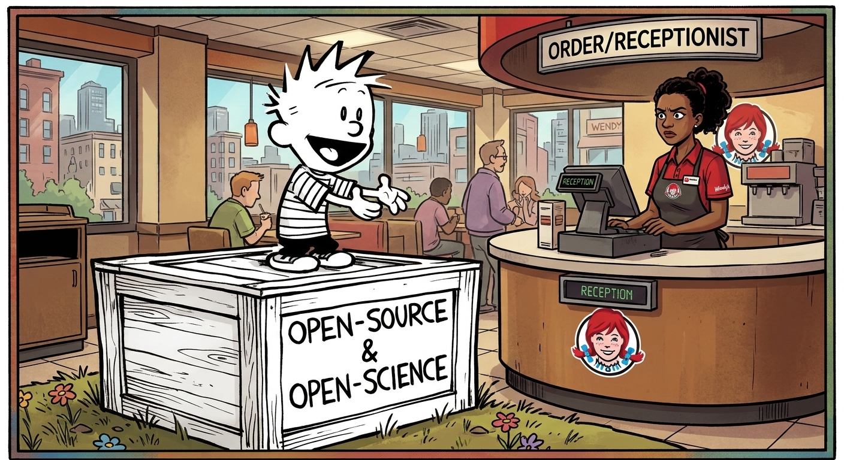
Just my two over-caffeinated cents

Slide 79




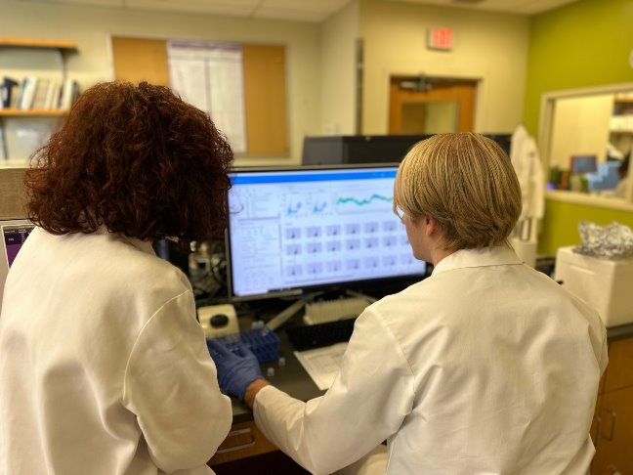




Acknowledgments
All mothers and their infants, and their communities
All the open-source contributors, developers, and maintainers, that collectively made the tool sets without which all of this would not be feasible
Cytometry
Discord
Bioconductor
Zulip
Dr. Cristiana Cairo
Dr. Kirsten E. Lyke
Dr. Xiaoxuan Fan
U01 HD092309
This publication was supported by funds through Maryland Department of Health’s Cigarette Restitution Fund Program – CH- 649-CRF and the National Cancer Institute – Cancer Center Support Grant (CCSG) – P30CA134274.d Service
www.linkedin.com/in/david-rach/
Want to collaborate? Reach out!
Dr. Daniela Franco
Dr. Natarajan Ayithan
Hiring?

Slide 80

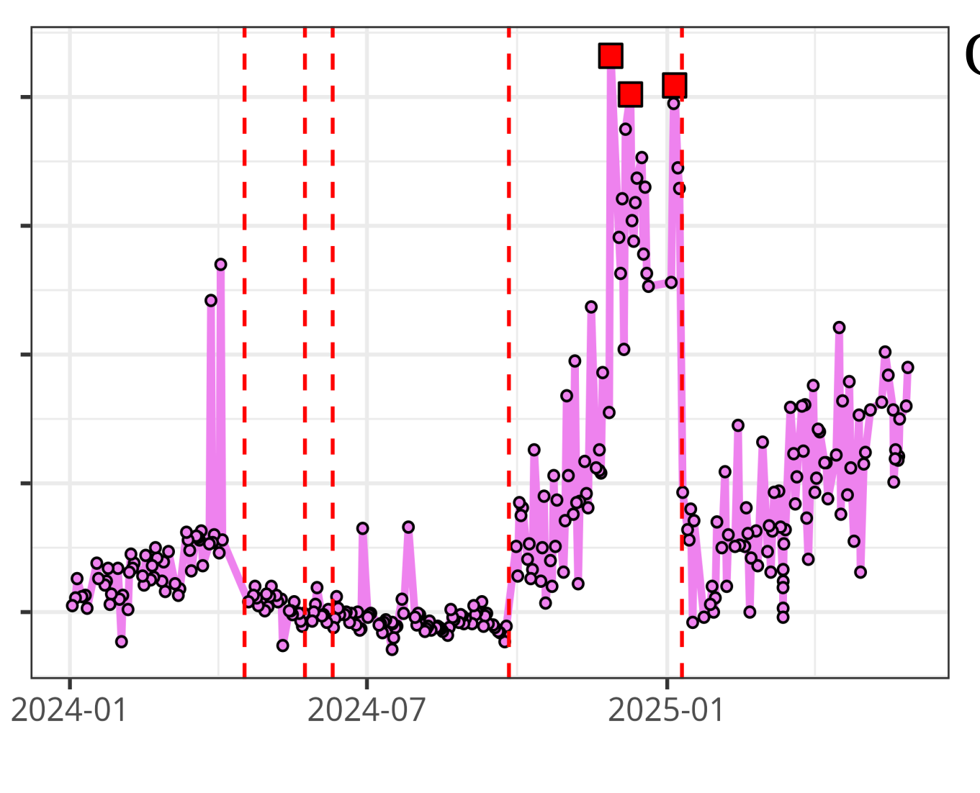



Questions?
Luciernaga
Website - CytometryInR
UMGCCC FCSR
InstrumentQC dashboard
InstrumentQC How-To
Coereba
YouTube @CytometryInR

