Slide 1



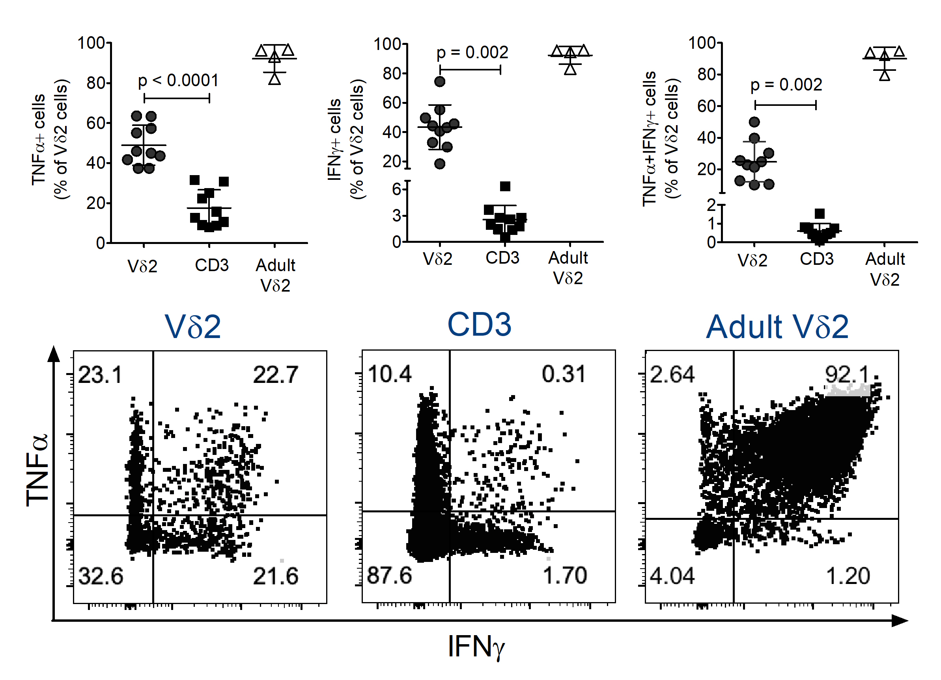
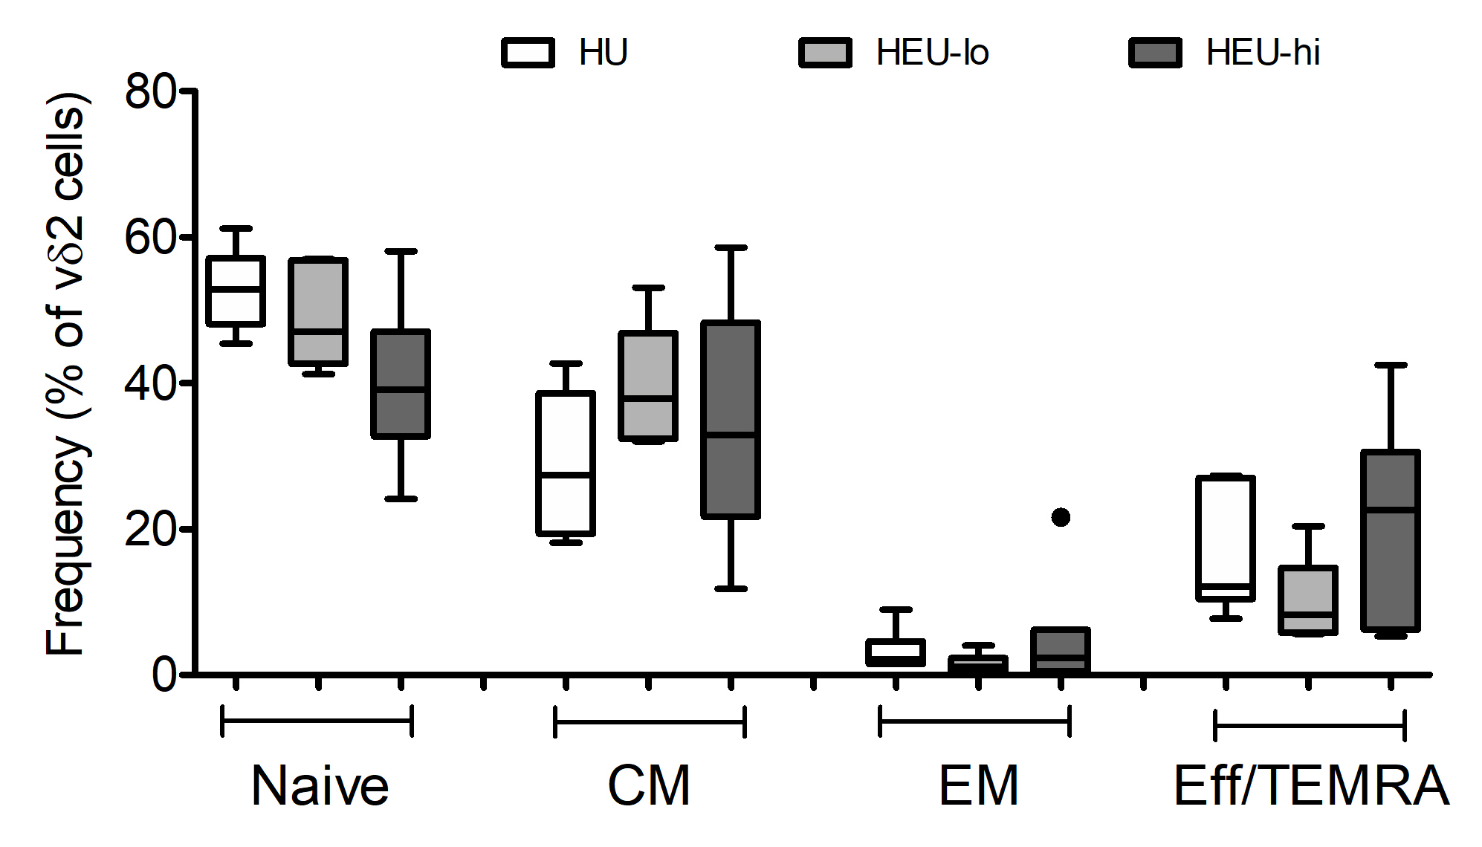
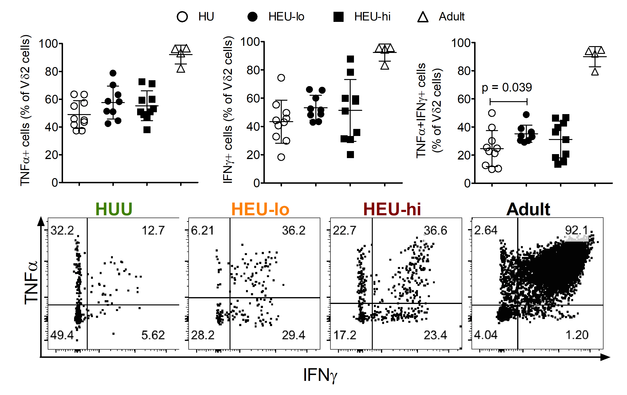
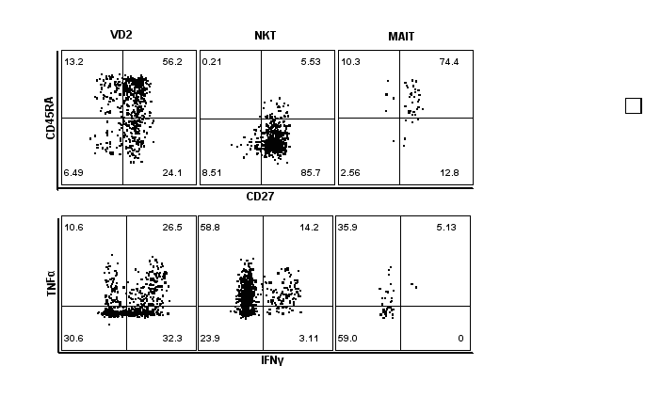
Poster #369
Innate-like T cell responses in HIV exposed uninfected (HEU) Malawian infants
David Thomas Rach¹, Hao-Ting Hsu², Nginache Nampota³, Godfrey Mvula³, Franklin R. Toapanta⁴, Marcelo B. Sztein⁴,
Miriam Laufer⁴, Kirsten E. Lyke⁴, Cristiana Cairo²
¹Molecular Microbiology and Immunology Graduate Program, University of Maryland School of Medicine, Baltimore, MD, United States,
²Institute for Human Virology, University of Maryland School of Medicine, Baltimore, MD, United States, ³Blantyre Malaria Project, KUHeS, Blantyre, Malawi,
⁴Center for Vaccine Development and Global Health, University of Maryland School of Medicine, Baltimore, MD, United States
Introduction
Results
With 1.5 million HIV+ women giving birth every year and effective prevention of mother-to-child transmission, HIV exposed but uninfected (HEU) infants are a growing population.
HEU infants exhibit increased rates of lower respiratory tract infections and diarrheal diseases, compared to HIV unexposed (HU) infants during their first year of life.
Exposure to HIV and/or ART before birth may perturb the developing fetal immune system by increasing inflammation at the fetal-maternal interface.
Innate-like T cells [γδ (Vδ2), MAIT, NKT cells) play important roles against pathogens in early life, being activated by microbial metabolites as well as cytokines produced by innate immune cells
Upon activation, they mount Th1-like and cytotoxic responses in the early phase of the infection.
Perturbation of Innate-like T cells by prenatal exposure to HIV/ART may contribute to the increased infectious morbidity seen in HEU infants.
Figure 1. The frequency of Th1-cytokine-producing cells is higher in cord blood Vδ2 lymphocytes than in total CD3 cells
Figure 3. HEU neonates display lower frequencies of naïve Vδ2 cells compared to HU, but the difference is not statistically significant
After thawing, Cord Blood Mononuclear Cells (CBMC) were resuspended in complete RPMI 1640
1.5x10⁶ CBMCs were stimulated with PMA-ionomycin (plus protein transport inhibitor) at 37*C for 6 hours.
After stimulation, cells were stained with fixable viability dye, surface, and intracellular markers. Cells were then analyzed on a BD LSR-II Flow Cytometry analyzer.
After thawing, cells were stained with differentiation markers and analyzed on an LSR-II Flow Cytometry analyzer. Boxplots display median frequency and interquartile range of the main differentiation subsets for each of the three HIV exposure groups.
Future Directions
Table 1. Study Inclusion/Exclusion Criteria
Figure 2. The frequency of polyfunctional Vδ2 cells is higher in HEU than in HU neonates.
Figure 4. Neonatal ILT subsets exhibit different memory and cytokine
production phenotype
 |  | All |  |  |  | HEU-Lo | HEU-Hi | HU
Eligibility criteria​ | Informed consent​ First antenatal visit​ Intending to breast feed​ Gestational age 24-36 weeks​ Cord blood specimen collected ​ |  |  |  |  | Mother began first line ART prior to conception​ Undetectable viral load at first screening visit and at delivery ​ | Mother initiates first line therapy at ANC clinic​ Viral load at screening >10,000 copies/mL​ ​ | Mother has a negative HIV RDT at enrollment and at delivery​
Final evaluable specimens​ | Received BCG x1 and diphtheria-pertussis-tetanus vaccine (DPT) x3​ No milk substitute formula feeding​ HIV negative at 9 months of age​ |  |  |  |  | Continues ART through the study period​ | Continues ART through the study period​ | Mother has a negative HIV rapid test at delivery and at 9 months​
Analyze the 3 infant groups for the main human ILT subsets employing a 30-color panel (optimized for a Cytek Aurora) that includes hCD1d & hMR1 tetramers to identify NKT and MAITs.
Analyze adaptive responses (T & B cells) to vaccine antigens
Acknowledgements
The Blantyre Malaria Project All Study Participants
NIH Tetramer Core UMGCCC Flow Cytometry Core
U01 HD092308
PBMCs and CBMCs were treated in the same manner as described in Figure 1

