Slide 1


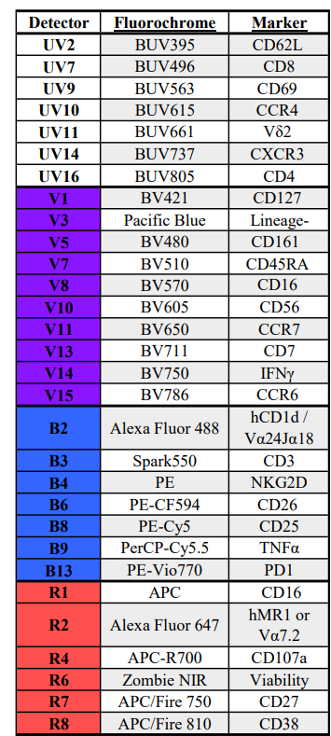
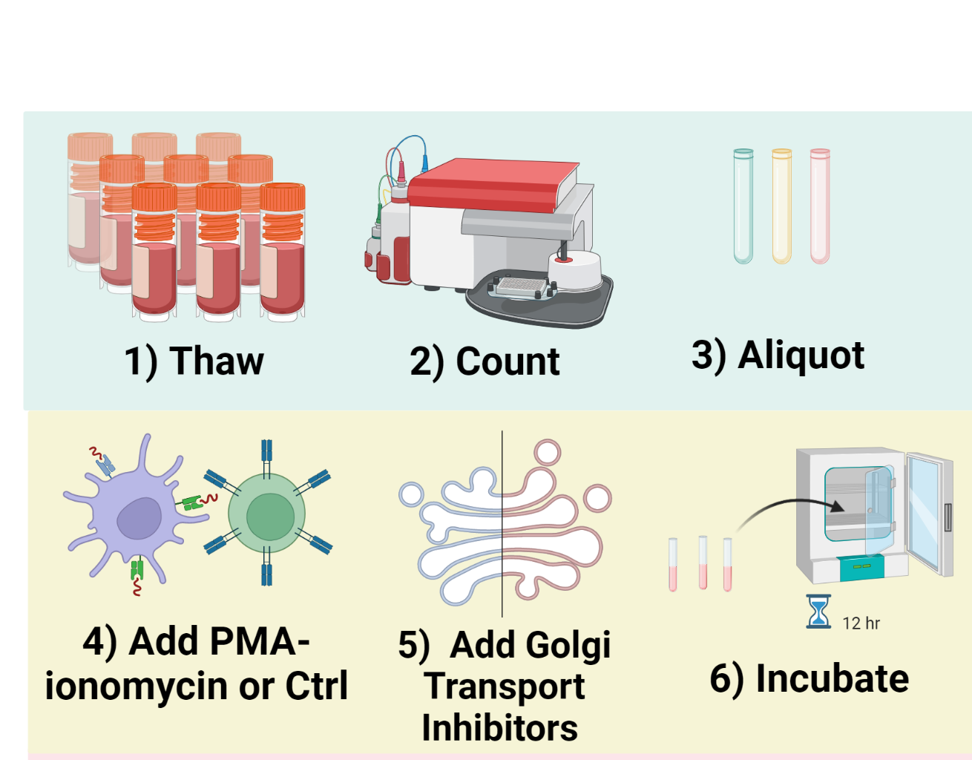
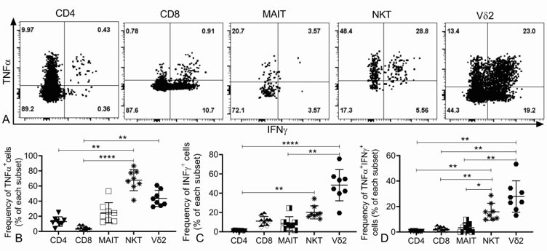
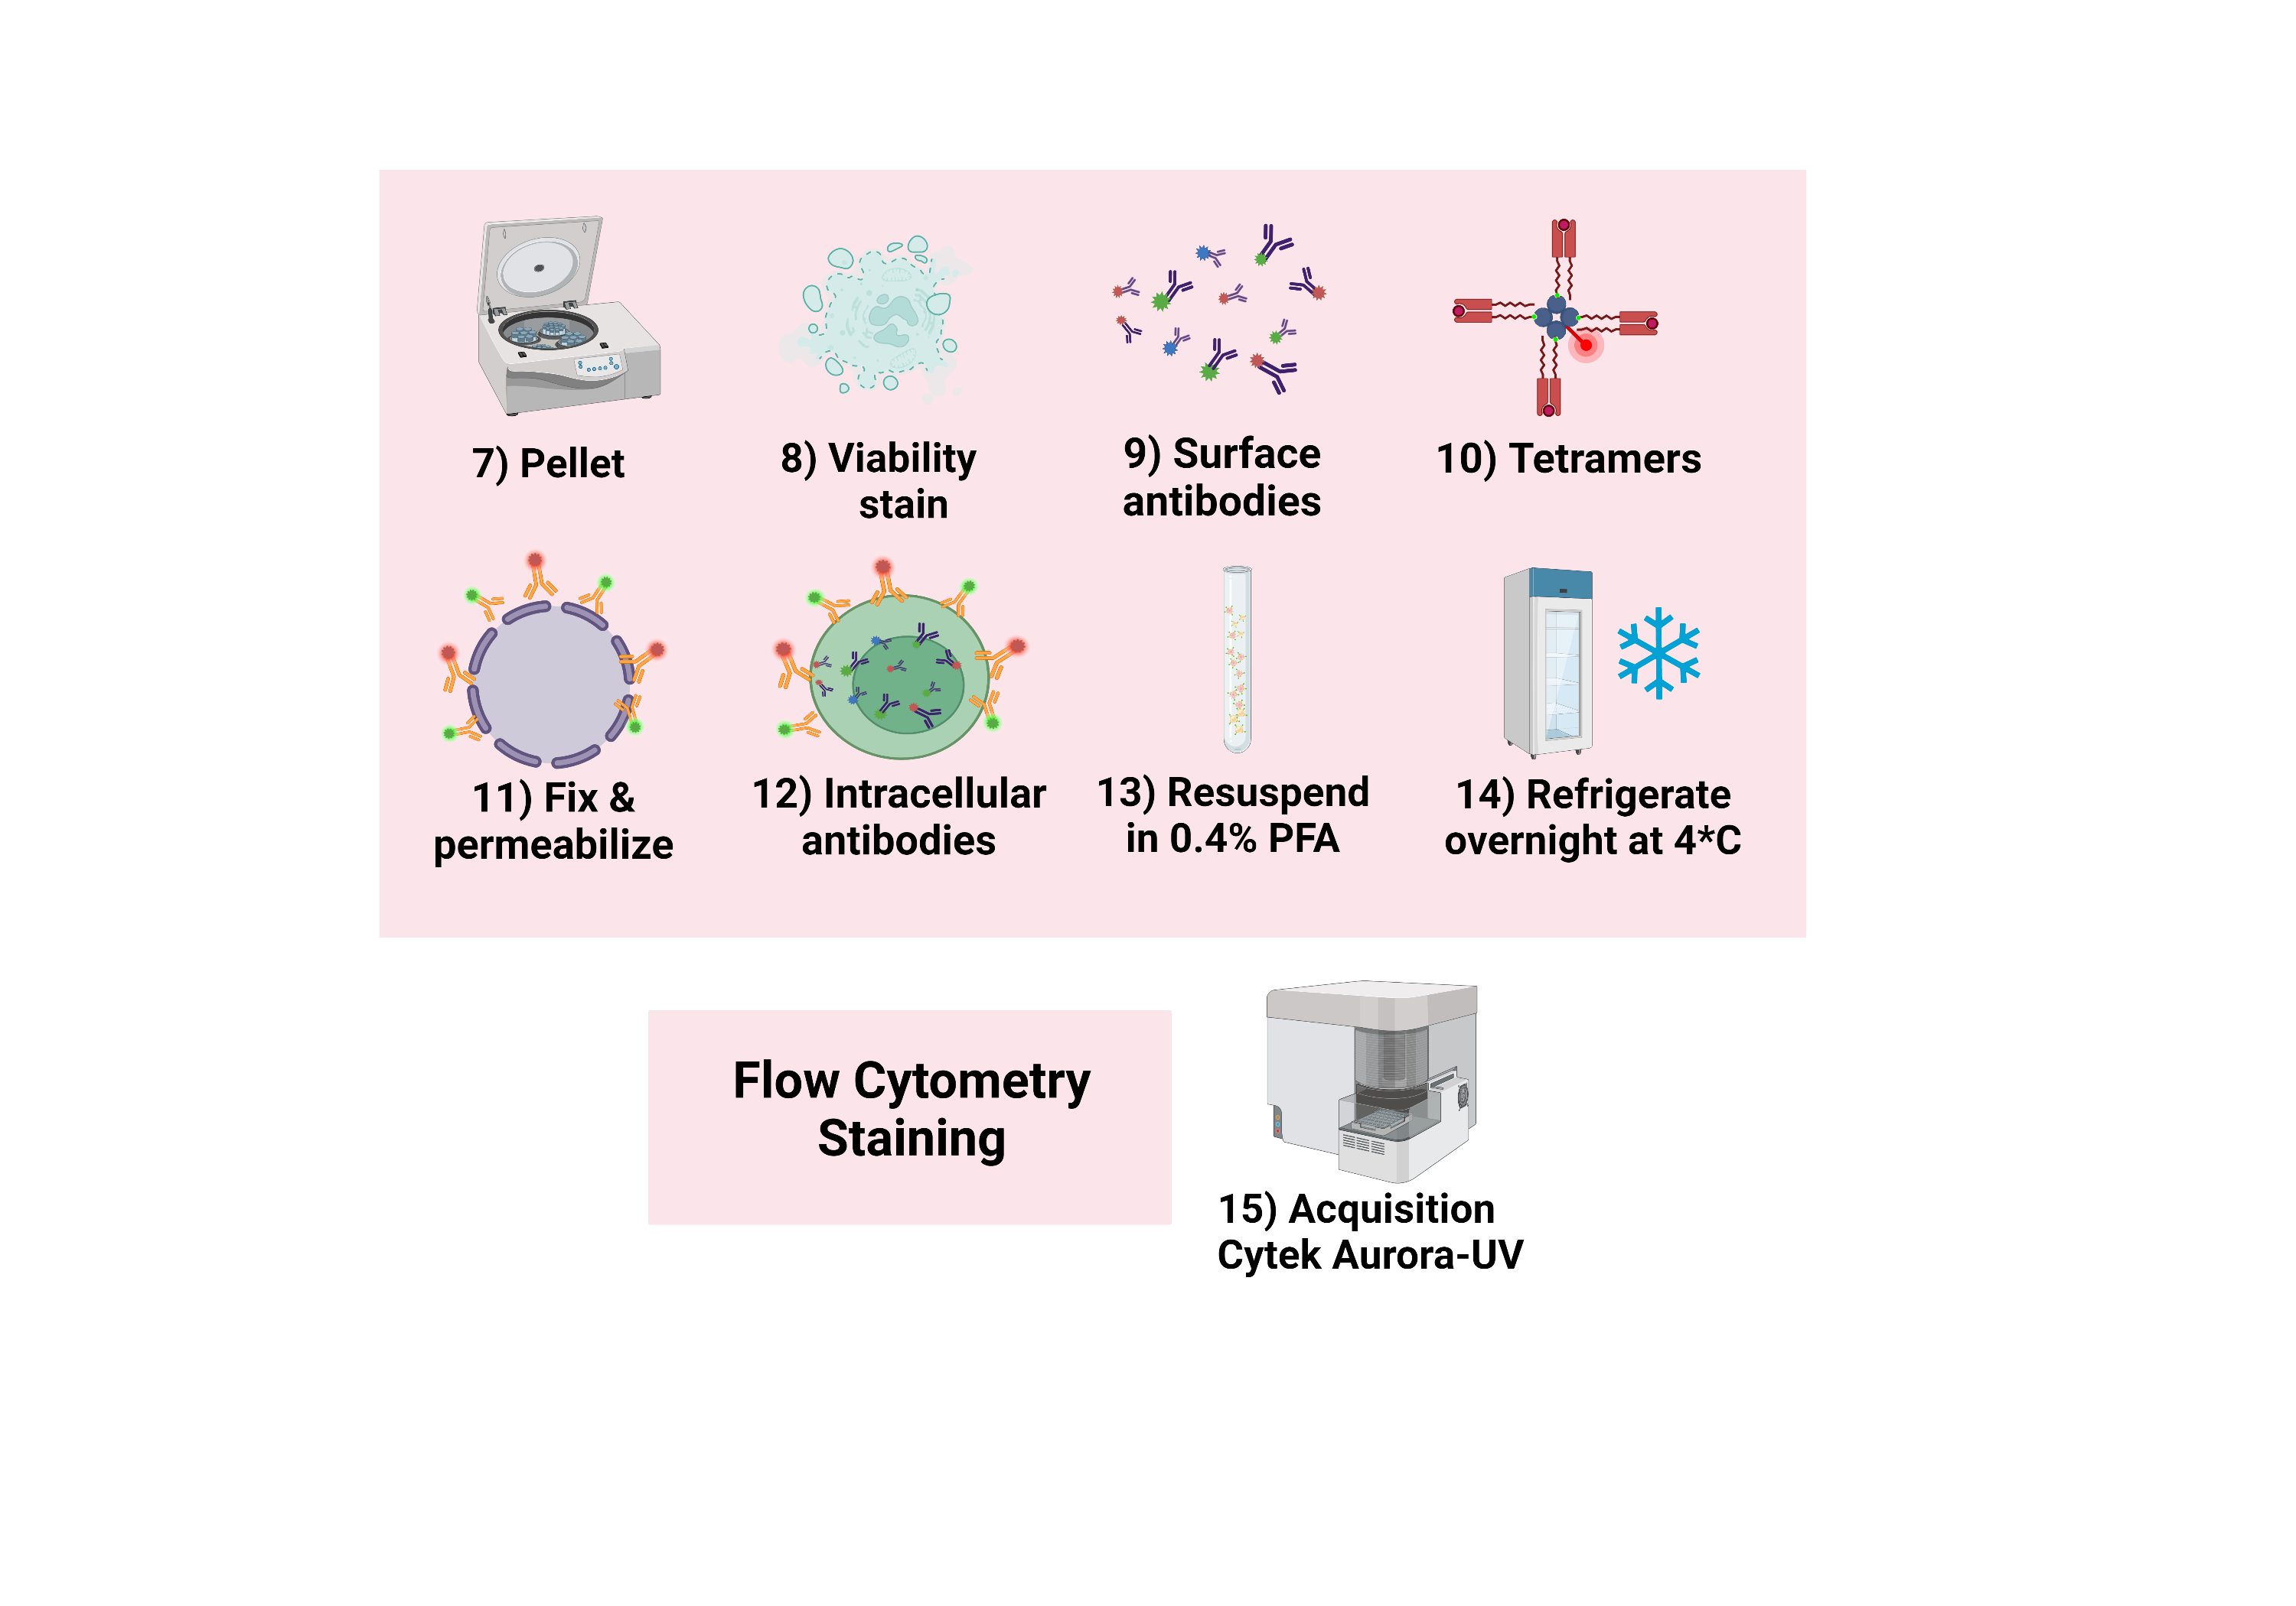
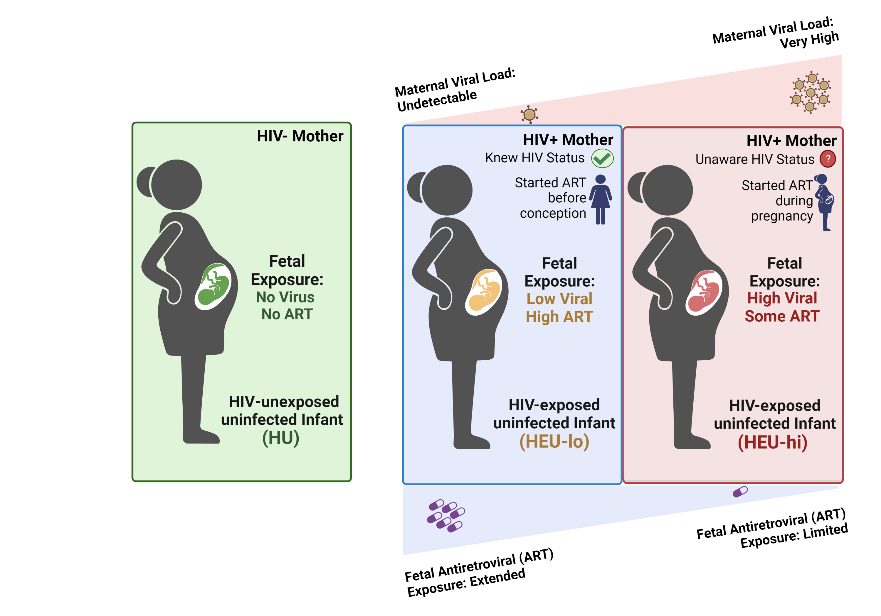
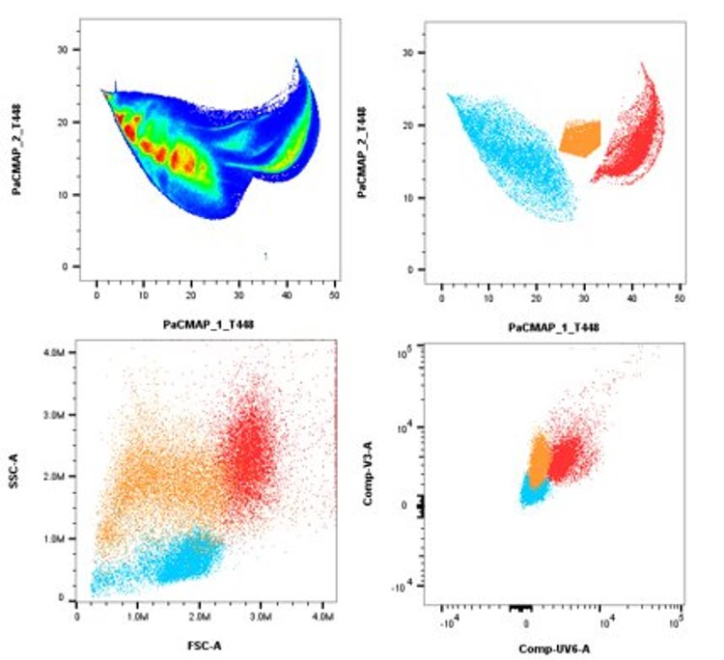
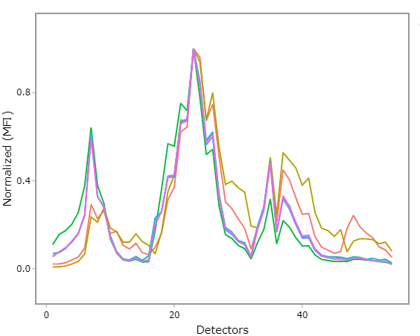
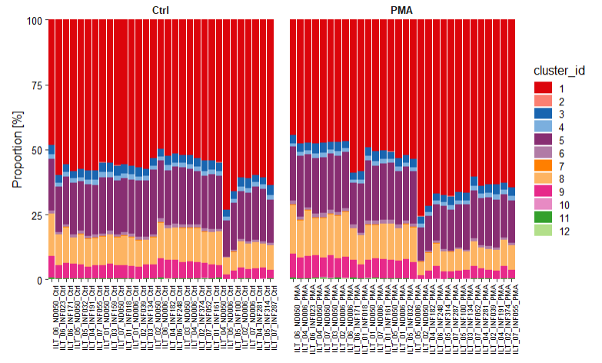
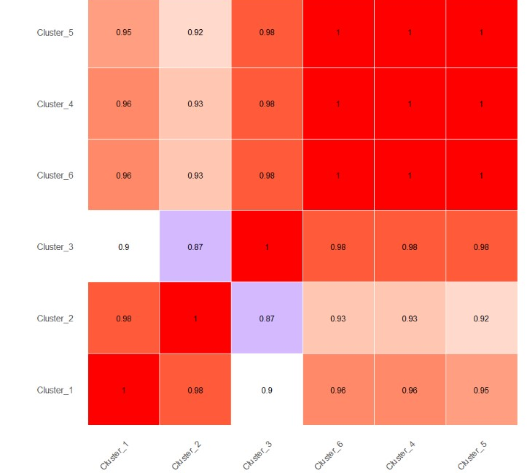
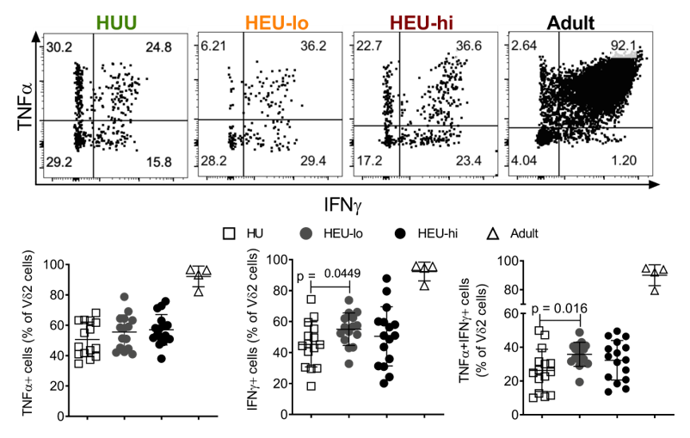
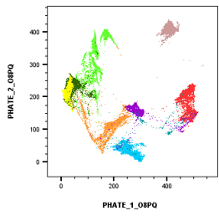
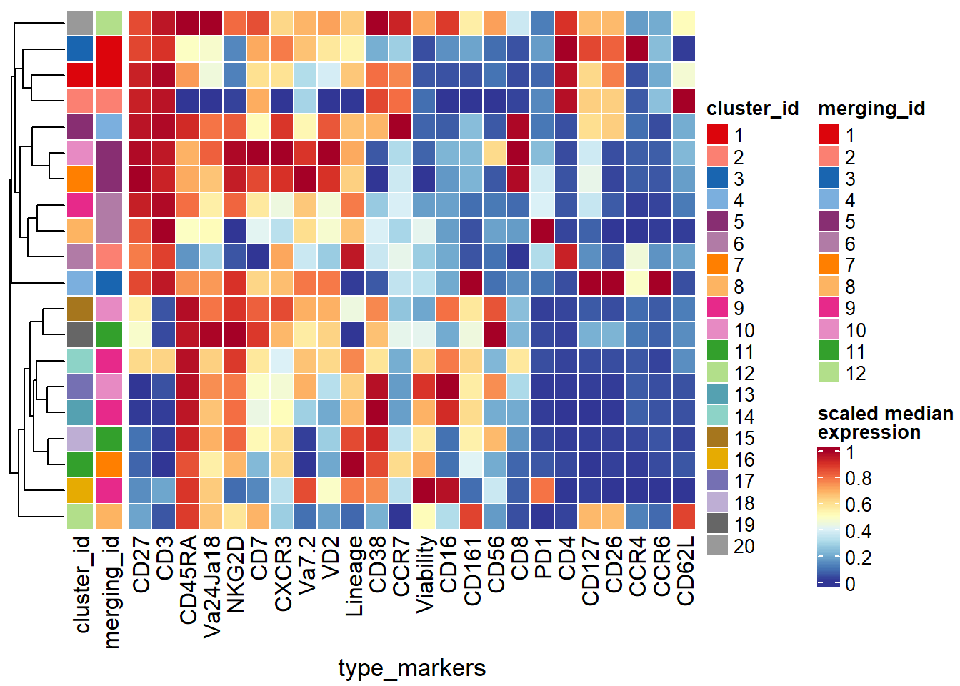
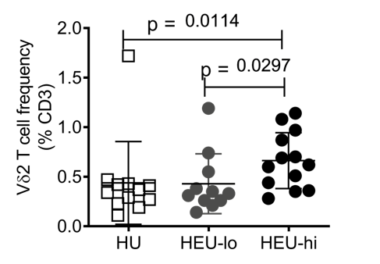



Spectral Flow Cytometry Analysis of Innate-like T cell responses in Malawian HIV-exposed Uninfected (HEU) Infants
David Rach¹, Hao-Ting Hsu², Nginache Nampota³, Godfrey Mvula³, Felix A. Mkandawire³, Osward M. Nyirenda³, Ingrid Peterson⁴, Franklin R. Toapanta⁴, Marcelo B. Sztein⁴, Miriam Laufer⁴, Kirsten E. Lyke⁴, Cristiana Cairo²
1 Molecular Microbiology and Immunology Graduate Program, University of Maryland School of Medicine, Baltimore, USA. 2 Institute of Human Virology, University of Maryland School of Medicine, Baltimore, USA. 3 Blantyre Malaria Project, Kamuzu University of Health Sciences, Blantyre, Malawi. 4 Center for Vaccine Development and Global Health, University of Maryland School of Medicine, Baltimore, USA
INTRODUCTION
METHODS
RESULTS
Maternal antiretroviral therapy (ART) effectively prevents perinatal infection of infants born to HIV+ mothers.
HIV-exposed Uninfected (HEU) Infants exhibit increased morbidity to lower respiratory tract and diarrheal infections during first six months life compared to HIV-unexposed infants.
Prenatal exposure to HIV and/or ART may perturb the fetal immune system, resulting in observed increased infectious morbidity.
Innate-like T cells (ILTs)[Vγ9Vδ2 (Vδ2) T cells, Mucosal-associated Invariant T cells (MAITs), Natural Killer T cells (NKTs)] can be activated by both microbial metabolites and innate cytokines. Their Th1-like and cytotoxic responses may play important roles against pathogens in early life.
The effect exerted by in utero HIV exposure on infant ILTs is unknown.
Thaw and Count
Figure 3. The frequency of Th1-cytokine producing cells is higher ex-vivo in cord blood Innate-like T cell subsets than conventional T cells
Polyclonal Stimulation
Flow Cytometry Staining
STUDY POPULATION: MALAWIAN COHORT
PBMCs and CBMCs were treated in the same manner as described in Figure 1. Cells acquired on Cytek Aurora (UV16-V16-B14-R8) for Spectral Flow Cytometry.
Figure 4. Autofluorescences of cryopreserved cord blood mononuclear cells are similar across specimens and is comparable to adult PBMCs.
Acquired Cytek Aurora (UV16-V16-B14-R8) 29 colors
.
RESULTS
Figure 2. The frequency of polyfunctional Vδ2s cells is higher in HEU than HU infants
0.5x10⁶ unstained lymphocytes were acquired on a Cytek Aurora (UV16-V16-B14-R8) for autofluorescence analysis. Raw files were imported to FlowJo v10.8.1 and gated for single cells. Dimensionality visualization using all detectors was run with PaCMAP. Raw files and XML gatings were imported to R using the flowCore and CytoML packages. Autofluorescent cells were clustered with FlowSOM, and frequency across specimen and treatment conditions visualized using CATALYST package. Normalized spectral signatures and cosine similarity heatmap were generated using a custom R script.
FUTURE DIRECTIONS
RESULTS
Figure 1. The frequency of cord blood Vδ2 T cells ex-vivo is higher in HEU-hi infants, but not HEU-lo infants, compared to HU infants.
After thawing, Cord Blood Mononuclear cells were resuspended in complete RPMI I640.
3.0 x 10⁶ CBMCs were stimulated with PMA-ionomycin (plus protein transport inhibitor) at 37°C for six hours.
After stimulation, cells were stained with fixable viability dye, and antibodies for surface and intracellular markers.
Cells were analyzed on a BD LSR II for Conventional Flow Cytometry
PBMCs and CBMCs were treated in the same manner as described in Figure 1
ACKNOWLEDGEMENTS
All Study Participants
The Blantyre Malaria Project
UMGCCC Flow Cytometry Core
NIH Tetramer Core
U01 HD092308
R61 HD103066-01
P30CA134274
Analyze the ILT spectral flow cytometry data for the 3 infant groups using combination of supervised and unsupervised approaches.
Finish acquisition and analyze longitudinal adaptive T cell responses in our cohort to vaccine antigen (Bacillus Calmette Guerin (BCG)).
drach@som.umaryland.edu
davidrach.github.io
@DavidRach2

