Slide 1


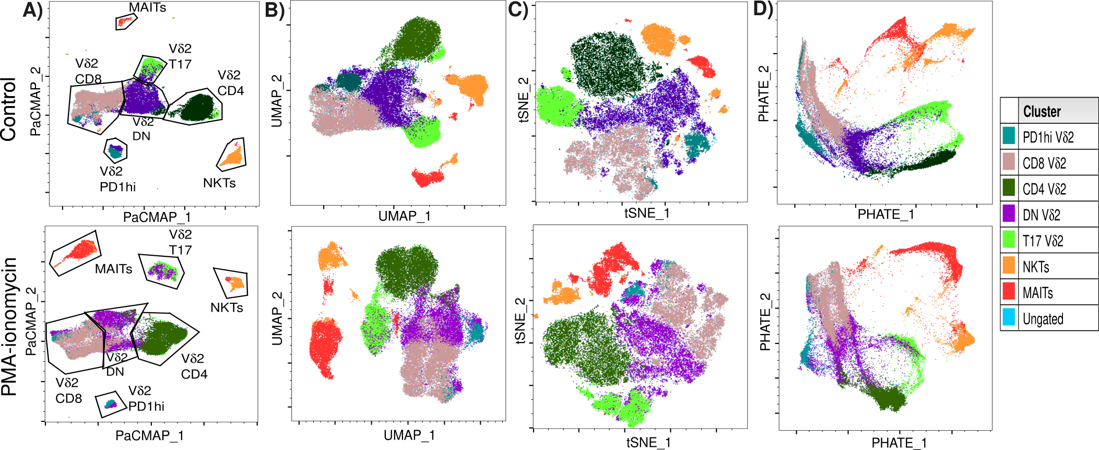
Towards ‘No Cell Left Behind’: open-source tool sets to
leverage Spectral Flow Cytometry’s full biological discovery potential
David Rach, Ph.D.
UMGCCC Flow Cytometry Shared Resource
Baltimore, MD
October 23, 2026
Slides

Slide 2


Spectral Flow Cytometry is amazing!!!
Capable of resolving remarkably similar fluorophores → increased number of markers per panel compared to conventional flow cytometry (CFC)
Allows for rapid acquisition of millions of events in a few minutes → typically greater number of acquired cells per sample compared to mass cytometry (MC)
Spectral Flow Cytometry (SFC) datasets have an unique combination of width and depth compared to preceding technologies

Slide 3
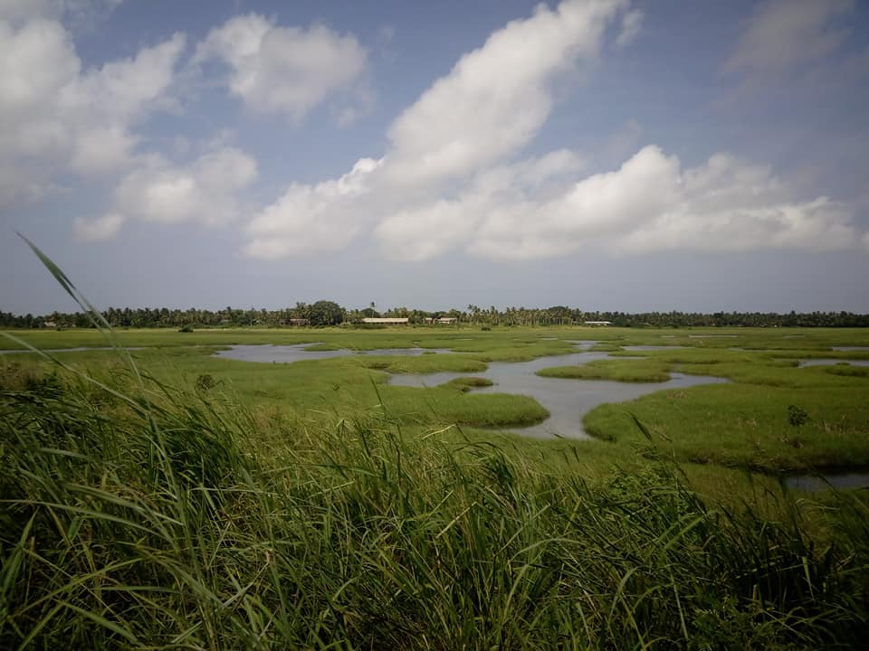
Spectral Flow Cytometry is amazing!!!
Able to efficiently acquire greater number of cells → more thorough profiling of rare cell subsets
Build one panel, evaluate multiple cell types → invaluable for studies with limited biospecimen
Expand our knowledge about immune system heterogeneity

Slide 4

Trade-off: Increasing analytical complexity
If you are only interested in a single population of cells → analysis process remains essentially unchanged (manual gating with a few more gates)
If your goal is to characterize all cell populations that may be present →
the breadth and depth of the datasets complicate the analysis

Slide 5
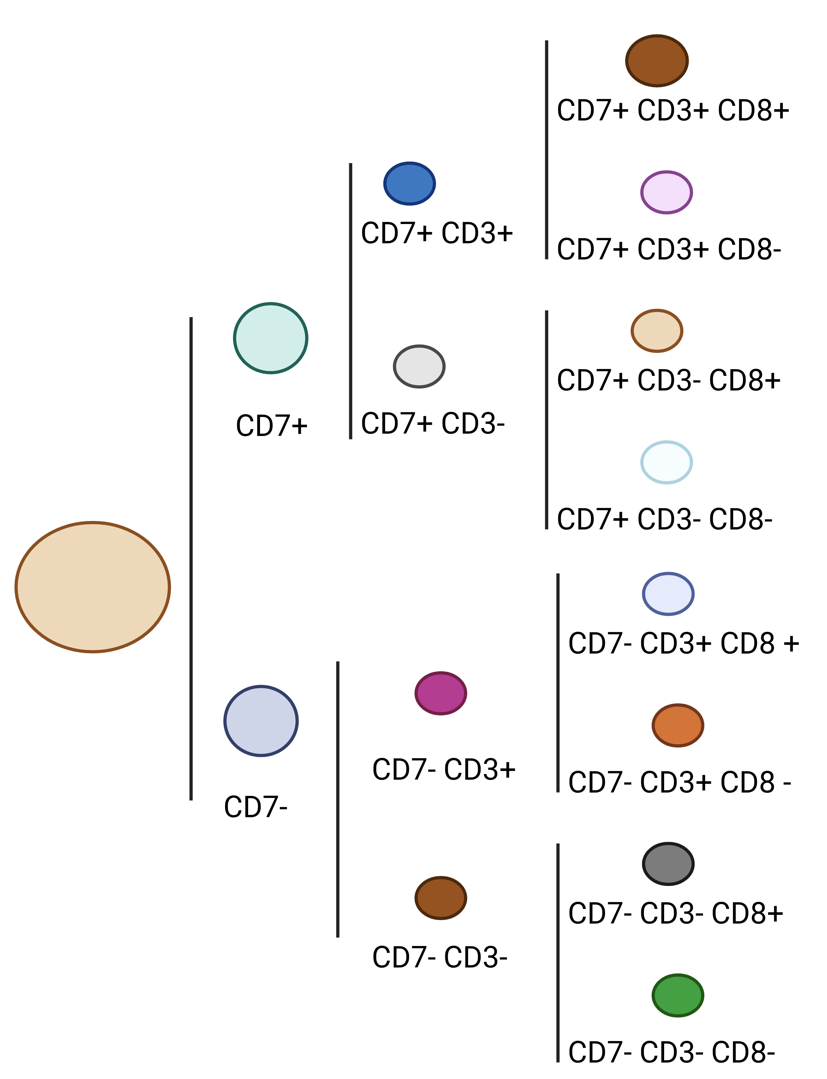
Complex Datasets: Combinatorially Exponential Clusters
If for a given marker in your panel, you split the cells into positive and negative populations
And this splitting process was repeated for every marker in your panel
And at the end, we grouped cells that only expressed the same markers
“Groups” per panel = 2^{Number of Fluorophores}

Slide 6
Complex Datasets: Combinatorially Exponential Clusters
If for a given marker in your panel, you split the cells into positive and negative populations
And this splitting process was repeated for every marker in your panel
And at the end, we grouped cells that only expressed the same markers
9-color CFC panel → 512 groups at most
40-color SFC panel → 1.1e+12 groups (trillion)
60-color SFC panel → 1.2e+18 groups (quintillion)

Slide 7
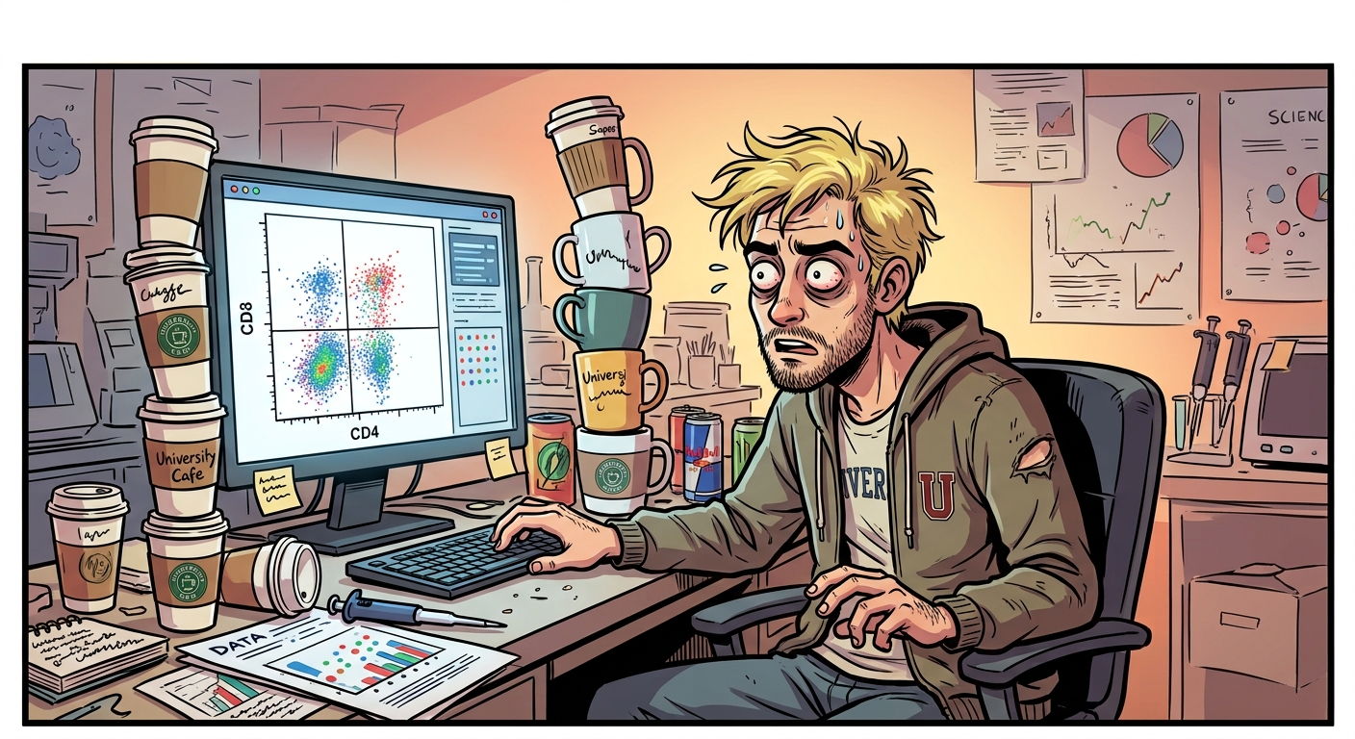
What even is a quintillion?
If I were to manually check for every combination...
60-color SFC panel → 1.2e+18 groups (quintillion)
1 gate, every 10 seconds → 6 groups/minute
60 minutes in an hour → 360 groups/hour
Awake 16 hours a day → 5760 groups/day
365 days per year → 2,102,400 groups/year

Slide 8
What even is a quintillion?
If I were to manually check for every combination...
60-color SFC panel → 1.2e+18 groups (quintillion)
1 gate, every 10 seconds → 6 groups/minute
60 minutes in an hour → 360 groups/hour
Awake 16 hours a day → 5760 groups/day
365 days per year → 2,102,400 groups/year
….Not even close….

Slide 9

Continuously since the Big Bang
60-color SFC panel → 1.2e+18 groups (quintillion)
365 days per year → 2,102,400 groups/year
Invent a time-machine, become immortal
13.8 billion years → 2.9e+16 groups/reality

Slide 10
Continuously since the Big Bang
60-color SFC panel → 1.2e+18 groups (quintillion)
365 days per year → 2,102,400 groups/year
Invent a time-machine, become immortal
13.8 billion years → 2.9e+16 groups/reality
….Still not enough….

Slide 11

Continuously since the Big Bang
60-color SFC panel → 1.2e+18 groups (quintillion)
365 days per year → 2,102,400 groups/year
Invent a time-machine, become immortal
13.8 billion years → 2.9e+16 groups/reality
So we need ~ 50 immortal researchers working continuously since the Big Bang just to check all group combinations for a single 60-fluorophore panel .fcs file

Slide 12
Continuously since the Big Bang
60-color SFC panel → 1.2e+18 groups (quintillion)
365 days per year → 2,102,400 groups/year
Invent a time-machine, become immortal
13.8 billion years → 2.9e+16 groups/reality
So we need ~ 50 immortal researchers working continuously since the Big Bang just to check all group combinations for a single 60-fluorophore panel .fcs file
1 file down, 99 more to go!

Slide 13
Alternative: Unsupervised Analysis (Algorithms)
Consequently, if the goal is to characterize all cell populations present, some form of unsupervised (algorithm) or semi-supervised analytical approaches will be needed
Consequently, if the goal is to characterize all cell populations present, some form of unsupervised (algorithm) or semi-supervised analytical approaches will be needed
Clustering → FlowSOM, Phenograph, Xshift, etc.
Dimensionality visualization → opt-SNE, UMAP, PaCMAP, Phate, etc.
Automated Gating → openCyto, flowMagic, ElasticGate, etc.

Slide 14
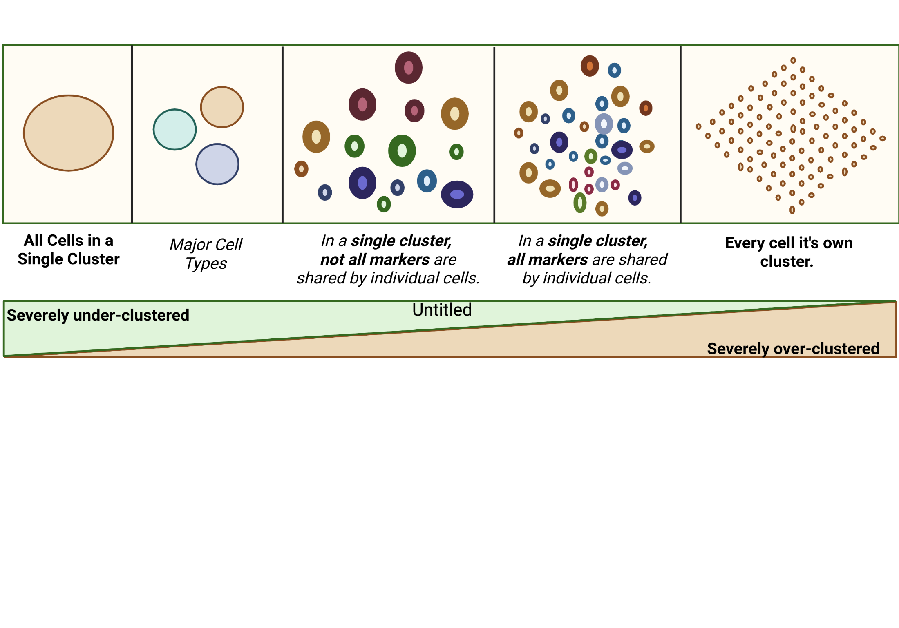
The challenge for unsupervised approaches

Slide 15
The challenge for unsupervised approaches

Slide 16
The challenge for unsupervised approaches

Slide 17
The challenge for unsupervised approaches

Slide 18
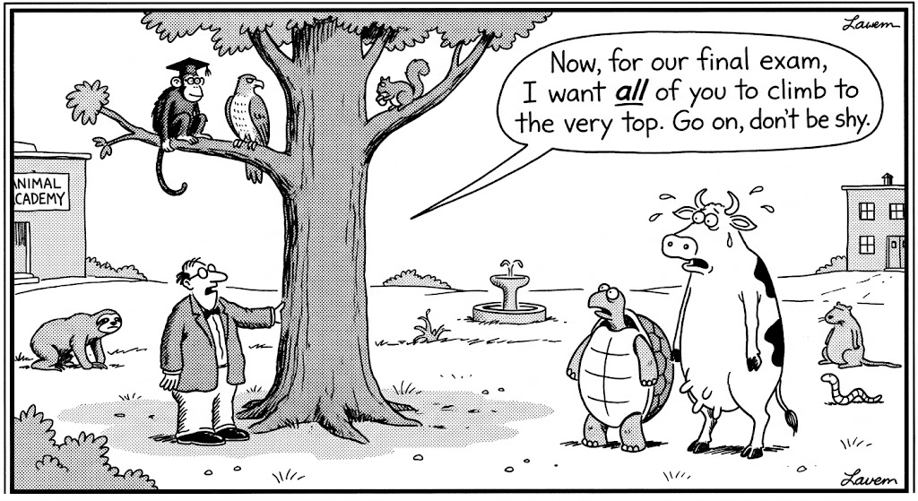
Adapted algorithmic tools struggle with number of events
Many of these software tools were originally implemented as R or Python packages, for use in analysis of mass cytometry or single-cell RNA-seq datasets
Mass cytometry → similar number of markers, typically fewer events, no unmixing variation due to autofluorescence
Single-cell RNA-seq → substantially more markers, typically way fewer events. No equivalent “negative” gate events for not expressed transcripts
Down-sampling becomes often necessary

Slide 19
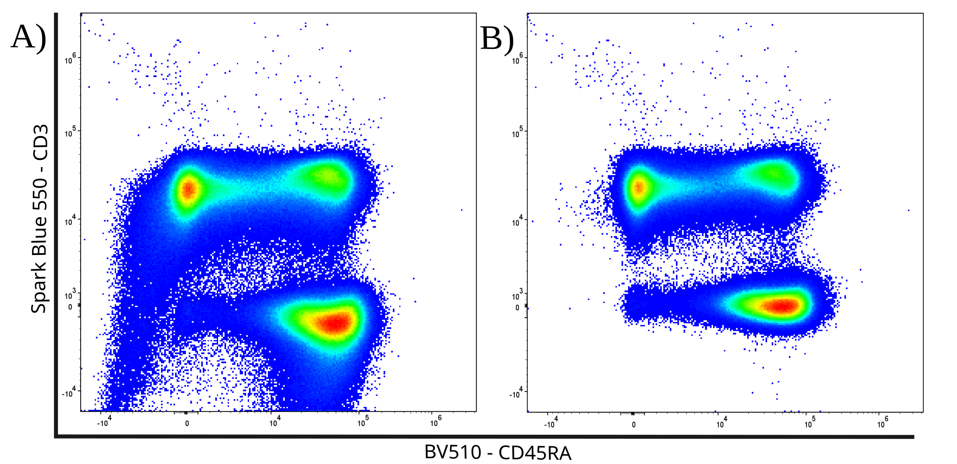
Adapted algorithmic tools struggle with unmixing errors
Adapted software packages heavily rely on having a consistent median fluorescent intensity (MFI) to cluster cells based on positive or negative marker expression
Existing batch correction / normalization / scaling tools target instrumental or experimental level variation for correction
Unmixing errors can seriously shift the MFI ranges for “negative” and “positive” cells for individual acquired specimens

Slide 20

“We discovered a novel dendritic cell cluster”
Despite the critical importance unmixing controls play, few tools permit us to determine quality of the individual control before unmixing
Existing quality control algorithms (PeacoQC, FlowAI, etc.) primarily focus on detecting laser and fluidic issues in already acquired .fcs files.
Unmixing errors can be introduced by tandem degradational, additional autofluorescences, undiagnosed instrumental issues, etc.

Slide 21
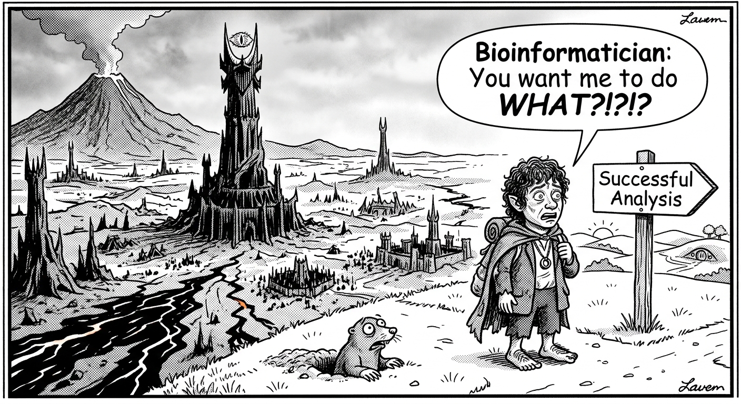
Full biological discovery potential often out of reach
Most flow cytometrist don’t code
You likely lost your bioinformatician while describing manual gating
The statisticians were never consulted
For most spectral flow cytometry datasets, only a handful of cell populations end up being analyzed by any method

Slide 22
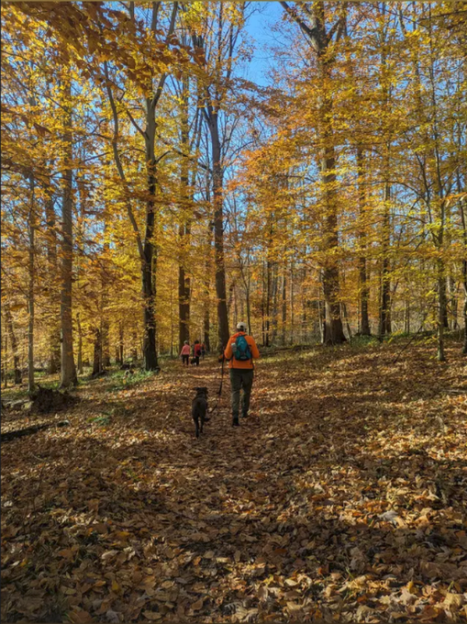
Personal Goal: No cell left behind
Repeated 3 AM thoughts
What makes spectral flow cytometry data amazing is both the depth and the breadth
How to fully profile the entirety of the acquired dataset, not just a single cell population of interest

Slide 23
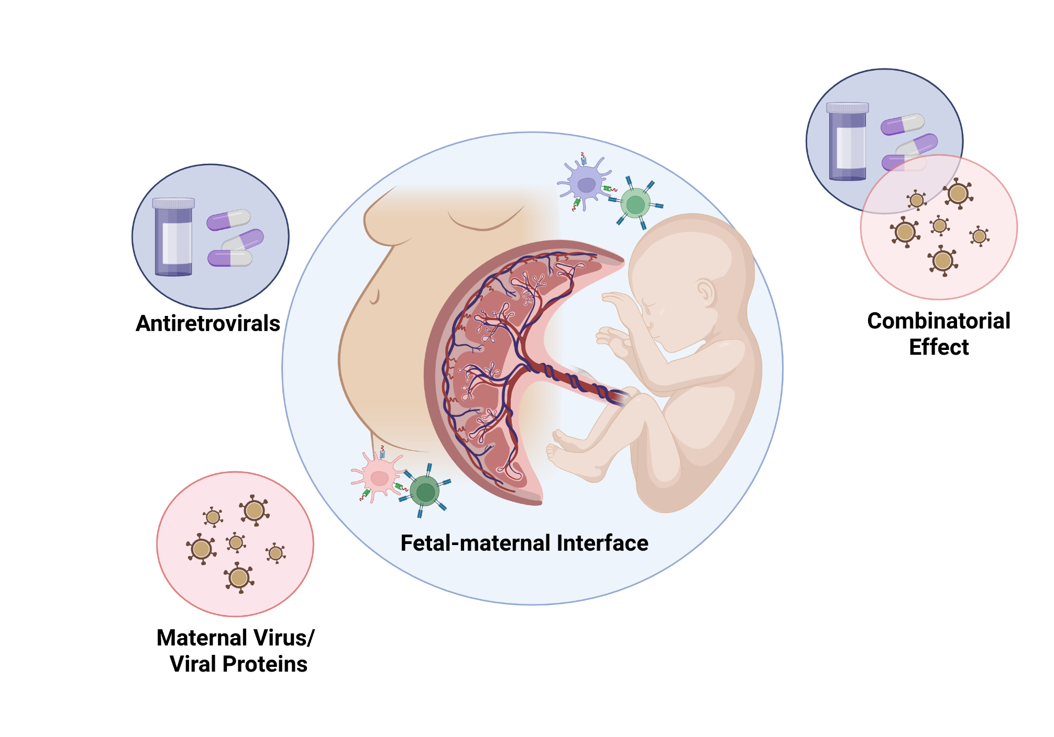
My PhD’s focus: HIV-exposed Uninfected Infants

Slide 24
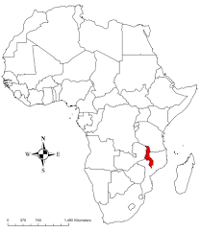
Our Malawian Cohort

Slide 25
Study Timeline

Slide 26
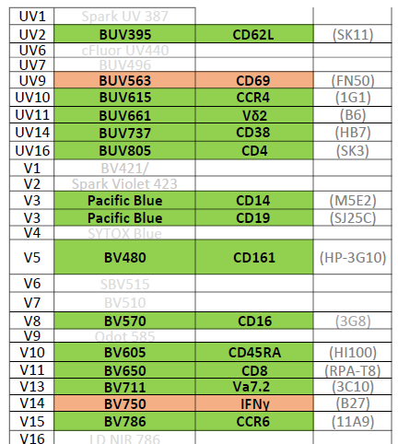
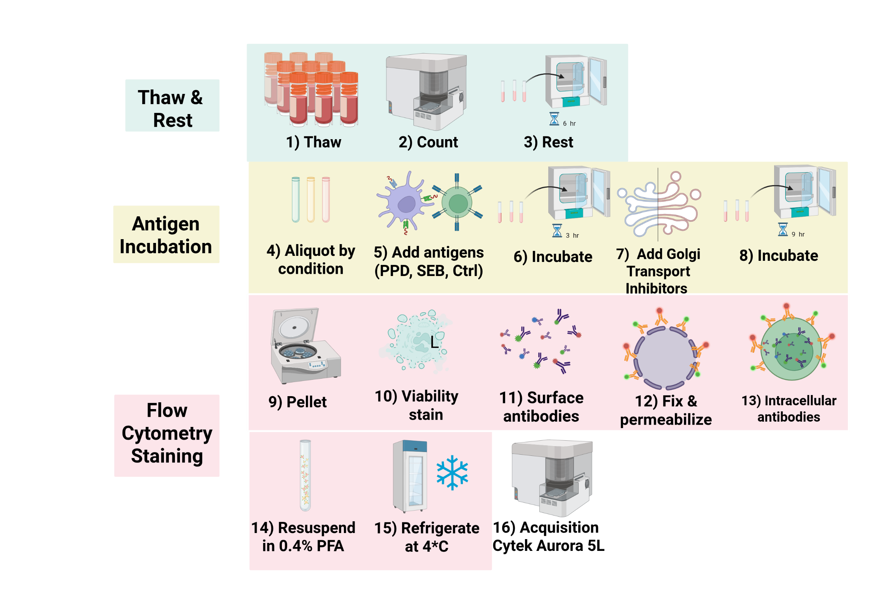
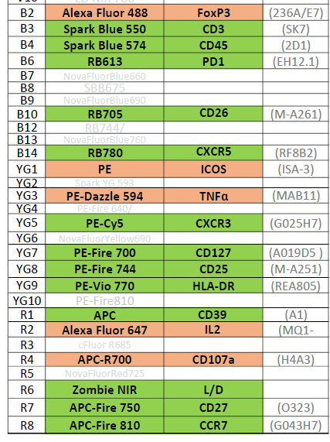
32-Fluorophore Spectral Flow Cytometry Panel

Slide 27
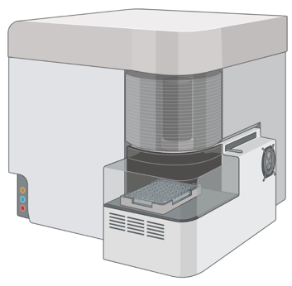

To unlock the comprehensive biological discovery potential,
we need to address these pink elephants
Quality of the unmixed full-stained data is linked to the quality of our single-color controls (and our ability to provide appropriate autofluorescence controls).
If we are acquiring 3 million cells to detect 100 rare cells, how do we thoroughly explore the rest of the sample to avoid wasting useful data?

Slide 28




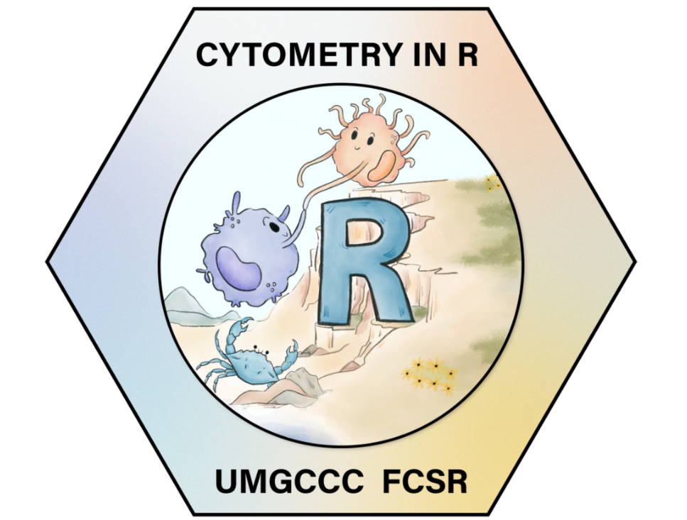
Building open-source tool-sets to address SFC’s quirks
Spectral Signature Characterization and Isolation
Incorporation of manually-annotated gating information
Automated Instrument
Quality-Control Dashboards
Rust

Slide 29
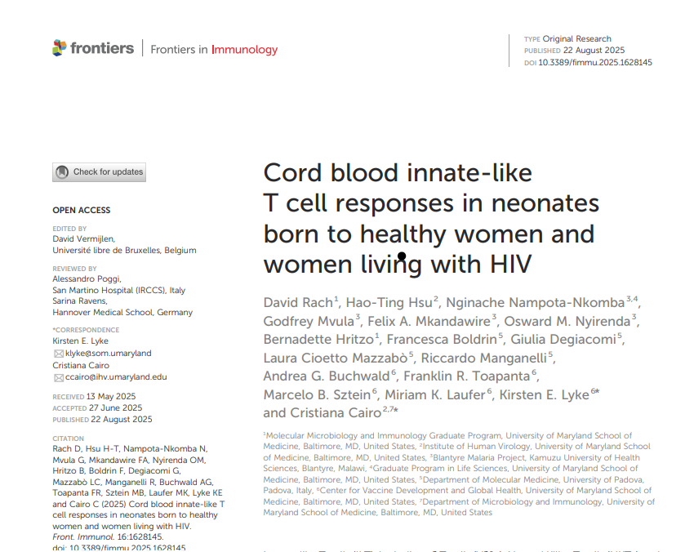

Previously looked at unconventional T cells
Main differences this time around:
Shifting from 50%-50% FlowJo – R to increasingly more R
Targeted re-writes in Rust to speed up original R code
Building around reproducibility from the start (not as an after thought)
Paper
Improved Bioconductor interoperability

Slide 30
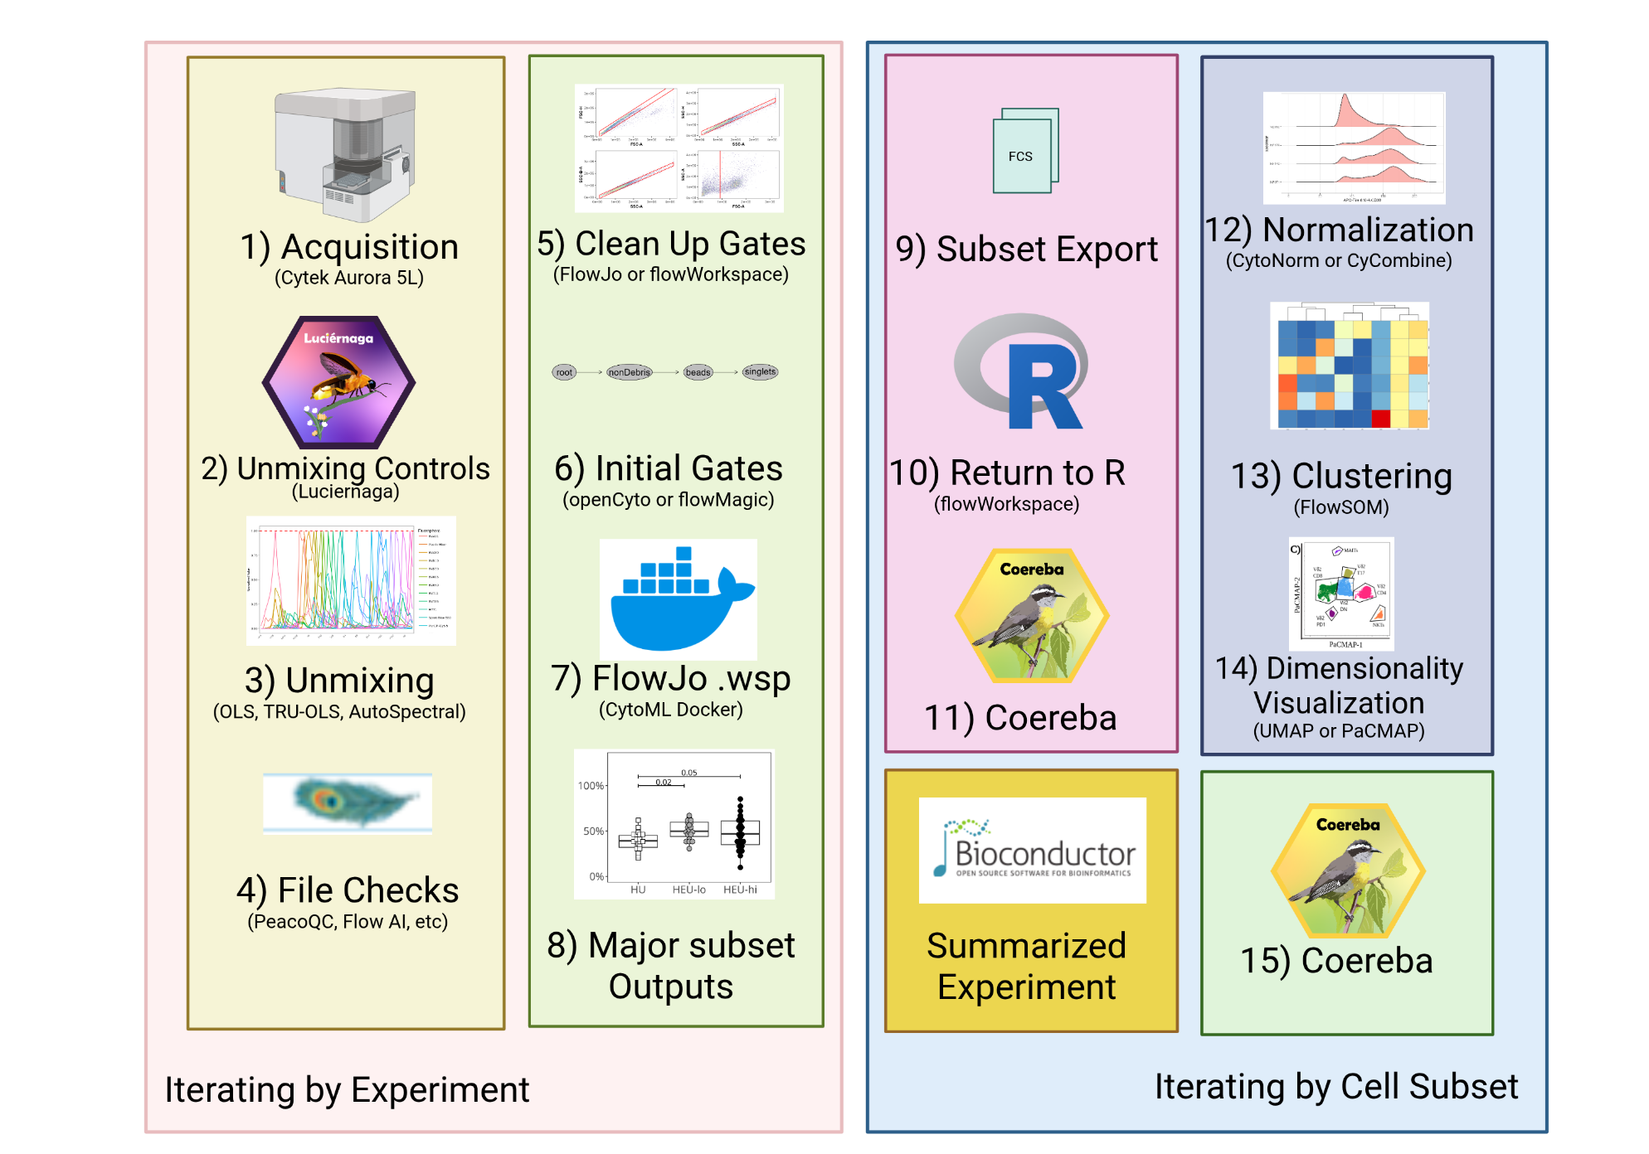
Semi-supervised Pipeline

Slide 31




Pipeline: Acquisition
Acquired day of staining on a 5-Laser Cytek Aurora
Instrument flushed with 10% Contrad and Water for 20 minutes pre-use
Instrument passed by both the UMGCCC FCSR and Cytek’s QC criteria immediately before acquisition
UMGCCC FCSR
InstrumentQC
Dashboard
Plots for our
5L Aurora
Historical Data
5L Aurora
Dashboard
How-To-Set-Up

Slide 32
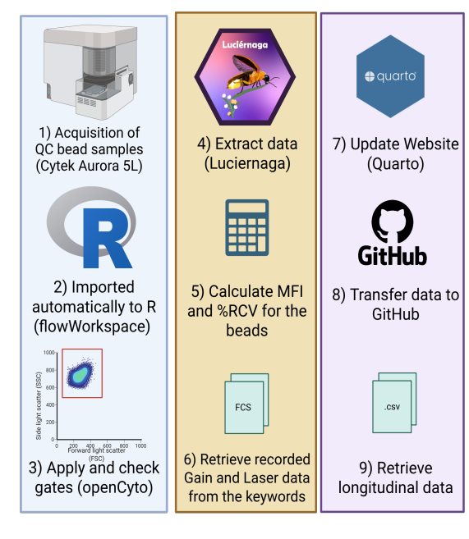
Automated Daily Processing
Behind-the-scenes:
Using R (and increasingly Rust) to process the .fcs files
Automated transfer to GitHub via Windows Task Scheduler
Our Quarto Website gets updated twice daily via a GitHub action

Slide 33
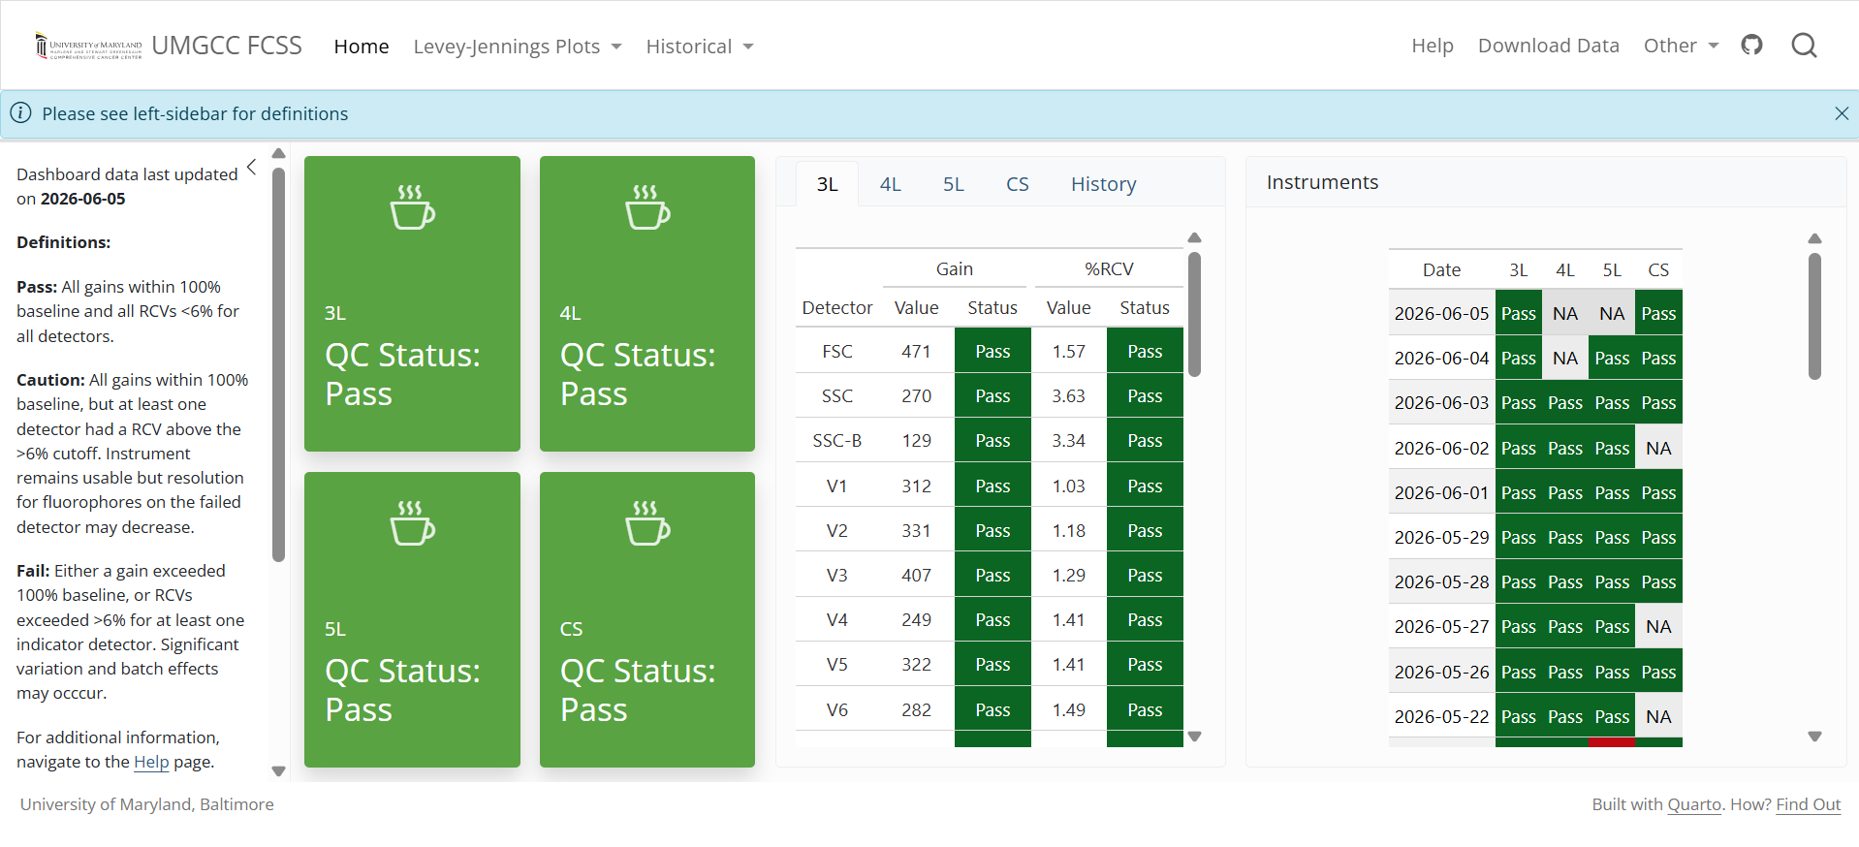
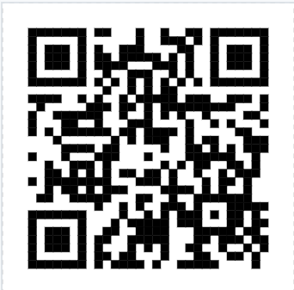
Instrument Quality Control Dashboard
Dashboard
How-To

Slide 34
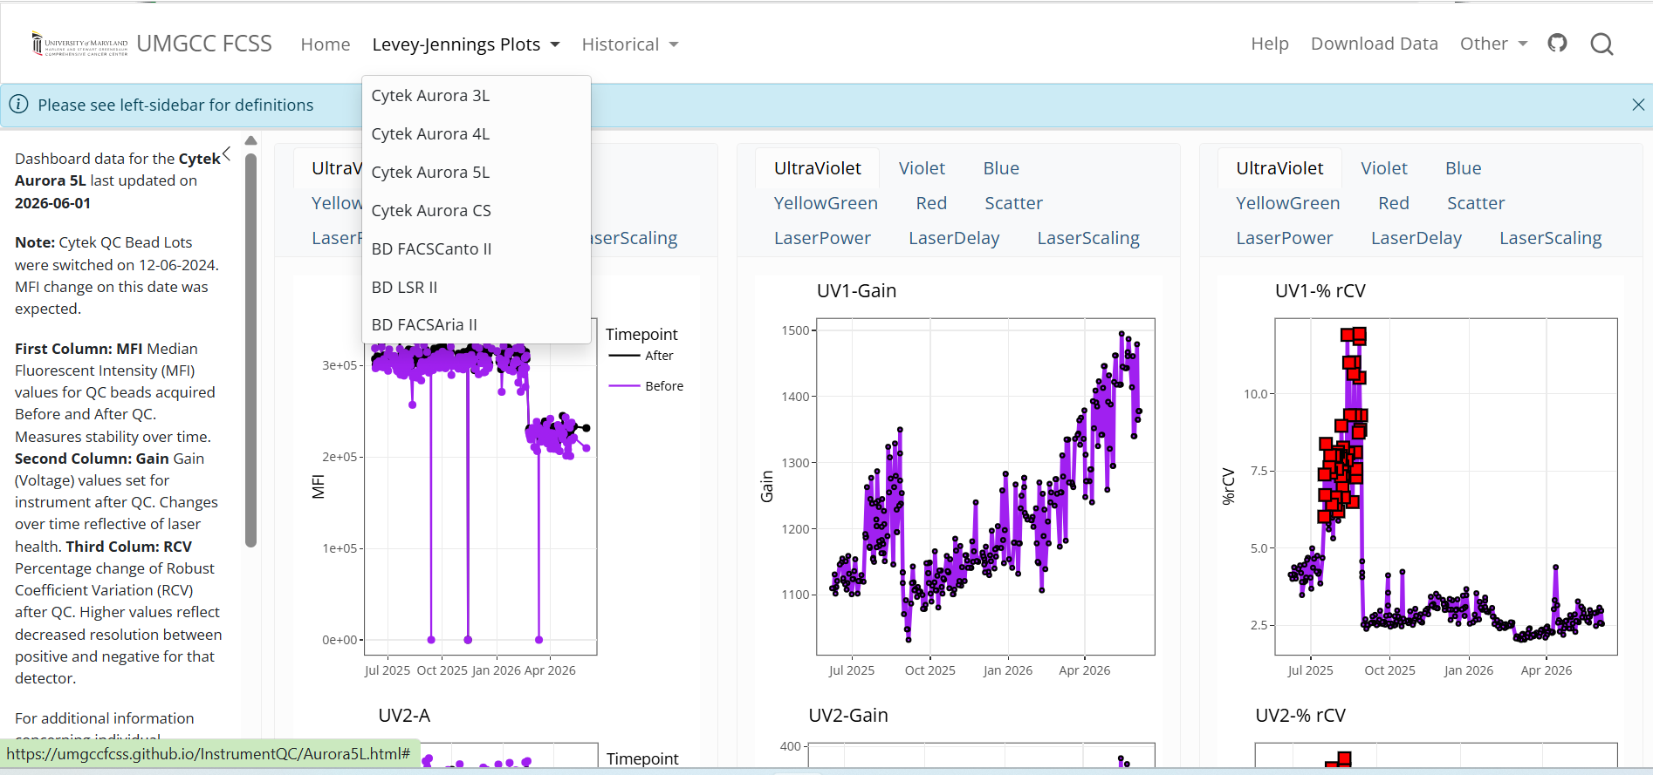
Instrument Quality Control Dashboard

Slide 35


Pipeline: Evaluating Unmixing Controls
New unmixing controls acquired with each experiment.
Extra specimen cells acquired as additional unstained controls
Unmixing Controls are screened for suitability for unmixing
Single-colors: Tandem degradation, and autofluorescence contamination
Unstained(s): Presence of multiple-autofluorescences in lymphocyte gate
Flagged unmixing controls are replaced with equivalents from adjacent experimental date
Luciernaga
Luciernaga
Vignette

Slide 36
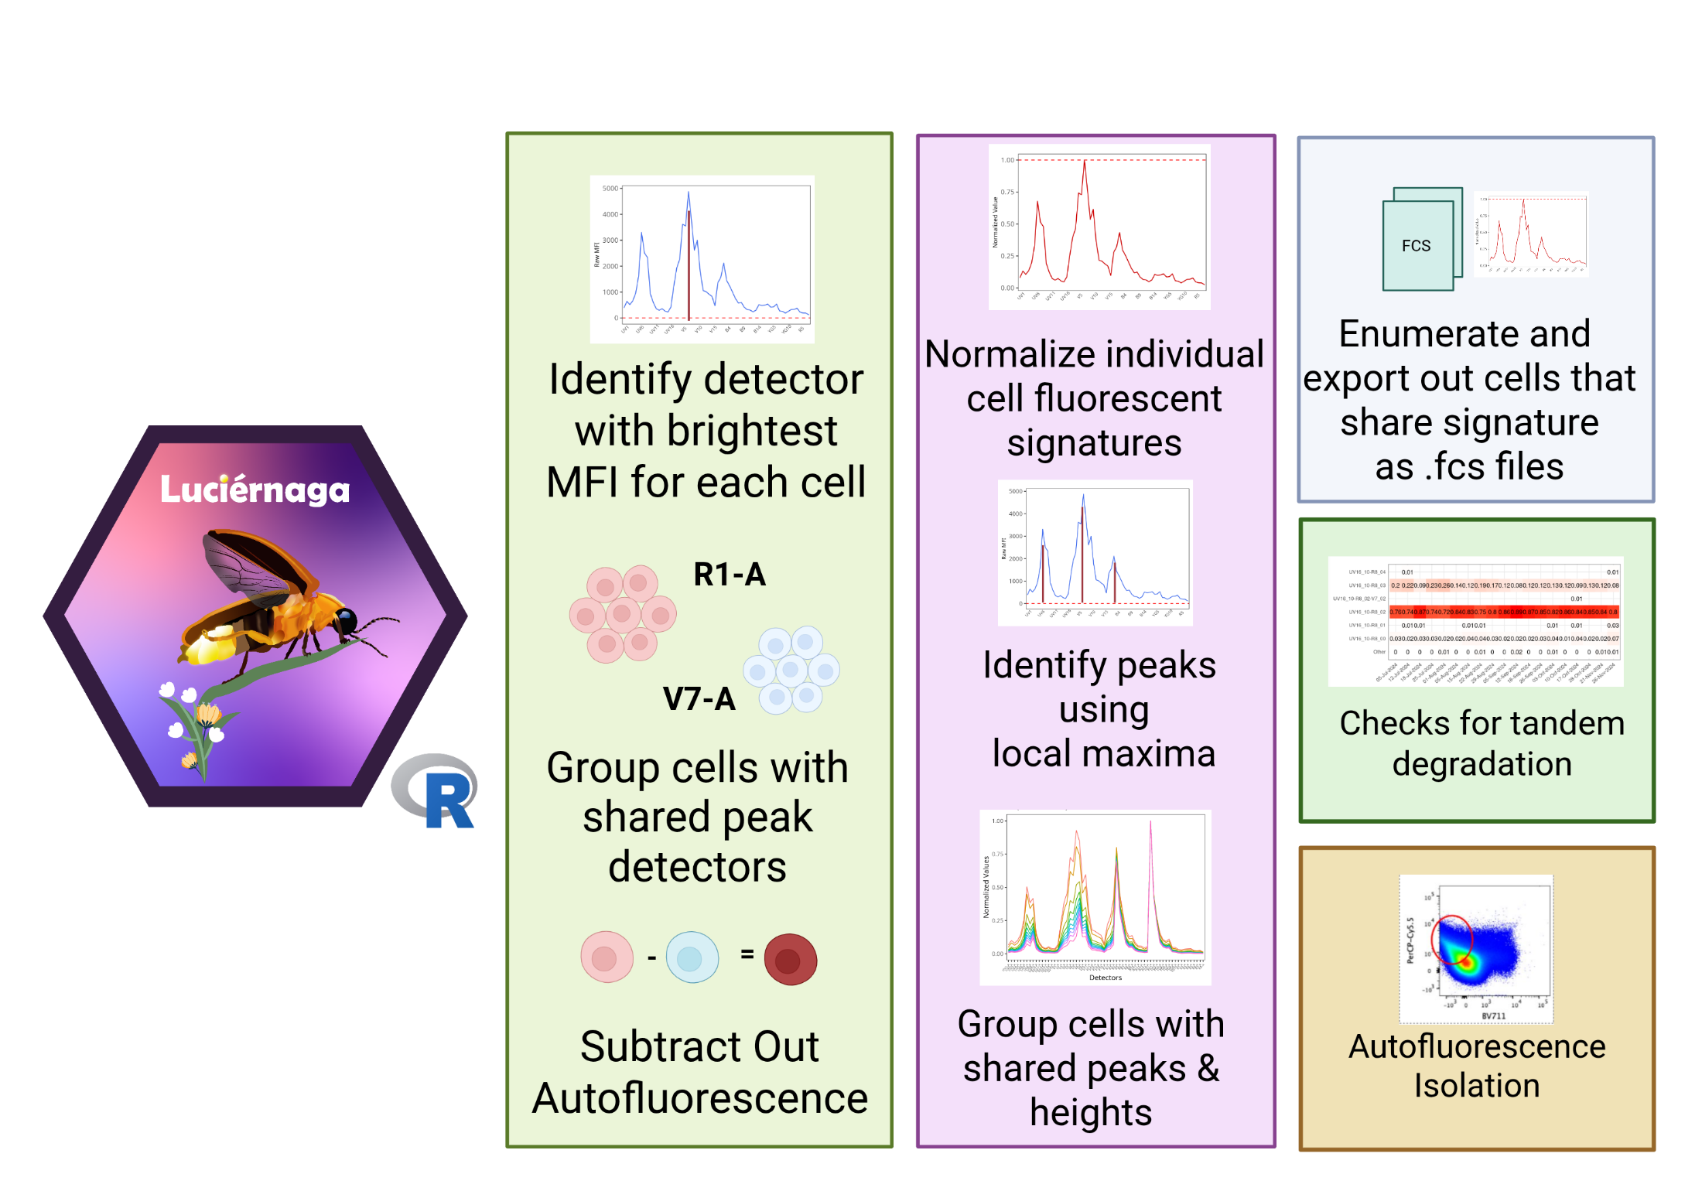
Luciernaga: Individual Cell Normalized Signatures
Code

Slide 37
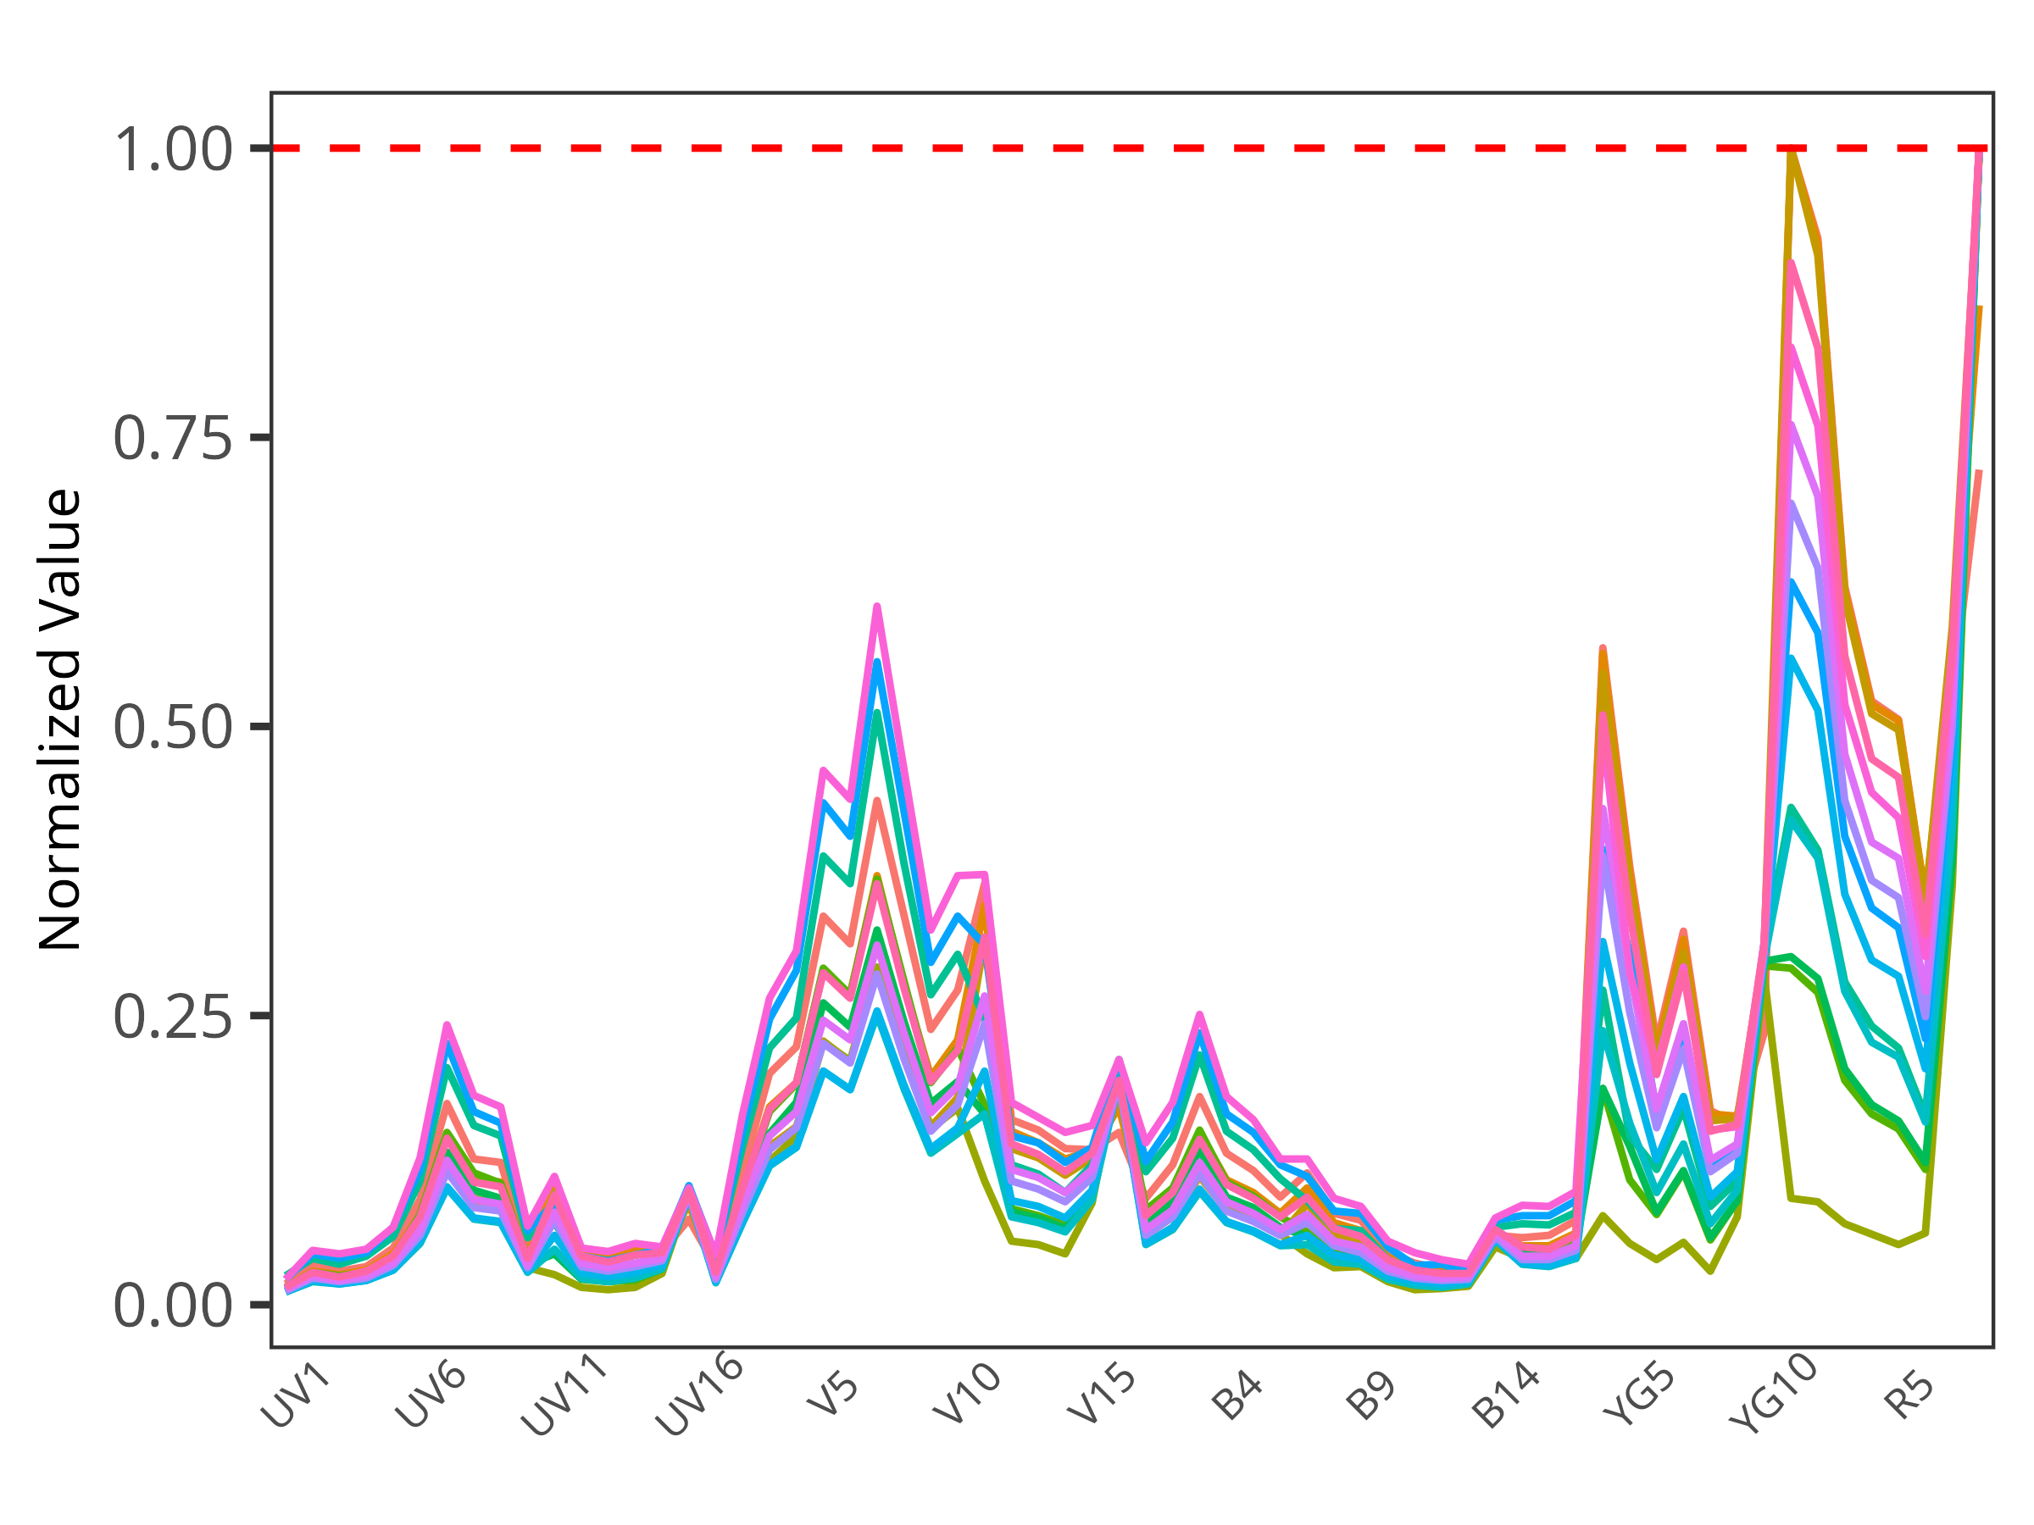
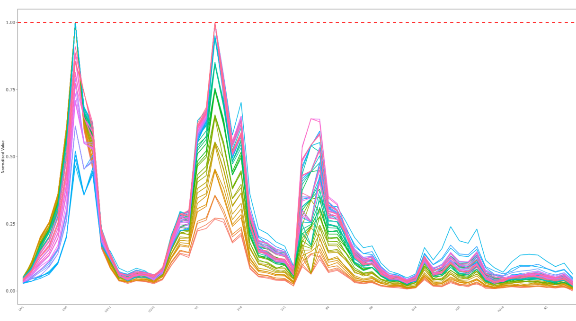
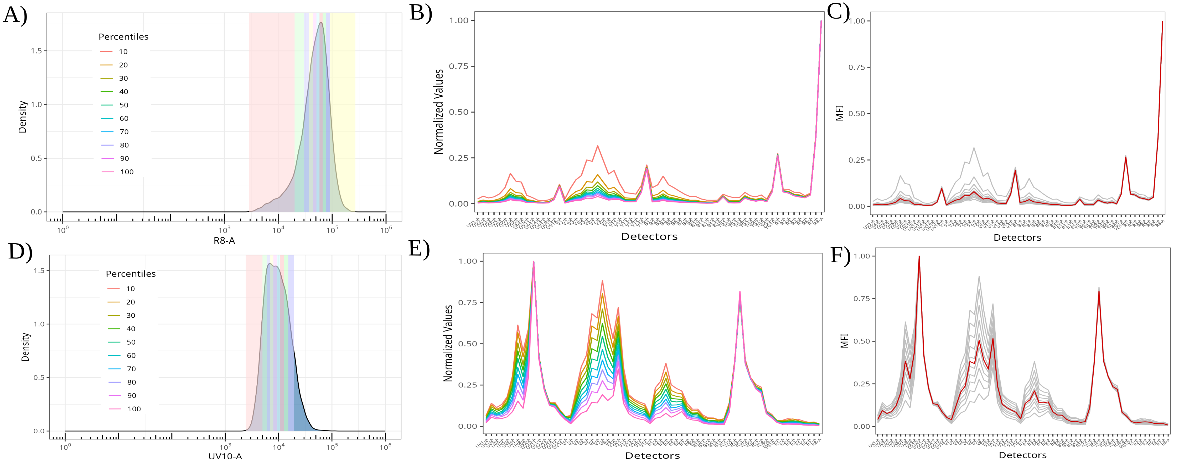
Automated tools for screening unmixing controls
APC
APC-Fire 810
Tandem Degradation
Autofluorescence Isolation
Residual Autofluorescence

Slide 38
Identifying degrading fluorophores
Fluorophores in good shape → one predominant normalized signature within the unmixing control raw .fcs file
When the fluorophore degrades, noticeable increase in variant signatures, making up substantial proportion of all cells in the unmixing control
Automated screening all acquired unmixing controls from campus users during off-hours

Slide 39
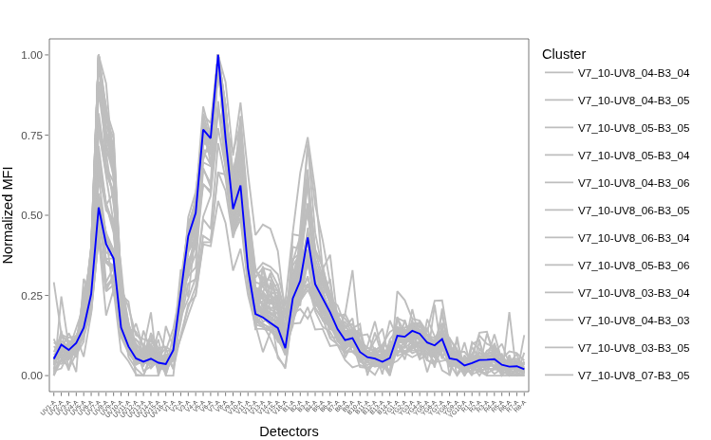
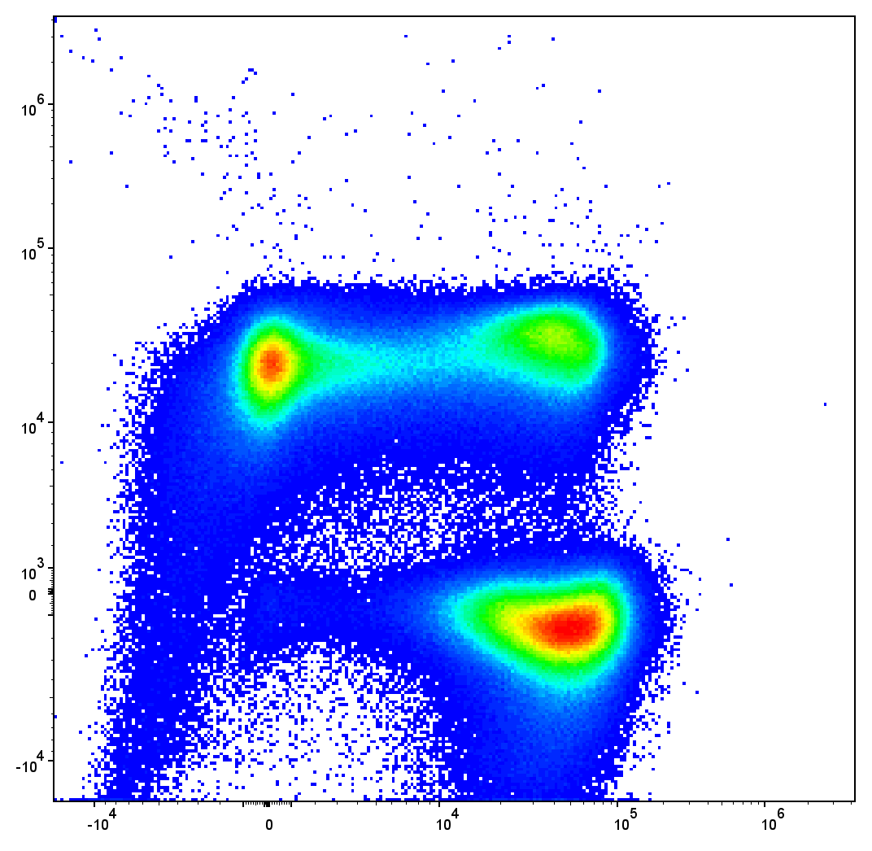
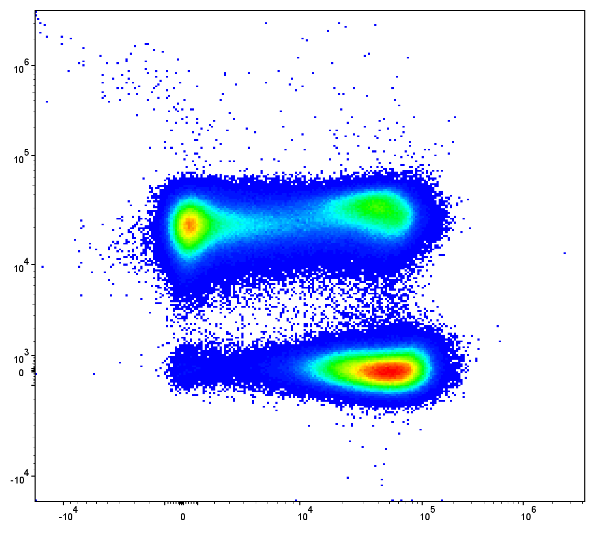
Isolating additional autofluorescence signatures
This approach also works to isolate variant autofluorescence signatures from unstained controls
Unlike other approaches, the isolated cells share normalized signatures, only differing in terms of brightness
Return directly as an .fcs file containing just cells with same signature for use as an autofluorescent tag in SpectroFlo

Slide 40
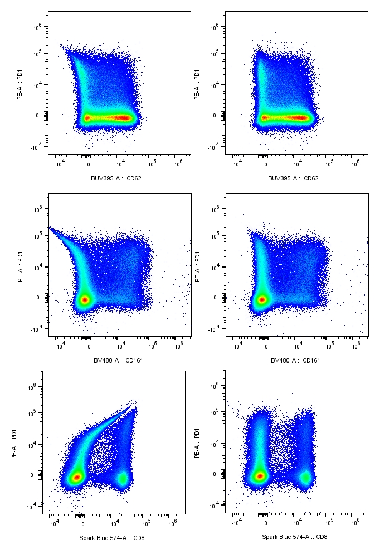
Residual autofluorescence in dim cell single-color controls
“As bright or brighter”
Dim antigen-fluorophore combinations acquired as cell single-color controls often have residual autofluorescence contribution to their signature
Identifying and switching these dim cell single-color controls to bead single-color controls significantly improved unmixing for our panels
Signature with
residual AF
Signature without
residual AF

Slide 41




Pipeline: Unmixing
Unmixing Method Agnostic
Unmixing in SpectroFlo (with modified single-color and unstained inputs via Luciernaga)
Unmixing in R
- OLS (Luciernaga using Rust)
- TRU-OLS (via Julia wrapper)
- AutoSpectral
TRU-OLS
TRU-OLS
Walkthrough
AutoSpectral
AutoSpectral
Walk-through

Slide 42





Pipeline: File Checks
PeacoQC Vignette
PeacoQC
Checking for fluidic or laser-related issues in the unmixed files
R: PeacoQC or FlowAI
Rust: PeacoQC (thanks James!)
FlowAI
FlowAI
Vignette
PeacoQC in Rust

Slide 43






Pipeline: Manual and Automated Gating
flowGate
flowGate
Walkthrough
Doublets, Debris, Dead cell cleanup (in R or FlowJo)
Automated Gating for major cell subsets (openCyto or flowMagic)
All automated gate placements visualized via export to a .pdf
openCyto
openCyto
Walk-through
flowMagic Manual
flowMagic

Slide 44





Pipeline: Save to FlowJo v10 .wsp
Everything is saved to a FlowJo v10 .wsp, via CytoML
Any automated gates that need adjustment get corrected
flowWorkspace
CytoML
Major cell subset statistics exported and analyzed
FlowJo to R
R to FlowJo
Data for Statistics
Walkthrough

Slide 45




Pipeline: Iterating through cell subsets
Cell subset of interest exported out as own .fcs
All cell subset .fcs files brought into R
Subset Export
Walkthrough
GatingSets
Walkthrough
Coereba
Coereba
Vignette

Slide 46
Pipeline: Coereba
Coereba
Subset Export
Walkthrough
GatingSets
Walkthrough
Coereba
Coereba
Vignette

Slide 47
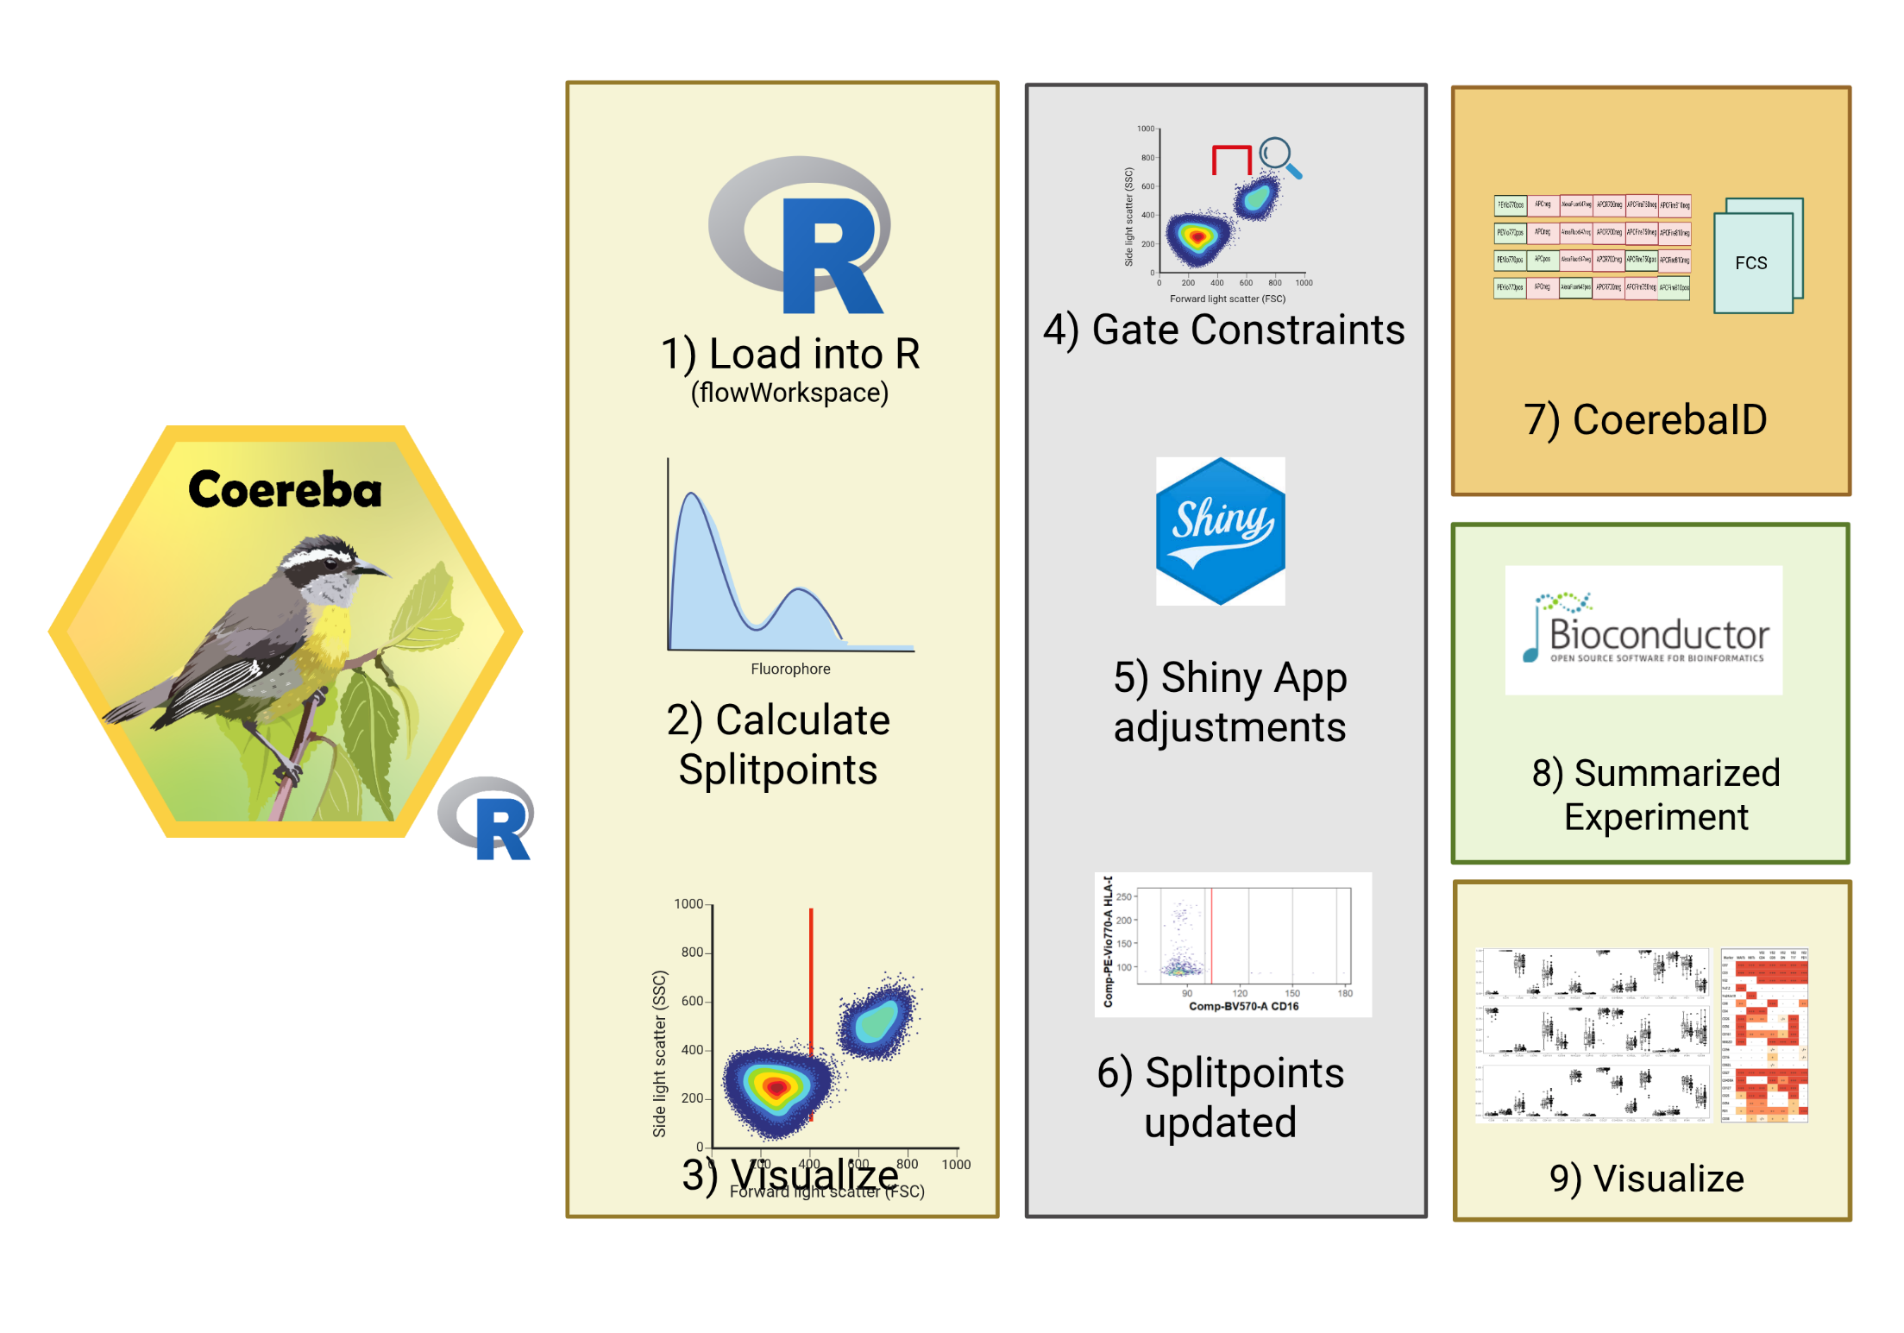
Coereba
Code

Slide 48

Grouping cells that share every marker

Slide 49
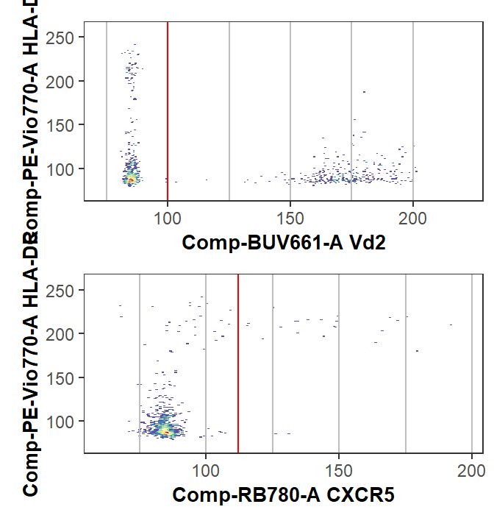
Initial automated gate, with ability to adjust
Initial gates for designated markers calculated via openCyto (mindensity)
Ability to update gate_range constraints
Launch a Shiny app and designate interactively

Slide 50
CoerebaID column gets added to the .fcs file

Slide 51
Pipeline: Summarized Experiment
Data stored in a Summarized Experiment
Interoperability with Bioconductor statistics packages

Slide 52
Summarized Experiment
Permits rapid re-aggregation of the terminal nodes for re-evaluation
Ties in with downstream Bioconductor statistics packages
Portable. Don’t like how we aggregated groups of cells? File is small enough to store in the same data repository as .fcs files for subsequent re-analysis.
Filterable by metadata or node.
- Nodes only in HEU-hi?
- Nodes unique to one individual?

Slide 53
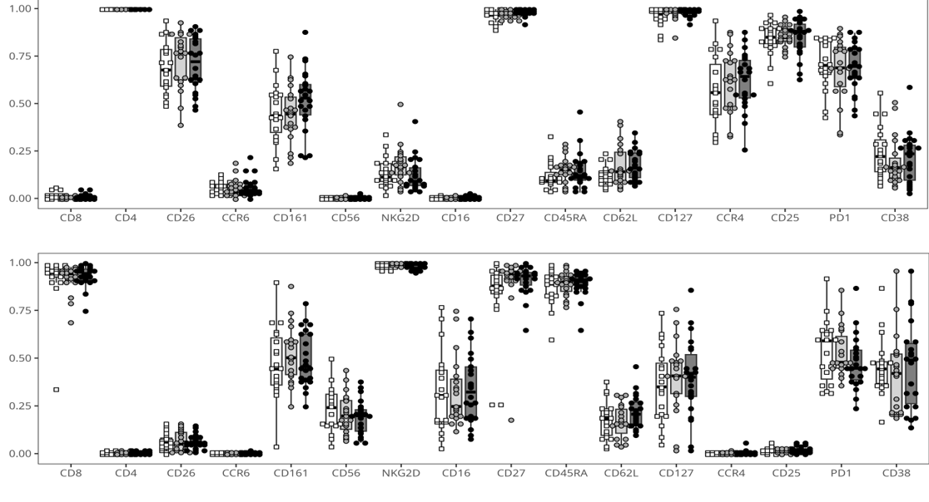
Retrieval of marker expressions

Slide 54




Pipeline: Normalization
CytoNorm
CytoNorm
Vignettes
CyCombine
CyCombine
Vignettes

Slide 55


Pipeline: Clustering
FlowSOM
FlowSOM
Vignettes

Slide 56



Pipeline: Dimensionality Visualization
UMAP
UMAP
Wrapper
PaCMAP
PaCMAP
Wrapper

Slide 57
Ability to contrast unsupervised methods vs. “manual” ground-truth

Slide 58
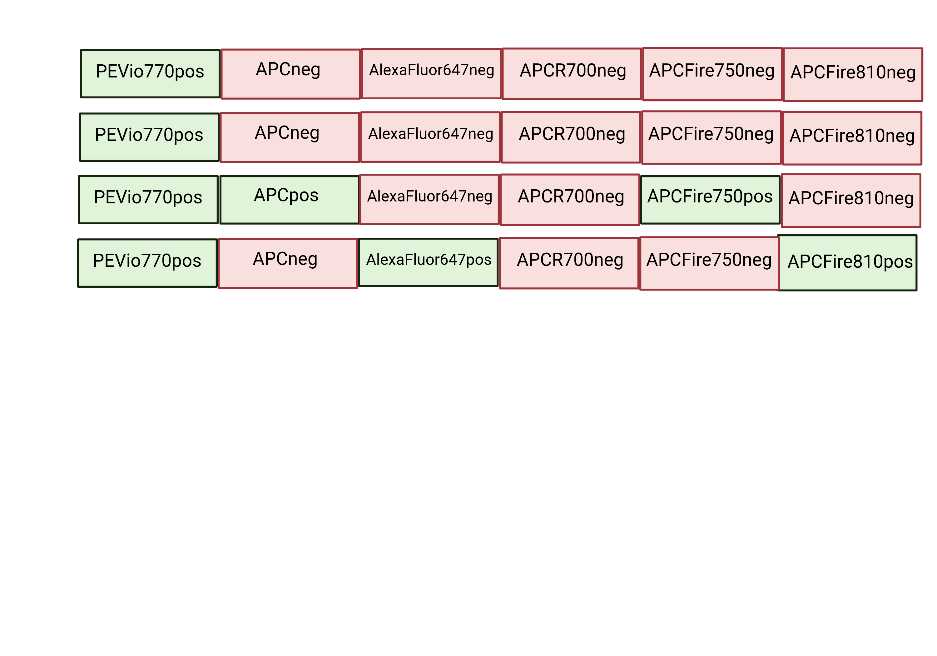
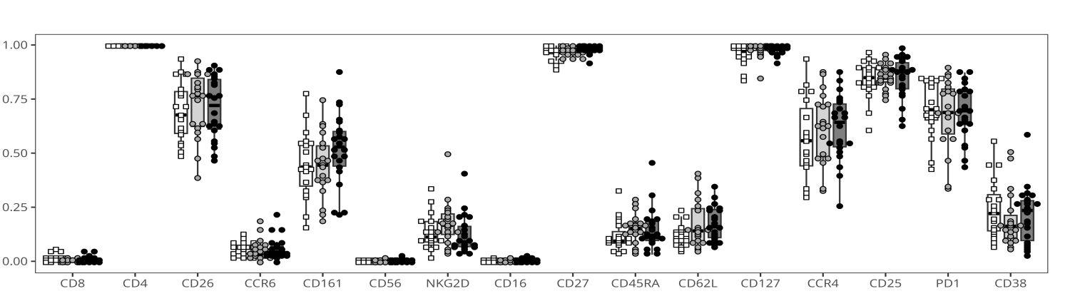
Retrieving and re-enumerating
2) Retrieve manual-annotated gates
3) Re-enumerate
and plot
1) Gate

Slide 59
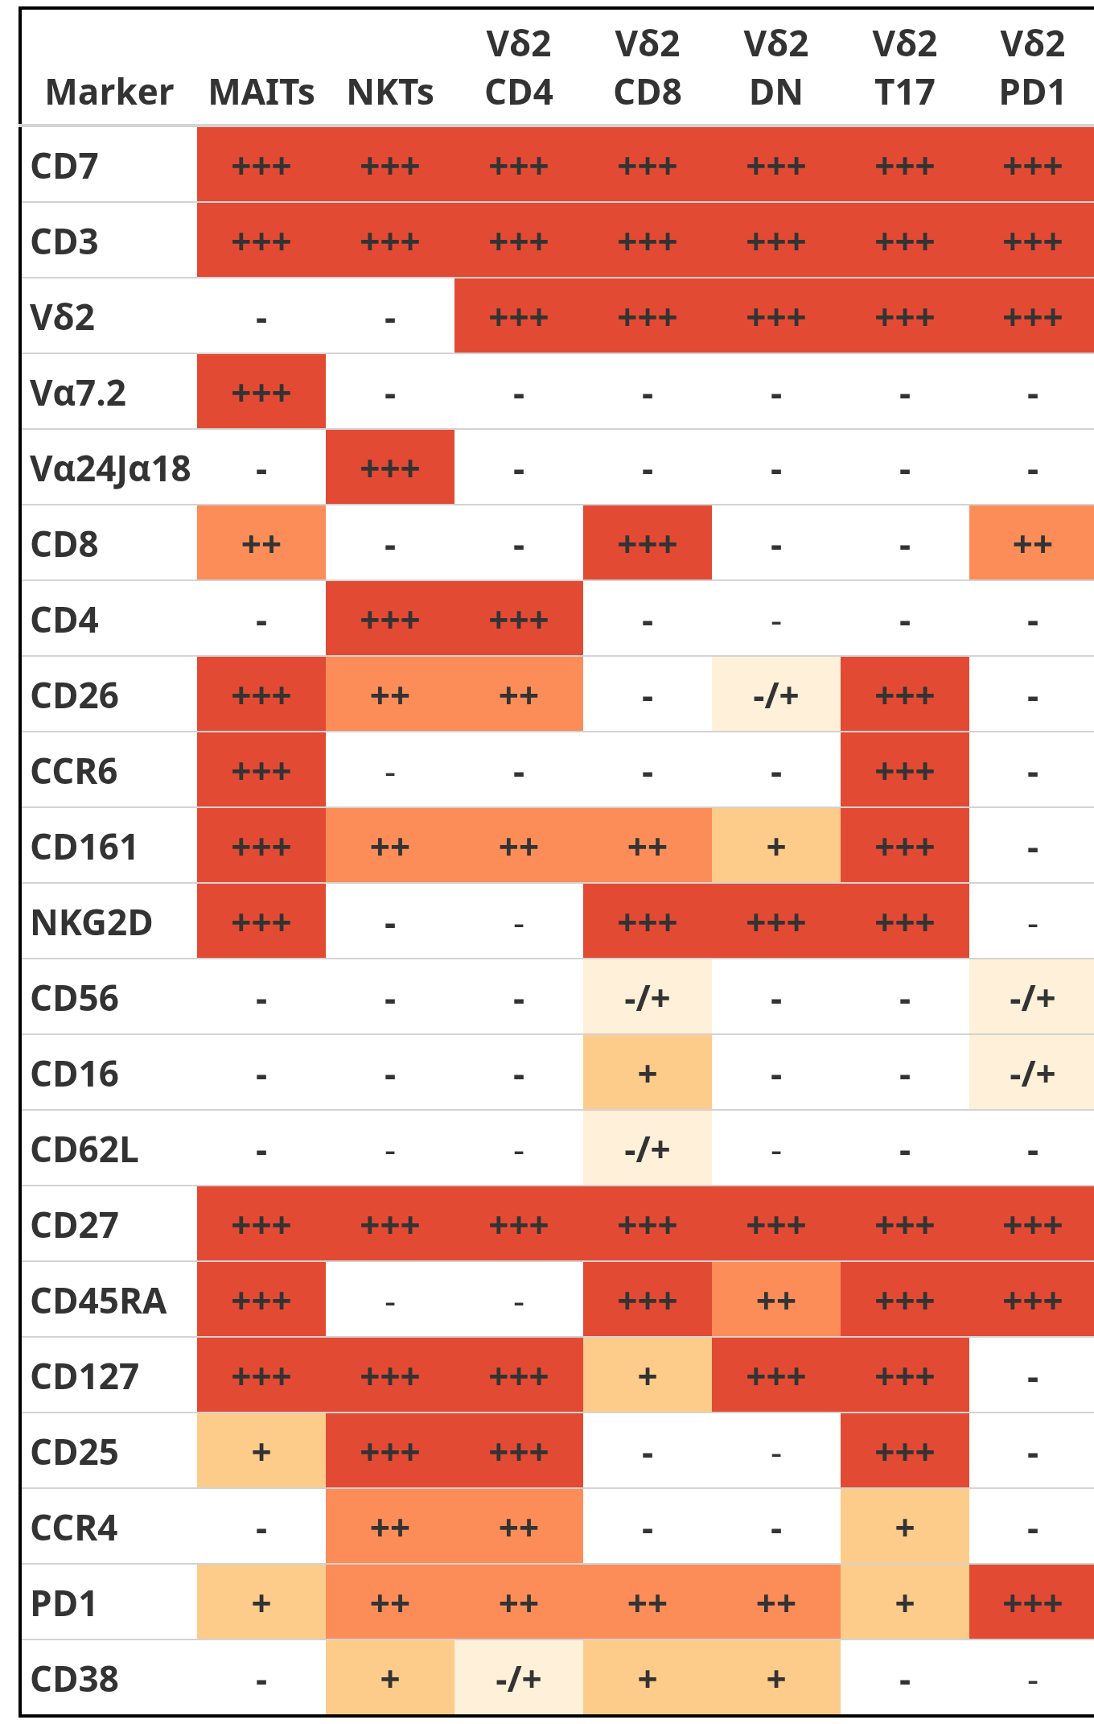
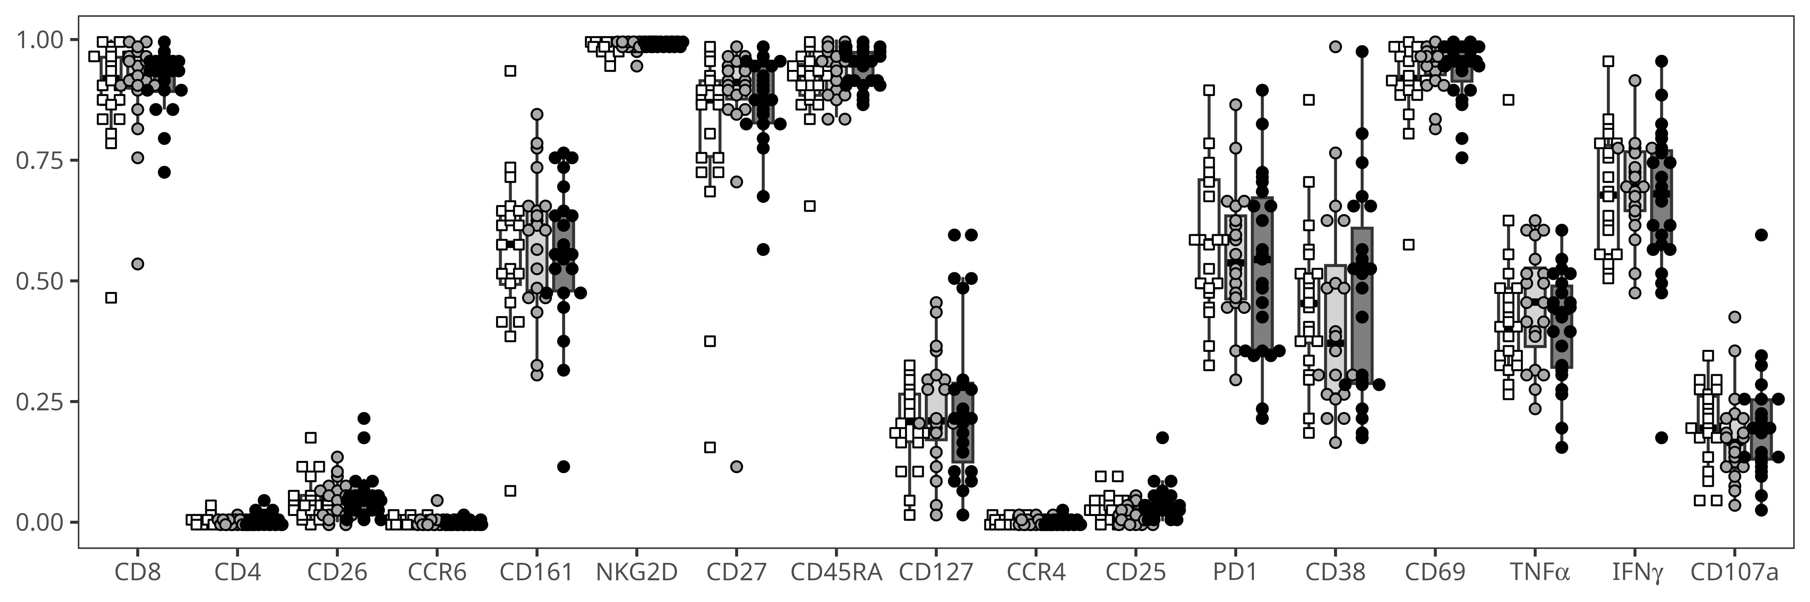
Retrieve manual annotated gating information following unsupervised steps

Slide 60
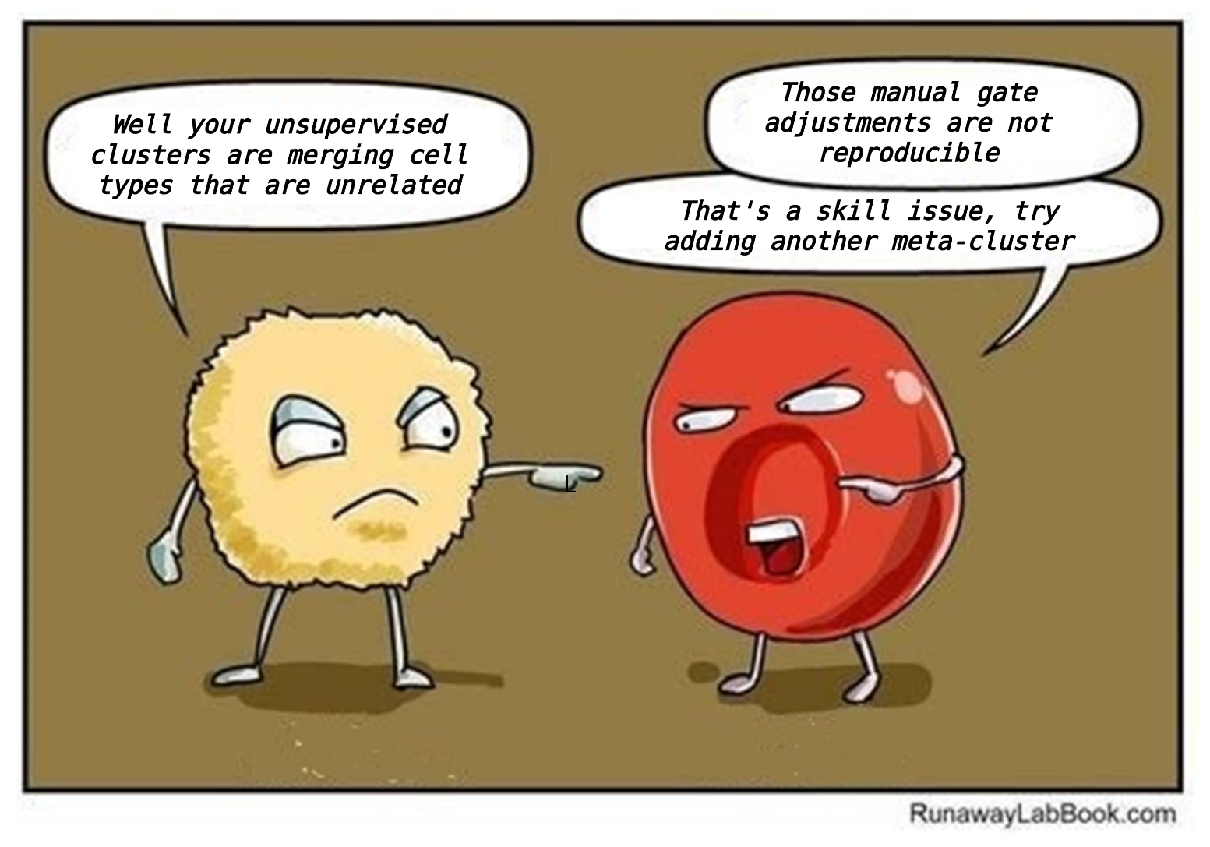
Functional and Iterative: plenty for everyone to dislike ☺
Fun off-label uses thus far:
Contrasting where “manually-gated” cells end up vs. our unsupervised methods (normalization, clustering, etc.)
Added benefit of looking-at-the-forest: Easy to identify badly cryopreserved specimens where cell populations were lost

Slide 61
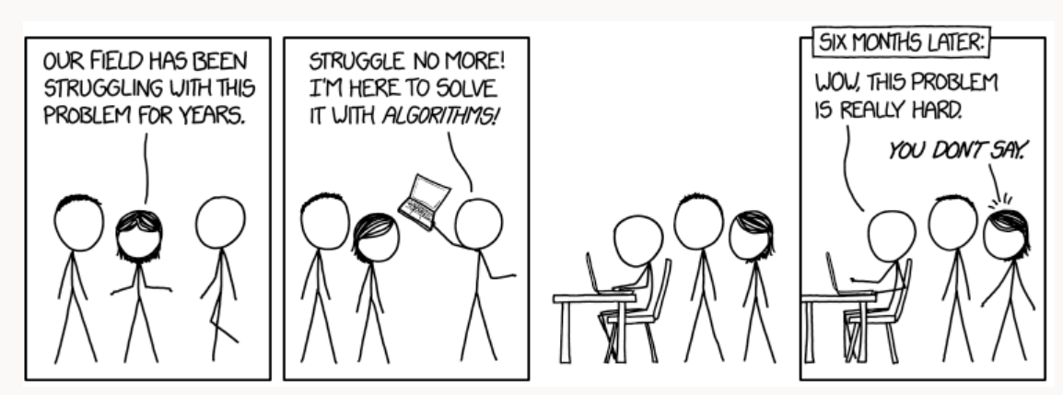
Are our high-dimensional analysis problems fixed?

Slide 62
Semi-supervised Pipeline

Slide 63


What good is any tool if the community is not able to use it?
Few resources to learn Cytometry in R to begin with
Those that exist aimed at those with intermediate-advanced R skills, not beginners
Know-how concentrated at a few institutions
Most self-learning attempts end in frustration

Slide 64

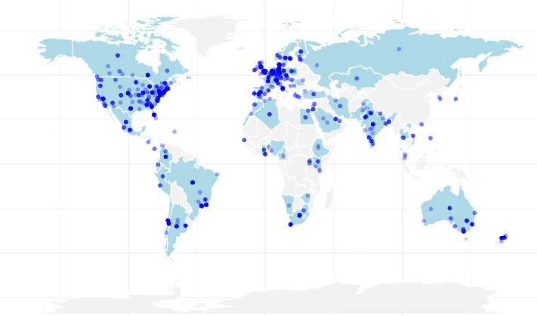

Cytometry in R: A free weekly course for flow cytometrist with no-to-little coding experience
Website

Slide 65
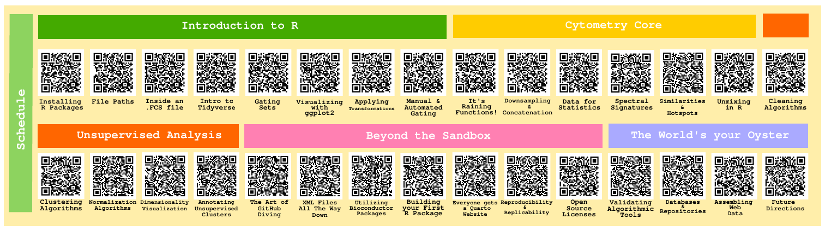
Half-way through this passion project
Wrapping up Cytometry Core module
Gathering steam to start on the Unsupervised Analysis section

Slide 66




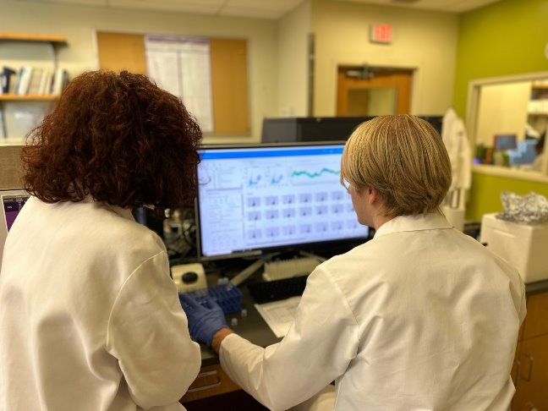



Acknowledgments
All mothers and their infants, and their communities
All the open-source contributors, developers, and maintainers, that collectively made the tool sets without which all of this would not be feasible
Cytometry
Discord
Bioconductor
Zulip
Dr. Cristiana Cairo
Dr. Kirsten E. Lyke
Dr. Xiaoxuan Fan
U01 HD092309
This publication was supported by funds through Maryland Department of Health’s Cigarette Restitution Fund Program – CH- 649-CRF and the National Cancer Institute – Cancer Center Support Grant (CCSG) – P30CA134274.d Service
www.linkedin.com/in/david-rach/
Dr. Daniela Franco
Dr. Natarajan Ayithan
Want to collaborate? Reach out!

Slide 67

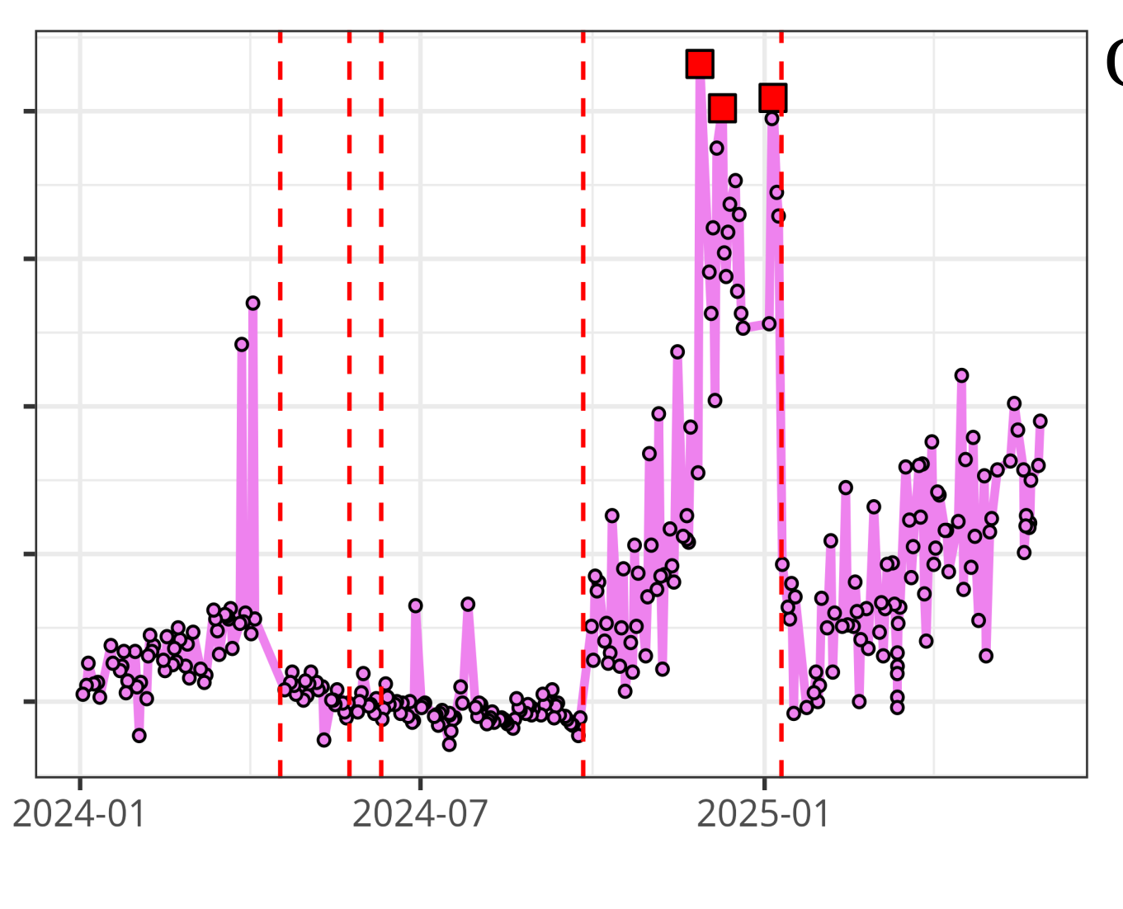

Questions?
UMGCCC FCSR
InstrumentQC dashboard
Luciernaga
Website - CytometryInR
InstrumentQC How-To
Coereba
YouTube @CytometryInR

