Slide 1



Quirks and All: unlocking comprehensive biological discovery
out of your spectral flow cytometry datasets
David Rach, Ph.D.
UMGCCC Flow Cytometry Shared Resource
Baltimore, MD
September 22, 2026
Slides

Slide 2


Spectral Flow Cytometry is amazing!!!
Capable of resolving remarkably similar fluorophores → increased number of markers per panel compared to conventional flow cytometry (CFC)
Allows for rapid acquisition of millions of events in a few minutes → typically greater number of acquired cells per sample compared to mass cytometry (MC)
Spectral Flow Cytometry (SFC) datasets have an unique combination of width and depth compared to preceding technologies

Slide 3
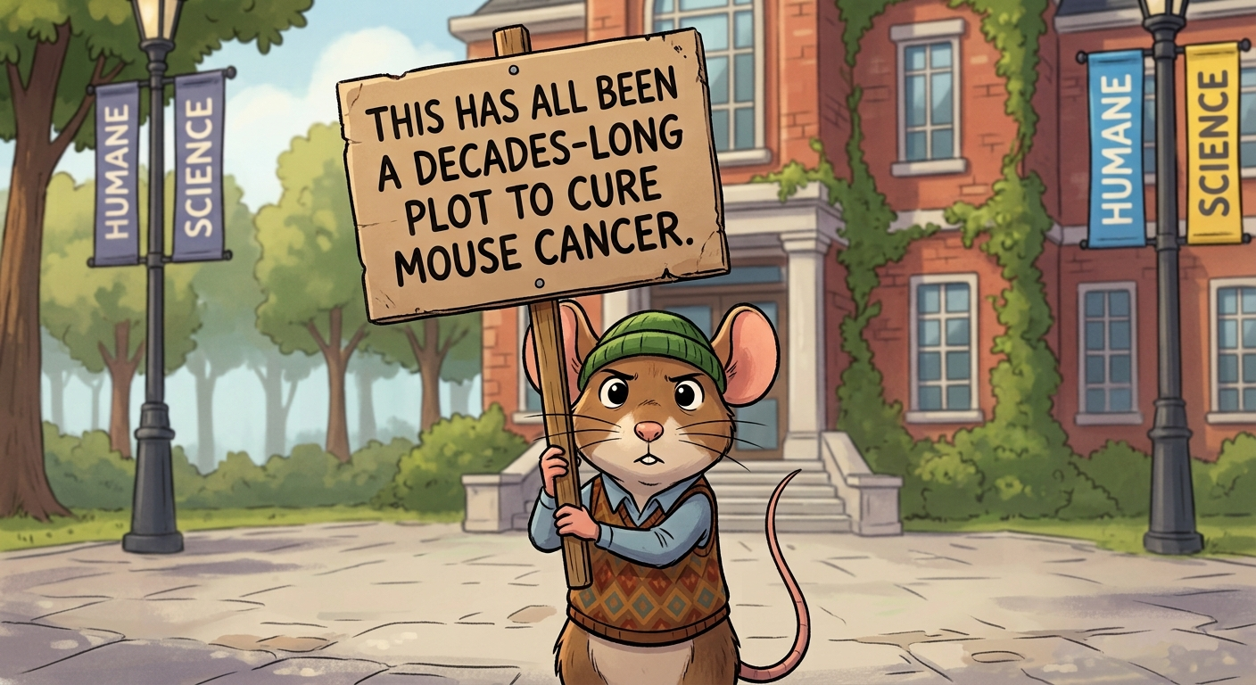
SFC has expanded our biological discovery potential
Able to efficiently acquire greater number of cells → more thorough profiling of rare cell subsets
Build one panel, evaluate multiple cell types → invaluable for studies with limited biospecimen
Reduced experimental cost
Expand our knowledge about immune system heterogeneity

Slide 4
Trade-off: More complicated data analysis
If you are only interested in a single population of cells → analysis process via manual gating remains essentially unchanged, just more gates
If your goal is to profile all cell populations present in your .fcs →
the breadth and depth necessitate new analytical approaches beyond manual gating

Slide 5
Complex Datasets: Combinatorially Exponential Clusters
If for a given marker in your panel, you split the cells into positive and negative populations
And this splitting process was repeated for every marker in your panel
And at the end, we grouped cells that only expressed the same markers
9-color CFC panel → 512 groups at most
40-color SFC panel → 1.1e+12 groups (trillion)
60-color SFC panel → 1.2e+18 groups (quintillion)

Slide 6
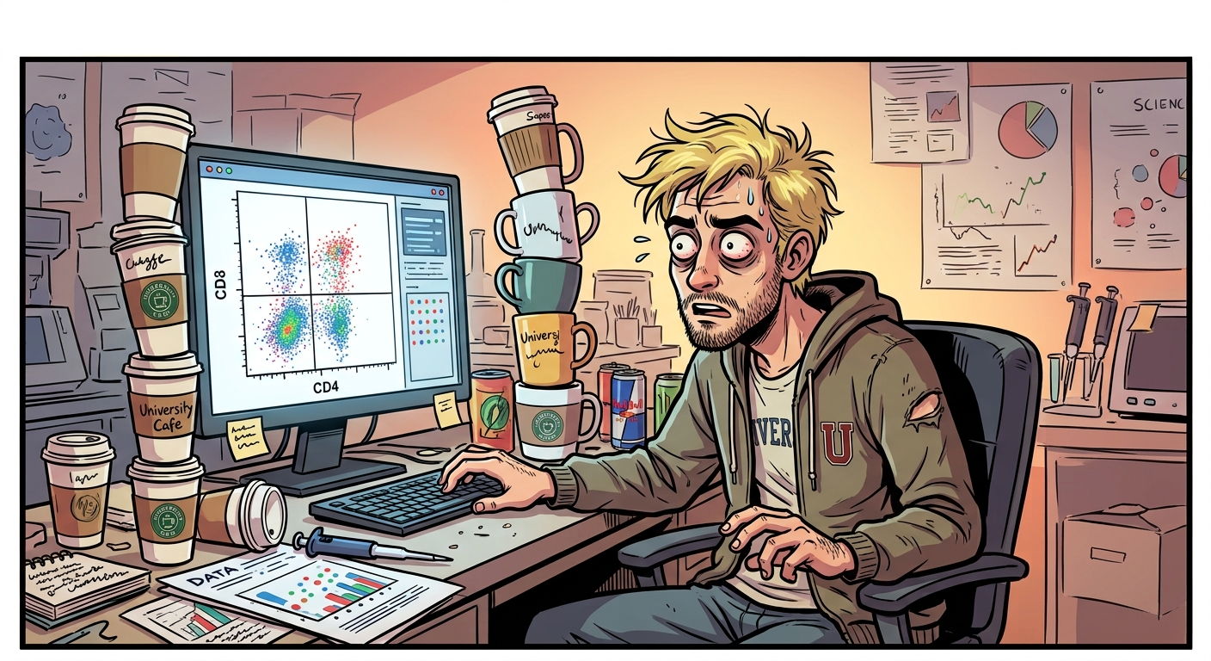
If I manually checked every combination
60-color SFC panel → 1.2e+18 groups (quintillion)
1 gate, every 10 seconds → 6 groups/minute
60 minutes in an hour → 360 groups/hour
Awake 16 hours a day → 5760 groups/day
365 days per year → 2,102,400 groups/year
76 years - 22 pre-PhD = 54 years
→ 1.13e+8 groups/life-time

Slide 7

Continuously since the Big Bang
60-color SFC panel → 1.2e+18 groups (quintillion)
365 days per year → 2,102,400 groups/year
Invent a time-machine, become immortal
13.8 billion years → 2.9e+16 groups/reality
So we need ~ 50 immortal researchers working continuously since the Big Bang just to check all group combinations for a single 60-fluorophore panel .fcs file

Slide 8
Alternative: Unsupervised Analysis (Algorithms)
Consequently, if the goal is to characterize all cell populations present, some form of unsupervised (algorithm) or semi-supervised analytical approaches will be needed
Consequently, if the goal is to characterize all cell populations present, some form of unsupervised (algorithm) or semi-supervised analytical approaches will be needed
Clustering → FlowSOM, Phenograph, Xshift, etc.
Dimensionality visualization → opt-SNE, UMAP, PaCMAP, Phate, etc.
Automated Gating → openCyto, flowMagic, ElasticGate, etc.

Slide 9
What all the arguments are about

Slide 10
What all the arguments are about

Slide 11
What all the arguments are about

Slide 12
What all the arguments are about

Slide 13
Adapted algorithmic tools struggle with number of events
Many of these software tools were originally implemented as R or Python packages, for use in analysis of mass cytometry or single-cell RNA-seq datasets
Mass cytometry → similar number of markers, typically fewer events, no unmixing variation due to autofluorescence
Single-cell RNA-seq → substantially more markers, typically way fewer events. No equivalent “negative” gate events for not expressed transcripts
Down-sampling becomes often necessary

Slide 14
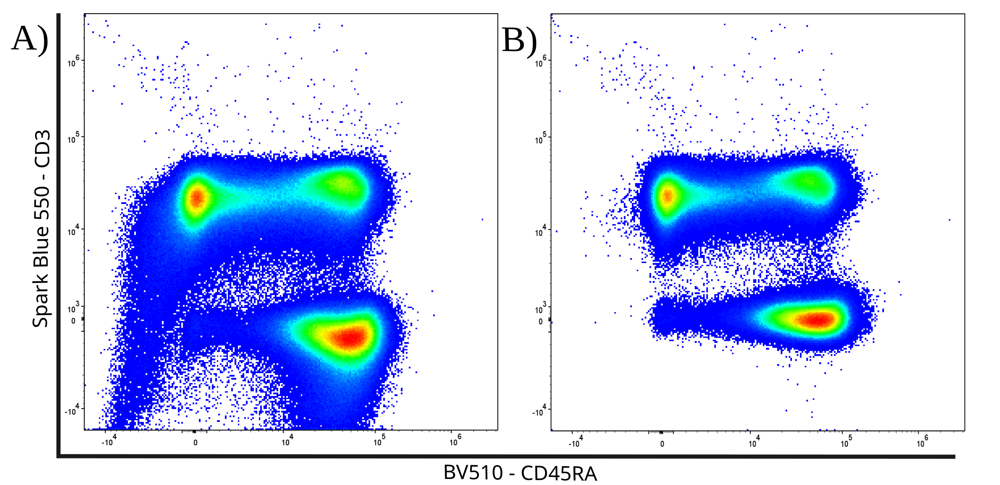
Adapted algorithmic tools struggle with unmixing errors
Adapted software packages heavily rely on having a consistent median fluorescent intensity (MFI) to cluster cells based on positive or negative marker expression
Existing batch correction / normalization / scaling tools target instrumental or experimental level variation for correction
Unmixing errors can seriously shift the MFI ranges for “negative” and “positive” cells for individual acquired specimens

Slide 15
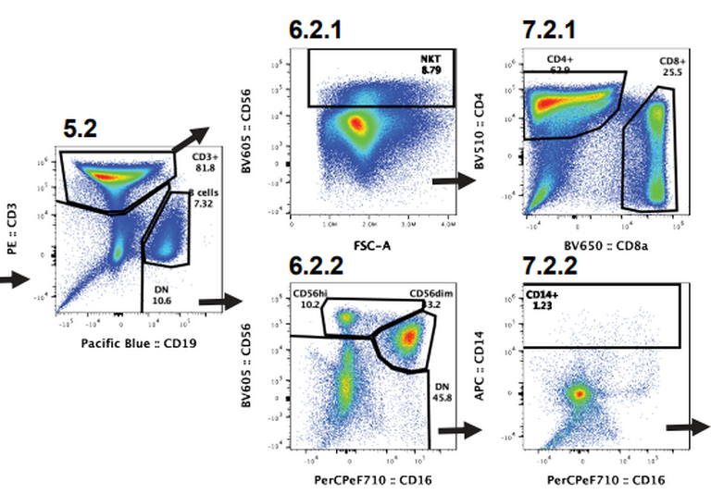

“We discovered a novel dendritic cell cluster”
Despite the critical importance unmixing controls play, few tools permit us to determine quality of the individual control before unmixing
Existing quality control algorithms (PeacoQC, FlowAI, etc.) primarily focus on detecting laser and fluidic issues in already acquired .fcs files.
Unmixing errors can be introduced by tandem degradational, additional autofluorescences, undiagnosed instrumental issues, etc.

Slide 16
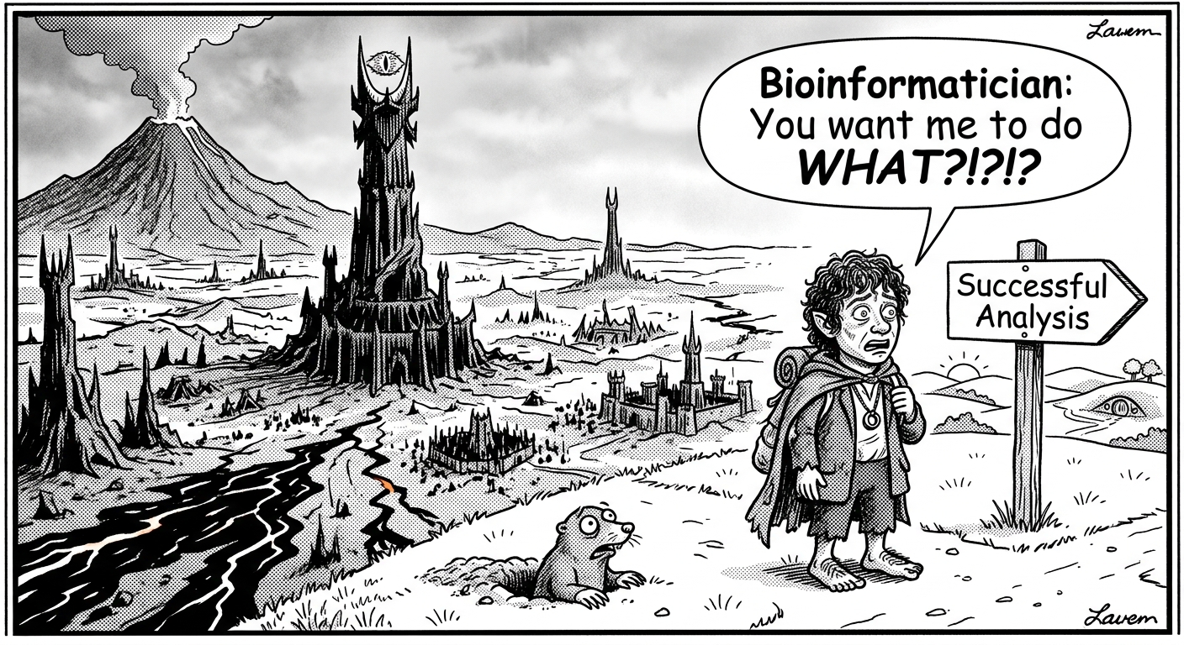
Full biological discovery potential often out of reach
Most flow cytometrist don’t code
You likely lost your bioinformatician while describing manual gating
The statisticians were never consulted
For most spectral flow cytometry datasets, only a handful of cell populations end up being analyzed by any method

Slide 17
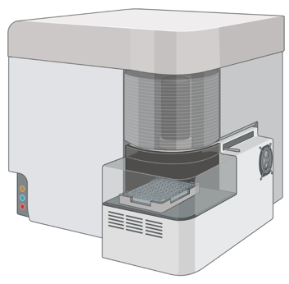

To unlock the comprehensive biological discovery potential,
we need to address these pink elephants
Quality of the unmixed full-stained data is linked to the quality of our single-color controls (and our ability to provide appropriate autofluorescence controls).
If we are acquiring 3 million cells to detect 100 rare cells, how do we thoroughly explore the rest of the sample to avoid wasting useful data?

Slide 18

Building open-source tool-sets to address SFC’s quirks
Spectral Signature Characterization and Isolation
Incorporation of manually-annotated gating information
Automated Instrument
Quality-Control Dashboards
Rust

Slide 19
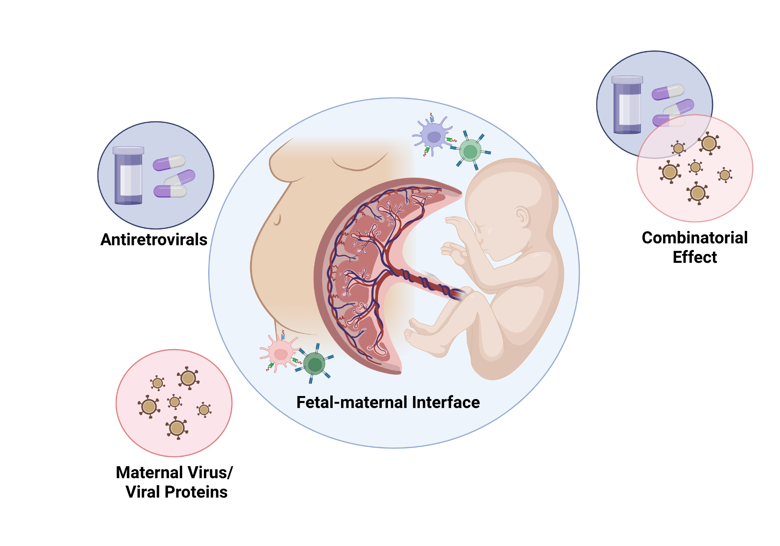
My PhD’s focus: HIV-exposed Uninfected Infants

Slide 20
HIV-exposed Uninfected Infants

Slide 21
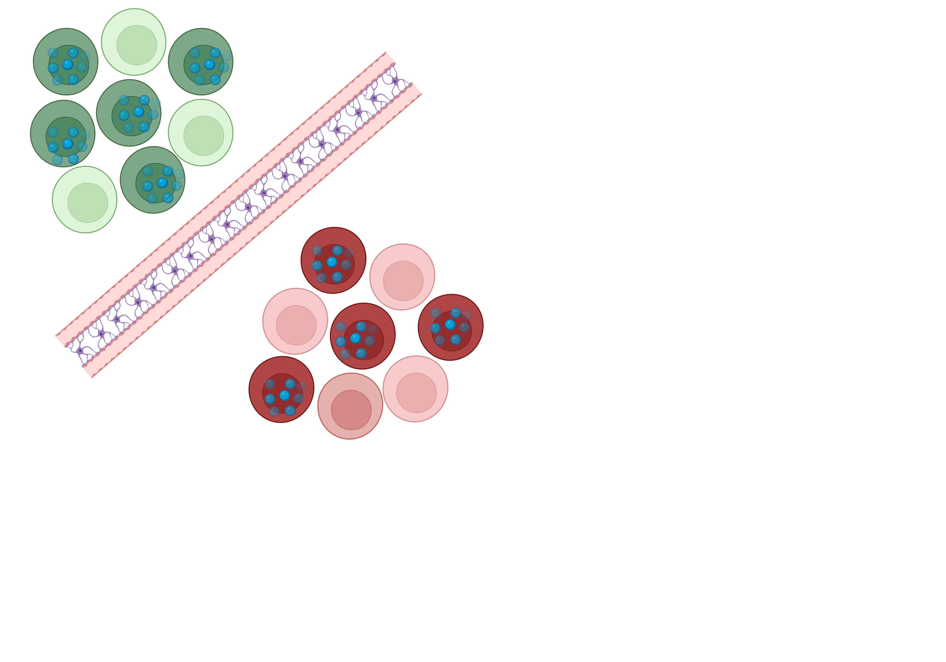
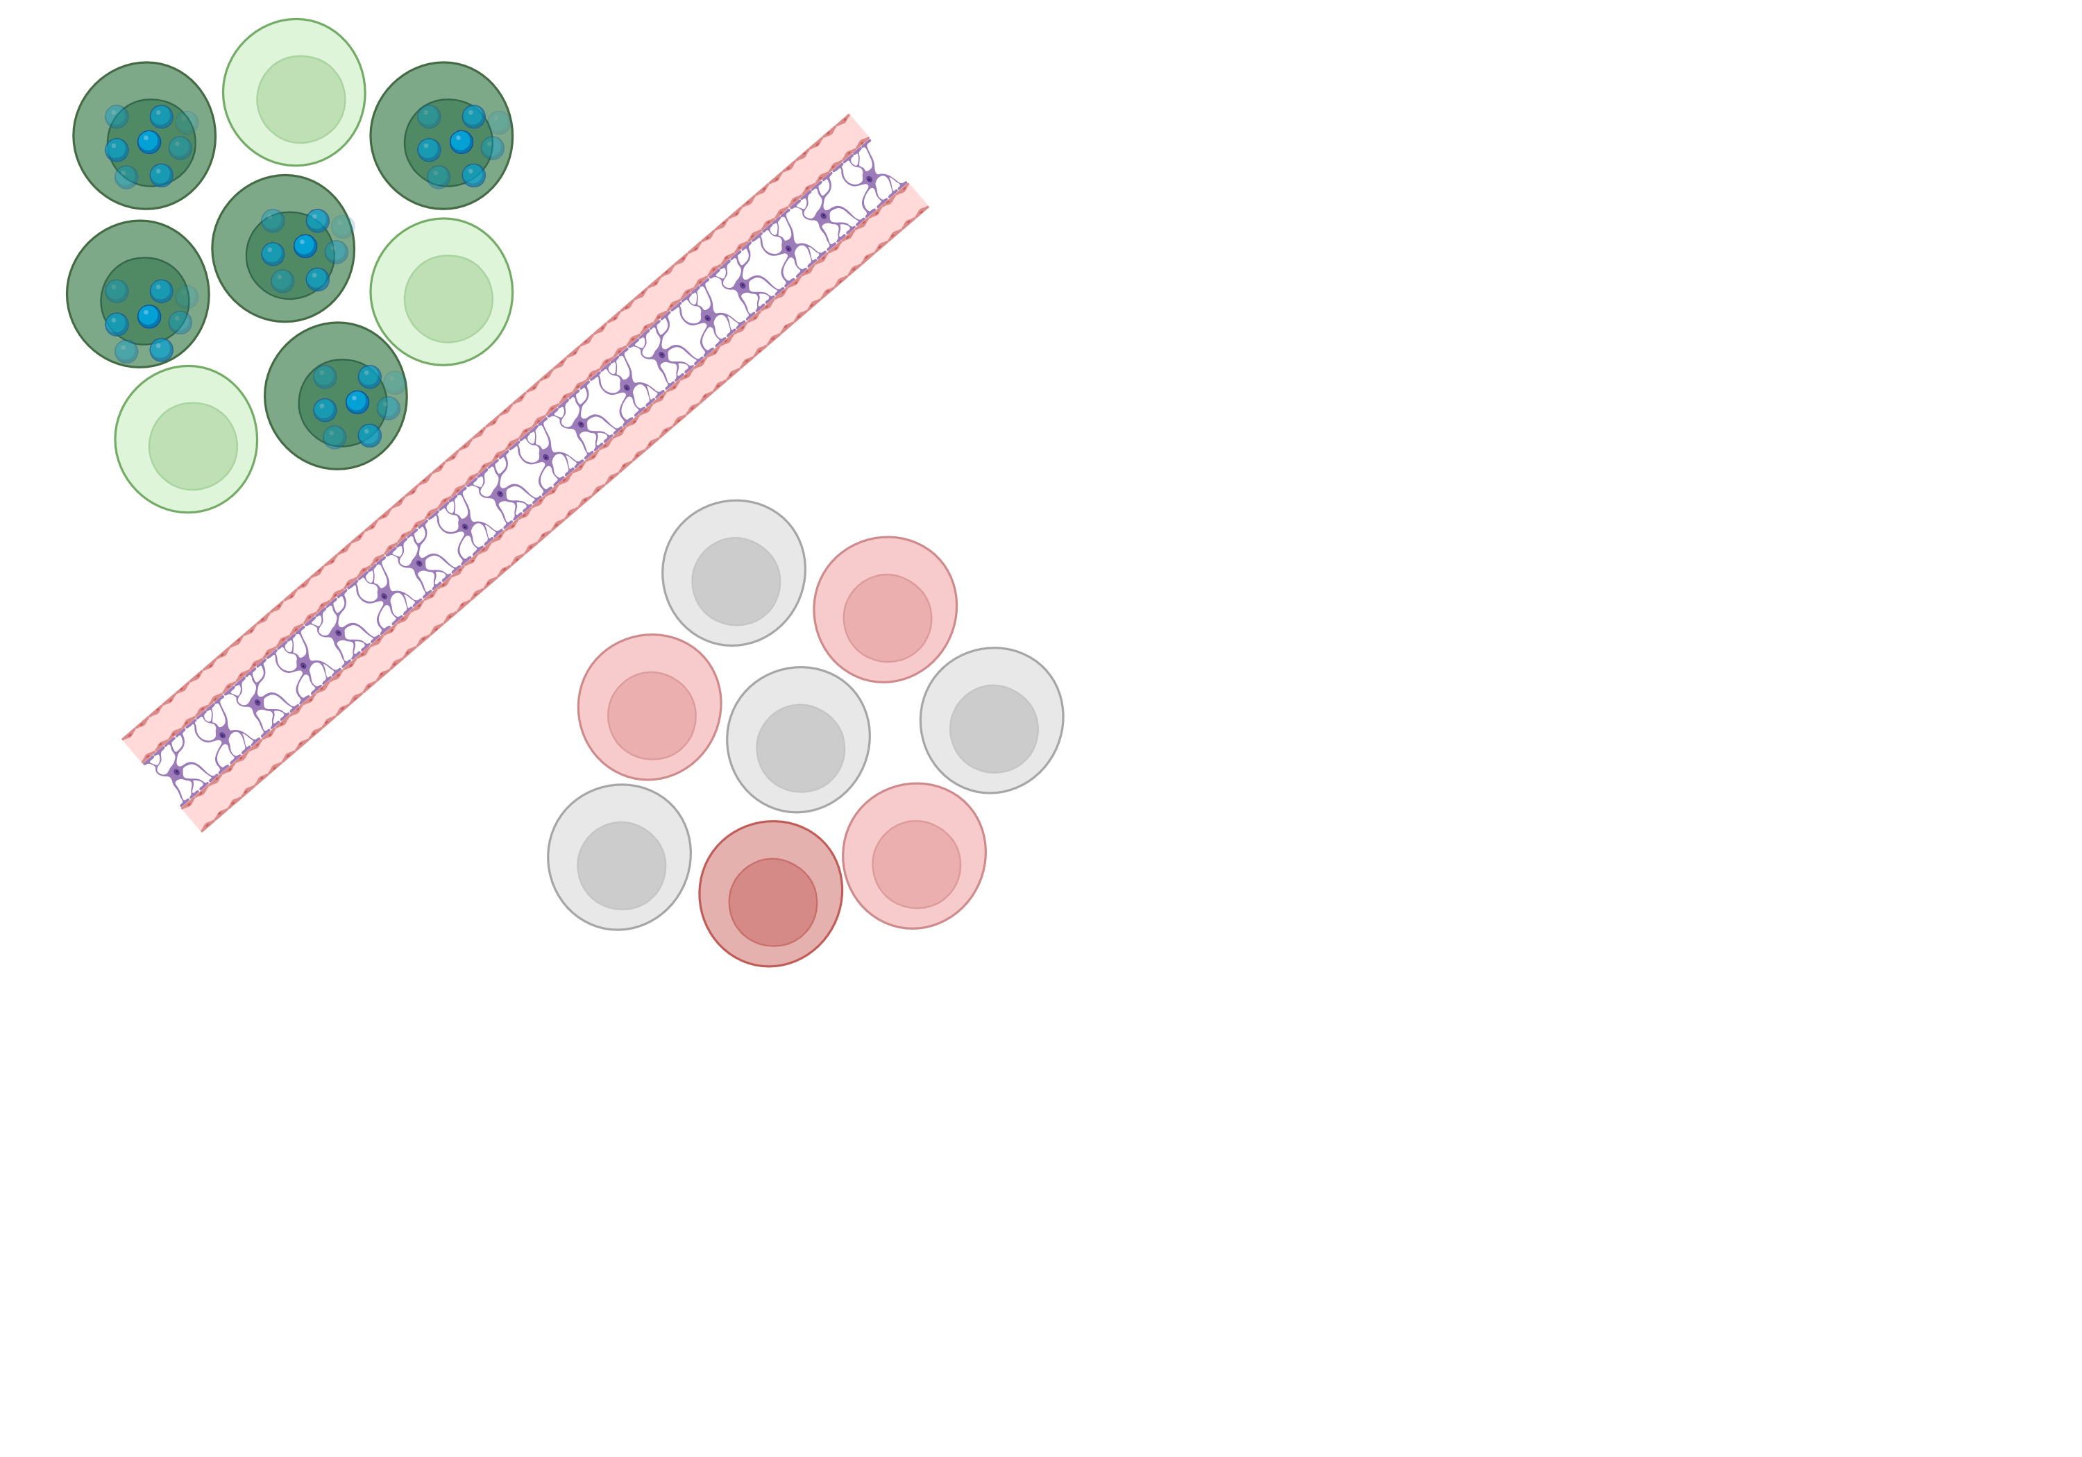
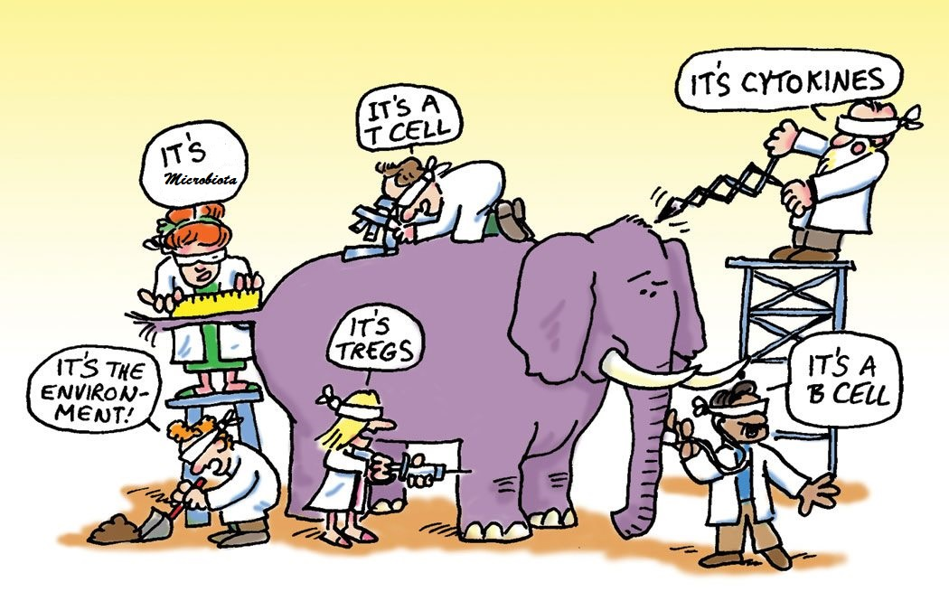
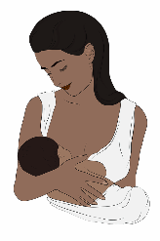

Is there an immunological cause?
Immunological cause?
Too active
Too
inactive
Cells
missing
Other factor?
Formula vs. Breastfeeding
Maternal Antiretrovirals

Slide 22
Infection during pregnancy
Mother
Does the maternal immune system respond?
Is there interaction?
Is there damage?
Is the developing fetal immune system affected?
Shared circulation
Location, Scale, Timing
  Cold, Upper Nasal
  Influenza, Systemic
Fetus

Slide 23
What effect does early exposure have on the fetal immune system?
Infection during pregnancy
Never
Activated
Activated, Differentiated
Activated, Repressed
Activated, Eliminated

Slide 24
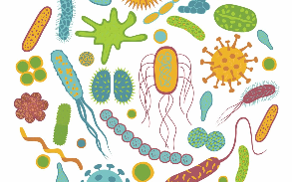
Does this fetal exposure impact immune responses during early life?
Never
Activated
?
Health
Activated, Differentiated
Sickness
?
Activated, Repressed
Hospital
?
Activated, Eliminated

Slide 25
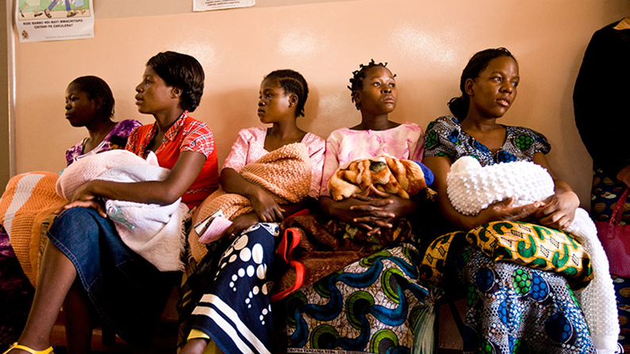
Conflicting Studies
Some Studies:
Increased frequency of Th1-like cytokines in T cells ex-vivo
Decreased proliferation in culture
Lower antibody titers for maternal antibodies
Other Studies:
Same (or lower) frequency of Th1-like cytokines in T cells
ex-vivo
No change in proliferation in culture
Higher antibody titers for maternal antibodies

Slide 26
Treatment standards changed over time
As anti-retrovirals became more available, health policy changed
Maternal antiretroviral until birth →
Single antiretroviral for life →
Combined antiretroviral for life
Prior studies may have grouped infants with varied viral and antiretroviral exposures together

Slide 27
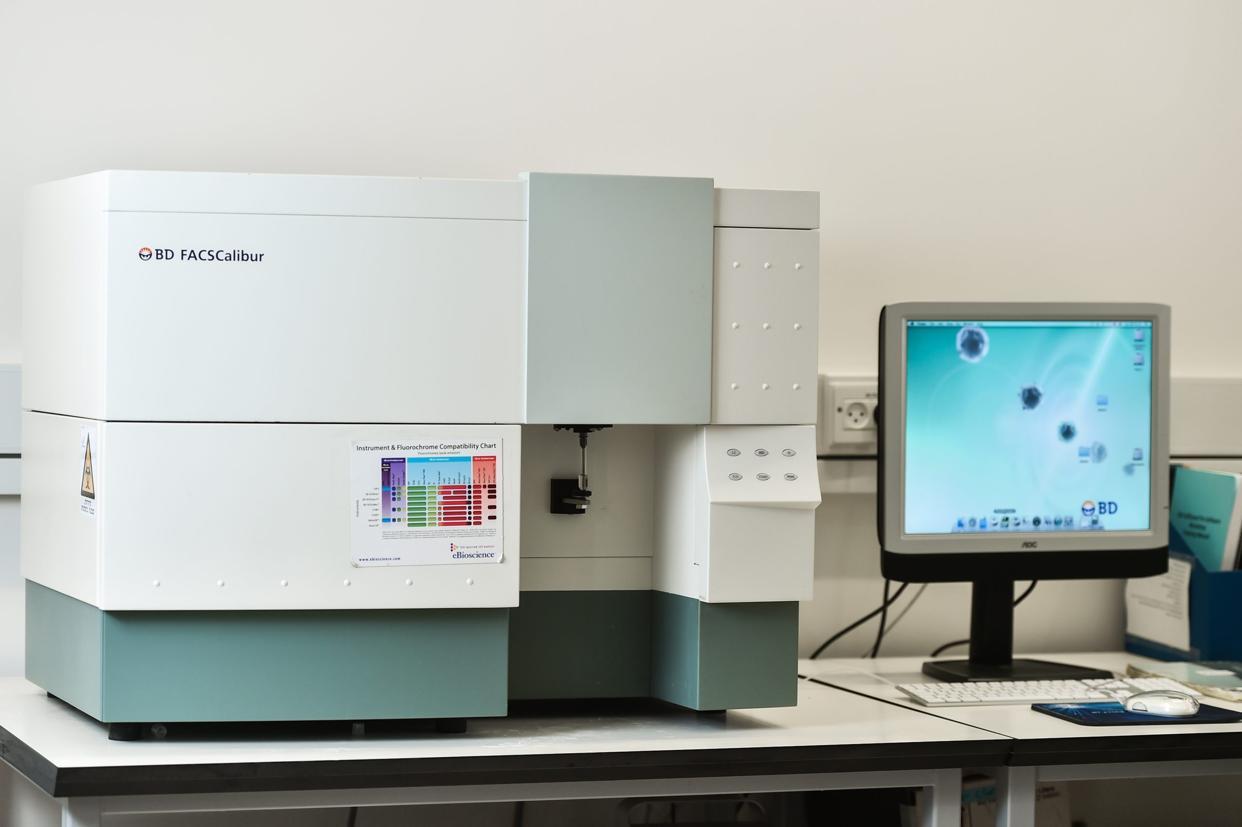
Snapshots in Time
Even carefully controlled ground-breaking studies are defined by the technology and resources available at time
Conventional Flow Cytometers
Calibur (2007) (4-fluorophores)
LSR II (2017) (14-fluorophores)
Spectral Flow Cytometers
Up to 60! fluorophores now

Slide 28
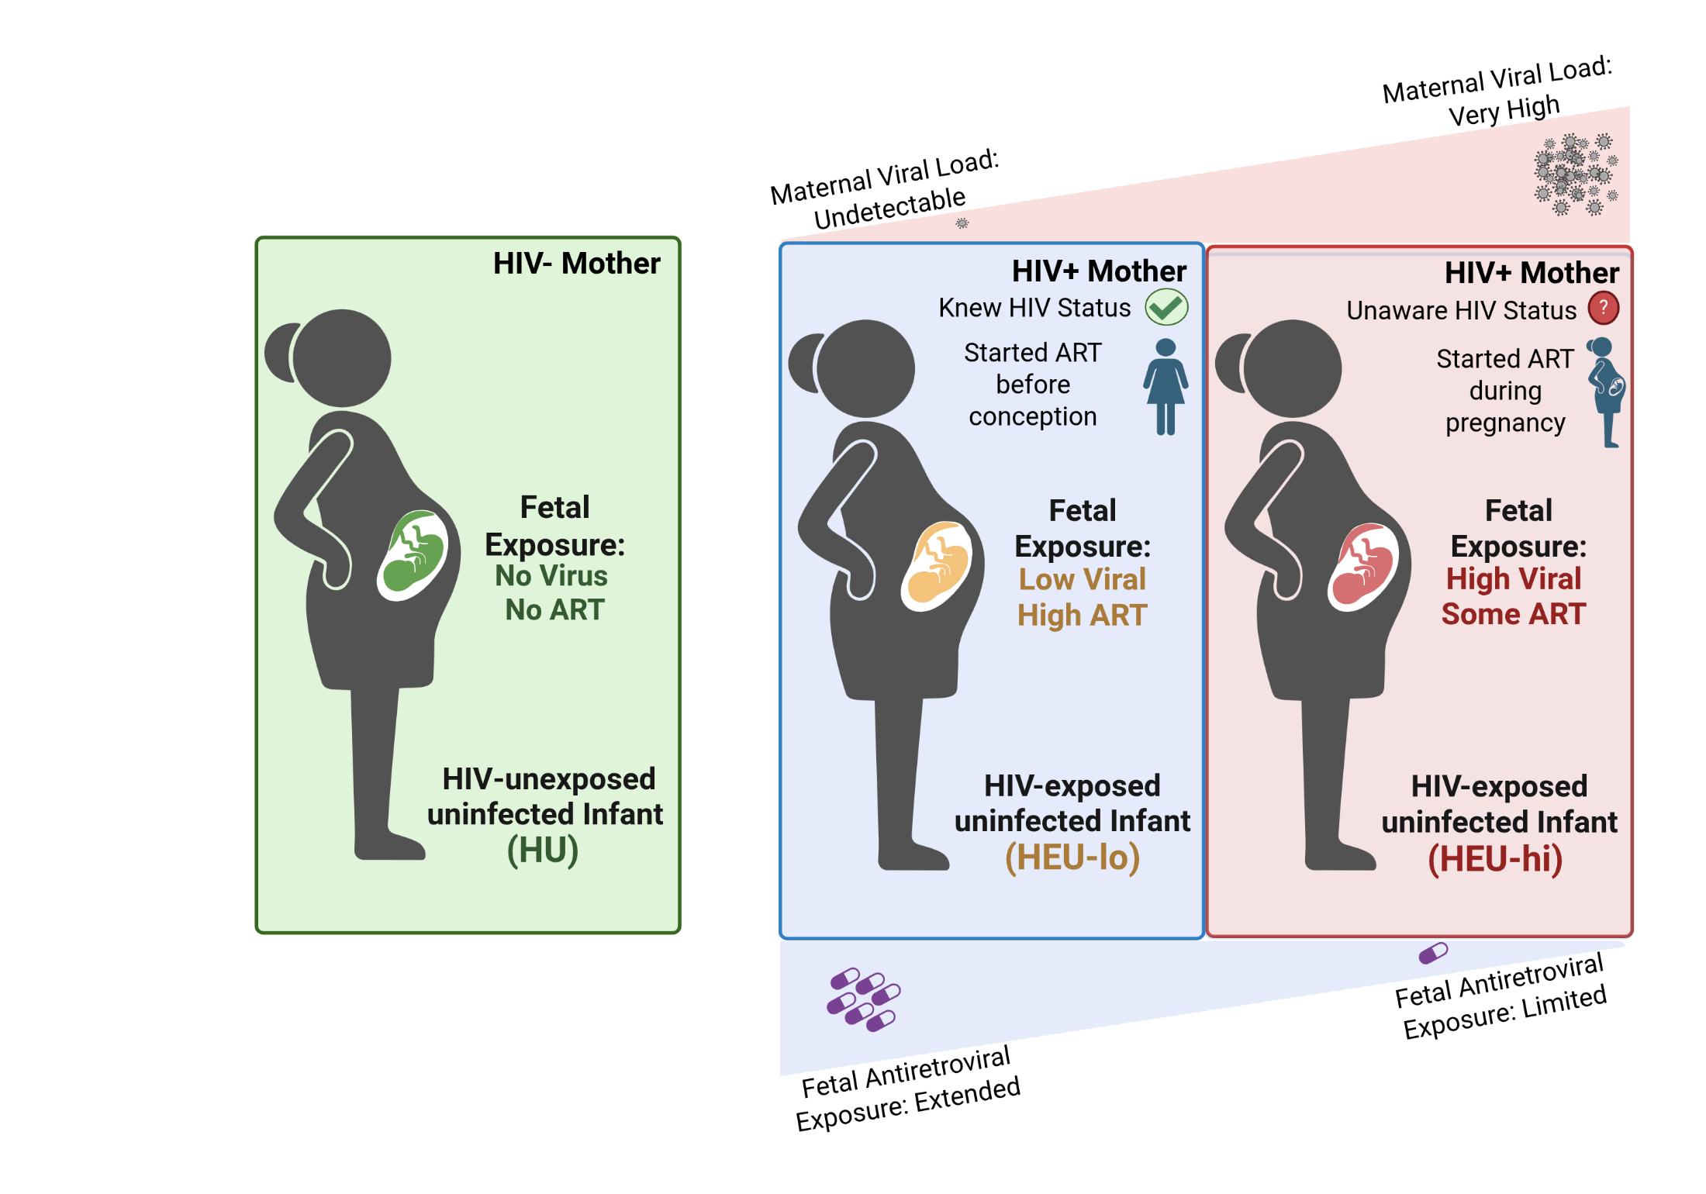
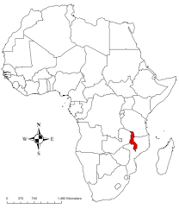
Our Malawian Cohort

Slide 29
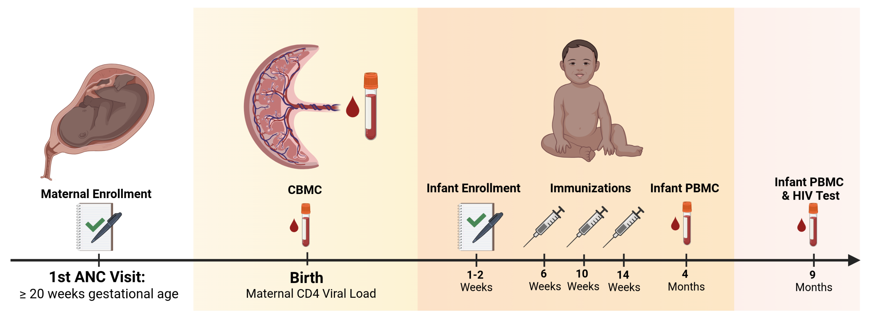
Study Timeline

Slide 30
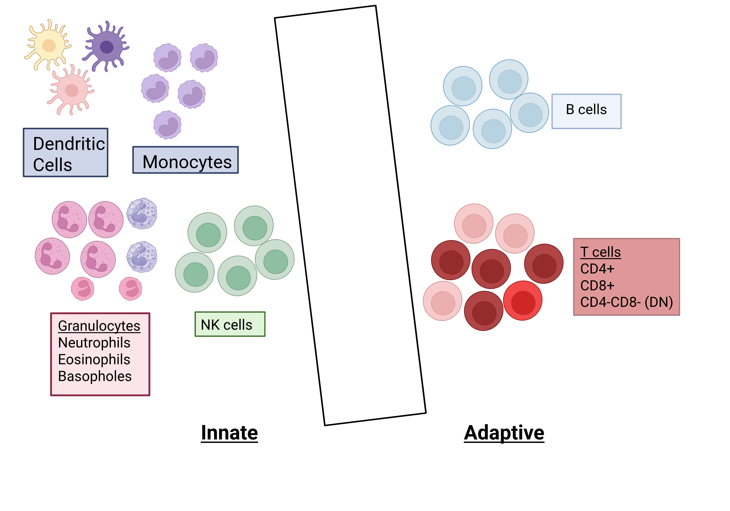
Cells of the Immune System
Innate:
Rapid response
Conserved patterns
Adaptive:
Slower response
Antigen-specific

Slide 31
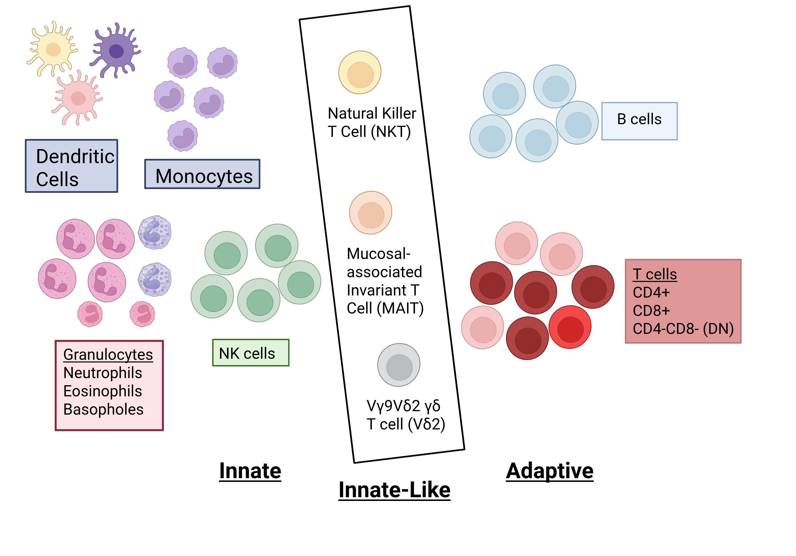
Innate-like T cells
Natural Killer T cells (NKTs)
Vɑ24Jɑ18+ (antibody)
CD1d (tetramer) with PBS-57 (Lipid)
Mucosal-Associated Invariant T cells (MAITs)
Va7.2+CD161hi (antibody)
MR1 (tetramer) + OP-RU-56
Vᵧ9+Vδ2+ ᵧδ T cells (Vδ2)
Vᵧ9+Vδ2+ (antibody)

Slide 32
Little is known about cord blood Innate-like T cells
Additional lineage markers
  Vδ2+, Vɑ24Jɑ18+, Vɑ7.2+
Unfeasible for Conventional Flow Cytometry due to smaller panels
Mass Cytometry
Conventional Flow Cytometry
Cord ILT
Rare in Cord Blood!
< 0.1% of T cells
Unfeasible for Mass Cytometry due to low acquisition rate
Breadth (Total Markers Profiled)
Depth (Total Cells Acquired)

Slide 33
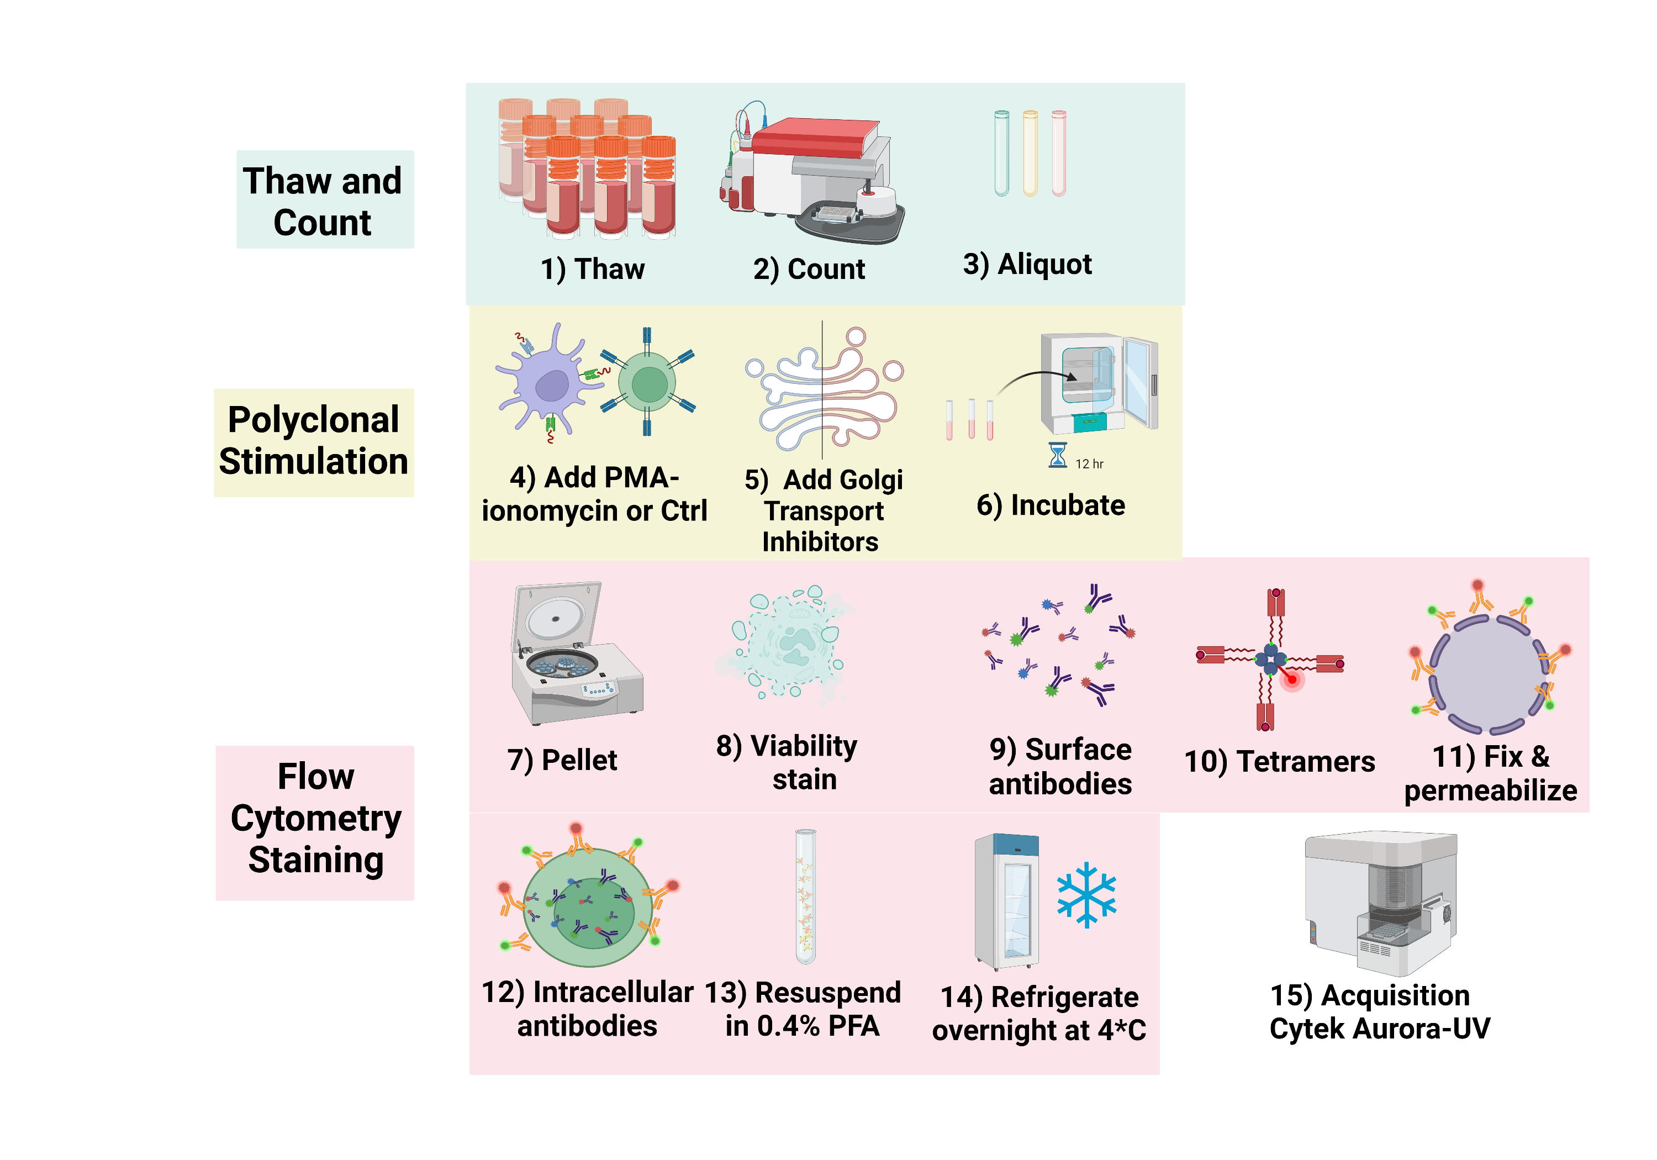
Innate-like T cell SFC Panel – 29 fluorophores

Slide 34
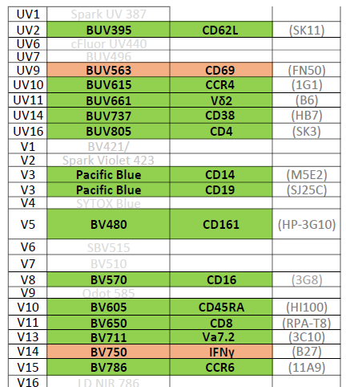
32-Fluorophore Spectral Flow Cytometry Panel
Lineage markers for ILTs
Phenotypic markers for T and NK cells
Cytokines (TNFɑ, IFNᵧ, IL-2)

Slide 35
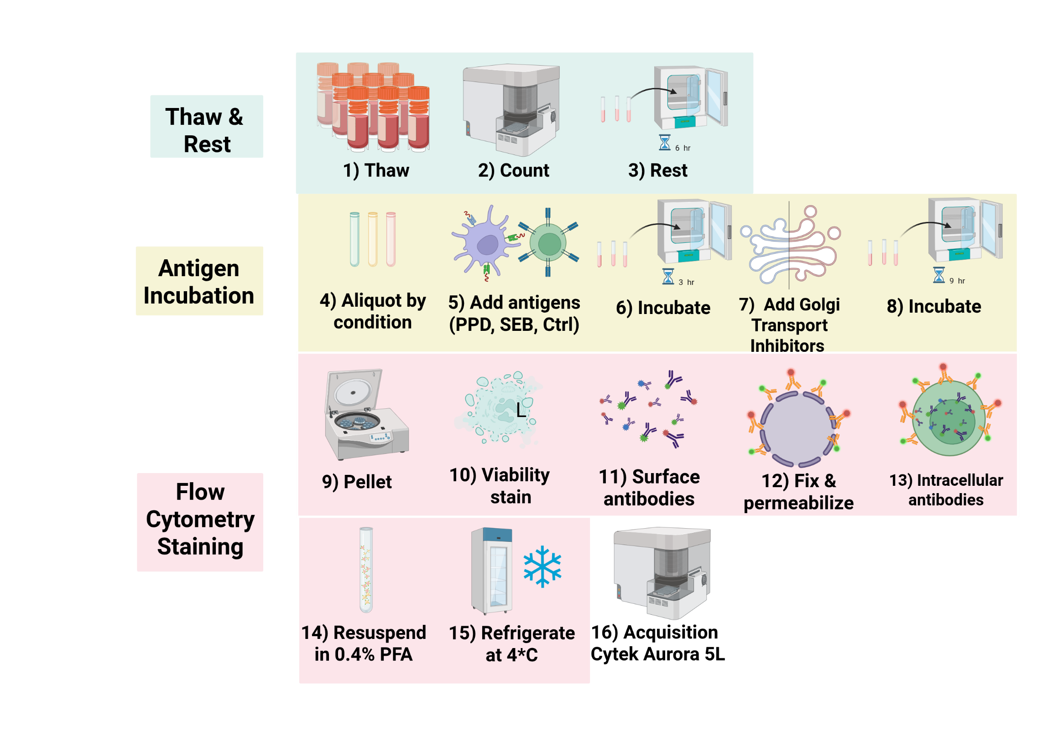
ɑβ T cell SFC Panel – 32 fluorophores

Slide 36
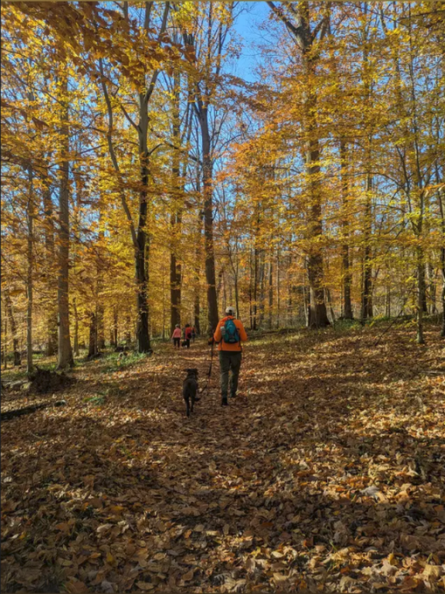
Personal Goal: No cell left behind
Repeated 3 AM thoughts
What makes spectral flow cytometry data amazing is both the depth and the breadth… why in the world would we want to down-sample as a routine step!
If acquiring 3 million cells to profile just 100 rare ones, how to fully profile the rest of the dataset to avoid missing other changes

Slide 37
To unlock the comprehensive biological discovery potential,
we need to address these pink elephants
Quality of the unmixed full-stained data is linked to the quality of our single-color controls (and our ability to provide appropriate autofluorescence controls).
If we are acquiring 3 million cells to detect 100 rare cells, how do we thoroughly explore the rest of the sample to avoid wasting useful data?

Slide 38
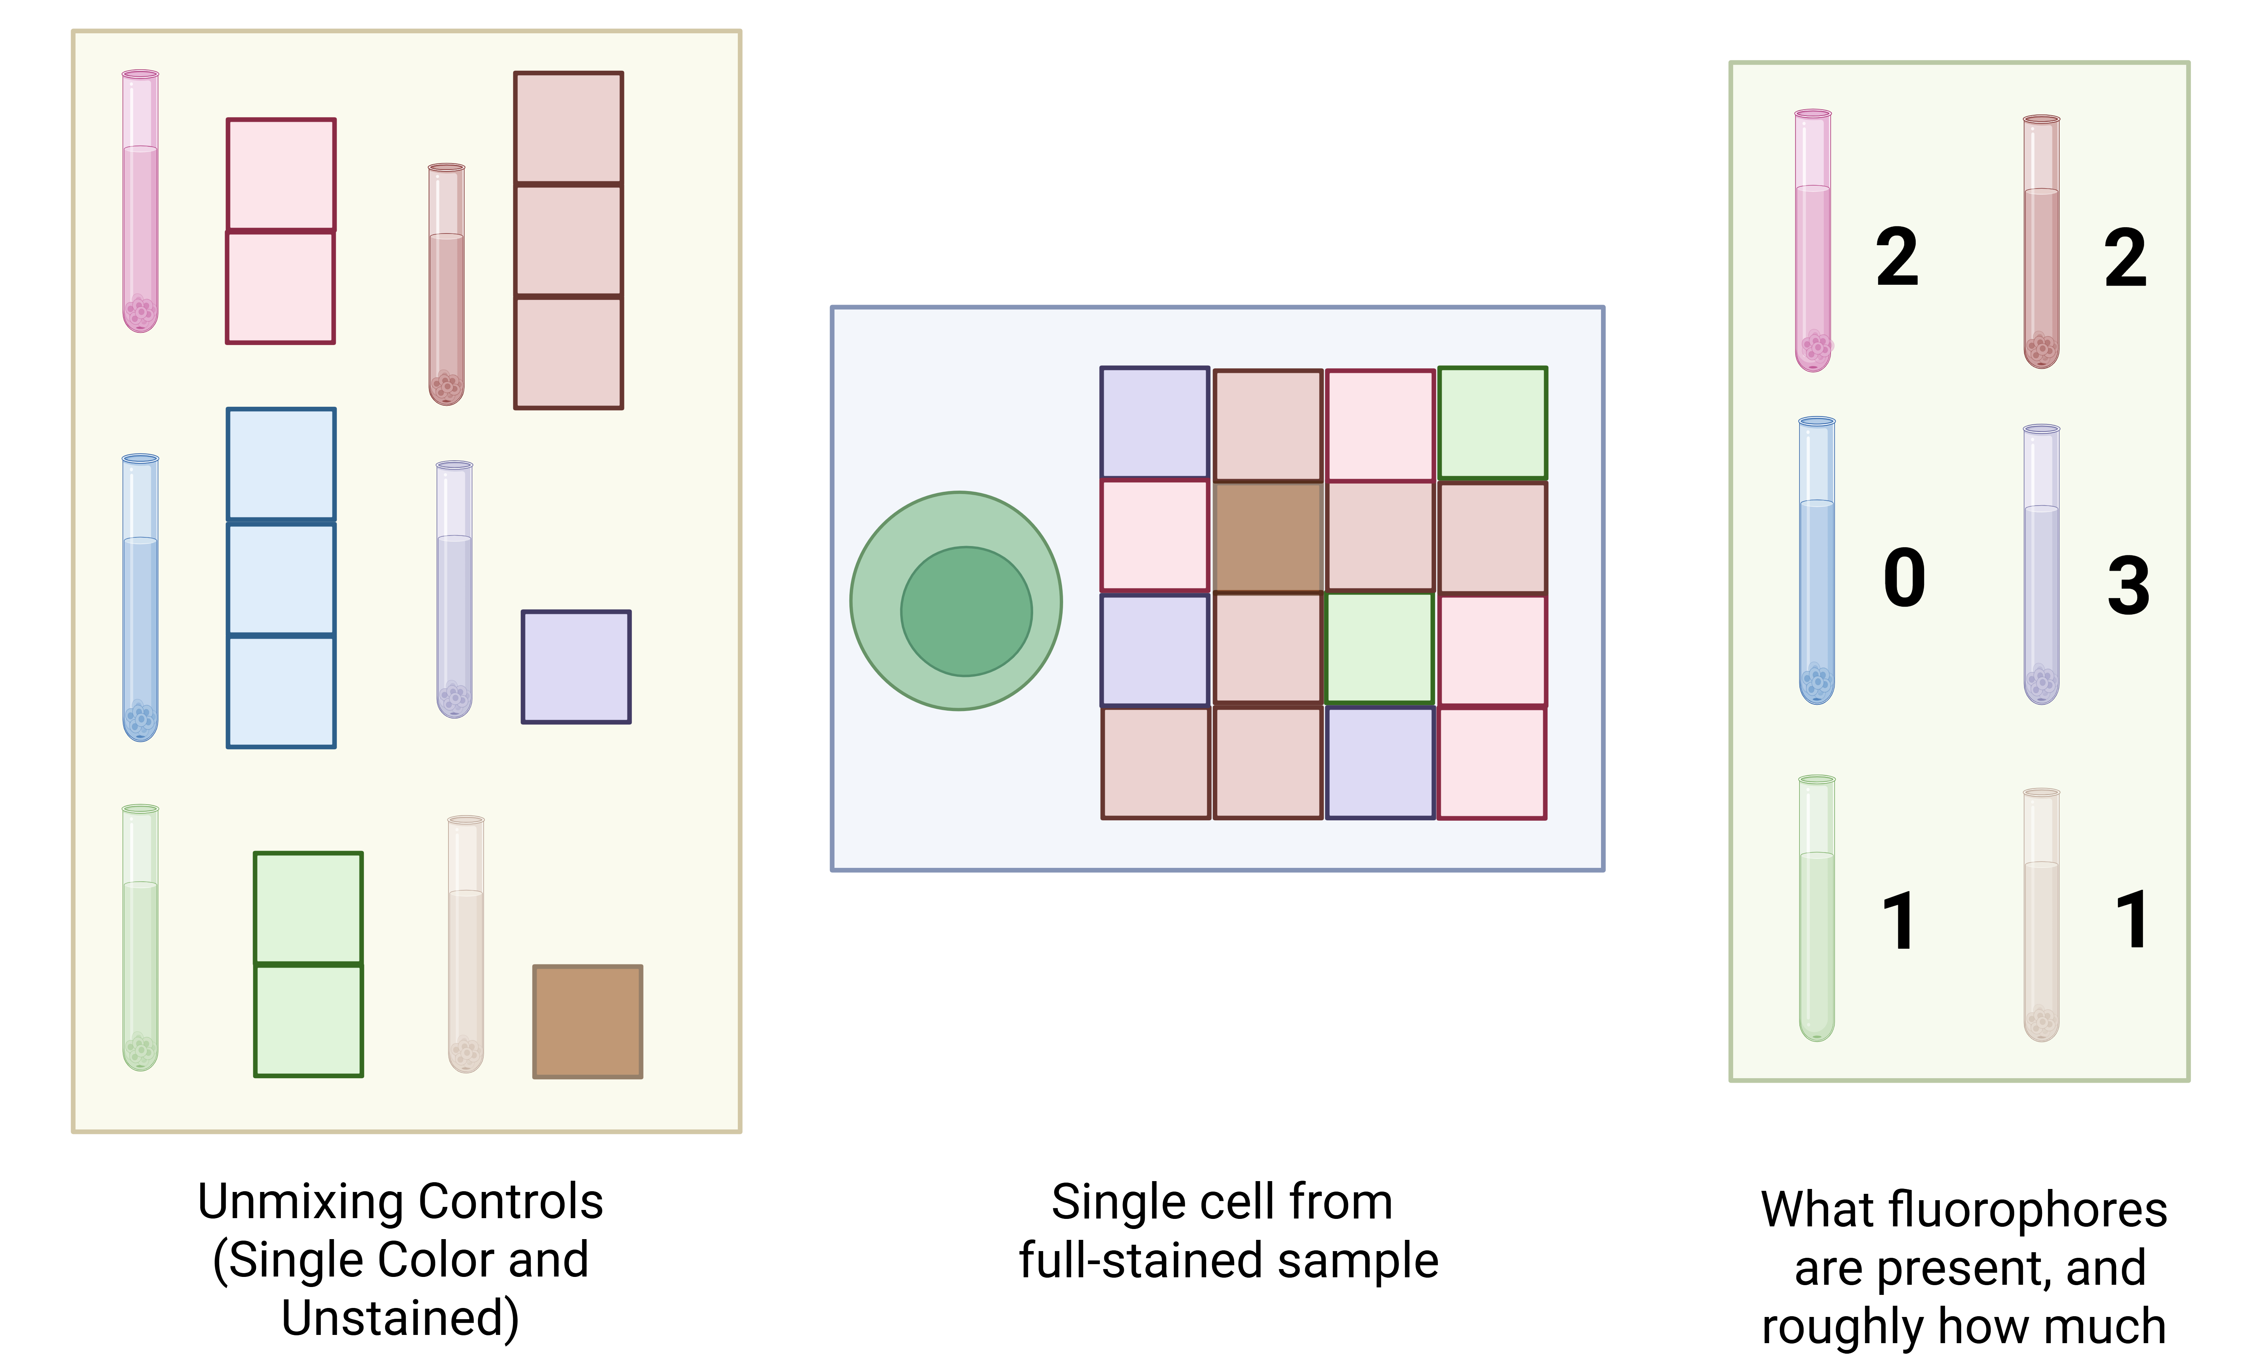
Spectral Unmixing
APC-Vio 770
PE-Vio 770

Slide 39
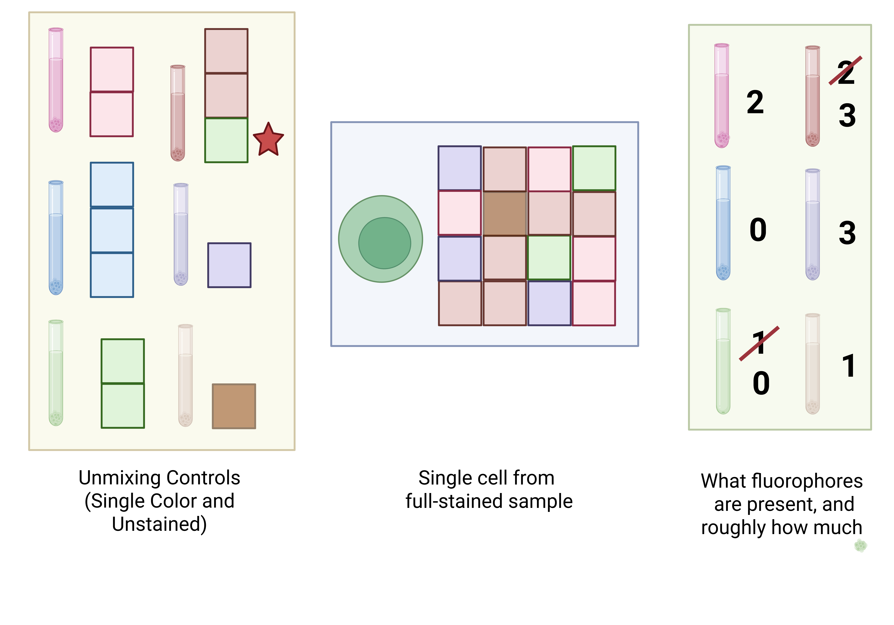
Mismatched References lead to errors in attribution
APC-Vio 770
PE-Vio 770

Slide 40
Unmixing Errors
Is the population you are seeing biological, or just a technical artifact?

Slide 41
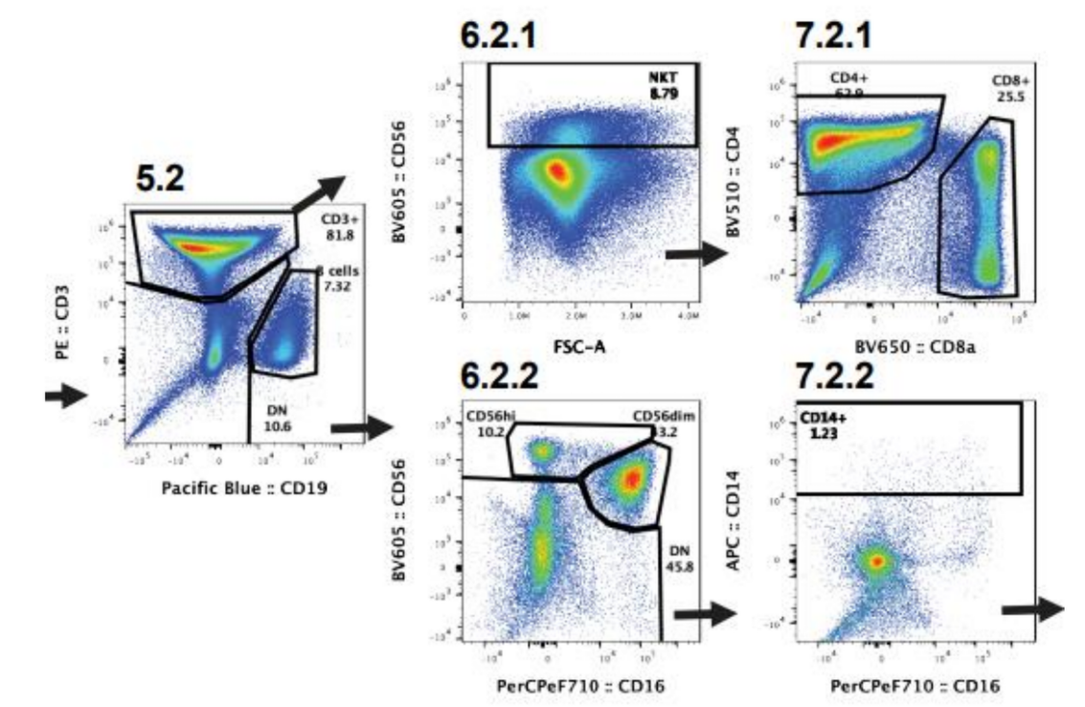
Why does this matter?
The power to shoot yourself in the foot
Garbage In, Garbage Out
Adding to the reproducibility crisis
Wasting time, effort and funds
* Paper used an identical viability dye signature as the fluorophore of their main marker of interest. No way to tell if their entire paper is based on necrotic cells

Slide 42
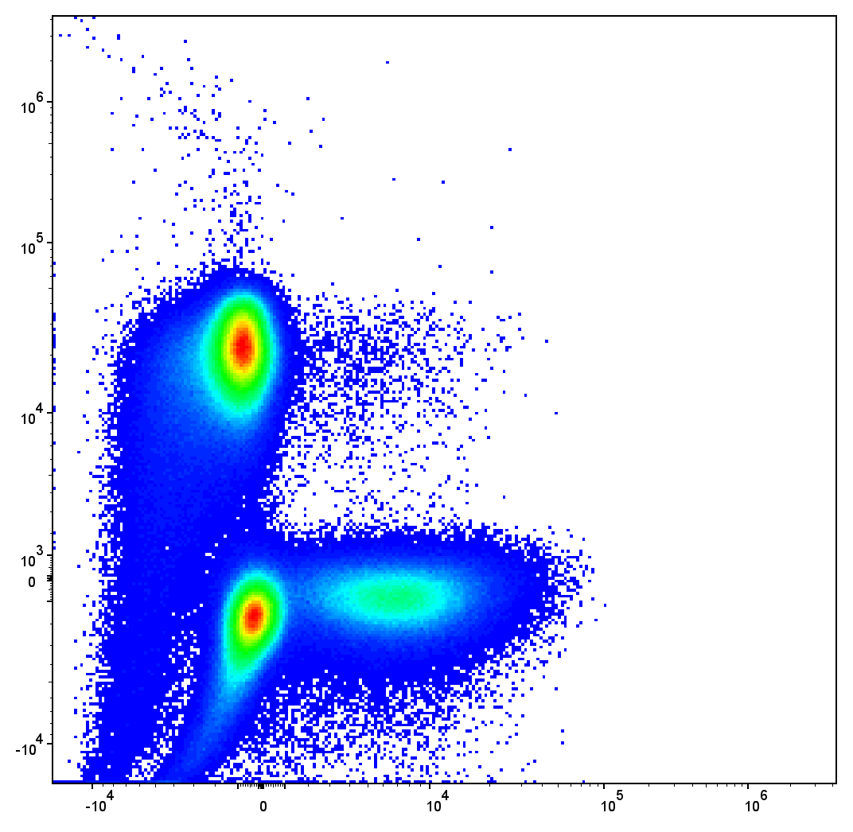
Breaking into the unmixing black box
Reference signatures extracted from our unmixing controls are critical to the final data quality of the full-stained sample
No tools exist to screen the quality of your unmixing control derived signatures pre-unmixing
Multiple rounds of unmixing trial and error to spot problematic single-color controls

Slide 43
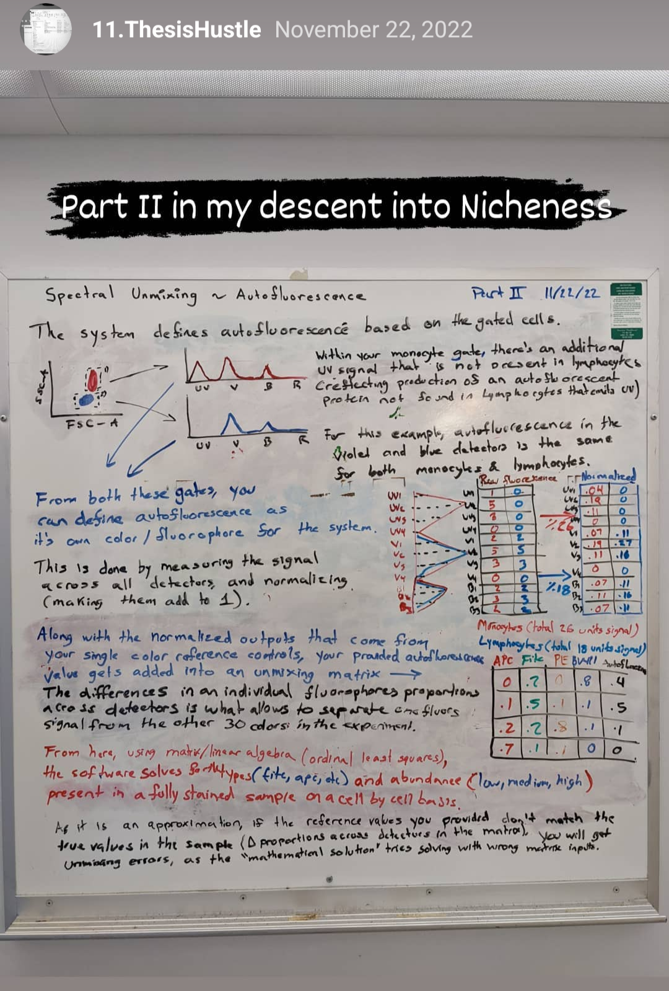
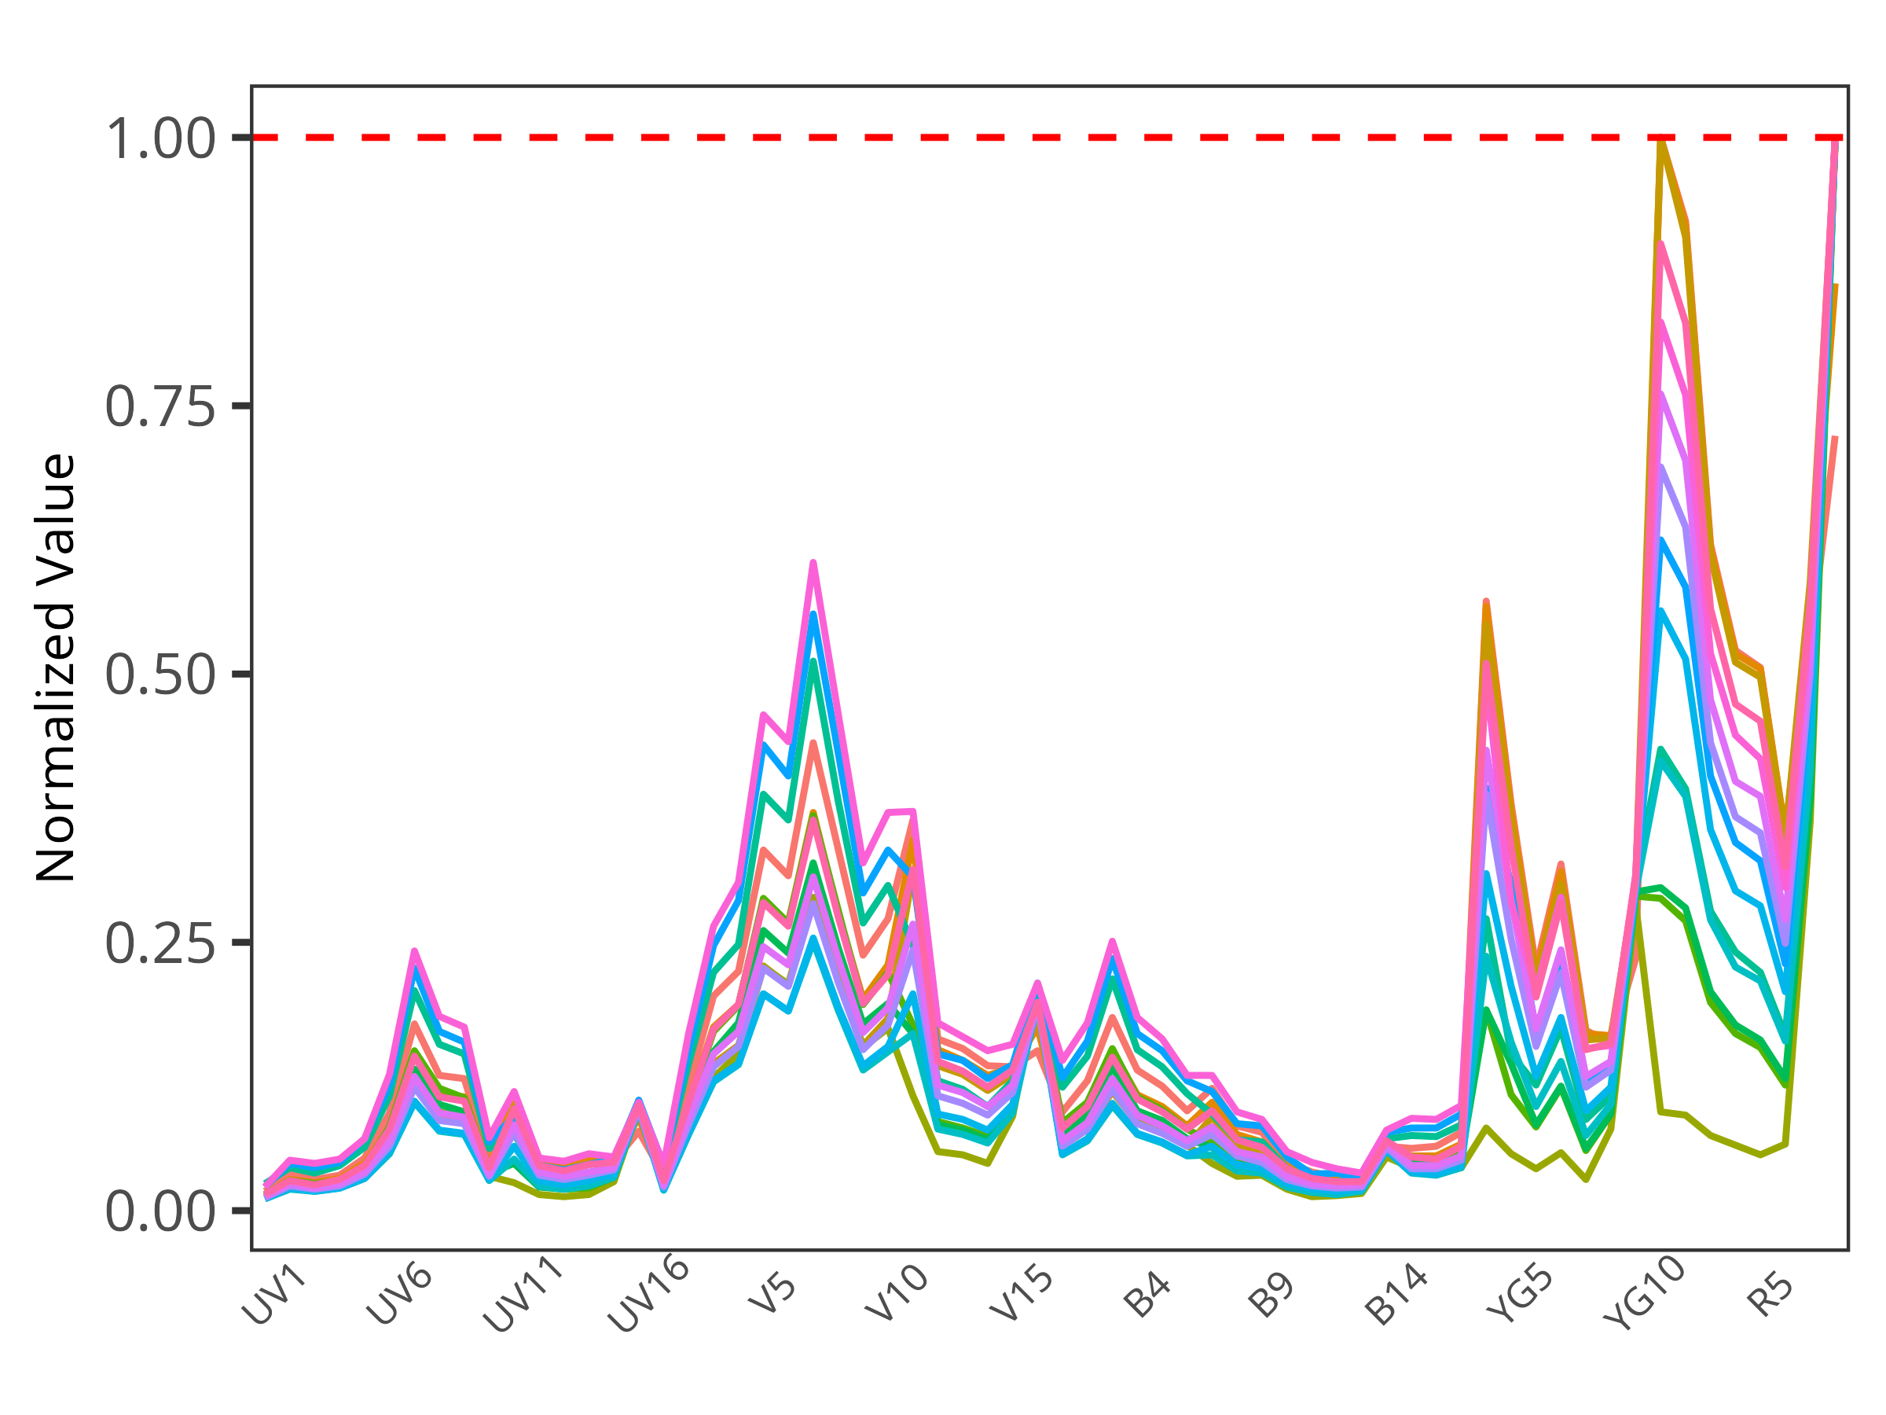
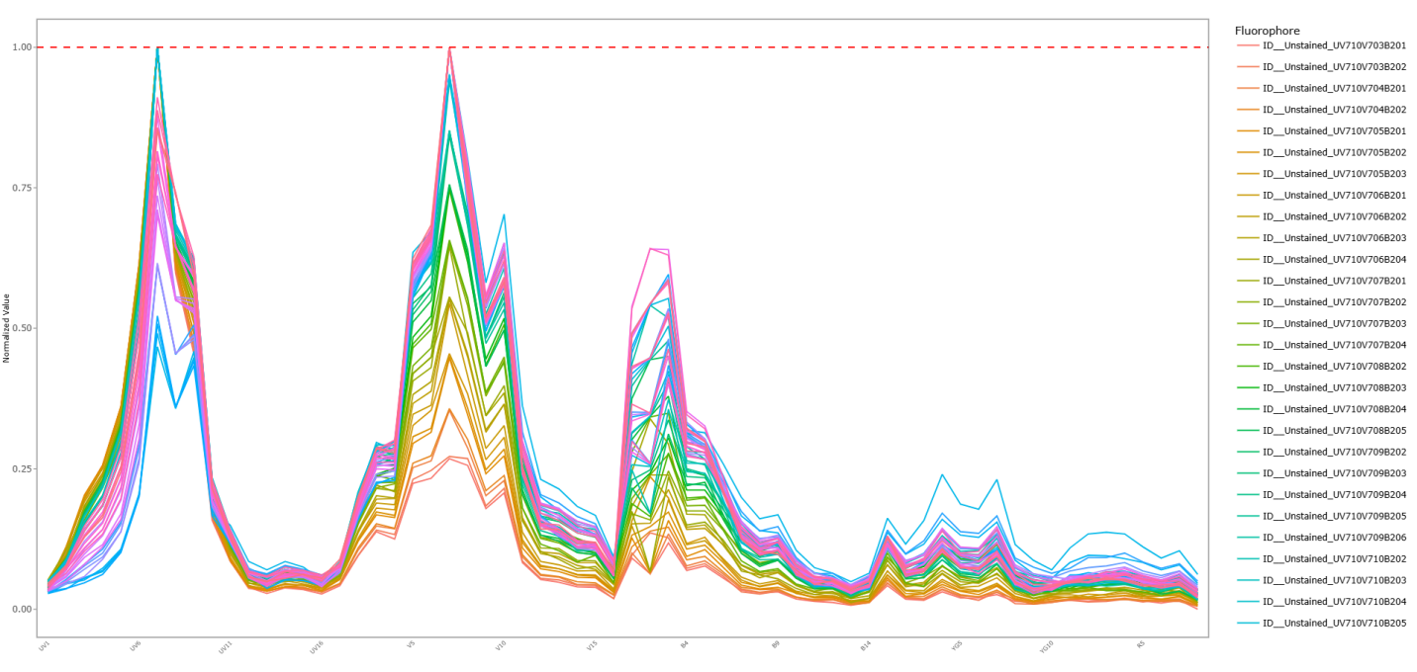
Breaking into the unmixing black box
Reference signatures extracted from our unmixing controls are critical to the final data quality of the full-stained sample
Tandem Degradation
Tandem Degradation
No tools exist to screen the quality of your unmixing control derived signatures pre-unmixing
Multiple rounds of unmixing trial and error to spot problematic single-color controls
Multiple Autofluorescence
What if instead of looking at the signature of the population, we looked at the signatures of the individual cells?

Slide 44
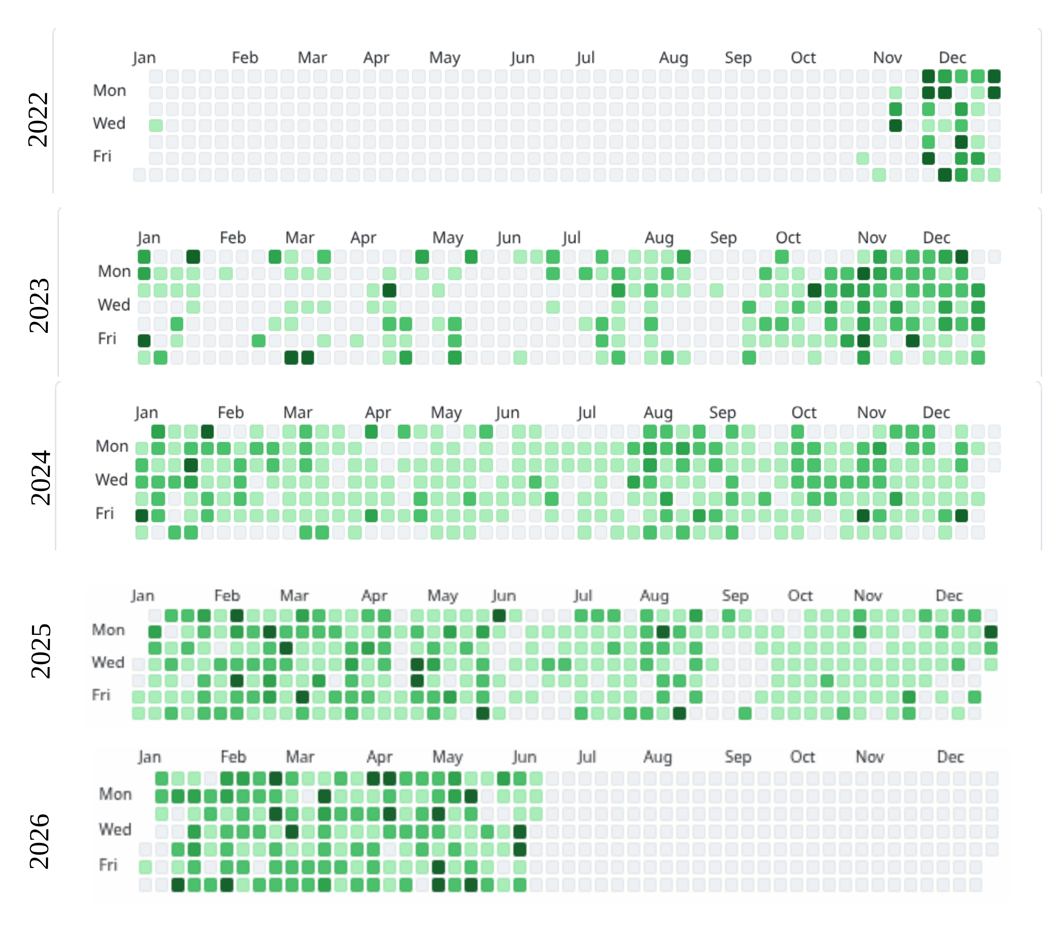
Sparked journey into R programming

Slide 45

Luciernaga
Code

Slide 46
Luciernaga
Code

Slide 47
Luciernaga
Code

Slide 48
Automated tools for screening unmixing controls
APC
APC-Fire 810
Tandem Degradation
Autofluorescence Isolation
Residual Autofluorescence

Slide 49
Identifying degrading fluorophores
When looking at normalized signatures of individual cells in the unmixing controls grouped on the basis of shared detectors of relatively same heights
Fluorophores in good shape → one predominant normalized signature within the unmixing control raw .fcs file
When the fluorophore degrades, noticeable increase in variant signatures, making up substantial proportion of all cells in the unmixing control
Automated screening all acquired unmixing controls from campus users during off-hours

Slide 50
Isolating additional autofluorescence signatures
This approach also works to isolate variant autofluorescence signatures from unstained controls
Return directly as an .fcs file containing just cells with same signature for use as an autofluorescent tag in SpectroFlo
Unlike other approaches, the isolated cells share normalized signatures, only differing in terms of brightness

Slide 51
PSA: For dim antigen-fluorophore combinations,
be cautious using cell unmixing controls
For cell controls with a moderate density antigen on bright fluorophores, we see that any
residual autofluorescence contributes minimally to the overall isolated single-color signature
when gated according to best practices

Slide 52
Residual autofluorescence after background subtraction still present in single-color reference signatures
For cell controls with a moderate density antigen on dim fluorophores, we see substantial
residual autofluorescence contributions to the isolated single-color normalized signatures even
when gated according to best practices

Slide 53
Swap dim antigen-fluorophore combinations for beads
PE signature with
residual AF
PE signature without
residual AF
This residual autofluorescence contribution results in unmixing errors,
and when switched out for bead controls the panel unmixing significantly improved

Slide 54
To unlock the comprehensive biological discovery potential,
we need to address these pink elephants
Quality of the unmixed full-stained data is linked to the quality of our single-color controls (and our ability to provide appropriate autofluorescence controls).
If we are acquiring 3 million cells to detect 100 rare cells, how do we thoroughly explore the rest of the sample to avoid wasting useful data?

Slide 55
Evidence for additional heterogeneity present in Vδ2
Unlike what we saw for NKTs and MAITs, marker co-expression matrices suggested additional heterogeneity within the Vδ2s

Slide 56
Grouping cells that share every marker

Slide 57
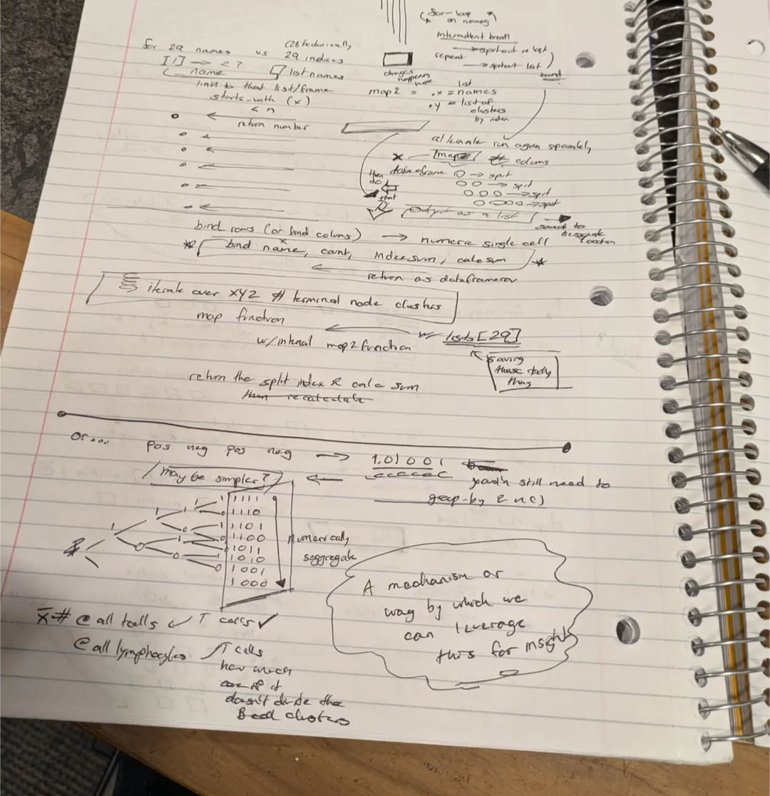
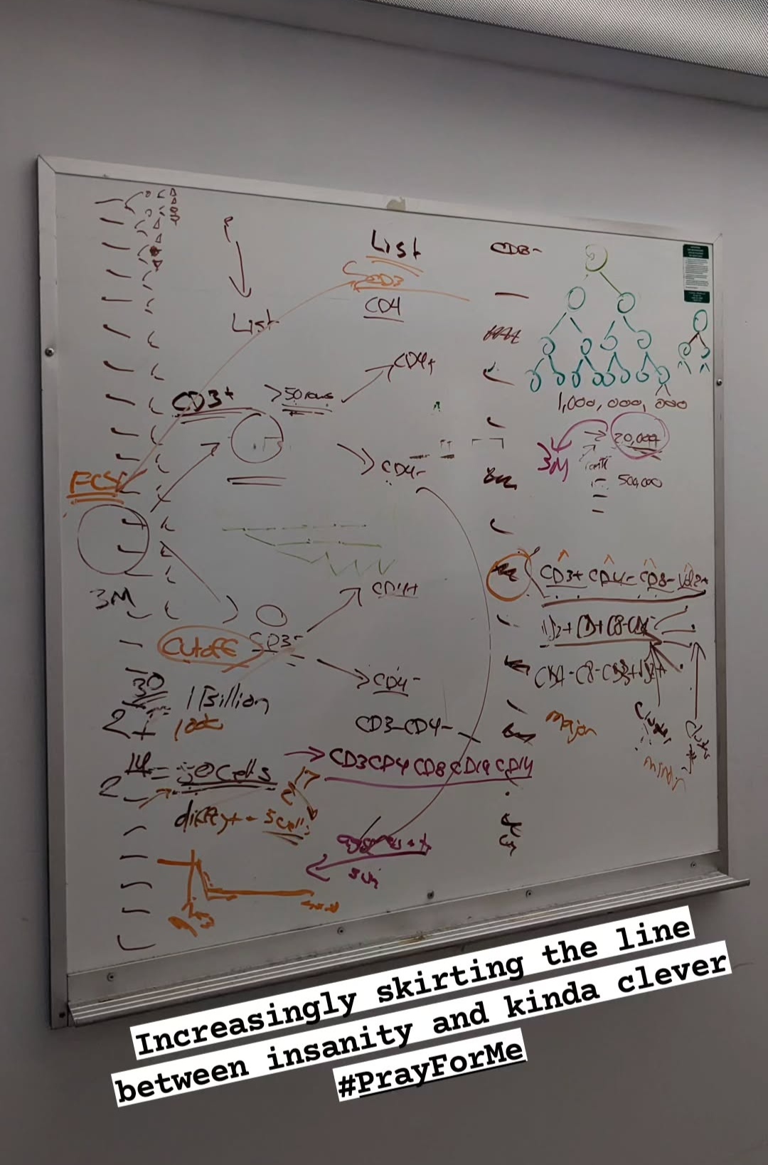
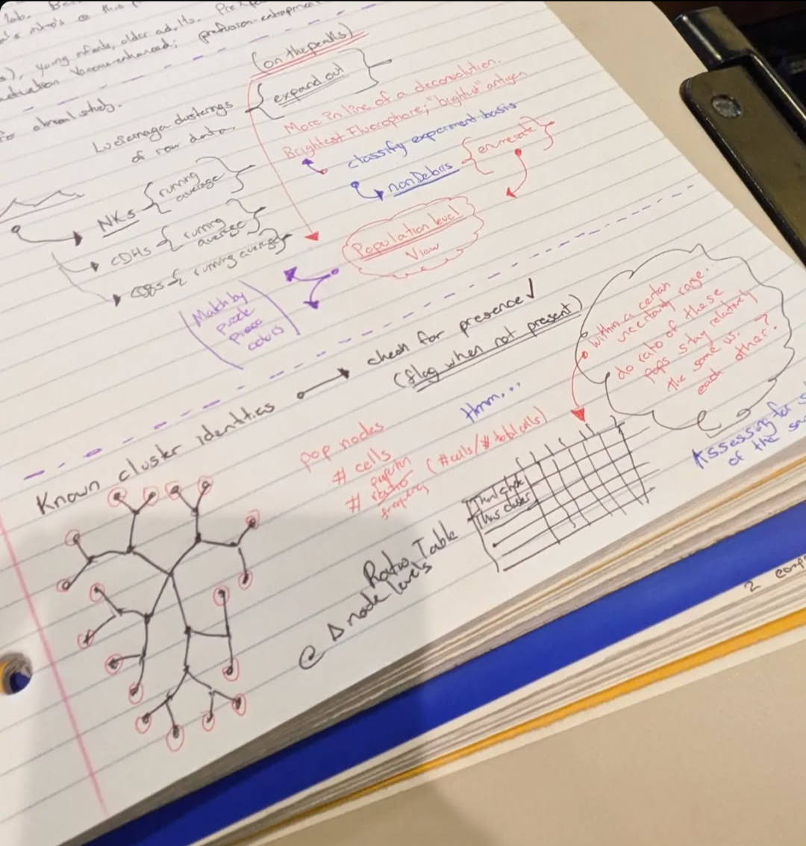
Grouping for shared marker expression
Different clustering methods tend to inappropriately group or split
Manual gating doesn’t scale
Automated gates aren’t easily adjustable
Unclear what drives various unsupervised algorithms
What if we just annotated manual-gating information in before passing off to the unsupervised algorithms?

Slide 58
Grouping cells that share every marker

Slide 59

Coereba
Code

Slide 60
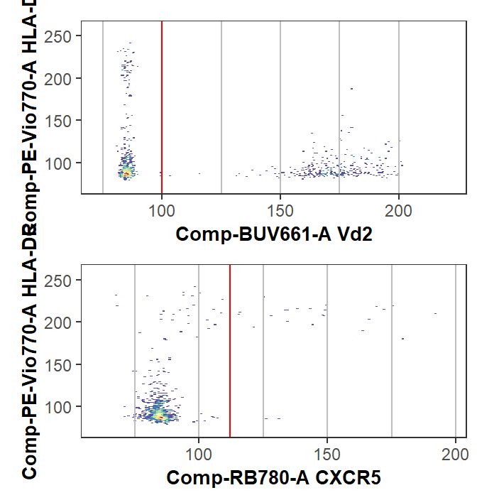
Initial automated gate, with ability to adjust
Initial gates for designated markers calculated via openCyto (mindensity)
Ability to update gate_range constraints
Launch a Shiny app and designate interactively

Slide 61
CoerebaID column gets added to the .fcs file

Slide 62
Pipeline: Summarized Experiment
Data stored in a Summarized Experiment
Interoperability with Bioconductor statistics packages

Slide 63
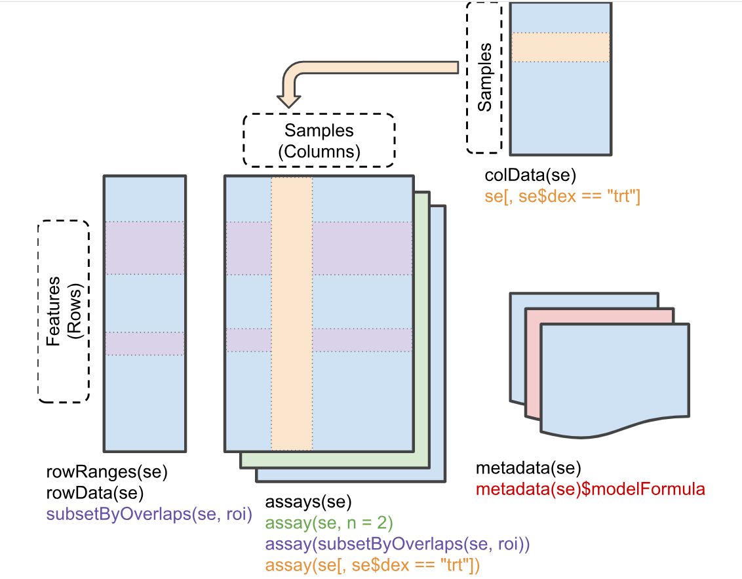
Summarized Experiment
Permits rapid re-aggregation of the terminal nodes for re-evaluation
Ties in with downstream Bioconductor statistics packages
Portable. Don’t like how we aggregated groups of cells? File is small enough to store in the same data repository as .fcs files for subsequent re-analysis.
Filterable by metadata or node.
- Nodes only in HEU-hi?
- Nodes unique to one individual?

Slide 64
Retrieval of marker expressions

Slide 65
Ability to contrast unsupervised methods vs “manual” ground-truth

Slide 66
Retrieving and re-enumerating
2) Retrieve manual-annotated gates
3) Re-enumerate
and plot
1) Gate

Slide 67
Marker expression of cord blood ILT subsets
Control
PMA-
Ionomycin

Slide 68
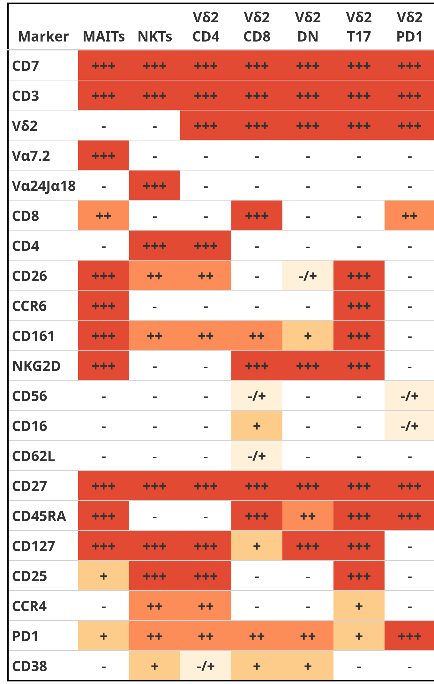
Retrieve manual annotated gating information following unsupervised steps

Slide 69
Functional and Iterative: plenty for everyone to dislike :)
Fun off-label uses thus far:
Contrasting where “manually-gated” cells end up vs. our unsupervised methods (normalization, clustering, etc.)
Added benefit of looking-at-the-forest: Easy to identify badly cryopreserved specimens where cell populations were lost

Slide 70
Semi-supervised Pipeline

Slide 71
To unlock the comprehensive biological discovery potential,
we need to address these pink elephants
Quality of the unmixed full-stained data is linked to the quality of our single-color controls (and our ability to provide appropriate autofluorescence controls).
If we are acquiring 3 million cells to detect 100 rare cells, how do we thoroughly explore the rest of the sample to avoid wasting useful data?

Slide 72
So are all our problems solved?

Slide 73
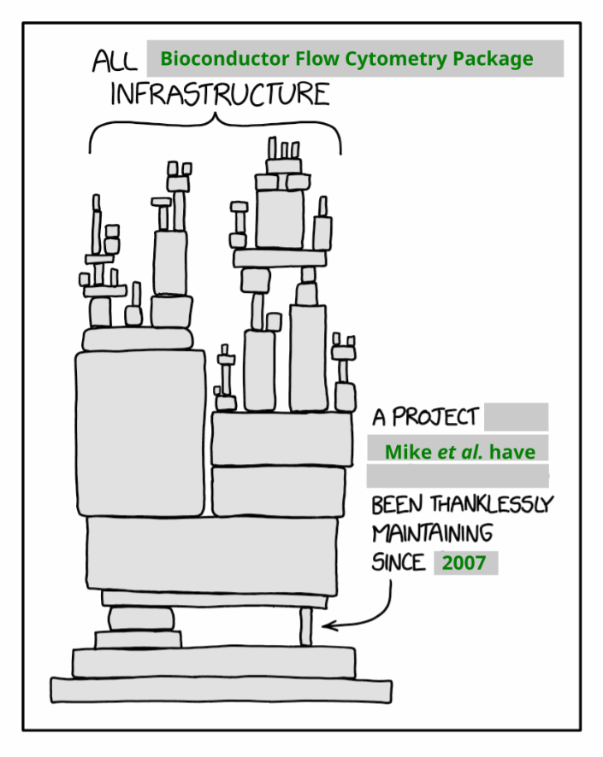
What good is any tool if the community is not able to use it?
Working towards formally submitting my R packages to Bioconductor this year (adding documentation, generalizing for different instrument manufacturers)
Still learning better ways to parallelize and speed up the process
72 Bioconductor cytometry packages (+ 20? GitHub based packages)
Heavily under-utilized, some unmaintained
Evidence that “Build the `software tool` and they will come” approach doesn’t work in practice

Slide 74

Major barrier to entry
Few resources to begin with
Those that exist aimed at those with intermediate-advanced R skills, not beginners
Know-how concentrated at a few institutions
Most self-learning attempts end in frustration

Slide 75

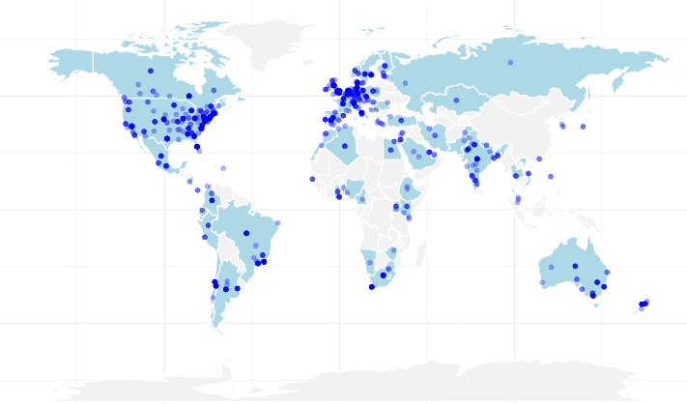

Cytometry in R: A free weekly course for flow cytometrist with no-to-little coding experience
Website

Slide 76
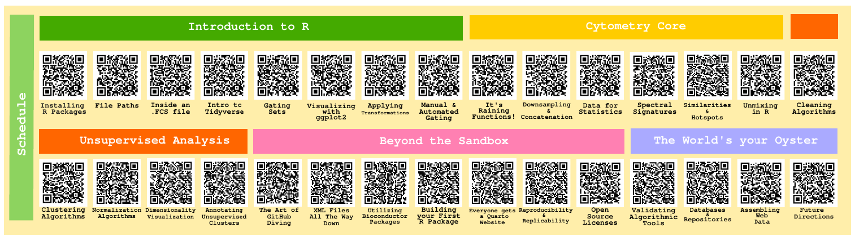
Overall structure
30-week course, starting from Intro to R, gradually moving to more advanced content.
Multiple ways to learn with flexible scheduling
Taught in Positron instead of Rstudio (ask me why!)
Version Control/Git introduced from the beginning

Slide 77
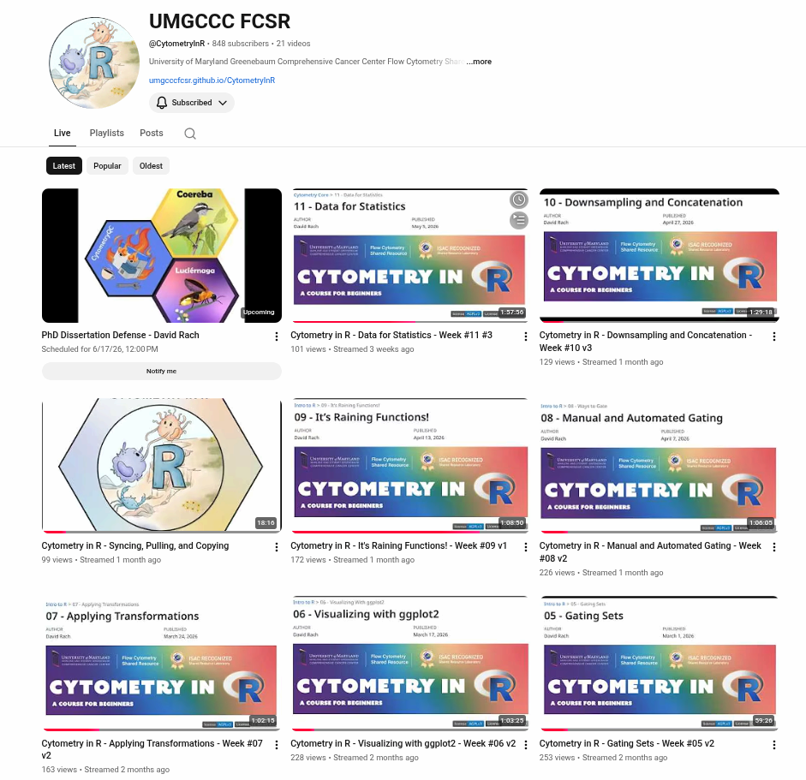
YouTube
Three live-streams a week (accommodating different timezones and schedules)
Recordings available immediately after
Best of the weekly livestreams added to the playlist, cutting down on editing

Slide 78
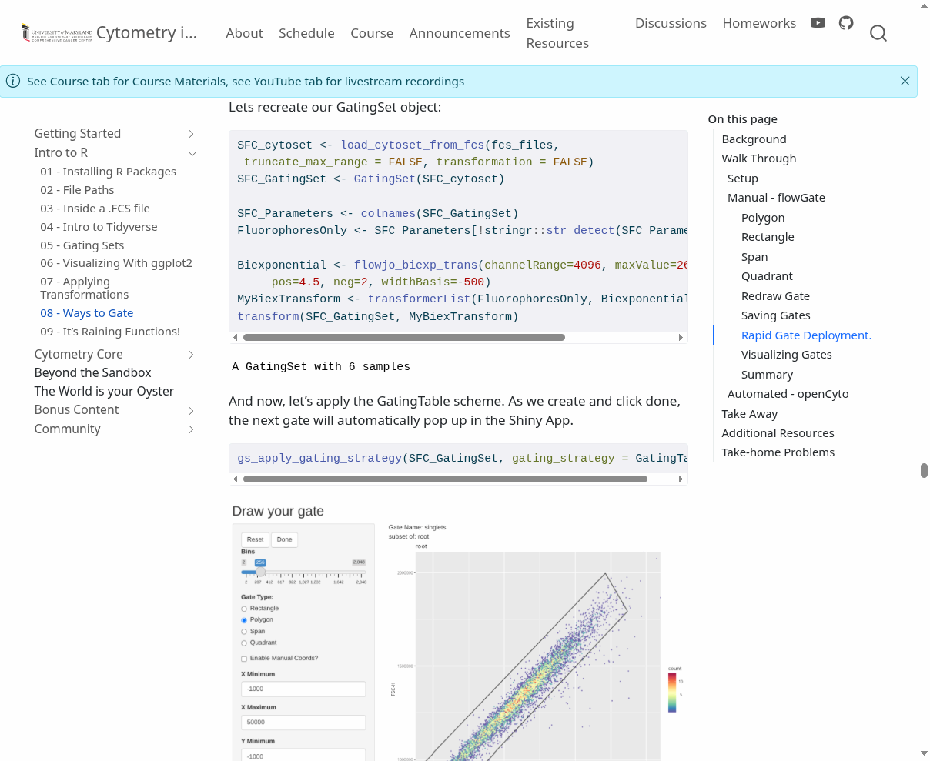
Website
Created with Quarto, hosted via GitHub pages.
Code, code outputs, screenshots and explanations
Searchable
New weekly material added as a new .qmd file

Slide 79
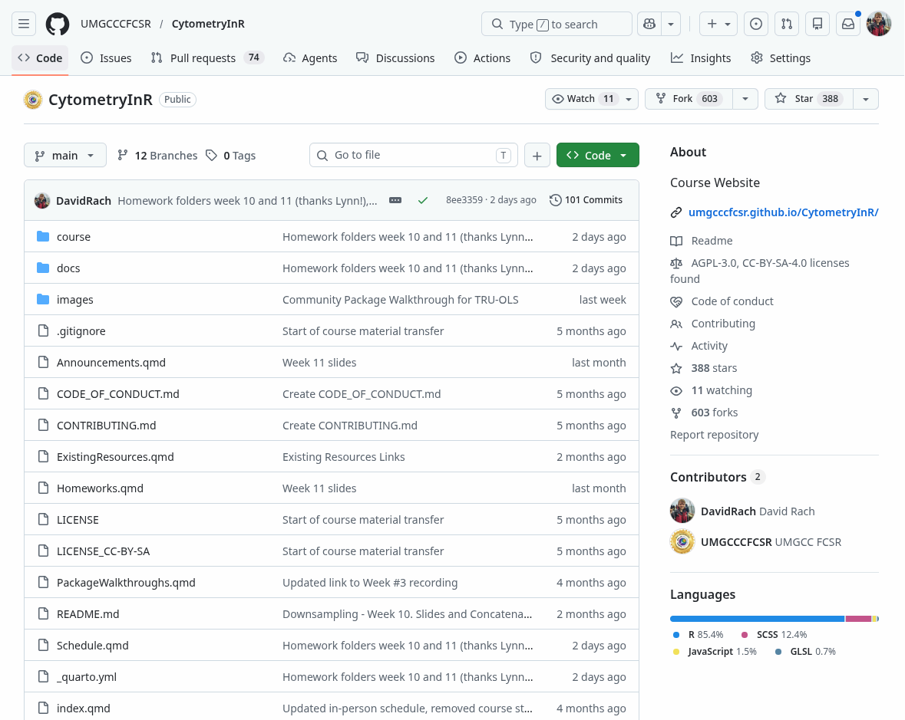
GitHub
Code and datasets available via the GitHub repository
Course participants start course by creating GitHub account and forking the repository
After Positron is linked to GitHub account, pull locally
When new material posted each week, sync and pull

Slide 80
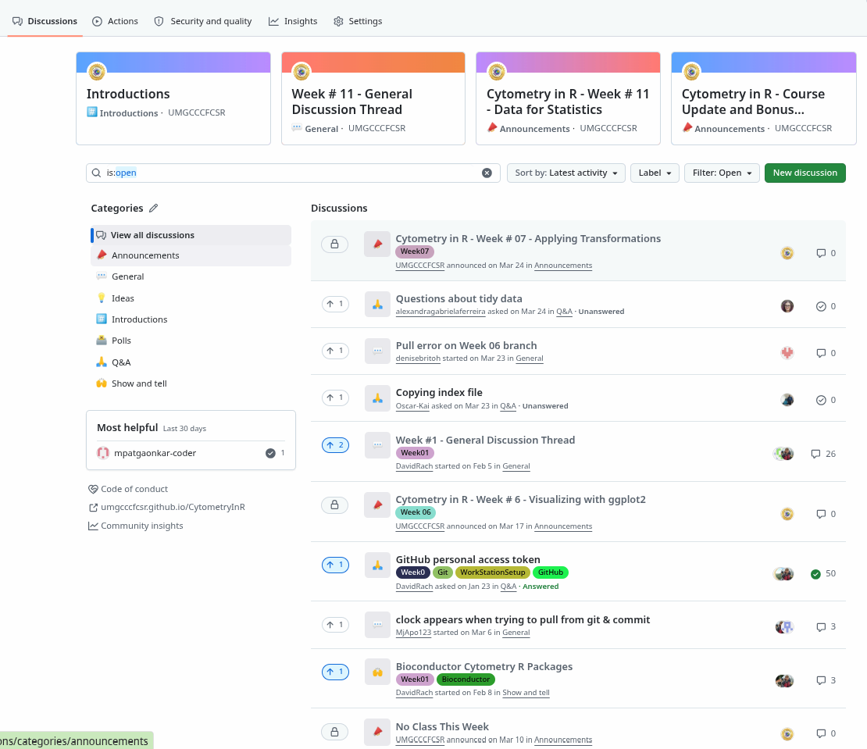
Discussion Forum
GitHub Discussions page has been repurposed as a community forum for questions, etc.

Slide 81
Where to next?
Wrapping up Cytometry Core module
Gathering steam to start on the Unsupervised Analysis section

Slide 82
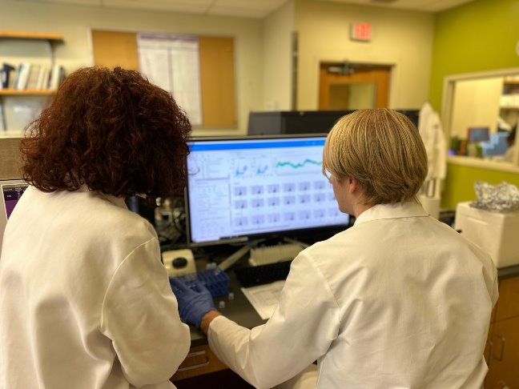




Acknowledgements
All mothers and their infants, and their communities
All the open-source contributors, developers, and maintainers, that collectively made the tool sets without which all of this would not be feasible
This publication was supported by funds through Maryland Department of Health’s Cigarette Restitution Fund Program – CH- 649-CRF and the National Cancer Institute – Cancer Center Support Grant (CCSG) – P30CA134274.d Service
Cytometry
Discord
Bioconductor
Zulip
Dr. Cristiana Cairo
Dr. Kirsten E. Lyke
Dr. Xiaoxuan Fan
Dr. Daniela Franco

Slide 83

Questions?
Current Works
In Progress
Website:
https://github.com/UMGCCCFCSR/CytometryInR
Luciernaga
YouTube @CytometryInR
Coereba

Slide 84

Published in Frontiers in Immunology
Paper

