Slide 1


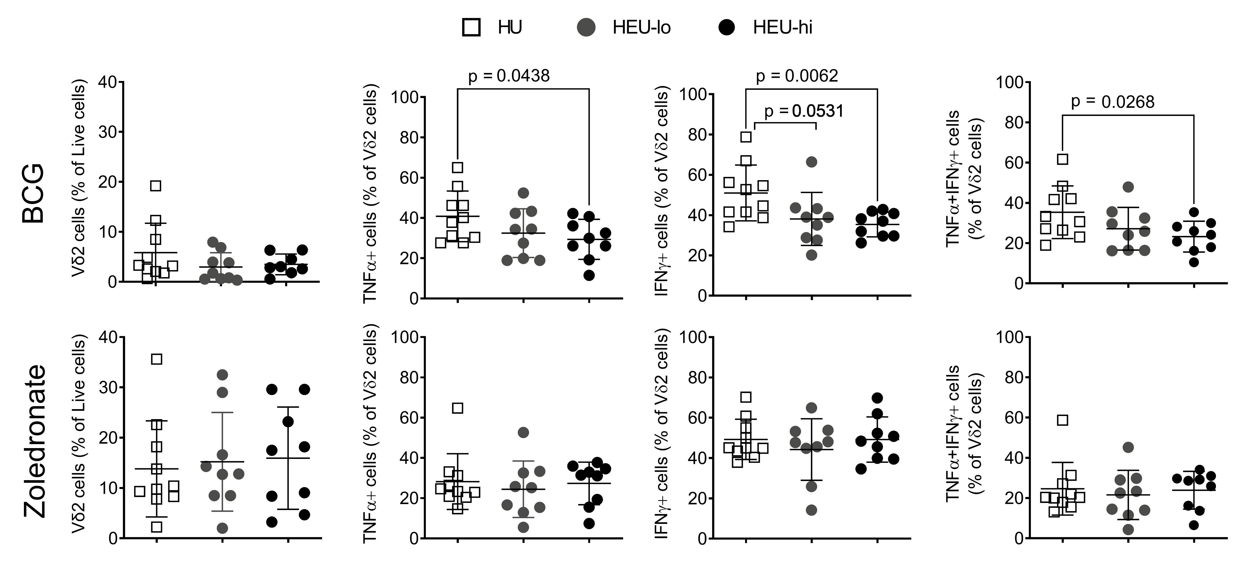
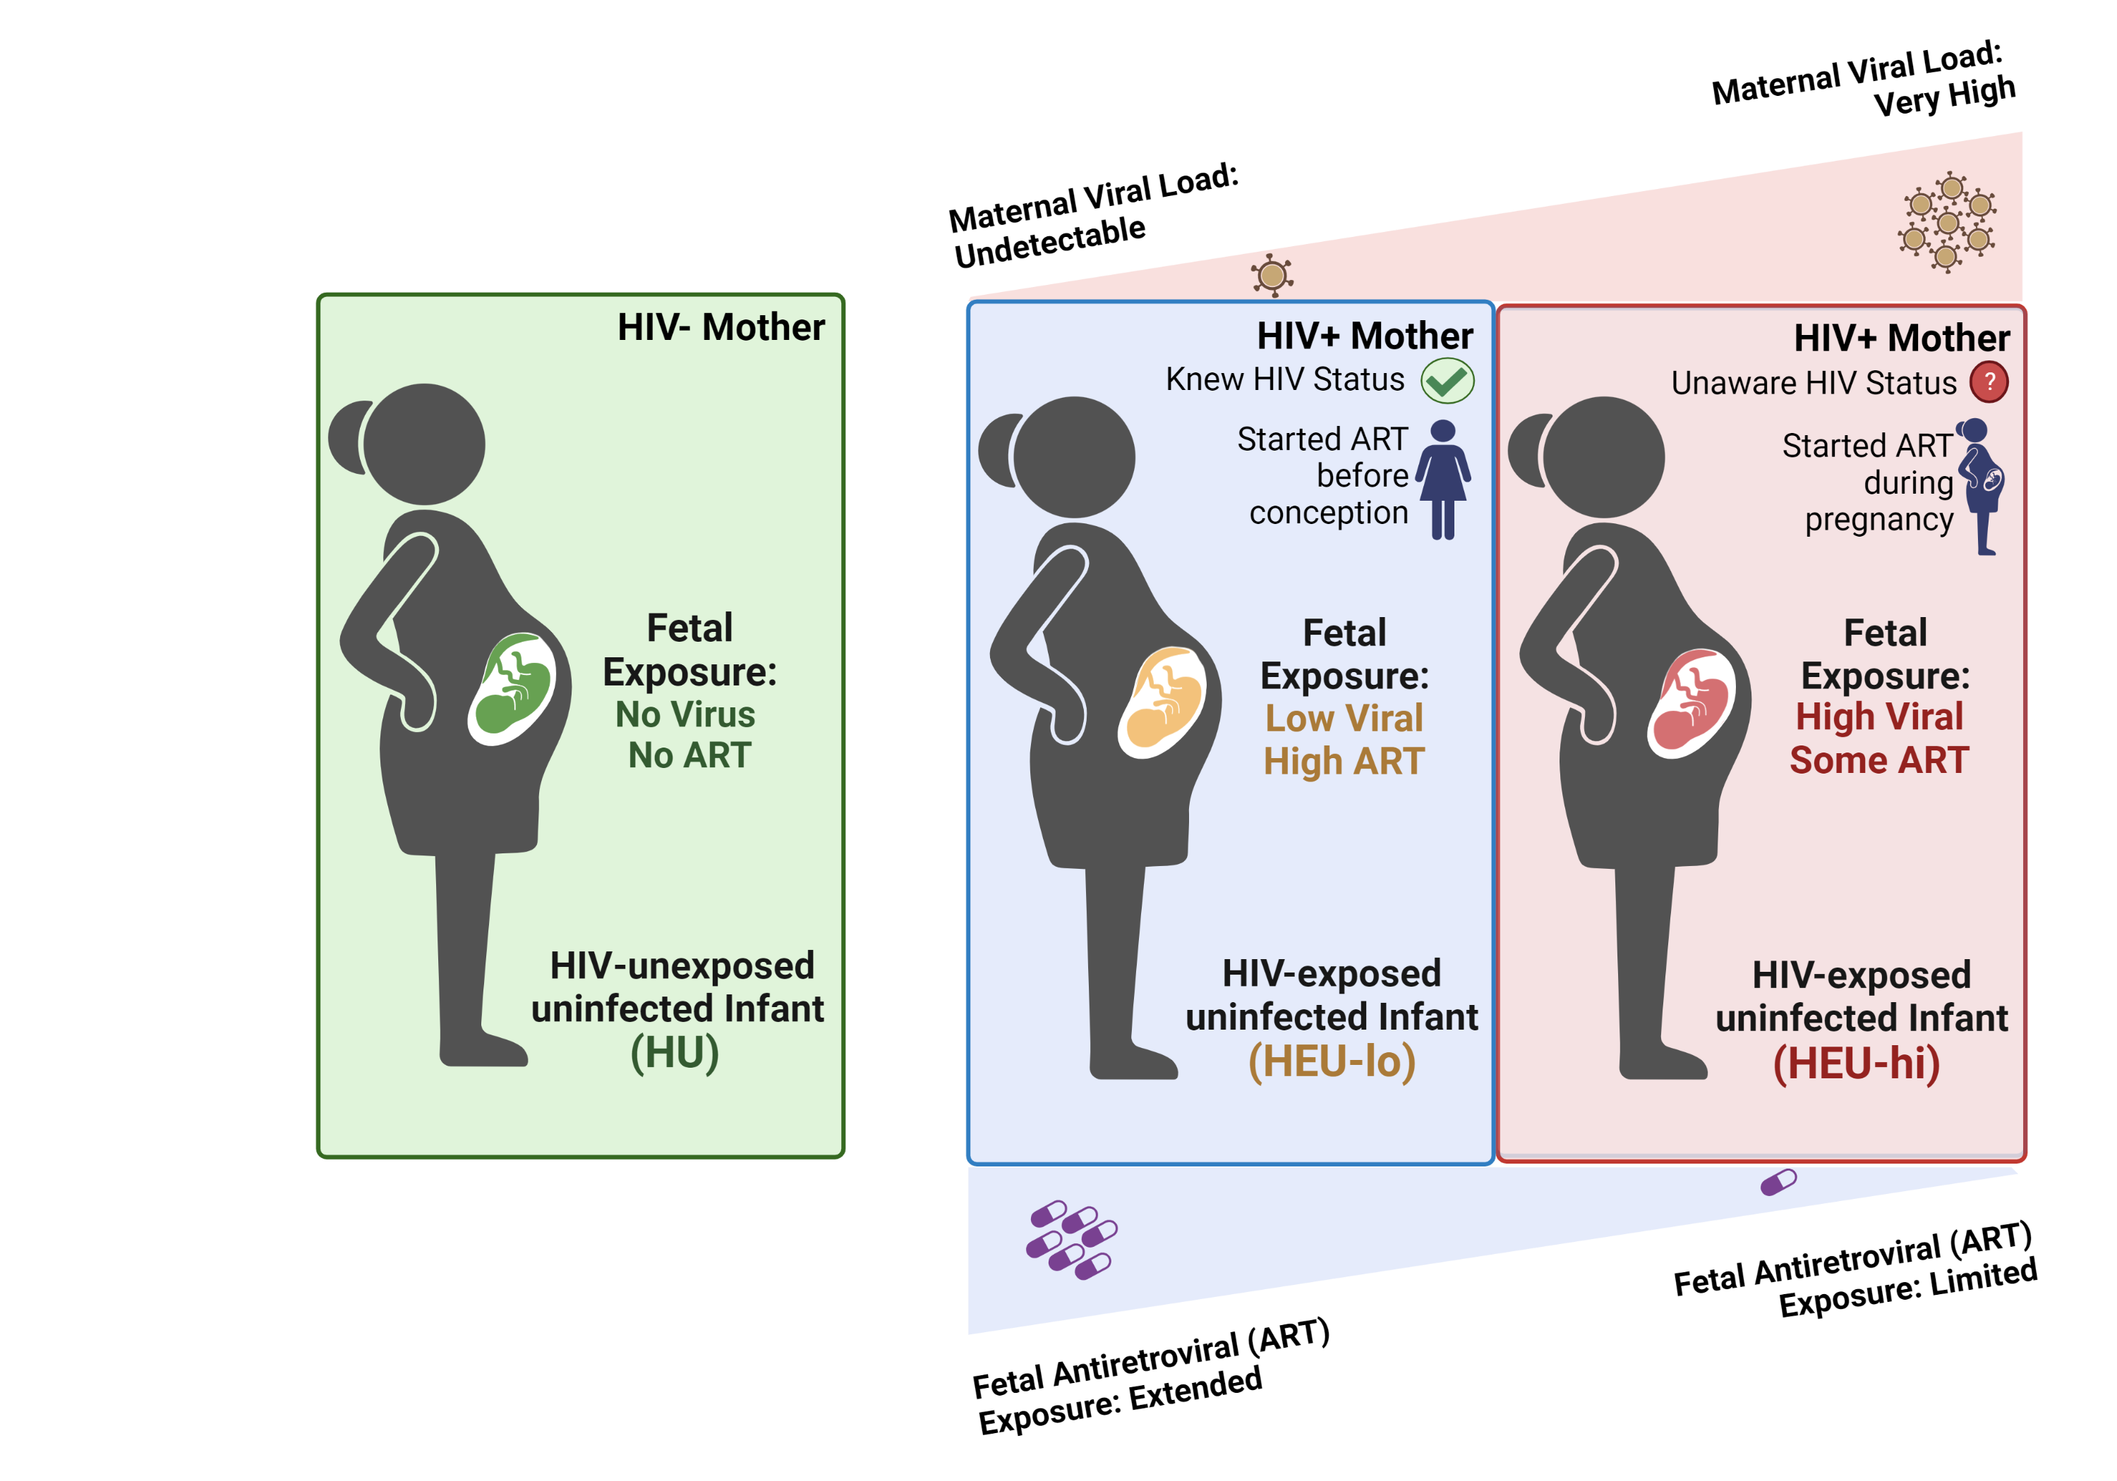
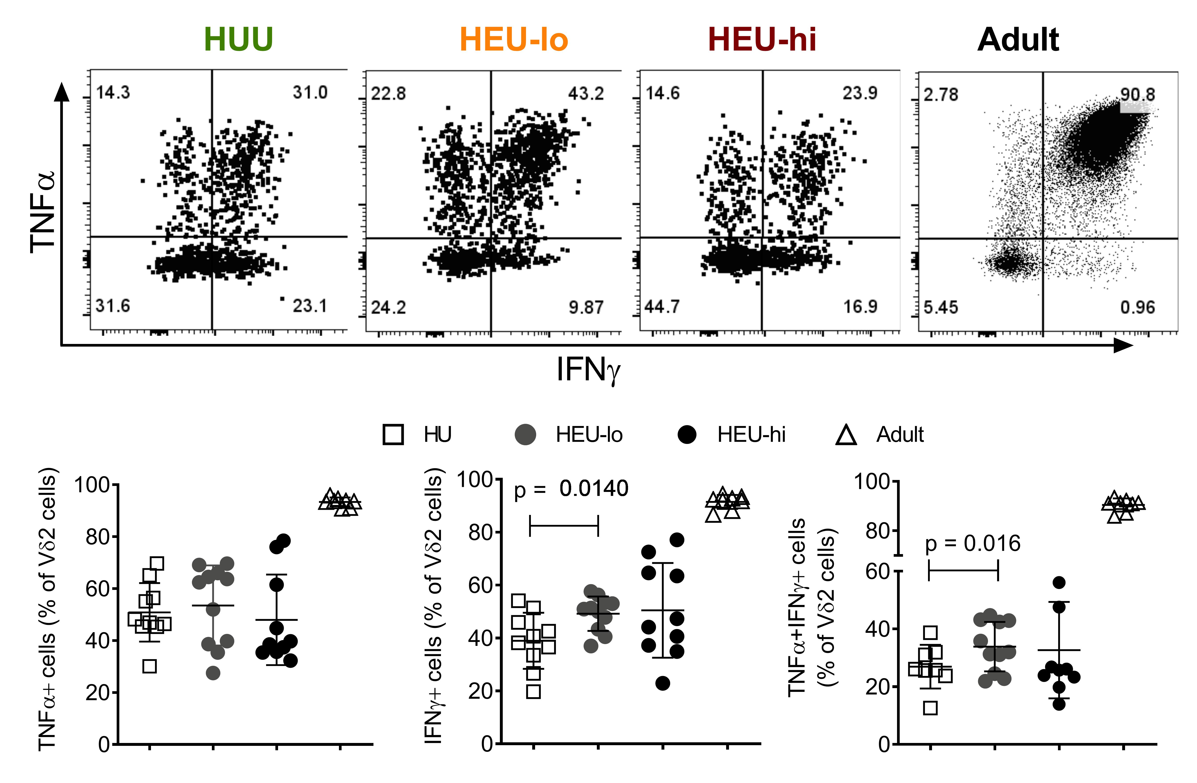
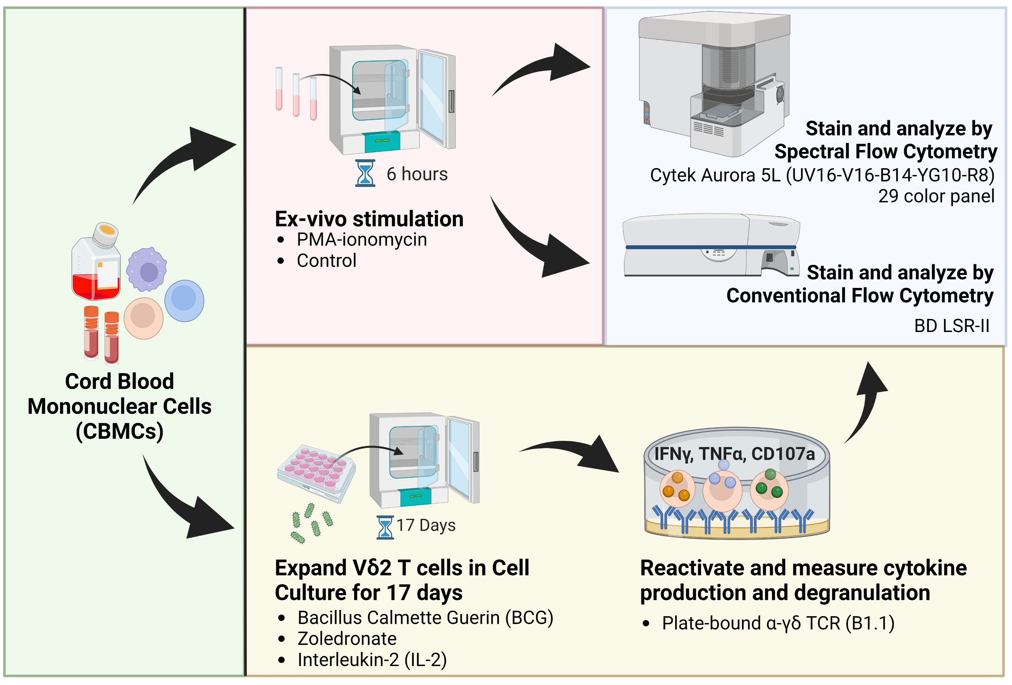
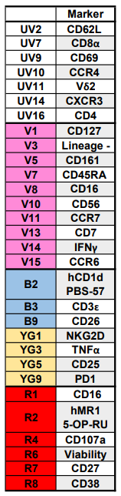
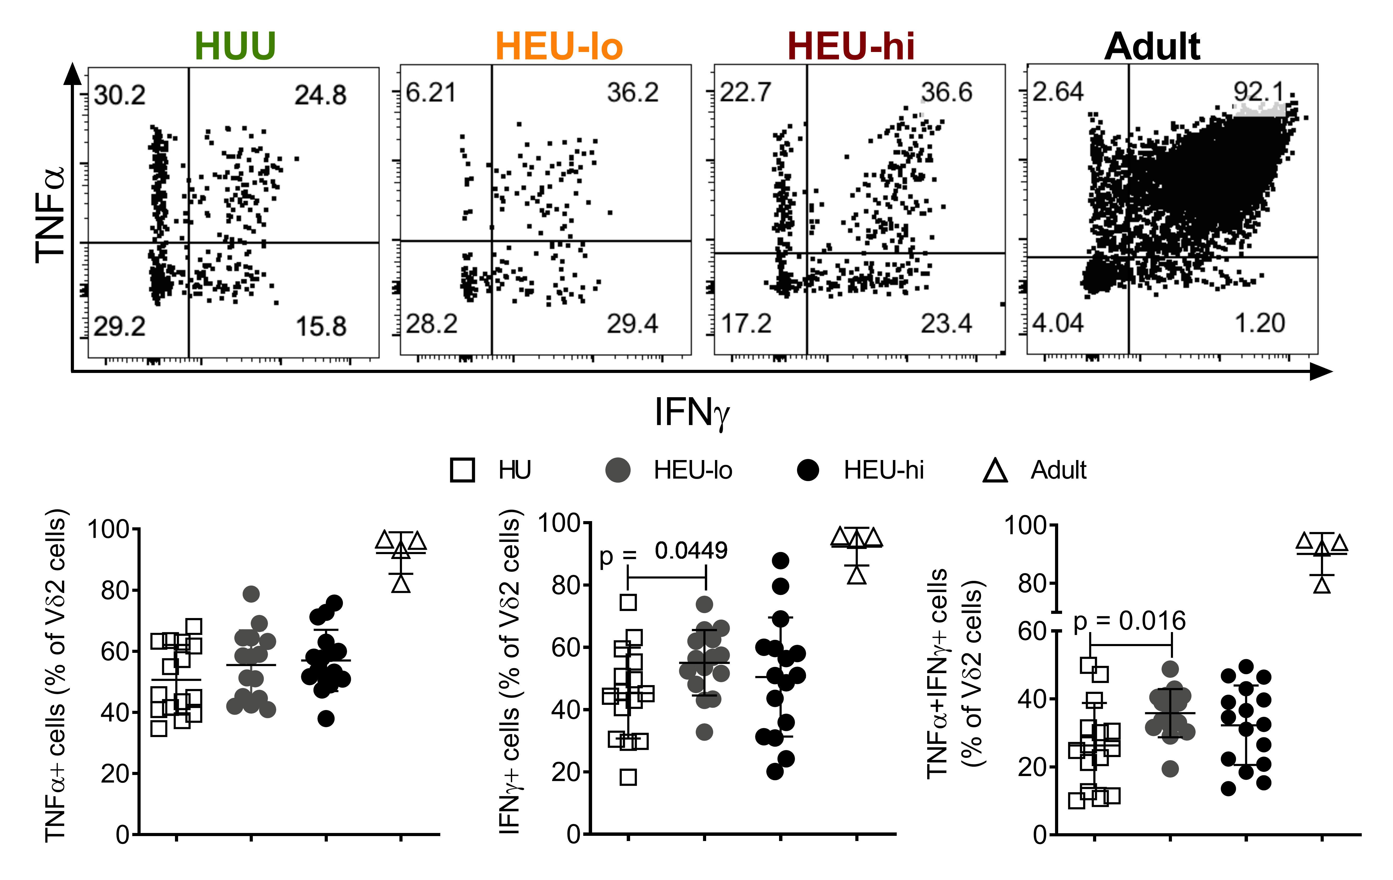
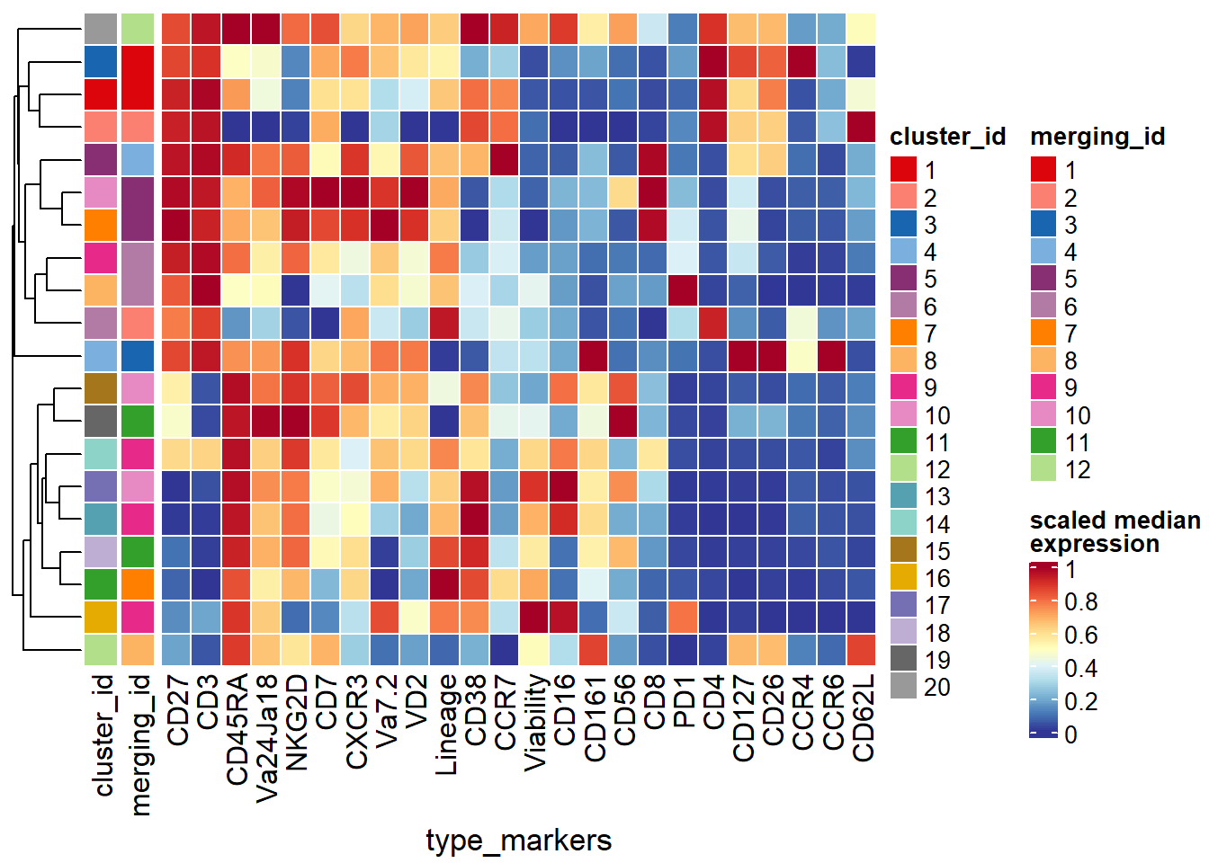
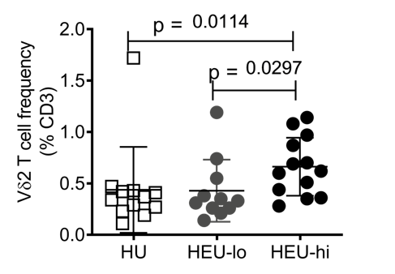



Vγ9Vδ2 T cell responses in HIV-exposed Uninfected (HEU) Infants
David Rach¹, Hao-Ting Hsu², Nginache Nampota³, Godfrey Mvula³, Felix A. Mkandawire³, Osward M. Nyirenda³,
Bernadette Hritzo¹, Ingrid Peterson⁴, Franklin R Toapanta⁴, Marcelo B Sztein⁴, Miriam Laufer⁴, Kirsten E. Lyke⁴, Cristiana Cairo²
¹Molecular Microbiology and Immunology Graduate Program, University of Maryland School of Medicine, Baltimore, USA. ²Institute of Human Virology, University of Maryland School of Medicine, Baltimore, USA. ³Blantyre Malaria Project, Kamuzu University of Health Sciences, Blantyre, Malawi. ⁴Center for Vaccine Development and Global Health, University of Maryland School of Medicine, Baltimore, USA
INTRODUCTION
RESULTS: FLOW CYTOMETRY - CULTURE
Maternal antiretroviral therapy (ART) effectively prevents perinatal infection of infants born to mothers living with HIV.
HIV-exposed Uninfected (HEU) Infants exhibit increased morbidity to lower respiratory tract and diarrheal infections during the first six months life compared to HIV-unexposed (HU) infants.
Prenatal exposure to HIV and/or ART may perturb the fetal immune system, contributing to the observed increased infectious morbidity.
Vγ9Vδ2 T (Vδ2) cells, due to their rapid secretion of Th1 cytokines in response to a broad array of pathogens, are likely to play a key role against infections in early life.
Elevated inflammation at the fetal-maternal interface may result in dysfunction of Vδ2 cells; however, the effect of in-utero HIV exposure on this subset is unknown.
Figure 2. In vitro proliferation of Vδ2 cells is similar across the cohorts
STUDY POPULATION: MALAWIAN COHORT
CBMCs were treated with A) Bacillus Calmette-Guérin [BCG] (MOI=1) or B) Zoledronate (0.5μM); plus IL-2 (100 U/mL) for two weeks to expand Vδ2 cells, before resting for 3 days. Intracellular Th1 cytokines were detected in Vδ2 cells after restimulation with plastic-immobilized anti-γδ TCR antibody (B1.1), followed by processing and analysis on a BD LSR II.
No statistically significant differences in frequency of Vδ2 cells following BCG or ZOL expansion between HEU and HU infants were noted. Following restimulation, HEU-hi infants had a lower frequency of cytokine-producing cells compared to HU controls in the BCG expansion cultures. This altered cytokine response, however, was not observed in Zoledronate expansion cultures.
RESULTS: SPECTRAL FLOW CYTOMETRY
Figure 3. The cytokine production patterns across exposure groups are replicated by spectral flow cytometry.
METHODS
CBMCs were resuspended at 3.0 x 10⁶ CBMCs and stimulated with PMA plus ionomycin (in the presence of protein transport inhibitors) for six hours, processed and analyzed on a Cytek Aurora 5L.
As in conventional Flow Cytometry data shown in Figure 1, the frequency of cytokine producing Vδ2 cells was increased in HEU-lo infants compared to HU controls when analyzed by spectral flow cytometry. Cytokine-production in HEU-hi infants appears heterogeneous.
CONCLUSIONS
RESULTS: FLOW CYTOMETRY – EX VIVO
In-utero HIV and/or ART exposure impacts cord blood Vδ2 cells in HEU infants
- An increased frequency of cord blood Vδ2 cells in HEU infants; corroborating previous observations noted in a Nigerian cohort.
- An increased frequency of ex-vivo cytokine-producing Vδ2 cells was noted in response to PMA-ionomycin. Conversely, a decreased frequency of cytokine-producing cells was noted after expansion with BCG, but not with Zoledronate.
Figure 1. The frequency and polyfunctionality of Vδ2 cells are altered in HEU infants compared to HU controls
FUTURE DIRECTIONS
A
Cord Blood Mononuclear cells (CBMCs) were resuspended at 1.5 x 10⁶ CBMCs and stimulated with PMA plus ionomycin (in the presence of protein transport inhibitors) for six hours, processed and analyzed on a BD LSR II. A) Frequency of cytokine-producing Vδ2 cells was increased in HEU-lo infants compared to HU controls. B) The frequency of Vδ2 cells was increased in HEU-hi infants compared to both HU and HEU-lo infants.
Analyze the spectral flow cytometry data using both supervised and unsupervised approaches to understand the impact on other Innate-like T cells.
Finalize acquisition and analysis of longitudinal adaptive T cell responses in our cohort to vaccine antigen (Bacillus Calmette Guerin (BCG)).
ACKNOWLEDGEMENTS
All Study Participants
The Blantyre Malaria Project
UMGCCC Flow Cytometry Core
NIH Tetramer Core
U01 HD092308
R61 HD103066-01
P30CA134274
B
drach@som.umaryland.edu
davidrach.github.io
@DavidRach2

