Slide 1

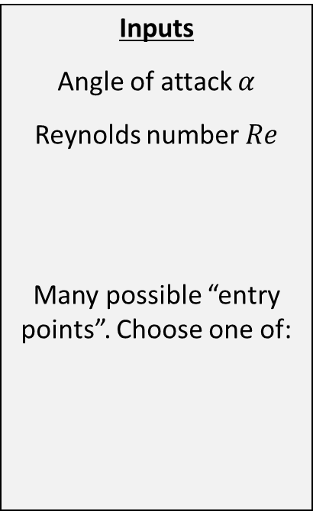
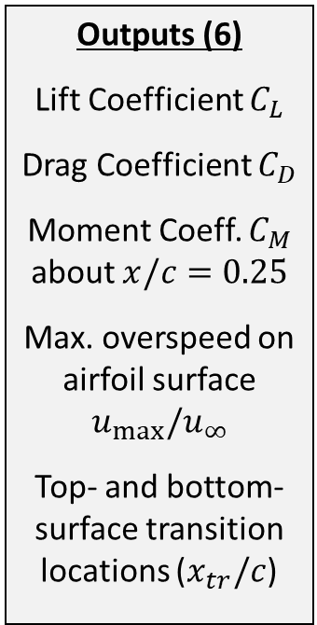
Inputs
Angle of attack $α$
Reynolds number $Re$
Many possible “entry points”. Choose one of:
Outputs (6)
Lift Coefficient $C_{L}$
Drag Coefficient $C_{D}$
Moment Coeff. $C_{M}$ about $x/c=0.25$
Max. overspeed on airfoil surface $u_{max}/u_{∞}$
Top- and bottom-surface transition locations ($x_{tr}/c$)

