Slide 1
Sample Figures

Slide 2
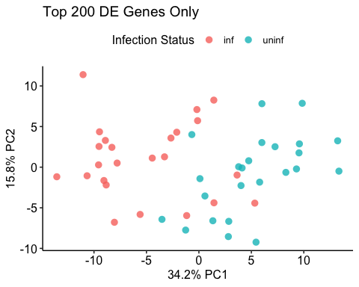
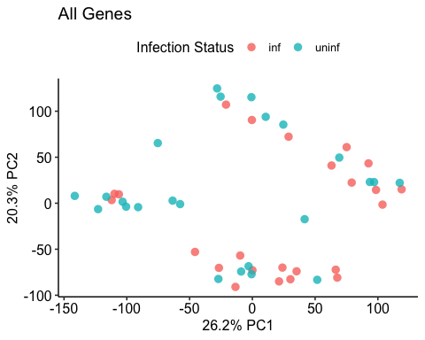
Varriance Stabilizing Transformation

Slide 3
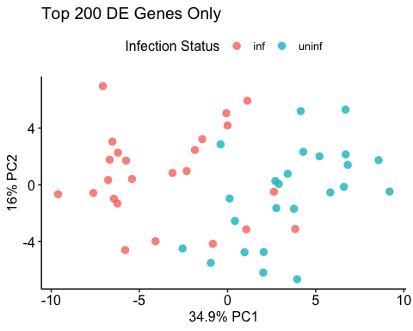
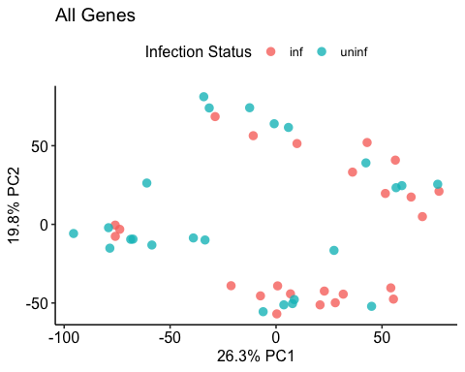
Logarithmic

Slide 4
Differential Expression

Slide 5
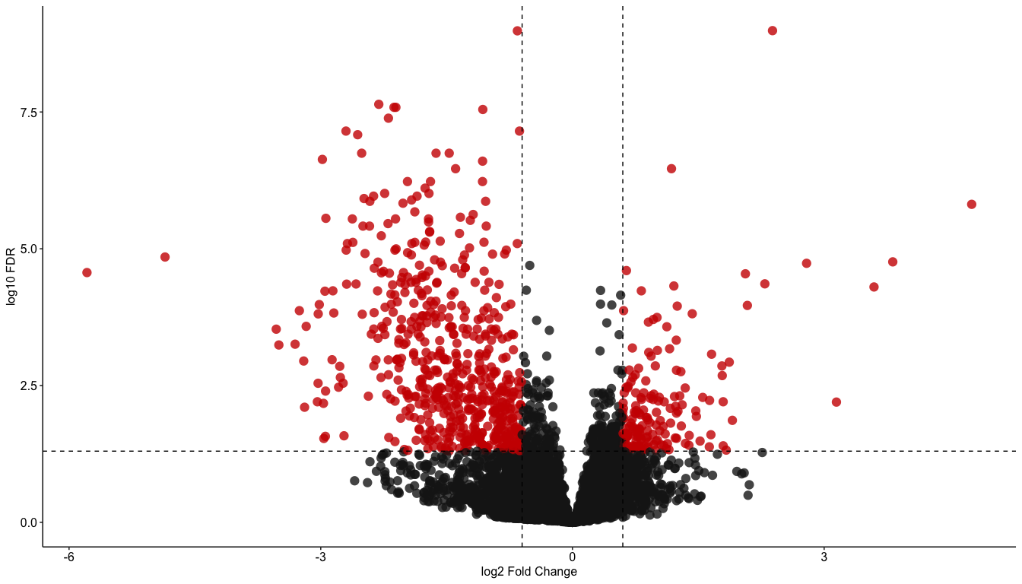
Volcano Plot

Slide 6
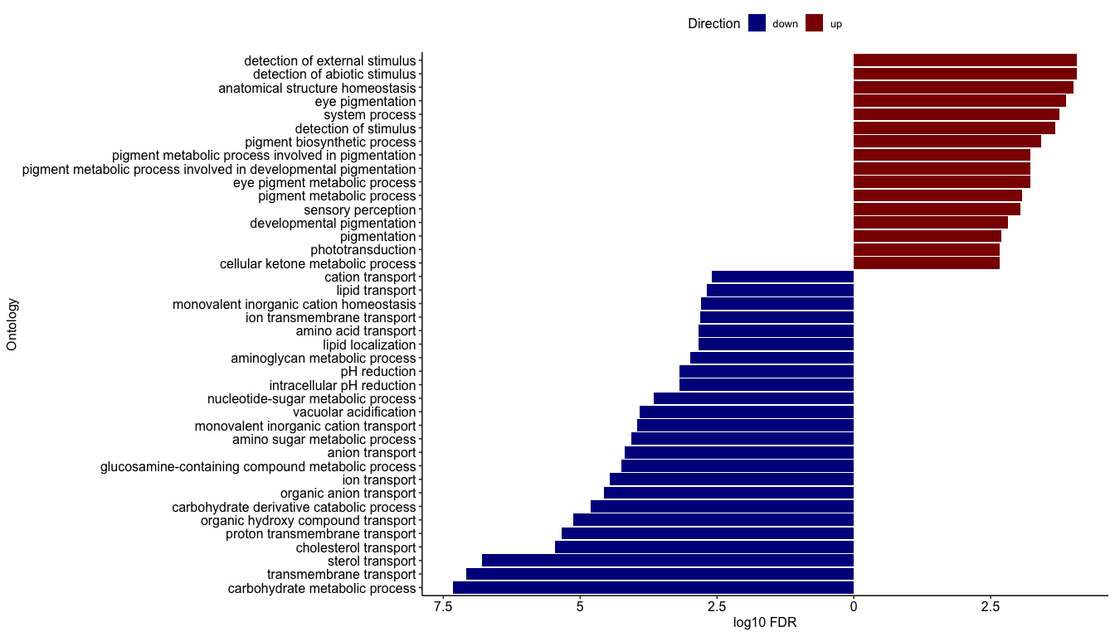
Gene Ontology

Slide 7
V-ATPases
Sample Plot
Other ways to plot this, ways to handle multiple predicted genes having same annotation

Slide 8
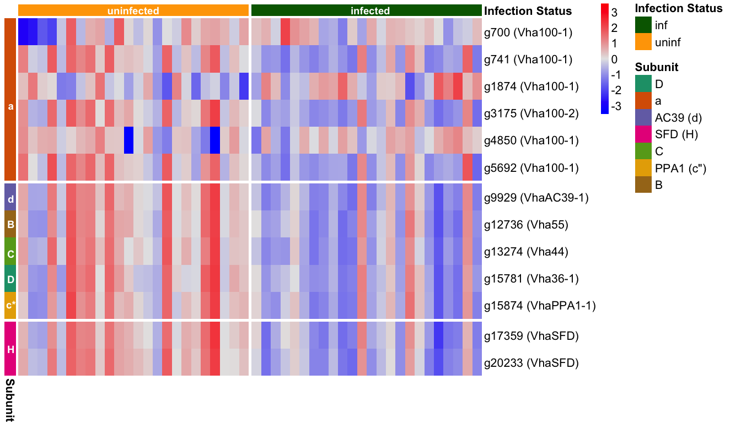

Slide 9
Overlap of Methods
## [1] TRUE
## [1] TRUE
## [1] TRUE

Slide 10
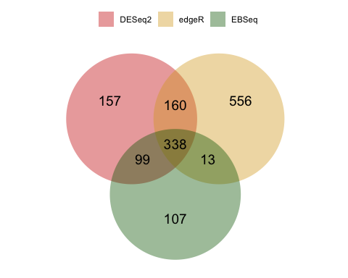

Slide 11
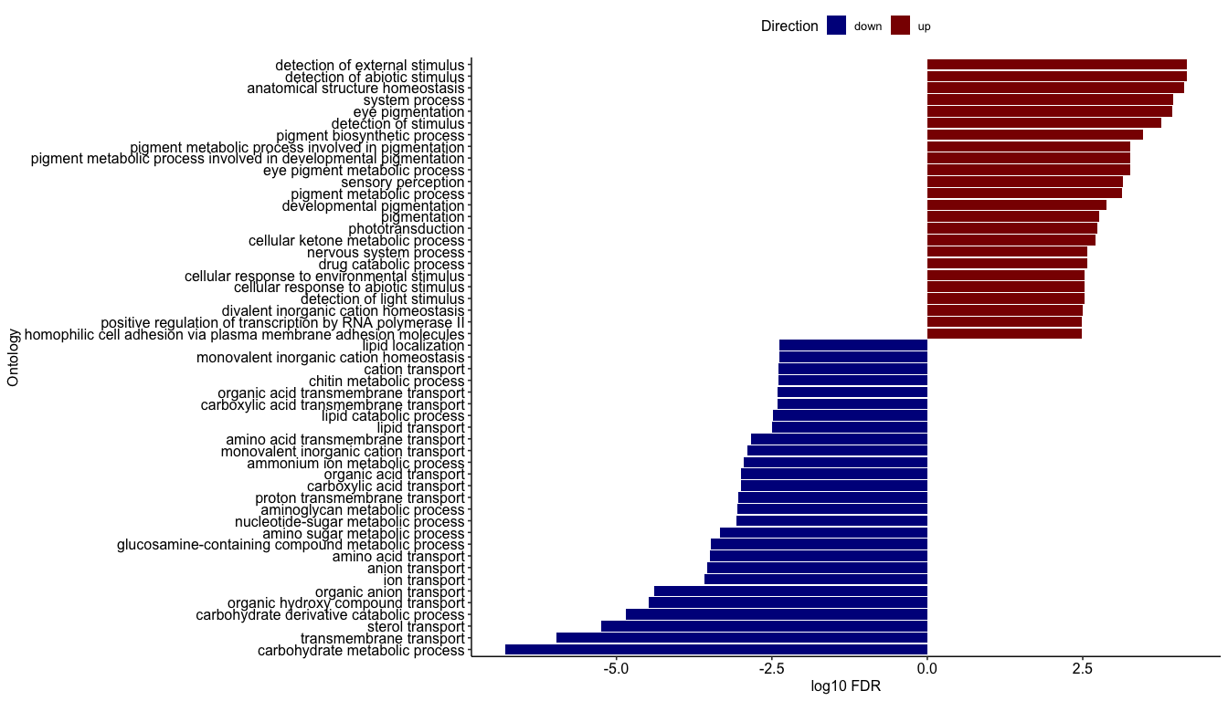
GO overlap

