Slide 1

How to do a Custom Evalution in ConQAT?
Klaus Lochmann
lochmann@in.tum.de
30.04.2012
http://www.quamoco.de/

Slide 2
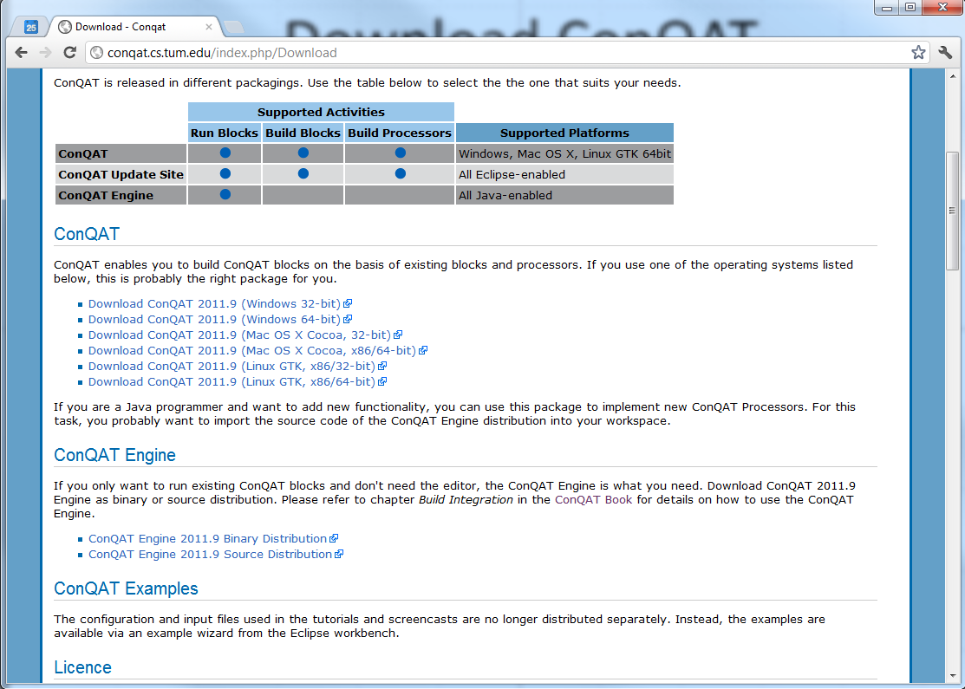
Download ConQAT

Slide 3
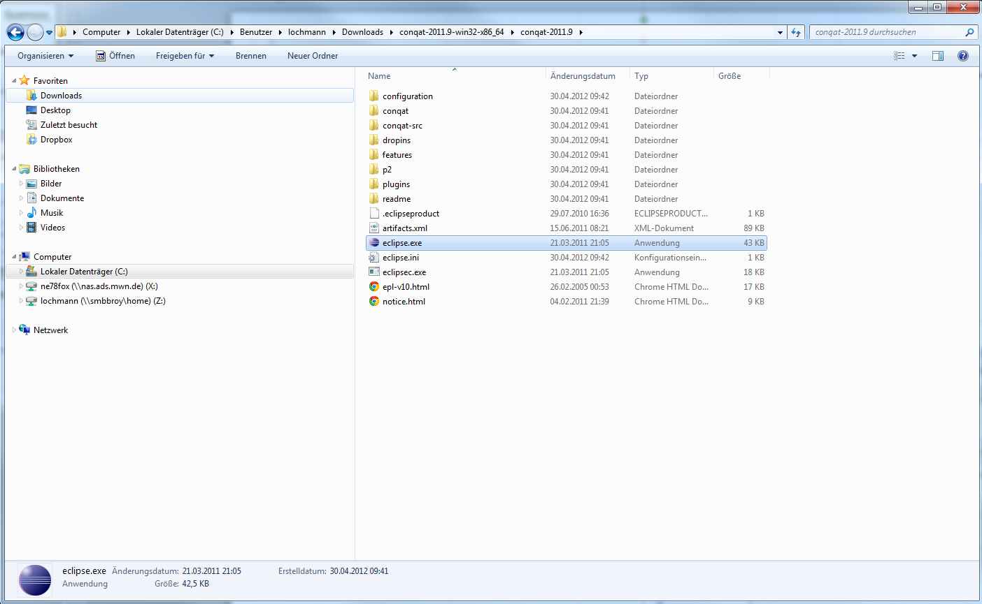
Extract Zip-File

Slide 4
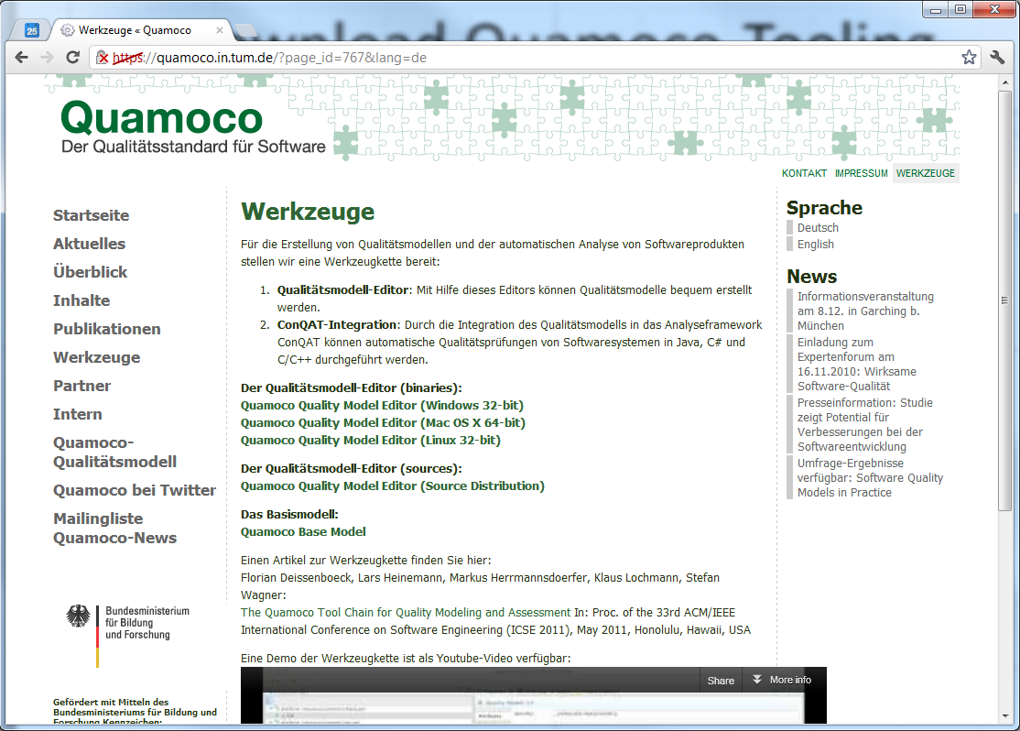
Download Quamoco-Tooling

Slide 5
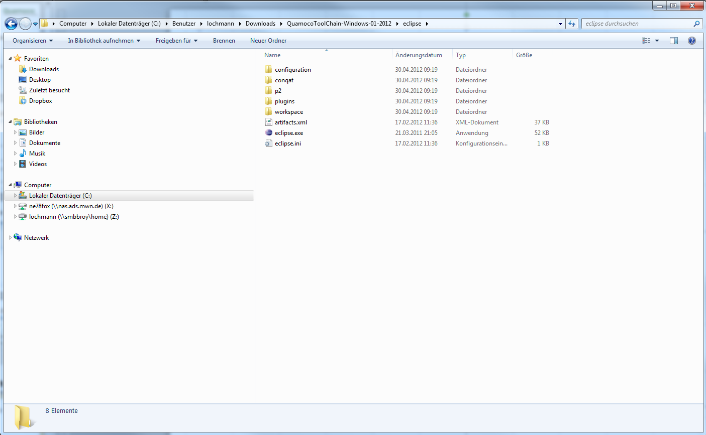
Extract Zip-file

Slide 6
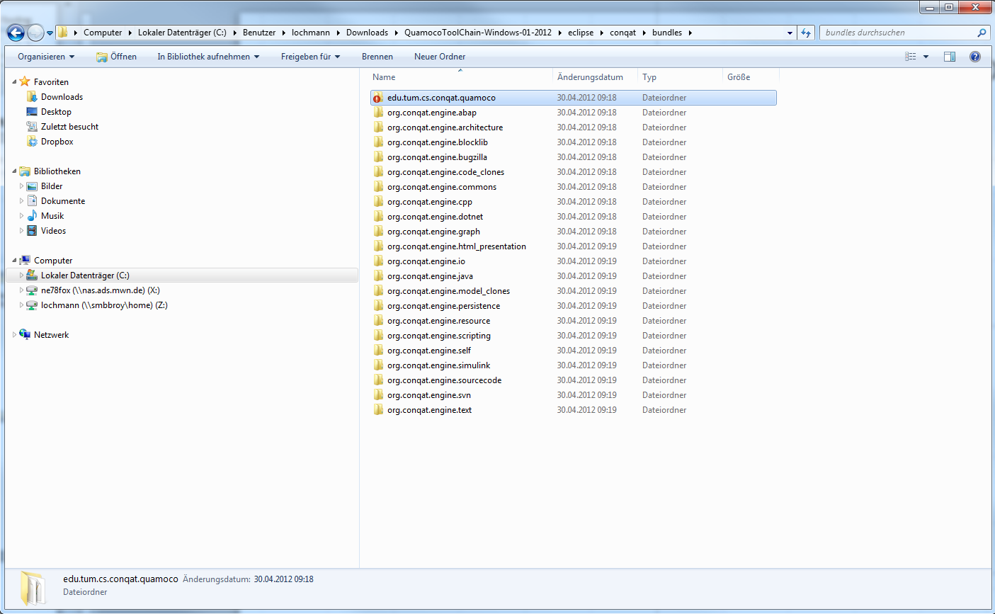
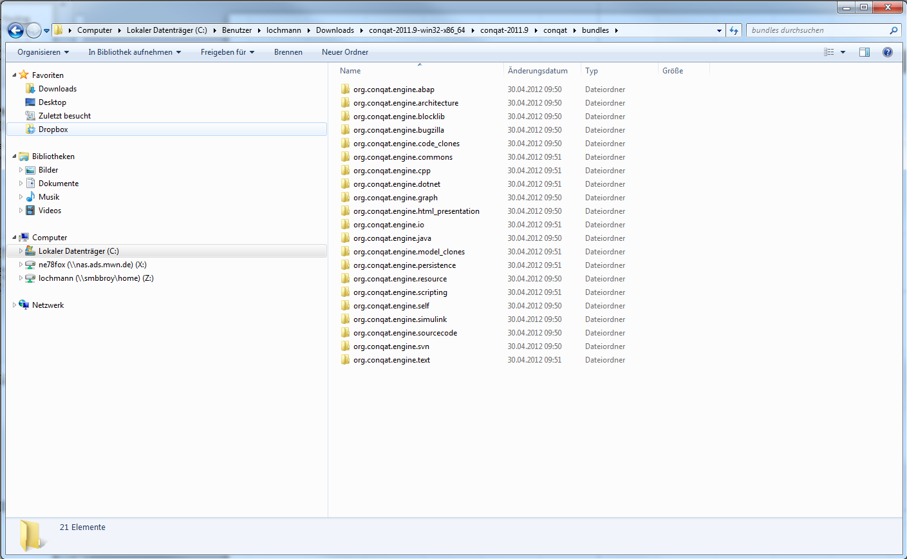
Copy Quamoco-Bundle from „Quamoco-Tool-Chain-Dir“ to „ConQAT-Dir“
copy

Slide 8
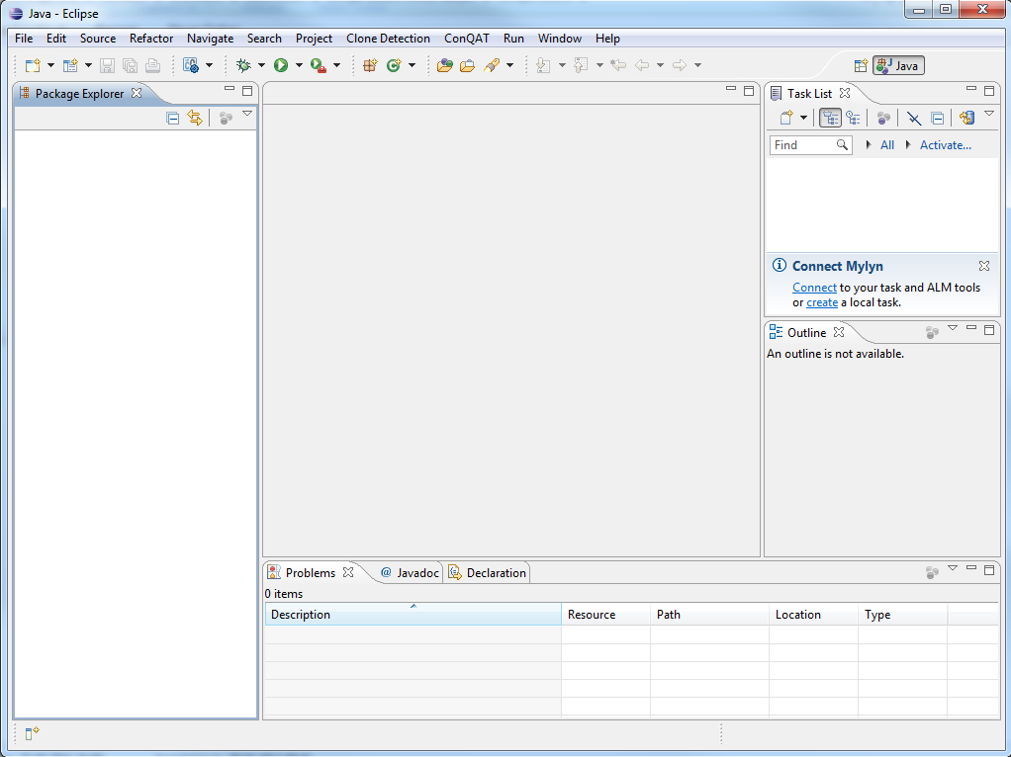

Slide 9
