Slide 1

How to do an Evaluation of a Java System?
Klaus Lochmann
lochmann@in.tum.de
30.04.2012
http://www.quamoco.de/

Slide 2
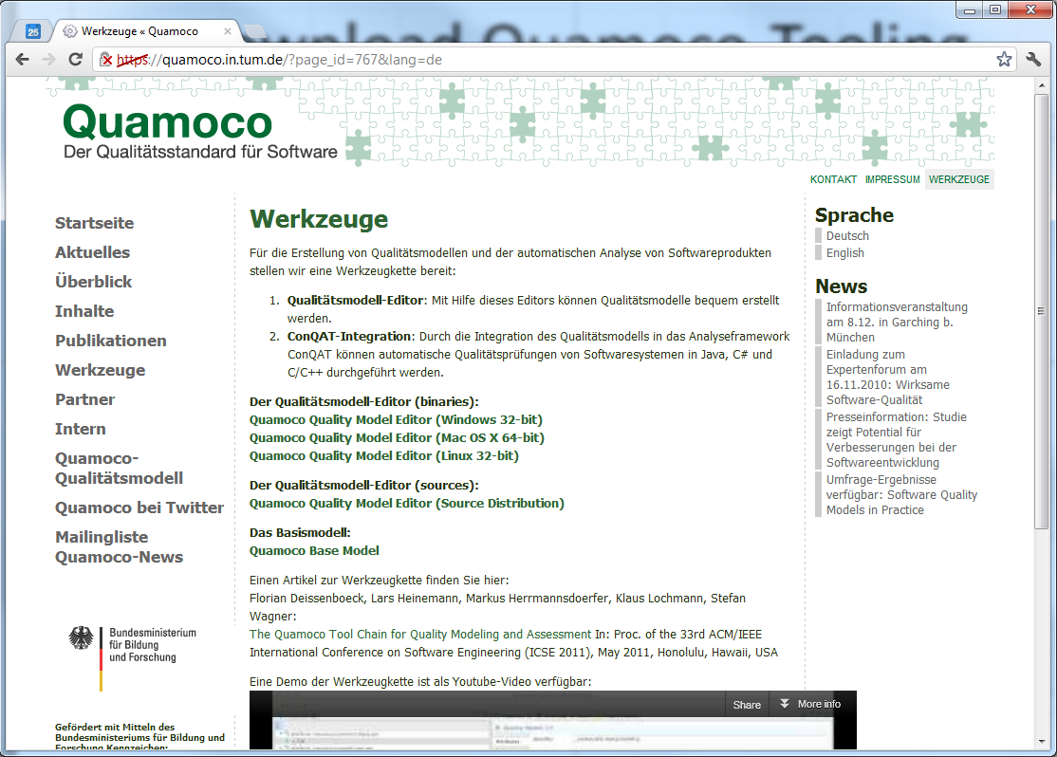
Download Quamoco-Tooling

Slide 3
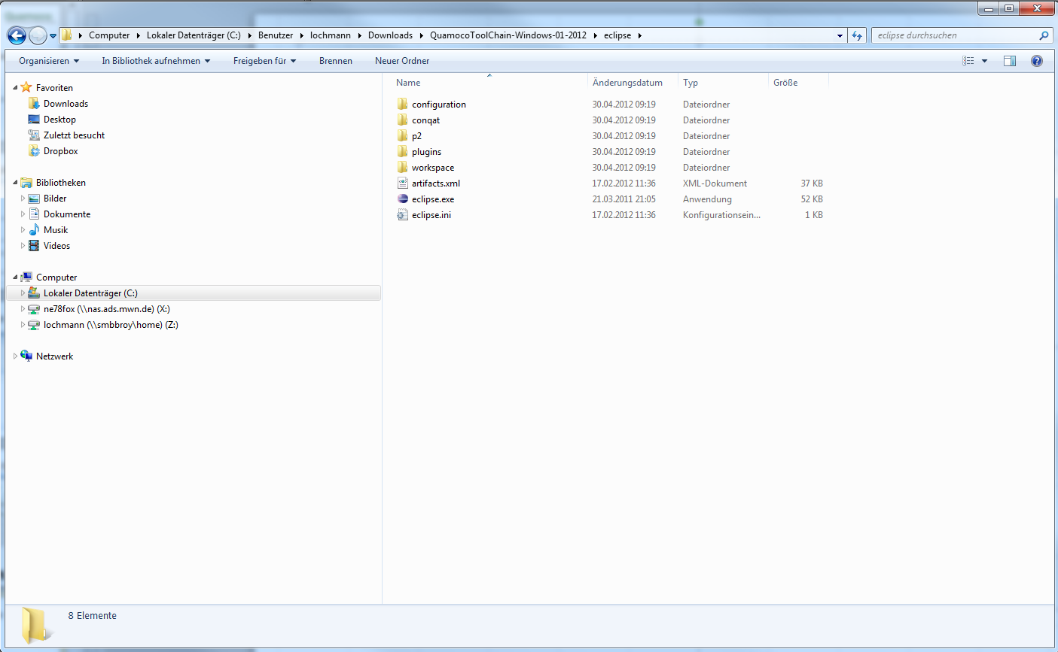
Extract Zip-file

Slide 4
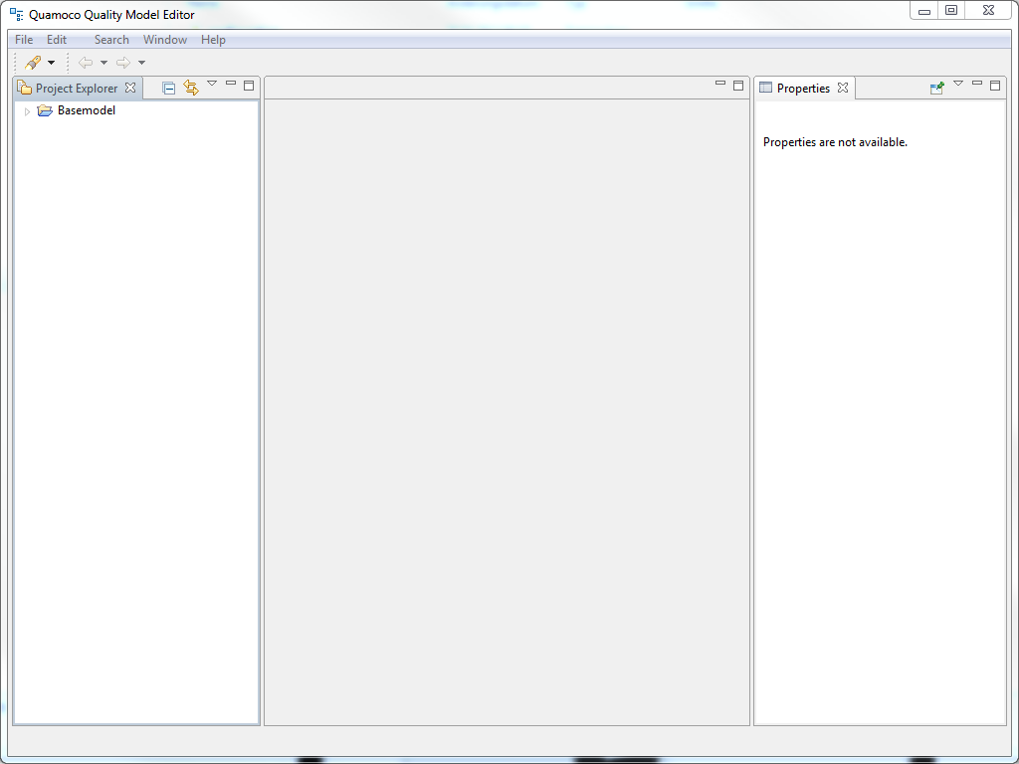
Start the Editor

Slide 5
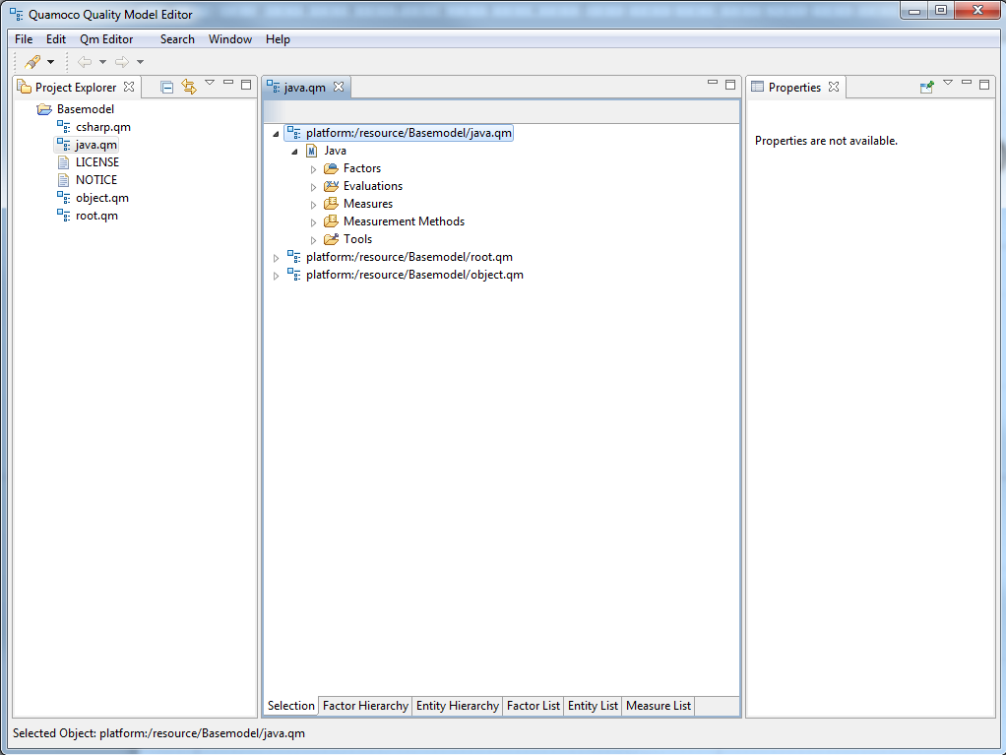
Open the Java Base Model

Slide 6
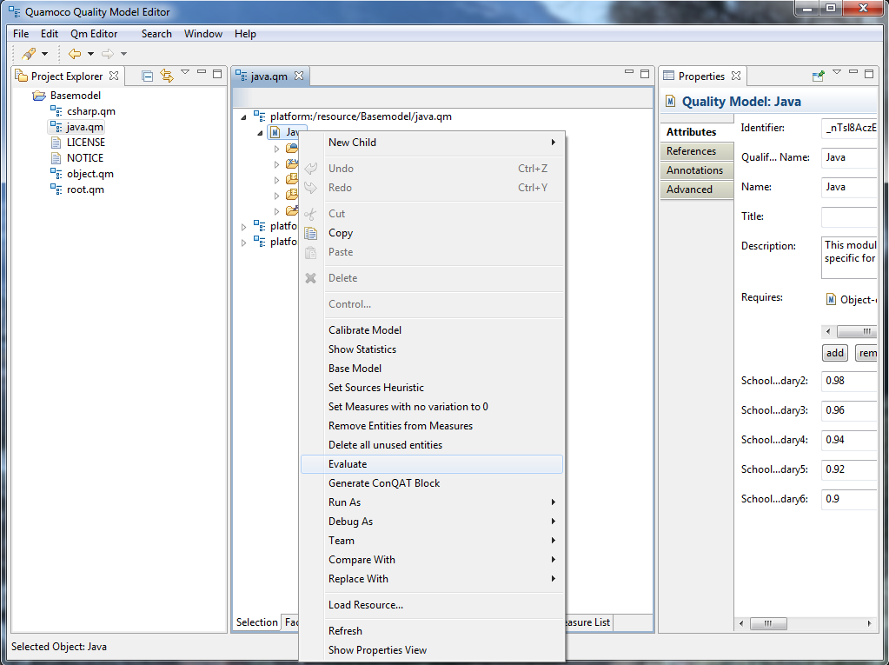
Select „Evaluate“ in the Context-Menu

Slide 7
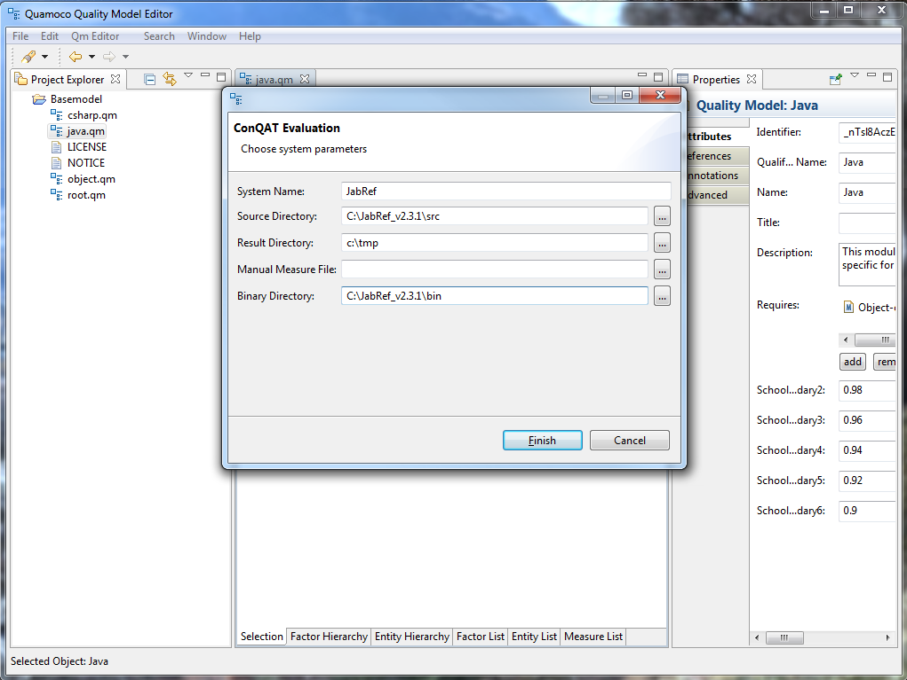
Set Source, Binary Directory Set Output (result) Directory

Slide 8
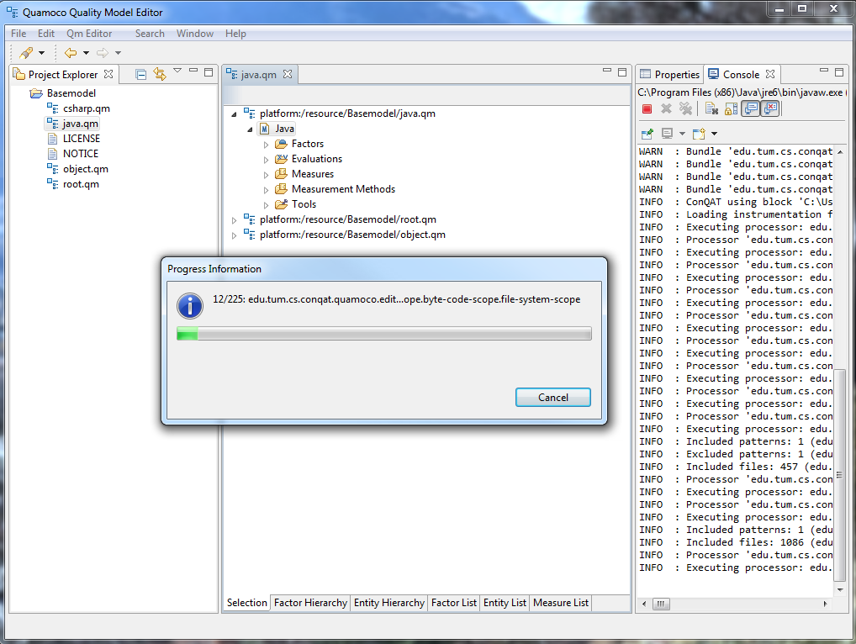
Run Evaluation

Slide 9
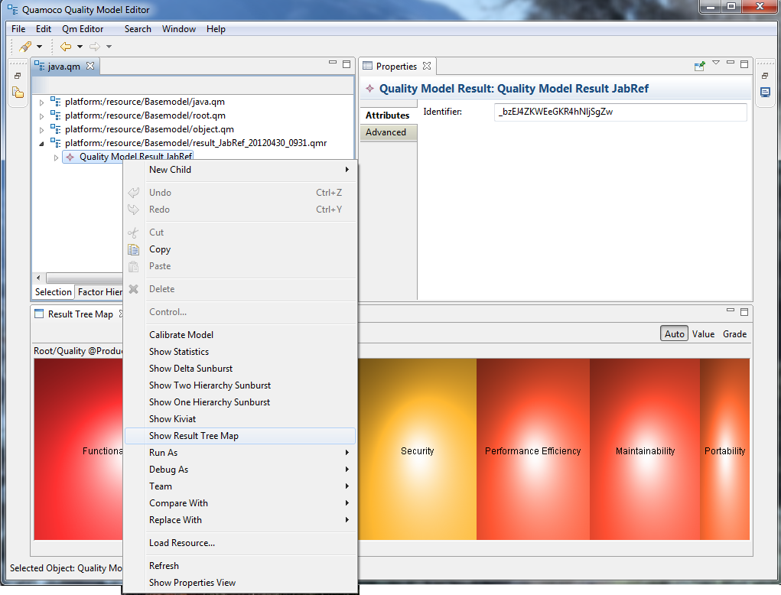
Browse Results in the Editor

Slide 10
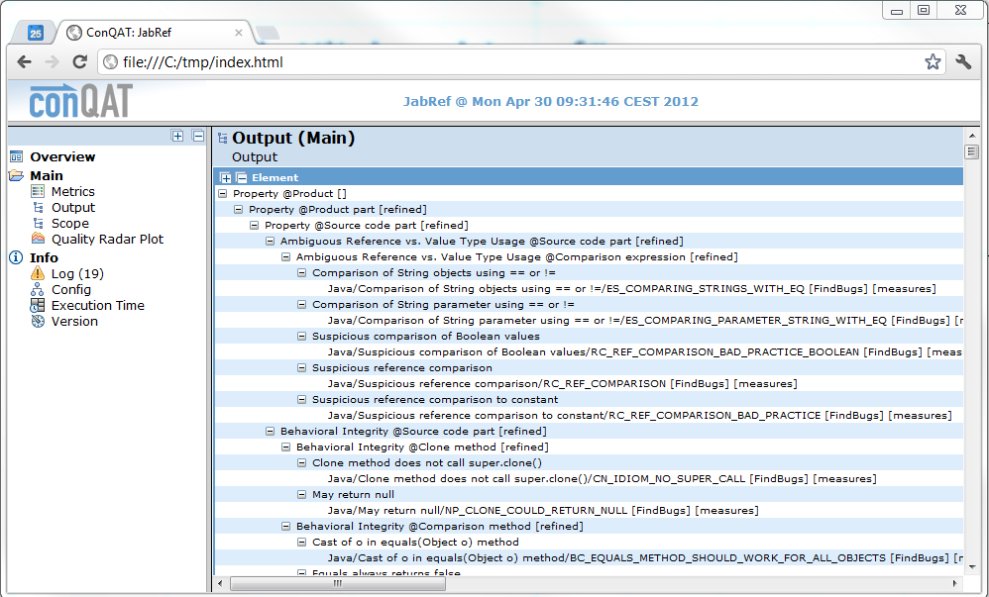
Browse ConQAT-Output

