Slide 1
Introduction to Git
A Distributed Version Control System

Slide 2
Presenter
David Rogers
.NET Developer
Web: http://davidrogers.id.au
Blog: http://davidrogers.id.au/wp

Slide 3


Created by Linus

Slide 4
Installation and Setup
For Installation, see Chapter 1.5 of Pro Git - Getting Started - Installing Git
For First-Time Setup Tasks e.g. specifying your name and email see Chapter 1.6 of Pro Git - Getting Started - First-Time Git Setup

Slide 5
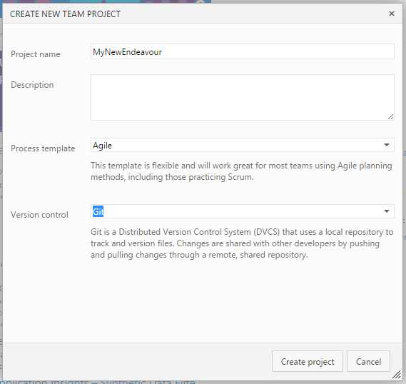
Demo – Create from VS Online

Slide 6
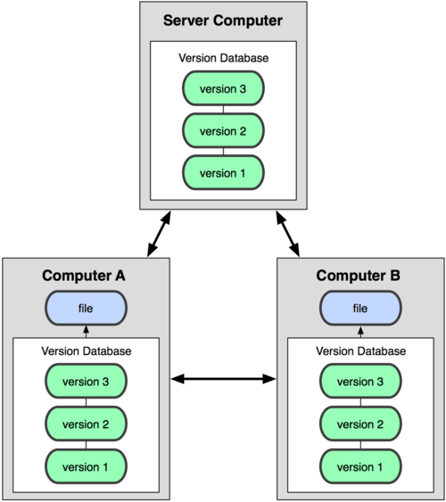
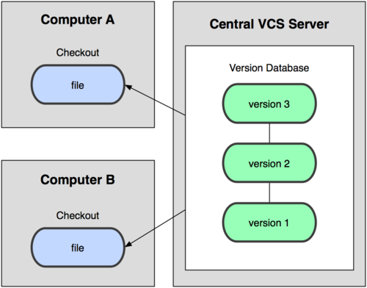
Distributed vs Centralised
Centralised
Distributed

Slide 7
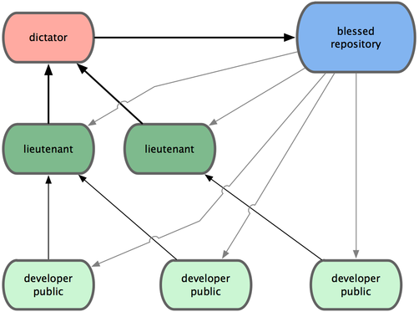
Heirarchies Possible

Slide 8
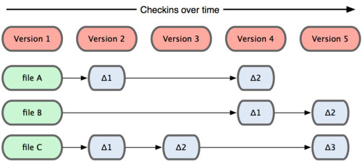
Common Version Control Storage

Slide 9
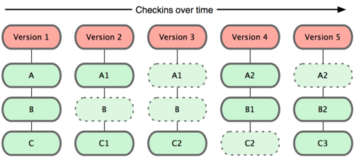
GIT Storage

Slide 10
Sync - Pull - Fetch
Each morning, first thing - get latest What is the GIT equivalent?
git fetch followed by
git merge
Fetch/Merge so common, they created Pull
git pull
Visual Studio has Sync = Pull then Push

Slide 11
.gitignore
Mechanism by which you can choose to exclude files/folders from source control
I usually add this in my first commit
Can have a global .gitignore
gitignore.io

Slide 12


Command Line v.s GUI
Msysgit ships with Bourne Again SHell
Reasons to Learn the Command Line:
Finer grain control – VS can be vague
Get the power of aliases
When seeking help on forums
GUI Options:
Gitextensions
Source Tree

Slide 13
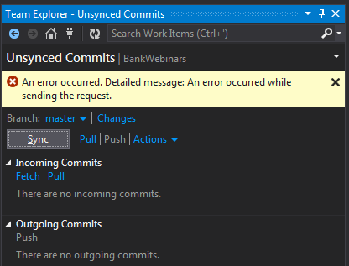
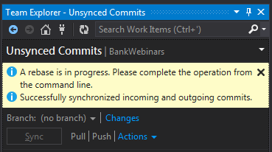
Back

Slide 14
Local Operations
3 important concepts
Working Directory (contains working copy of code)
Staging Area (also known as the Index)
HEAD (commit at the tip of the current branch)
Anatomy of a commit – GITGUI view
Commit workflow diagram
Why a Staging Area?
http://gitolite.com/uses-of-index.html
http://programmers.stackexchange.com/a/69187

Slide 15
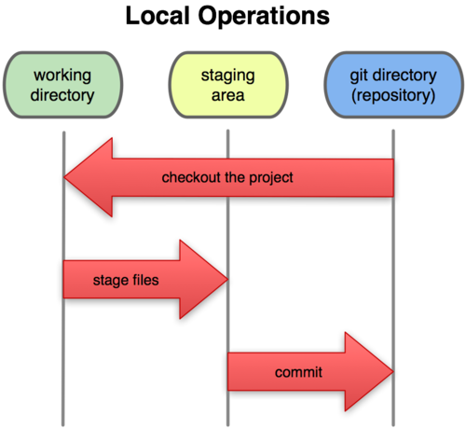
Commit Workflow
Back

Slide 16
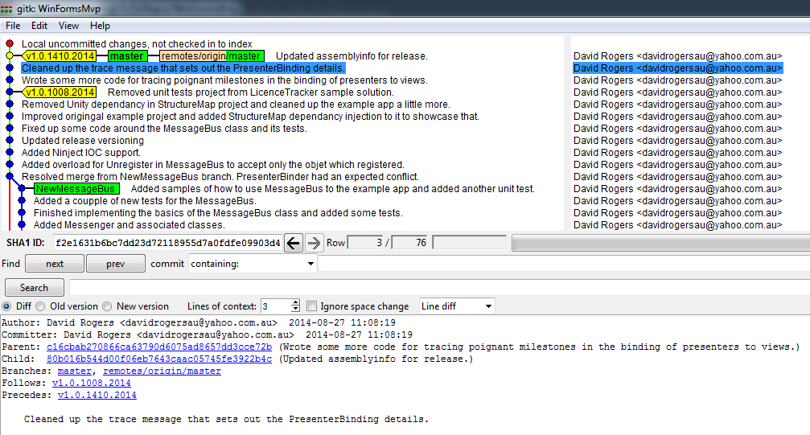
Commit Details in GitGUI
Back

Slide 17
Configuration
There are 3 levels
System E:\Program Files\Git\etc\gitconfig
User %userprofile%\.gitconfig
Repo [repo folder]\.git\config
Some Configuration Commands
git config --global user.name "Lorenzo Lamas"
git config --global user.email "lorenzolamas@sixkiller.com.au"
git config --global color.ui auto
git config --list

Slide 18
Aliases
Repository Level
git config alias.s status
Global
git config --global alias.last 'log -1 HEAD'
External Program
git config alias.v '!"gitk"'
Veritable treasure trove: http://bit.ly/13gitaliases

Slide 19
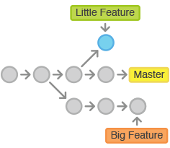
Branching
Create and checkout branch
Either
git branch [name-of-new-branch]
git checkout [name-of-new-branch]
Or
git checkout –b [name-of-new-branch]
Branch off an earlier commit
git branch [name-of-new-branch] <sha1-of-commit>
git branch [name-of-new-branch] HEAD~4

Slide 20
Branch Facts
A Branch is just a pointer to a commit, with a label.
Does not copy files from directory to directory like Subversion to create a branch
So, a branch:
Represents the tip of a series of commits and is not a container for those commits.
History is implicit through commit relationships

Slide 21
Branching Strategy
You’ll inevitably find this post: http://nvie.com/posts/a-successful-git-branching-model/
BUT not so fast
https://sandofsky.com/blog/git-workflow.html
https://www.mail-archive.com/dri-devel@lists.sourceforge.net/msg39091.html
Compare

Slide 22

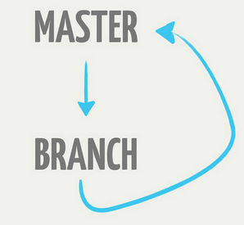
Comparison
Back
Github

Slide 23
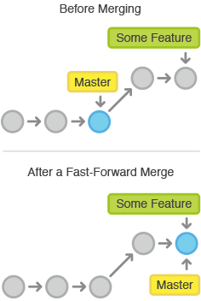
Merging
Putting a forked history back together again
Fast Forward Merge
there is a linear path from the current branch tip to the target branch

Slide 24
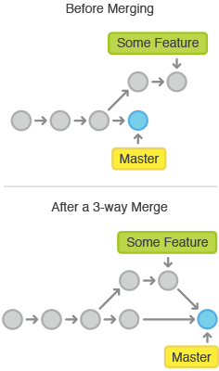
Merging Cont.
3-way Merge
3-way merges use a dedicated commit to tie together the two histories
Git uses three commits to generate the merge commit:
the two branch tips; and
their common ancestor.

Slide 25
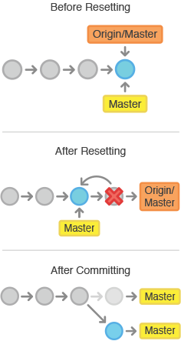
Resetting
Reset
git reset --soft HEAD
git reset --hard HEAD
use hard reset with caution!
Good explanation in this SO answer

Slide 26
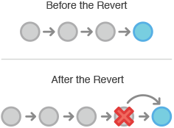
Reverting
undoes a committed snapshot. But, instead of removing the commit from the project history, it figures out how to undo the changes introduced by the commit and appends a new commit with the resulting content.

Slide 27
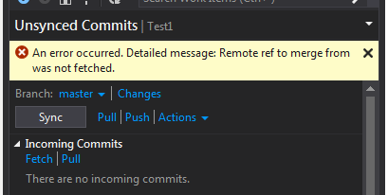
Tip
If you see the above error after having clicked Sync, just do a push.

Slide 28
Commands
git init
git status
git add -u adds files with changes to the Staging Area
git add -A adds files with changes plus new files to the Staging Area
git commit -m "with a message"
git log
git log --graph --oneline --decorate
git log --pretty=format:"%h %ad | %s%d [%an]" --graph --date=short

Slide 29
Commands Continued
git clone https://github.com/dojo/dojo.git
git ls-tree --full-tree -r HEAD | less pipe output to LESS
git blame [path to file]
git diff shows difference between HEAD and version of a file in the working area.
git diff --cached shows difference between HEAD and version of a file in the staging area.
git reset --soft HEAD~1
git reset --hard HEAD~1
git checkout -f (but note http://stackoverflow.com/a/6202572/540156)

Slide 30
Links
https://www.atlassian.com/git/tutorials/
http://git-scm.com/book/en/v2 (Free eBook)
http://rogerdudler.github.io/git-guide/files/git_cheat_sheet.pdf

