Slide 1
Claims Authentication with MembershipReboot
A Claims-aware Library for Authentication

Slide 2
Presenter
David Rogers
.NET Developer
Web: http://davidrogers.id.au
Blog: http://davidrogers.id.au/wp

Slide 3
Outline
Membership Providers
Claims
– what are they? History etc.
MembershipReboot
- what is it and why do we want it?
- configuration and setup (with Demo)
- password strength requirements
- hashing iterations
- tracing
- cookie decision
- custom notification templates
Brief look at Authorization with IdentityModel

Slide 4
Get Our Bearings
For a user to do something:
Authenticated (who are you?)
Authorized (what are you permitted to do)
MembershipReboot addresses item 1 – who are you?
Forms Authentication
Verify user’s identity
Authenticate subsequent requests
Issues a cookie to achieve those ends.
Cookie can be marked SSL-only (and should be)
Forms Authentication != Membership Provider
Don’t actually need Membership Provider to do Forms Authentication
Membership Provider is just a database lookup

Slide 5
Membership Providers
Membership providers – have shortfallings
Ancient
Built with a forum in mind – e.g. GetNumberOfUsersOnline
Leaky abstraction
e.g. UnLockUser, but where’s the LockUser
Violates SRP – logic of membership should be decoupled from the logic which does the CRUD stuff. Does EVERYTHING.
Note: with new Crypto class, can write own password management logic (hashing etc.).
SimpleMembership? Build on top of house of cards.
ASP.NET Identity (a review by Brock)
His response – extensions via IdentityReboot
Read Brock’s disdain for more details

Slide 6
Claims
Definition:
A claim is a statement that one subject makes about itself or another subject. The statement can be about a name, identity, key, group, privilege, or capability, for example. Claims are issued by a provider, and they are given one or more values and then packaged in security tokens that are issued by an issuer, commonly known as a security token service (STS).
(taken from P&P Guide to Claims-Based Identity)

Slide 7
Advantages of Claims
True key/value pairs.
E.g. dave has the email dave@dave.com is more expressive than some true/false construct
Abstracts away security implementation
Common ground cobble together disparate systems
Simply more information.
WindowsIdentity only has the Name property to identify it ClaimsIdentity has a whole ClaimsCollection

Slide 8
Claims by Issuers
If you try to determine what the different authentication mechanisms have in common, you can abstract the individual elements of identity and access control into two parts:
a single, general notion of claims, and
the concept of an issuer or an authority
A powerful abstraction.
Involve an explicit trust relationship with an issuer.
Your application believes a claim about the current user only if it trusts the entity that issued the claim.

Slide 9
IPrincipal and IIdentity
Role-Based Approach to authorization
var windowsIdentity = WindowsIdentity.GetCurrent();
var windowsPrincipal = new WindowsPrincipal(windowsIdentity);
Thread.CurrentPrincipal = windowsPrincipal;
Console.WriteLine(windowsPrincipal.IsInRole("HomeUsers"));

Slide 10
Claims in Code
var claims = new List<Claim>
{
new Claim(ClaimTypes.Name, "Dave"),
new Claim(ClaimTypes.NameIdentifier, ClaimTypes.Name),
new Claim(ClaimTypes.Email, "dave@dave.com"),
new Claim("http://dave.org/identity/claims/firstpet", "Nina"),
new Claim(ClaimTypes.HomePhone, "0414 444 444")
};
var claimsPrincipal = new ClaimsPrincipal(claimsIdentity); Thread.CurrentPrincipal = claimsPrincipal;
Console.WriteLine(claimsPrincipal.HasClaim(ClaimTypes.Email, "dave@dave.com"));
Console.WriteLine(claimsIdentity.IsAuthenticated);
Console.WriteLine(claimsPrincipal.HasClaim(
(claim) => claim.Type == ClaimTypes.HomePhone)
);
Console.WriteLine(claimsPrincipal.HasClaim(
(claim) => claim.Type == ClaimTypes.HomePhone && claim.Issuer == "LOCAL AUTHORITY" && claim.Value == "0414 444 444")
);

Slide 11
Backwards Compatible
Up til .NET 4.5
.NET 4.5
IIdentity
GenericIdentity
FormsIdentity
WindowsIdentity
IIdentity
ClaimsIdentity
GenericIdentity
FormsIdentity
WindowsIdentity

Slide 12
MembershipReboot – Config
Select no authentication option
Web.config
add configSections
ConnectionString (configure EF as to your liking)
Forms authentication
SessionAuthenticationModule
federationConfiguration
MembershipRebootConfig file in App_Start
Your IOC of choice – Ninject in Demo project
Refer to this article for a step-by-step

Slide 13
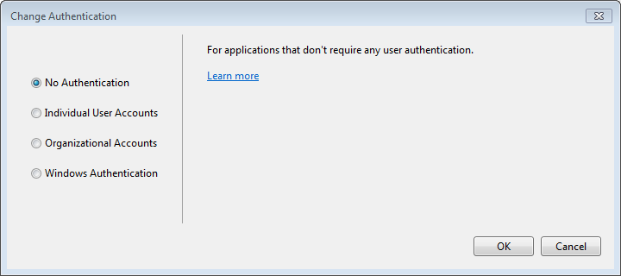
Select No Authentication
Back

Slide 14
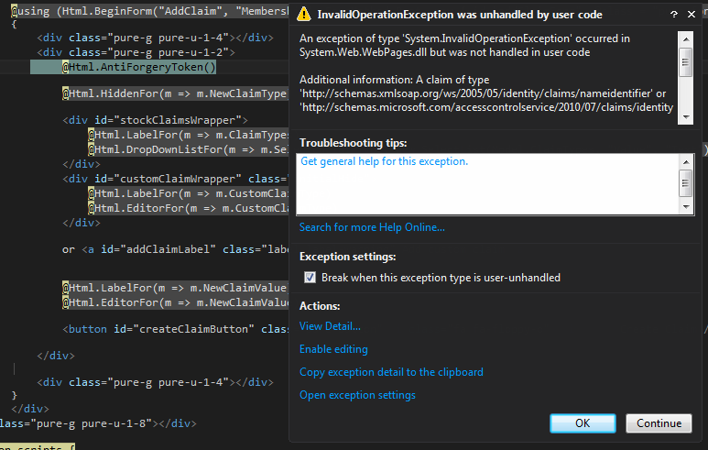
Unique Claim Identifier
In Global.asax.cs in Application_Start:
AntiForgeryConfig.UniqueClaimTypeIdentifier = ClaimTypes.Email;
OR, you can add NameIdentifier and IdentityProvider ClaimTypes to your claims:
List<Claim> _claims = new List<Claim>();
_claims.AddRange(new List<Claim>
{
new Claim(ClaimTypes.NameIdentifier , _user.Email)),
new Claim("http://schemas.microsoft.com/accesscontrolservice/2010/07/claims/identityprovider", _user.Email)
});

Slide 15
Password Complexity
Configure in your MembershipRebootConfig file
config.ConfigurePasswordComplexity( minimumLength: 8, minimumNumberOfComplexityRules: 4 );
4 rules
one upper
one lower
one digit
one other e.g @, #

Slide 16
Tracing
Configure in Web.config file in the normal way:
<system.diagnostics>
<trace autoflush="true" />
<sources>
<source name="MembershipReboot" switchValue="Verbose">
<listeners>
<add name="MembershipRebootListener" />
</listeners>
</source>
</sources>
<sharedListeners>
<add name="MembershipRebootListener" type="System.Diagnostics.XmlWriterTraceListener, System, Version=2.0.0.0, Culture=neutral, PublicKeyToken=b77a5c561934e089" initializeData="C:\logs\MembershipReboot.svclog" traceOutputOptions="Timestamp">
<filter type="" />
</add>
</sharedListeners>
</system.diagnostics>

Slide 17
Size of Session Tokens
Enable server-side caching of session tokens in Global.asax.cs:
public override void Init() {
var sam = FederatedAuthentication.SessionAuthenticationModule;sam.IsReferenceMode = true;
}

Slide 18
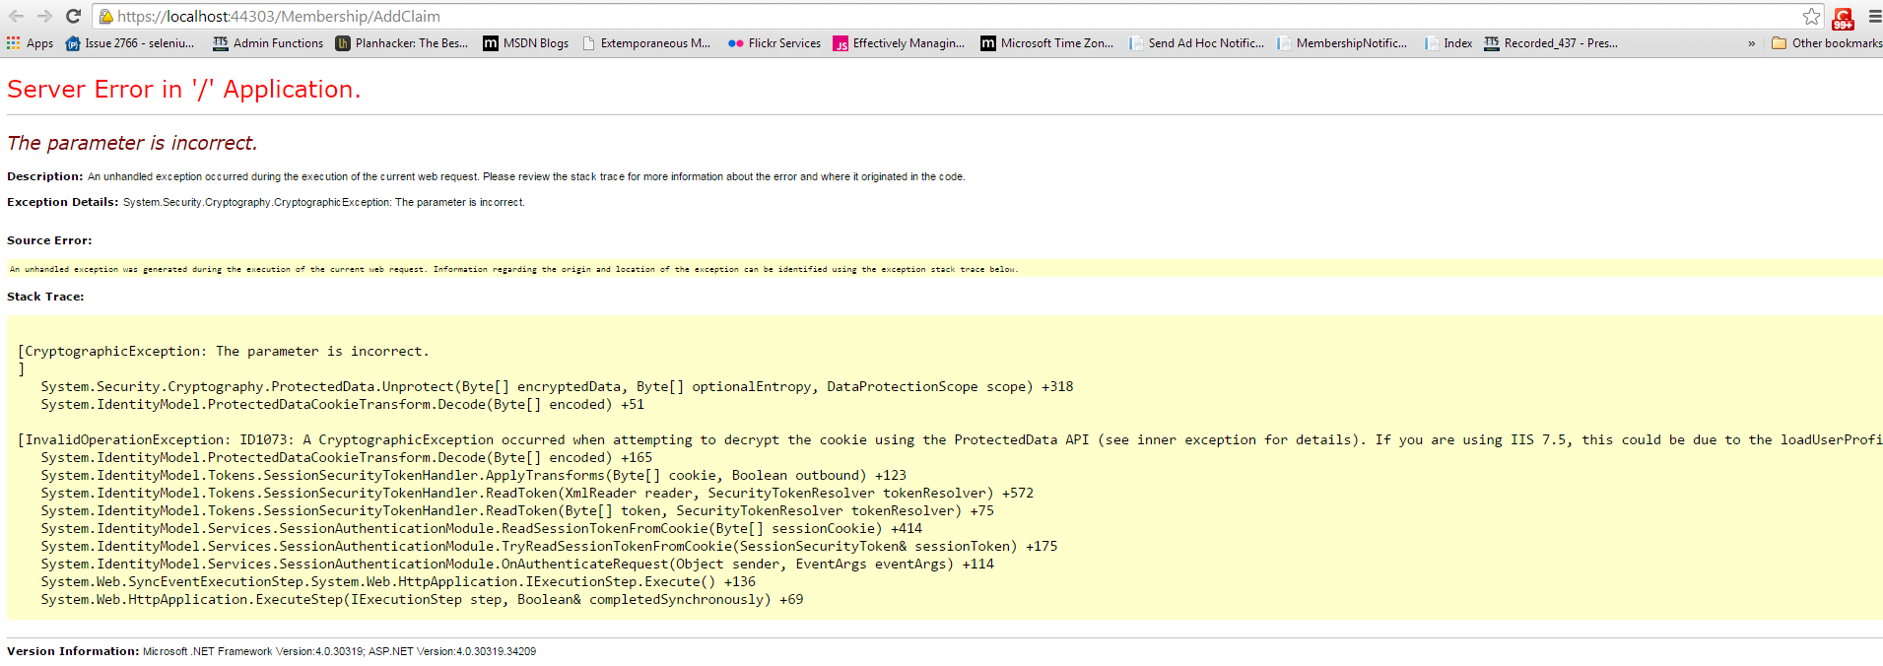
An Error to Look Out For
Same browser, more than 1 app with fedauth cookies
Resolve by clearing the cookies for that domain.

Slide 19
Brock Allen References
http://brockallen.com/2012/09/02/think-twice-about-using-membershipprovider-and-simplemembership/
http://brockallen.com/2012/06/04/membership-is-not-the-same-as-forms-authentication/
http://brockallen.com/2014/02/09/how-membershipreboot-stores-passwords-properly/
http://brockallen.com/2014/02/11/introducing-identityreboot/
http://brockallen.com/2012/07/08/mvc-4-antiforgerytoken-and-claims/
http://brockallen.com/2013/02/10/beware-setting-properties-or-registering-events-on-the-sam-and-fam/

Slide 20
General References
http://stackoverflow.com/a/14050719/540156 - Advantage of Claims over Roles
http://www.codeproject.com/Articles/639458/Claims-Based-Authentication-and-Authorization - step-by-step article
https://davidrogersdev@bitbucket.org/davidrogersdev/adnugdemo1.git - uri for source code for demo

Slide 21
ASP.NET Identity References
Dino Esposito series in MSDN Magazine:
http://msdn.microsoft.com/en-gb/magazine/dn605872.aspx
http://msdn.microsoft.com/en-gb/magazine/dn745860.aspx
http://msdn.microsoft.com/en-us/magazine/dn818488.aspx
Chapters from Adam Freeman book
http://www.apress.com/files/extra/ASP_NET_Identity_Chapters.pdf

Slide 22
Book References for Identity
Patterns & Practices Book
http://msdn.microsoft.com/en-au/library/ff423674.aspx

