Slide 1
NoSQL: It Doesn’t mean what you think it means
David Rollins. Consultant, Slalom, L.L.C.
Twitter: @DavidRollinsTX
Notes:
Experience:
SQL Server DBA
Web Developer 10 years
Interested in NoSQL, little practical experience until recently
What I’ve learned…

Slide 2
Agenda
NoSQL
101
Relational
vs
NoSQL
Misconceptions
In the Wild
MongoDB
In Action

Slide 3
NoSQL 101

Slide 4
NoSQL = Not Just SQL
NoSQL DataStore:
Thinks in clusters
Persistent data (not just caches)
No fixed schemas
SQL “like” syntax
Eventual consistency

Slide 5
Types of NoSQL
Key-value Store
Big Table Store
Document Store
Graph Store
Notes:
NoSQL is a broad term used to describe specialized systems under one banner

Slide 6






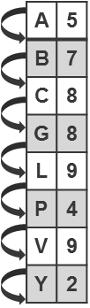
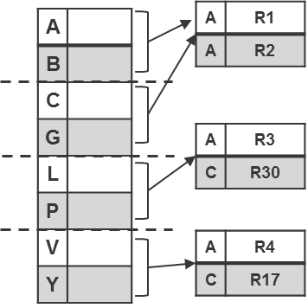

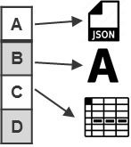
Evolution?
Key-Value
Ordered
Key-Value
Big Table
Document
Graph

Slide 7
Key-Value Store
Strength: Fast lookups
Weakness: Stored data has no schema
Examples:
DynamoDB
Redis
Riak
Voldemort
Key-Value
Ordered
Key-Value
Notes:
Key-value stores are generally good solutions if you have a
Simple application
with only one kind of object,
need to look up objects up based on one attribute.
The simple functionality of key-value stores may make them the simplest to use, especially if you’re already familiar with Memcached.

Slide 8
Big Table Store
Strengths:
Fast lookups
Good distributed storage of data
Weaknesses:
Very low-level API Example application:
Examples:
Apache Hbase
Apache Cassandra
Notes:
Model values as:
a map-of-maps-of-maps,
namely,
column families,
columns, and
timestamped versions.

Slide 9
Document Store
Strength: Tolerant of incomplete data
Weaknesses:
Query performance
No standard query syntax
Examples:
MongoDB
CouchDB
RavenDB
RaptorDB
Document
Notes:
Sample application:
A good example application for a document store would be one with multiple different kinds of objects (say, in a Department of Motor Vehicles application, with vehicles and drivers),
where you need to look up objects based:
on multiple fields (say, a driver’s name, license number, owned vehicle, or birth date).

Slide 10
Graph Store
Strength: Graph algorithms
e.g. shortest path, connectedness, n degree relationships, etc.
Weaknesses:
Has to traverse the entire graph to achieve a definitive answer.
Not easy to cluster.
Examples:
Neo4J
InfoGrid
Infinite Graph
Graph
Notes:
Any application that requires social networking is best suited to a graph database.
Interested in the relationship between Paul and Marry rather than knowing how many Bananas are left

Slide 11
Relational vs NoSQL

Slide 12
What’s wrong with Relational DBs?
NOTHING

Slide 13
Two Valid World Views
Relational View
Systems View
All about the data
Clean model
ACID Transactions
Easy long-term evolution
All about the system
Evolve modules
Flexibility

Slide 14
ACID vs BASE
ACID
BASE
Atomicity
All or nothing
Consistency
Moves from one known state to another
Isolation
Can’t see data from incomplete tx
Durability
Data from successful tx is not lost
Basically Available
Soft state
Eventually consistent
All nodes eventually see same data

Slide 15
CAP Theorem
Availability
Partition Tolerance
Consistency
Pick of 2 choices
Consistency – data is always the same
Availability – data is always available (r/w)
Partition tolerance – data exists across network partitions.
RDBMS
Notes:
Proposed by Eric Brewer; Professor, UC Berkeley; 2000
According to the CAP Theorem, you can only pick two.
Consistency means that each client always has the same view of the data.
Availability means that all clients can always read and write.
Partition tolerance means that the system works well across physical network partitions.

Slide 16
Relational
Column-oriented/Tabular
Key-value
Document-oriented
A
Availability:
Everyone can always read and write
CA
AP
MySQL
PostgreSQL
Vertica
Cassandra
CouchDB
SimpleDB
Dynamo
Voldermort
Pick Two
C
P
Consistency:
Same view of the data always
CP
Partition Tolerance:
Works well despite network partitioning conditions
Big Table
Hbase
MemecacheDB
Redis
MongoDB
Terrastore
16

Slide 17
Impedance mismatch
Difficulties that are arise when often encountered when a RDBMS is being used by a program written in an object-oriented style
Store XML in your DB?
Store data as blobs?
In reality:
I found that I now think relational
Document schema has been an adjustment

Slide 18
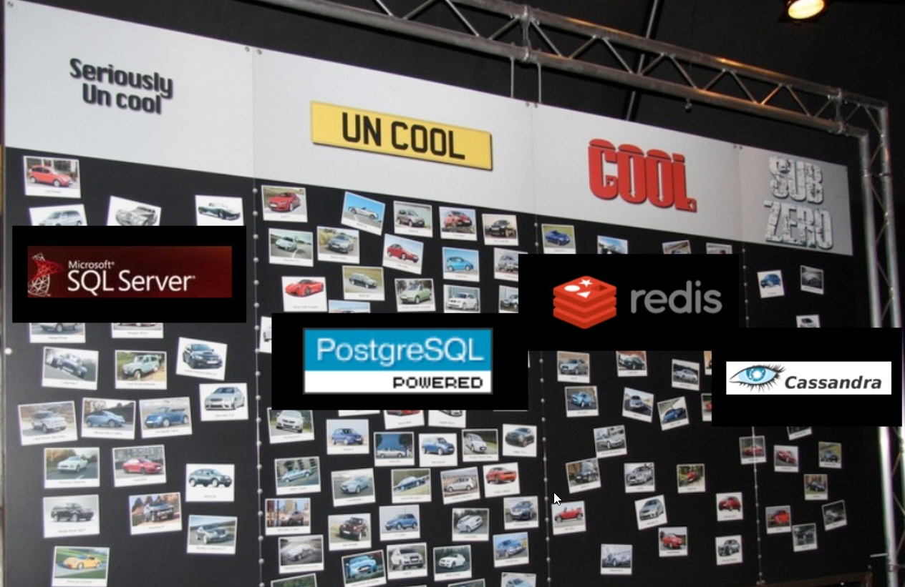
What’s really wrong with RDBMS?
Coolness Factor

Slide 19
Relational vs. NoSQL
Scaling

Slide 20
Scaling RDBMS
Read Saturation – Add caching
Write Saturation – Add hardware
Queries Slow – denormalize
Queries Still Slow – batch tables; stop joining
Writes slow – drop extra indexes and triggers

Slide 21
Scaling NoSQL
Just add more servers…
Well… that’s the promise.
Reality:
Pick the right shard key - Mongo
Elastic Search - >8G Index

Slide 22
Relational vs. NoSQL
Performance Comparison

Slide 23
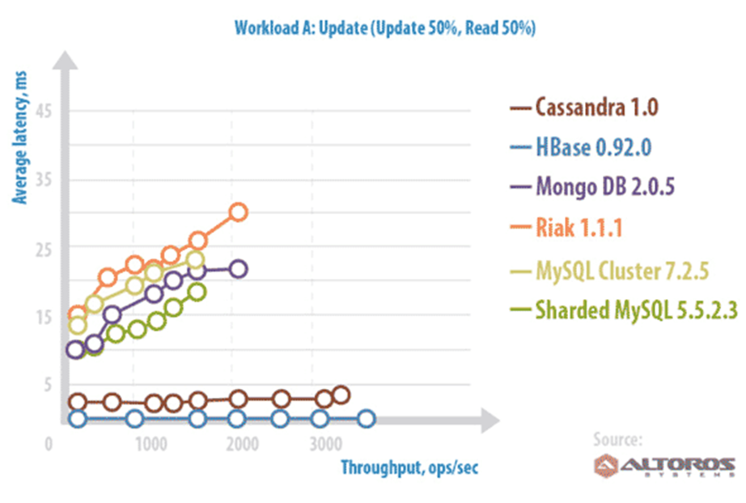
Server Comparisons-Update (50/50)
Notes:
BEST:
- Cassandra
- Hbase
Worst Latency:
- Riak
Worst Throughput:
- MySQL

Slide 24
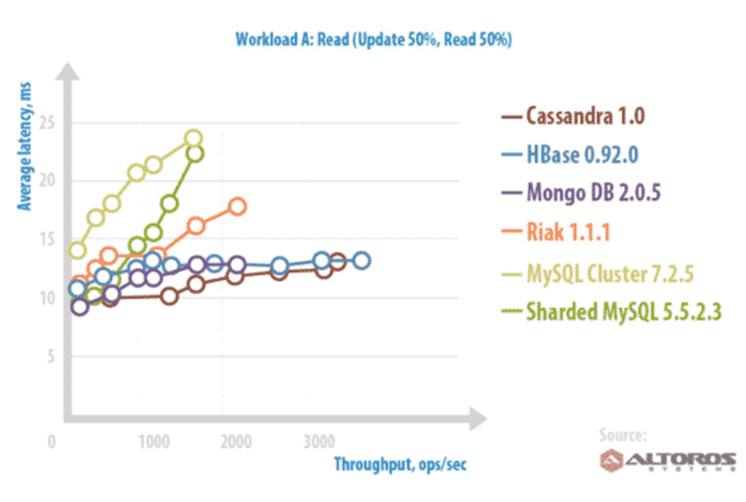
Server Comparisons-Read (50/50)
Notes:
BEST:
- Cassandra
- Hbase
Worst Latency:
- MySQL
Worst Throughput:
- MySQL

Slide 25
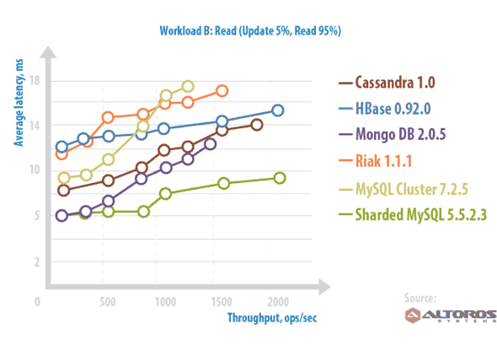
Server Comparison – Read (Read Heavy)
Notes:
BEST:
- MySql Sharded
Worst Latency:
- MySQL Cluster
Worst Throughput:
- MySQL Cluster
- Riak

Slide 26
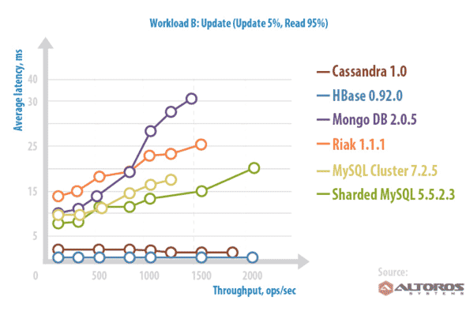
Server Comparison – Update (Read Heavy)
Big table
Document
Key-Value
RDBMS
Notes:
BEST:
- Cassandra
- Hbase
Worst Latency:
- MongoDB
Worst Throughput:
- MySQL Cluster

Slide 27
Misconceptions

Slide 28
Misconception 1
Replaces Relational DB
Augment not replace
Notes:
Analysis
Caching
Map reduce

Slide 29
















Misconception 2
Technology unproven
http://planetcassandra.org/companies/
http://www.mongodb.org/about/production-deployments/

Slide 30
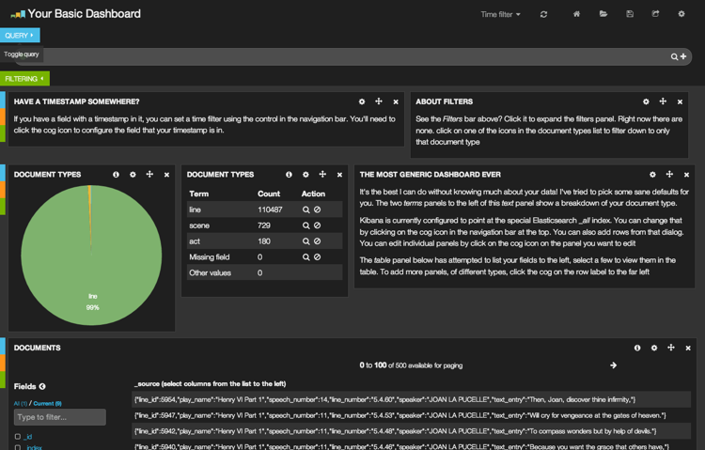
Misconception 3
That doesn’t apply to us
ELK Stack
Elasticsearch
Logstash
Kibana
Data Warehouse – Caching
Prototyping

Slide 31
In the Wild
Real World Projects

Slide 32
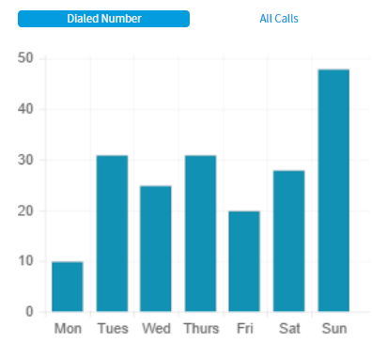
Augment Oracle Project
Oracle DB performance
3-5 seconds query response
6 billion records
Couldn’t run real-time reports
Nasty Joins on the queries
Augment with Elastic Search
ETL job feeds Oracle and ElasticSearch
“Google-like” queries
Aggregations to pull metrics

Slide 33
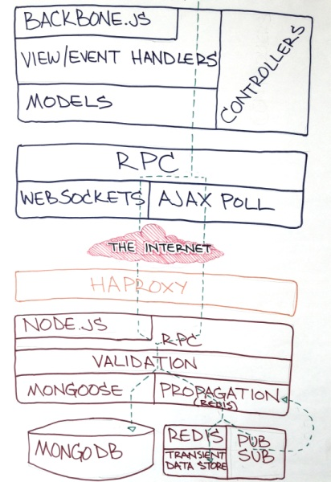
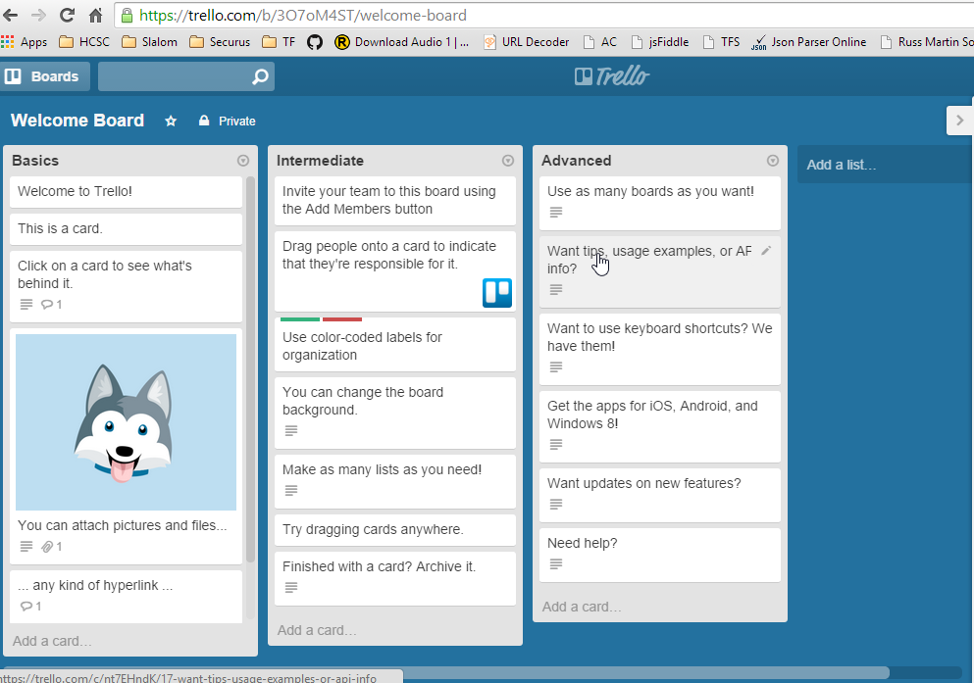
Trello.com
The Trello Stack

Slide 34









Slide 35
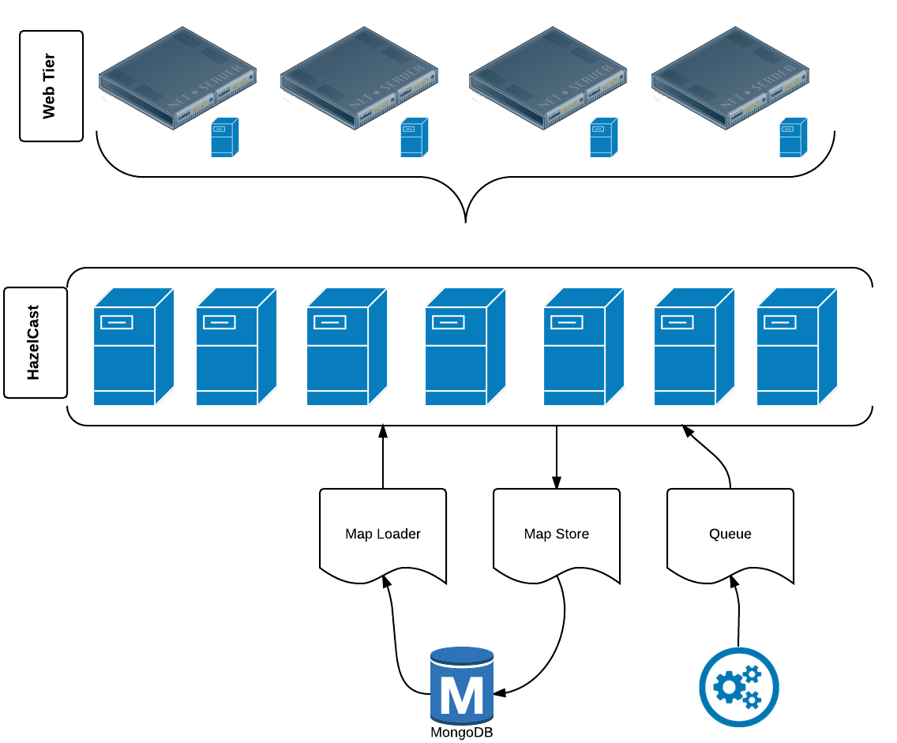

Slide 36
MongoDB
Details

Slide 37
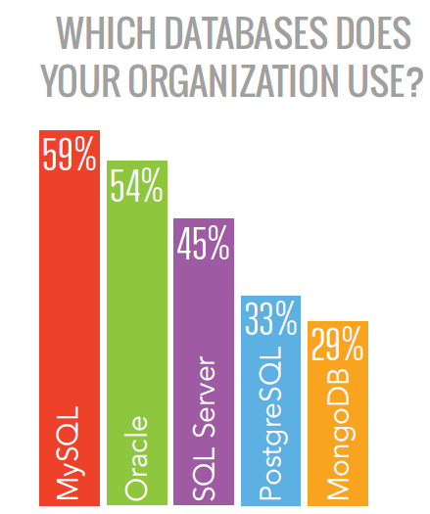
Why Mongo
Dzone BigData Research Guide
Quick Sharding
Quick replication sets
Good documentation
Free on-line training
Trade-offs
Performance
Number of servers for replication

Slide 38

Full Index Support
Index on any attribute
Geospatial indexes
Replication & High Availability
Mirror across LANs and WANs for scale and peace of mind.
Sharding
Scale horizontally without compromising functionality.
Querying
Rich, document-based queries.
Complex queries through aggregates
GridFS
Store files of any size without complicating your stack.
Familiar Format
JSON style format saved as BSON

Slide 39
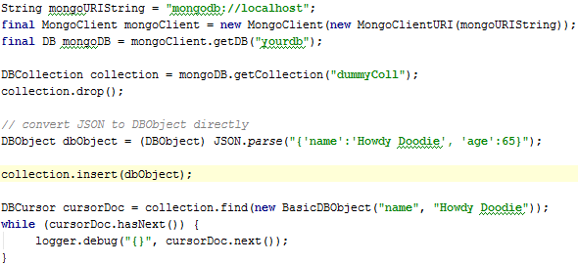
Java Client – Save JSON
Sample Output:
{ "_id" : { "$oid" : "51a6b568e15dd747023adeeb"}, "name" : "Howdy Doodie",
"age" : 65}

Slide 40
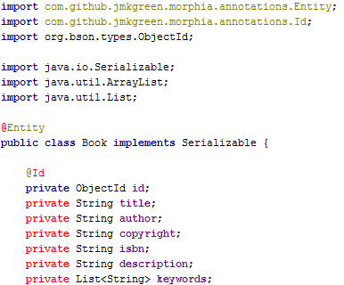
Morphia Object Mapper
https://github.com/mongodb/morphia

Slide 41
MongoDB
Scaling

Slide 42
MongoDB – Replica Sets
One Primary Member; many secondary members
Auto-failover via majority election
Only write to primary
Optional to read from secondary
Member
1
Member
3
Member 2
PRIMARY
read
read, write
Client

Slide 43
MongoDB – Read/Write Concern
Write to OpLog before committing to DB!
Read (only when SlaveOK IS set)
Application
Replication
Write
OpLog
Read (only when SlaveOK IS set)
Replication
Read (only when SlaveOK IS set)

Slide 44
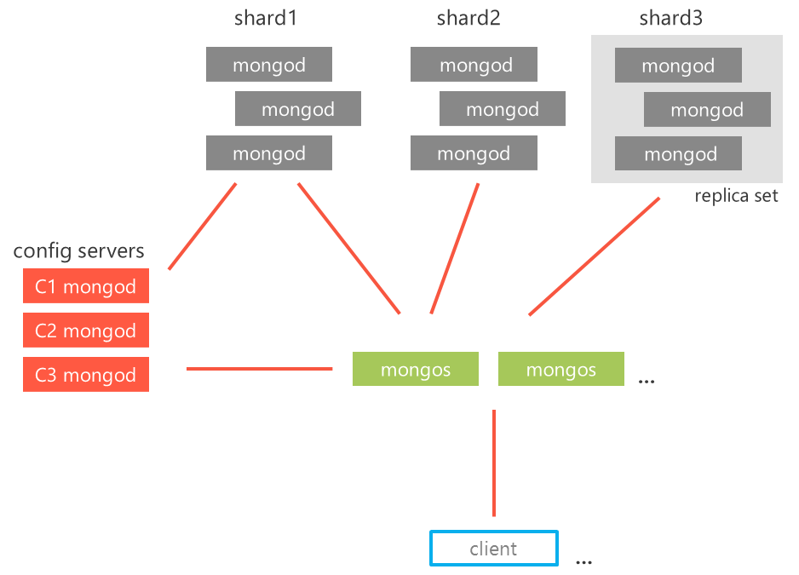
MongoDB - Sharding

Slide 45
MongoDB – Sharding Players
shard1
shard2
shard3
mongod
mongod
mongod
The shards are the worker bees
The mongos is the boss
The config server is the record keeper
mongod
mongod
mongod
mongod
mongod
mongod
replica set
config servers
C1 mongod
C2 mongod
C3 mongod
mongos
mongos
…
client
…

Slide 46
Sharding Gotchas
Considerations before sharding with MongoDB:
Meta-data must be writeable for data to be repartitioned
(i.e. Config server up)
Choose sharding keys wisely
Some queries will use multiple shards

Slide 47
In Action
Demo time!

Slide 48
Questions?
SLALOM CONTACTS
David Rollins
Consultant
David.rollins@slalom.com
Twitter: @DavidRollinsTX

