Slide 1
Interest Rate Instruments and Related Quantitative Modeling

Slide 2
Overview
US interest rate market is one of the largest and most liquid financial markets, serving as the backbone of global fixed income and derivatives trading
Money market (short-term: overnight to 1Y)
Federal Reserve/Treasury: Fed Funds (unsecured overnight lending rates), SOFR (secured overnight financing rate); T-bills (1M to 1Y)
Banks/Broker-Dealers: Repos (collateralized short-term loans), CDs(certificates of deposits)
Corps: CPs
Cash instruments (medium to Long-term: 1Y-30Y)
Treasury: T-Notes/Bonds
GSE (e.g., FNM): Agency bonds
State/local government: muni bonds
Corps: corp bonds
Derivatives (market makers: banks/dealers; asset managers/hedge funds, corps)
Futures, forwards, interest rate swaps
Caps/Floors, Swaptions
US IR Market: Instruments Across the Maturities
Overnight
Fed Funds
SOFR
Repo
Short-Term (<1Y)
T-Bills
CDs
CPs
Med-Term (1Y-10Y)
T-Notes
FRAs
Futures
Long-Term (10Y-30Y)
T-Bonds
IRSs
Maturity: Overnight - 30Y

Slide 3
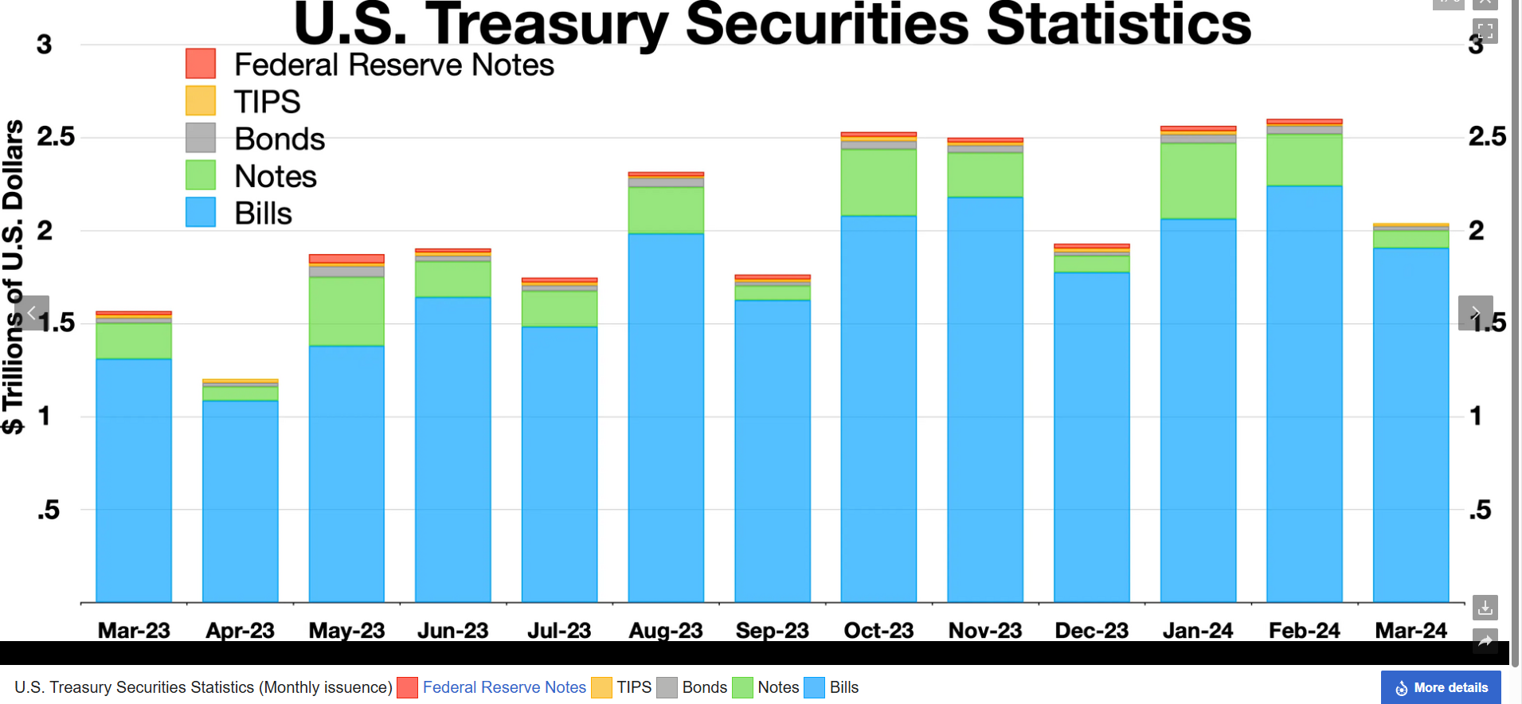
Treasury securities
Treasury securities: influenced by FOMC rate decisions (e.g., inflation expectations), demand for safe assets, etc.
Treasury Statistics
Rate transmission steps
 | T-Bills | T-Notes | T-Bonds
Maturity | 4wk – 1Y | 2Y – 10Y | 20Y – 30Y
Coupon | Zero-coupon | Semi-annual coupon | Semi-annual coupon
FOMC sets Fed Fund rate target
Eff Fed Fund Rate
SOFR
Treasury Security
Mortgage Rate
SOFR Futures
OIS Swaps

Slide 4
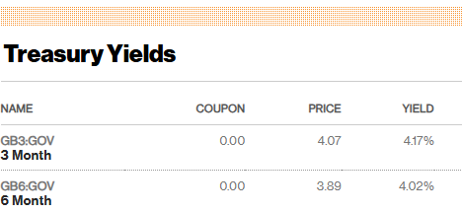

Treasury bill yield calculation*
Market quotes**
The “price”: discount rate
Price (assume face value = $100)
$$Price=100⋅\left(1−DiscountRate⋅\frac{Days to Maturity}{360}\right)$$
Yield
$$Yield=\frac{100−Price}{Price}⋅\frac{365}{Days to Maturity}$$
Note: we can also calculate discount rate using price
$$Discount Rate=\frac{100−Price}{100}⋅\frac{360}{Days to Maturity}$$
*: Treasury Calculation Examples 033104 v11.xls
**: United States Rates & Bonds - Bloomberg

Slide 5


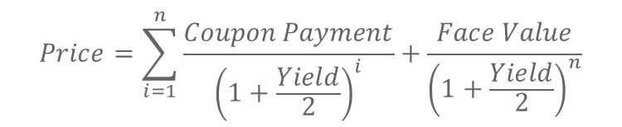
Treasury note yield calculation*
Market quotes
Price
Note: Coupon Payment is semi-annual coupon determined by coupon rate, e.g., for a 3.88% coupon, $Coupon Payment=3.88\%⋅\frac{100}{2}=1.94$; $n$ is number of semi-annual periods until maturity
$$Price=\sum_{i=1}^{n}{\frac{Coupon Payment}{{\left(1+\frac{Yield}{2}\right)}^{i}}}+\frac{Face Value}{{\left(1+\frac{Yield}{2}\right)}^{n}}$$

Slide 6
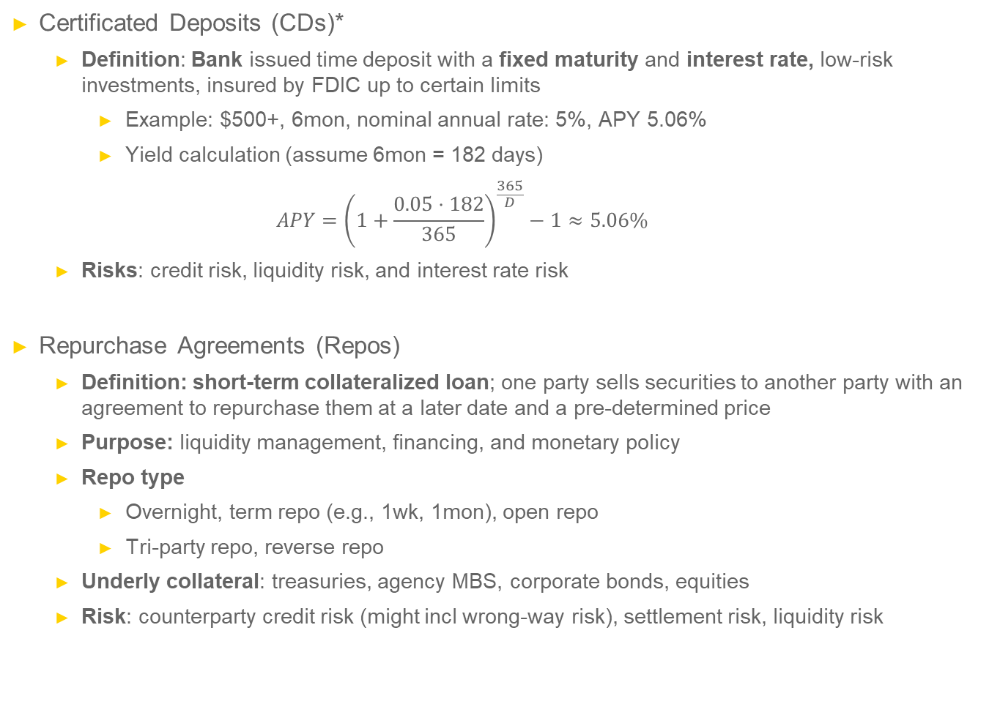
Other cash instruments
Certificated Deposits (CDs)*
Definition: Bank issued time deposit with a fixed maturity and interest rate, low-risk investments, insured by FDIC up to certain limits
Example: $500+, 6mon, nominal annual rate: 5%, APY 5.06%
Yield calculation (assume 6mon = 182 days)
$$APY={\left(1+\frac{0.05⋅182}{365}\right)}^{\frac{365}{D}}−1≈5.06\%$$
Risks: credit risk, liquidity risk, and interest rate risk
Repurchase Agreements (Repos)
Definition: short-term collateralized loan; one party sells securities to another party with an agreement to repurchase them at a later date and a pre-determined price
Purpose: liquidity management, financing, and monetary policy
Repo type
Overnight, term repo (e.g., 1wk, 1mon), open repo
Tri-party repo, reverse repo
Underly collateral: treasuries, agency MBS, corporate bonds, equities
Risk: counterparty credit risk (might incl wrong-way risk), settlement risk, liquidity risk

Slide 7
Other cash instruments (cont’)
Municipal bonds (Munis)
Definition: Debt securities issued by states, cities, and other local entities
usually tax-exempt at federal level, sometimes at state levels
Purpose: Financing infrastructure, transportation, schools, etc.
Type
General Obligations (GO) bonds: back by taxing power of issuing municipality
Revenue bonds: back by revenues from a specific project (e.g., toll roads)
Risk: credit risk, market risk, liquidity risk, interest rate risk
Corporate bonds
Definition: Debt securities issued by a corporation
Purpose: raise capital for various purposes (e.g., M&A)
Type
By seniority: secured, unsecured, subordinated
By rating: IG/HY
By embedded options: callable, puttable, convertible
Risk: credit risk, market risk, liquidity risk, interest rate risk

Slide 8

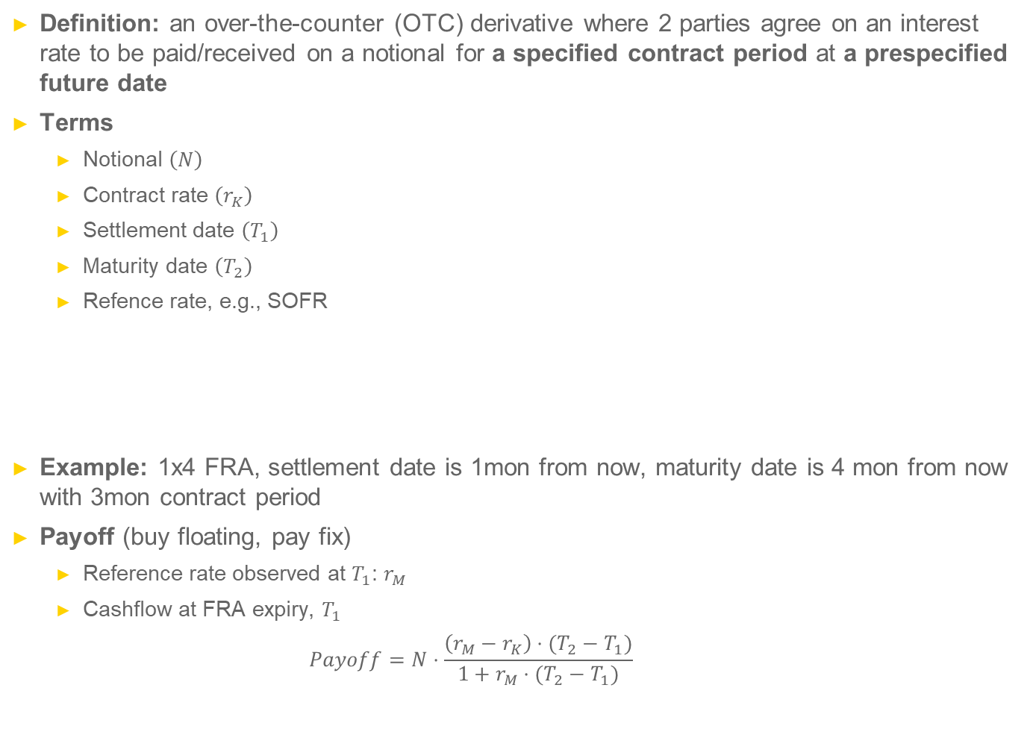


Derivatives – FRA
Definition: an over-the-counter (OTC) derivative where 2 parties agree on an interest rate to be paid/received on a notional for a specified contract period at a prespecified future date
Terms
Notional $\left(N\right)$
Contract rate $\left(r_{K}\right)$
Settlement date $\left(T_{1}\right)$
Maturity date $\left(T_{2}\right)$
Refence rate, e.g., SOFR
Example: 1x4 FRA, settlement date is 1mon from now, maturity date is 4 mon from now with 3mon contract period
Payoff (buy floating, pay fix)
Reference rate observed at $T_{1}$: $r_{M}$
Cashflow at FRA expiry, $T_{1}$
$$Payoff=N⋅\frac{\left(r_{M}−r_{K}\right)⋅(T_{2}−T_{1})}{1+r_{M}⋅(T_{2}−T_{1})}$$
contract period
Trade date $(0)$
Settlement date $\left(T_{1}\right)$
Maturity date $\left(T_{2}\right)$

Slide 9
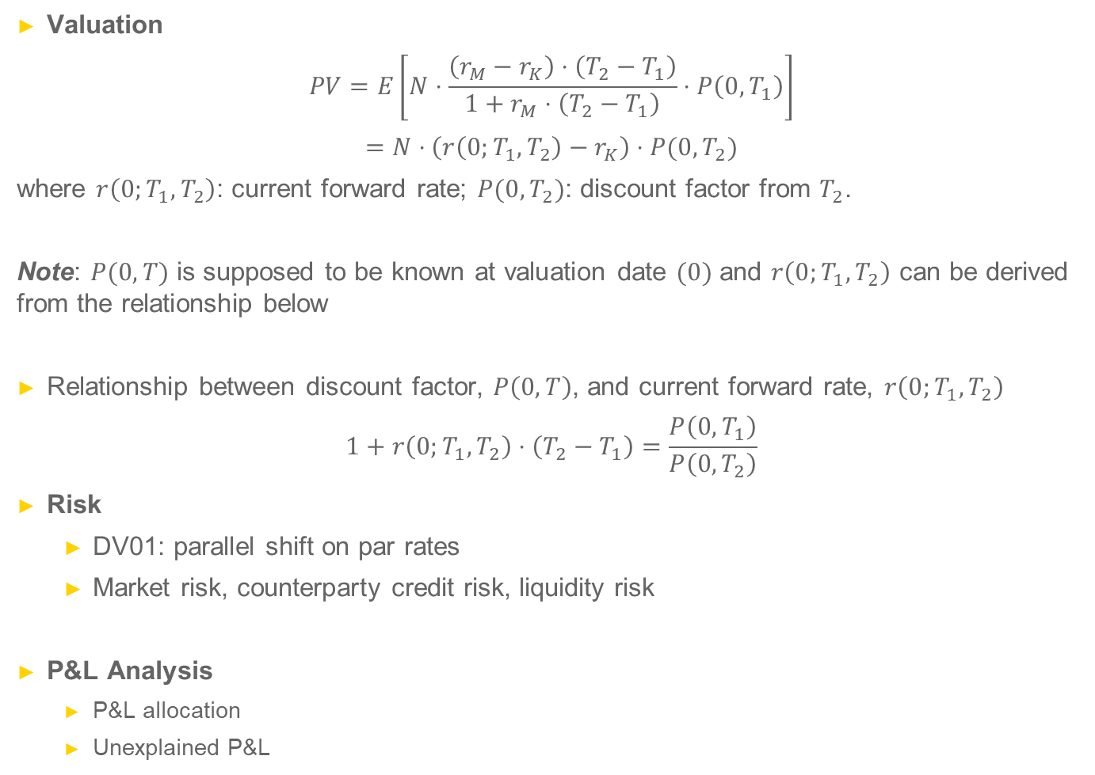
Derivatives – FRA (cont’)
Valuation
$$PV=E\left[N⋅\frac{\left(r_{M}−r_{K}\right)⋅\left(T_{2}−T_{1}\right)}{1+r_{M}⋅\left(T_{2}−T_{1}\right)}⋅P\left(0,T_{1}\right)\right]$$
$$=N⋅\left(r\left(0;T_{1}, T_{2}\right)−r_{K}\right)⋅P(0,T_{2})$$
where $r\left(0;T_{1}, T_{2}\right)$: current forward rate; $P(0,T_{2})$: discount factor from $T_{2}$.
Note: $P(0,T)$ is supposed to be known at valuation date $(0)$ and $r\left(0;T_{1}, T_{2}\right)$ can be derived from the relationship below
Relationship between discount factor, $P\left(0,T\right)$, and current forward rate, $r\left(0;T_{1}, T_{2}\right)$
$$1+r\left(0;T_{1},T_{2}\right)⋅\left(T_{2}−T_{1}\right)=\frac{P\left(0,T_{1}\right)}{P\left(0,T_{2}\right)}$$
Risk
DV01: parallel shift on par rates
Market risk, counterparty credit risk, liquidity risk
P&L Analysis
P&L allocation
Unexplained P&L

Slide 10
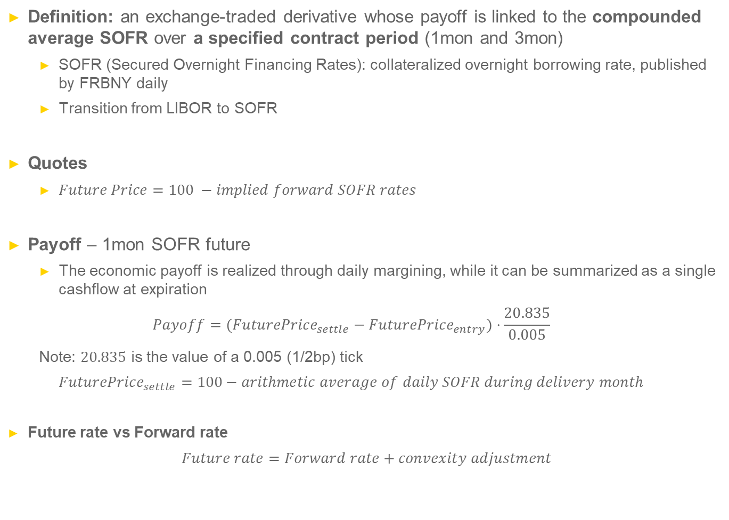
Derivatives – SOFR futures*
Definition: an exchange-traded derivative whose payoff is linked to the compounded average SOFR over a specified contract period (1mon and 3mon)
SOFR (Secured Overnight Financing Rates): collateralized overnight borrowing rate, published by FRBNY daily
Transition from LIBOR to SOFR
Quotes
$Future Price=100 −implied forward SOFR rates$
Payoff – 1mon SOFR future
The economic payoff is realized through daily margining, while it can be summarized as a single cashflow at expiration
$$Payoff=(FuturePrice_{settle}−FuturePrice_{entry})⋅\frac{20.835}{0.005}$$
Note: $20.835$ is the value of a 0.005 (1/2bp) tick
$$FuturePrice_{settle}=100−arithmetic average of daily SOFR during delivery month$$
Future rate vs Forward rate
$$Future rate=Forward rate+convexity adjustment$$
*: Understanding SOFR Futures - CME Group

Slide 11

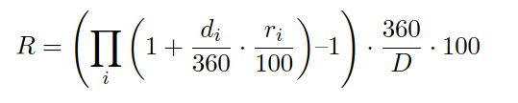
Derivatives – SOFR futures (cont’)
SOFR 3-month Future
SOFR 1-month Future
Trading Unit: Compounded daily Secured Overnight Financing Rate (“SOFR”) interest during contract Reference Quarter, such that each basis point per annum of interest = $25 per contract. Reference Quarter: For a given contract, interval from (and including) 3rd Wed of 3rd month preceding Delivery Month, to (and not including) 3rd Wed of Delivery Month.
Notional: N.
Price Basis: Contract-grade IMM Index: 100 minus R. R is the compounded daily SOFR interest during contract Reference Quarter.
Delivery: Cash settlement, by reference to Final Settlement Price, on ﬁrst US government securities market business day following Last Day of Trading.
Delivery month: Nearest 20 March Quarterly months
Final Settlement Price: Contract-grade IMM Index evaluated on the basis of realized SOFR values during contract Reference Quarter
Trading Unit: Average daily SOFR interest during futures contract delivery month.
Notional: N.
Price Basis: Contract-grade IMM Index: 100 minus R. R is the compounded daily SOFR interest during contract Reference Quarter.
Delivery: Cash settlement, by reference to Final Settlement Price, on ﬁrst US government securities market business day following Last Day of Trading.
Delivery month: Nearest 7 calendar months
Final Settlement Price: Contract-grade IMM Index evaluated on the basis of realized SOFR values during contract Reference month

Slide 12
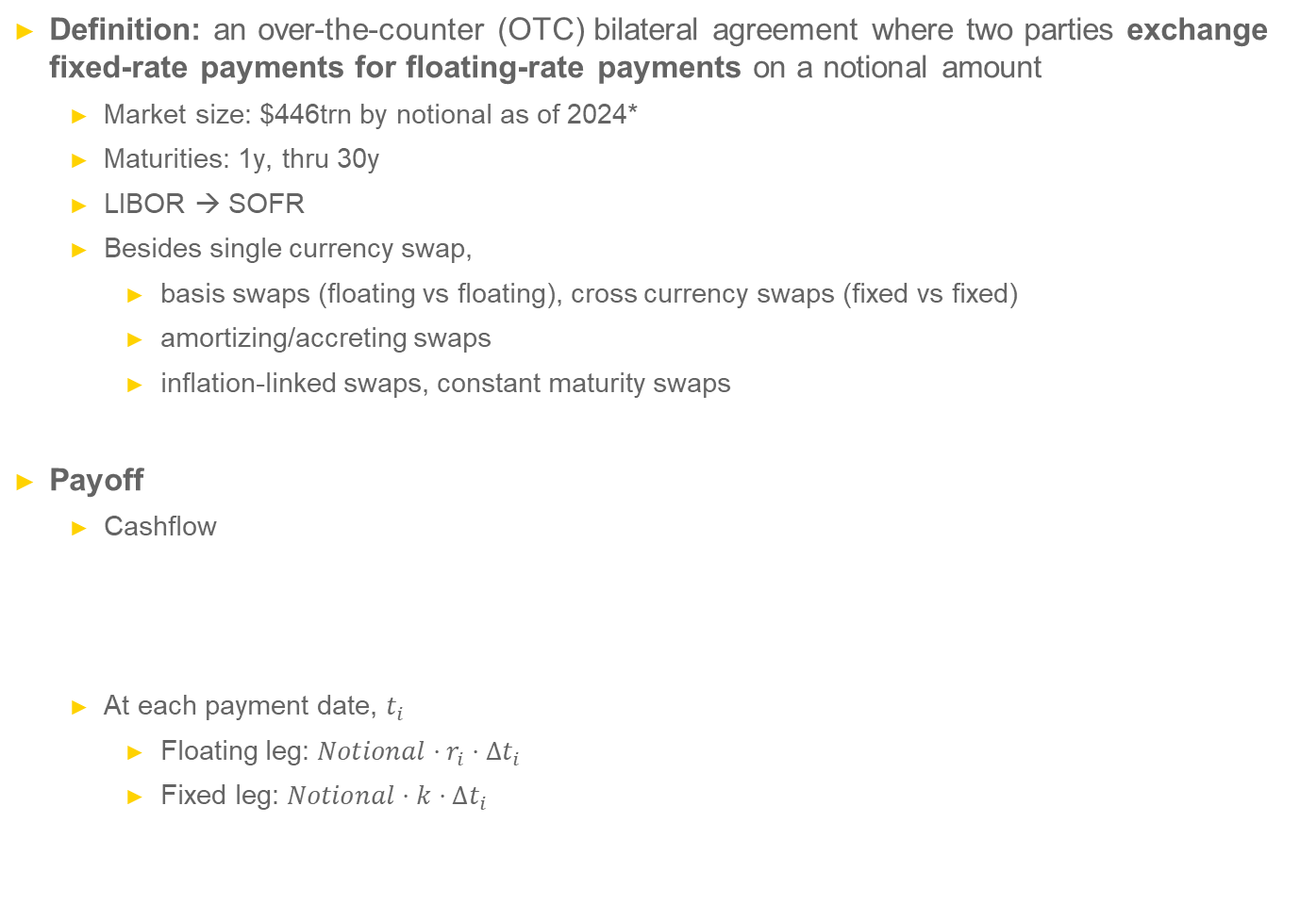
Derivatives – Interest rate swaps (IRS)
Definition: an over-the-counter (OTC) bilateral agreement where two parties exchange fixed-rate payments for floating-rate payments on a notional amount
Market size: $446trn by notional as of 2024*
Maturities: 1y, thru 30y
LIBOR → SOFR
Besides single currency swap,
basis swaps (floating vs floating), cross currency swaps (fixed vs fixed)
amortizing/accreting swaps
inflation-linked swaps, constant maturity swaps
Payoff
Cashflow
At each payment date, $t_{i}$
Floating leg: $Notional⋅r_{i}⋅Δt_{i}$
Fixed leg: $Notional⋅k⋅Δt_{i}$
Party A
Floating leg
Party B
Fixed leg
*: OTC derivatives statistics - tables | BIS Data Portal

Slide 13
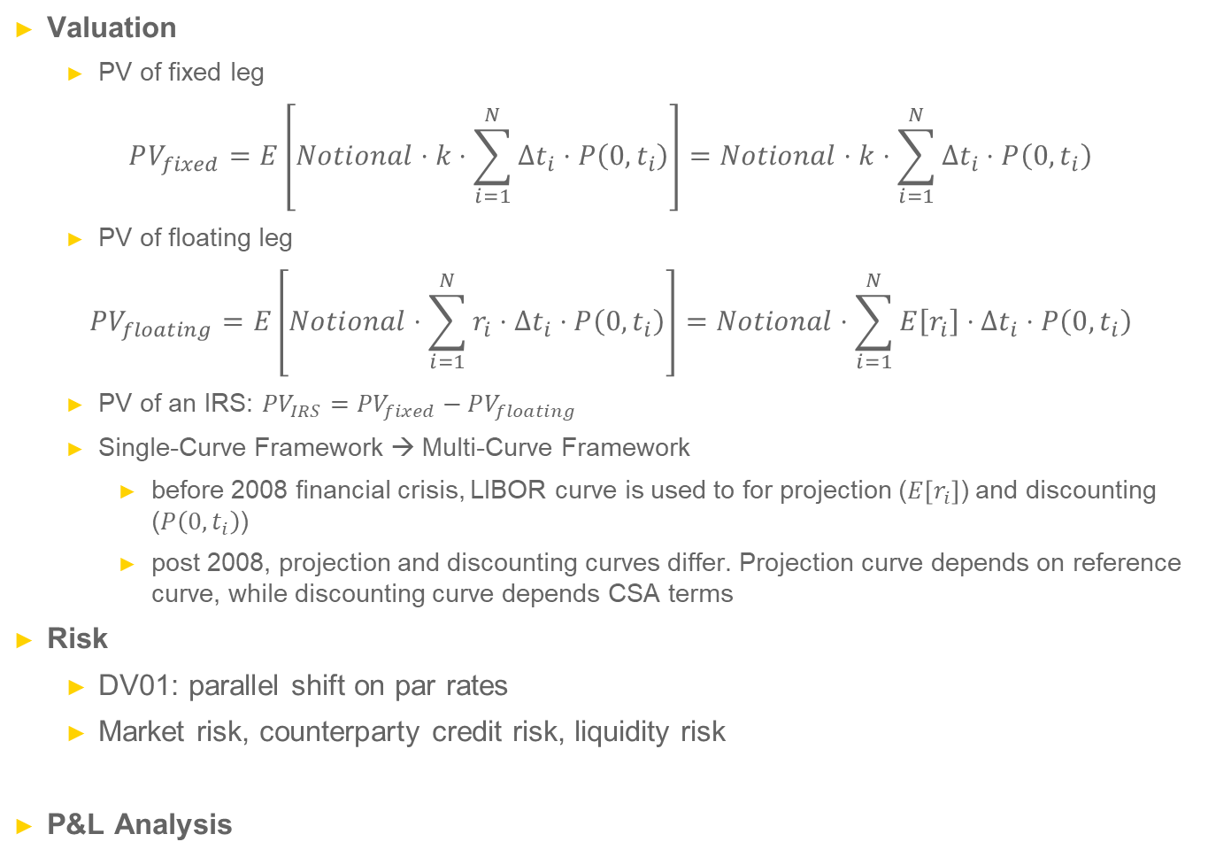
Derivatives – Interest rate swaps (cont’)
Valuation
PV of fixed leg
$$PV_{fixed}=E\left[Notional⋅k⋅\sum_{i=1}^{N}{Δt_{i}⋅P\left(0,t_{i}\right)}\right]=Notional⋅k⋅\sum_{i=1}^{N}{Δt_{i}⋅P\left(0,t_{i}\right)}$$
PV of floating leg
$$PV_{floating}=E\left[Notional⋅\sum_{i=1}^{N}{r_{i}⋅Δt_{i}⋅P\left(0,t_{i}\right)}\right]=Notional⋅\sum_{i=1}^{N}{E\left[r_{i}\right]⋅Δt_{i}⋅P\left(0,t_{i}\right)}$$
PV of an IRS: $PV_{IRS}=PV_{fixed}−PV_{floating}$
Single-Curve Framework → Multi-Curve Framework
before 2008 financial crisis, LIBOR curve is used to for projection ($E\left[r_{i}\right]$) and discounting ($P\left(0,t_{i}\right)$)
post 2008, projection and discounting curves differ. Projection curve depends on reference curve, while discounting curve depends CSA terms
Risk
DV01: parallel shift on par rates
Market risk, counterparty credit risk, liquidity risk
P&L Analysis

