Slide 1
Backtesting CCR Models
Recommended Practices for Distribution Testing

Slide 2
Outline
Background and Motivation
Concepts
Backtest Design
Alternative Methods
Recommendations
Appendix and Demos

Slide 3
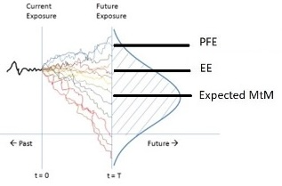
Background: Motivation
In CCR, the Exposure is the amount that a trade is in your favor.
Exposures are always positive.
A family of metrics measure the risk.

Slide 4
Background: Motivation
PFE
Potential Future Exposure
The VaR amount of the exposure.

Slide 5
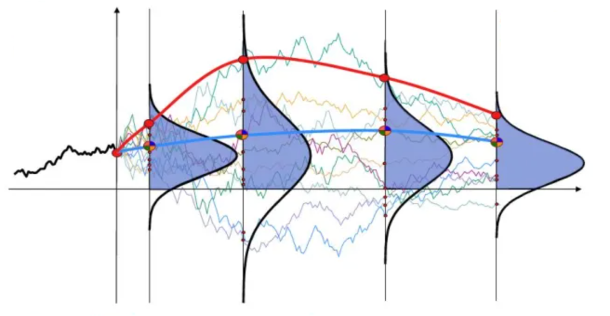

Background: Motivation
EE
Expected Exposure
E(X | X > 0 )
CVA$=LGD ×\sum{PDi × EEi }$

Slide 6
Background: Motivation
EMtM
Expected Mark to Market
Expected value of the trade.
Identifies drift and collateral.

Slide 7
Background: VaR Backtesting
Basel supervisory framework for the use of “Backtesting” 1996
Given VaR(α) and K observed exceedances of (1- α) out of n
P(K) ~ Binomial(n,1- α)
Acceptance / Rejection
P-Value > 5% Green
P-Value > 0.01% Amber
P-Value < 0.01% Red

Slide 8
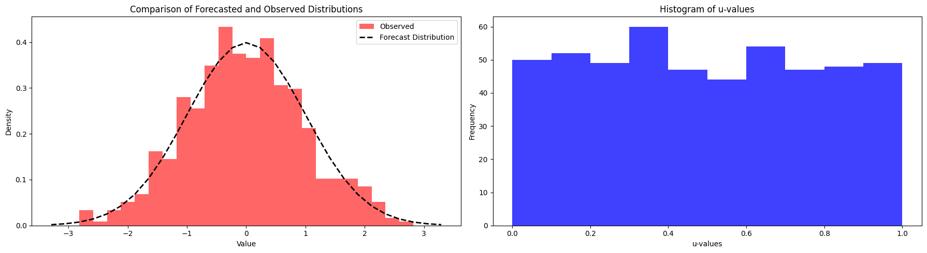
Comparing Distributions
If the distribution of the observations is the same as the forecast distribution, samples from the observations should uniformly span percentiles of the forecast distribution.

Slide 9
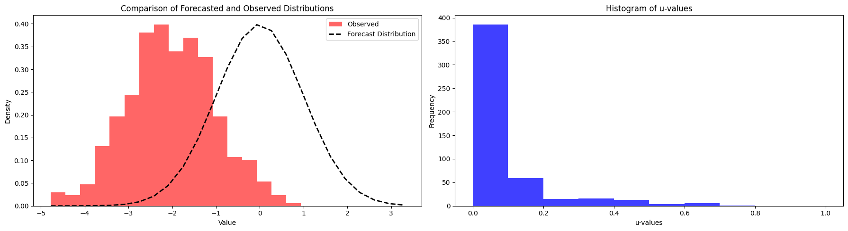
Concepts: Comparing Distributions
If the distribution of the observations is the same as the forecast distribution, samples from the observations should uniformly span percentiles of the forecast distribution.

Slide 10
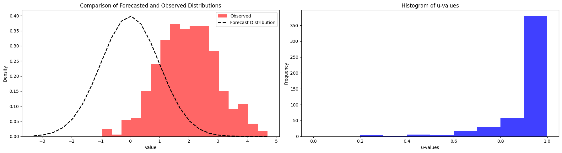
Concepts: Comparing Distributions
If the distribution of the observations is the same as the forecast distribution, samples from the observations should uniformly span percentiles of the forecast distribution.

Slide 11
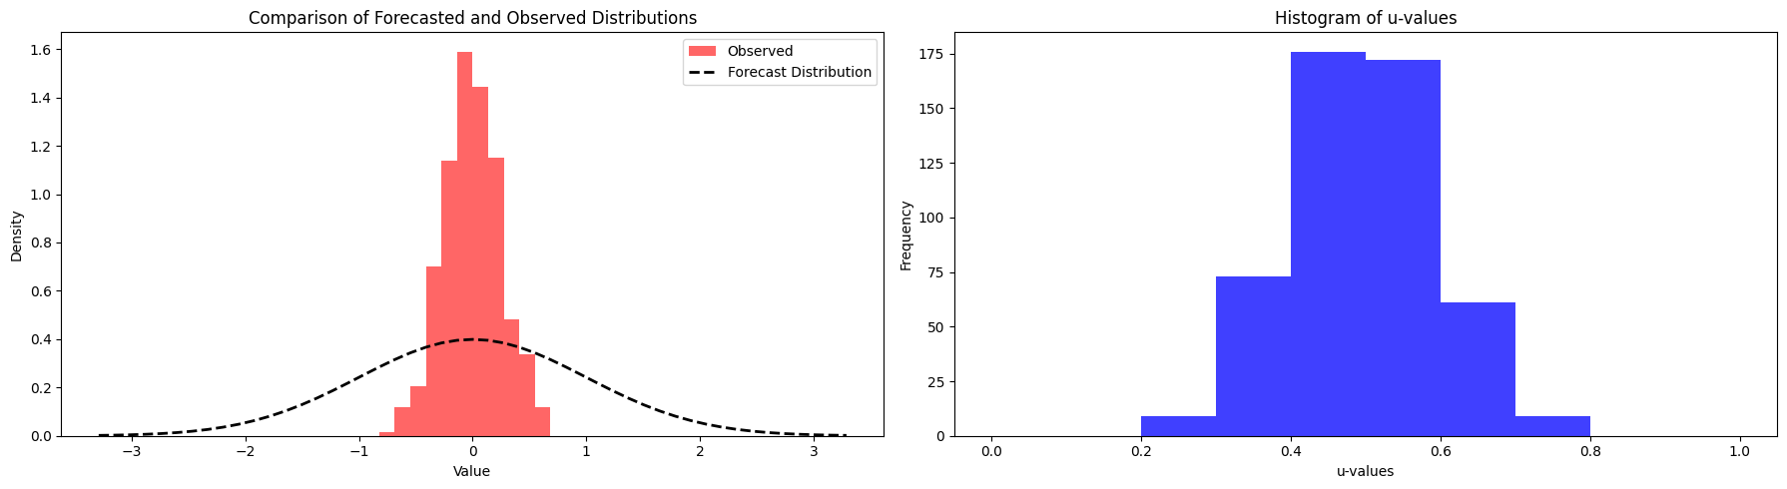
Concepts: Comparing Distributions
If the distribution of the observations is the same as the forecast distribution, samples from the observations should uniformly span percentiles of the forecast distribution.

Slide 12
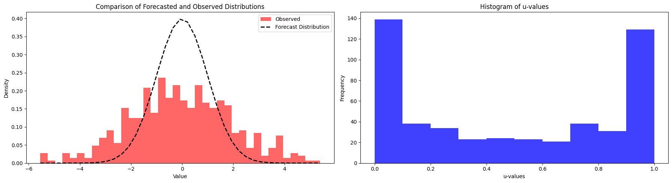
Concepts: Comparing Distributions
If the distribution of the observations is the same as the forecast distribution, samples from the observations should uniformly span percentiles of the forecast distribution.

Slide 13
Concepts: Comparing Distributions
We want a uniform distribution.
How do we measure that?

Slide 14
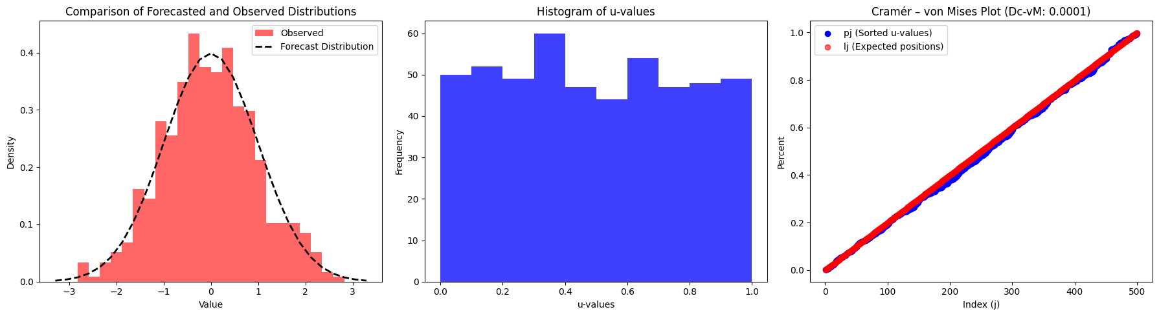
Concepts: Testing Uniformity

Slide 15
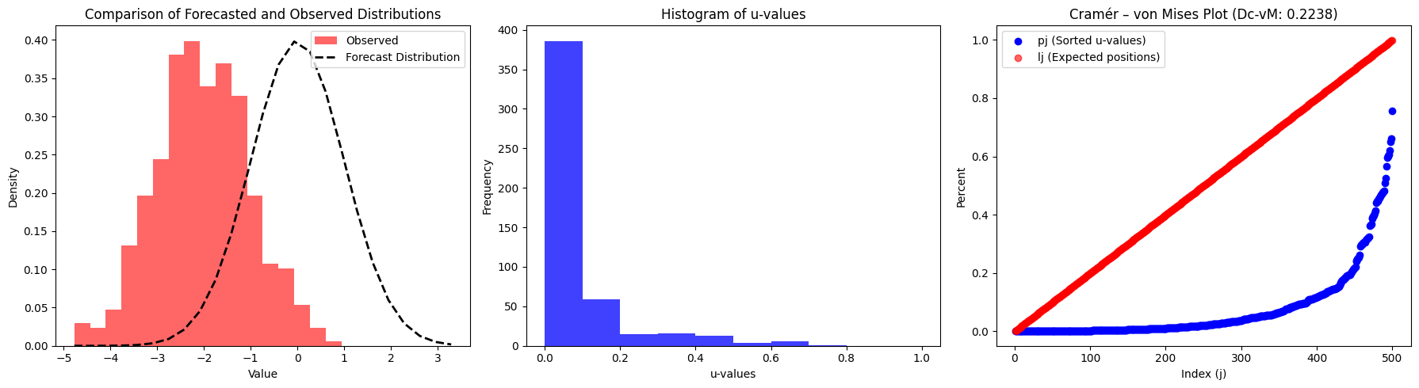
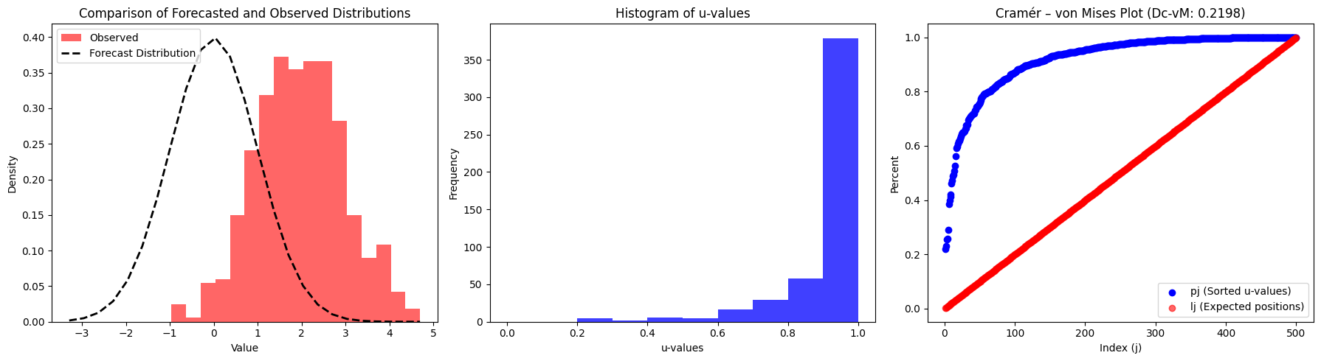
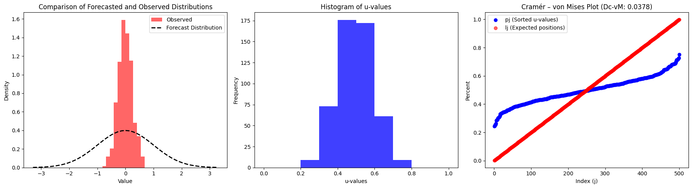
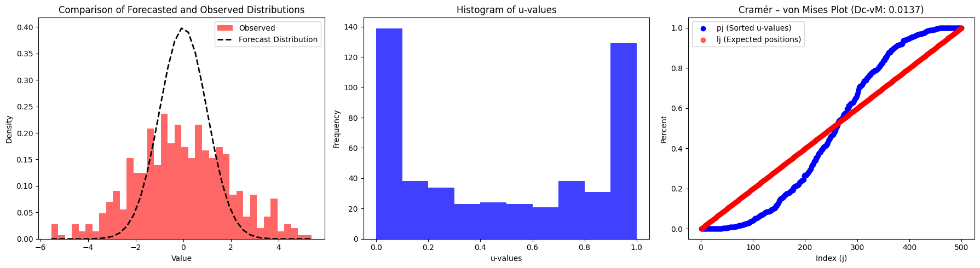
Concepts: Testing Uniformity

Slide 16
Concepts: Testing Uniformity
Steps:
Get the average of squared deviations
1/N * [ Σ (p_{j} – l_{j})² + 1/12N ]
Cramer – von Mises
Use a hypothesis testing distribution
Tables
Simulation
Accept or reject sameness of the distributions
P-Value > 5% Green
P-Value > 0.01% Amber
P-Value < 0.01% Red

Slide 17
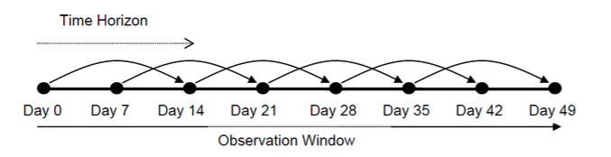
Backtest Design
Observation window: period over which data is aggregated
Time horizon: time between initialization and realization
Initialization points: date when forecast is made

Slide 18
Backtest Design: Adjusting Significance Tests
For backtests with overlapping initializations …
Observations are no longer independent.
The distribution of the D_{c-vM} test statistic must be adjusted.
Use simulation to make a new testing distribution.
Generate factor paths with daily observations
Run the backtest method on the generated paths
Collect the test statics D_{c-vM} from each path to create a distribution

Slide 19
Backtest Design
Observation window: 49
Time horizon: 14
Initialization points: 6 points, 7-day step

Slide 20
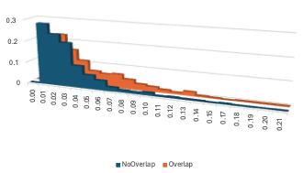
Backtest Design
Observation window: 49
Time horizon: 14
Initialization points: 6 points
Simulate daily with GBM
Observe distribution of C-vM

Slide 21
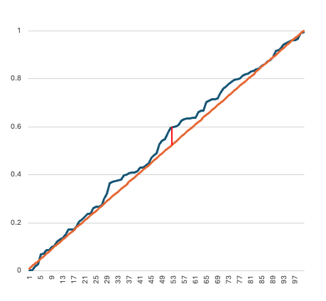
Alternative Approaches: KS
The Kolmogorov-Smirnov test focuses on the largest deviation between two distributions.
Not flexible enough to adjust for overlapping initialization points.
Requires more data points.

Slide 22
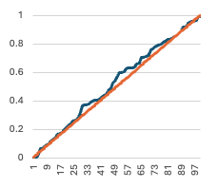
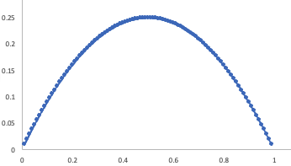
Alternative Approaches: AD
The Anderson-Darling test focuses on tails.
Divides the CvM Score by F(x)*(1-F(x))

Slide 23
Recommendations
Backtest every 6 months
Backtest at different horizons
1 day, 1 week, 2 weeks, 1 month, 3 months, 6 months,1 year
Use Cramer – von Mises test statistic
Simulate statistical test distributions for overlapping horizons
Use at least 100 observations for the statistical tests

Slide 24
Appendix
Links to interactive Python demos and Excel workbooks
Methodology for Cramer – von Mises Test Statistic calculation.
References

Slide 25
Questions

Slide 26
Appendix: Demos
Python Interactive Demo in Google Colab
Excel Demo Download – CvM Calculations
Excel Demo Download – CvM Simulations

Slide 27
Appendix: Methodology
Generate 1000 simulations of the forecast distribution
Sort the simulations, s, in ascending order and let s_{i} denote the simulation at index i
Convert each observation to a u value
u = [ i + (obs – s_{i})/(s_{i+1} – s_{i}) ] / 1000
If obs < s₁, let u = 0
If obs > s₁₀₀₀, let u = 1
Sort the u values and re-label them as p_{j} where j denotes the index
For each pj, it’s corresponding expected distance on the line lj is
l_{j} = (2j – 1) / 2n where N is the number of realized observations
Calculate the overall distance score, D_{c-vM}
D_{c-vM} = 1/N * [ 1/12N + Σ (p_{j} – l_{j})² ]
The 1/12N is a mathematical adjustment that can be ignored
Identify P-value of D_{c-vM}
Tables
Simulation

Slide 28
References
Basel Committee, "Sound practices for backtesting counterparty credit risk models," Basel, 2010.
Basel Committee, "Supervisory framework for the use of "backtesting" in conjunction with the [IMA …]," 1996.
I. Ruiz, "Backtesting Counterparty Risk: How Good is your Model?," working paper, 2012.
F. James, Statistical Methods in Experimental Physics: 2nd Edition, World Scientific Publishing Co., 2006.
"Overlapping Returns for Risk Measurement," MSCI Research, 2014.
"Backtesting counterparty credit risk models," MSCI Research, 2020.
M. Hayes, "Managing risk-model uncertainty through a crisis," MSCI Blog post, 2020.

