Slide 1
The Social Cookbook
David Rutqvist
Erik Halén

Slide 2
User Problem
Simple portal to share everyday food recipes
Food inspiration
Recipe feed
Notes:
The idea is to create a simple portal for users to share food recipes of their everyday meal.
This since often you need inspiration when going grocery shopping.
Since the recipes are presented using a feed you get a quick overview of seasonal recipes.

Slide 3









Server Architecture
Internet
DMZ
API dev
Frontend dev
API prod
Frontend prod
Database

Slide 4



Automation
1. Developer pushes changes
~30 seconds
2. GitHub Webhook
3. Jenkins pulls repo
6. Triggers update of development container at host
7. Pulls new image from private registry
4. Jenkins builds Docker image
5. Jenkins pushes image to private registry

Slide 5
System Architecture
Frontend (what the user sees) | Backend | API | Database
User makes request User sees result | Incoming request is mapped to a REST request REST response is mapped to a view and sent to the browser | Actual request is handled REST response | CRUD of Data

Slide 6
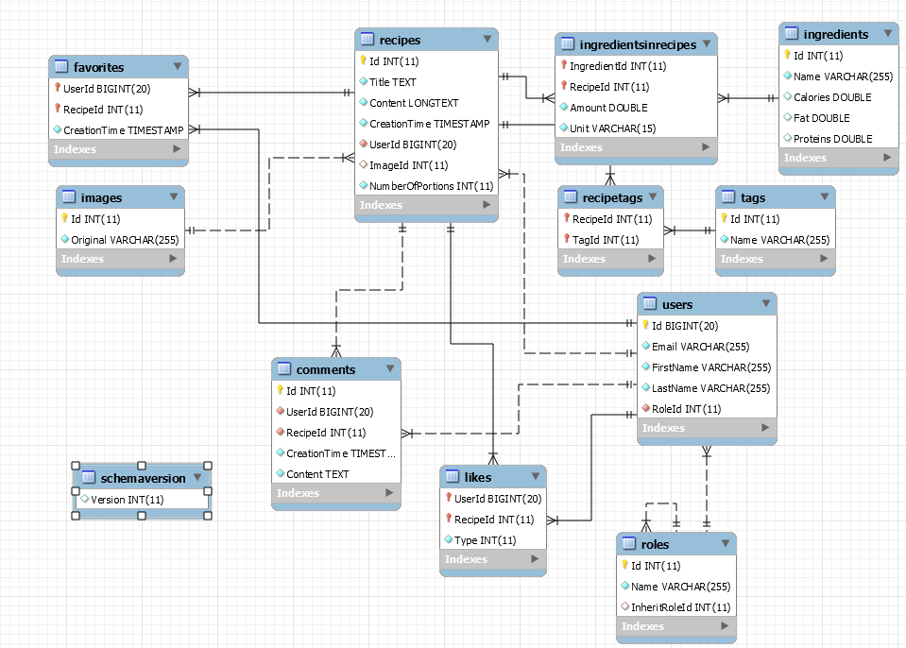
Database Design

Slide 7
Current Status
90 % of the functionality is implemented in the front end (99 % is implemented in the back end)
Missing parts now are like (yum/yuck)
View user
Set user as admin
Some security issues (validation of input)

Slide 8
Demonstration
http://cookbook.rutqvist.com

Slide 9
Future Work
Nutrition data for ingredients
Related recipes
“What have you cooked today?”
Suggestions
Followers / Friends
Search (by tag and content using for example Lucene)

Slide 10
Questions?

