Slide 1
Auto Stock
Student: David Ryan Student Number: 20052274
WebServer Programming Assignment

Slide 2
Topic
This application is a stock ordering system for an auto factor shop. The main aim of the system is to allow a employee make sales to the customer, generate invoices in both web and printable format, add parts to the system and alert the employee when the stock is running low for a particular part.

Slide 3
List of Features
Login & Logout Functionality
Register Customer & Employee
Create a Part for a specific make and model
View Part Catalogue
Create an order.
Cart functionality
View pending invoice

Slide 4
List of Features Cont…
Update the part model with cart id
Update the stock model when part sold
Total price and vat calculation for invoice
Stock Level warning
Site styling with Twitter bootstrap
Session management for cart and user with cookies
Multiple Association Types

Slide 5
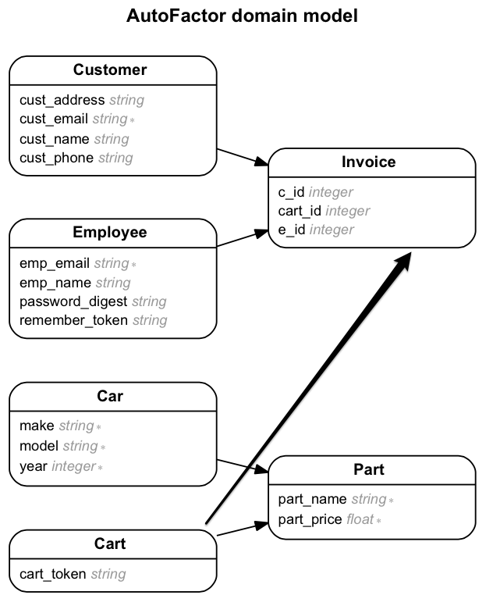

Slide 6
Extra Features
Download Pdf of the invoice
Heroku Hosted URL: https://autostock.herokuapp.com/
Git practiced
Ajax calls to update Part catalogue

Slide 7
Screen shots
The next few slides contain screenshots of some of the key areas of the site.
Register Employee Page
Home Page
Register Customer Page
Catalog Page
Catalog Page Expanded
Create Part Page
Create Part Page Expanded
Create Order Page
View Invoice Invoice
Invoice Pdf

Slide 8
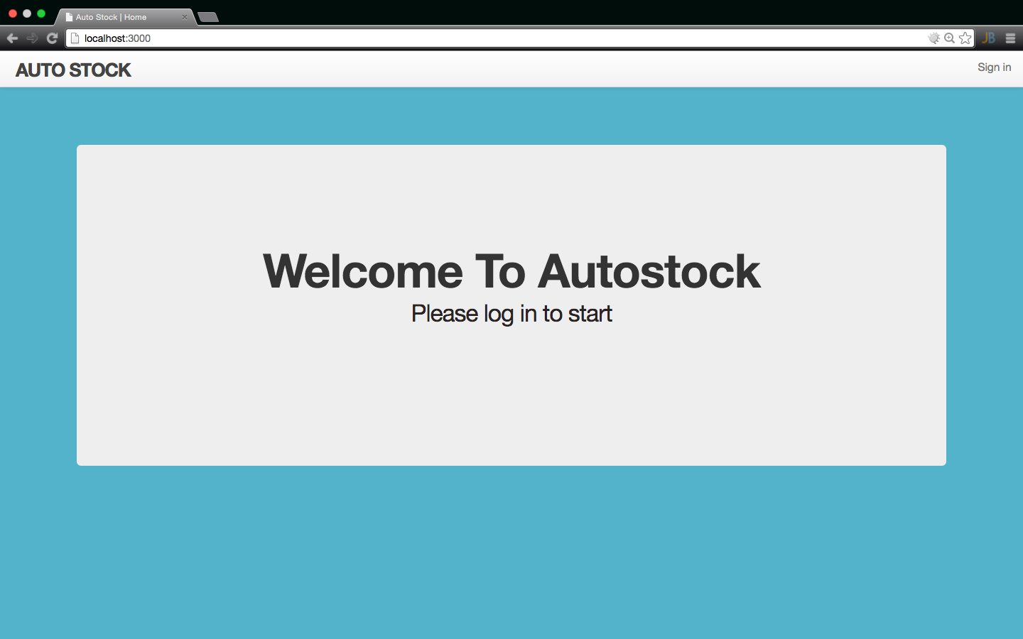
Home Page

Slide 9
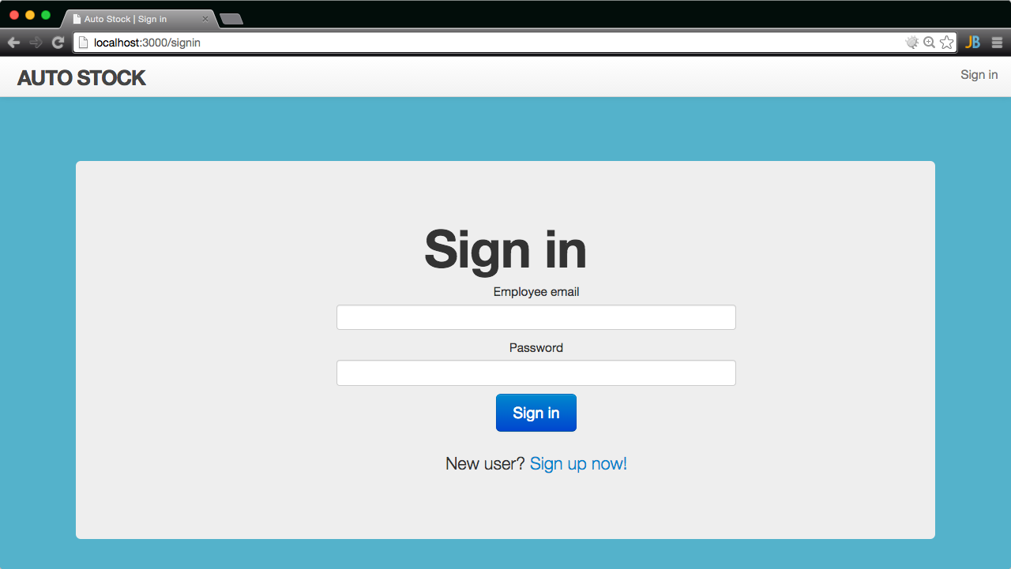
Sign in Page

Slide 10
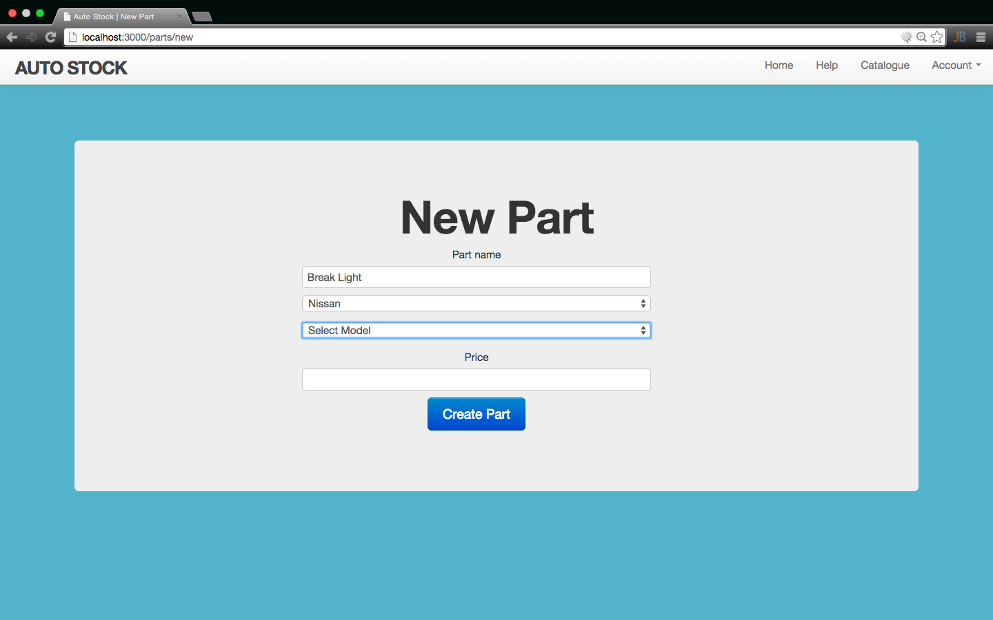
New Part Page

Slide 11
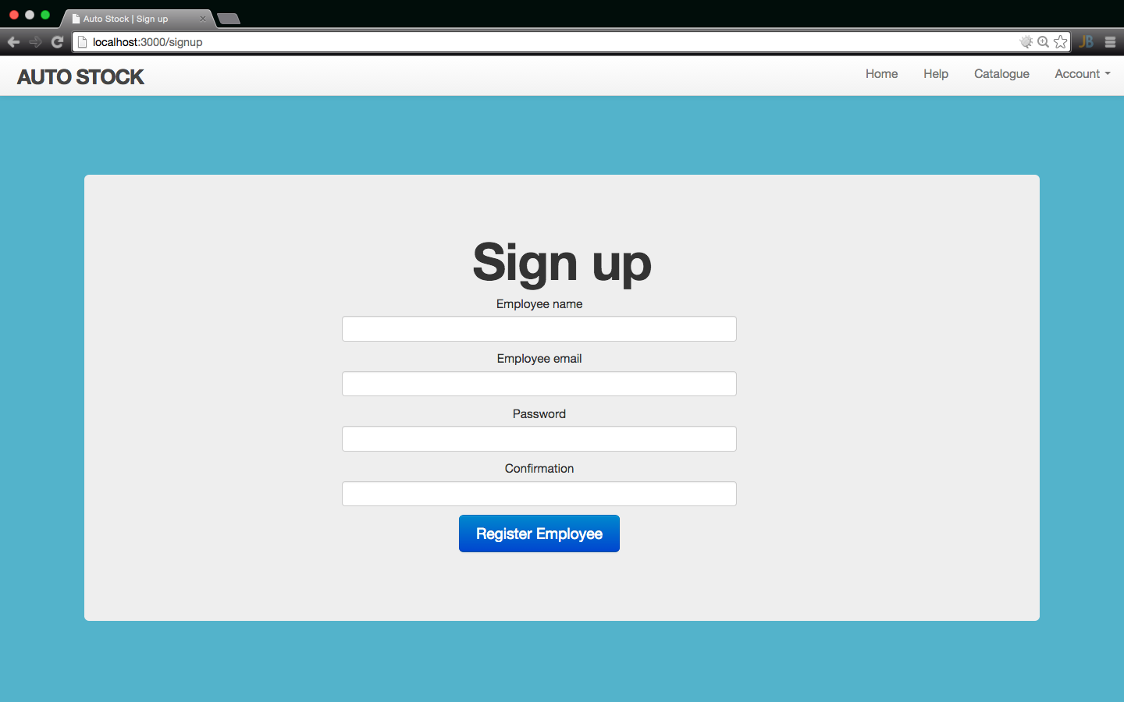
Sign Up Page

Slide 12
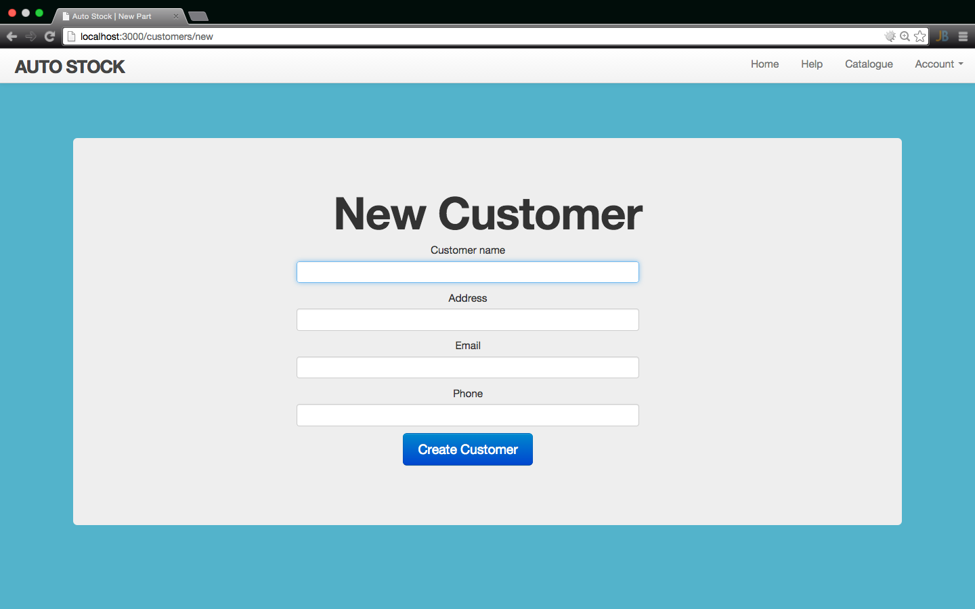
New Customer Page

Slide 13
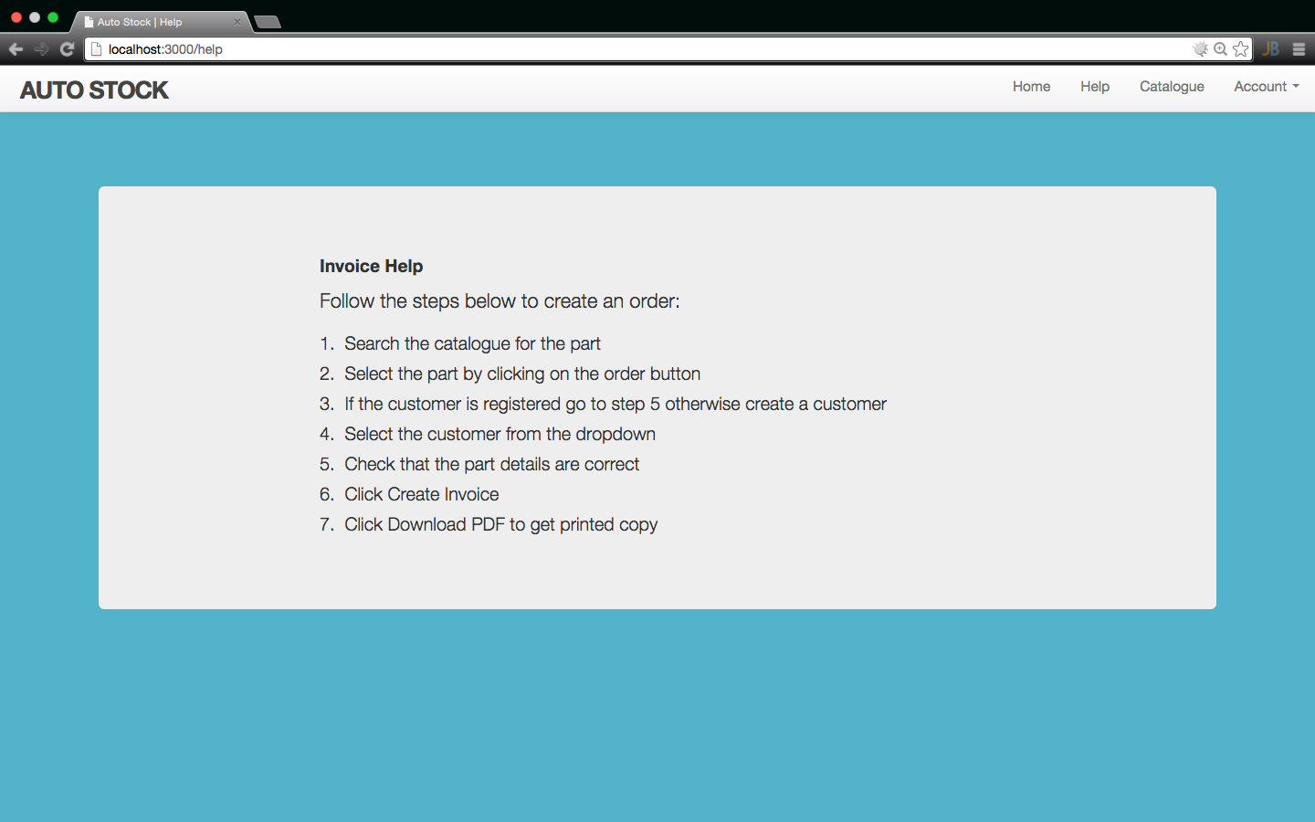
Help Page

Slide 14
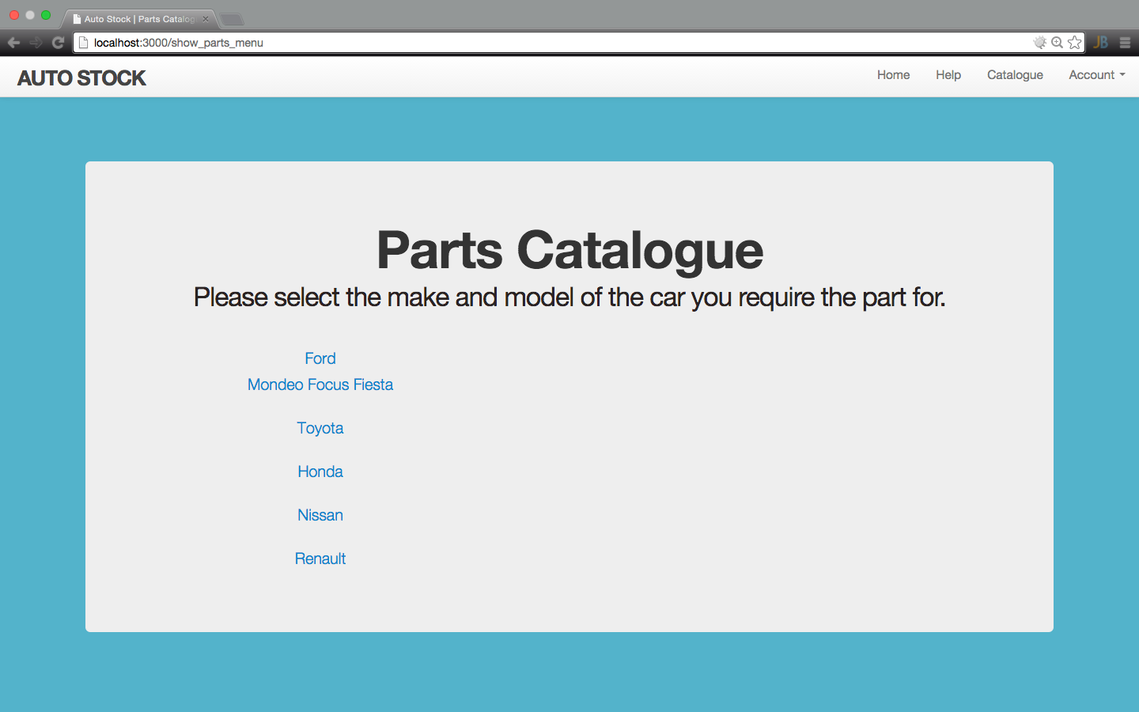
Part Catalogue Menu Page

Slide 15
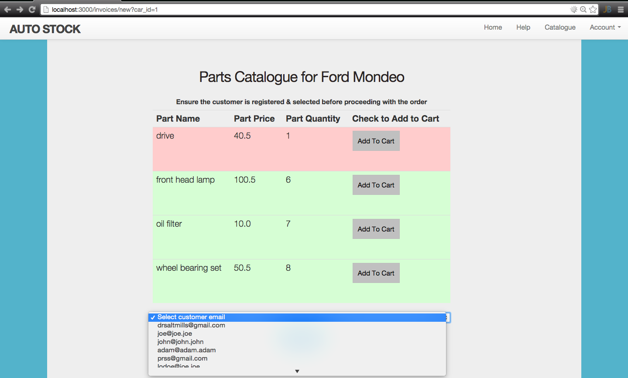
Order Parts Page

Slide 16
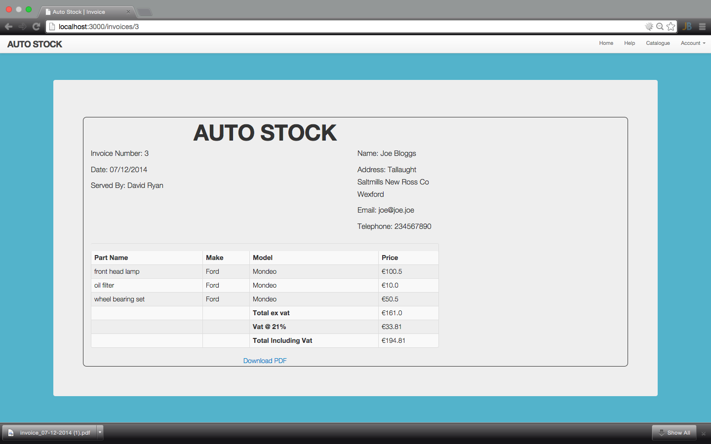
Invoice Page

Slide 17
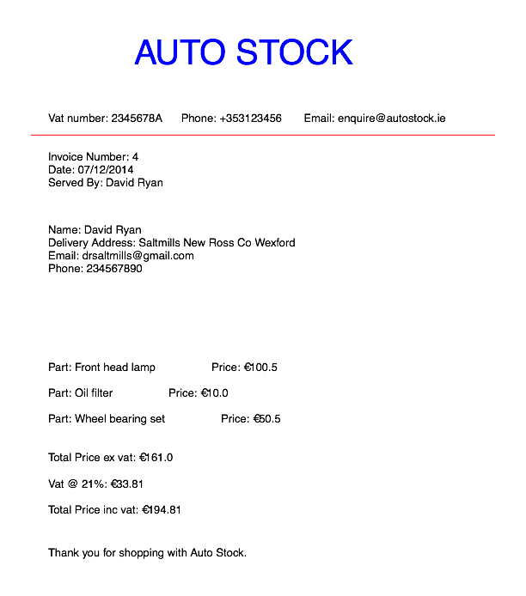
PDF version of the invoice in the previous slide

