Slide 1
antupy
by david saldivia salazar
mechanical engineer, phd in renewable energy engineering

Slide 2
antupy
A python toolkit for (energy) engineering simulations.
antü-: sun in mapuzugun.
-py: python package.
influences:
SAM
EES
TRNSYS
solarPILOT
dependancies:
numpy
pandas (polars)
+
targets:
education
research

Slide 3
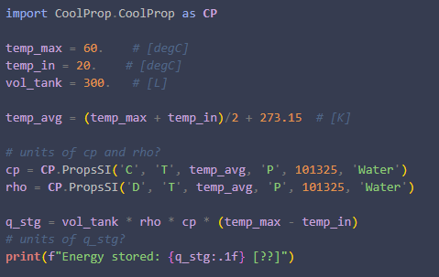
antupy
statement of need:
unit management.

Slide 4
antupy
statement of need:
simulation structure
glue code
multi-disciplinary research

Slide 5
antupy (0.6.0) architecture
core
catalog
Unit
Var
(float, str)
Array
(np.ndarray, str)
Frame
(pd.DataFrame, str)
csp
dwh
utils
desal
props
htc
solar
loc
+
stg
cycles
simulation
TSGs
chem
Model
Simulation / Plant
Parametric
Weather
Market
cold
HWD
Loads
+
+

Slide 6
antupy: core classes
Var:
Array:

Slide 7
antupy: utils
props:
htc:
solar:

Slide 8
antupy: simulations
Model:
Plant:
Parametric:
TSGs:
Weather
Market

Slide 9
existing implementations
med_fortran: desal (fortran, master’s code).
hdh (ees, usm research).
caes (ees, usm research).
tm_solarshift : dewh (python/trnsys, postdoc 1).
bdr_csp: csp (phd code).

Slide 10
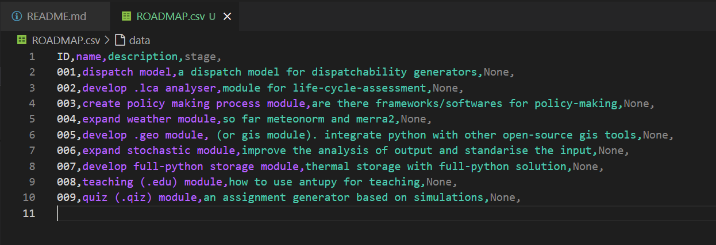

Slide 11
antupy wishlist
dispatch model
create life-cycle analysis (.lca) module
create policy making process module
expand weather module
geo module (or gis module). integrate python with other open-source gis tools.
expand stochastic module.
develop full python
education module

