Slide 1
antupy
by david saldivia salazar (et al.)*
mechanical engineer, phd in renewable energy engineering
*: r. taylor, a.bruce, b. yildiz, r. barraza, j. cardemil

Slide 2
antupy
some definitions.
what is antupy?
statement of need.
examples.
collaborate.

Slide 3
some important definitions
python
package
module
library
repository
script
: programming language.
: a set of related modules organized under one namespace.
: a single importable python code. usually a single file.
: it is reusable functionality, delivered through package/modules.
: it’s where the package/library lives and it is developed (git/github).
: a python file intended for direct use.

Slide 4
antupy: what is it?
a python toolkit to support (energy) engineering simulations.
latest version: 0.6.2
published in PyPI (pip). no yet in conda.
etymology:
antü-: sun in mapuzugun.
-py: python package.
influences:
SAM
EES
TRNSYS
solarPILOT
dependancies:
numpy
pandas (polars)
+
targets:
education
research

Slide 5
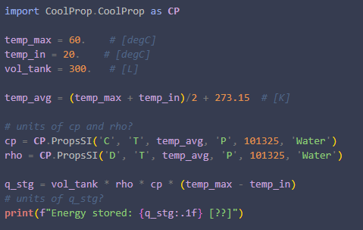
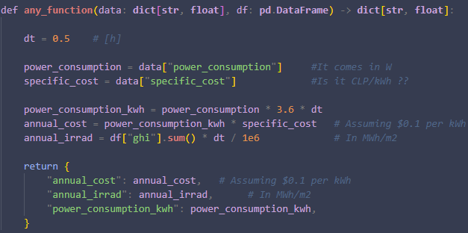
statement of need (why):
unit management:
“it would be good to incorporate the units in the variables themselves”

Slide 6
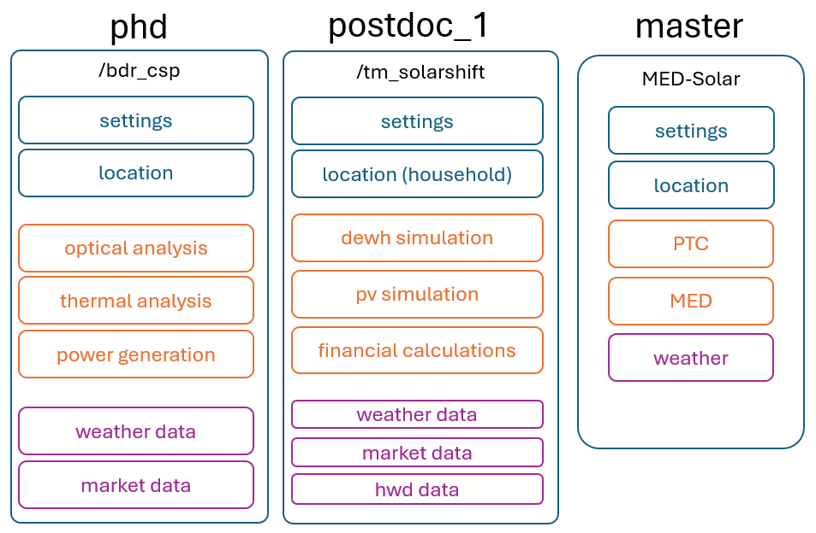
statement of need (why):
(thermal) energy simulations have common tasks:
“how to reuse functionality already implemented in other projects?”

Slide 7
antupy (0.6.0) architecture
core
catalog
Unit
Var
(float, str)
Array
(np.ndarray, str)
Frame
(pd.DataFrame, dict[str, str])
csp
dwh
utils
desal
props
htc
solar
loc
+
stg
cycles
simulation
TSGs
chem
Weather
Market
op
Model
Simulation / Plant
Parametric
refrig
HWD
Loads
dev
+
+
wish

Slide 8
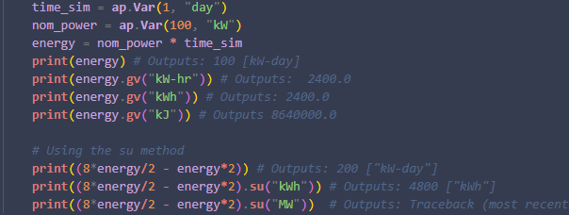
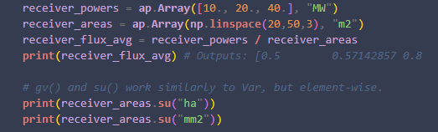
antupy: core classes
Var:
Array:
main attributes:
value: float (alias v)
unit: str (alias u)
main methods:
get_value(str) -> float (alias gv())
set_unit(str) -> Var|Array (alias su())
most arithmetical operations are valid between Var’s and Array’s (following the rules of floats and np.ndarray)

Slide 9
antupy: unit management system
what’s under the hood:
unit strings are converted into a base representation using a Unit class.
the base representation is a factor (float) and a dict[str, int] with exponents.
valid unit strings:
all seven SI base units plus “-” and “USD”.
all 22 derived SI units and +30 related units.
all units can be used with any of 22 SI prefixes (e.g.: k, M, T)
units can be combined by:
multiplication using hyphon (“-”). other symbols (*, x, etc.) are not allowed.
division using slash (“/”). only one slash per string.
exponentiation, using appending integers (e.g. “m2”). “^” is not supported.
parenthesis are not supported (yet)

Slide 10
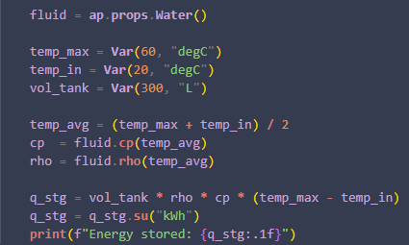
antupy: utils
props:
thermophysical properties for several fluids and materials.
based on CoolProp (wrapper) and other correlations.
htc: only some basic correlations are implemented.

Slide 11
existing implementations
bdr_csp: csp (my phd code).
tm_solarshift : dewh (python/trnsys, my first postdoc).
hopefully more in the future.

Slide 12
collaboration
github.com/DavidSaldivia/antupy

