Slide 1
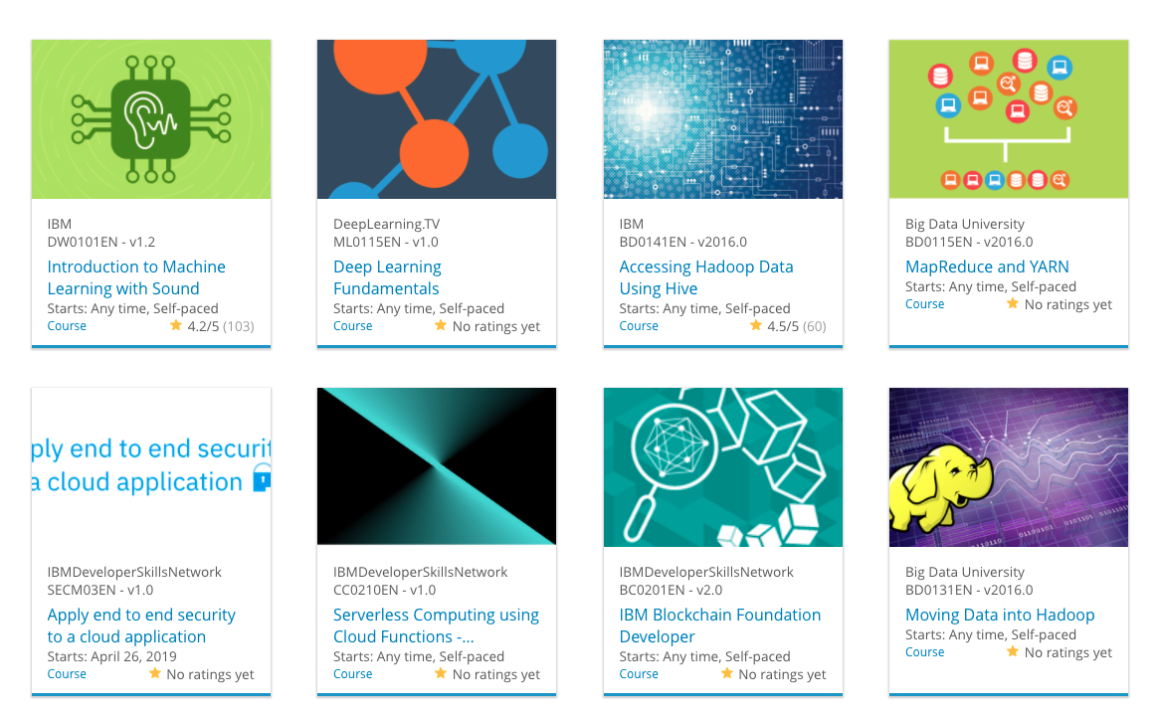

Build a Personalized Online Course Recommender System with Machine Learning
By David Satria Alamsyah
18 July 2025

Slide 2

Outline
Introduction and Background
Exploratory Data Analysis
Content-based Recommender System using Unsupervised Learning
Collaborative-filtering based Recommender System using Supervised learning
Conclusion
Appendix

Slide 3
Introduction
Project background:
Context: We are an ML team at AI Training Room, a rapidly growing MOOC platform with millions of global learners.
Goal: To develop a course recommender system to enhance the learning experience. This project is currently in the Proof of Concept (PoC) phase, focusing on offline model evaluation.
Problem Statement & Hypothesis:
Problem: With a massive and growing catalog, learners may find it difficult to discover new, relevant courses, potentially leading to decreased engagement.
Hypothesis: A personalized recommender system will improve course discovery and increase learner interaction, leading to better learning paths and potentially higher revenue.

Slide 4
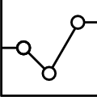
Exploratory Data Analysis

Slide 5
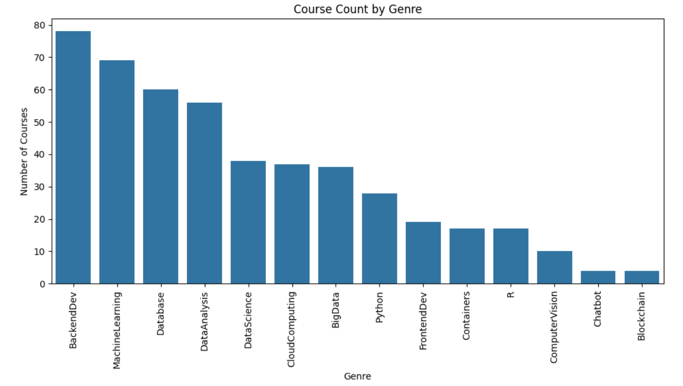
Course counts per genre
Web Development has the highest number of courses.
Machine Learning and Data Science are also dominant subjects.
Subjects like Blockchain and Cloud have fewer, more specialized courses.
Notes:
The bar chart illustrates the distribution of courses across different subjects. It's clear that our platform has a strong focus on Web Development and AI/Data Science, which likely reflects current market demand. This information can help guide the creation of new courses in underrepresented but high-potential areas.

Slide 6
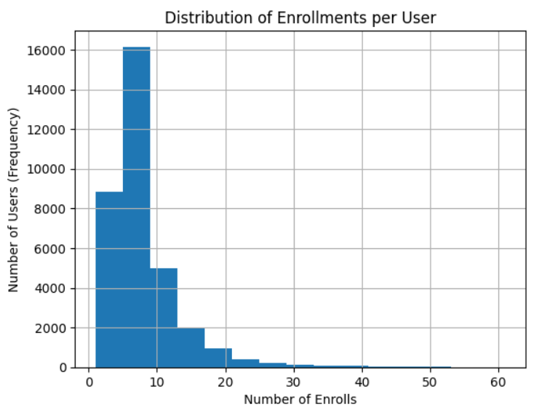
Course enrollment distribution
The vast majority of users are enrolled in 1-10 courses.
The number of users drops sharply as the number of enrolled courses increases.
A very small number of "power users" enroll in a large number of courses (e.g., 20+).
Notes:
This histogram reveals a classic long-tail distribution for user enrollments. Most learners enroll in only a few courses, suggesting they may have a specific, immediate goal. Our recommender system should aim to engage this majority by suggesting the right next course to continue their learning journey.

Slide 7
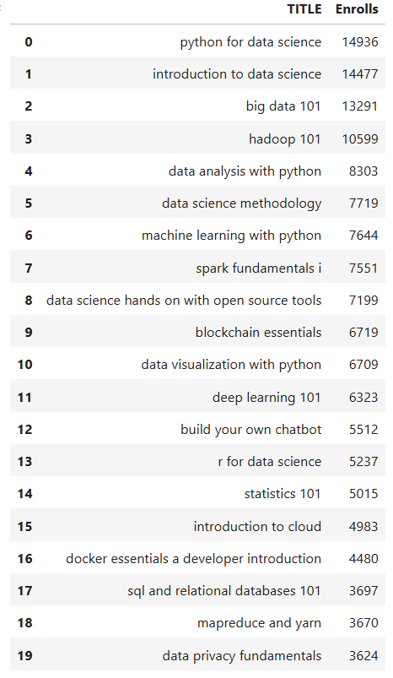
20 most popular courses
Foundational courses like "Introduction to Data Science" and “Python for Data Science" are the clear leaders, each with over 10,000 enrollments.
AI and Data Science subjects ("Machine Learning for Beginners", "Data Science with Python") form the next most popular group, showing strong interest in this domain.
The list also includes many courses on specific, in-demand tools like AWS, React, Docker, and TensorFlow, indicating learners are seeking practical job skills.
Notes:
This list highlights our "blockbuster" courses. The most popular ones are foundational (e.g., "Intro to Python") or cover highly in-demand technologies (e.g., "Machine Learning", "Web Development"). These courses are key drivers of initial user engagement.

Slide 8
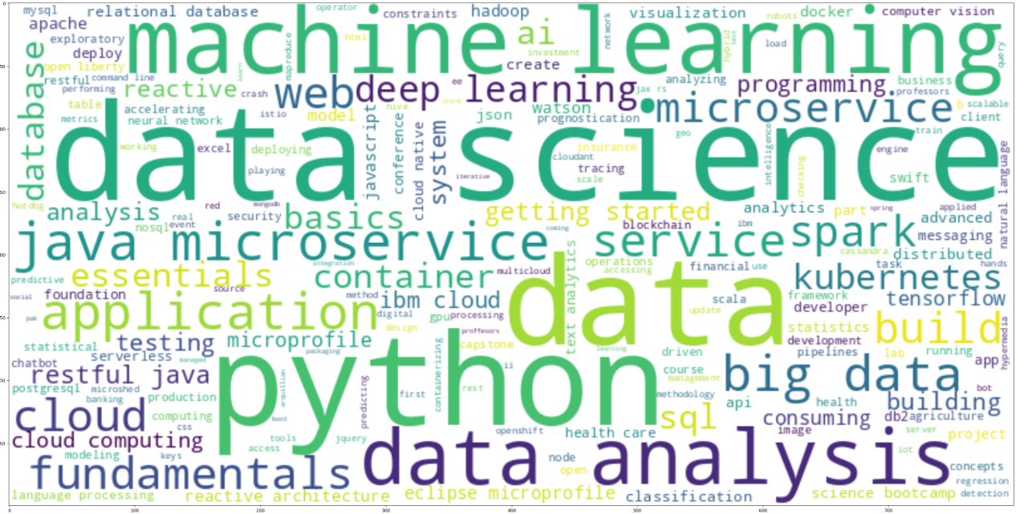
Word cloud of course titles
The most prominent words are "Python", "Data", "Learning", "Web", and "Machine".
The size of the words visually confirms the platform's strong focus on Data Science, Python, AI, and Web Development.
Keywords like "Introduction" and "Beginners" are also frequent, aligning with the popularity of foundational courses.
Notes:
This word cloud visually confirms the key themes from our course catalog. Words like "Python", "Data", and "Learning" are prominent, aligning perfectly with our most popular subjects. This illustrates the core identity of our platform's offerings.

Slide 9
Content-based Recommender System using Unsupervised Learning
Cluster2
Cluster1

Slide 10
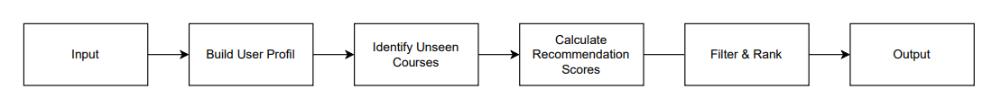
Flowchart of content-based recommender system using user profile and course genres
Hyper-parameters:
A recommendation score threshold of 20.0 was set. Only courses with a score above this value are considered
The maximum number of recommendations is capped at 20 courses per user
Notes:
This flowchart outlines our first content-based model. It works by creating a profile of each user's genre interests. We then recommend unseen courses that are topically similar by calculating a simple but effective dot product score between the user and course vectors.

Slide 11
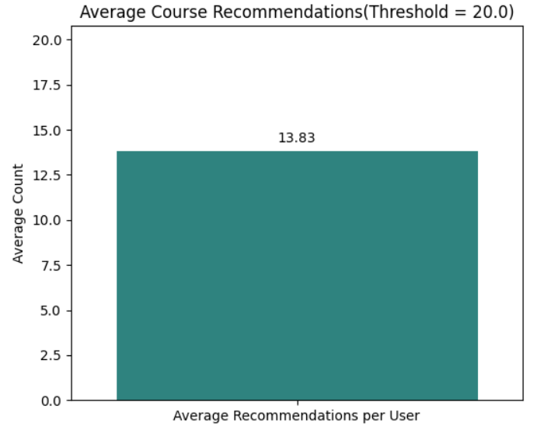
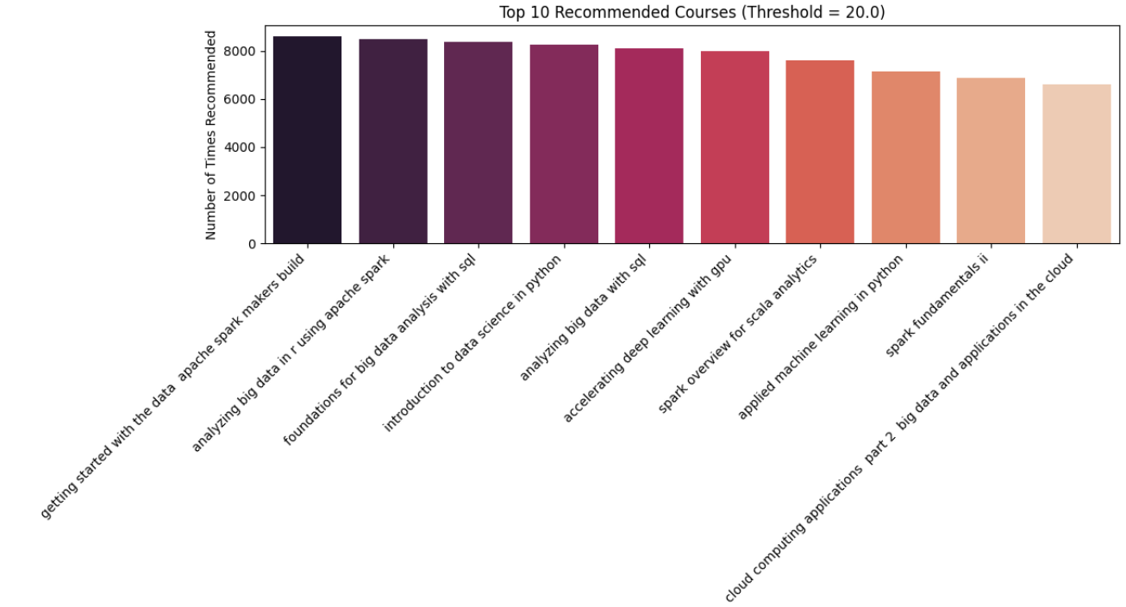
Evaluation results of user profile-based recommender system
On average, 13.83 new/unseen courses were recommended per user in the test dataset.
The most frequently recommended courses are heavily focused on Big Data (Spark, SQL) and Data Science
Notes:
With a score threshold of 20 , the system provides a manageable list of about 14 recommendations per user. The most frequently recommended courses are heavily focused on Big Data (Spark, SQL) and Data Science, which accurately reflects the primary interests of our current user base.

Slide 12
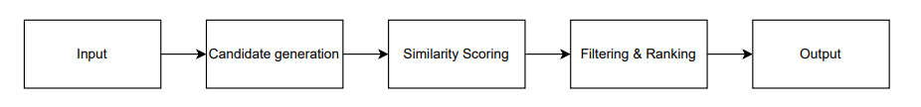
Flowchart of content-based recommender system using course similarity
Hyper-parameters:
Similarity Score Threshold: 0.5. A course is only considered for recommendation if its similarity score with an enrolled course is greater than this value.
The maximum number of recommendations is capped at 20 courses per user
Notes:
This flowchart illustrates the course similarity-based recommender system. The process works by taking a user's list of enrolled courses and comparing each one against a pool of candidate courses the user has not yet taken. To determine similarity, the system retrieves a pre-calculated score for each course pair from a similarity matrix. Finally, it recommends new courses by filtering for those that surpass a specific similarity threshold, then ranking them to present the top 20 highest-scoring options to the user.

Slide 13
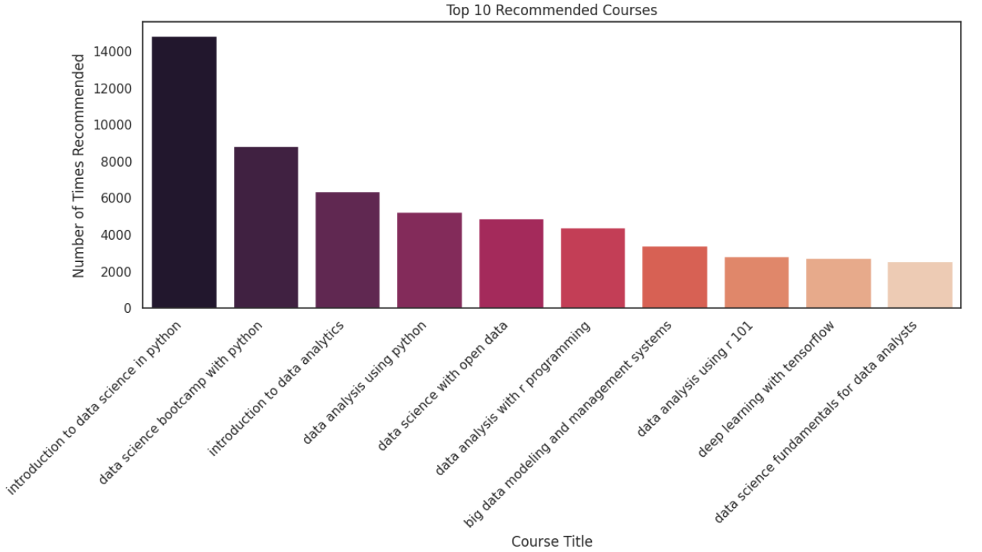
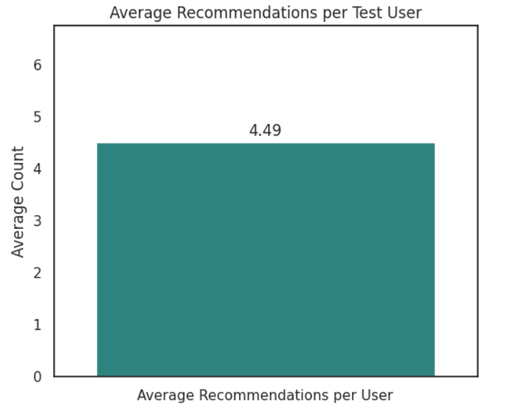
Evaluation results of course similarity based recommender system
On average, each user in our test dataset receives 4.49 new course recommendations.
The single most recommended course is "introduction to data science in python", appearing in over 14,800 user recommendations.
The top recommended courses are overwhelmingly focused on foundational skills in Data Science, with a heavy emphasis on the Python and R programming languages.
Notes:
The analysis of our course recommender system demonstrates its effectiveness in delivering targeted and relevant content. On average, each user is presented with a manageable list of approximately 4.49 new course suggestions, a figure directly influenced by the 0.5 similarity threshold we set. This focused approach avoids overwhelming users with too many choices. Furthermore, the top 10 most frequently recommended courses are heavily concentrated in foundational topics like "introduction to data science in python," which validates that our content-based model successfully identifies and promotes core "gateway" courses in popular, interconnected fields like Data Science, Python, and R. This confirms the system is working as intended by recognizing strong thematic links between courses.

Slide 14
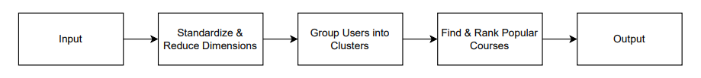
Flowchart of clustering-based recommender system
Hyper-parameters:
Number of Principal Components (PCA): 9. This was determined as the minimum number of components required to explain at least 90% of the variance in the original user profile data.
Number of Clusters (K-Means): 9. This was identified as the optimal number of user clusters using the elbow method.
Recommendation Cutoff: The Top 20 most popular courses within a user's cluster are selected as potential recommendations.
Notes:
This flowchart outlines our clustering-based recommendation model. It works by first grouping all users into distinct clusters based on their shared interests, which are derived from their course ratings in various genres. We then recommend unseen courses to a specific user by identifying the most popular (most frequently enrolled) courses within their assigned cluster and filtering out any they have already taken.

Slide 15
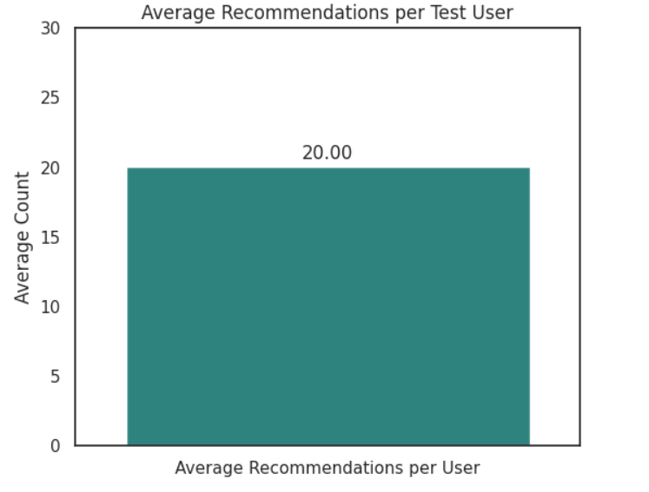
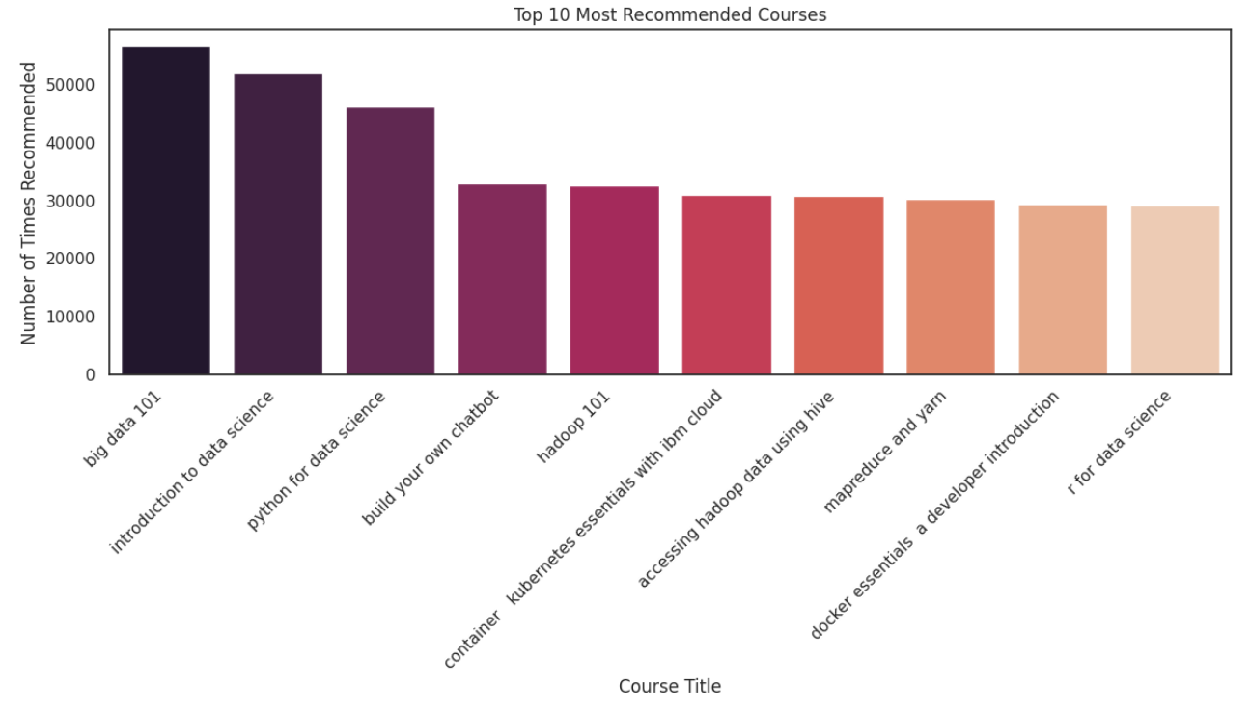
Evaluation results of clustering-based recommender system
On average, each user in the test dataset received 20.00 new course recommendations
The most frequently recommended courses are foundational topics in Big Data and Data Science.
"big data 101" was the most common suggestion, recommended over 56,000 times, followed by "introduction to data science" and "python for data science".
Notes:
Our clustering-based model provides each user with a comprehensive list of up to 20 popular courses from within their interest group. This ensures that active users in any cluster receive a full set of relevant suggestions to explore, maximizing their engagement opportunities based on their community's preferences. This analysis confirms that our clustering algorithm effectively groups users with strong, shared interests in high-demand technology fields. The top recommendations directly reflect the most popular and essential courses within these data-focused communities, validating that the system successfully suggests core content based on the collective behavior of similar users.

Slide 16
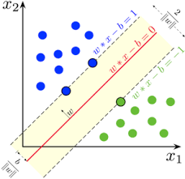
Collaborative-filtering Recommender System using Supervised Learning

Slide 17
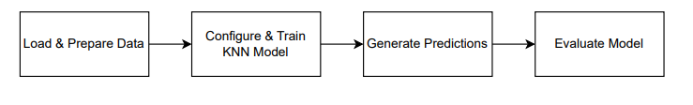
Flowchart of KNN based recommender system
Hyper-parameters:
Algorithm: KNNBasic from the surprise library.
Collaborative Filtering Method: The notebook implemented and tested two methods: Item-based and User-based.
Number of Neighbors (k): 40
Minimum Neighbors (min_k): 1
Similarity Metric: Cosine similarity
Notes:
Our collaborative filtering model is built using the K-Nearest Neighbors (KNN) algorithm, operating on a user-item rating matrix. The process begins by loading the rating data, which is then split into training and test sets. We then configure the KNN model using the surprise library, specifying key hyper-parameters: we test both item-based (user_based: False) and user-based (user_based: True) approaches, use cosine similarity as the metric, and set the number of neighbors (k) to 40. The model is trained on this data to find similar users or items and then generates rating predictions, with its performance evaluated by the Root Mean Square Error (RMSE).

Slide 18
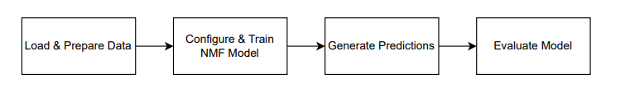
Flowchart of NMF based recommender system
Hyper-parameters:
Algorithm: NMF from the surprise library.
Number of Latent Factors: 32.
Initialization Range: The initial random values for the user and item feature matrices are set between 0.5 and 5.0.
Notes:
This flowchart details our collaborative filtering model based on Non-negative Matrix Factorization (NMF). The process works by taking the user-item rating matrix and decomposing it into two smaller, dense matrices representing latent features for both users and items. These feature matrices are learned by training the NMF model on a subset of the rating data, with key hyper-parameters including the number of latent features, which we set to 32. Predictions for unknown ratings are then generated by calculating the dot product of a user's and an item's latent feature vectors, and the model's overall accuracy is evaluated using Root Mean Square Error (RMSE).

Slide 19
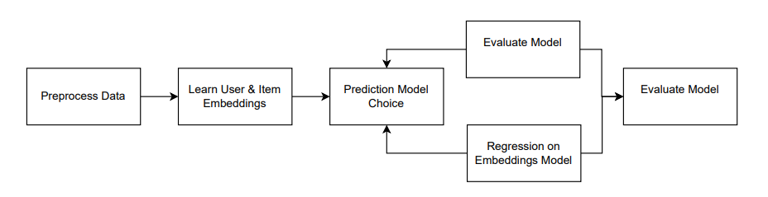
Flowchart of Neural Network Embedding based recommender system
Hyper-parameters:
Model A: ANN (Deep Learning) Model
Embedding Size: 16 for both user and item latent feature vectors.
Neural Network Architecture: Two Dense Layers with 128 units each.
ReLU activation function for the dense layers.
Training Parameters:
- Optimizer: adam.
- Loss Function: mse (Mean Squared Error).
- Batch Size: 64.
- Epochs: 5.
Input Features: Concatenated user and item embedding vectors (each of size 16), extracted from a pre-trained ANN model.
Hyperparameter Tuning Method: GridSearchCV with 5-fold cross-validation (cv=5).
Algorithm 1: Ridge Regression
- Parameter Grid for alpha: [0.001, 0.01, 0.1, 1, 10,
100]
Algorithm 2: Lasso Regression
- Parameter Grid for alpha: [0.001, 0.01, 0.1, 1, 10,
100]
- Max Iterations (max_iter): Set to 10000
Notes:
This flowchart outlines two collaborative filtering approaches that leverage learned embeddings. The first model is a baseline deep learning network that simultaneously learns user and item embeddings and uses dense layers to predict ratings directly. The second model takes a two-step approach: it first extracts the pre-trained embeddings from the baseline model and then uses these embeddings as input features for traditional regression algorithms. Specifically, both Ridge and Lasso models are implemented, with their regularization strength (alpha) optimized using 5-fold cross-validation to find the best hyper-parameters before making the final rating predictions.

Slide 20
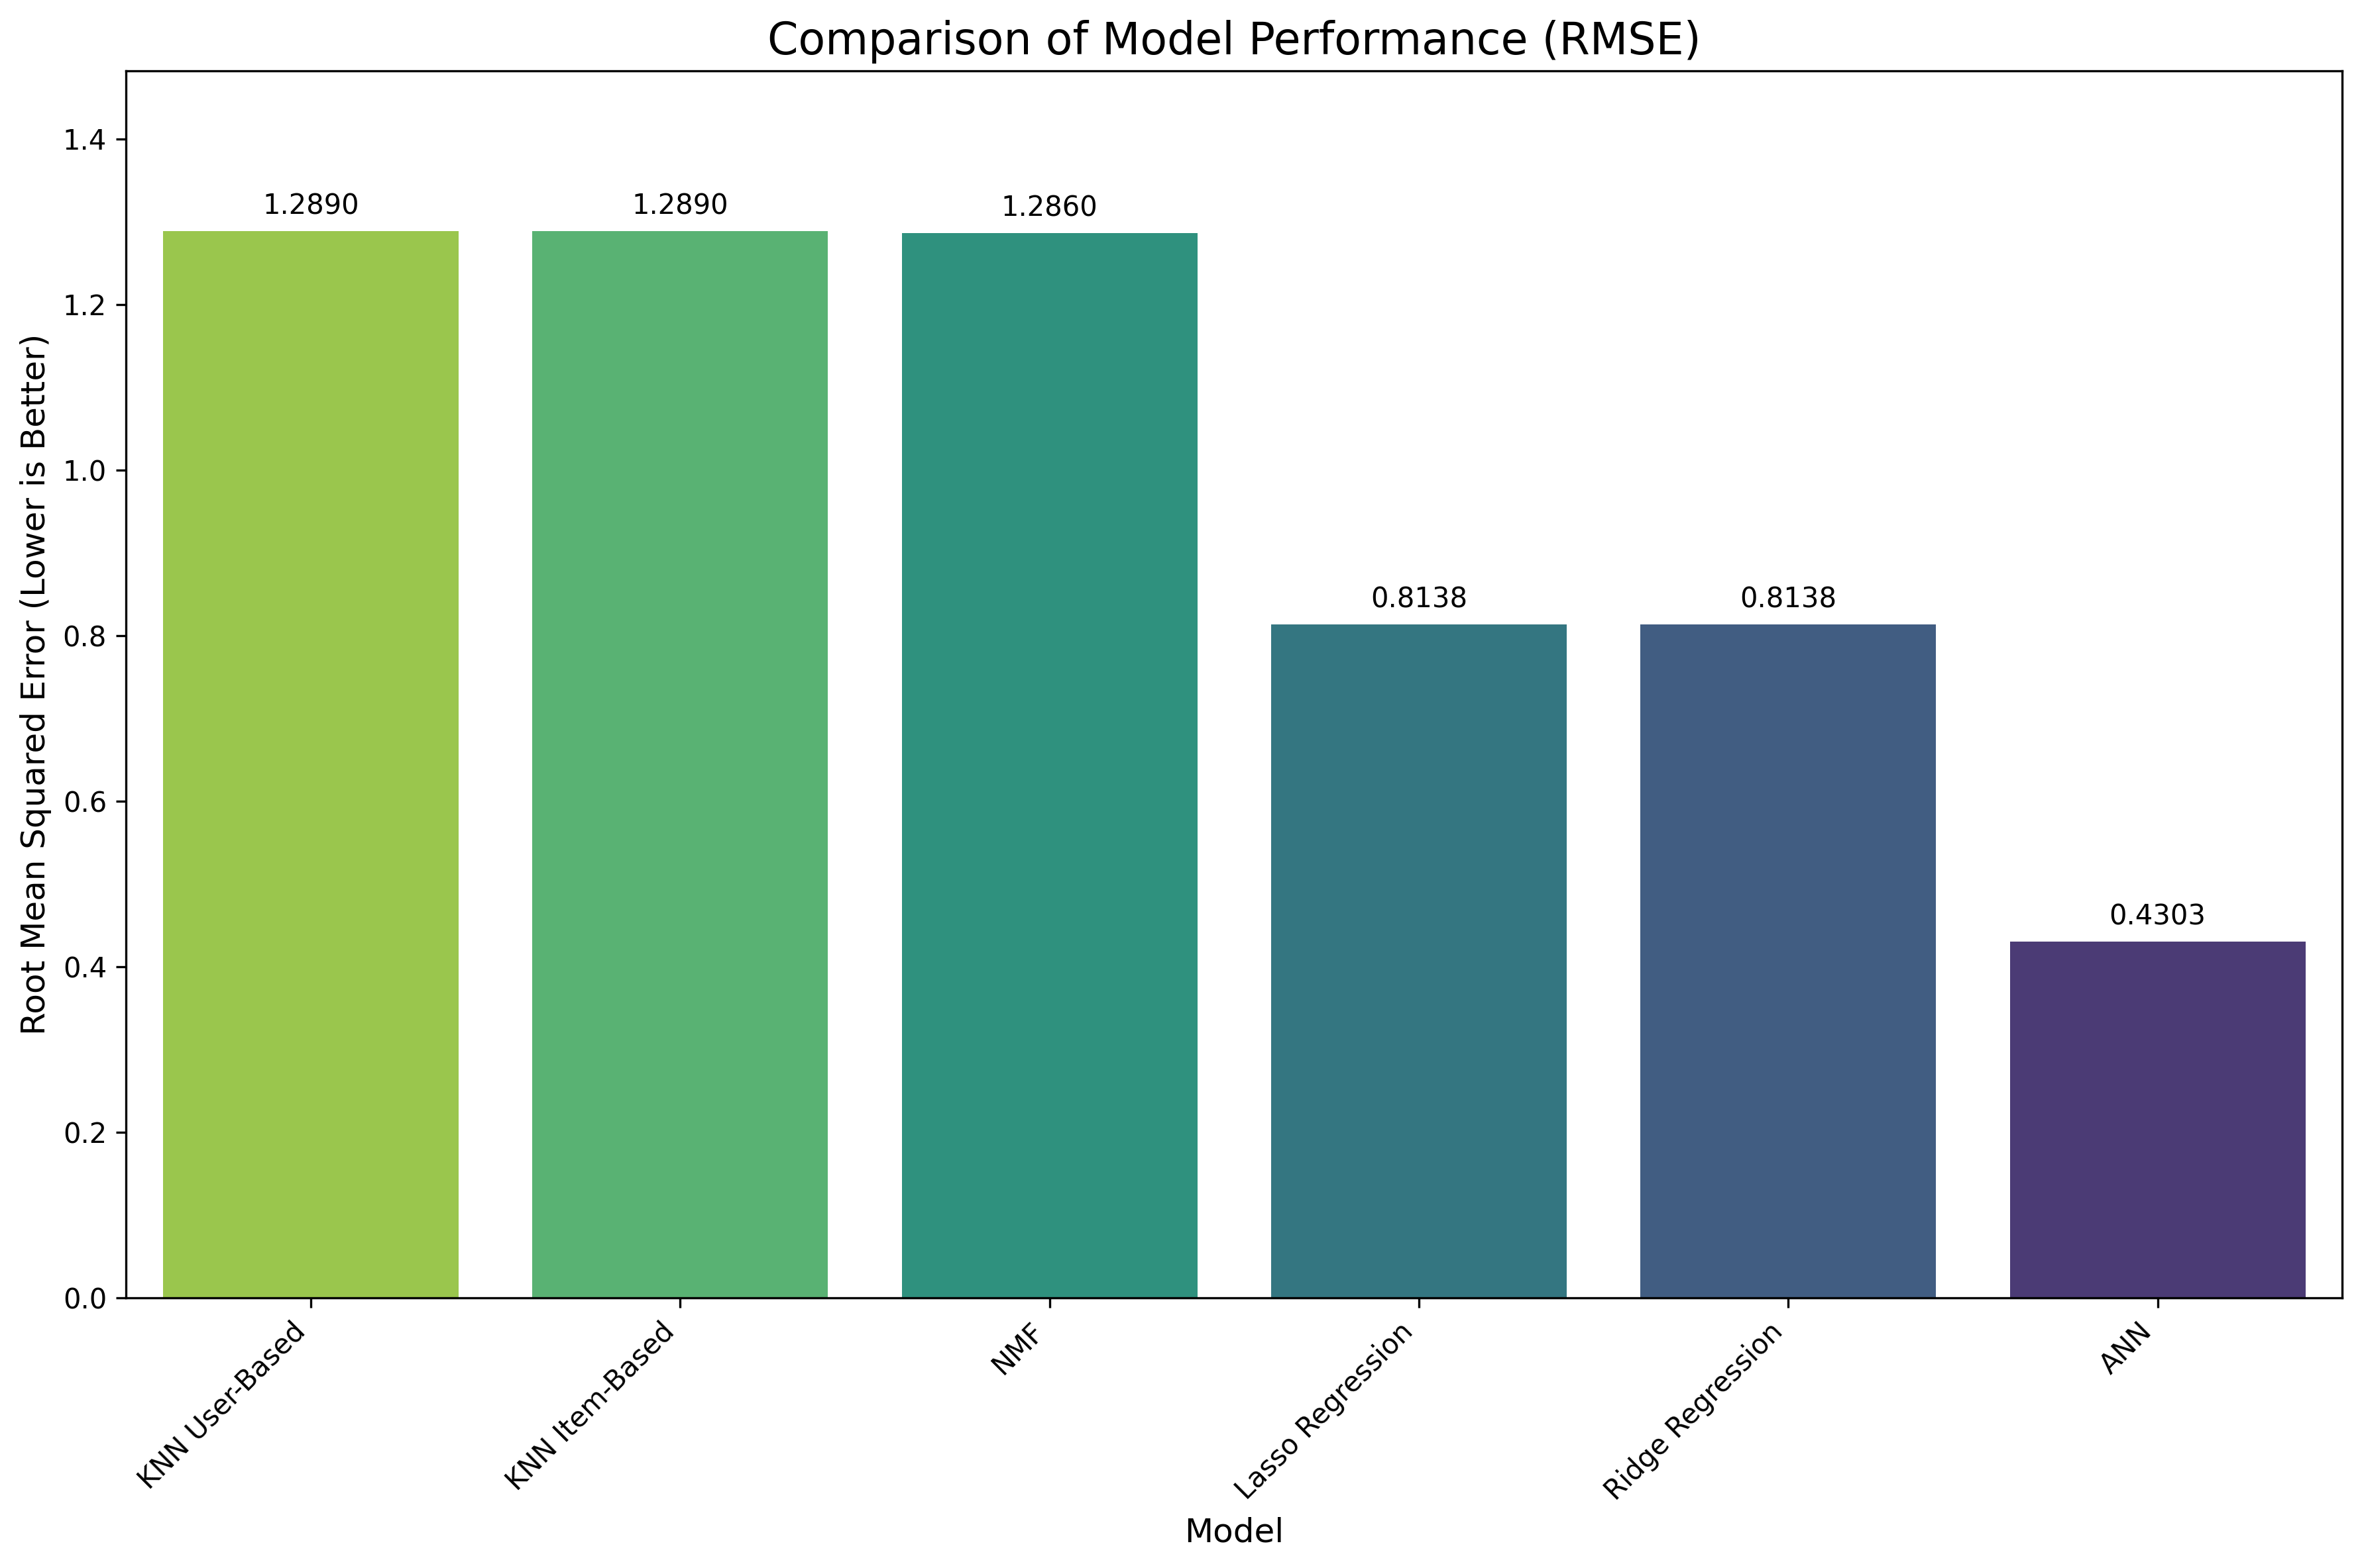
Compare the performance of collaborative-filtering models
Clear Performance Tiers: The models can be grouped into three distinct performance tiers based on their Root Mean Square Error (RMSE).
Baseline Performance: The traditional models (User-based KNN, Item-based KNN, and NMF) perform similarly, establishing a baseline with the highest error (RMSE ≈ 1.29).
Mid-Tier Improvement: Lasso and Ridge regression models, which use learned embeddings as features, offer a significant improvement over the baseline, with a much lower RMSE of approximately 0.81.
Top Performer: The Artificial Neural Network (ANN) model is the clear top performer, achieving the lowest error with an RMSE of 0.43, nearly halving the error of the regression models.
Notes:
This analysis, based on the updated RMSE values, reveals three distinct performance tiers among our collaborative filtering models, where a lower error value is better. The traditional KNN and NMF models establish a baseline with a high error rate around 1.29. A significant improvement is seen with the Ridge and Lasso regression models, which cut the error down to approximately 0.81. However, the Artificial Neural Network (ANN) model is definitively the most accurate, achieving a remarkably low RMSE of 0.43. This performance gap is explained by the power of embeddings; while the Ridge and Lasso models perform well by applying regression to pre-trained embeddings, the ANN is superior because it learns these rich, non-linear feature representations and optimizes the rating prediction in a single, end-to-end process, allowing it to capture the most complex user preferences.

Slide 21
Key Insights
Multi-Model Approach: The project successfully implemented and compared multiple recommender system models, including a content-based model and several collaborative filtering methods (K-Means Clustering, NMF, and ANN). This provides a comprehensive overview of different techniques for course recommendation.
Deep Learning Superiority: For the task of predicting user ratings (collaborative filtering), the Artificial Neural Network (ANN) model significantly outperformed traditional methods. It achieved the lowest Root Mean Square Error (RMSE) of 0.43, compared to higher error rates for KNN and NMF models (RMSE ≈ 1.29).
Complementary Strengths: The report highlights that content-based and collaborative filtering models have complementary strengths. The content-based model is effective at finding topically similar courses, while collaborative filtering excels at predicting user ratings based on the behavior of similar users

Slide 22
Conclusions
The project successfully developed functional content-based and collaborative filtering recommender systems to help learners discover relevant courses.
The content-based model proved effective for suggesting courses with similar textual content, while the ANN-based collaborative filtering model was the most accurate at predicting user ratings.
The analysis concludes that a hybrid model, which combines both content-based and collaborative filtering techniques, would likely provide the most robust and comprehensive recommendation solution by leveraging the strengths of each approach.

Slide 23
Next Steps
Develop a Hybrid System: The primary recommendation for future work is to build a hybrid recommender system that integrates both the content-based and the best-performing collaborative filtering models to generate more powerful and accurate suggestions.
Model Deployment: A key next step is to deploy the finalized model as an interactive web application or a REST API, making the recommender system accessible to end-users on the learning platform.
Explore Advanced Models: The report suggests investigating more advanced deep learning architectures, such as Transformer-based models, to potentially improve recommendation accuracy further by capturing more complex patterns and sequential user behaviors.

Slide 24
Appendix
Code Program for EDA
- https://colab.research.google.com/drive/1ygK_jR1uKGW7CM30pvjYNqW31qTDcGNK?usp=sharing
Code Program for Content-Based
- User profile: https://colab.research.google.com/drive/1CQwEkaRxxybvlTTkVLtP5oQ_PNWFEef8?usp=sharing
- Course Similarity: https://colab.research.google.com/drive/1J5FlI-n7ZVGjrhwgQjlmr78auJ4qerad?usp=sharing
- Clustering: https://colab.research.google.com/drive/1NpA43uWK1qyy5QCwSDhfchmrBvFV_acb?usp=sharing
Code Program for Collaborative-Filtering
- KNN: https://colab.research.google.com/drive/1j7kBBgyIgTEXpH-zoe4dwQYXhdwwsh1s?usp=sharing
- NMF: https://colab.research.google.com/drive/14yg8umTbJc4sSuErUHQy08in_xwwdphs?usp=sharing
- ANN: https://colab.research.google.com/drive/1nz85nOAU-raiCWrs31--eG0v_BDx-GLT?usp=sharing
- Regression : https://colab.research.google.com/drive/1Ne9YyizpNGmP8Ktv3Wkxd3VlftJ0lkRl?usp=sharing
Pptx : if you want to see the slide notes for further explanation
- https://docs.google.com/presentation/d/1A096KjIH5iA2tD66vvugt9ZLYkfbPln_/edit?usp=sharing&ouid=111107553465690610542&rtpof=true&sd=true

