Slide 1
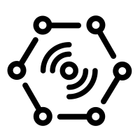


Send device twin to gateway
Send data from device to cloud (JSON telemetry data)
Stream Processing (Stream Analytics)
Weather
Station
(IoT Device)
Cloud Gateway
(IoT Hub)
Device Twin
Update
(Function App)
Send Data from cloud to device (JSON Device Twin)
Send
Wind
Speed
Store Data
Cold Path
Storage
(Data Lake Store)
Calculate Averange
(Data Lake Analytics)
Things
Insights
Actions

Slide 2
Why was the subsystem chosen? MXChip: Simulate a weather station(Wind speed, temperature, pressure, direction). Secure device Connection with MQTT Protocol. Cloud GW: Device and Cloud 2-Way communication. Stream Processing: Process and redirect incoming data from Weather Station. Data Lake Store : Device telemetry data -> long-term storage for analysis. (Cheap) Data Lake Analytics: To calculate the averange. Function APP: Receive Wind Speed / Send the changed Device Twin.

